Slide 1

An Incrementally Better Domain Violation Detection System
Team Incremental
Notes:
Hi,
We are Team Incremental and we would like to talk about Domain Violation Detection.

Slide 2
The Problem We Care About
Potential collisions at sea are a key risk to be mitigated
The present monitoring system applies a large (400m) safety radius to each ship regardless of vessel type.
… and the speedy fast craft cause too many unnecessary alarms.
Notes:
Now, potential collisions at sea are a key risk to be mitigated.
Presently, the existing monitoring system puts a 400m safety radius over each ship regardless of their size and movement.
As a result, speedy fast craft, in their 400m bubbles, trigger too many false alarms…
… causing “false alarm fatigue” which itself reduces response effectiveness.

Slide 3
Our Solution
Automatic Domain Violation Detection
Clear Practical Value
Subject Matter Expert Customization of Domains
Notes:
We present a solution that…
Provides the customary automatic detection of domain violation (and ordering according to severity)
Enables subject matter experts to design domains that better conform to risk.
Put together, this has clear practical value to the maritime community (even if it is merely Incremental)
Allow me to take a moment to discuss domain design.

Slide 4
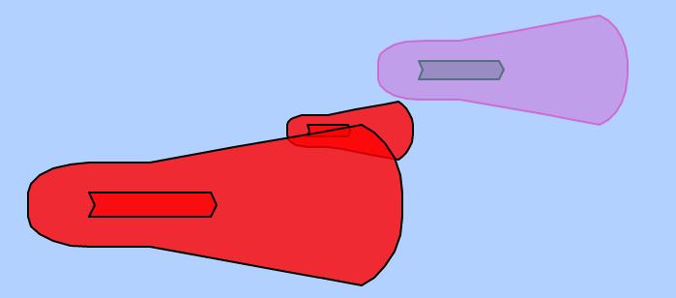
Domain Design
We propose a family of domains parameterized by four numbers (three distances, one “angle”), enabling better description of “collision risk” in terms of domains.
Appropriate conformation to risk means fewer false alarms.
Domains can dynamically adapt as functions of length, beam, speed, gross tonnage, etc.
Notes:
We propose a flexible parametric description of domains, enabling better description of “collision risk” in terms of domains.
Appropriate conformation to risk means fewer false alarms.
With this, domains can dynamically adapt as functions of length, beam, speed, gross tonnage, etc.
Of course, the knowledge of subject matter experts can and should be tapped to develop the right descriptions.
(Since “landlubbers” like us cannot hope to get those relationships right.)
---
Non-convex polygon intersection can be tested by geometric methods

Slide 5
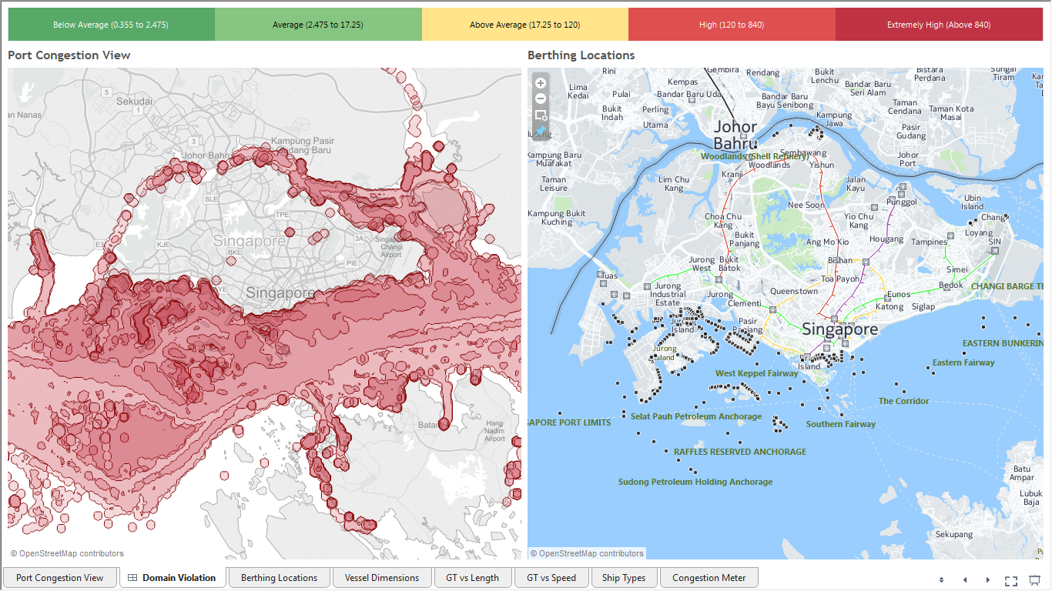
Notes:
One direction to take this is to use ideas behind domain violation to think more rigorously about what it really means to be congested.
Here are some heat map visualizations with Tableau using the base data to give a sense of what is possible.

Slide 6
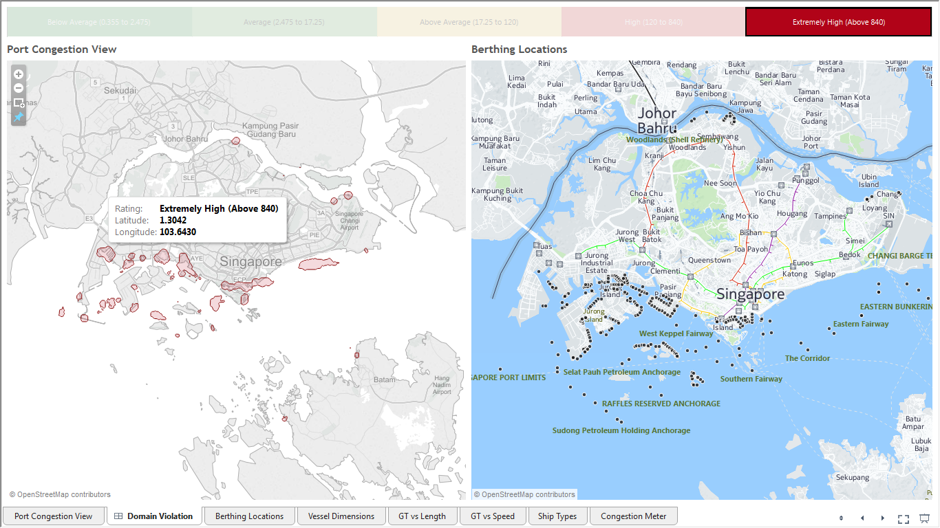

Slide 7
Our Hackish Solution
A Mockup of a Real Time Data Feed
(Based on given Location Data)
Web+Tableau Front End for Presentation
(Recommended Compute Back End Lumped in for Purposes of Demo)
To the demo!
Notes:
Our quick and dirty solution replaces a real time data feed with a mock up based on the given AIS transponder data.
In this hack, we have collapsed the recommended middle layer for computation and the front end together.
Without further ado, TO THE DEMO!
-----
Back end note: Polygon intersection is embarrassingly parallel (no practical need for spatial data structures to reduce complexity)

Slide 8
Thank You for Listening Team Incremental: Jeremy (convexset@gmail.com) Bodhi (thebbroy@gmail.com) Vivek (vksingh.iitb@gmail.com) Daniel (gimshin@gmail.com) Hien (hien.mai.tianhui@gmail.com)

