Slide 1
Microsoft Azure Fundamentals: AZ-900
Pooja Patil

Slide 2
Introduction to cloud
What Is cloud computing?
History
Architecture
Applications

Slide 3
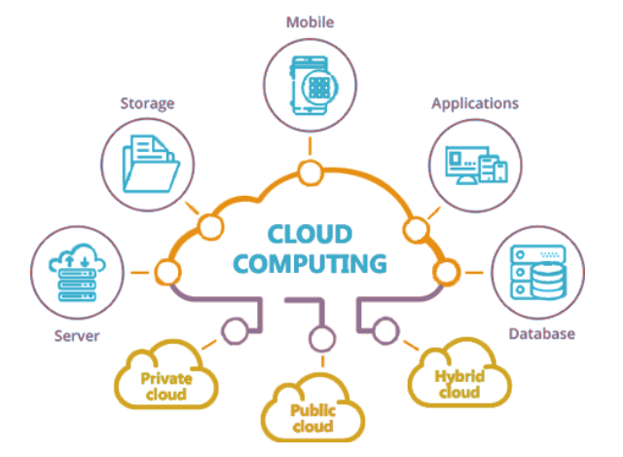
What Is cloud computing?
The term cloud refers to a network or the internet. It is a technology that uses remote servers on the internet to store, manage, and access data online rather than local drives. The data can be anything such as files, images, documents, audio, video, and more.
There are the following operations that we can do using cloud computing:
Developing new applications and services
Storage, back up, and recovery of data
Hosting blogs and websites
Delivery of software on demand
Analysis of data
Streaming videos and audios

Slide 4
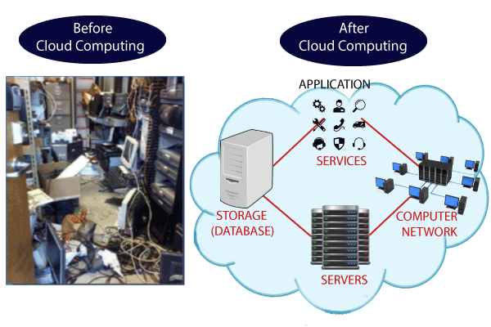
Why Cloud Computing:
To establish such IT infrastructure, we need to spend lots of money. To overcome all these problems and to reduce the IT infrastructure cost, Cloud Computing comes into existence.

Slide 5
Characteristics:
Agility:The cloud works in a distributed computing environment. It shares resources among users and works very fast.
High availability and reliability
High Scalability
Multi-Sharing
Device and Location Independence
Maintenance
Low Cost
Services in the pay-per-use mode

Slide 6
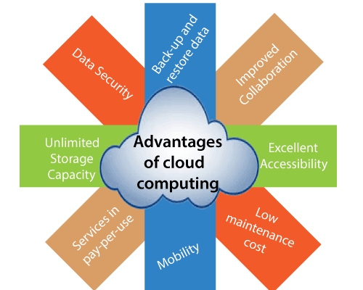
Advantages of Cloud Computing:

Slide 7
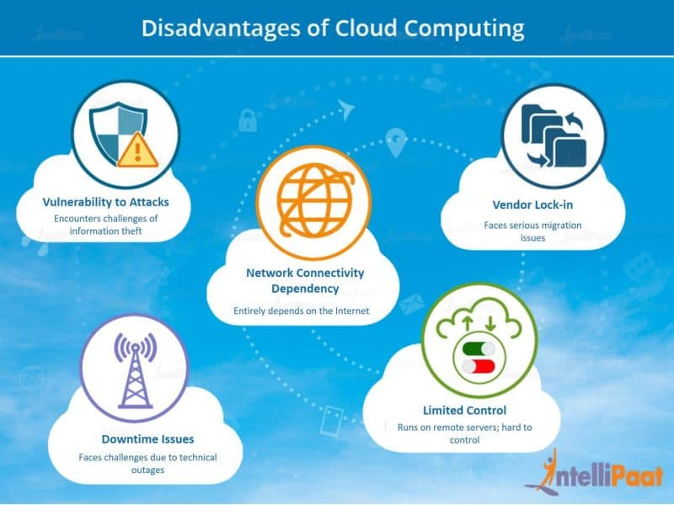
Disadvantages of Cloud Computing:

Slide 8
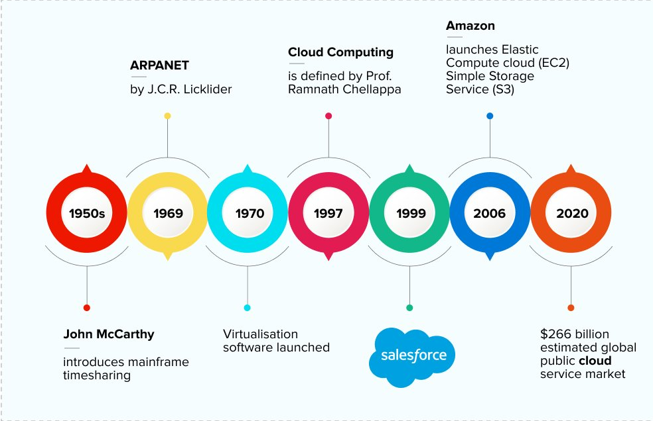
History of Cloud Computing:

Slide 9
Cloud Computing Architecture:
Cloud computing technology is used by both small and large organizations to store the information in cloud and access it from anywhere at anytime using the internet connection.
Cloud computing architecture is a combination of service-oriented architecture and event-driven architecture.
Cloud computing architecture is divided into the following two parts -
Front End
Back End

Slide 10
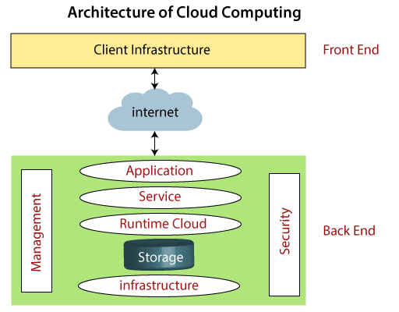
Cloud Computing Architecture

Slide 11
Front End:
The front end is used by the client. It contains client-side interfaces and applications that are required to access the cloud computing platforms. The front end includes web servers (including Chrome, Firefox, internet explorer, etc.), thin & fat clients, tablets, and mobile devices.
Back End
The back end is used by the service provider. It manages all the resources that are required to provide cloud computing services. It includes a huge amount of data storage, security mechanism, virtual machines, deploying models, servers, traffic control mechanisms, etc.

Slide 12
Components of Cloud Computing Architecture:
Client Infrastructure:Client Infrastructure is a Front end component. It provides GUI (Graphical User Interface) to interact with the cloud.
Application:The application may be any software or platform that a client wants to access.
Service:A Cloud Services manages that which type of service you access according to the client’s requirement.
Runtime Cloud:Runtime Cloud provides the execution and runtime environment to the virtual machines.
Storage: It provides a huge amount of storage capacity in the cloud to store and manage data.
Infrastructure:It provides services on the host level, application level, and network level.
Management:Management is used to manage components such as application, service, runtime cloud, storage, infrastructure, and other security issues in the backend and establish coordination between them.
Security:Security is an in-built back end component of cloud computing. It implements a security mechanism in the back end.
Internet:The Internet is medium through which front end and back end can interact and communicate with each other.

Slide 13
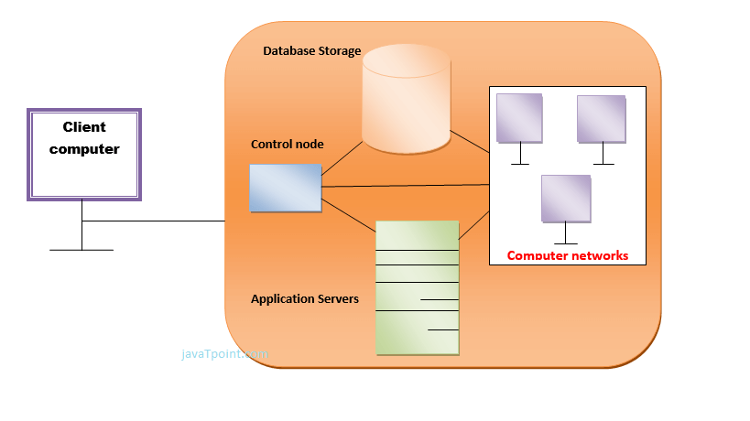
How does cloud computing work

Slide 14
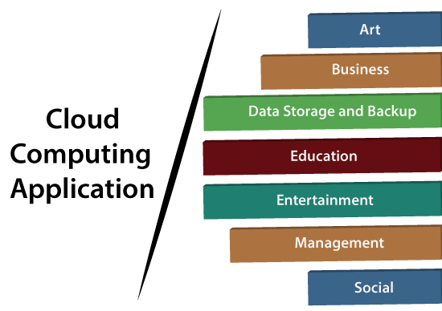
Applications:

Slide 15
Slide Tite
Thank You……

