Slide 1
Microsoft Azure Fundamentals: AZ-900
Pooja Patil

Slide 2
Introduction to cloud
Different services model
Differences between PaaS, IaaS And SaaS
Different deployment Models
Difference Between Models

Slide 3
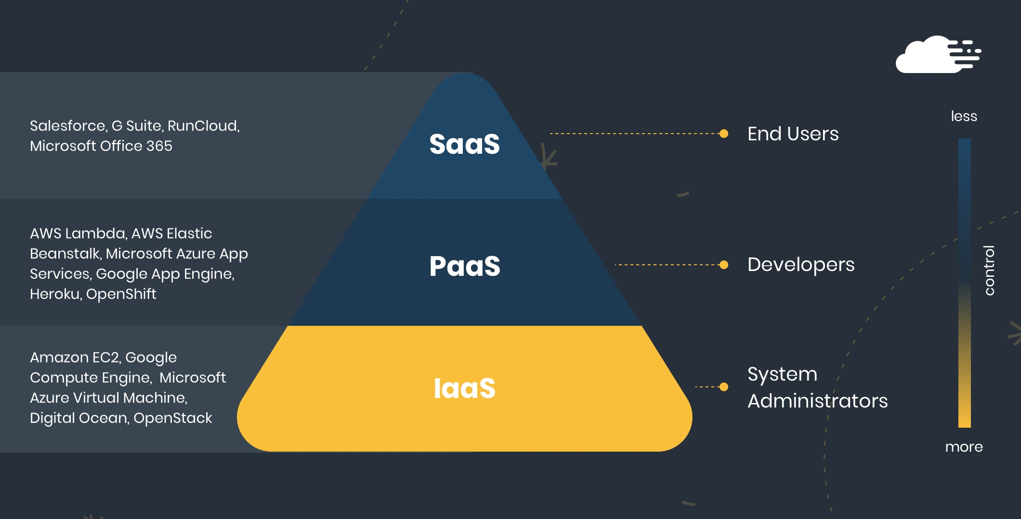
Different Services Model

Slide 4
SAAS(SOFTWARE AS A SERVICE):
Software as a Service offers applications that are accessed over the web and are not managed by your company, but by the software provider. This relieves your organization from the constant pressure of software maintenance, infrastructure management, network security, data availability, and all the other operational issues involved with keeping applications up and running.
SaaS billing is typically based on factors such as number of users, usage time, amount of data stored, and number of transactions processed. This service model has the largest market share in cloud computing; according to Gartner, its sales will reach 117 billion USD by the year 2021. Current applications for SaaS include Field Service solutions, system monitoring solutions, schedulers and more.

Slide 5
PAAS(PLATFORM AS A SERVICE):
Platform as a Service is halfway between Infrastructure as a Service (IaaS) and Software as a Service (SaaS).
It offers access to a cloud-based environment in which users can build and deliver applications without the need of installing and working with IDEs (Integrated Development Environments, which are often very expensive.
Additionally, users can often customize the features they want included with their subscription. According to Gartner, PaaS has the smallest market share of the three service models, with a projected revenue of 27 billion USD by the year 2021. In today’s market, PaaS providers offer applications such as Microsoft Azure (also IaaS), Google App Engine, and Apache Stratos.

Slide 6
IaAs(INFRASTRUCTURE AS A SERVICE):
Infrastructure as a service offers a standardized way of acquiring computing capabilities on demand and over the web.
Such resources include storage facilities, networks, processing power, and virtual private servers.
These are charged under a “pay as you go” model where you are billed by factors such as how much storage you use or the amount of processing power you consume over a certain timespan.
In this service model, customers do not need to manage infrastructure, it is up to the provider to guarantee the contracted amount of resources and availability. According to Gartner, this service model is forecasted to grow by 35.9% in 2018. IaaS services offered today, include Google Cloud Platform and Amazon EC2.

Slide 7
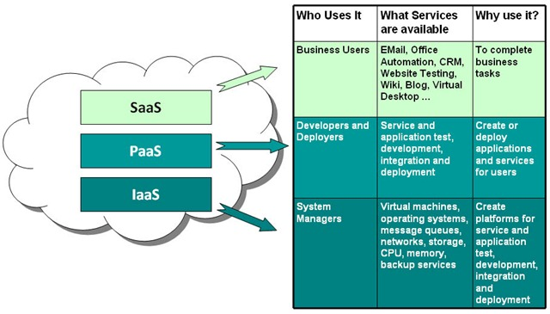
Difference Between sAAS, pAAS & iaas

Slide 8
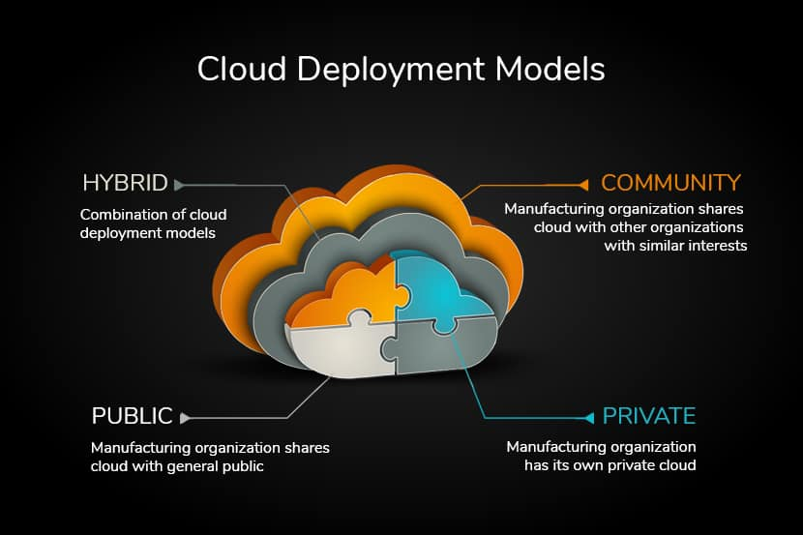

Slide 9
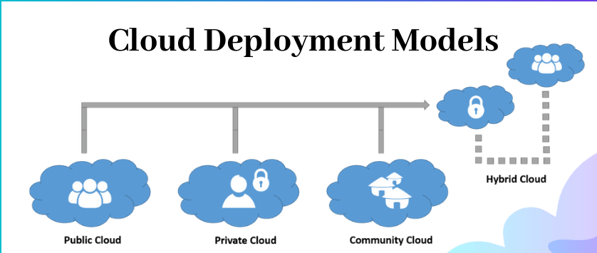
Deployment Models:

Slide 10
What Is public cloud?
Public cloud is an IT model where on-demand computing services and infrastructure are managed by a third-party provider and shared with multiple organizations using the public Internet.
Public cloud service providers may offer cloud-based services such as infrastructure as a service (IaaS), platform as a service (PaaS), or software as a service (SaaS) to users for either a monthly or pay-per-use fee, eliminating the need for users to host these services on site in their own data center.
Public cloud makes computing resources available to anyone for purchase. Multiple users typically share the use of a public cloud.
In contrast, private cloud involves cloud-based services that are hosted within an organization’s own private servers.

Slide 11
What Is private cloud?
A Private Cloud is a model of cloud computing where the infrastructure is dedicated to a single user organization.
A private cloud can be hosted either at an organization’s own data center, at a third party colocation facility, or via a private cloud provider who offers private cloud hosting services and may or may not also offer traditional public shared multi-tenant cloud infrastructure.
Private Cloud Solutions offer organizations more control over and better security of private cloud servers, although it does require a much higher level of IT expertise than utilizing a public cloud.

Slide 12
Predictable costs: Public cloud costs can be very unpredictable based on usage, storage charges and data egress charges. Private cloud costs are the same each month, regardless of the workloads an organization is running or how much data is moved.
Regulatory governance: Regulations such as the EU’s GDPR may dictate where data resides and where computing occurs. In those regions where public cloud providers cannot offer service, a private cloud may be required. Additionally, organizations with sensitive data such as financial or legal firms may opt for private cloud storage to ensure they have complete control over personally identifiable or sensitive information.

Slide 13
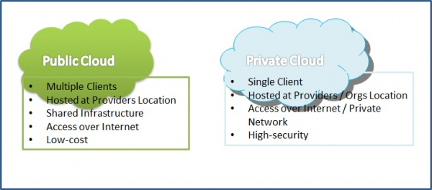
Why private & public Cloud?

Slide 14
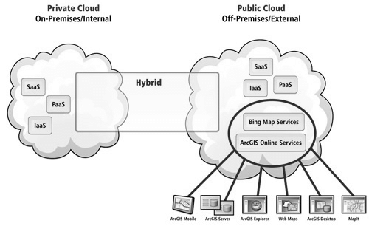
What is Hybrid Cloud?
A hybrid cloud is a cloud computing model that uses a combination of at least one private cloud and at least one public cloud, which work together to provide a flexible mix of cloud computing services. Hybrid cloud computing extends infrastructure and operations consistently to provide a single operating model that manages application workloads across both environments, allowing for seamless migration of workloads from private to or from public cloud as business needs dictate.

Slide 15
Why Hybrid Cloud:
Hybrid clouds use public and private clouds as a single combined entity where data and application workloads can move seamlessly between platforms and share data between application workloads.
There are many hybrid cloud benefits to consider, including:
Workload migration,
Reduce IT workload,
Increase flexibility,
Reduce complexity,
Support existing and new applications,
Increase cloud utility.

Slide 16
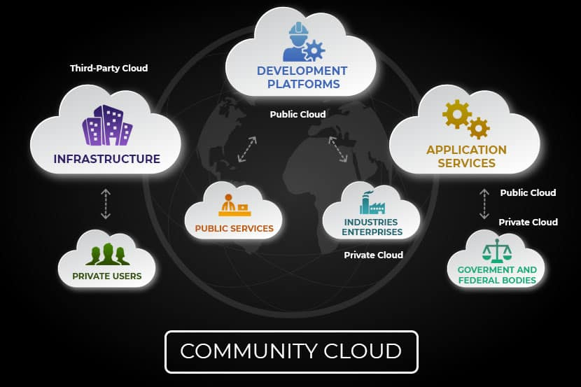
What is community Cloud?
Community Cloud is a hybrid form of private cloud. They are multi-tenant platforms that enable different organizations to work on a shared platform.

Slide 17
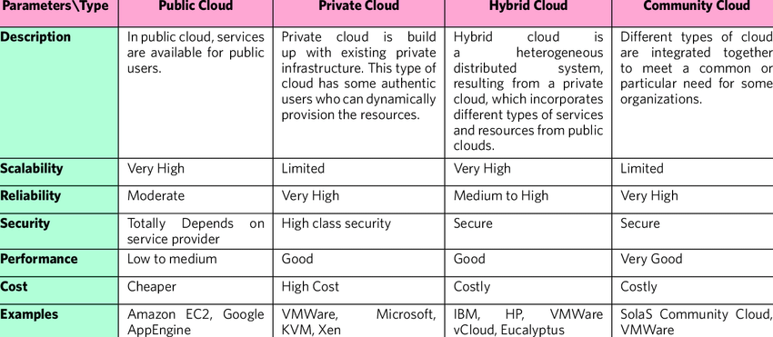
Difference:

Slide 18
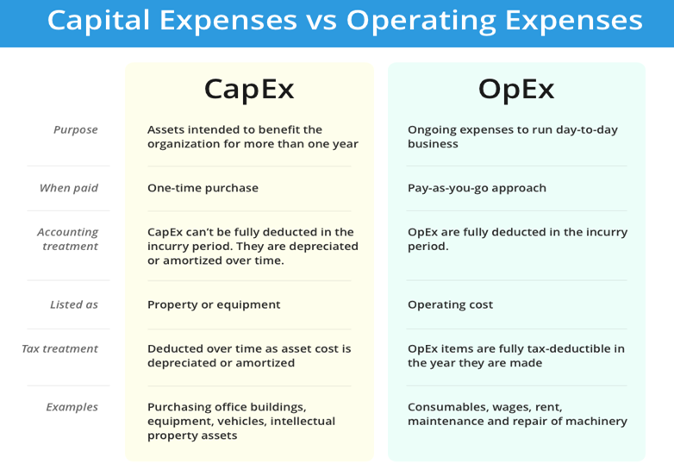
Difference:

Slide 19
Slide Tite
Thank You……

