Slide 1
Microsoft Azure Fundamentals: AZ-900

Slide 2
Introduction to Azure
What is Azure?
Services of Azure.
How Azure Works

Slide 3
What is azure?
Microsoft Azure is a growing set of cloud computing services created by Microsoft that hosts your existing applications, streamline the development of a new application, and also enhances our on-premises applications. It helps the organizations in building, testing, deploying, and managing applications and services through Microsoft-managed data centers.

Slide 4
Services of azure:
Compute services:It includes the Microsoft Azure Cloud Services, Azure Virtual Machines, Azure Website, and Azure Mobile Services, which processes the data on the cloud with the help of powerful processors.
Data services: This service is used to store data over the cloud that can be scaled according to the requirements. It includes Microsoft Azure Storage , Azure SQL Database, and the Redis Cache.
Application services: It includes services, which help us to build and operate our application, like the Azure Active Directory, Service Bus for connecting distributed systems, HDInsight for processing big data, the Azure Scheduler, and the Azure Media Services.
Network services:It helps you to connect with the cloud and on-premises infrastructure, which includes Virtual Networks, Azure Content Delivery Network, and the Azure Traffic Manager.

Slide 5
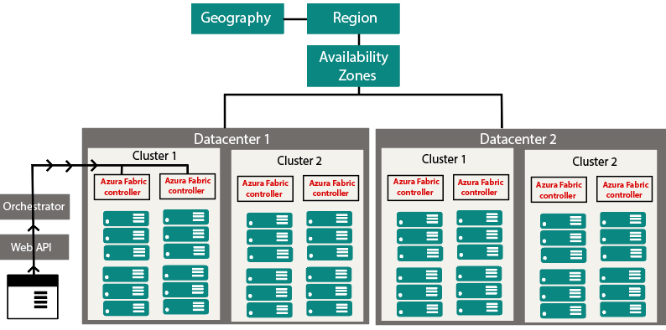
How Azure works:
It is essential to understand the internal workings of Azure so that we can design our applications on Azure effectively with high availability, data residency, resilience, etc.

Slide 6
Microsoft Azure is completely based on the concept of virtualization. So, similar to other virtualized data center, it also contains racks. Each rack has a separate power unit and network switch, and also each rack is integrated with a software called Fabric-Controller. This Fabric-controller is a distributed application, which is responsible for managing and monitoring servers within the rack. In case of any server failure, the Fabric-controller recognizes it and recovers it. And Each of these Fabric-Controller is, in turn, connected to a piece of software called Orchestrator. This Orchestrator includes web-services, Rest API to create, update, and delete resources.
When a request is made by the user either using PowerShell or Azure portal. First, it will go to the Orchestrator, where it will fundamentally do three things:
Authenticate the User
It will Authorize the user, i.e., it will check whether the user is allowed to do the requested task.
It will look into the database for the availability of space based on the resources and pass the request to an appropriate Azure Fabric controller to execute the request.
Combinations of racks form a cluster. We have multiple clusters within a data center, and we can have multiple Data Centers within an Availability zone, multiple Availability zones within a Region, and multiple Regions within a Geography.

Slide 7
Geographies: It is a discrete market, typically contains two or more regions, that preserves data residency and compliance boundaries.
Azure regions: A region is a collection of data centers deployed within a defined perimeter and interconnected through a dedicated regional low-latency network.
Azure covers more global regions than any other cloud provider, which offers the scalability needed to bring applications and users closer around the world. It is globally available in 50 regions around the world. Due to its availability over many regions, it helps in preserving data residency and offers comprehensive compliance and flexible options to the customers.
Availability Zones: These are the physically separated location within an Azure region. Each one of them is made up of one or more data centers, independent configuration.

Slide 8
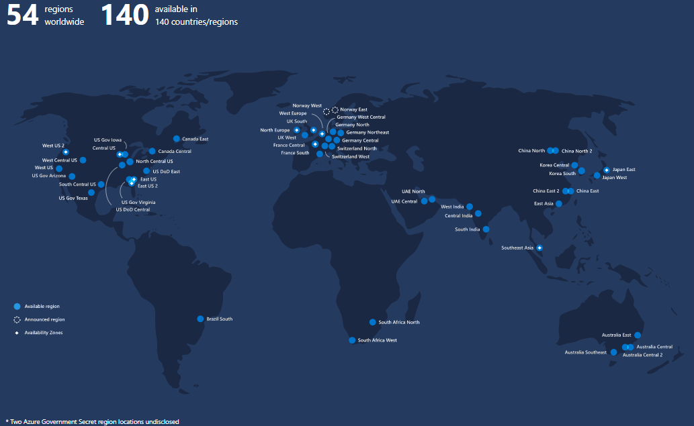

Slide 9
Azure storage service:
Azure Storage Building Blocks:
The fundamental building block of Azure storage service is the Azure storage account. The Storage account is more like an administrative container for most of the Azure storage services. All the storage services are explained below.
Azure Blob: We can have Azure Blob storage within the storage account, which is used to store the unstructured data such as media files, documents, etc.
Azure file: Azure file can be used in case if we want to share files between two virtual machines, then we can create an Azure file share and access it on both of the virtual machines. We can share the data between two or more VMs.

Slide 10
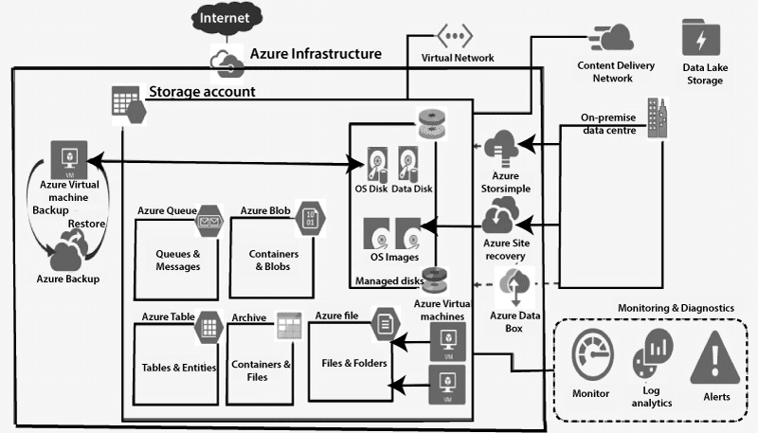

Slide 11
Archive: Archive is recently introduced, and it is in preview. We can use the archive for cost optimization. So, we can move any infrequently accessed blobs or files into the archive to optimize the cost. However, once you move the data into an archive, it will take some time for the recovery of that data.
Azure Queues: It can be used to store messages.
Azure Table: It can be used to store entities. The Azure Table is a bit different from the SQL table. This is a NoSQL datastore where the schema within the table is not enforced.
And apart from all these services, there is one other key service which is:
Azure Disk Storage: Any OS disk associated with the virtual machine in Azure will get stored in a disk storage account. And also, any OS image from which this OS disk is generated will get stored as a .vhd file within the disk storage.
Azure Storsimple: In a hybrid cloud storage solution, Azure offers Storsimple. Storsimple is a hybrid storage solution that works at a SAN(Storage Area Network) level. It was used to be a separate company, but Microsoft brought it with them and is now offering the same services as a part of Azure and from DR (Disaster Recovery) perspective.

Slide 12
Azure Site Recovery: In case if we want to use Azure as a DR data-center, then we can use Azure site recovery to replicate the workloads from our on-premises data-center into Azure. Replicated workloads will be stored as images within a storage account. Whenever our on-premises data-center is down, we can run some automated scripts which will consider that recent image and build a virtual machine.
Azure Data Box: In that case, we can use the Azure data box. By using Azure Data Box, we can load the data into the data box and give that data box to Microsoft. Microsoft will load that data into Azure
Azure Backup: We can use Azure backup to backup the disks of our virtual machine into a recovery service vault and restore the same using that image. We have to be aware that Azure backup doesn't utilize storage to store the disk image. They are stored in the recovery services vault.
Azure Monitor: It can be used for the monitoring of all these services. We can use Azure Monitor for simple monitoring, and we can use log analytics for advance monitoring and analysis. We can also use alerts in case if we want to get alerted on certain things, for example, if the file share capacity is reaching its limit, then we configure it in such a way that we will get alert about the same.
CDN (Content Delivery Network): It is used for the delivery of the contents stored in the storage account. We can use a content delivery network to reduce the latency of the delivery. We'll create a CDN endpoint near to the users to reduce the latency.

Slide 13
Slide Tite
Thank You……

