Slide 1
Microsoft Azure Fundamentals: AZ-900

Slide 2
Core azure services
Region and region pairs
Availability Zones
Resources Groups
Management Groups
Subscription

Slide 3
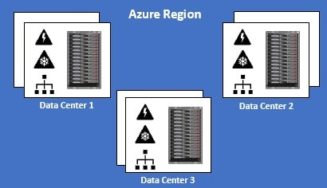
What is an Azure Region
Simply put, an Azure Region is a set of Datacenters that are connected through a dedicated low-latency network. How many datacenters does a region contain. Well, we do not have a fixed number. It varies. There are regions of different sizes. A Region could be made up of just one datacenter or multiple datacenters. The point is, an Azure Region is a group of one or more Azure Datacenters. As of this course recording, Azure has 58 regions worldwide.

Slide 4
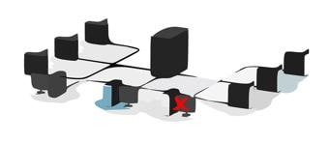
What is cross-region resiliency
resilience is the ability of a software to react to problems in one of its components and still provide the best possible service.
Both your software and the underlying infrastructure must be resilient. If there is a problem, the end user should not know about it. The request must be handled and processed by another region. The end user should get the same level of service.

Slide 5
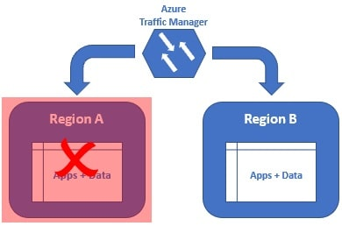
We can get this resiliency, by deploying our application and data in at least 2 regions. In this example we have our application and data deployed in two regions - Region A and Region B.
If there is a region level failure, for example, let's say Region A has gone down. The Azure Traffic Manager is smart enough to send all the requests to Region B. The end user gets the same response. He does not even know there is a region level failure. When Region A is back online, the Azure Traffic Manager will distribute the traffic between both the regions again.

Slide 6
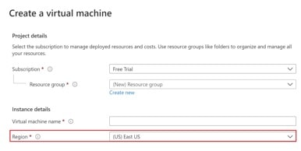
Why are Azure Regions important
Well, because every time we create an Azure resource like a Virtual Machine for example, we need to specify the Azure Region where we want this resource to be created.

Slide 7
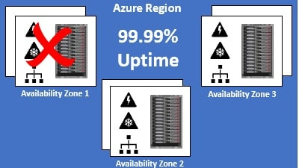
What is an Azure Availability Zone
An Azure Availability Zone is a unique physical location within an Azure region. Each Availability Zone is made up of one or more datacenters with independent power, cooling, and networking. Not all Regions have Availability Zones. Regions that support Availability Zones have a minimum of three separate zones to ensure resiliency.
If one of the Availability Zones has gone down for some reason, we still have our applications and data available from the rest of the two Availability Zones. There is a physical separation between each Availability Zone and it is this separation that protects our applications and data from Datacenter failures. With Availability Zones, Azure offers industry best 99.99% VM uptime SLA.

Slide 8
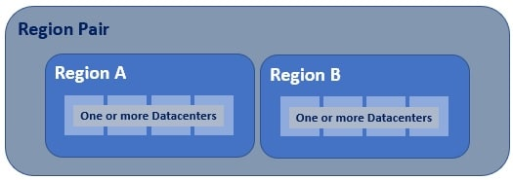
What are Azure paired regions
Azure regional pair, paired regions, or region pair, all these terms are used interchangeably and they refer to the same thing, i.e a pair of azure regions. So in simple terms, a regional pair consists of two regions within the same geography.
As you can see from the image, at the highest level we have an Azure Geography. As we have already discussed, an Azure geography is an area of the world that contains one or more Azure Regions. For example, India, United States, Europe, Asia Pacific are a few examples of Azure Geographies.

Slide 9
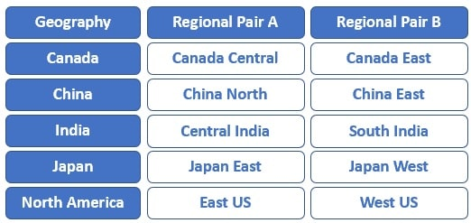
Most regions in a geography are paired to ensure business continuity and disaster recovery (BCDR). The following are a few examples of azure paired regions. For the complete list of Azure paired regions, please check out the Microsoft official docs

Slide 10
Benefits of paired regions
Physical separation between datacenters : When possible, there is at least 300 miles of separation between datacenters in a regional pair, although this isn't practical or possible in all geographies. Physical datacenter separation reduces the likelihood of natural disasters, civil unrest, power outages, or physical network outages affecting both the regions at the sametime. So for whatever reason, if one of the regions is down, we still have the other region available.
Region recovery in the event of an outage : If for whatever reason, several regions world-wide are down, azure prioritizes recovery of one region out of every pair. So if you want your apps and data to be highly available, deploy them in paired regions. With this setup, if both the regions are down, azure prioritizes to recover at least one region from the pair, so we have our apps and data available again soon. If applications are deployed across regions that are not paired, recovery might be delayed, in the worst case the chosen regions may be the last two to be recovered.

Slide 11
Automatic Platform-provided replication : Some services such as Geo-Redundant Storage provides automatic replication to the paired region. This is a great benefit. In an event, where one of the regions go down, you still have the data available from the other region in the region pair.
Data residency, compliance and legal requirements : With the exception of Brazil South, regions with in a region pair are from the same geography. This helps us meet data residency, compliance and legal requirements.
Sequential system updates : From time to time, patches and software updates need to be applied. Regions in a region pair are never updated simultaneously at the same time. They are always applied sequentially. This reduces the downtime to a great extent. If the planned update contains any bugs or logical errors, only one region is affected. Our apps and data will still be available from the other region in the region pair.

Slide 12
What are Azure Resources
Resources are instances of azure services that you create, like virtual machines, app services, storage accounts, SQL databases, function apps etc. All these are azure services. Everytime you create an instance of a service, you are creating a resource. There are hundereds of azure services.
You can see the complete list of azure services by navigating to https://portal.azure.com/#allservices. You need to login to the azure portal, otherwise it will redirect you to the login page.
On the left you see the service categories like General, Compute, Networking, Storage etc. For example if you want to create a storage account to store your data, click on the Storage category and you will see all the services related to Storage.
Anytime you create a resource, you also need to specify a resource group.

Slide 13
What is an Azure Resource Group
As the name implies, a Resource Group is a group of azure resources like virtual machines, app services, storage accounts, SQL databases etc. It's a logical container for grouping related azure resources.
Azure Resource Group Example
Let's say we are developing a web application. There are several ways to do this. To keep this example simple, let's just assume we need the following 3 azure resources.
Virtual Machine - To host and run our web application
Storage Account - To store images, videos and other resources that our web application needs
SQL database - To store our application data
Let's say for this example sake we have the following environments. Most organisations have these deployment environments.
Development
Testing
Staging
Preproduction
Production

Slide 14
Let's say our web application name is PragimTech.com. We might create the following 4 resource groups, one
for each environment.
rg-pragimtech-development
rg-pragimtech-staging
rg-pragimtech-preproduction
rg-pragimtech-production
We have the following naming pattern here. The prefix rg stands for resource group.
Grouping by deployment environment is just one way of grouping. Obviously you can group resources
any way you want. Anyway that makes sense to your oragnisation really.
By department,
By country,
By application,
By resource type
Combination of these
rg-<applicationName>-<deploymentEnvironment>

Slide 15
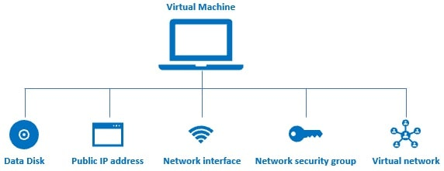
Benefits of Azure Resource Groups
Administration is much easier:
When we create a virtual machine in azure several other associated resources like the following are created. a data disk for the virtual machine, Public IP address, Network interface, Network security group, Virtual network.
Without these resources, an azure virtual machine doesn't work as expected. After you are done with the VM, you may want to delete it to save on cost. However, when you delete the VM the associated resources are not automatically deleted. You have to delete them manually. If you forget to delete 1 or more associated resources, you are unnecessarily paying for those resources that you are not actually using.
On the other hand, if you create a virtual machine in a resource group, all the other associated resources are also created in the same resource group. When we delete the resource group, not just the virtual machine, all it's associated resources are also automatically deleted.

Slide 16
Cost management is easier:
In the azure portal, on the cost analysis blade, you can see the cost of running each resource. You can also see the total cost of all the resources in the resource group. When you are done with a set of resources, there is no need for you to delete each resource individually. When you delete a resource group, all the resources in that group are also deleted. This obviously eliminates any possibility of orphaned resources left running, and as a result running up costs.
Role-based access control (RBAC)
Role-based access control (RBAC) can be applied at the resource group level. This makes it much easier to manage user access to the resources in the group. When the users log into the azure portal, they will only see resource groups they have access to and not others within the subscription. Administrators will still be able to assign access control for users to individual resources within the resource group based on their roles.

Slide 17
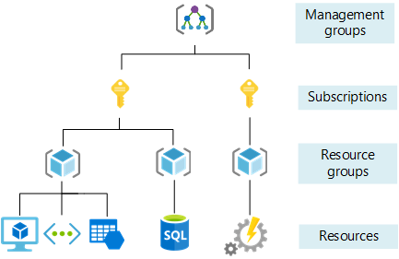
Azure management groups and subscriptions
If there are only a few subscriptions in your organisation, then it's relatively simple to manage them independently. However, in an organisation there are usually many employees and may be, many applications. If all these employees are provided azure subscriptions and if they start creating azure resources at will, it may soon become difficult to control, manage and track who is creating what and eventually the costs may go out of control. So, Azure has four levels of management-scope to organize, secure, manage and track the costs. The following image from MSDN shows the four levels of management-scope and the relationship between them.

Slide 18
Management groups
Management group is at the top of the hierarchy. All subscriptions in a management group automatically inherit the conditions or settings specified at the management group level. So, a management group is like a container for all your subscriptions. Just like how there can be multiple subscriptions, there can also be multiple management groups in an organisation.
The following image is from MSDN, and it shows, how we can build a flexible structure of management groups and subscriptions to organize our resources into a hierarchy for unified policy and access management.
For whatever reason, let's say, in our organisation, we want to allow azure resources to be created only in the East US region. One easy way to do this is to create such a policy at the IT Management Group level. This policy is then automatically enforced on all the Management Groups and Subscriptions that are descendants of the IT management group. The descendants will not be able to alter this security policy in any way and it is also applicable to all resources under those subscriptions. So, obviously governance becomes much easier.

Slide 19
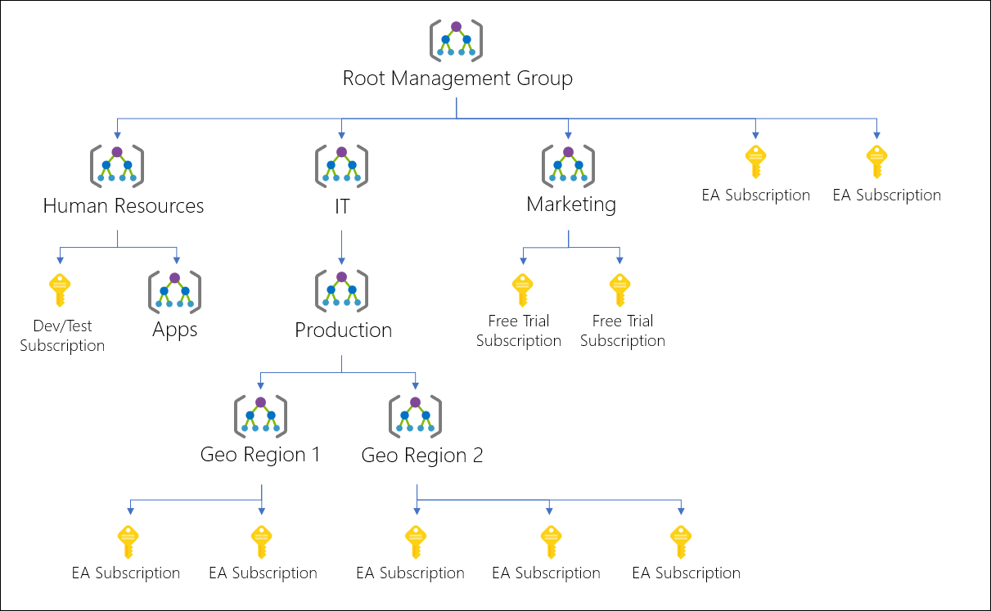

Slide 20
Subscriptions
A subscription sits under a management group. It associates user accounts and the resources that were created by those user accounts. Each subscription has limits or quotas on the amount of resources you can create and use. Organizations can use subscriptions to manage costs and the resources that are created by users, teams, or projects.

Slide 21
Slide Tite
Thank You……

