Slide 1
Microsoft Azure Fundamentals: AZ-900

Slide 2
resources available in Azure
Azure Virtual Machine
Azure App Services
Azure Container Instances
Azure Kubernets Services
Windows Virtual Desktop

Slide 3
Virtual Machines:
Azure Virtual machine will let us create and use virtual machines in the cloud as Infrastructure as a Service. We can use an image provided by Azure, or partner, or we can use our own to create the virtual machine. Virtual machines can be created and managed using:
Azure Portal
Azure PowerShell and ARM templates
Azure CLI
Client SDK's
REST APIs
Following are the configuration choices that Azure offers while creating a Virtual Machine.
Operating system (Windows and Linux)
VM size, which determines factors such as processing power, how many disks we attach etc.
The region where VM will be hosted
VM extension, which gives additional capabilities such as running anti-virus etc.
Compute, Networking, and Storage elements will be created during the provisioning of the virtual machine.

Slide 4
Azure VM Storage
Disks used by VMs
Operating system disk: In Azure, every virtual machine will have an operating system disk.
Temporary disk: Each VM contains a temporary drive. The temporary disk provides short-term storage for applications and processes.
Data disk: A data disk is a VHD that's attached to a virtual machine to store application data or other data we need to keep.
Performance tiers
Standard Storage: It is backed by HDDs and deliver cost-effective storage while still being performant. It is ideal for development and testing, not-critical, and Infrequent access because the max throughput and IOPS per disk is 60MB/s and 500, respectively.
Premium Storage: It is backed by SSDs, and deliver high-performance, low-latency disk support for VMs running I/O-intensive workloads. The maximum throughput and IOPS per disk are 250MB/s and 7500, respectively.

Slide 5
Virtual Machine Availability
Availability Set: Availability Set is a logical grouping of VMs within a data center that allows Azure services to understand how our application is built to provide redundancy and availability. An availability set is composed of two additional groupings that protect against hardware failures and allow updates to be applied safely.
Fault domains- It is a logical group of the underlying hardware that shares a common network switch and power source, similar to a rack within an on-premises datacenter.
Update Domain: It is a logical group of the underlying hardware that will go under maintenance or be rebooted at the same time.
Managed Disk fault domains: For VMs using Azure Managed Disks, VMs are aligned with managed disk fault domains when using a managed availability set. This alignment ensures that all the managed disks attached to a VM are within the same managed disk fault domain.
Availability Zones: It is a physically separate zone within an Azure region. There are three Availability zones per supported within the Azure region. All availability zone has the same amount of power source, network, and cooling, and is separated from the other Availability Zones within the Azure region.

Slide 6
Storage Availability
Azure Managed Disks
Locally redundant storage (LRS): We will have three copies of the same data within the same facility. So, if there is a datacenter failure, then there is a high probability that we might lose the data.
Storage account-based disks
Locally redundant storage (LRS): It maintains three replicas with the facility.
Zone redundant storage (ZRS): It maintains three replicas but across facilities.
Geo-redundant storage (GRS): The replicas will be maintained in a paired region. For example - if our disk is in Central US, a copy will be kept in East US also.
Read-access geo-redundant storage (RA-GRS): The copy will be available for read-only access in a different region.

Slide 7
Azure Cloud Service
Cloud Service is a Platform as a Service that is designed to support web applications that are scalable, reliable, and cheaper to operate. Using cloud service, we can deploy a web application into Azure. We have more control over Virtual Machines. We can install custom software on VMs that uses Azure Cloud Service, and we can access them remotely.
Using cloud service, we don't create virtual machines. Instead, we provide a configuration file that tells Azure how many instances we would like to create, the size of the instance, and the platform will create them for us.
Cloud service is able to detect any failed VMs and applications and ready to start new VMs or application instances when a failure occurs. Cloud service applications shouldn't maintain state in the file system of its own VMs

Slide 8
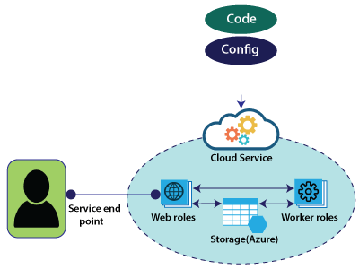
Cloud Service Roles
Web role: It automatically deploys and hosts our app through IIS.(internet information service).
Work role: It does not use IIS and runs our app standalone. If we want to run any continuous bathes, then we can use worker roles, and both the Web role and Worker role will interact with storage to get an application package, etc.
To deploy these Web roles and Worker roles, we will provide configuration and code associated with these web applications.

Slide 9
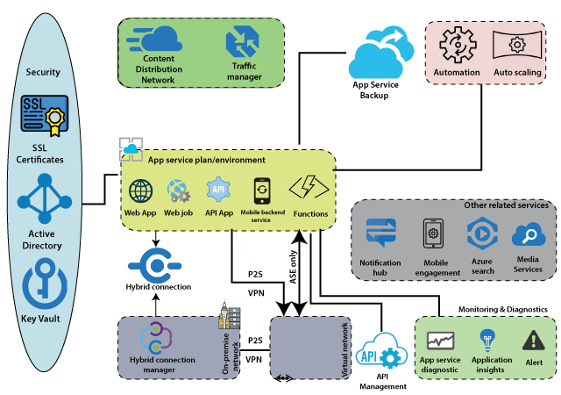
Azure App Services

Slide 10
There are two types of hosting environments within App Service. App Service plan and App Service environment. App Service Environment is a more sophisticated version of the App Service plan and comes with a lot more features when compared to the App Service plan. Within these, we can host several Apps like - web applications, web jobs, batches, APIs, and mobile backend services that can be consumed from our mobile Front-End.
Other related services are closely related to these apps within the App service plan. Those related services are a notification hub that we can use to push notifications into mobile devices. We can use Mobile engagement to carry out Mobile analytics.
Apart from these related services, there is one more service, which is very important when it comes to APIs, which is API management. API management can act as a wrapper around our API apps when we're exposing those APIs to the outside world. It comes with a lot of features such as throttling, security, and it will be beneficial if we want to commoditize our APIs and sell it to the outside world.

Slide 11
App Service plan
An app service plan denotes a set of features and capacity that we can share across multiple apps in the same subscription and geographical region. A single or dual app can be configured to run on the same computing resources.
Each App Service plan defines:
Region (West US, East US, etc.)
Number of VM instances
Size of VM instances (Small, Medium, Large)
Pricing tier
Shared compute: Free and shared, the two basic tiers, runs an app over the same Azure VM as other App Service app runs, including apps of different customers.
Dedicated compute: Basic, Standard, Premium, and PremiumV2 tiers run apps on a fixed Azure VM.
Isolated: This tier runs dedicated Azure VMs on dedicated Azure Virtual Networks, which provides network isolation on top of computing isolation to your apps.
Consumption: It is only available to function apps. It scales the functions dynamically, depending on the workload.

Slide 12
Azure App Service Web Apps is a service for hosting web applications. The key feature of App Service Web Apps.
Multiple language and frameworks
DevOps optimizations
Security & Compliance
Application template
Visual Studio integration

Slide 13
Azure API Apps and API Management
The API apps features make it easy to develop, host, and consume APIs in the cloud and on-premises. The advantage of hosting APIs in Azure API apps is that we will get enterprise-grade security and simple access control, automatic SDK generation, and seamless integration with Logic Apps. Logic Apps are system workflows that you can build within Azure. And as a part of the workflow, each activity needs to interact with the functionality exposed by a different system. By having those interfaces hosted in Azure, it makes it easy to integrate with the logic apps also.

Slide 14
Features of API apps
Bring our own existing API as-is: API can be developed in any language framework supported by App Service such as C#, Java, PHP, Node.js, etc.
Easy Consumption: There is integrated support for Swagger API. By enabling swagger, we are making it easy for others to consume our APIs, and also we will provide excellent visibility of APIs to developers.
Simple access control: Protect an API app from unauthenticated access with no changes to your code.
Visual Studio Integration
Integration with Logic apps

Slide 15
Azure App Service Security
Authentication and Authorization: Every App service comes with an Authentication and Authorization module that handles several things for our app.
It will authenticate the user with a specified provider such as Facebook, Google, Twitter, Azure Active Directory, etc.
It will store, validate, and refreshes tokens.
It also manages the authenticated session.
It injects identity formation into request headers.
App Service Environments security
If we are using App service environments, then we will get additional benefits in terms of security.
Network security groups: We can associate with network security groups and control the traffic coming into our App service using network security groups.
Web Application Firewall: It is a feature of application Gateway that provides centralized protection of your web applications from common exploits and vulnerabilities. The web application firewall is based on rules from the OWASP core rule sets 3.0 or 2.2.9

Slide 16
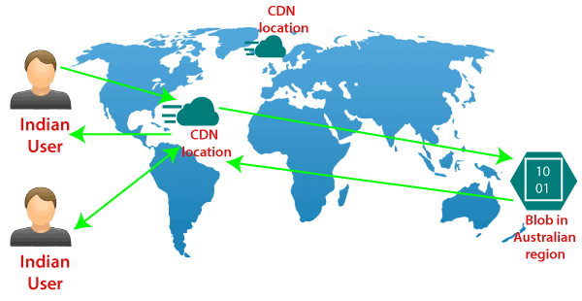
Azure Content Delivery Network
We have a vast amount of video content located in Australia, but the primary users of that content are located in the US, and if any of the users from India will try to access the content from Australia. Then they will experience some latency because of the distance between Australia and India. In that scenario, we can use a content delivery network to reduce that latency.

Slide 17
CDN products
There are several types of products that are available by Azure, and there are two other third party providers that provide CDN products in partnership with Microsoft.
Azure CDN Standard from Microsoft (Preview)
Azure CDN Standard from Akamai
Azure CDN Standard from Verizon
Azure CDN Premium from Verizon
Features of Content Delivery Network (CDN)
Dynamic site acceleration: It is the capability to deliver dynamic web content with minimum latency. It is achieved by using different techniques such as route optimization to avoid congestion points, TCP optimization, etc.
HTTPS support: It provides us the HTTPS support of secure web content.
Query string caching: Based on query string caching, we can cache the content also within CDN location.
Geo-Filtering: We can apply some geo-filtering if we want certain content filtered for a particular geographical region.
Azure diagnostics logs: It provides the facility of records of diagnosis.

Slide 18
Azure Container Instances (ACI)
Develop apps fast without managing virtual machines or having to learn new tools—it's just your application, in a container, running in the cloud.
Features:
Run containers without managing servers
By running your workloads in Azure Container Instances (ACI), you can focus on designing and building your applications instead of managing the infrastructure that runs them.
Increase agility with containers on demand
Deploy containers to the cloud with unprecedented simplicity and speed—with a single command. Use ACI to provision additional compute for demanding workloads whenever you need. For example, with the Virtual Kubelet, use ACI to elastically burst from your Azure Kubernetes Service (AKS) cluster when traffic comes in spikes.
Secure applications with hypervisor isolation
Gain the security of virtual machines for your container workloads, while preserving the efficiency of lightweight containers. ACI provides hypervisor isolation for each container group to ensure containers run in isolation without sharing a kernel.

Slide 19
Azure Kubernetes Service (AKS)
Azure Kubernetes Service is a managed container orchestration service based on the open source Kubernetes system, which is available on the Microsoft Azure public cloud. An organization can use AKS to handle critical functionality such as deploying, scaling and managing Docker containers and container-based applications.
AKS became generally available in June 2018 and is most frequently used by software developers and IT operations staff.
An AKS cluster can be created using the Azure command-line interface (CLI), an Azure portal or Azure PowerShell. Users can also create template-driven deployment options with Azure Resource Manager templates.
AKS availability and costs
AKS is a free Azure service, so there is no charge for Kubernetes cluster management. AKS users are, however, billed for the underlying compute, storage, networking and other cloud resources consumed by the containers that comprise the application running within the Kubernetes cluster.
AKS is currently available in numerous regions, including Eastern, Central and Western U.S.; Central Canada; Northern and Western Europe; and Southeast Asia. Other regions will be added over time.

Slide 20
AKS features and benefits
1. Accelerated app development
75 percent of developer’s time is typically spent on bug-fixing. AKS removes much of the time-sink (and headache) of debugging by handling the following aspects of your development infrastructure:
Auto upgrades
Patching
Self-healing
Through AKS, container orchestration is simplified, saving you time and enabling your developers to remain more productive. It’s a way to breathe life into your application development by combatting one of developer’s biggest time-sinks.
2. Supports agile project management
As this PWC report shows, agile projects yield strong results and are typically 28 percent more successful than traditional projects.
This is another key benefit to AKS – it supports agile development programs, such as continuous integration (CI), continuous delivery/continuous deployment (CD) and dev-ops. This is done through integration with Azure DevOps, ACR, Azure Active Directory and Monitoring. An example of this is a developer who puts a container into a repository, moves the builds into Azure Container Registry (ACR), and then uses AKS to launch the workload.

Slide 21
AKS features and benefits
3. Security and compliance done right
Cyber security must be a priority for all businesses moving forward. Last year, almost half of UK businesses suffered a cyber-attack and, according to IBM’s study, 60 percent of data breaches were caused by insiders. The threat is large, and it often comes from within.
AKS protects your business by enabling administrators to tailor access to Azure Active Directory (AD) and identity and group identities. When people only have the access they need, the threat from internal teams is greatly reduced.
You can also rest assured that AKS is totally compliant. AKS meets the regulatory requirements of System and Organisation Controls (SOC), as well as being compliant with ISO, HIPAA and HITRUST.
4. Use only the resources you need
AKS is a fully flexible system that adapts to use only the resources you need. Additional processing power is supported via graphic processing units (GPUs) – processor intensive operations, such as scientific computations, enables on-top processing power. If you need more resources, it’s as simple as clicking a button and letting the elasticity of Azure container instances do the rest.
When you only use the resources you need, your software (and your business) enjoys the following benefits:
Reduced cost – no extra GPUs need to be bought and integrated onsite.
Faster start-up speed compared to onsite hardware and software which takes time to set-up.
Easier scaling – get more done now without worrying about how to manage resources

Slide 22
Azure Virtual Desktop
Access your desktop and applications from virtually anywhere
Set up Azure Virtual Desktop (formerly Windows Virtual Desktop) in minutes to enable secure remote work. Provide the familiarity and compatibility of Windows 11 with the new scalable multi-session experience for your end users and save costs by using existing eligible Windows licences. Manage your end-to-end Azure Virtual Desktop deployment alongside other Azure services within the Azure portal.
Features:
1. Deliver Windows 11 desktops and applications virtually anywhere
Provide employees the best virtualised experience with the only solution fully optimised for Windows 11 and Microsoft 365.
2. Built-in intelligent security
Help keep your applications and data secure and compliant with security capabilities that can proactively detect threats and take remedial action.
3. Deploy and scale in minutes
Simplify deployment and management of your infrastructure and scale quickly based on your business needs.
4. Reduce cost using existing licenses
Use existing eligible licences to reduce costs with a modern cloud-based virtual desktop infrastructure (VDI) and pay only for what you use.

Slide 23
Slide Tite
Thank You……

