Slide 1
Microsoft Azure Fundamentals: AZ-900

Slide 2
Virtual machine in Azure
Azure Sql
Azure Marketplace
Azure Core solutions
Azure Management tool

Slide 3
What is Azure Cosmos DB?
Azure Cosmos DB is a fully managed, serverless NoSQL database for high-performance applications of any size or scale.
It guaranteed single-digit millisecond performance and 99.999-percent availability. Backend by SLAs (service level agreement), automatic and instant scalability, enterprise-grade security, and open-source APIs for NoSQL databases including MongoDB and Cassandra. Enjoy fast writes and reads anywhere in the world with multi-region writes and data replication.
Benefits:
Guaranteed speed at any scale with instant and limitless elasticity, seamless burst capacity, fast reads, and multi-region writes anywhere in the world
Fast, flexible app development with SDKs for popular languages plus a native Core (SQL) API, APIs for MongoDB, Cassandra, and Gremlin, and free dev/test options
Fully managed and cost-effective serverless database that responds to application needs by instantly and automatically scaling up and down, and offers consumption-based pricing options.

Slide 4
What is Azure SQL DATABASE?
Azure SQL Database is a fully managed platform as a service (PaaS) database which means that Microsoft operates SQL Server for you, and ensures its availability and performance.engine that handles most of the database management functions such as upgrading, patching, backups, and monitoring without user involvement.

Slide 5
Azure database For MySql:
Azure Database for MySQL is cost effective and easy to set up, operate, and scale. Enjoy advanced security, same-zone or zone-redundant high availability, and a service-level agreement (SLA) of up to 99.99 percent.
Benefits:
Fully managed MySQL, compatible with the latest community editions, that provides maximum flexibility for database operations
Simplified development experience and tight interoperability with Azure App Service and Azure Kubernetes Service (AKS)

Slide 6
Azure Database for PostgreSQL
Azure Database for PostgreSQL is a relational database service based on the open-source Postgres database engine.
It's a fully managed database-as-a-service that can handle mission-critical workloads with predictable performance, security, high availability, and dynamic scalability.

Slide 7
The benefits of using virtual network peering, whether local or global, include:
A low-latency, high-bandwidth connection between resources in different virtual networks.
The ability for resources in one virtual network to communicate with resources in a different virtual network.
The ability to transfer data between virtual networks across Azure subscriptions, Azure Active Directory tenants, deployment models, and Azure regions.
The ability to peer virtual networks created through the Azure Resource Manager.
The ability to peer a virtual network created through Resource Manager to one created through the classic deployment model. To learn more about Azure deployment models, see Understand Azure deployment models.
No downtime to resources in either virtual network when creating the peering, or after the peering is created.
Network traffic between peered virtual networks is private. Traffic between the virtual networks is kept on the Microsoft backbone network. No public Internet, gateways, or encryption is required in the communication between the virtual networks.

Slide 8
Sql Managed Instance:
SQL Managed Instance is the intelligent, scalable, cloud database service that combines the broadest SQL Server engine compatibility with all the benefits of a fully managed and evergreen platform as a service.
Benefits:
The broadest SQL Server compatibility on a fully managed service streamlines app.
Save up to 55 percent compared to pay-as-you-go pricing when you reuse your SQL licenses with Azure Hybrid Benefit
Build on the SQL Server code base with the tools and experience you already have
Secure.

Slide 9
What is the Marketplace?
The Marketplace is the premier destination for all your software needs - certified and optimized to run on Azure.
In Azure Marketplace you can find, try, buy, and deploy the software and services you need to build new solutions and manage your cloud infrastructure.

Slide 10
Internet Of Things (IoT) Hub:
Enable highly secure and reliable communication between your Internet of Things (IoT) application and the devices it manages. Azure IoT Hub provides a cloud-hosted solution back end to connect virtually any device. Extend your solution from the cloud to the edge with per-device authentication, built-in device management and scaled provisioning.
Features:
Security-enhanced communication channel for sending and receiving data from IoT devices
Compatibility with Azure IoT Edge for building hybrid IoT applications
air deployment of updates to help keep IoT devices up to date and secure

Slide 11
Azure Sphere:
Azure Sphere is a secured IoT platform for building solutions that start and extend through the OS and the cloud.
Securely connect, manage, and protect new and existing intelligent devices.
Azure Synapse Analytics:
Azure Synapse Analytics is a limitless analytics service that brings together data integration, and big data analytics.
Azure Synapse brings these worlds together with a unified experience to ingest, explore, prepare, transform, manage and serve data for immediate BI and machine learning needs.

Slide 12
Azure HDInsight:
Azure HDInsight is a fully-managed cloud service that makes it easy, fast, and cost-effective to process massive amounts of data. Use the most popular open-source frameworks such as Hadoop, Spark, Hive, LLAP, Kafka, Storm, HBase, Microsoft ML Server and more.

Slide 13
What is Databricks in Azure?
Azure Databricks is a data analytics platform optimized for the Microsoft Azure cloud services platform.
Is Databricks a cloud?
Databricks on Google Cloud. Databricks's open source platform is fully integrated into Google Cloud's data services in order to applications onto one open cloud platform.

Slide 14
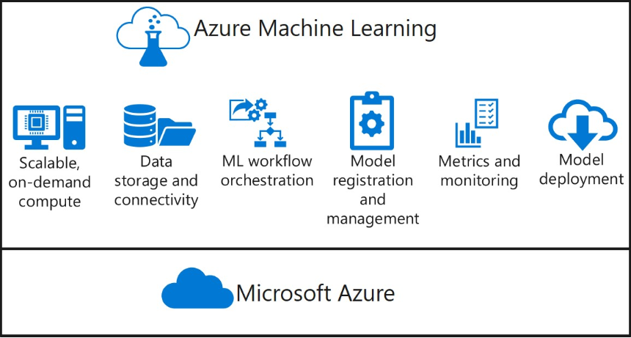
Azure Machine Learning
Azure Machine Learning (Azure ML) is a cloud-based service for creating and managing machine learning solutions.

Slide 15
What is Cognitive Services?
Cognitive services brings AI within reach of every developer and data scientist.
With leading models, a variety of use cases can be unlocked.
Deploy Cognitive services anywhere from the cloud to the edge with containers.
What is a bot service?
Your bot is a web service that implements a conversational interface and communicates with the Bot Framework Service to send and receive messages and events
A bot -- short for robot and also called an internet bot -- is a computer program that operates as an agent for a user or other program or to simulate a human activity.
Bots are normally used to automate certain tasks, meaning they can run without specific instructions from humans.

Slide 16
What is serverless computing?
Serverless computing enables developers to build applications faster by eliminating the need to manage infrastructure.
With serverless applications, it is the cloud platform, that automatically provisions, scales, and manages the infrastructure needed to execute code.
The benefits of serverless:
No infrastructure management (abstraction of servers)
Dynamic scalability
Faster time to market
Reduced DevOps

Slide 17
What are Azure Functions?
Azure Functions enable you to develop serverless applications on Microsoft Azure. With the platform, you write small blocks of code, or “functions.” which include just the code you need for the problem at hand, without worrying about the entire application and infrastructure to run it.
Azure functions offer:
Choice of language – Write functions using C#, F#, Node.js, Python, PHP, batch, bash, or any executable.
Automatic scaling – Azure functions detect workload volumes, and scale out and in automatically to handle it.
Pay-per-use pricing model – Pay only for the time spent running your code.
Bring your own dependencies – Functions supports NuGet and NPM, so you can use your favorite libraries.
Open-source – The Functions runtime is open-source and available on GitHub.

Slide 18
What are Logic Apps?
Logic Apps provide a way to simplify and implement scalable integrations and workflows in the cloud.
The Logic Apps Designer experience includes the following:
No Code, Browser-based, API composition
Full management API
Visual Studio IDE support
Why Use Logic Apps?
connect APIs easily
dozens of pre-built templates
Easy to use design tools – Logic Apps can be designed end-to-end in the browser
Reduce on-premises infrastructure
Quickly build and test software
Reduce time building

Slide 19
What is Azure DevOps?
Azure DevOps provides developer services for allowing teams to plan work, collaborate on code development, and build and deploy applications.You can work in the cloud using Azure DevOps Services or on-premises using Azure DevOps Server.
Choose Azure DevOps Services when you want the following outcomes:
Quick set-up
Maintenance-free operations
Easy collaboration across domains
Elastic scale
Rock-solid security

Slide 20
Azure Command-Line Interface (CLI)
The Azure command-line interface (Azure CLI) is a set of commands used to create and manage Azure resources. The Azure CLI is available across Azure services and is designed to get you working quickly with Azure, with an emphasis on automation.
Azure Cloud Shell
Azure Cloud Shell is an interactive, authenticated, browser-accessible shell for managing Azure resources. It provides the flexibility of choosing the shell experience that best suits the way you work, either Bash or PowerShell.

Slide 21
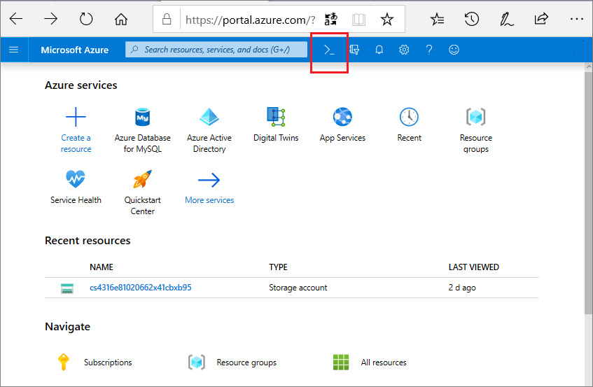
Choice of preferred shell experience
Users can choose between Bash or PowerShell.
Select Cloud Shell.

Slide 22
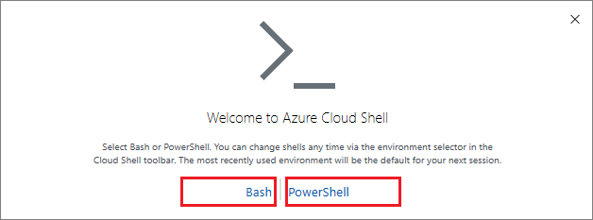

Select Bash or PowerShell.
After first launch, you can use the shell type drop-down control to switch between Bash and PowerShell:

Slide 23
What is Azure Mobile App?
Azure Mobile Apps is a technology that allows you to connect your mobile app to resources that are important in cloud connected mobile applications such as table data, authentication, and push notifications.
Azure Advisor:
Quickly and easily optimize your Azure deployments.
Azure Advisor analyzes your configurations and usage and offers personalized, actionable recommendations to help you optimize your Azure resources for reliability, security, operational excellence, performance, and cost.

Slide 24
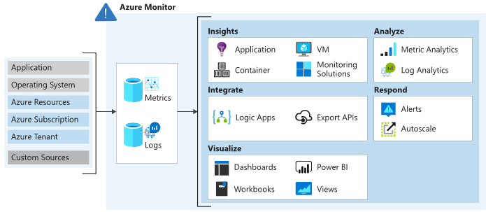
What is Azure resource manager ARM templates?
Azure Resource Manager templates are JavaScript Object Notation (JSON) files that define the infrastructure and configuration for your project.
What is Azure Monitor?
Azure Monitor helps you maximize the availability and performance of your applications and services.

Slide 25
What is Azure service health?
Azure Service Health is a suite of experiences that provide personalized guidance and support when issues in Azure services are or may affect you in the future. Azure Service Health is composed of Azure status, the service health service, and Resource Health.

Slide 26
Slide Tite
Thank You……

