Slide 1
Microsoft Azure Fundamentals: AZ-900

Slide 2
Virtual machine in Azure
Azure Identity services
Azure Governance Features
Azure privacy & compliance

Slide 3
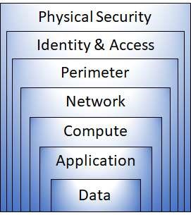
What is defense in depth?
The objective of defense in depth is to protect information and prevent it from being stolen by those who aren’t authorized to access it.

Slide 4
Data :
Stored in a database
Stored on disk inside virtual machines
Stored on a SaaS application such as Office 365
Stored in cloud storage
Application :
Ensure applications are secure and free.
Store sensitive application secrets in a
secure storage medium.
Make security a design requirement for all
application development.
Compute :
Secure access to virtual machines.
Implement endpoint protection and keep
systems patched and current.

Slide 5
Networking:
Limit communication between resources.
Deny by default.
Restrict inbound internet access and limit
outbound, where appropriate.
Implement secure connectivity to on-
premises networks.
Perimeter :
Use distributed denial of service (DDoS) protection to filter large-scale attacks before they can cause a denial of service for end users.
Use perimeter firewalls to identify and alert on malicious attacks against your network.
Identity and access :
Control access to infrastructure and change control.
Use single sign-on and multi-factor authentication.
Physical security
Physical building security and controlling access to computing hardware within the data center is the first line of defence.

Slide 6
Network Security Groups (NSG):
Azure network security group to filter network traffic and from Azure resources in an Azure virtual network.
Azure resources is critical for improving the security of your application.
What is an Azure Firewall?
Azure Firewall is a cloud-native and intelligent network firewall security service.
That provides the best of threat protection for your cloud workloads running in Azure.
It's a fully support different states.
Firewall as a service with built-in high availability and unrestricted cloud scalability.

Slide 7
Azure DDoS protection
( distributed denial of service) DDoS Protection enables you to protect your Azure resources from denial of service (DoS) attacks with always-on monitoring and automatic network attack.
There is no upfront commitment and your total cost scales with your cloud deployment.
A single Azure DDoS Protection Plan in a tenant can be used across multiple subscriptions.
The Azure DDoS Protection service will have a fixed monthly charge. The fixed monthly charge includes protection for 100 resources. Protection for additional resources will be charged on a monthly per-resource basis.

Slide 8
Examples of resources:
Data process (ingress/egress) for Azure firewall.
Scale out of VMs, AKS
Scale out of backend PaaS resources like SQL, CosmosDB, Storage, App Services etc.

Slide 9
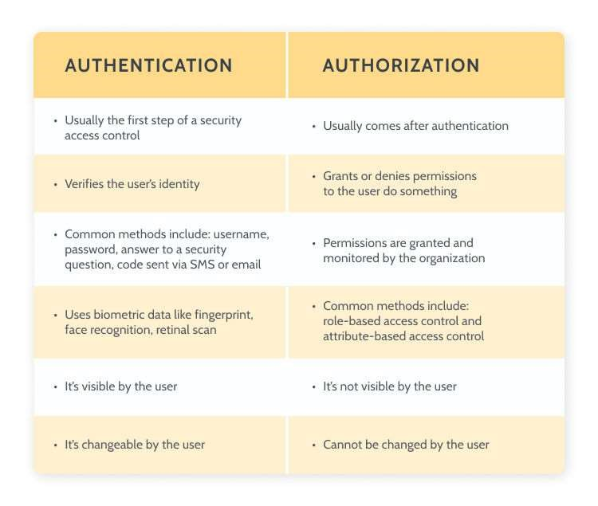
Explain the difference between authentication and authorization:

Slide 10
What is Azure Active Directory?
Azure Active Directory (Azure AD) is a cloud-based identity and access management service.
Azure Active Directory also helps them access internal resources like apps on your corporate intranet network, along with any cloud apps developed for your own organization.
Who uses Azure AD?
IT admins ,App developers
Microsoft 365, Office 365, Azure, or Dynamics CRM Online subscribers
Features in Azure AD:
Application management ,Authentication
Azure Active Directory for developers
Business-to-Business (B2B)
Business-to-Customer (B2C)
Device Management
Reports and monitoring

Slide 11
Conditional Access:
Conditional access is a set of policies and configurations that control which devices have access to various services and data sources.
In the Microsoft environment, conditional access works with the Office 365 suite of products, as well as with SaaS apps which are configured in Azure Active Directory.

Slide 12
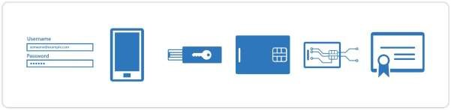
Multi-Factor Authentication (MFA):
Multifactor authentication (MFA) adds a layer of protection to the sign-in process.
When accessing accounts or apps, users provide additional identity verification, such as scanning a fingerprint or entering a code received by phone.
Why use multifactor authentication (MFA)?
It’s more secure than passwords.
Some types of multifactor authentication (MFA) are stronger than others.
Protect your business from common identity attacks with one simple action.

Slide 13
Single Sign-On (SSO):
Single sign-on (SSO) is a time-saving and highly secure user authentication process.
SSO lets users access multiple applications with a single account and sign out instantly with one click.
Single sign-on is an authentication method that allows users to sign in using one set of credentials to multiple independent software systems.

Slide 14
Role-Based Access Control (RBAC):
Azure role-based access control (Azure RBAC) helps you manage who has access to Azure resources, what they can do with those resources, and what areas they have access to.
What can I do with Azure RBAC?
Here are some examples of what you can do with Azure RBAC:
Allow one user to manage virtual machines in a subscription and another user to manage virtual networks
Allow a DBA group to manage SQL databases in a subscription
Allow a user to manage all resources in a resource group, such as virtual machines, websites, and subnets
Allow an application to access all resources in a resource group

Slide 15
Resource locks:
As an administrator, you can lock an Azure subscription, resource group, or resource to protect them from accidental user deletions and modifications.
The lock overrides any user permissions.
You can set locks that prevent either deletions or modifications.
In the portal, these locks are called Delete and Read-only.
In the command line, these locks are called CanNotDelete and ReadOnly.
In the left navigation panel, the subscription lock feature's name is Resource locks, while the resource group lock feature's name is Locks.
CannotDelete means authorized users can read and modify a resource, but they can't delete it.
ReadOnly means authorized users can read a resource, but they can't delete or update it. Applying this lock is similar to restricting all authorized users to the permissions that the Reader role provides.
Who can create or delete locks
Only the Owner and the User Access
Administrator built-in roles can create and delete management locks. You can create a custom role with the required permissions.

Slide 16
Tags in Azure:
Tags are metadata elements that you apply to your Azure resources.
They're key-value pairs that help you identify resources based on settings that are relevant to your organization.
If you want to track the deployment environment
for your resources, add a key named Environment.
You can apply tags to your Azure resources, resource groups, and subscriptions.
What is Azure Policy?
Azure Policy helps to enforce organizational standards and to assess compliance at-scale.
Common use cases for Azure Policy include implementing governance for resource consistency, regulatory compliance, security, cost, and management.
Policy definitions for these common use cases are already available in your Azure environment as built-ins to help you get started.

Slide 17
Azure Blueprints:
Just as a blueprint allows an engineer or an architect to sketch a project's design parameters.
Azure Blueprints enables cloud architects and central information technology groups to define a repeatable set of Azure resources that implements and otherize to an organization's standards, patterns, and requirements.
The Azure Blueprints service is backed by the globally distributed Azure Cosmos DB.
Blueprint objects are replicated to multiple Azure regions.
This replication provides low latency, high availability, and consistent access to your blueprint objects.

Slide 18
Cloud Adoption Framework for Azure:
The Microsoft Cloud Adoption Framework for Azure is a full lifecycle framework that enables cloud architects, IT professionals, and business decision makers to achieve their cloud adoption goals. It provides best practices, documentation, and tools that help you create and implement business and technology strategies for the cloud.
The Cloud Adoption Framework brings together cloud adoption best practices from Microsoft employees, partners, and customers.
Microsoft core tenets of Security:
Building on the principles of security, privacy, compliance, resiliency, and Microsoft strives to earn and keep your trust.
The Azure approach to trust is based on the following foundational principles:
Security, privacy, compliance, resiliency, and protection of intellectual property.
What is Azure security and compliance?
Fully managed service that helps secure remote access to your virtual machines.
A cloud-native web application firewall (WAF) service that provides powerful protection for web apps.
Cloud-native and intelligent network firewall security.

Slide 19
Microsoft Privacy Statement:
Your privacy is important to us.
This privacy statement explains the personal data Microsoft processes, how Microsoft processes it, and for what purposes.
Microsoft offers a wide range of products, including server products used to help operate worldwide, devices you use in your home, software that students use at school, and services developers use to create and host what’s next.
References to Microsoft products in this statement include Microsoft services, websites, apps, software, servers, and devices.
The Microsoft Privacy Statement explains what personal data Microsoft collects, how Microsoft uses it, and for what purposes.

Slide 20
What’s in the Online Services Terms?
The Online Services Terms (OST) is a legal agreement between Microsoft and the customer.
The OST applies specifically to Microsoft’s online services that you license through a subscription, including Azure, Dynamics 365, Office 365, and Bing Maps.
Microsoft Products and Services Data Protection Addendum (DPA) :
When you subscribe to a Product under the terms of the Product Terms site, the data processing and security terms are defined in Microsoft Online Services Data Protection Addendum (DPA).

Slide 21
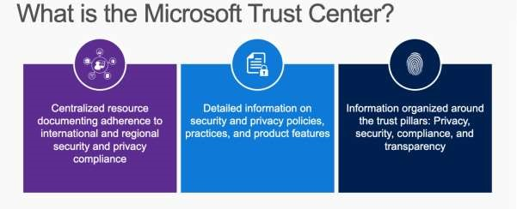
Trust Centre:
The Trust Center is an important part of the Microsoft Trusted Cloud Initiative and provides support and resources for the legal and compliance community.
The Trust Center provides:
In-depth information about security, privacy, compliance offerings, policies, features, and practices across Microsoft cloud products.
Additional resources for each topic.
Links to the security, privacy, and compliance blogs and upcoming events.

Slide 22
Azure compliance documentation
The Azure compliance documentation provides you with detailed documentation about legal and regulatory standards and compliance on Azure.
Here you find compliance offerings across these categories:
Global
US government
Financial services
Health
Media and manufacturing
Regional

Slide 23
Azure Sovereign Regions:
When you design your strategy to migrate to Azure, you can choose from many Azure regions around the world.
Each Azure region has specific characteristics that make choosing the correct region for your Azure resources essential.

Slide 24
Slide Tite
Thank You……

