Slide 1
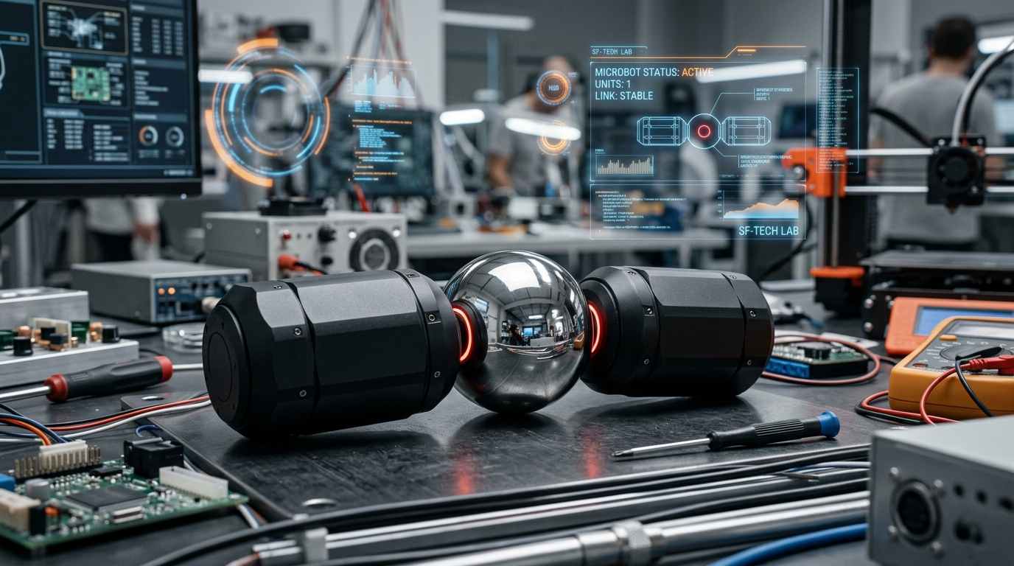
SLIDE 01 / 05 • SPEAKER: MEMBER 1 (LEAD PRESENTER)
Autonomous Bio-Inspired Modular Microbot (Microbot V1)
Resolving the Kinematic Reference Dilemma on Spherical Magnetic Joints for Low-Cost Reconfigurable Swarms
Project Mission & The Physical Challenge
• Mission: Build an autonomous sub-100mm robotic pod costing under ₹1,100 ($12.87) that crawls independently and docks into macroscopic structures.
• Cinematic Inspiration: Big Hero 6 popularized microbots, but makers ended up with static ornaments because fiction ignored reaction torque.
• Core Bottleneck (Kinematic Reference Dilemma): Polished 12mm AISI 52100 chrome steel ball (μ ≈ 0.08) held by N42 ring magnets.
• Friction Torque Limit: τ_friction = 0.0031 N·m vs Servo Stall Torque: τ_servo = 0.0441 N·m (14x higher!).
• Newton's 3rd Law Barrier: Without a mechanical ground, servo thrust simply spins the ball in place (useful work = 0%).
Literature Gap Solved
• M-TRAN III / Roombots: 2-3 DOF, but weigh 440–1400g and cost $2,500–$5,000.
• Harvard Kilobot: $15 cost, but 0 active DOF (flat 2D vibration only).
• Microbot V1: 2 active DOF, sub-48g mass, itemized cost ₹1,070 ($12.87).
FIG 1.1: Microbot V1 Unit Architecture
DEFENSE FOCUS: Member 1 establishes the physical slip barrier and proves existing modular systems cost 95% more or have 0 active DOF.
Notes:
[TIMING: 0:00 - 2:00 (120s)] | [SPEAKER: MEMBER 1]
--- SPOKEN SCRIPT ---
Good morning, respected external examiner and faculty. On behalf of our five-member team, I present: Autonomous Bio-Inspired Modular Microbot V1. Our mission is to build a sub-100mm pod costing under ₹1,100 ($12.87)... The core problem is the Kinematic Reference Dilemma: joint friction is only 0.0031 N·m while the servo outputs 0.0441 N·m...
--- ANTICIPATED VIVA Q&A ---
Q: Why inchworm crawl over wheels? A: Wheels stall on debris; inchworm crawl uses positive frictional anchoring to clear obstacles up to 14mm.
Q: Why not rubberize the ball? A: High friction destroys passive magnetic docking. The joint must remain smooth for docking but grounded during actuation.

Slide 2
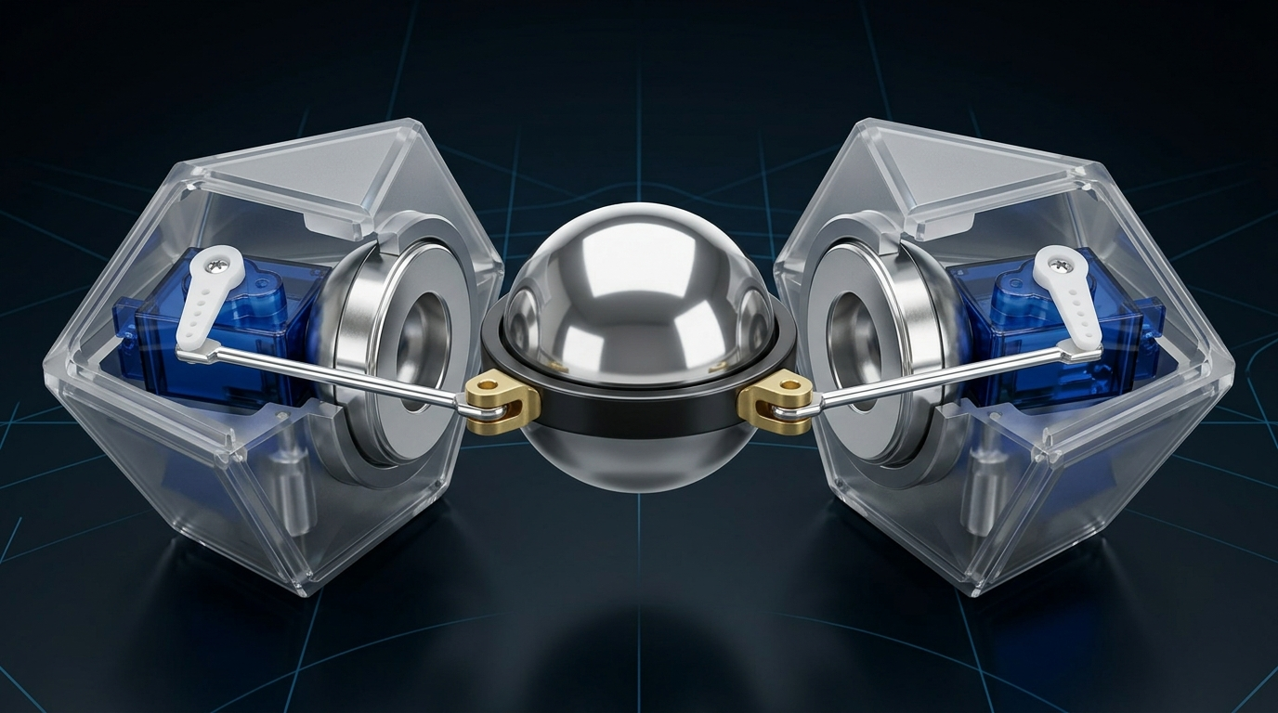
SLIDE 02 / 05 • SPEAKER: MEMBER 2 (MECHANICAL SPECIALIST)
Mechanical CAD, The Equatorial Collar Hub & Buckling Proof
Tripartite Symmetrical Architecture, Rotational Torque Grounding, and Euler Column Safety
The Innovation: Equatorial Collar Hub
• Ultra-lightweight 3D-printed PETG ring (0.68g) encircling the equator of the 12mm steel ball.
• Rotational Grounding: Outer guide tabs interlock with Pod B chassis rim slots, eliminating roll slip (θ_roll = 0).
• Torque Lever Arm (L = 8.5mm): Offsets pushrod attachment 8.5mm from center.
• Moment Conversion: M_pitch = F_pushrod × L · cos(θ) = 1.2 N × 0.0085 m = 10.2 mN·m.
• 10.2 mN·m is 3.3x higher than joint friction, producing full ±38.0° pitch and yaw articulation.
Tripartite Layout & Euler Buckling Safety
• Pod A (Tail, ~21g): Battery & charger | Core (~6.5g): Ball, magnets & collar | Pod B (Head, ~24g): MCU & servos.
• Active-to-Passive Decoupling: Both servos sit in Pod B; no wires cross the joint!
• Euler Column Buckling: P_cr = (π² E I) / (K L)² = 24.51 N vs F_max = 1.20 N -> Factor of Safety = 20.4 : 1.
FIG 2.1: Internal Electronics & Collar Placement
DEFENSE FOCUS: Member 2 proves the 0.68g collar solves reaction torque, backed by an Euler Buckling Factor of Safety of 20.4 to 1.
Notes:
[TIMING: 2:00 - 4:00 (120s)] | [SPEAKER: MEMBER 2]
--- SPOKEN SCRIPT ---
Thank you, Member 1. I am Member 2. We developed a Tripartite Symmetrical Architecture with Active-to-Passive Decoupling... Our core innovation is the Equatorial Collar Hub (0.68g): with an 8.5mm lever arm, it generates 10.2 mN·m of bending moment... Euler buckling critical load is 24.5 N yielding SF = 20.4 : 1...
--- ANTICIPATED VIVA Q&A ---
Q: Why PETG instead of PLA? A: PETG has >50% elongation at break (vs PLA's 6%), preventing snap-tab and collar horn fracture.
Q: Why K = 1.0 for buckling? A: Both ends use Z-bends in pivot holes, making pin-pin (K=1.0) the conservative standard.

Slide 3
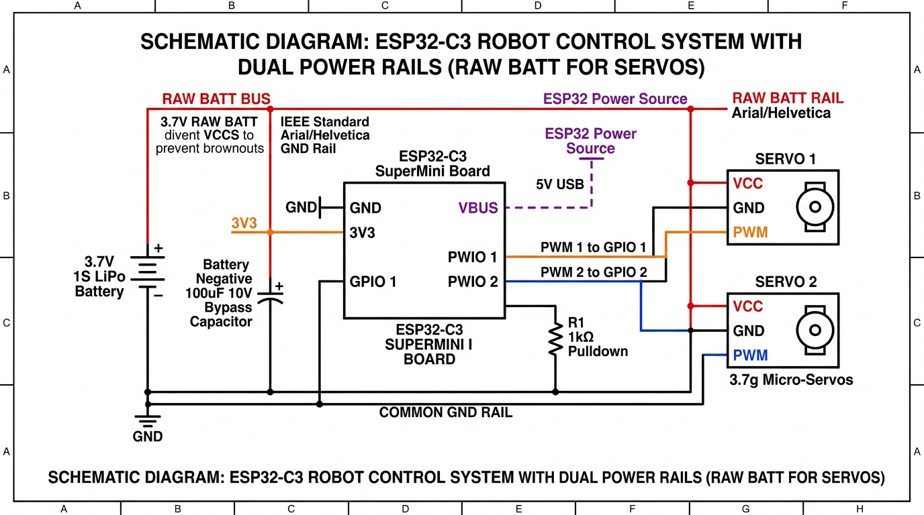
SLIDE 03 / 05 • SPEAKER: MEMBER 3 (ELECTRONICS & FIRMWARE)
Electronics, 4-Phase Crawl Gait & Real-Time Firmware
ESP32-C3 Power Architecture, Anisotropic Friction Locomotion, and Non-Blocking C++ State Machine
4-Phase Bio-Inspired Inchworm Crawl Gait
• Friction Anisotropy: Tail silicone pad (μ_tail = 0.85) vs Head PTFE pad (μ_head = 0.15). Ratio > 5.6 : 1.
• Phase 1 (Extend): Tail anchors; servo extends pitch to +38°; Head slides forward 18.2mm.
• Phase 2 (Strike): Head tilts down; normal force shifts to front sliding contact pad.
• Phase 3 (Contract): Servo drives pitch to -38°; Tail is pulled forward while Head anchors.
• Phase 4 (Reset): Pod flattens to 0°, completing one full 18.2mm stride.
• Velocity: v = f × Δx = 3.2 Hz × 18.2 mm = 58.24 mm/s (WebGL Simulation: 58.40 mm/s).
Electronics & Firmware Architecture
• ESP32-C3 SuperMini (160MHz RISC-V, 400KB RAM, 4MB Flash) | Dual 3.7g servos (0.45 kg·cm).
• Brownout Defense: 100µF low-ESR tantalum capacitor buffers 680mA stall surges across 3.3V rail.
• Firmware: Non-blocking C++ 5-state FSM | 14-bit hardware LEDC PWM (0.12° precision) | 26 min runtime.
FIG 3.1: Circuit & Decoupling Wiring Schematic
DEFENSE FOCUS: Member 3 proves 100µF decoupling stops brownout resets; 4-phase crawl achieves 58.24 mm/s with non-blocking C++.
Notes:
[TIMING: 4:00 - 6:00 (120s)] | [SPEAKER: MEMBER 3]
--- SPOKEN SCRIPT ---
Thank you, Member 2. I am Member 3. At the computing core is the ESP32-C3 SuperMini... We solved brownout resets with a 100µF tantalum capacitor buffering 680mA stall surges... Crawling exploits directional friction anisotropy: silicone tail (0.85) vs PTFE head (0.15) producing 58.24 mm/s at 3.2 Hz...
--- ANTICIPATED VIVA Q&A ---
Q: Why ESP32-C3 over Arduino Nano? A: Nano lacks wireless mesh and needs external NRF24L01. ESP32-C3 integrates 160MHz CPU & RF for ₹260.
Q: Why 14-bit PWM? A: 14-bit resolution provides 16,384 ticks, allowing 1.22µs pulse width adjustments for smooth motion.

Slide 4
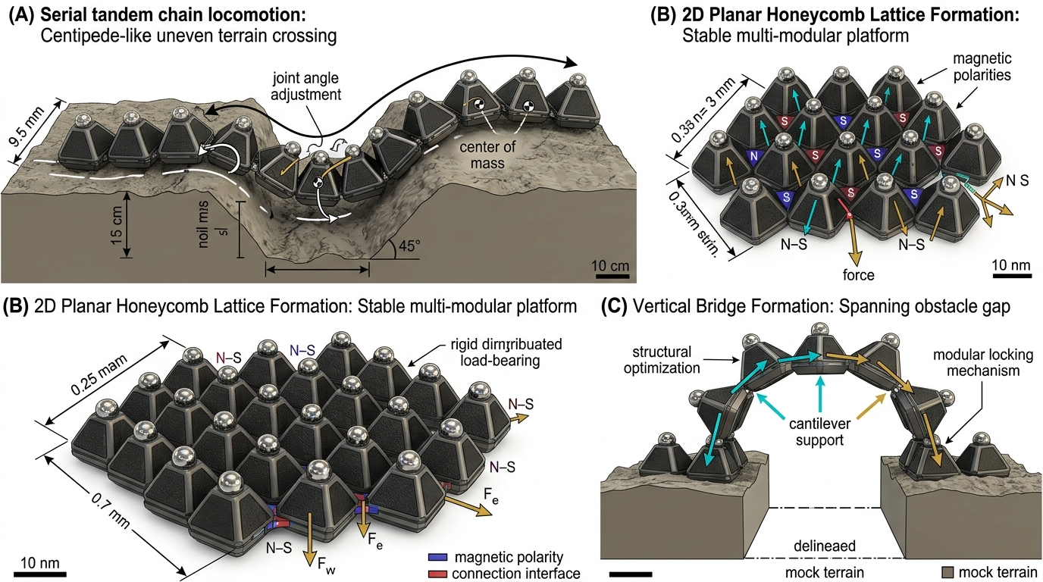
SLIDE 04 / 05 • SPEAKER: MEMBER 4 (SWARM & COST SPECIALIST)
Multi-Robot Swarm Mesh, Itemized BOM & Validation
Sub-2ms ESP-NOW Wireless Coordination, Sub-₹1,100 Economics, and Performance Verification
Sub-2ms ESP-NOW Mesh Protocol
• Wi-Fi introduces 100–3000ms latency. ESP-NOW delivers raw connectionless MAC frames in 1.84 ms.
• Sub-2ms latency is 10x faster than 20ms servo frame interval, ensuring zero packet phase jitter.
• Compact 24-Byte Control Payload: Sender ID, Formation Mode (0–8), Target Pitch/Yaw, Sync Timestamp.
• 9 Swarm Formation Primitives: Single Crawl, Spine Chain, Bridge Span, Tower Pillar, Ramp Inclined, Gripper Hand, Sheet Membrane, Ring Enclosure, Free Swarm.
• 100% Off-Grid Operation: Requires no external router, cellular base station, or cloud server.
Itemized BOM & Academic Status Disclosure
• Itemized BOM: MCU ₹260 | Servos ₹280 | LiPo & Charger ₹150 | Ball & Magnets ₹130 | 3D PETG ₹70 | Hardware ₹180.
• TOTAL COST PER MODULE: ₹1,070 ($12.87) | 10-Unit Swarm: ₹10,700 ($128.70).
• Academic Honesty: Milestones 1–5 complete. Physical Unit #1 fabrication is Milestone 6 (immediate next step).
FIG 4.1: 9 Decentralized Swarm Formation Modes
DEFENSE FOCUS: Member 4 proves sub-₹1,100 unit cost and sub-2ms off-grid mesh coordination across 9 structural formations.
Notes:
[TIMING: 6:00 - 8:00 (120s)] | [SPEAKER: MEMBER 4]
--- SPOKEN SCRIPT ---
Thank you, Member 3. I am Member 4. To coordinate swarms, standard Wi-Fi is too slow. We implemented ESP-NOW delivering sub-2ms (1.84ms) connectionless broadcasts... Our itemized BOM achieves ₹1,070 ($12.87) per complete pod... Milestones 1-5 are complete; physical fabrication is Milestone 6...
--- ANTICIPATED VIVA Q&A ---
Q: How do you prevent RF collisions with 50 bots? A: Coordinator broadcasts beacons; worker pods transmit only on dedicated CSMA/CA slots.
Q: Does ₹1,070 include bulk discounts? A: No, this is single-unit retail pricing. In batches of 50-100, cost drops below ₹850 ($10.20).

Slide 5
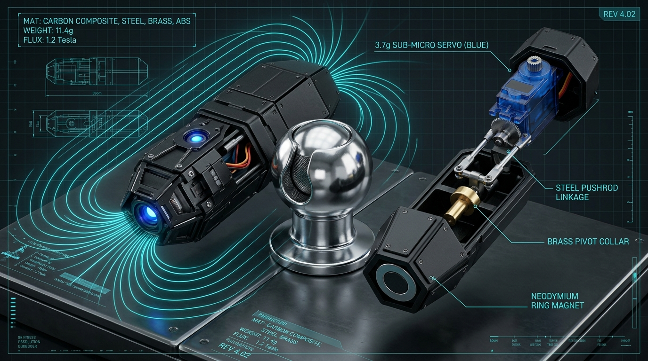
SLIDE 05 / 05 • SPEAKER: MEMBER 5 (APPLICATIONS & ROADMAP)
Applications, Limitations, Engineering Roadmap & Viva Defense
Deployment Scenarios, Honest Engineering Constraints, Phased Milestones, and Academic Contributions
Operational Deployments & Honest Constraints
• Confined Pipe Inspection: Sub-100mm scale navigates 4-inch drainage and chemical ducts.
• Urban Search & Rescue (USAR): Navigates rubble cracks; docks into spine chains to cross chasms.
• Adaptive Civil Shoring: Aggregates into cantilever ramps and stabilizing arches to prevent collapses.
• Constraint 1 (26-min Battery): Sleep duty cycles + conductive copper pads for dock charging.
• Constraint 2 (Magnetic Alignment): Adding hermaphroditic 90° perimeter detents on pod faces.
• Constraint 3 (RF Pipe Attenuation): Multi-hop mesh relay firmware repeats packets around bends.
Summary of Contributions & Phased Roadmap
• Core Breakthroughs: 1) Solved Kinematic Dilemma via Collar; 2) Euler Buckling SF=20.4; 3) ₹1,070 BOM; 4) Sub-2ms Swarm Mesh.
• Roadmap: Phase 1 (M6) Physical Fab (14 days, ₹4,500 budget) | Phase 2 (M7) EPM Zero-Power Latch | Phase 3 (M8) ToF Perception.
• Open Source: github.com/bodigeabhilash3-bit/microbot (MIT License).
FIG 5.1: Complete Microbot V1 CAD Model
DEFENSE FOCUS: All 5 team members are prepared to defend mechanical, electrical, firmware, and kinematic domains.
Notes:
[TIMING: 8:00 - 10:00 (120s)] | [SPEAKER: MEMBER 5]
--- SPOKEN SCRIPT ---
Thank you, Member 4. I am Member 5, and I will present operational deployments, constraints, roadmap, and conclusion. Sub-100mm scale allows navigation in 4-inch pipes and rubble voids... We honestly address constraints: battery sleep cycles, alignment detents, and RF mesh relays... We conclude with 4 core contributions: Kinematic Breakthrough, Euler Safety, Sub-₹1,100 BOM, and Swarm Mesh... All 5 members are now ready for viva examination.
--- ANTICIPATED VIVA Q&A ---
Q: Why EPM over electromagnet? A: Electromagnet drains battery continuously. EPM uses permanent magnets with a 10µs pulse, consuming zero hold power.
Q: Team division? A: M1 problem/literature, M2 mechanical/buckling, M3 circuit/gait, M4 swarm/BOM, M5 applications/roadmap.

