Slide 1


Harvesting Logs and Events Using MetaCentrum Virtualization Services
Radoslav Bodó, Daniel Kouřil
CESNET
Campus network monitoring and security workshop
Prague 2014

Slide 2
Agenda
Introduction
Collecting logs
Log Processing
Advanced analysis
Resume

Slide 3
Introduction
Status
NGI MetaCentrum.cz
approx. 750 worker nodes
web servers
support services
Motivation
central logging services for
security
operations

Slide 4
Goals
secure and reliable delivery
encrypted, authenticated channel
scalability
system handling lots of logs on demand
scaling up, scaling down
flexibility
system which can handle "any" data ...

Slide 5
Collecting logs
linux + logging = syslog
forwarding logs with syslog protocol
UDP, TCP, RELP
TLS, GSS-API
NGI Metacentrum
Debian environment
Kerberized environment
rsyslogd forwarding logs over GSS-API protected channel

Slide 6
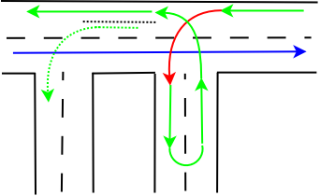
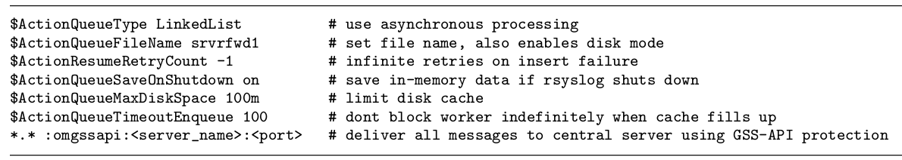
rsyslogd shipper
omgssapi.so -- client
forwarding is action
action queue must be non direct
queue must be limited
full queue must not block main queue

Slide 7
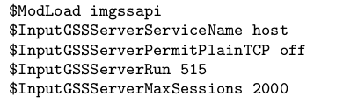
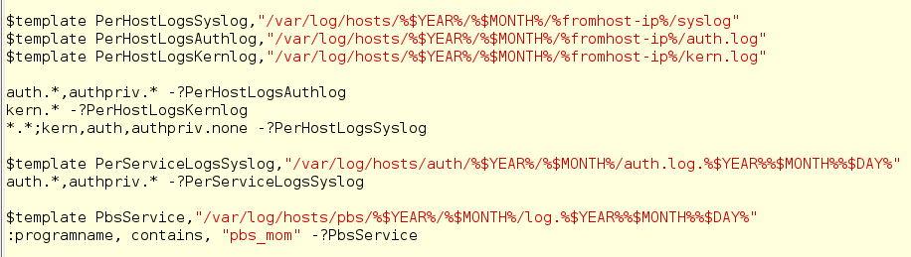
rsyslogd server
imgssapi.so -- server
nothing really special
listener
per IP layout
service logs

Slide 8
rsyslogd GSS patches
original GSS-API plugins are not maintained since 3.x
plugin does not reflect internal changes in rsyslogd >> occasional segfaults/asserts
not quite nice even after upstream hotfix
no more segfaults, but SYN storms (v5,v6,?v7,?v8)
a new omgssapi based on
old one + actual omfwd (tcp forward)
contributed to public domain but not merged yet
we'll try to push it again into v8

Slide 9
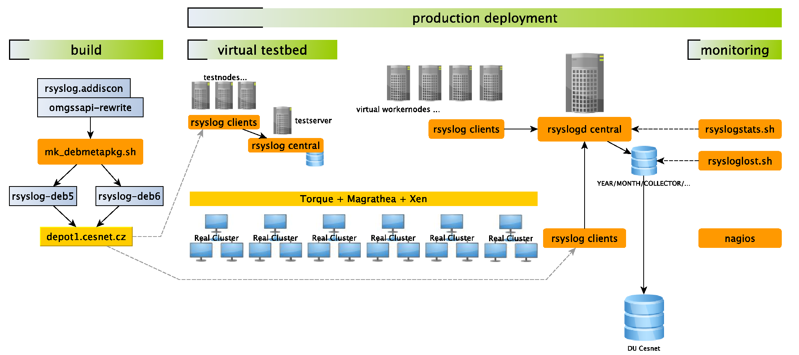
rsyslogd testbed
development of multithreaded application working with strings and networking is error prone process .. everytime
virtual testbed used to test produced builds

Slide 10
rsyslogd wrapup
in production about a 2 years
approx. 90% nodes coverage (700 nodes)
50 - 100GB per month
2GB compressed with 7zip
monitoring
nagios
cron scripts

Slide 11
Log processing
why centralized logging ?
having logs on single place allows us to do centralized do_magic_here
classic approach
grep, perl, cron, tail -f

Slide 12
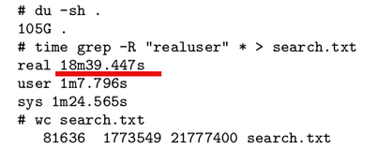
Log processing
classic approach
grep, perl, cron, tail -f
alerting from PBS logs
jobs_too_long
perl is fine but not quite fast for 100GB of data
example:
search for login from evil IPs
for analytics a database must be used
but planning first ...

Slide 13
The size
the grid scales
logs growing more and more
a scaling DB must be used
clustering, partitioning
MySQL, PostgreSQL, ...

Slide 14
The structure strikes back
logs are not just text lines, but rather a nested structure
logs differ a lot between products
kernel, mta, httpd, ssh, kdc, ...
and that does not play well with RDBMS (with fixed data structures)
LOG ::= TIMESTAMP DATA
DATA ::= LOGSOURCE PROGRAM PID MESSAGE
MESSAGE ::= M1 | M2

Slide 15
A new hope ?
NoSQL databases
emerging technology
cloud technology
scaling technology
c00l technology
focused on
ElasticSearch
MongoDB

Slide 16

ElasticSearch is a full-text search engine built on the top of the Lucene library
it is meant to be distributed
autodiscovery
automatic sharding/partitioning,
dynamic replica (re)allocation,
various clients already

Slide 17
REST or native protocol
PUT indexname&data (json documents)
GET _search?DSL_query...
index will speed up the query
ElasticSearch is not meant to be facing public world
no authentication
no encryption
no problem !!

Slide 18
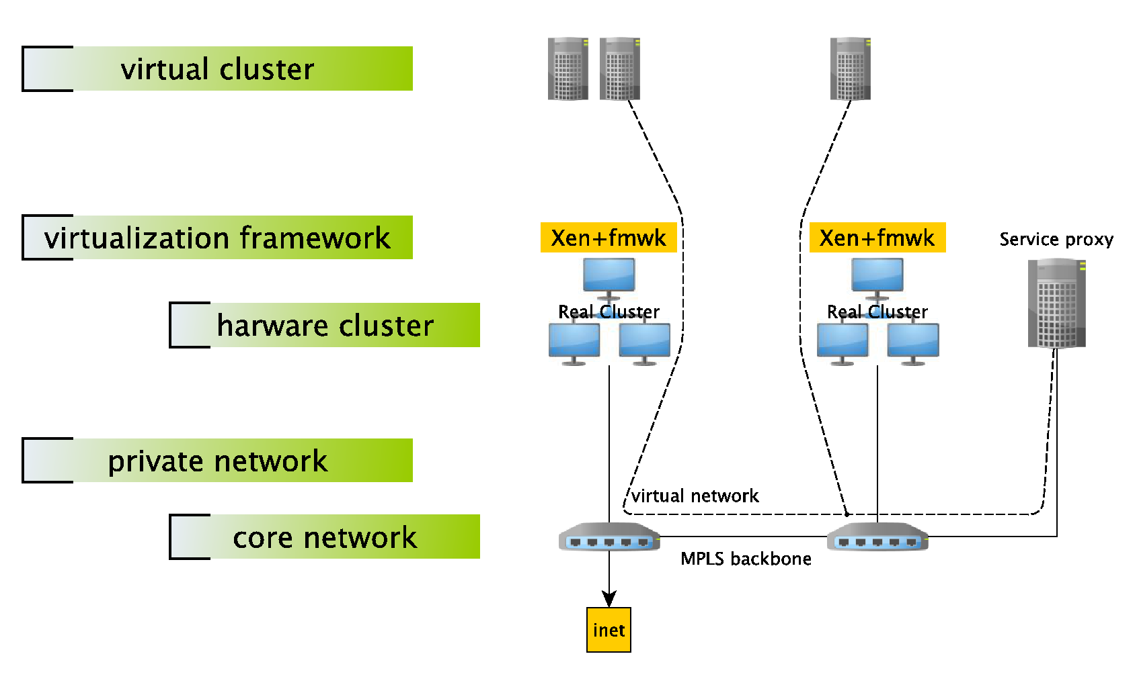
rsyslog testbed Private cloud
a private cloud has to be created in the grid
cluster members are created as jobs
cluster is interconnected by private VLAN
proxy is handling traffic in and out

Slide 19
Turning logs into structures
rsyslogd
omelasticsearch, ommongodb
Logstash
grok
flexible architecture
LOG ::= TIMESTAMP DATA
DATA ::= LOGSOURCE PROGRAM PID MESSAGE
MESSAGE ::= M1 | M2 | ...

Slide 20

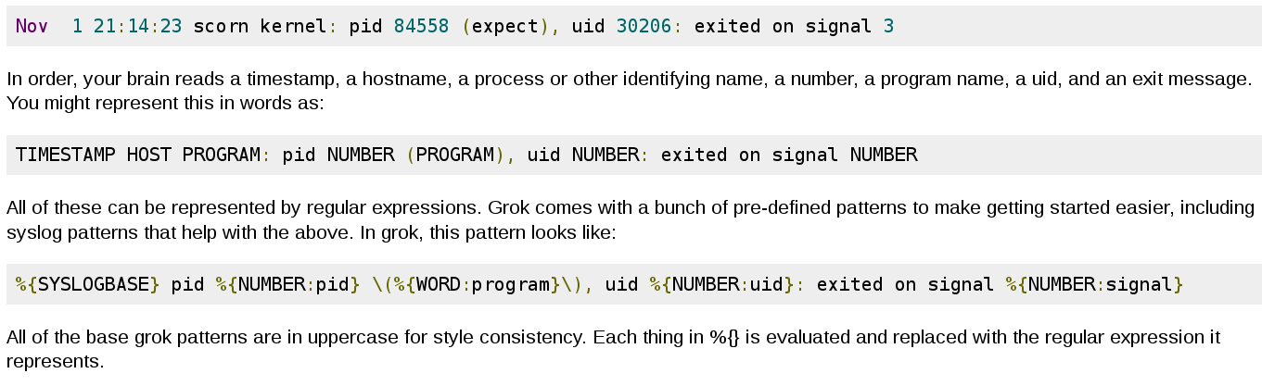
logstash -- libgrok
reusable regular expressions language and parsing library by Jordan Sissel

Slide 21
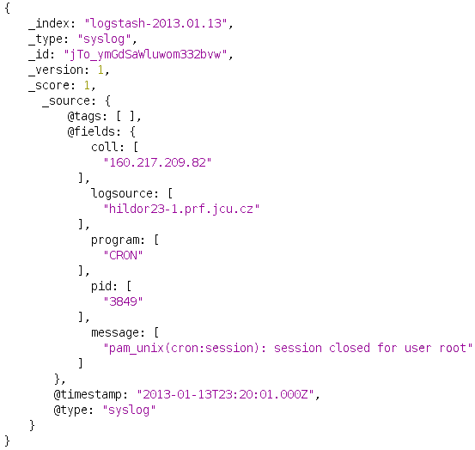
Grokked syslog

Slide 22
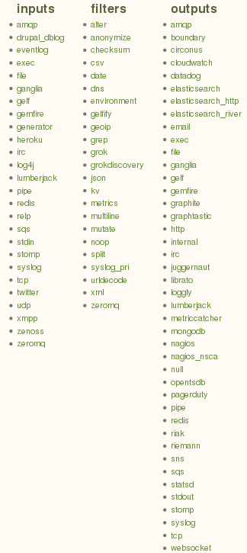
logstash -- arch
event processing pipeline
input | filter | output
many IO plugins
flexible ...

Slide 23
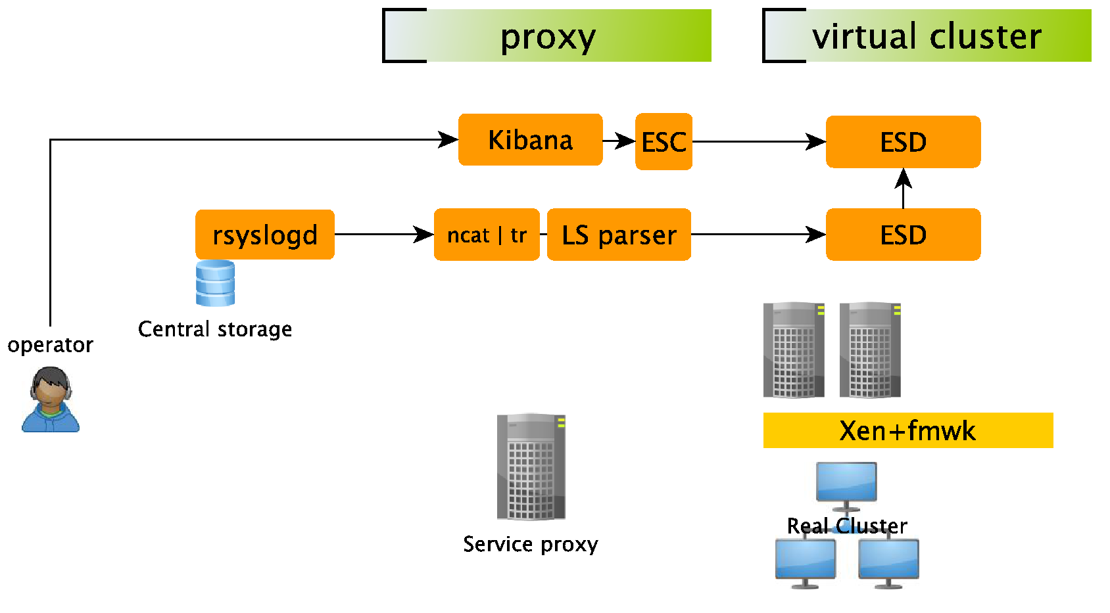
Log processing proxy
ES + LS + Kibana
... or even simpler (ES embedded in LS)

Slide 24
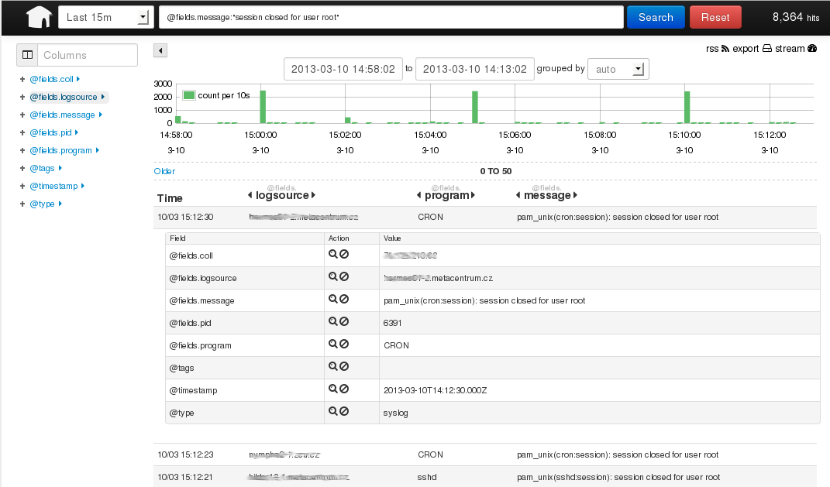
btw Kibana
LS + ES web frontend

Slide 25
Performance
Proxy parser might not be enough for grid logs ..
creating cloud service is easy with LS, all we need is a spooling service >> redis
Speeding things up
batching, bulk indexing
rediser
bypassing logstash internals overhead on a hot spot (proxy)
Logstash does not implement all necessary features yet
http time flush, synchronized queue ...
custom plugins, working with upstream ...

Slide 26
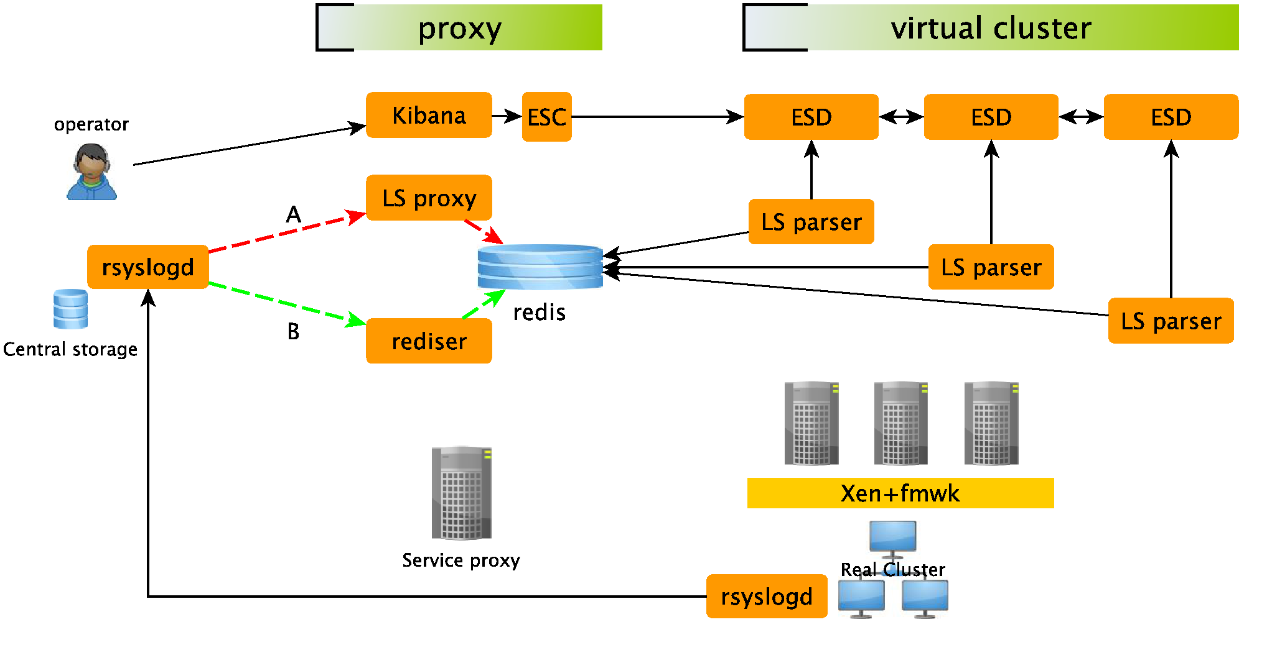
Cloud parser

Slide 27
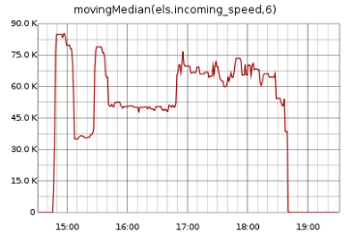
LS + ES wrapup
upload
testdata
logs from January 2013
105GB -- cca 800M events
uploaded in 4h
8 nodes ESD cluster
16 shared parsers (LS on ESD)
4 nodes cluster - 8h
speed vary because of the data (lots of small msgs)
during normal operations a large cluster is not needed

Slide 28
LS + ES wrapup
Speed of ES upload depends on
size of grokked data and final documents,
batch/flush size of input and output processing,
filters used during processing,
LS outputs share sized queue which can block processing (lanes:),
elasticsearch index (template) setting.
...
...
tuning for top speed is manual job (graphite, ...)

Slide 29
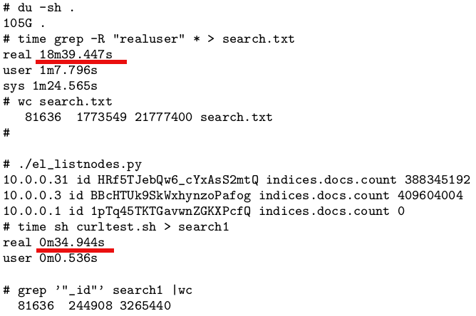
LS + ES wrapup
search speed ~

Slide 30

Advanced log analysis
ES is a fulltext SE, not a database
but for analytics a DB is necessary
Document-Oriented Storage
Schemaless document storage
Auto-Sharding
Mapreduce and aggregation framework

Slide 31
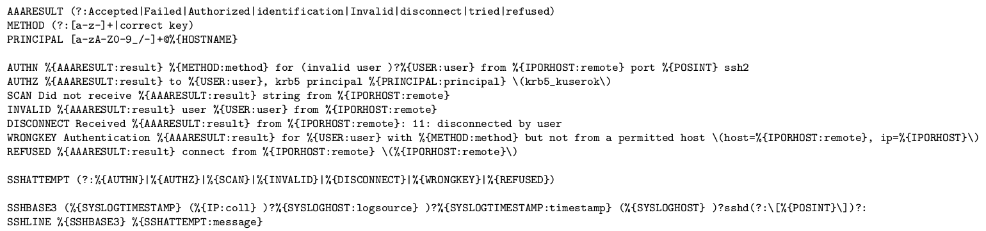
Advanced log analysis
MongoDB
Can be fed with grokked data by Logstash
sshd log analysis

Slide 32
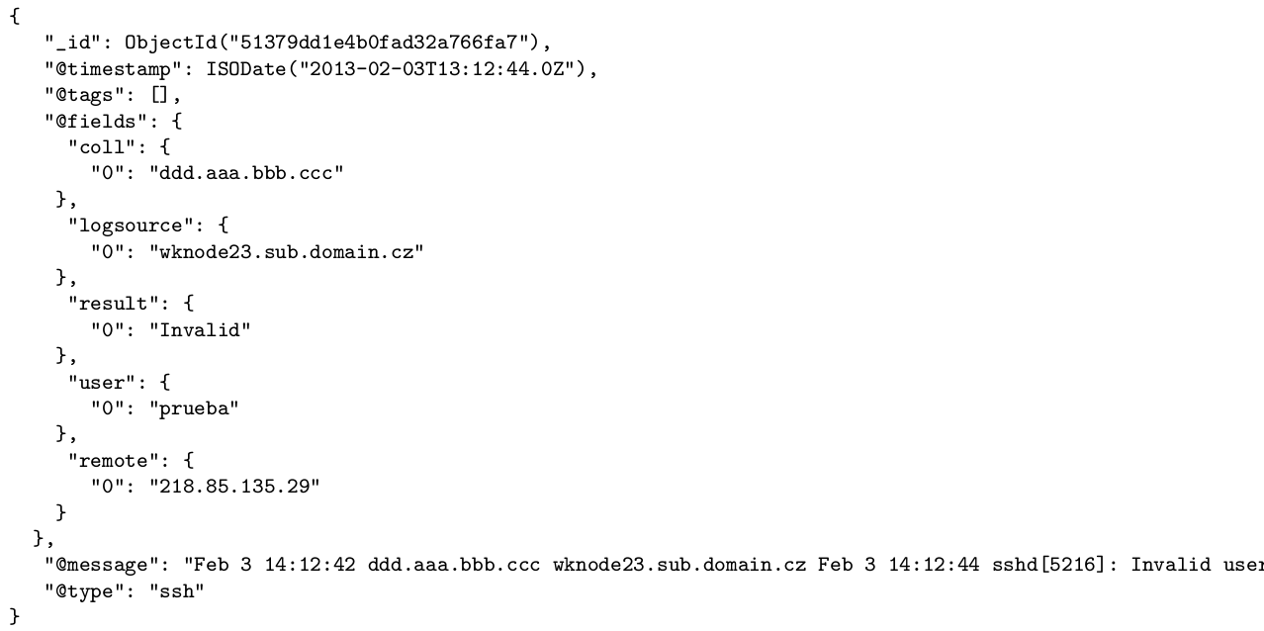
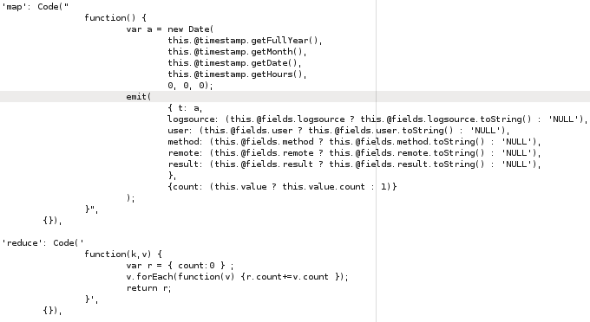
MapReduce

Slide 33
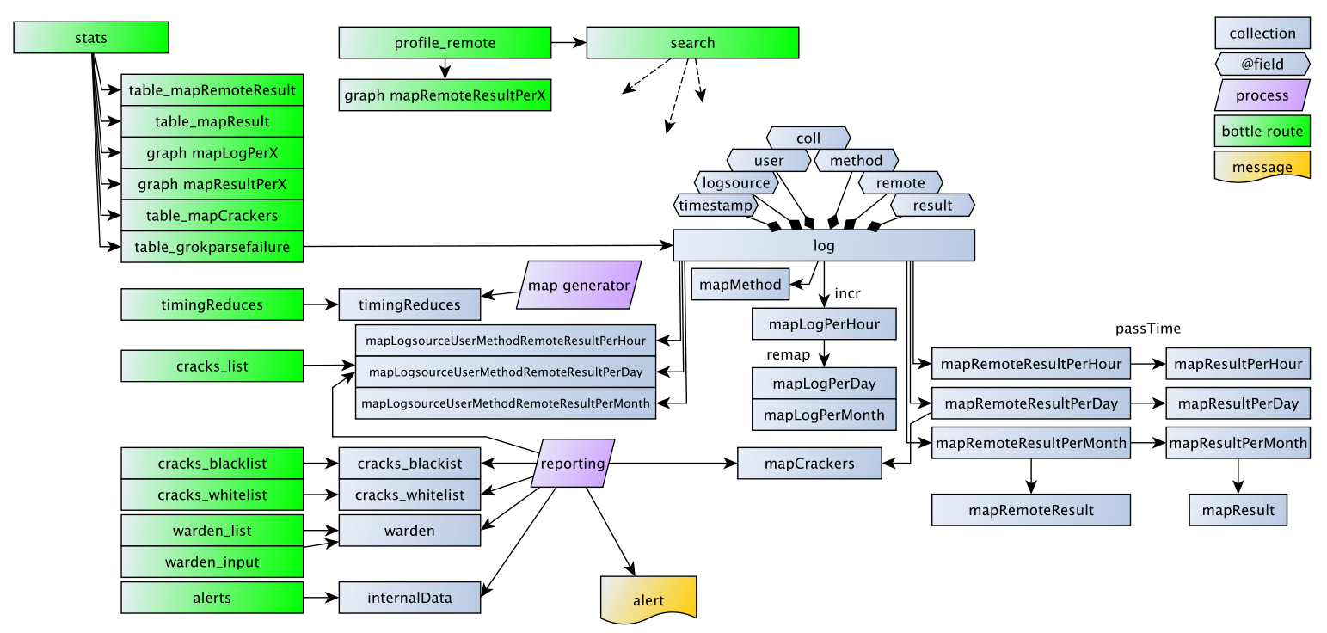
Mongomine
on the top of created collection
time based aggregations (profiling, browsing)
custom views (mapCrackers)
mapRemoteResultsPerDay.find( {time= last 14days, result={fail}, count>20} )
external data (Warden, torlist)

Slide 34
Mongomine
Logstash + MongoDB application
sshd log analysis
security events analysis
python bottle webapp
Google Highcharts
automated reporting
successful logins from
mapCrackers
Warden
Tor lists

Slide 35
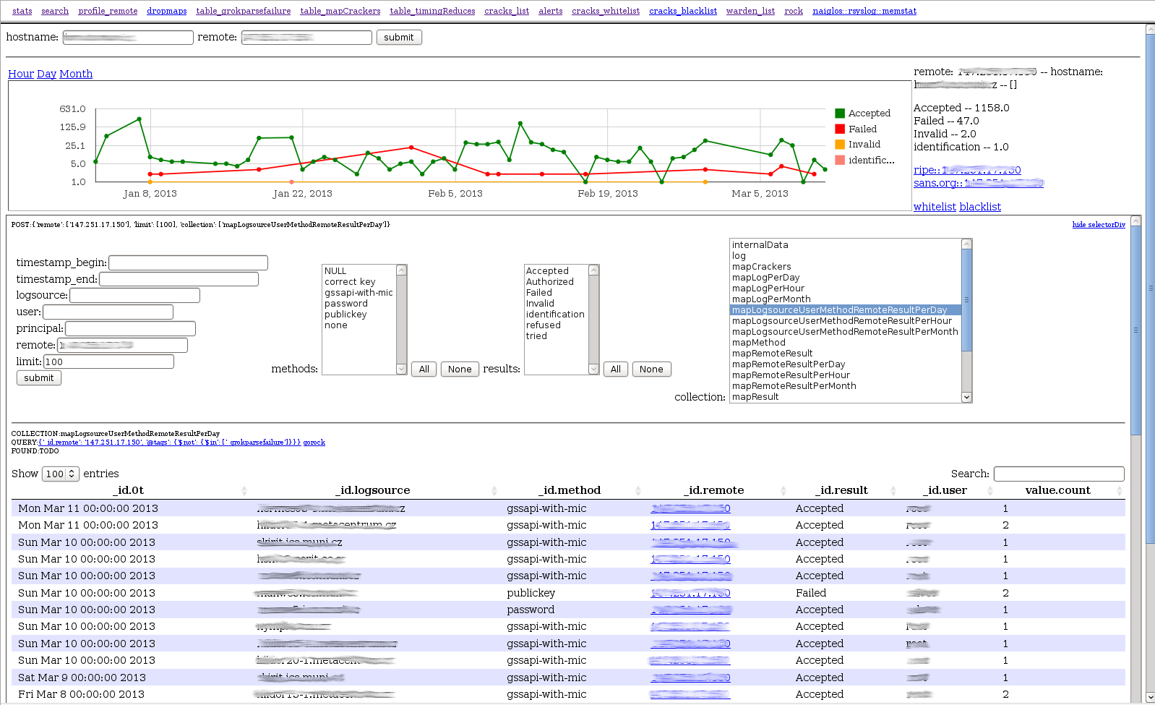
Mongomine

Slide 36
Mongomine wrapup
testcase
20GB -- January 2013
1 MongoDB node, 24 CPUs, 20 shards
1 parser node, 6 LS parsers
speed
upload -- approx. 8h (no bulk inserts :(
1st MR job -- approx. 4h
incremental MR during normal ops -- approx. 10s

Slide 37
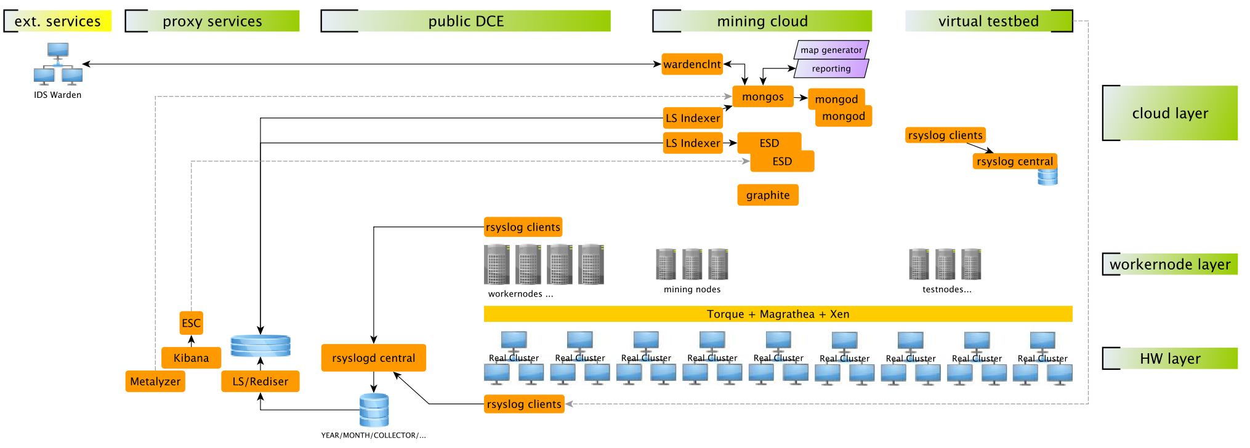
Overall schema
rsyslogd + testbed
LS + ES
LS + Mongomine + Ext

Slide 38
Virtual Machine Walkthrough
ESB EGI Technical forum 2013
http://home.zcu.cz/~bodik/metasw/esbegitf/

Slide 39
Other Applications - Wardenweb2
{
"priority":null,
"source":"222.133.237.62",
"target_proto":"TCP",
"hostname":"nfsen.ics.muni.cz",
"service":"honeyscan",
"note":null,
"attack_scale":"1",
"detected":"2014-04-24 21:04:25",
"timeout":null,
"source_type":"IP",
"type":"probe",
"id":"57341436",
"target_port":"8080"
}

Slide 40
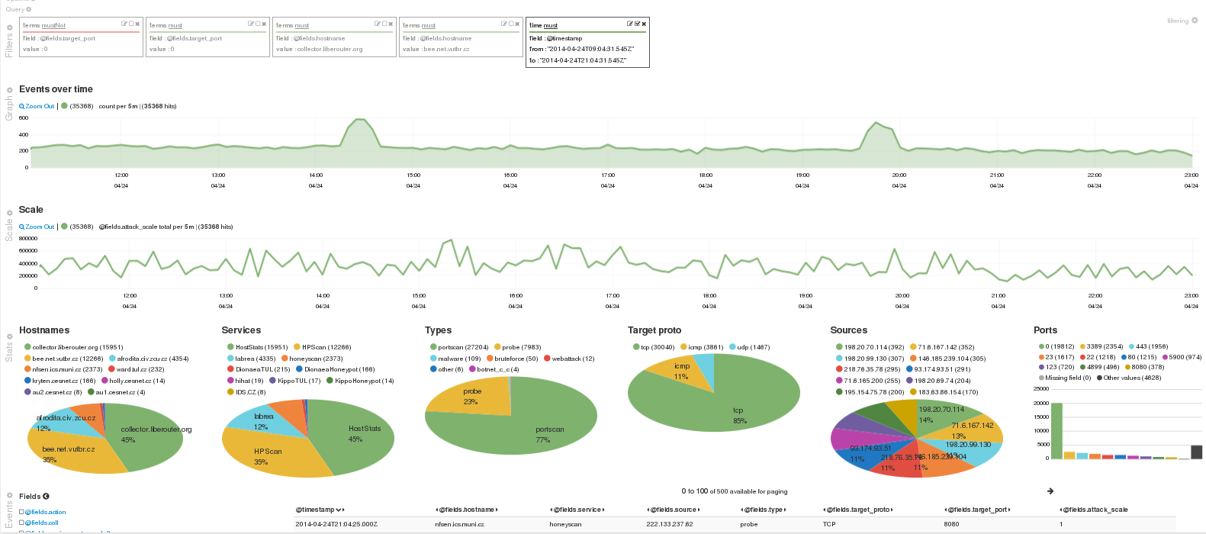
Other applications - wardenweb2
last 12 hours before yesterday’s brewery event

Slide 41
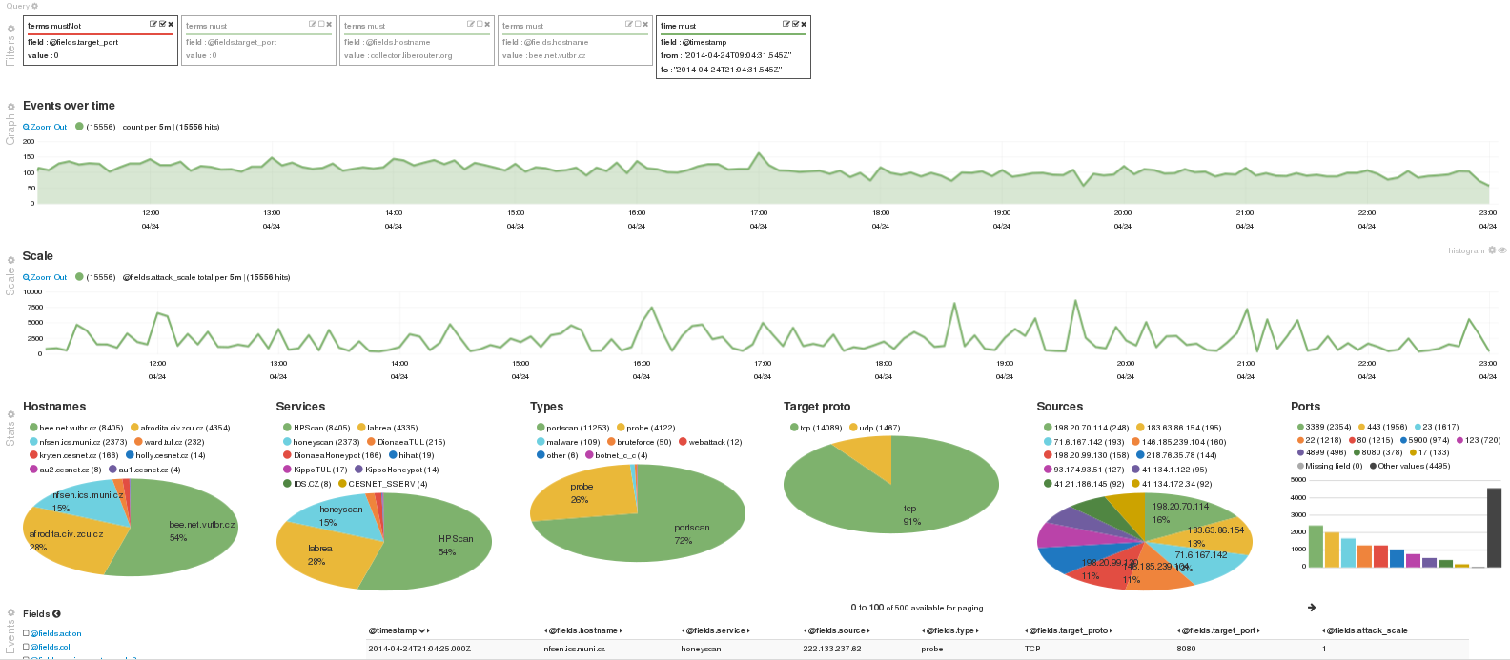
Other applications - wardenweb2
exclude top port 0 >> peak gone

Slide 42
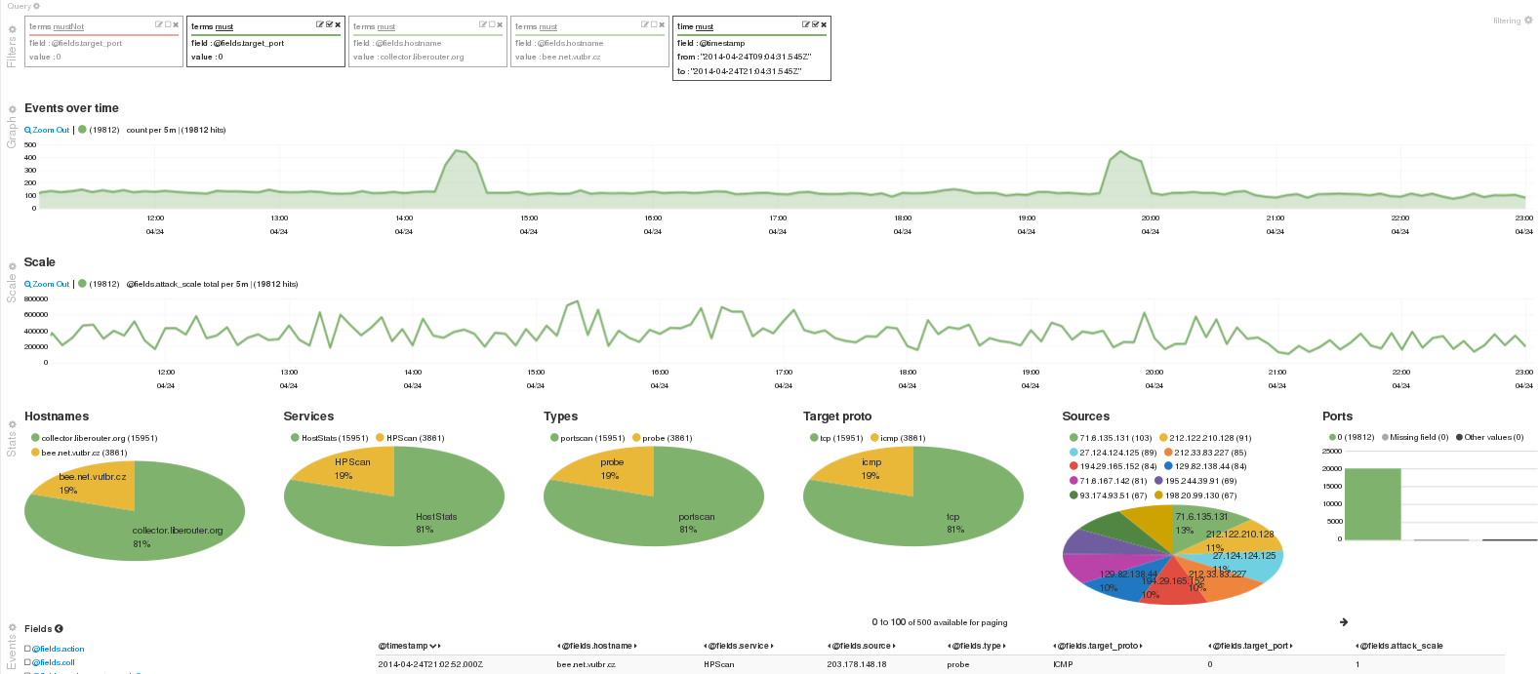
Other applications - wardenweb2
include top port 0 >> just 2 sensors left

Slide 43
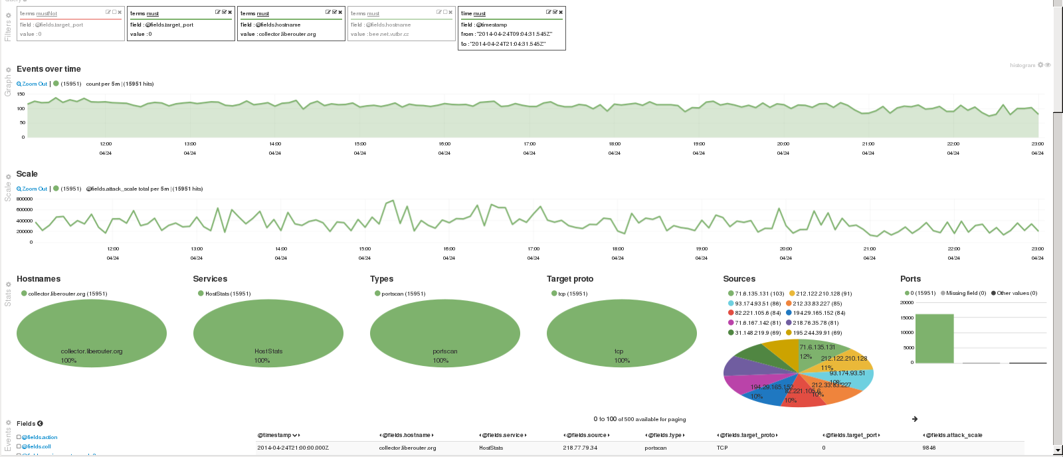
Other applications - wardenweb2
include top collector >> peak gone

Slide 44
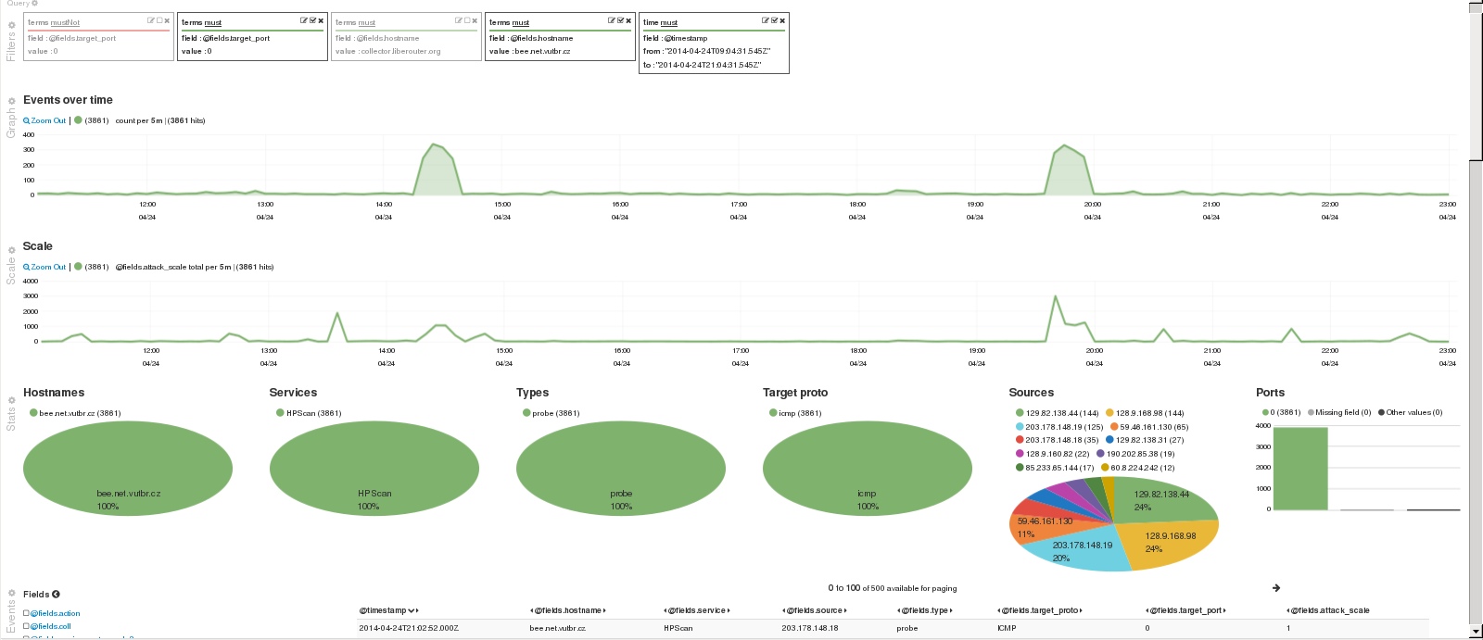
Other applications - wardenweb2
include the other >> peak >> icmp scan

Slide 45
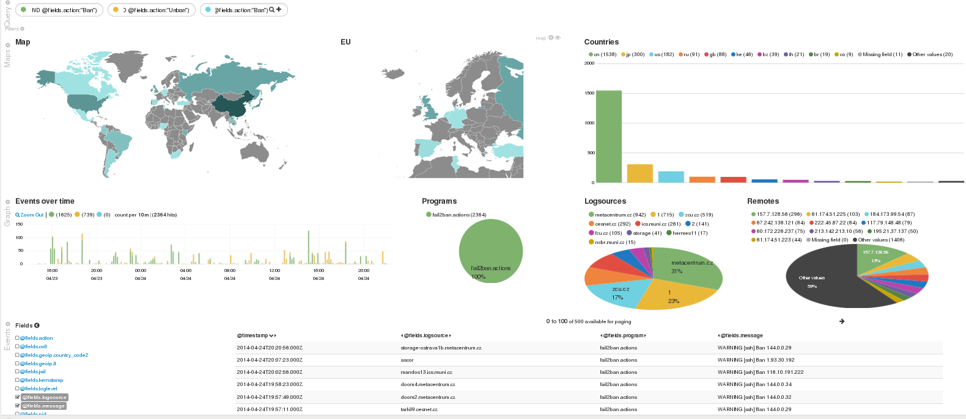
Other applications - fail2ban + geoip
beside groking, logstash can do other things in the pipeline >> geoip resolution
besi

Slide 46
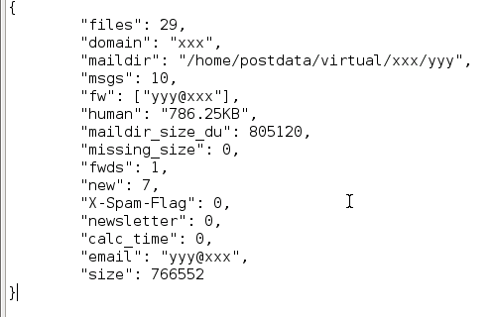
Other applications - maildir screening

Slide 47
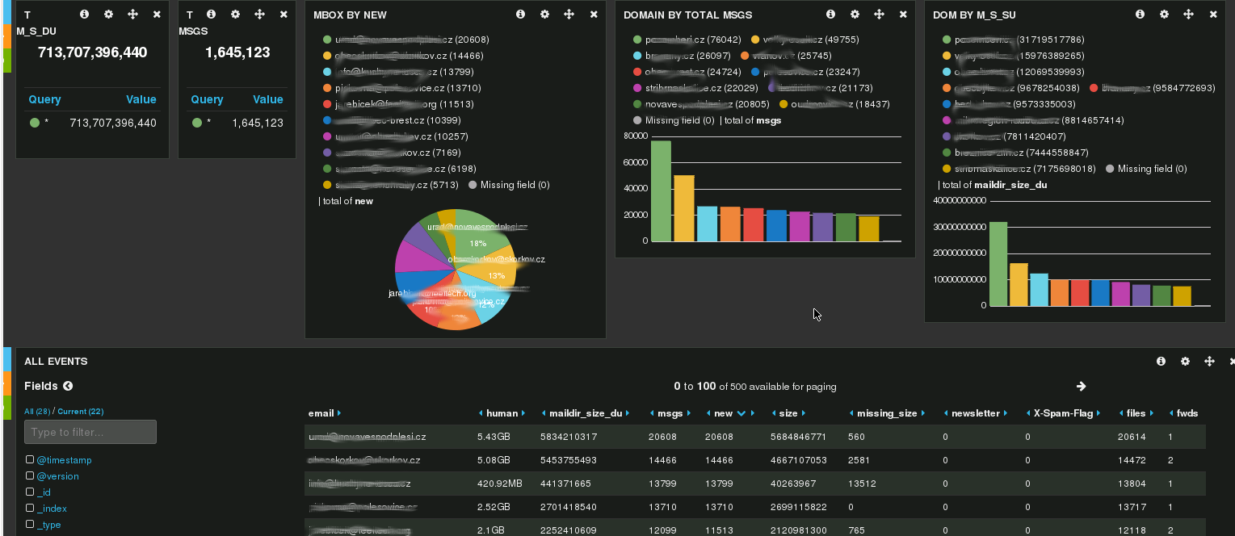
Other applications - maildir screening

Slide 48
Resume
It works
system scales according current needs
custom patches published
solution is ready to accept new data
with any or almost no structure
Features
collecting -- rsyslog
processing -- logstash
high interaction interface -- ES, kibana
analysis and alerting -- mongomine

Slide 49
Questions ?
now or …
https://wiki.metacentrum.cz/wiki/User:Bodik
http://bit.ly/RQ0LML
mailto:bodik@civ.zcu.cz
mailto:kouril@ics.muni.cz

