Slide 1
Capture design
Heng’s 35bp alignability filter
  /mnt/454/HCNDCAM/Hengs_Alignability_Filter/hs37m_filt35_99.bed.gz
Tandem Repeat Finder filter
  http://hgdownload.cse.ucsc.edu/goldenPath/hg19/database/simpleRepeat.txt.gz
→ for the design of probes:
    include bases in Heng's alignability filter
    +
    remove those within TRF regions

Slide 2
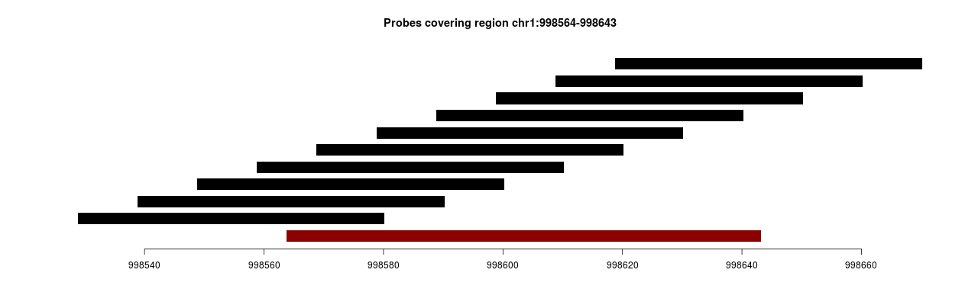
Probe design parameters
probe length = 52bp
tiling step = 10bp
flank length = 34bp
region that passed filtering

Slide 3
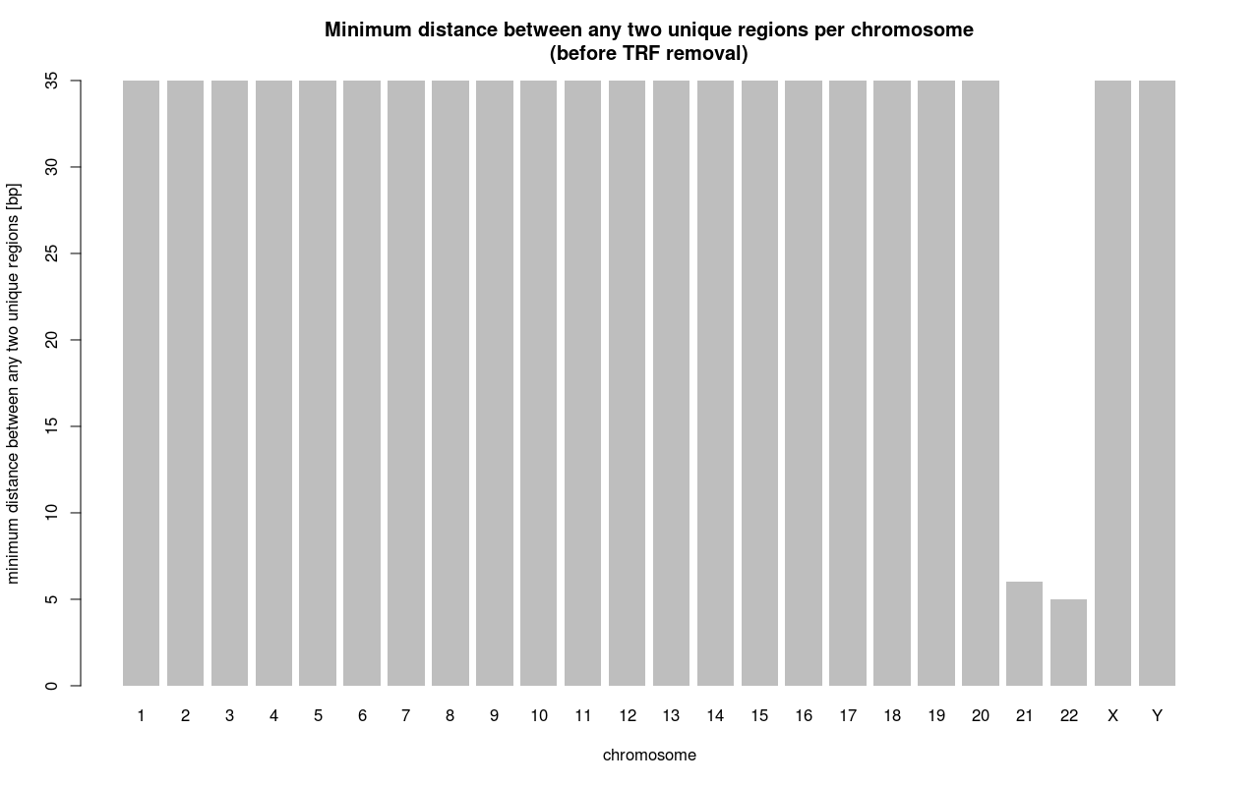
How far apart are two neighboring unique regions?
gaps between unique regions can't be < 35bp – is it true?

Slide 4
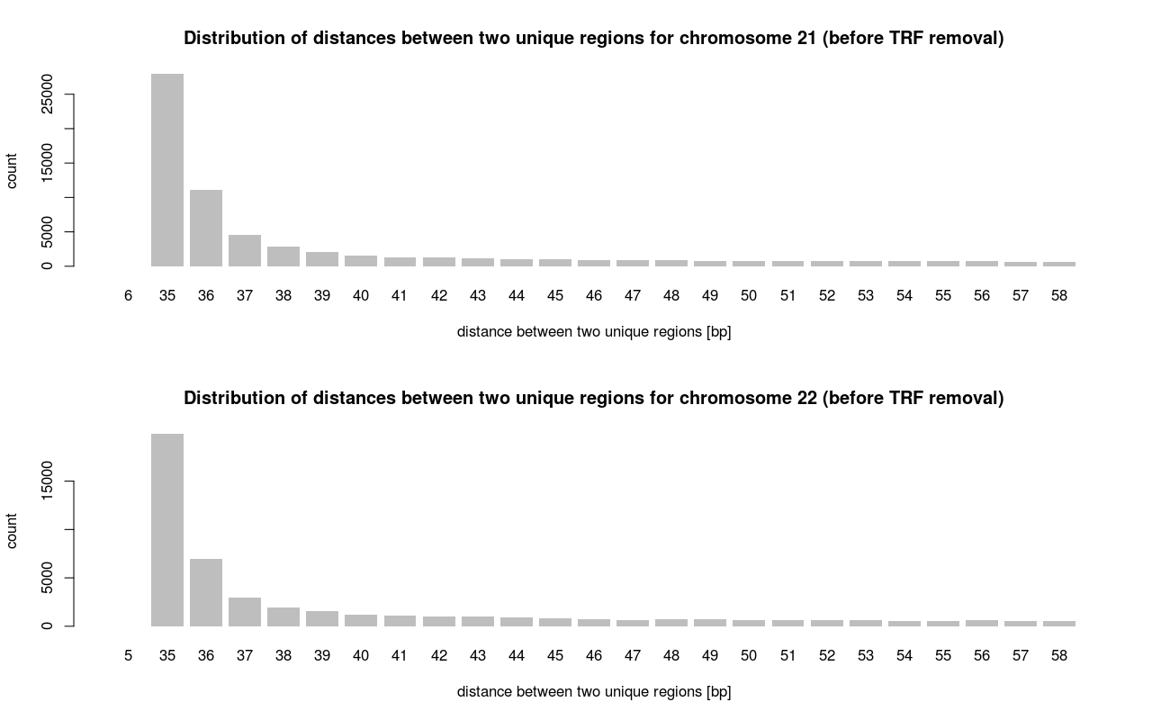
(3x)
(1x)

Slide 5
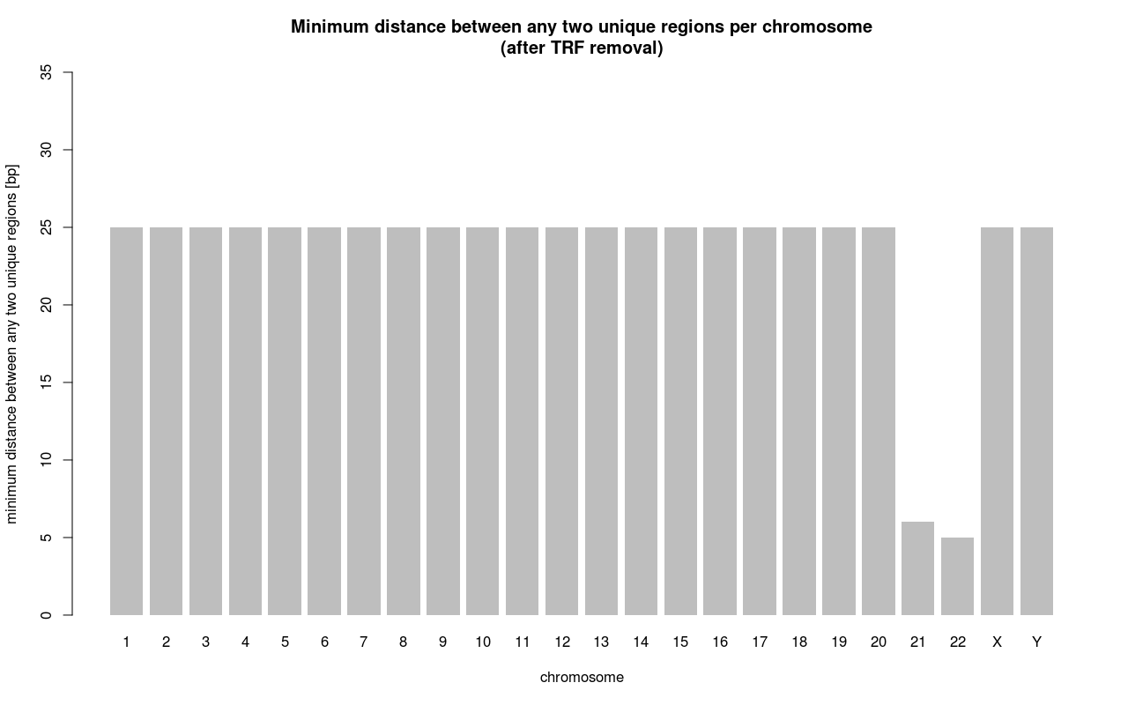
How far apart are two neighboring unique regions after TRF filtering?

Slide 6
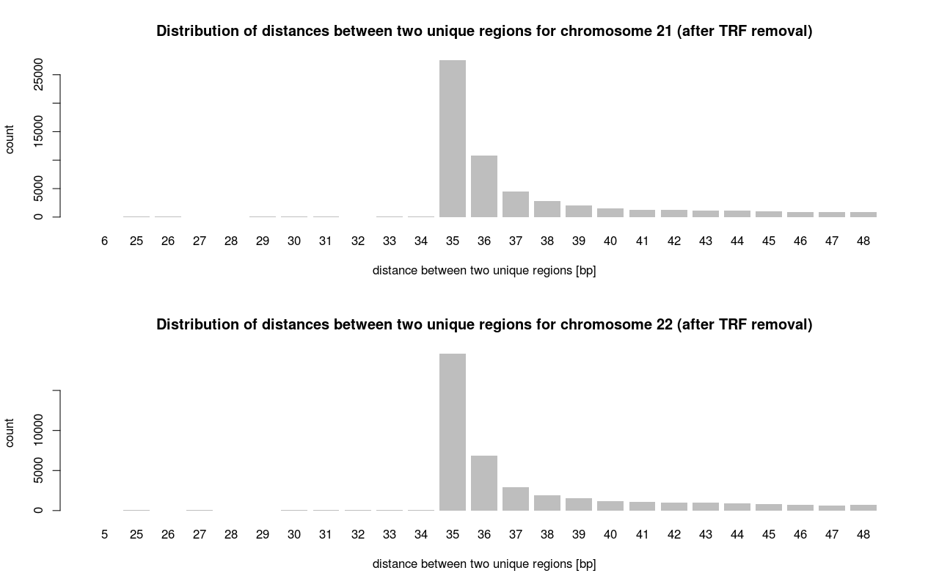

Slide 7
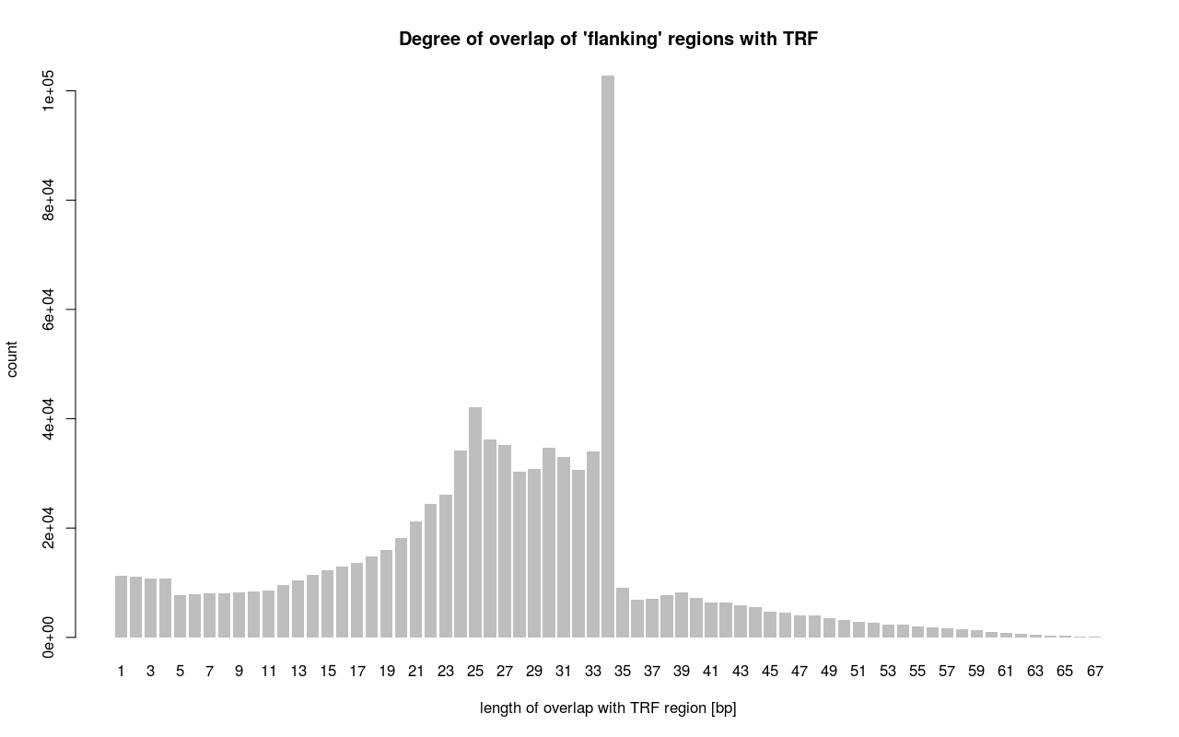

Slide 8
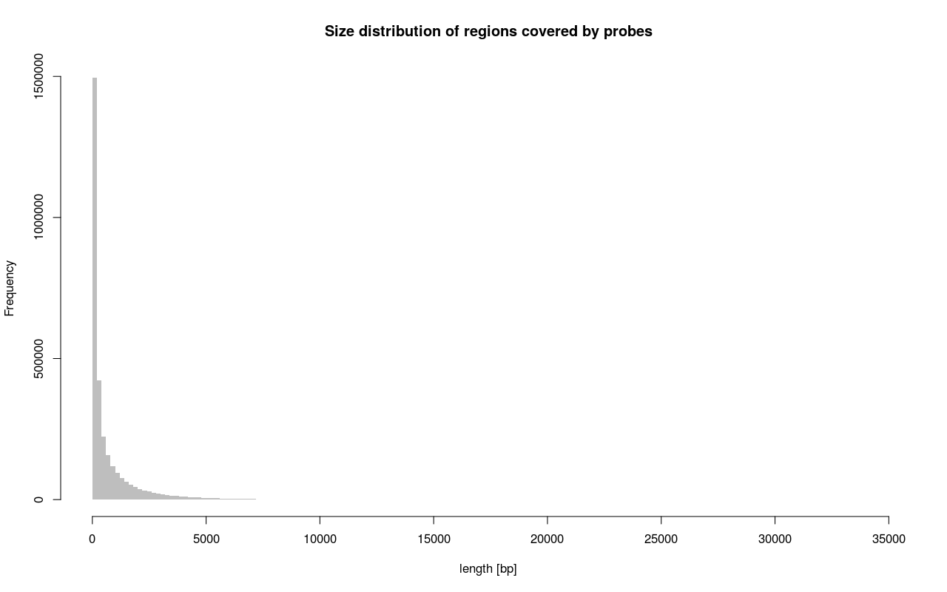
> fragment_lengths %>% quantile(seq(0.1, 1, 0.1))
10% 20% 30% 40% 50% 60% 70% 80% 90% 100%
62 72 102 142 212 349 606 1071 2051 34687
> width(no_trf_map_filter) %>% quantile(seq(0.1, 1, 0.1))
10% 20% 30% 40% 50% 60% 70% 80% 90% 100%
6 16 31 53 86 137 216 343 587 9170

Slide 9
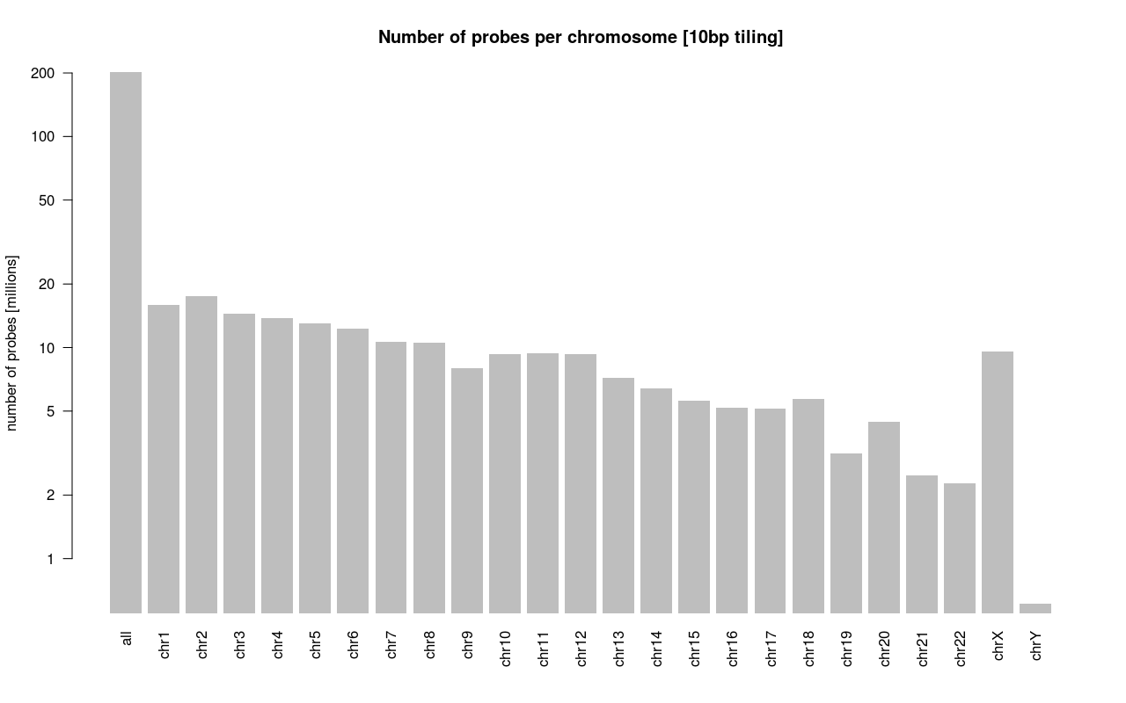
Number of probes per chromosome
[in mil., 10bp tiling]
total # of probes: 202,029,729
# of probes not overlapping any TRF region: 199,553,704
# of remaining probes not overlapping any 1bp “unique region” = 198,923,626

Slide 10
Region passing Heng Li's alignability filter
>5:155188725-155188747
NNTCATCTTCACCATTGCCCTT
The same region extended 34 bp upstream
>5:155188691-155188747
NNNNNNNNNNNNNNNNNNNNNNNNNNNNNNNNNNNNTCATCTTCACCATTGCCCTT

