Slide 1
Module 2: CLI
JVA-083

Slide 2
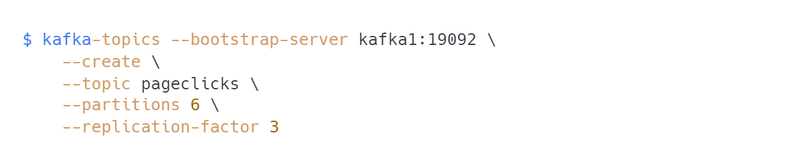
Topic creation
Command Line Interface
how many partitions should you specify?
what is the maximum replication factor?

Slide 3

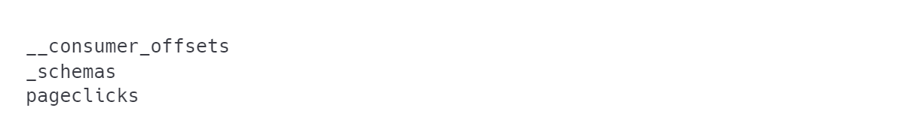
Topic listing
Command Line Interface
CAUTION: there are some topics we did not create...

Slide 4

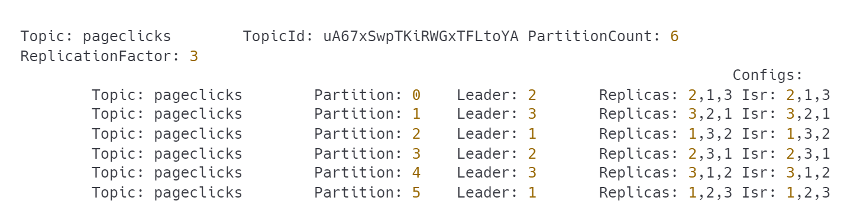
Topic description
Command Line Interface

Slide 5

Topic deletion
Command Line Interface
delete.topic.enable=true by default. You will probably not have that comfort in production environment.

Slide 6
There will be more…
Command Line Interface
First let's produce something into the topic.

Slide 7
Producer/Consumer CLI
Command Line Interface

Slide 8

Produce from console
Command Line Interface
TIP: Stop with Ctrl-C

Slide 9
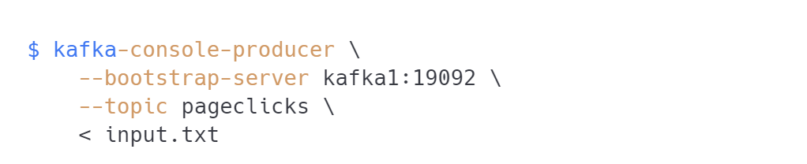
Produce from file
Command Line Interface

Slide 10

Have the messages been sent?
Command Line Interface
Let's check...
where are the messages?
is something wrong?
use --from-beginning

Slide 11
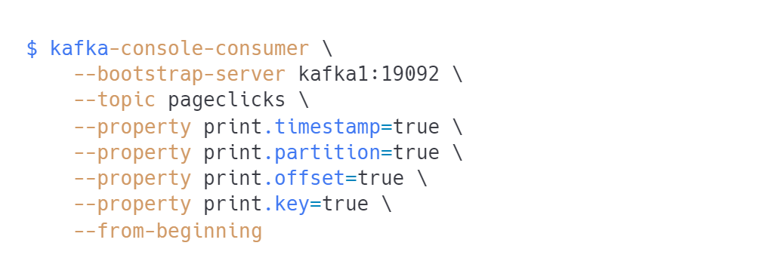
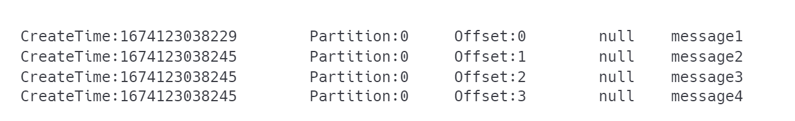
Reading messages from beginning
Command Line Interface
TIP: Switch from --topic to --include to specify multiple topics.

Slide 12
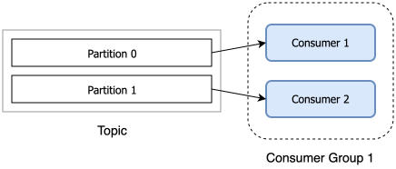
Run multiple consumers
Command Line Interface
Notice how messages are delivered
Is that what you expected?
SOLUTION: use consumer groups!
Notes:
TODO change diagram

Slide 13
Consumer groups
Command Line Interface

Slide 14
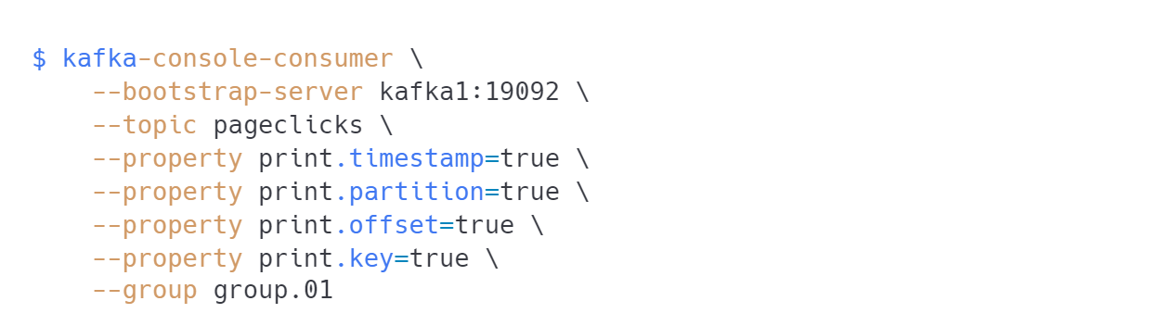
Consuming data specifying consumer group
Command Line Interface

Slide 15

Listing consumer groups
Command Line Interface

Slide 16
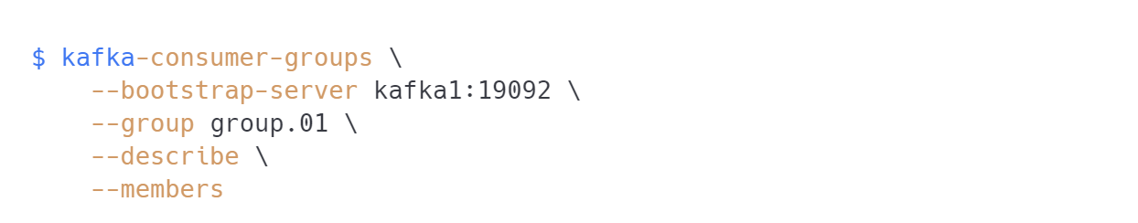
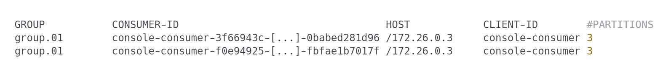
Consumer groups details
Command Line Interface
TIP: notice client-id and number of partitions assigned

Slide 17
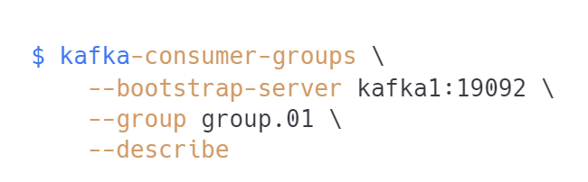
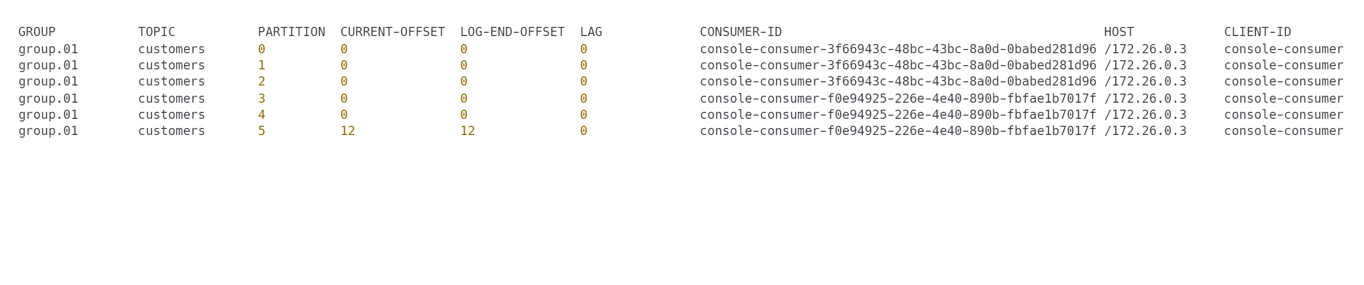
I want more details!
Command Line Interface
CAUTION: what is consumer lag? Why is it important?

Slide 18
Gotchas
Command Line Interface
What was the consumer group when I didn't specify it?
Run multiple consumers. Produce messages. How are they assigned to partitions?
Run more consumers than partitions. What happened?
Run multiple consumers in multiple groups. Analyze the behavior.
Stop one of customers. What happened?
Stop all consumers. Keep producing. Reconnect. What happened?

Slide 19
Rebalance!
Command Line Interface
When does rebalance happen?
new consumer joins
consumer leaves
consumer hangs
consumer crashes

Slide 20
I want to read those messages again!
Command Line Interface
Why?
I want to reprocess a message (bug)
I want to skip forward (poison pill 💀)
How?
change consumer group
move offsets manually
delete group's offsets (all or for topic)
read from specified partition/offset

Slide 21
Resetting offsets
Command Line Interface
kafka-consumer-groups
--reset-offsets:
--to-datetime
--by-duration
--to-earliest
--to-latest
--shift-by
--to-offset
--all-topics, --topic
--delete-offsets

Slide 22
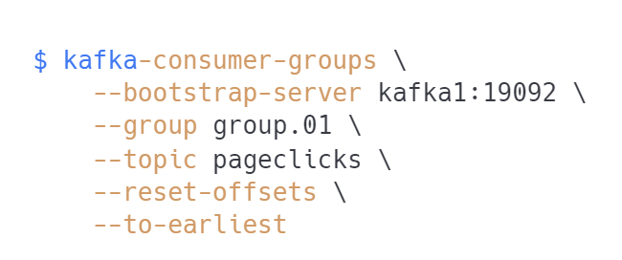
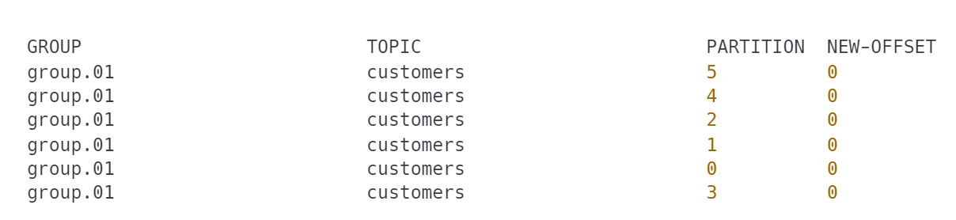
Resetting offsets
Command Line Interface
TIP: This is dry run. Now add --execute
IMPORTANT: the group cannot be active!

Slide 23
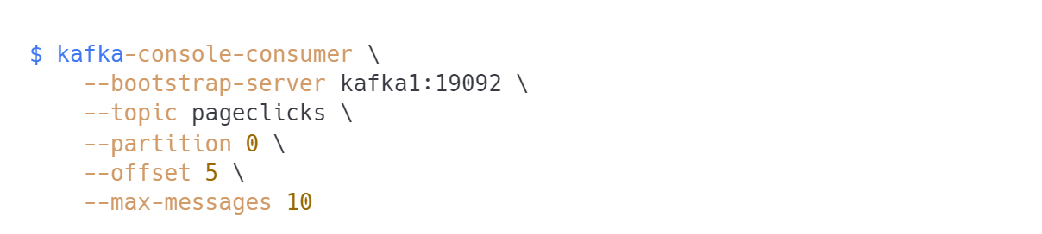
Read data from specified partition/offset
Command Line Interface

Slide 24
Messages with keys
Command Line Interface

Slide 25
Some urgent questions
Command Line Interface
why do we need to specify keys?
how is partition assigned?
what is partition assignment strategy for null keys?

Slide 26

Producing messages with keys
Command Line Interface
Use tab to separate key from value (or specify different key.separator)
Make sure the input has correct syntax (console producer does not handle it well)
--property key.separator=:
Run multiple consumers. Check which messages appear in which consumer.

Slide 27
Topic structure
Command Line Interface

Slide 28

How is topic stored?
Command Line Interface
TIP: inspect contents of directories
topics are stored as directories
one directory for each partition
segments
offset index
timestamp index

Slide 29
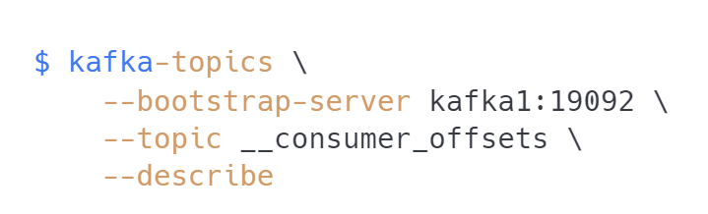
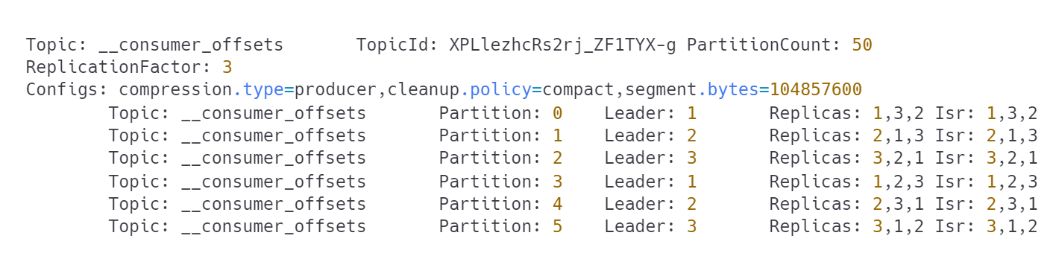
__consumer_offsets
Command Line Interface
NOTE: Heavily partitioned (50)
We will address `cleanup.policy=compact` later.

Slide 30


Questions?
30
Notes:
The final slide of the course is for answers to any remaining questions of participants.
Font requirements:
Title font: Arial (Headings), bold, white, 60 size.

Slide 31
Thank you!
Please share your feedback. Your opinion is important to us!
Notes:
The final slide of the course is for answers to any last questions of the participants.
Font requirements:
Title font: Arial (Headings), bold, white, 54 size.

