Slide 1
Module 3: Java Client API
JVA-083

Slide 2
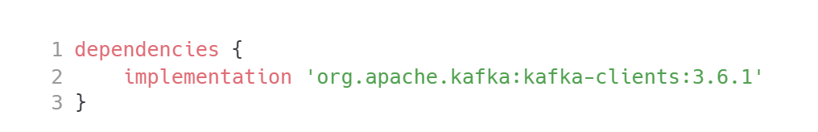
The setup
Java Client API
NOTE: At the time of writing this course (Jan 2024) the lastest released Kafka version is 3.6.1, released Dec 7th, 2023

Slide 3
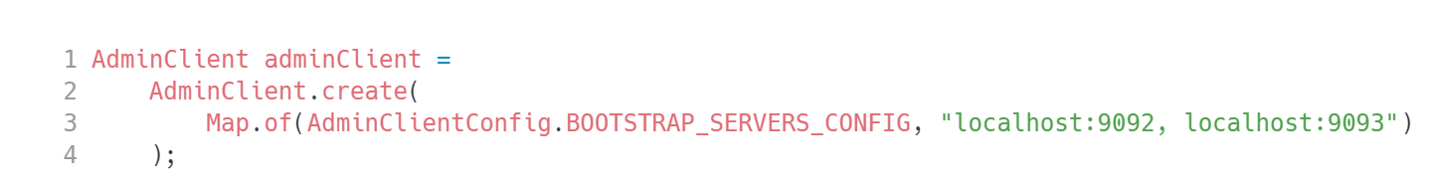
Admin API
Java Client API

Slide 4
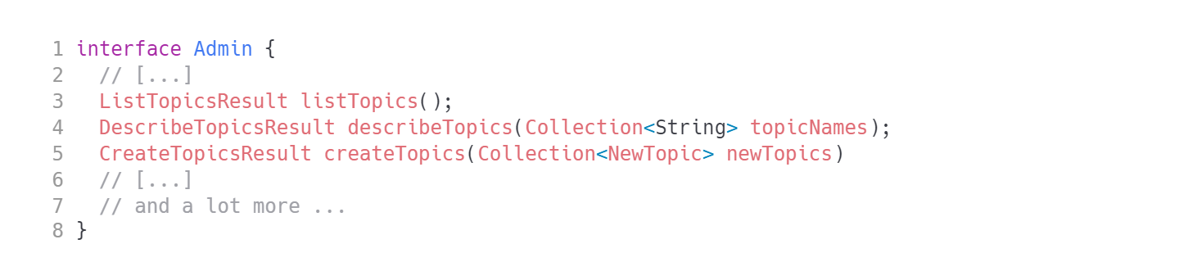
AdminClient
Java Client API
HINT: responses are asynchronous.

Slide 5
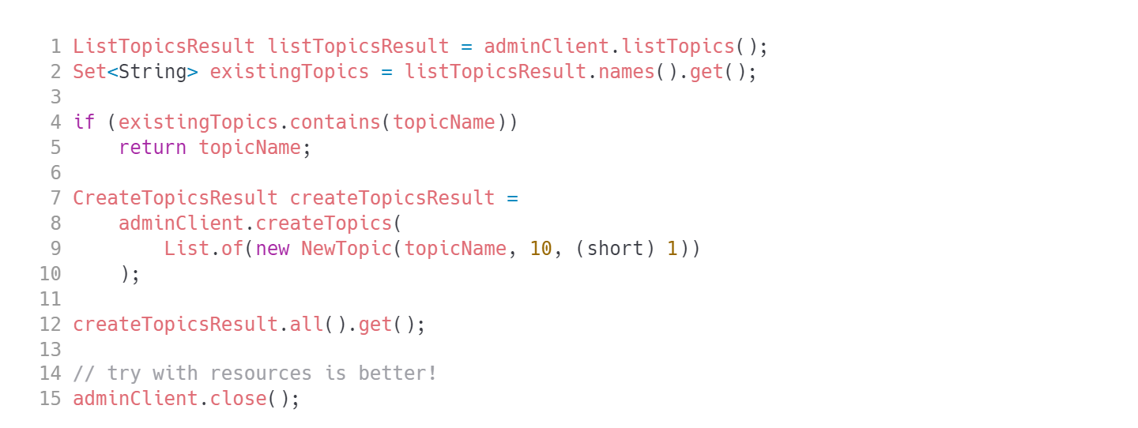
Creating a topic
Java Client API
HOMEWORK: Create an application that will automatically create a topic with 6 partitions, replication factor 3 and min insync replicas 2.
Notes:
Create an application that will automatically create a topic with 6 partitions, replication factor 3 and min insync replicas 2.

Slide 6
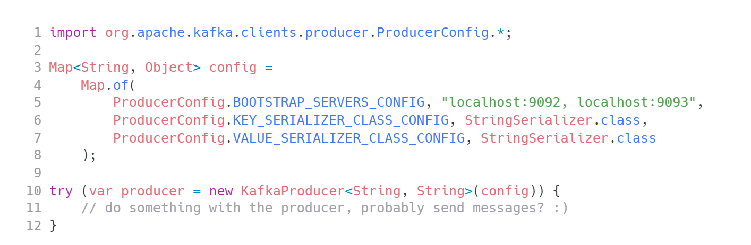
Producer API
Java Client API
CAUTION: KafkaProducer uses generics, make sure key/value generics parameters match serializers configured. HINT: KafkaProducer is thread safe. You may reuse the instance (provided you do not use transactions).

Slide 7
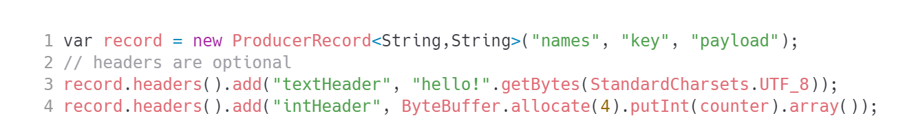
Create record
Java Client API
ProducerRecord is also a generic class. Same rules apply as for KafkaProducer.
HINT: Use different variants of ProducerRecord constructors!
Kafka only deals with byte arrays. Serializers help mitigate that problem for keys/values.
There is no support of this kind for headers.

Slide 8
Send
Java Client API
NOTE: Kafka API is asynchronous. Any request you make to the cluster returns a Future. That is java.util.concurrent.Future, not a java.util.concurrent.CompletableFuture, which is quite inconvenient. Only when you invoke .get(), and wait for the result you may be sure the record has been successfully delivered and stored in the broker.
HINT: There is also producer.send(record, Callback) variant.

Slide 9
Cleanup
Java Client API
Close the producer, before application exits and wait! This flushes all internal buffers.
TIP: Run com.luxoft.lmd.kafka.simple.BasicProducer
Notes:
TIP: Run `com.luxoft.lmd.kafka.simple.BasicProducer`

Slide 10
Write your own producer
Java Client API
It’s now time for you to write the simplest Kafka producer application.
Use the template provided.
You already know how to run Kafka console consumer – use it to verify the data is being properly sent to the cluster.

Slide 11
Most common producer settings
Java Client API
Property | Meaning | Default value
batch.size | Amount of data to batch before sending out to broker. | 16384 (16kB)
linger.ms | The time to wait before sending the batch. | 0
compression.type | Compression algorithm used | none
acks | The number of acknowledgments the producer requires the leader to have received before considering a request complete. | all
enable.idempotence | Producer will ensure that exactly one copy of each message is written in the stream. | true
HINT: It’s a bit too early to dive deep into configuration settings. Keep coming back to this slide later to understand your possibilities.

Slide 12
Other producer settings
Java Client API
Property | Meaning | Default value
delivery.timeout.ms | An upper bound on the time to report success or failure after a call to `send()` returns. | 120000 (2 minutes)
request.timeout.ms | Maximum amount of time the client will wait for the response of a request. | 30000 (30s)
max.in.flight.requests.per.connection | The maximum number of unacknowledged requests the client will send on a single connection before blocking. | 5
HINT: It’s a bit too early to dive deep into configuration settings. Keep coming back to this slide later to understand your possibilities.

Slide 13
Producer acknowledgements
Java Client API
acks=all
acks=0 do not wait for any acknowledgements from the broker… and loose your messages easily
acks=1 wait for acknowledgement from replica leader – still very unsafe.
acks=all (or -1) wait for acknowledgement from replica leader and all insync replicas. The best option. Still not safe enough without further topic configuration.
TIP: acks=all is the default setting for Kafka 3+ installations.
CAUTION: Watch out for Spring powered clients – they fall back to acks=1 for compatibility reasons!

Slide 14
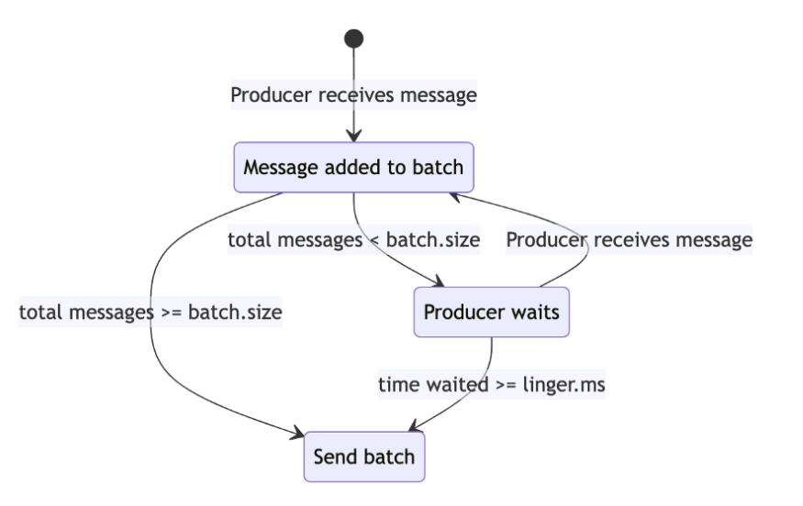
Message batching
Java Client API
Manage your throughput
Kafka producer automatically batches the messages being sent.
Control the behaviour using batch.size and linger.ms properties.
Increased batching will provide optimal throughput
…and harm your latency
CAUTION: it makes no sense to make batch.size big, without giving it enough time to fill (linger.ms). This requires tests.

Slide 15
Compression
Java Client API
Set it up at producer size
Compression affects the producer and consumer. Not the broker (it might but that config is quite rare)
Producer is responsible for configuring compression using compression.type
Compressed data is stored (and replicated) as-is in the broker
The consumer is able to handle both compressed and uncompressed data without any additional configuration.
Generally improves producer throughput, at the cost of instance CPU (and latency)
compression.type
none
gzip
snappy
lz4
Zstd
TIP: Textual data allows for high compression ratio. Compressing encrypted data makes no sense.

Slide 16
Retries
Java Client API
Kafka producer manages retries automatically. Just give the client some time to work with failed network calls.
delivery.timeout.ms – total time you are willing to wait (by default 2 minutes).
request.timeout.ms – maximum time to wait before giving up on a single retry (30s)
Early Kafka versions controlled retrying via retries property (specifying retry count). This property is Integer.MAX_VALUE now and should not be changed.

Slide 17
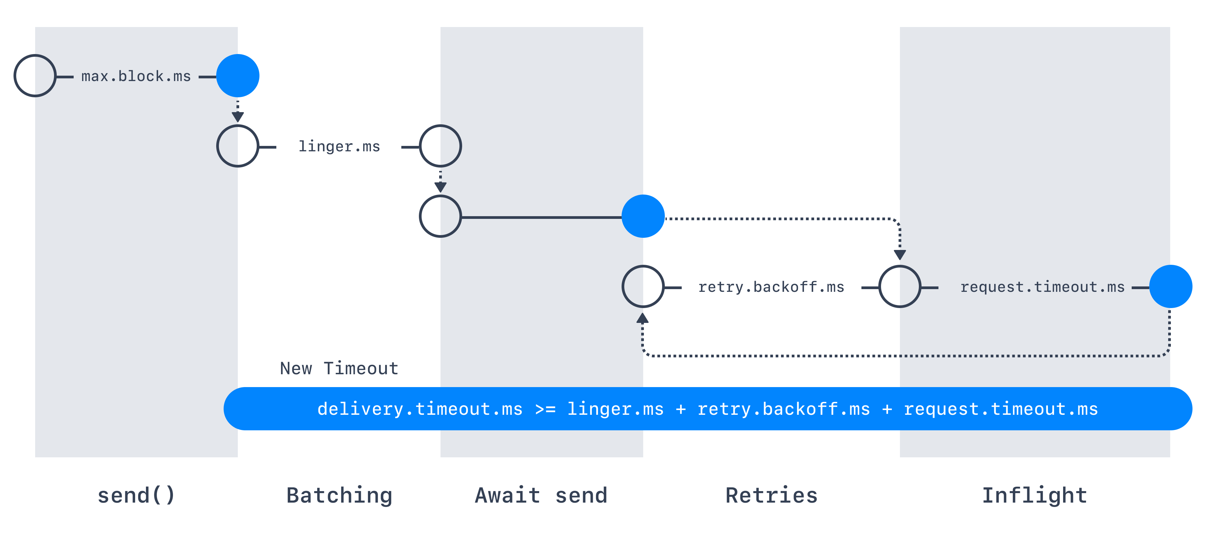
Producer timings
Java Client API
Notes:
Note: diagram downloaded from conduktor.io

Slide 18
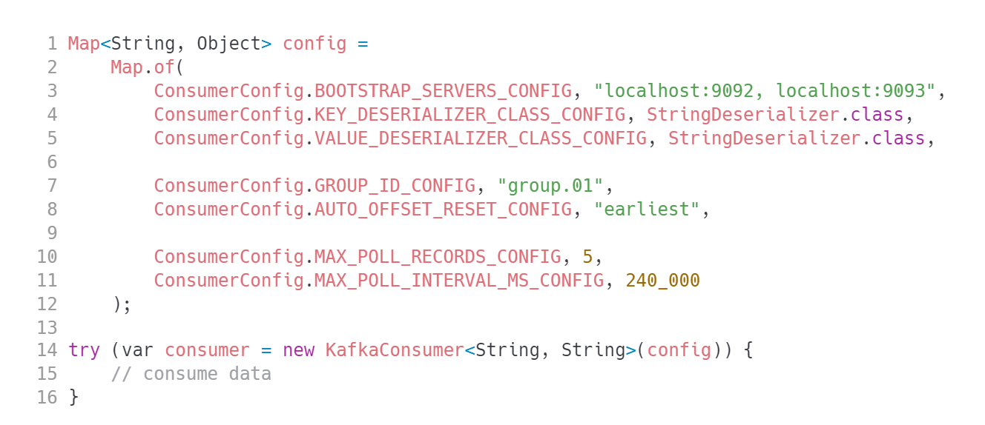
Kafka consumer
Java Client API
TIP: Consumer is NOT thread safe. Beware!

Slide 19
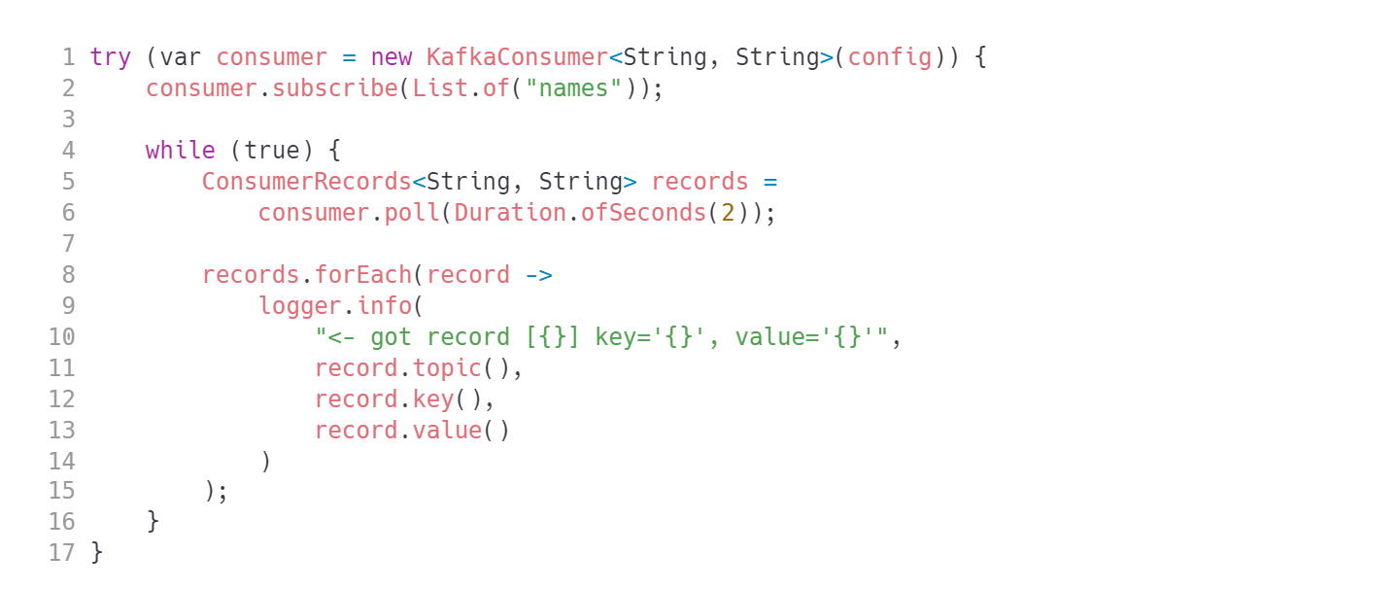
Consuming records
Java Client API
CAUTION: Looks trivial, but lots of magic happens inside consumer.poll(Duration).
Notes:
TIP: Run `com.luxoft.lmd.kafka.simple.BasicConsumer`

Slide 20
Important configuration
Java Client API
Every configuration property has a long backstory
Property | Meaning | Default value
group.id | Consumer group name
auto.offset.reset | Start reading data from the beginning of the topic (earliest) or end of the topic (latest) | latest
fetch.min.bytes | Minimum batch size to receive | 1
fetch.max.wait.ms | Maximum time to wait for batch to acumulate | 500
fetch.max.bytes | Max batch size to fetch | 57671680 (55 MiB)
max.poll.interval.ms | Maximum timespan between polls broker should expect | 5 minutes
max.poll.records | Max number of records to fetch with each poll | 500

Slide 21
Other consumer properties
Java Client API
Property | Meaning | Default value
enable.auto.commit | Enable automatic offset sending to broker | true
auto.commit.interval.ms | The frequency that the consumer offsets are auto-committed to Kafka | 5000 (5s)
partition.assignment. strategy | A list of class names or class types, ordered by preference, of supported partition assignment strategies | o.a.k.c.c.RangeAssignor, o.a.k.c.c..CooperativeStickyAssignor
session.timeout.ms | The timeout used to detect client failures when using Kafka's group management facility. | 45000 (45s)
heartbeat.interval.ms | The expected time between heartbeats to the group coordinator. Lower than session.timeout.ms and no higher than 1/3 of that value. | 3000 (3s)

Slide 22
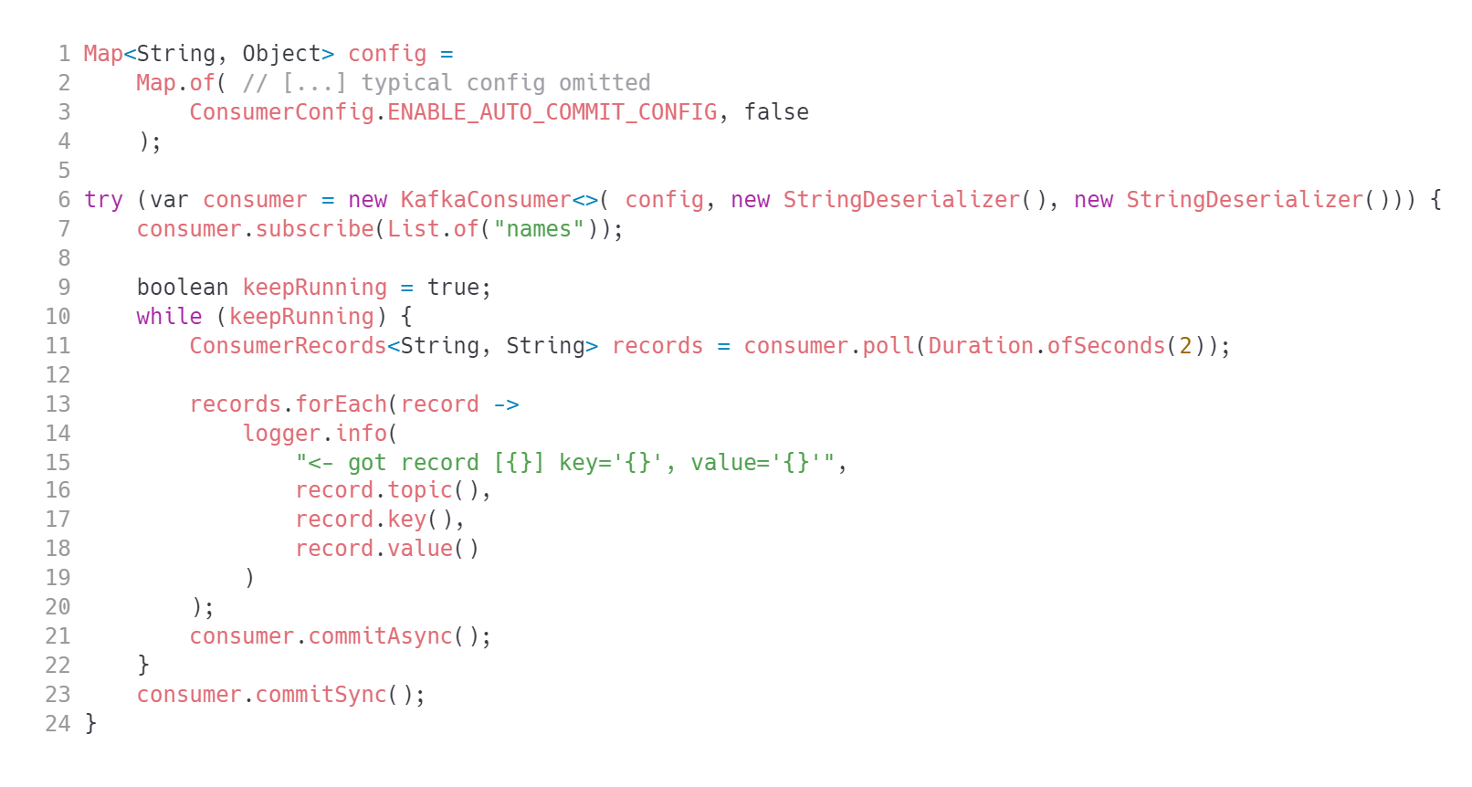
Auto commit disabled
Java Client API
TIP: Run com.luxoft.lmd.kafka.offsetcommit.CommittingConsumer

Slide 23
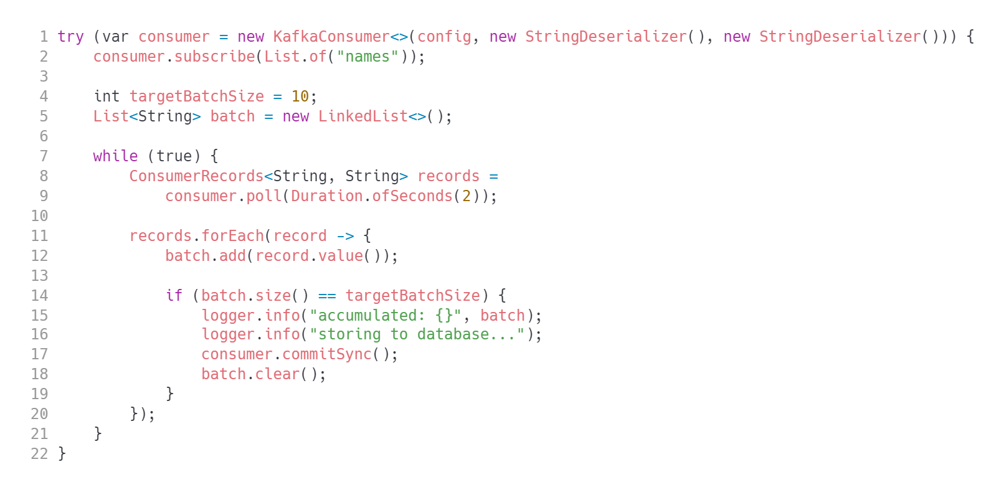
Committing data in batches
Java Client API
NOTE: There is even more committing control using consumer.commitSync(Map<TopicPartition,OffsetAndMetadata>) but that is too difficult now.
TIP: Run com.luxoft.lmd.kafka.offsetcommit.BatchingConsumer

Slide 24
Dealing with rebalancing
Java Client API
Is your consumer stateless? No problem!
Your consumer is stateful? well...
introduce ConsumerRebalanceListener
switch off rebalancing entirely

Slide 25
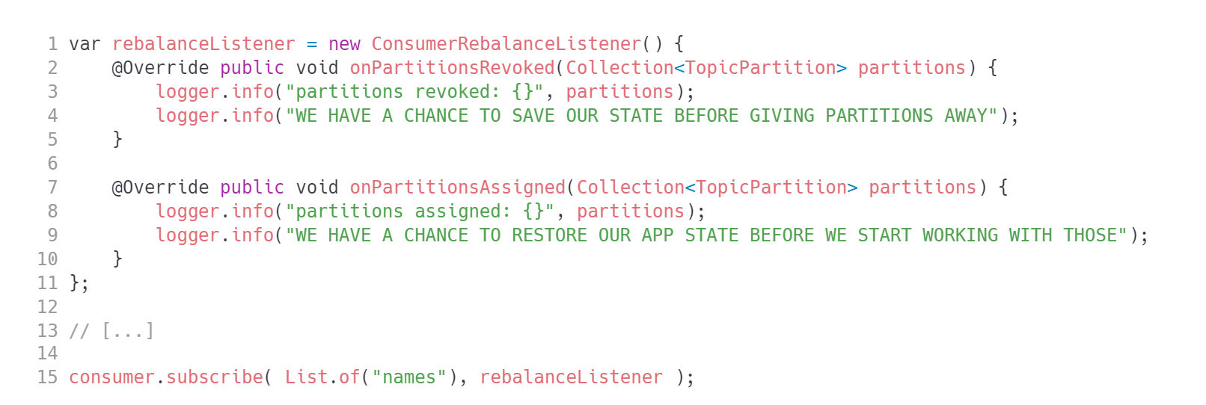
Tapping into rebalance process
Java Client API
TIP: Run com.luxoft.lmd.kafka.simple.RebalanceListeningConsumer in multiple instances. Make sure you have a topic with multiple partitions.
Notes:
TIP: Run `com.luxoft.lmd.kafka.simple.RebalanceListeningConsumer` in multiple instances. Make sure you have a topic with multiple partitions.

Slide 26
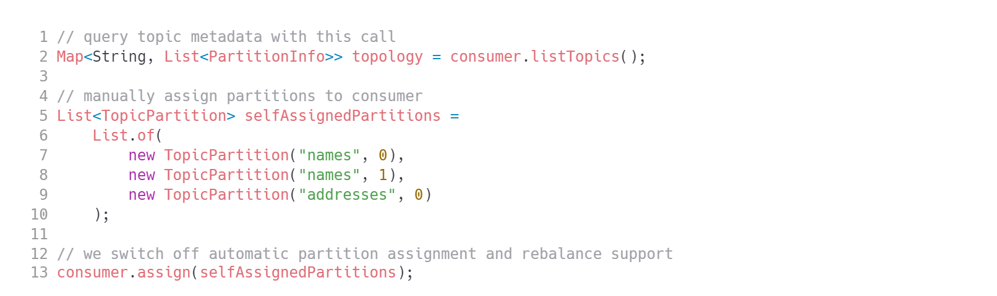
Assigning partitions manually
Java Client API
By assigning the partitions you are turning off consumer rebalance.
TIP: use this approach if your infrastructure manages and observes app instances (Kubernetes, YARN, Mesos)
Notes:
TIP: Run `com.luxoft.lmd.kafka.assign.AssigningConsumer`

Slide 27
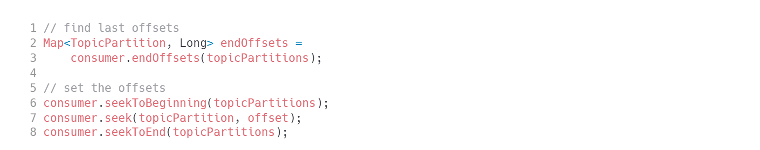
Let me choose the read position myself
Java Client API
TIP: Run com.luxoft.lmd.kafka.seek.SeekConsumer
Notes:
TIP: Run `com.luxoft.lmd.kafka.seek.SeekConsumer`

Slide 28
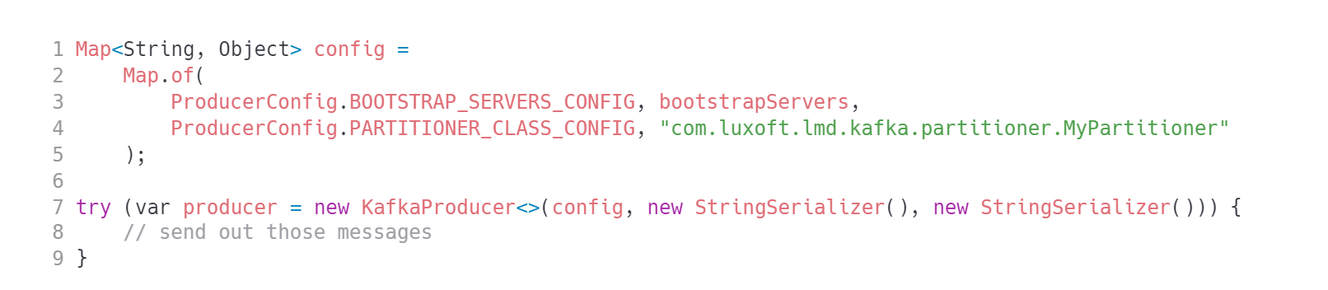
Custom partitioner
Java Client API
Implement org.apache.kafka.clients.producer.Partitioner interface and pass it as partitioner.class configuration property.

Slide 29
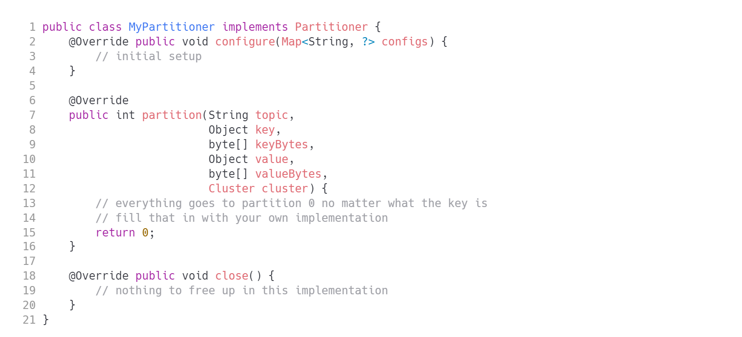
Partitioner class
Java Client API

Slide 30
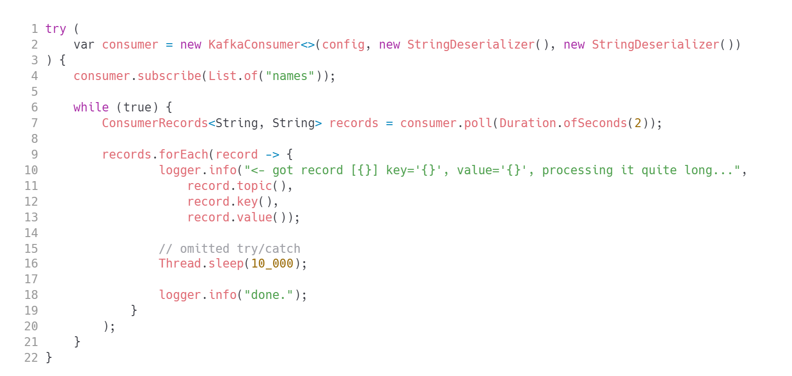
This example looks innocent
Java Client API
…but it will cause you quite a headache during message processing
Where is the problem?

Slide 31
You need to poll every 30 seconds!
Java Client API
you need to consumer.poll(Duration) at least once in 30s (by default), or the broker will declare you dead and trigger a rebalance
how do we fix it?
make sure we are faster - might not be possible though!
make sure we get fewer records with each consumer.poll()
max.poll.records or fetch.max.bytes
extend that default 30s time expressing it in max.poll.interval.ms config property

Slide 32
Polling issue
Java Client API
Example
you are processing invoice DTO and generating PDF documents
each render takes 5 seconds
Solution 1: limit the number of records polled to 5 (5x5s=25s - under 30s limit)
Solution 2: set max.poll.interval.ms=60000 and you can extend the number of records polled to 11. (11x5s=55s - under 60s limit)

Slide 33
Consumer heartbeat
Java Client API
Why do we need one?
If the consumer processes data quickly – Kafka has no problem detecting problems (crash, OOME, hanging) early and is able to trigger rebalance without large delay.
If the consumer processes data slowly (fetching external resources, expensive computation: i.e. video transcoding) – processing might take minutes. In between consumer.poll() Kafka has no idea if the consumer is alive.
Waiting 10 minutes to find out the consumer is actually dead is an ETERNITY in event streaming world.
SOLUTION: automatic heartbeat thread that is sending requests every few seconds.
Fine tune the behaviour with heartbeat.interval.ms and session.timeout.ms. Usually you do not need to.

Slide 34
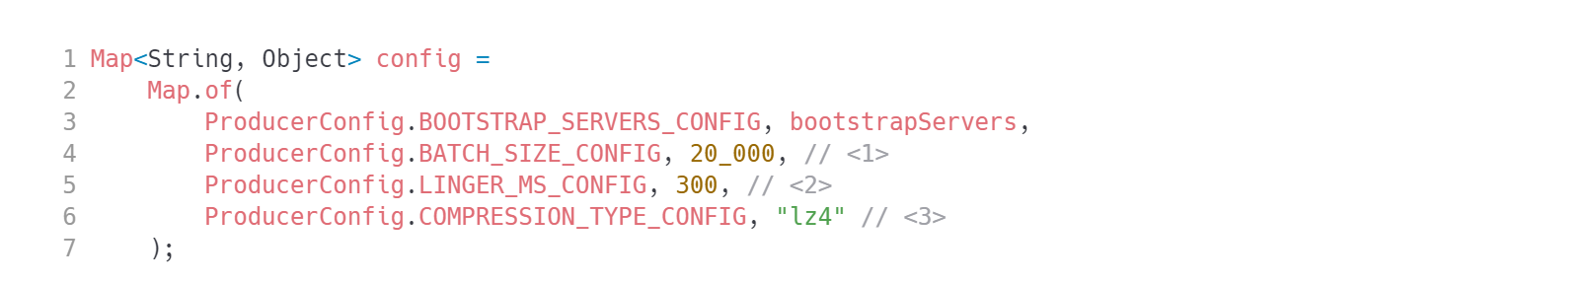
Designing for large throughput
Java Client API
The producer
Remember that batch is allocated separately for each partition. Did you configure memory limits for your app?
No point in setting batch size if we do not give the client proper time to fill it up.
Compression will additionally increase latency and CPU usage on the client, but it will be very beneficial network wise (and HDD wise for the broker). String data compresses really well (JSON?), especially multiple messages of the same format.

Slide 35
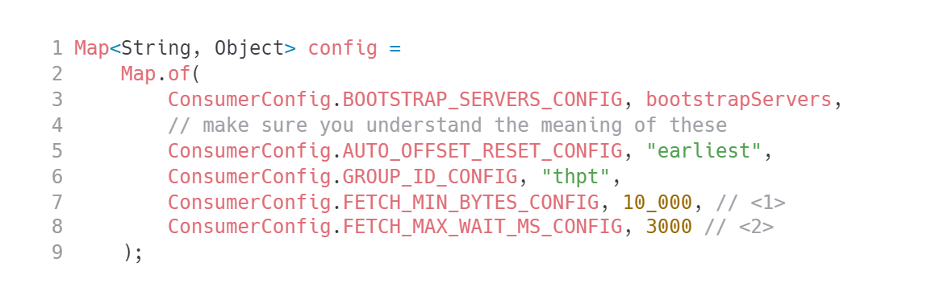
Large throughput consumer
Java Client API
How much data should Kafka accumulate before answering with whole buffer at once.
How long is the consumer willing to wait (thus introducing added latency). What happens when 3s pass and there is no 10000 bytes ready to read?
TIP: Run com.luxoft.lmd.kafka.throughput.LargeThroughputConsumer. Check what happens when you poll every 2 seconds. Why does that happen? Is that a problem?

Slide 36
Assuring consistency
Java Client API
producer idempotence
transactions

Slide 37
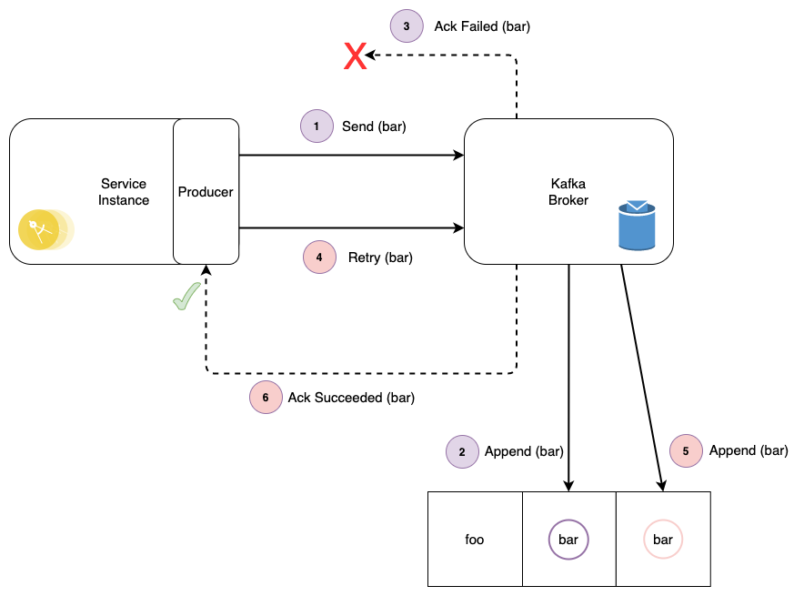
Producer idempotence
Java Client API
enable.idempotence is on by default for Kafka 3+
Notes:
TODO: replace diagram

Slide 38
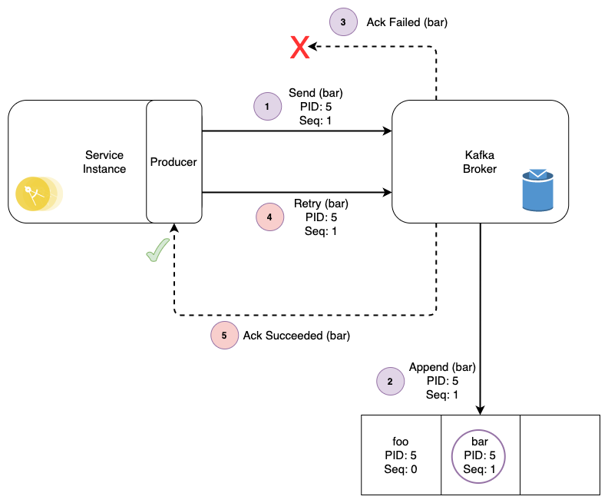
Producer idempotence
Java Client API
enable.idempotence is on by default for Kafka 3+
Notes:
TODO: replace diagram

Slide 39
Producer transactions
Java Client API
The checklist:
set producer's transactional.id (turns on idempotence)
use different producer instances for different threads (or you will have one large transaction - you do not want that!)

Slide 40
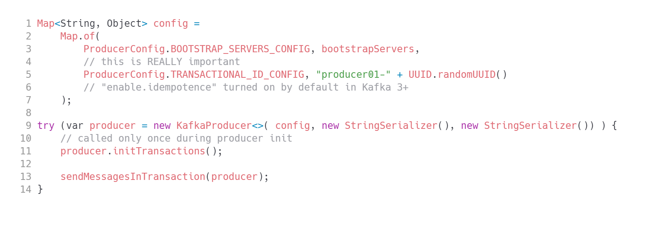
Sample code - setup
Java Client API

Slide 41
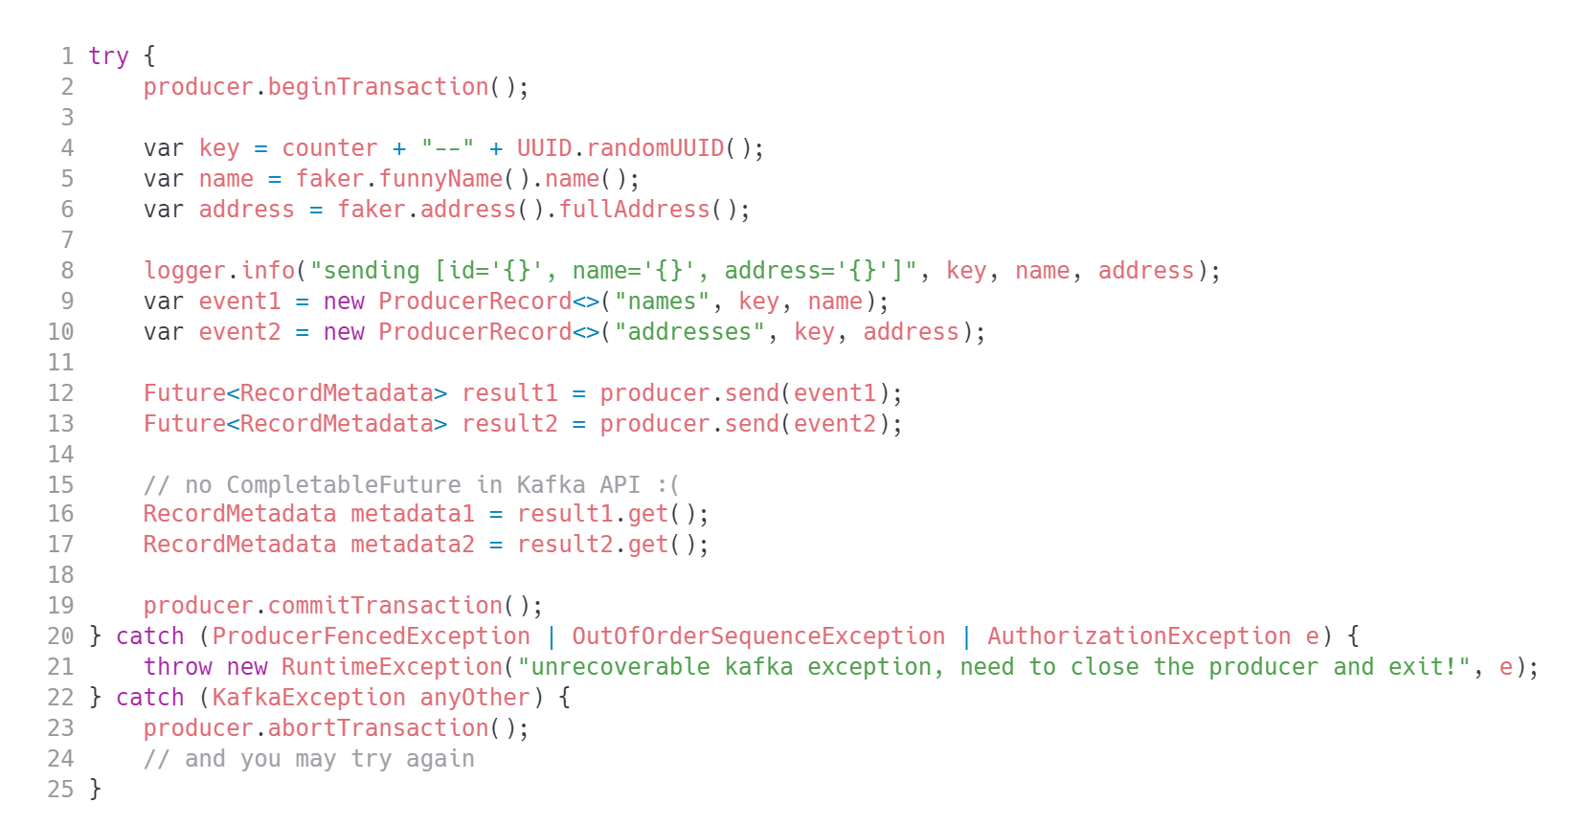
Sample code - actual producer transaction
Java Client API

Slide 42
Transaction aware consumer
Java Client API
AKHQ was "cheating" a bit. The actual java consumer will be more tricky
Let's run a basic consumer which is not aware of transactions first.
Something is wrong - you see messages from aborted transactions!

Slide 43
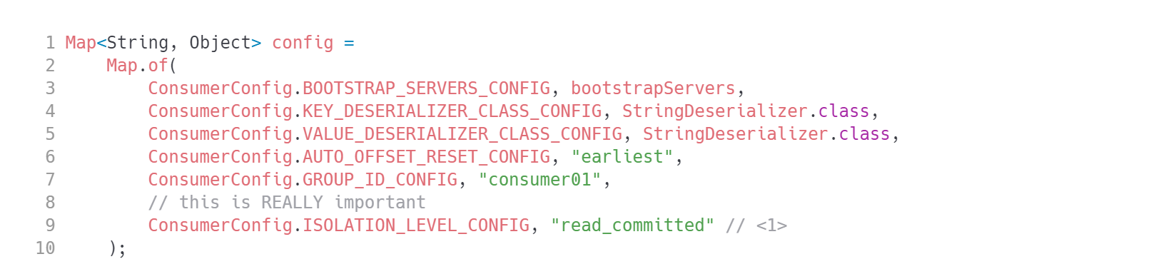
Transaction aware consumer - sample
Java Client API
isolation.level=read_committed is required for the broker to filter out uncommited records while sending data to consumer.
LSO - Last Stable Offset WARNING: You need to ask the developers responsible for producers 'Are you using transactions?'. read_committed is not the default!

Slide 44
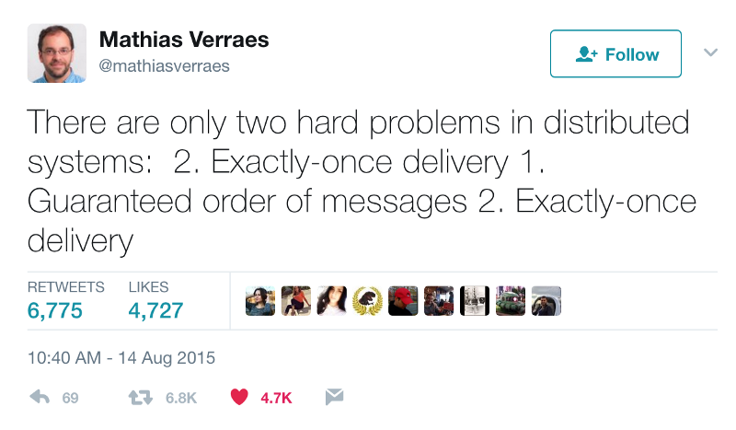
Transaction aware processor
Java Client API
Processor = consumer + producer
The pipeline is trivial, but... the code is not. Do not worry if you don't understand it at first.
NOTE: The code is too long for a slide. Let's analyze and run com.luxoft.lmd.kafka.tx.
TransactionalProcessor.
Read another example: https://www.baeldung.com/kafka-exactly-once

Slide 45
Multi threaded processing
Java Client API
Kafka provides surprisingly good summary
https://kafka.apache.org/31/javadoc/org/apache/kafka/clients/consumer/KafkaConsumer.html

Slide 46


Questions?
46

Slide 47
Thank you!
Please share your feedback. Your opinion is important to us!

