Slide 1
Module 4: Data Exchange Design
JVA-083
Notes:
Font requirements:
XXX-000: Arial (Body), bold, white, 28 size
Title: Arial (Headings), bold, white, 54 size
Module 1: Arial (Body), white, 28 size
Example of title:
REQ-039 BPMN: Business process modeling. Advanced level Module 1: Introduction to…

Slide 2
How to design a durable and performant data exchange?

Slide 3
Issues
Data exchange design
Message size
Partition count
Data retention
Segment size
Deletion policy
Compression
Durability and resiliency
Design for
low latency
high throughput
durability
high availability
Simple performance testing
Cluster-wide guidelines
Production topic reconfiguration

Slide 4
Message size
Data exchange design
default: 1MB
want more?
change a lot of broker/client settings
offload payload to S3 or HDFS and just send a "link"

Slide 5
Partition count
Data exchange design
producer is FAST(usually)
consumers might be slow
take consumer throughput into consideration
take consumer instance count into account
account for business growth
more partitions allow to scale but put more stress on brokers
no predictions? for small cluster brokerCount*3, for large clusters brokerCount*2

Slide 6
Configuring data retention
Data exchange design
broker wide
log.retention.hours|.minutes|.ms (default: 1 week)
log.retention.ms is CLI default
log.retention.bytes (default: -1)
for particular topic
retention.ms
retention.bytes

Slide 7
Configuring segments
Data exchange design
broker wide
log.segment.bytes
log.segment.ms (watch for performance)
for particular topic
segment.bytes
segment.ms

Slide 8
Log deletion
Data exchange design
log.cleanup.policy=delete
what if consumer does not catch up?

Slide 9
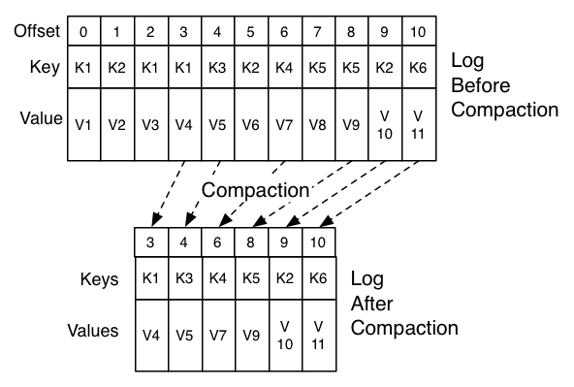
Log compaction
Data exchange design
log.cleanup.policy=compact
order guaranteed
offsets immutable
Tombstone
A message with null payload
Allows to remove a key from compacted topic

Slide 10
Compression
Data exchange design
Where?
producer level
topic level (watch out!)
How can I make compression better?
Configure for message batching!
compression.type
none
lz4
snappy
gzip
https://developer.ibm.com/articles/benefits-compression-kafka-messaging/

Slide 11
I want to be sure my data is not lost
Data exchange design
Use proper replication factor (RF)
Set min.insync.replicas
Use proper acknowledgement settings (acks) while producing

Slide 12
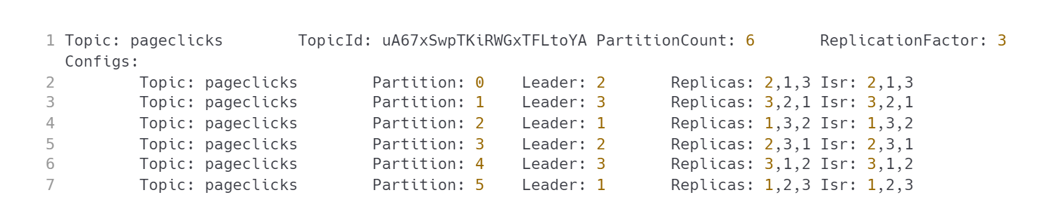
ISR
Data exchange design
CAUTION: the default min.insync.replicas is 1. Does that guarantee data safety?

Slide 13
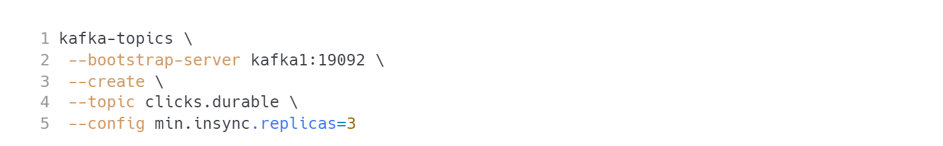
min.insync.replicas
Data exchange design
What if there aren't enough in sync replicas and I want to produce messages?
TIP: experiment!

Slide 14
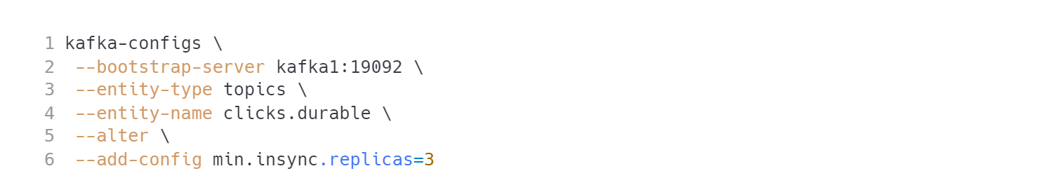
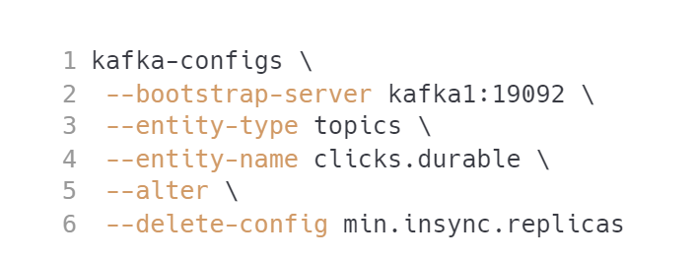
I already have a topic
Data exchange design
Modifying configuration of existing topic

Slide 15
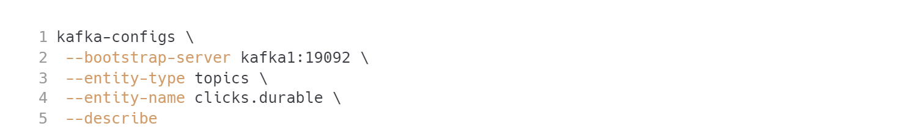
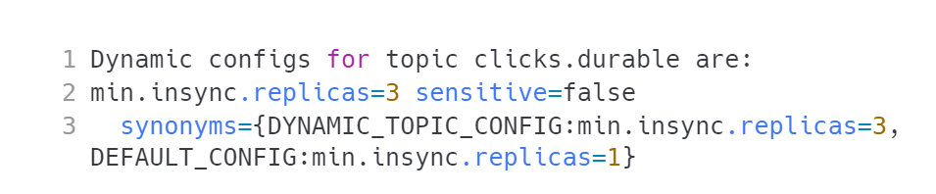
Checking current topic config
Data exchange design
CAUTION: is that a good configuration for 3 broker cluster? Let's find out

Slide 16
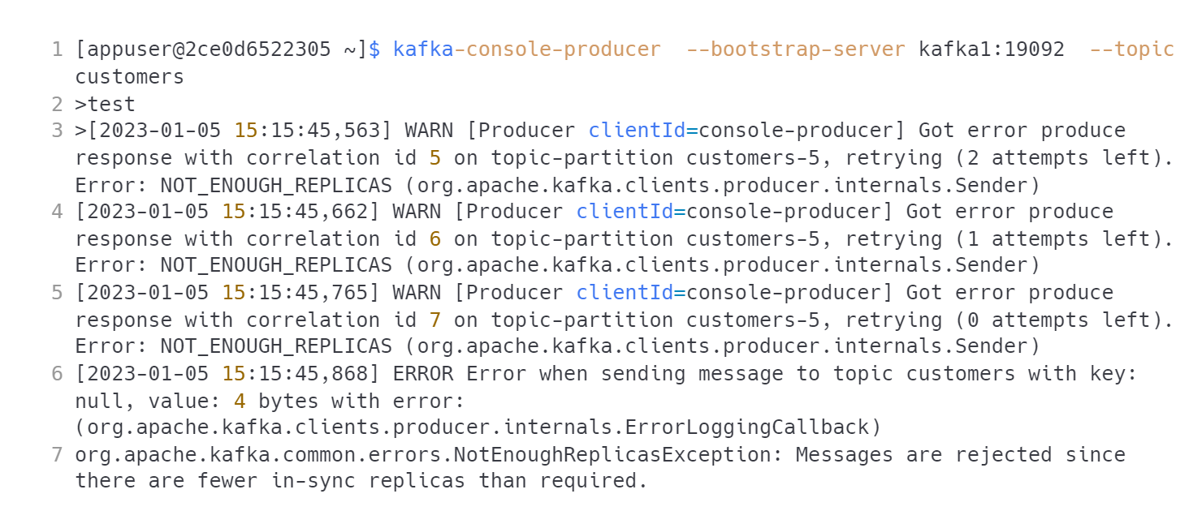
Kill one topic, try producing messages…
Data exchange design
IMPORTANT: we cannot survive a single broker crash with this configuration.

Slide 17
Producer acknowledgements
Data exchange design
acks=0 - do not wait for broker to ack at all
acks=1 - wait for leader ack
acks=all (or -1) - wait for all in sync replicas
TIP: `acks=all is default for Kafka 3+

Slide 18
Latency
Data exchange design
Let’s revisit important terms
producer latency
end-to-end latency
tail latency

Slide 19
Designing for low latency
Data exchange design
Producer
TIP: linger.ms=0 might not always be the best solution
Consumer
https://docs.confluent.io/cloud/current/client-apps/optimizing/latency.html

Slide 20
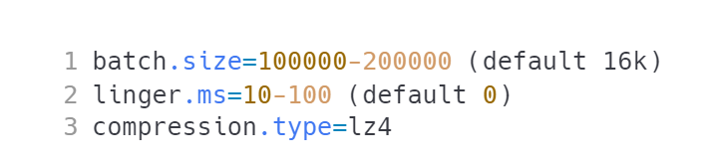
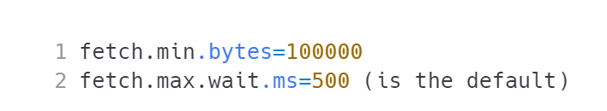
Designing for high throughput
Data exchange design
Producer
Increase buffer.memory if you deal with producing to lots of partitions.
Consumer
https://docs.confluent.io/cloud/current/client-apps/optimizing/throughput.html

Slide 21
Can you have both low latency and high throughput?

Slide 22
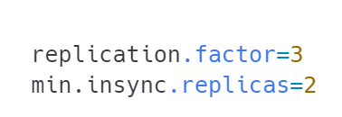
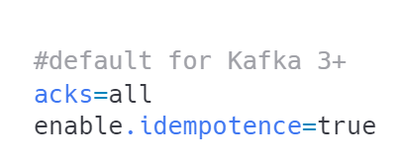
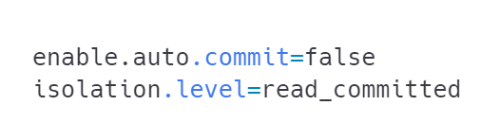
Designing for durability
Data exchange design
Topic
Producer
Consumer
https://docs.confluent.io/cloud/current/client-apps/optimizing/durability.html https://docs.confluent.io/cloud/current/client-apps/optimizing/availability.html

Slide 23
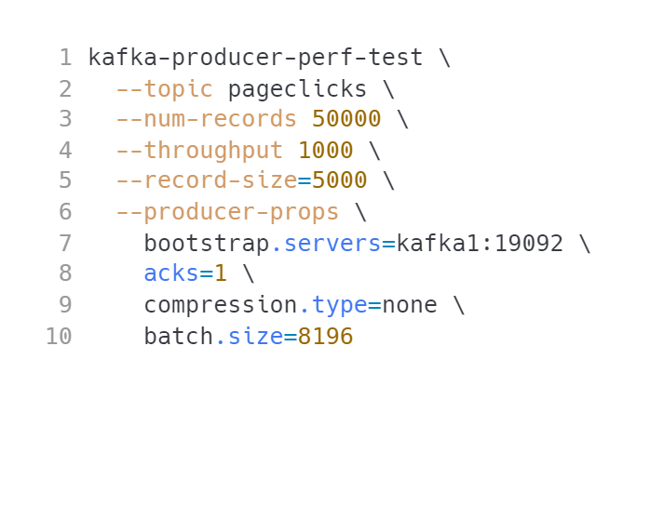
Do some tests!
Data exchange design
Experiment with different settings for latency/throughput.
WARNING: your Docker drive will fill up fast if you keep the process running.

Slide 24
Cluster guidelines
Data exchange design
no more than 200k partitions
4k partitions per broker (Confluent recommendation)
if you need more - create multiple clusters
the limits may go away with KRaft

Slide 25
Topic reconfiguration
Data exchange design
replication factor - easy
message size - easy
compression level - easy
min insync replicas - easy
log cleanup policy - your design was probably bad...
number of partitions - well...
CAUTION: What is the catch with changing the number of partitions?

Slide 26


Questions?
26
Notes:
The final slide of the course is for answers to any remaining questions of participants.
Font requirements:
Title font: Arial (Headings), bold, white, 60 size.

Slide 27
Thank you!
Please share your feedback. Your opinion is important to us!
Notes:
The final slide of the course is for answers to any last questions of the participants.
Font requirements:
Title font: Arial (Headings), bold, white, 54 size.

