Slide 1
Module 5: Managing data formats
JVA-083

Slide 2


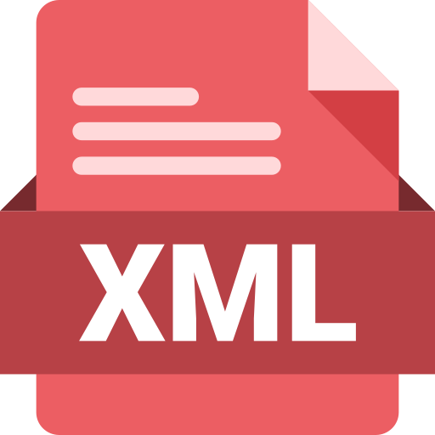
What data formats do you know?
Data formats
Plain text
CSV
JSON
XML
NOTE: Let's discuss pros and cons of those

Slide 3
What do we need from a robust data format?
Data formats
well defined specification
row oriented
validation support
schema language
efficient
binary instead of textual
schema separate from data
tooling available
serialization/deserialization
multi-language support
safe schema evolution support
NOTE: read about column oriented data format. This will not help you to solve in-Kafka tasks, but a lot of data sinks accept column oriented formats (ORC, Parquet).

Slide 4
Introduction to Avro
Notes:
Please separate the new section of training.
Font requirements:
Title font: Arial (Headings), bold, white, 54 size.

Slide 5

What is Avro?
Data formats
https://avro.apache.org/
Apache Avro™ is a data serialization system.
Avro provides:
Rich data structures.
A compact, fast, binary data format.
A container file, to store persistent data.
Remote procedure call (RPC).
Simple integration with dynamic languages. Code generation is not required to read or write data files nor to use or implement RPC protocols. Code generation is an optional optimization.

Slide 6
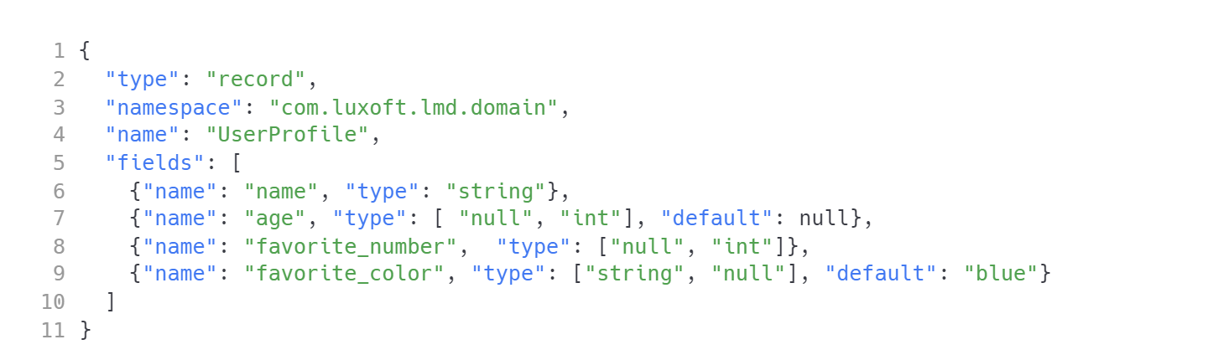
Schema example
Data formats
user-profile.avsc

Slide 7
How does it differ from other formats?
Data formats
Dynamic typing: Avro does not require that code be generated. Data is always accompanied by a schema that permits full processing of that data without code generation, static datatypes, etc. This facilitates construction of generic data-processing systems and languages.
Untagged data: Since the schema is present when data is read, considerably less type information need be encoded with data, resulting in smaller serialization size.
No manually-assigned field IDs: When a schema changes, both the old and new schema are always present when processing data, so differences may be resolved symbolically, using field names.

Slide 8
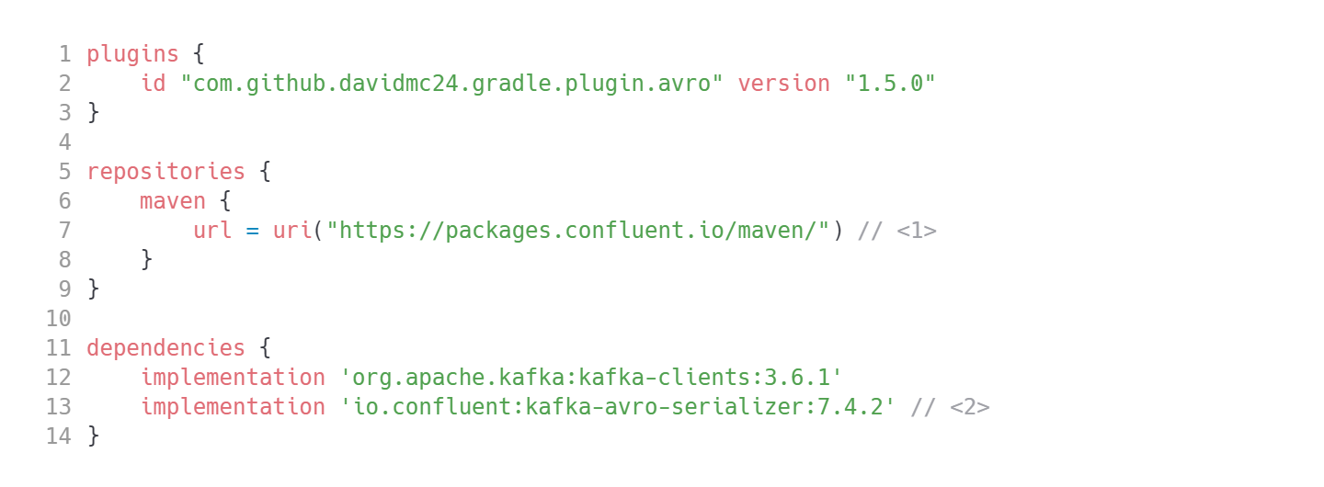
Dependencies
Data formats
KafkaAvroSerializer is not available in Maven Central.
Transitively pulls implementation 'org.apache.avro:avro:1.11.3'

Slide 9
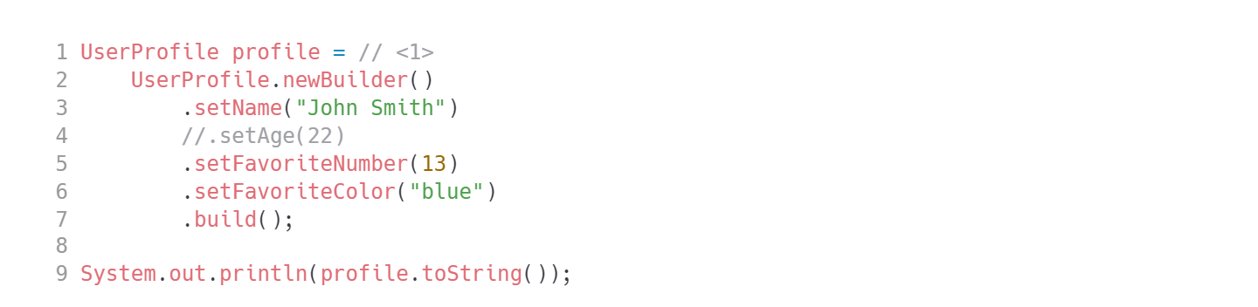
Usage: static
Data formats
All generated classes implement org.apache.avro.specific.SpecificRecord. That is going to be relevant later.

Slide 10
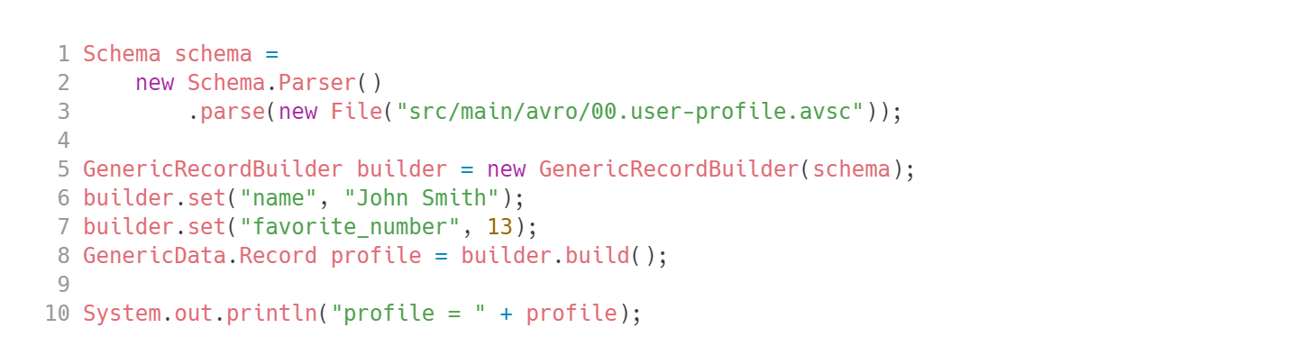
Usage: dynamic
Data formats

Slide 11
Primitive types
Data formats
null: no value
boolean: a binary value
int: 32-bit signed integer
long: 64-bit signed integer
float: single precision (32-bit) IEEE 754 floating-point number
double: double precision (64-bit) IEEE 754 floating-point number
bytes: sequence of 8-bit unsigned bytes
string: unicode character sequence

Slide 12
Complex types
Data formats
records
enums
arrays
maps
unions
fixed

Slide 13
Records
Data formats
Records use the type name “record” and support the following attributes:
name: a JSON string providing the name of the record (required).
namespace, a JSON string that qualifies the name (optional).
doc: a JSON string providing documentation to the user of this schema (optional).
aliases: a JSON array of strings, providing alternate names for this record (optional).

Slide 14
Records
Data formats
fields: a JSON array, listing fields (required). Each field is a JSON object with the following attributes:
name: a JSON string providing the name of the field (required), and
doc: a JSON string describing this field for users (optional).
type: a schema, as defined above
default: A default value for this field, only used when reading instances that lack the field for schema evolution purposes.
CAUTION: The presence of a default value does not make the field optional at encoding time. NOTE: Avro encodes a field even if its value is equal to its default.

Slide 15
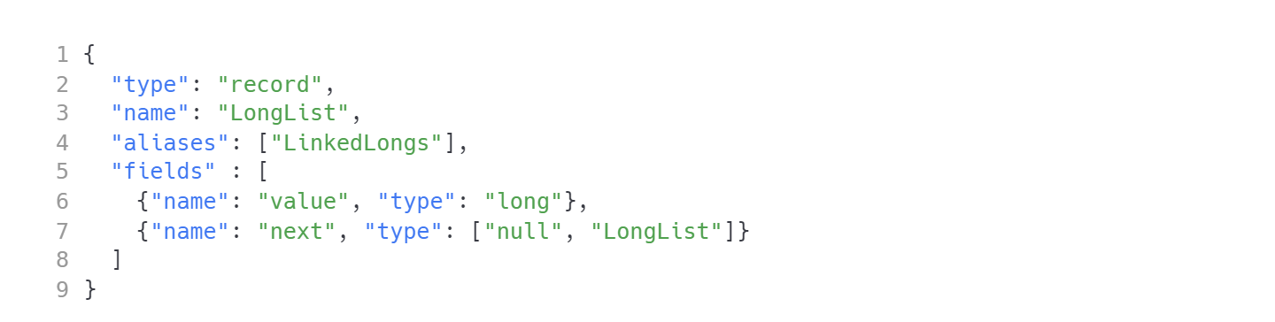
Records
Data formats
Example

Slide 16
Enums
Data formats
Enums use the type name enum and support the following attributes:
name, namespace, aliases, doc
symbols: a JSON array, listing symbols, as JSON strings (required). All symbols in an enum must be unique; duplicates are prohibited. Every symbol must match the regular expression [A-Za-z_][A-Za-z0-9_] (the same requirement as for names).
default: A default value for this enumeration, used during resolution when the reader encounters a symbol from the writer that isn’t defined in the reader’s schema (optional). The value provided here must be a JSON string that’s a member of the symbols array. See documentation on schema resolution for how this gets used.

Slide 17
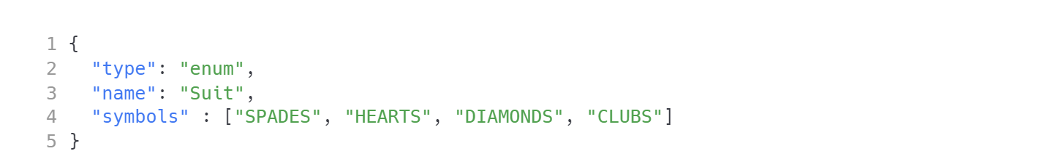
Enums
Data formats
Example

Slide 18
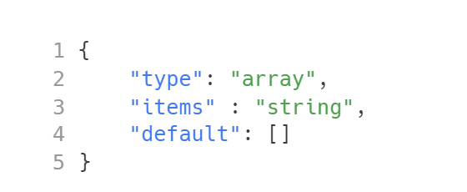
Arrays
Data formats
Arrays use the type name array and support a single attribute:
items: the schema of the array’s items.

Slide 19
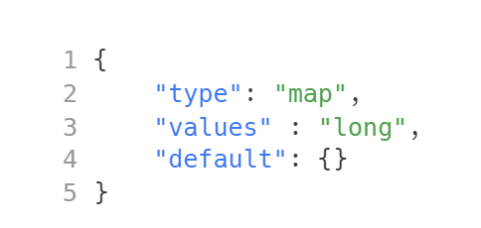
Maps
Data formats
Maps use the type name map and support one attribute:
values: the schema of the map’s values.
Map keys are assumed to be strings.

Slide 20
Unions
Data formats
Unions, are represented using JSON arrays.
For example, ["null", "string"] declares a schema which may be either a null or string.
TIP: Note that when a default value is specified for a record field whose type is a union, the type of the default value must match the first element of the union. Thus, for unions containing null, the null is usually listed first, since the default value of such unions is typically null.

Slide 21
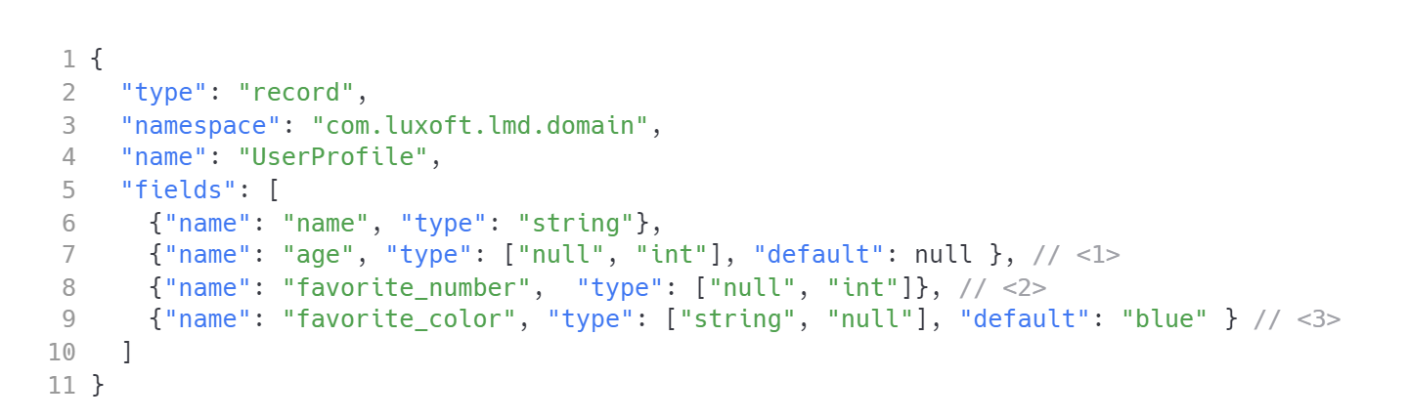
Unions
Data formats
Example
Nullable with default value of null.
Nullable, still required to set a value!
Nullable, but default value is not null, hence different order in the union type.

Slide 22
Fixed
Data formats
Fixed uses the type name “fixed” and supports the following attributes:
name: a string naming this fixed (required).
namespace, a string that qualifies the name (optional);
aliases: a JSON array of strings, providing alternate names for this enum (optional).
size: an integer, specifying the number of bytes per value (required).
For example, 16-byte quantity may be declared with:

Slide 23
Schema evolution and compatibility
Notes:
Please separate the new section of training.
Font requirements:
Title font: Arial (Headings), bold, white, 54 size.

Slide 24
Schema evolution and compatibility
Data formats
Your schema needs to evolve
How do you assure both producers and consumers can work with new modified data format?
https://docs.confluent.io/platform/current/schema-registry/avro.html#schema-evolution-and-compatibility
?

Slide 25
Compatibility types
Data formats
Compatibility Type | Changes allowed | Check against which schemas | Upgrade first
BACKWARD | Delete fields Add optional fields | Last version | Consumers
BACKWARD_TRANSITIVE | Delete fields Add optional fields | All previous versions | Consumers
FORWARD | Add fields Delete optional fields | Last version | Producers
FORWARD_TRANSITIVE | Add fields Delete optional fields | All previous versions | Producers
Notes:
Table example.

Slide 26
Compatibility types
Data formats
Compatibility Type | Changes allowed | Check against which schemas | Upgrade first
FULL | Add optional fields Delete optional fields | Last version | Any order
FULL_TRANSITIVE | Add optional fields Delete optional fields | All previous versions | Any order
NONE | All changes are accepted | Compatibility checking disabled | It depends
Notes:
Table example.

Slide 27
What is Schema Registry?
Data formats
Serving layer for your metadata.
Provides a RESTful interface for storing and retrieving your schemas.
Supports Avro®, JSON Schema, and Protobuf.
Stores a versioned history of all schemas based on a specified subject name strategy
Provides multiple compatibility settings
Allows evolution of schemas according to the configured compatibility settings and expanded support for these schema types.
Provides serializers that plug into Apache Kafka® clients that handle schema storage and retrieval for Kafka messages that are sent in any of the supported formats.

Slide 28
Schema Registry
Data formats
Schema Registry lives outside of and separately from your Kafka brokers.
Your producers and consumers still talk to Kafka to publish and read data (messages) to topics.
Concurrently, they can also talk to Schema Registry to send and retrieve schemas that describe the data models for the messages.

Slide 29
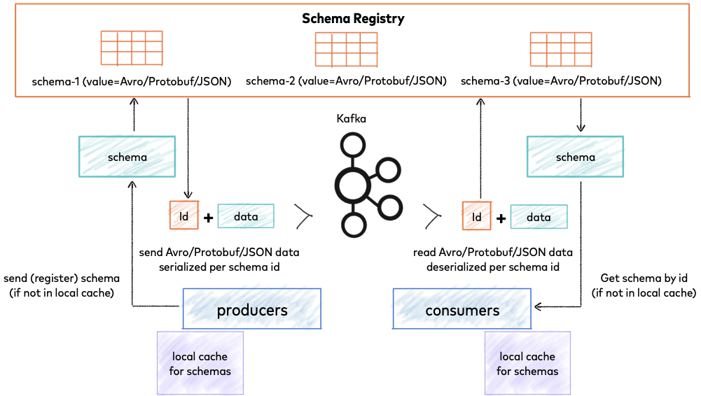
Schema Registry
Data formats

Slide 30
Terminology
Data formats
Name | Description | Example
Topic | A Kafka topic contains messages, and each message is a key-value pair. Either the message key or the message value, or both, can be serialized as Avro, JSON, or Protobuf. | transactions
Schema | A schema defines the structure of the data format. The Kafka topic name can be independent of the schema name. | Payment
Subject | Schema Registry defines a scope in which schemas can evolve, and that scope is the subject. The name of the subject depends on the configured subject name strategy, which by default is set to derive subject name from topic name. | transactions-value

Slide 31
Subject naming strategies
Data formats
io.confluent.kafka.serializers.subject.TopicNameStrategy Derives subject name from topic name. (This is the default.)
io.confluent.kafka.serializers.subject.RecordNameStrategy Derives subject name from record name, and provides a way to group logically related events that may have different data structures under a topic.
io.confluent.kafka.serializers.subject.TopicRecordNameStrategy Derives the subject name from topic and record name, as a way to group logically related events that may have different data structures under a topic.

Slide 32
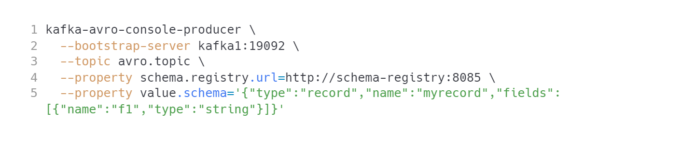
Console producer
Data formats
CAUTION: Avro powered command line clients are not provided by Kafka container!

Slide 33
Console consumer
Data formats
CAUTION: Avro powered command line clients are not provided by Kafka container!

Slide 34
Kafka Clients + Avro + Schema Registry
Data formats
create a Spring Boot application
add dependencies (at the beginning of this section)
author your schemas and put them into `src/main/avro`
build your project and check if Avro builder classes have been generated

Slide 35
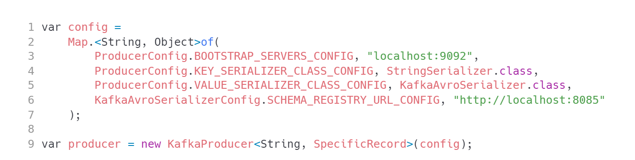
Avro powered producer
Data formats
NOTE: You can create a KafkaProducer<String,GenericRecord> and use it without code generation.

Slide 36
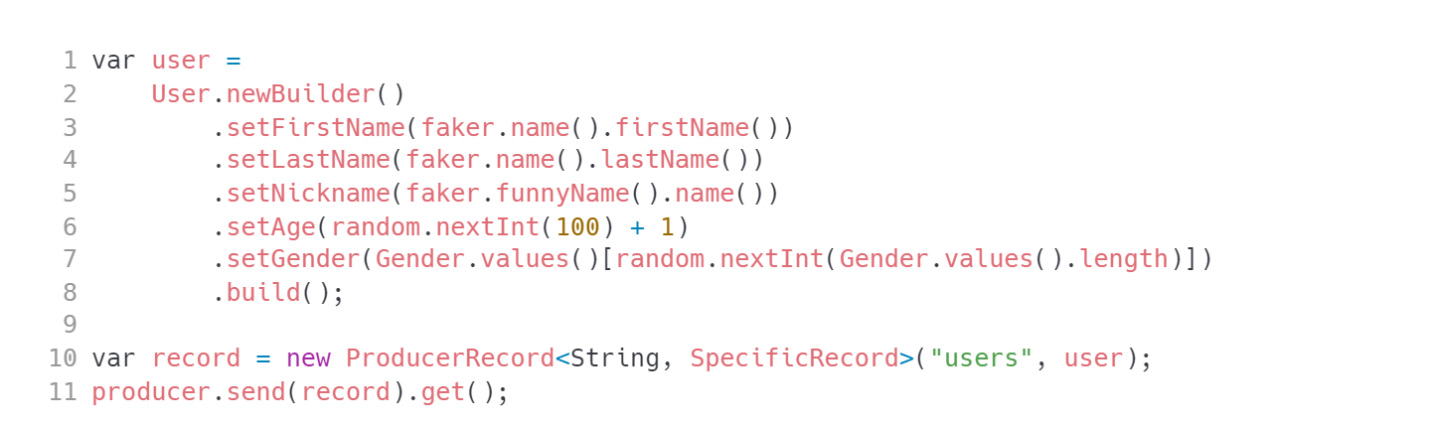
Send the data
Data formats

Slide 37
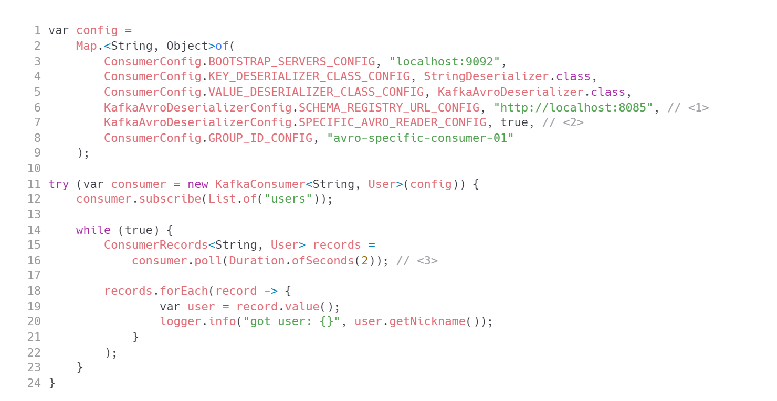
Avro powered consumer
Data formats
Set up schema registry location.
Specify whether you want to work with a GenericRecord or SpecificRecord subclass.
Consume as usual with strongly typed payload.

Slide 38
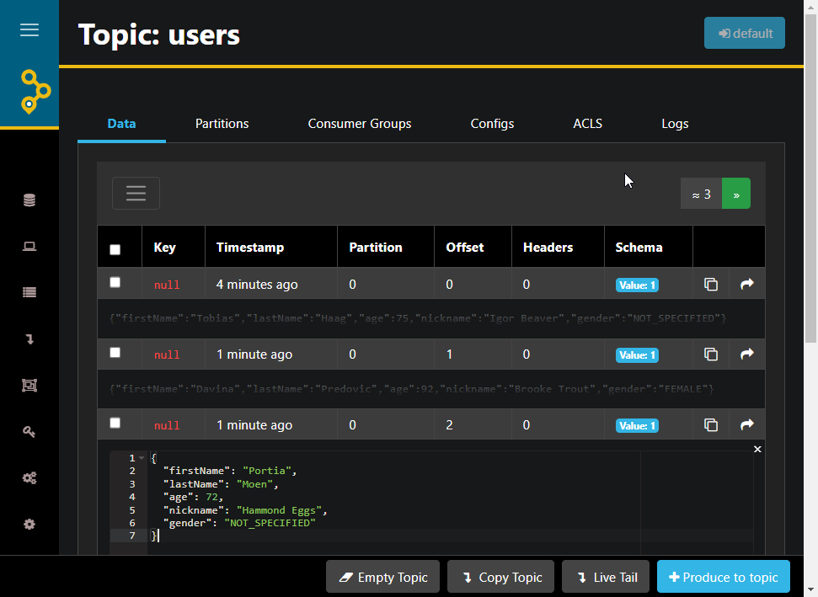
AKHQ support for schema registry
Data formats
Message keys/values are automatically decoded from Avro and presented in JSON format

Slide 39
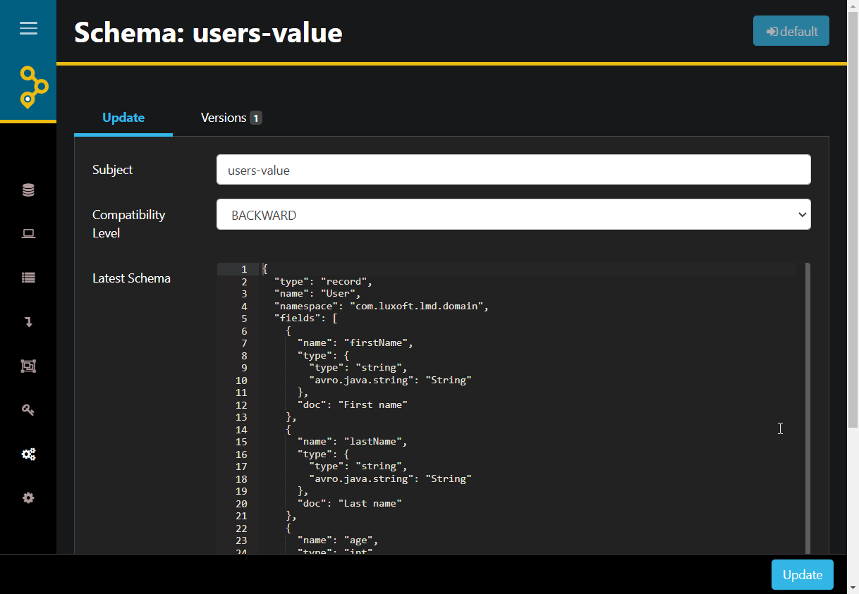
AKHQ support for schema registry
Data formats
Subject compatibility level can be set up.
Schema can be modified in-place.
The Update action will check if requested schema modifications are allowed by compatibility level chosen,

Slide 40
Links
Schema registry reference:
https://docs.confluent.io/platform/current/schema-registry/serdes-develop/index.html
Detailed external demo:
https://github.com/lydtechconsulting/kafka-schema-registry-avro/tree/v1.0.0
Multiple events in the same topic:
https://docs.confluent.io/platform/current/schema-registry/serdes-develop/serdes-avro.html#multiple-event-types-in-the-same-topic

Slide 41


Questions?
41
Notes:
The final slide of the course is for answers to any remaining questions of participants.
Font requirements:
Title font: Arial (Headings), bold, white, 60 size.

Slide 42
Thank you!
Please share your feedback. Your opinion is important to us!
Notes:
The final slide of the course is for answers to any last questions of the participants.
Font requirements:
Title font: Arial (Headings), bold, white, 54 size.

