Slide 1
Module 6: Spring for Kafka
JVA-083

Slide 2
What will we cover?
Spring For Kafka
Topic creation
Using KafkaTemplate
@EventListener
configuring Kafka client from application.yml
configuring Kafka clients from code
handling concurrency
JSON support
Avro support
Transactions
implementing processors
ReplyingKafkaTemplate - request/response pattern
Error handling, retries

Slide 3
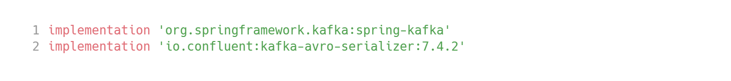
Dependencies
Spring For Kafka

Slide 4
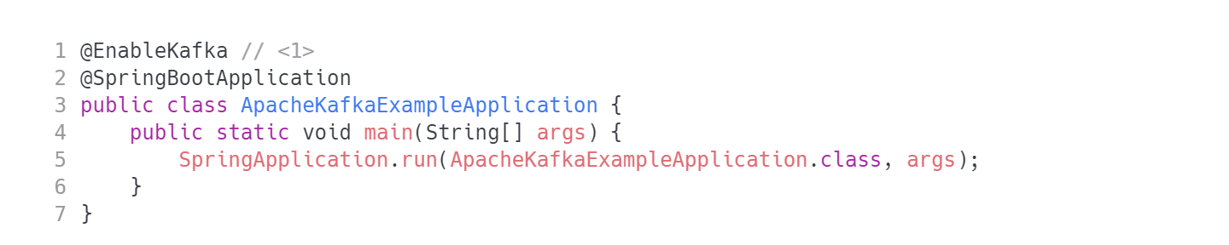
Setup
Spring For Kafka
1. @EnableKafka triggers Kafka beans and annotations discovery

Slide 5
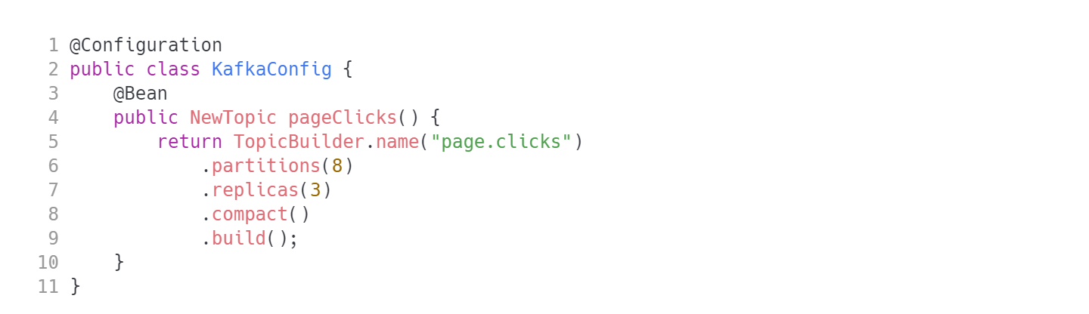
Topic creation
Spring For Kafka
Create topics using builder pattern
WARNING: watch out - Spring will automatically populate configuration changes to the message broker. Changing the number of partitions might be devastating for your system.

Slide 6
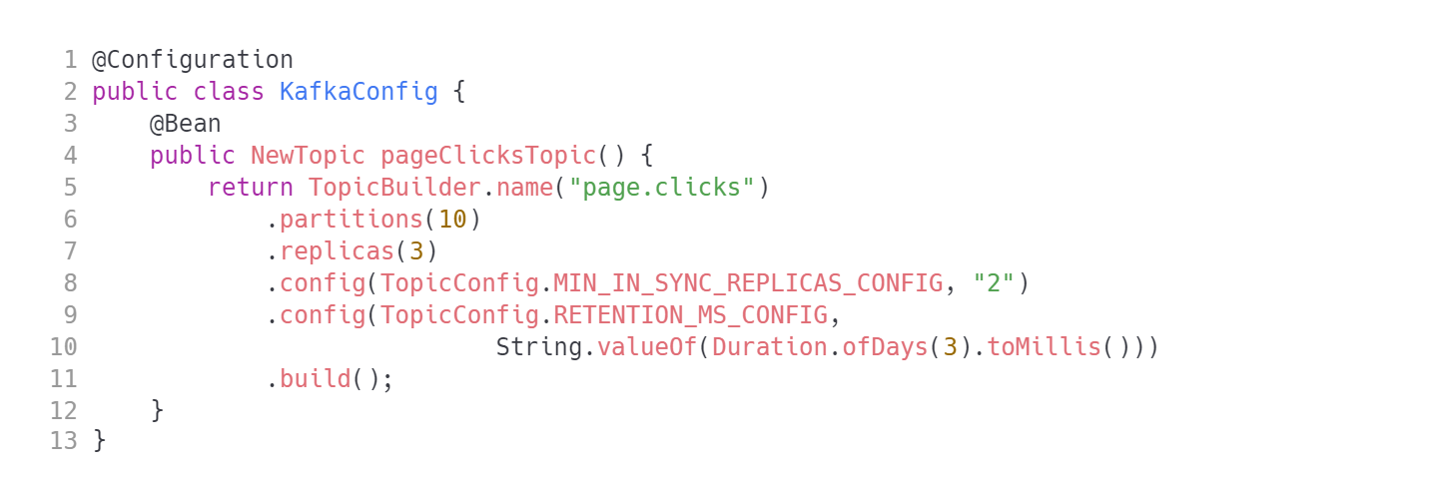
Topic creation
Spring For Kafka
Create topics using builder pattern
TIP: Only a small portion of configuration is exposed as type-safe API. Still you can simply provide additional configuration entries using properties.

Slide 7
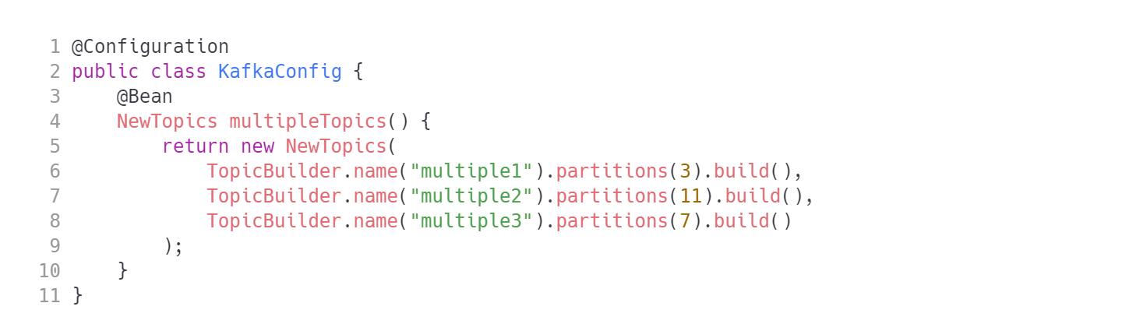
Topic creation
Spring For Kafka
Create topics using builder pattern
TIP: If you do not want to clutter your Spring context with multiple topic beans - create just one bean of type NewTopics (plural).

Slide 8
Sending messages
Spring For Kafka
JSON support
Avro support
Transactions
implementing processors
ReplyingKafkaTemplate - request/response pattern
Error handling, retries
Use KafkaTemplate
Inject a KafkaTemplate<String,String>
Use one of overloaded kafkaTemplate.send() variant that resembles ProducerRecord constructor.
All send() variants return CompletableFuture. Yay!

Slide 9
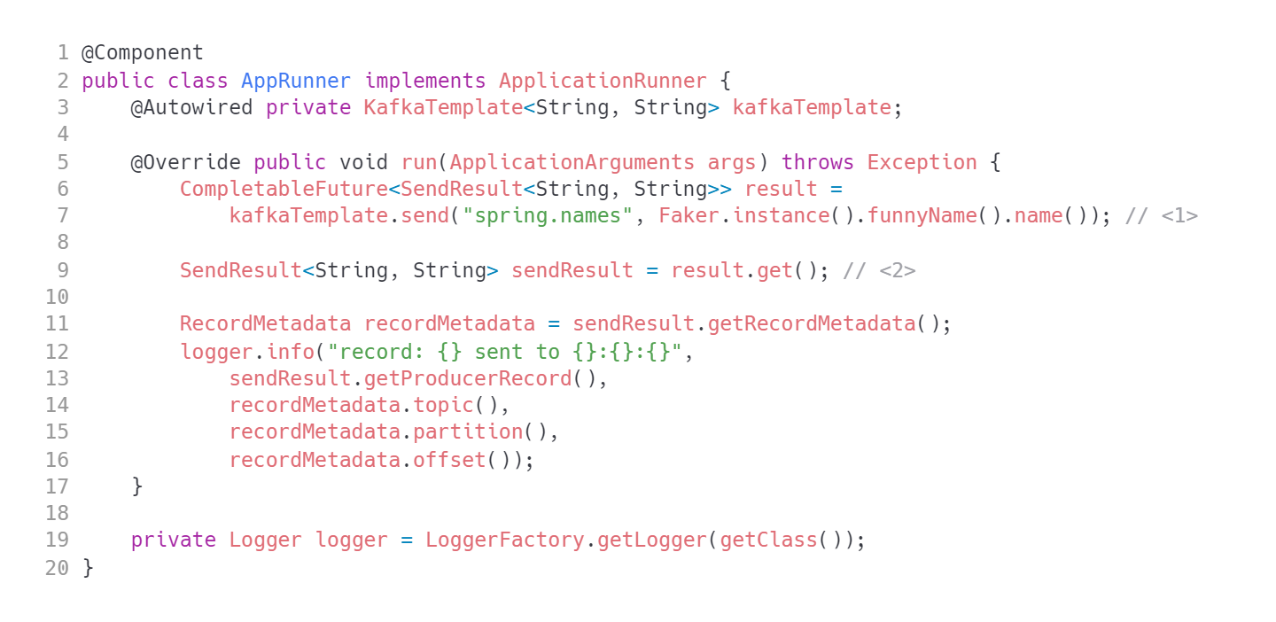
KafkaTemplate
Spring For Kafka
Check other .send() method variants
SendResult contains both ProducerRecord created and RecordMetadata returned.

Slide 10
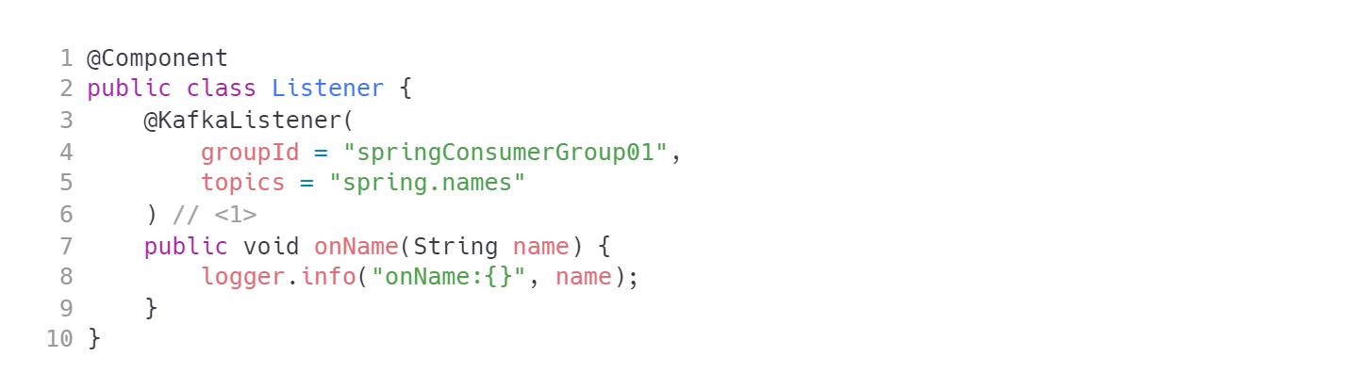
@KafkaListener
Spring For Kafka
Receive simple message
The listener has to be registered in any spring bean. This may be a @Component or a @Configuration.
TIP: the parameter type for handler method needs to match value deserializer configured.

Slide 11
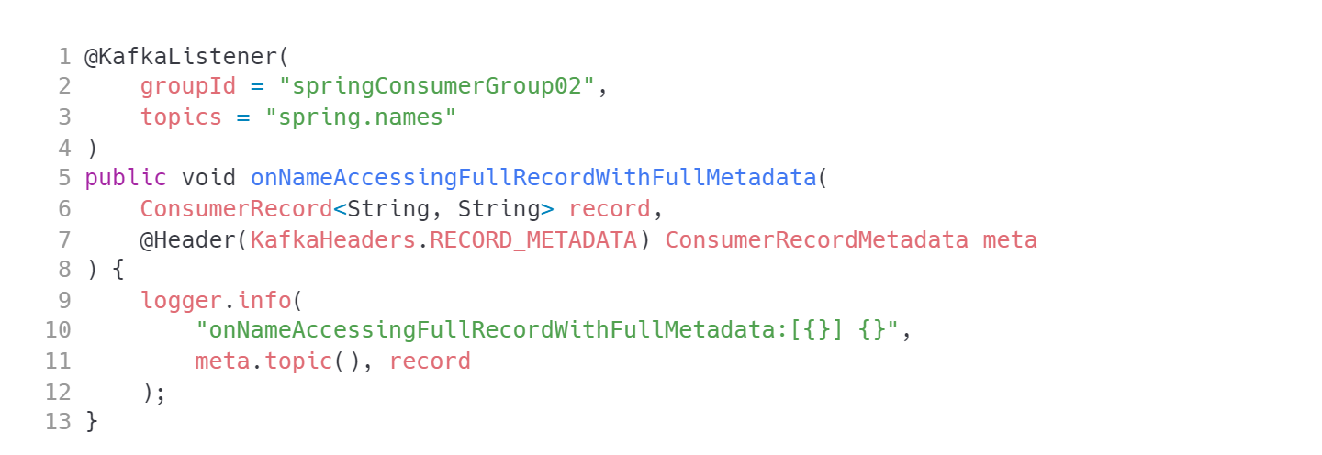
@KafkaListener
Spring For Kafka
If you require more than a payload injected - specify the method signature accordingly.
TIP: you can inject various data into handler method using @Header annotation. Consult KafkaHeaders class for possible options.

Slide 12
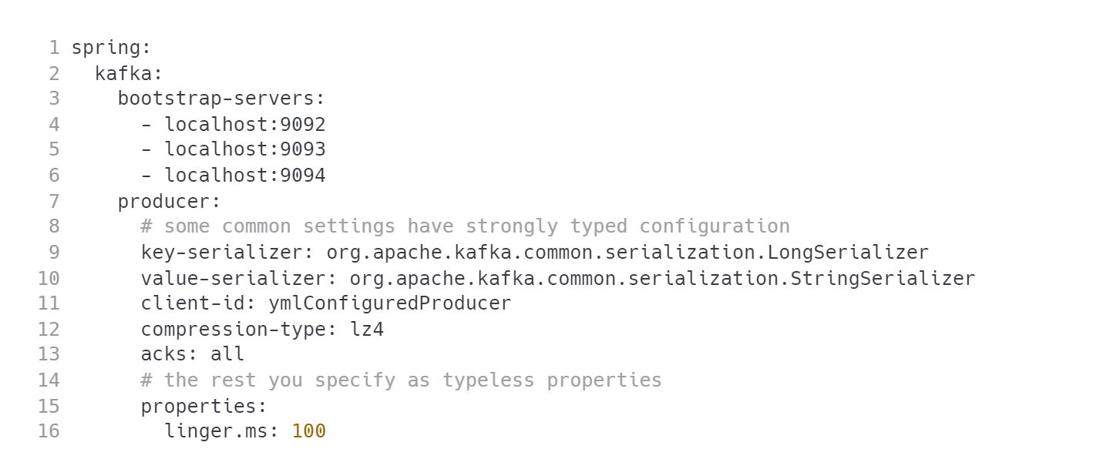
Configuring the producer
Spring For Kafka
Try to configure as much as possible in properties/yaml and not code.

Slide 13
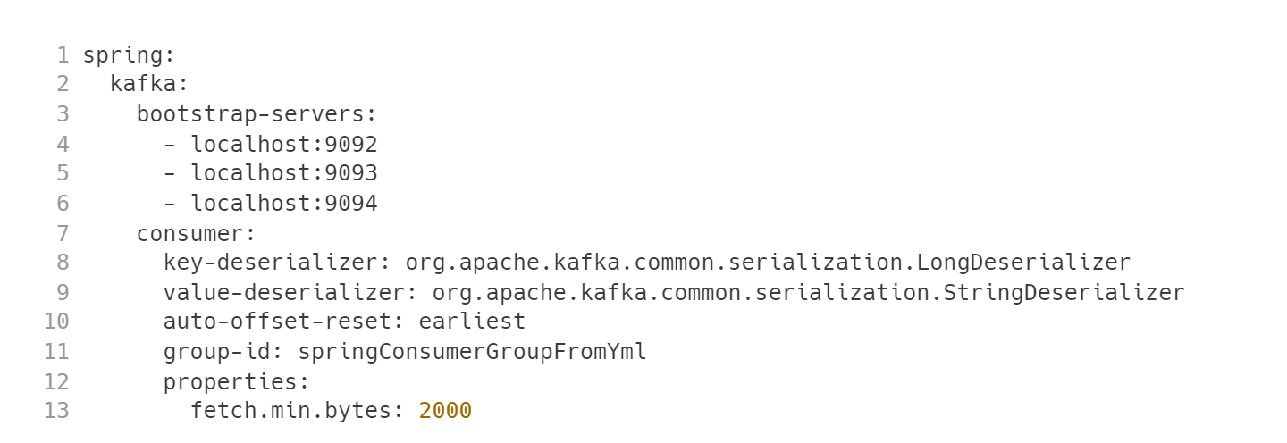
Configuring the consumer
Spring For Kafka
application.yml

Slide 14
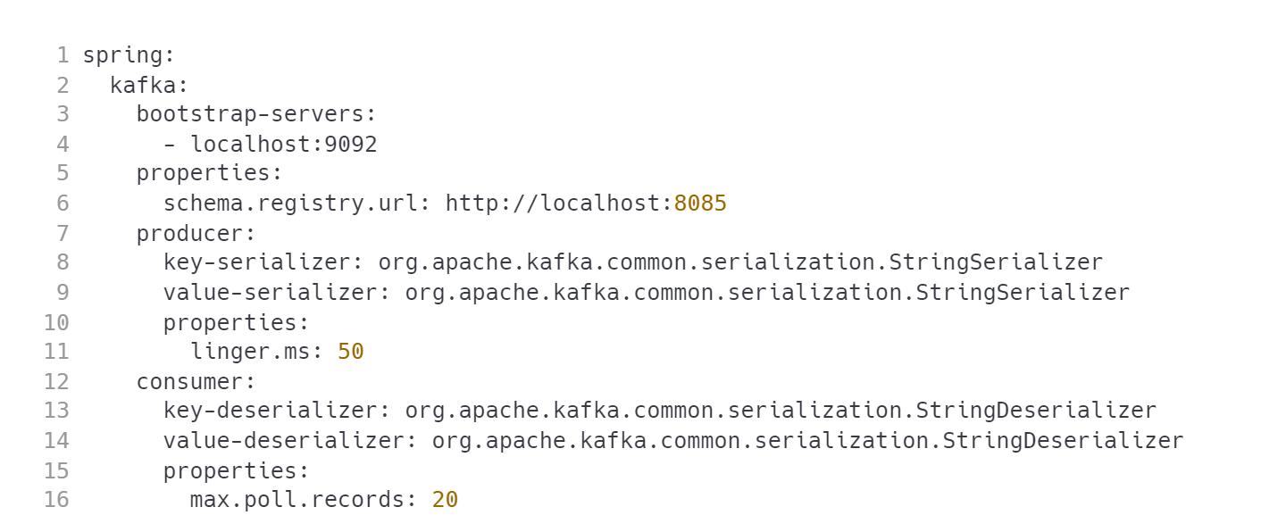
App configuration
Spring For Kafka
Is your app both the consumer and producer? No problem!

Slide 15
Shall we try?
Spring For Kafka
JSON support
Avro support
Transactions
implementing processors
ReplyingKafkaTemplate - request/response pattern
Error handling, retries
Use aformentioned code patterns to consume events in your own application!
TODO: describe the task

Slide 16
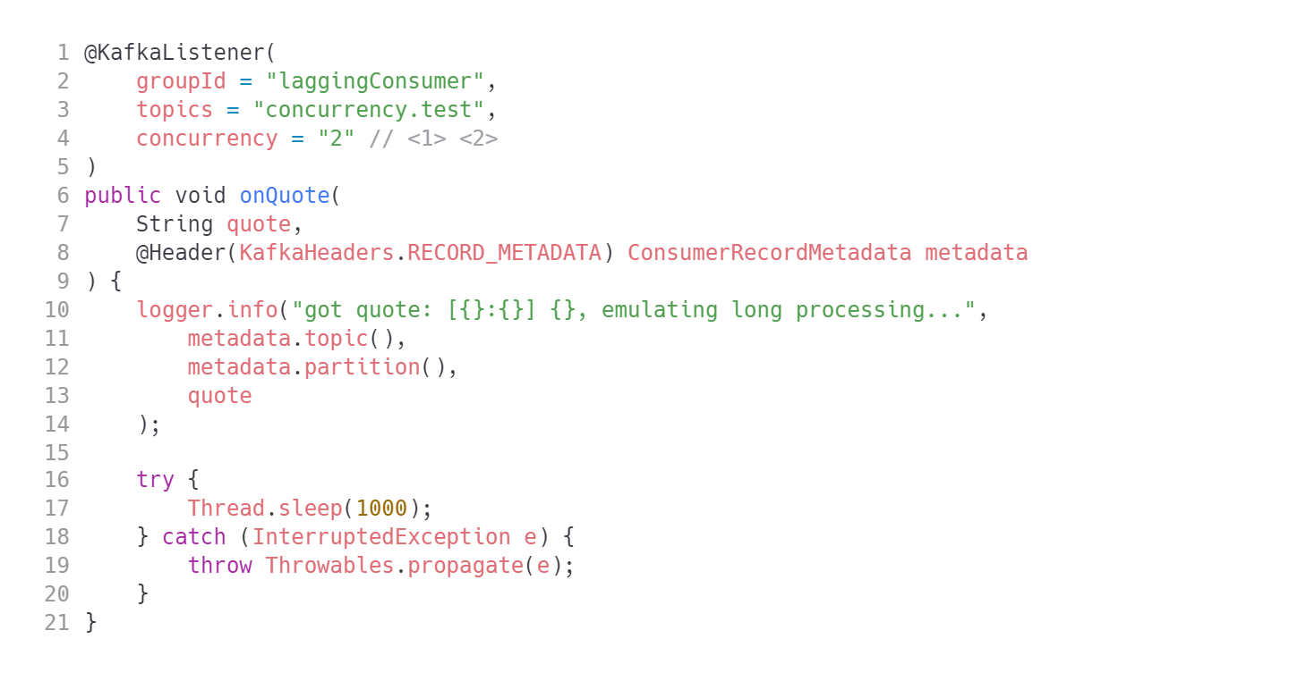
Handling concurrency
Spring For Kafka
Concurrency enabled at @KafkaListener annotation level. This can be set up in different places but this one is the easiest.
No need to manage the lifecycle of multiple consumers - Spring will do it for you.
QUESTION: When would you run multiple instances and when would you enable concurrency at app level?

Slide 17
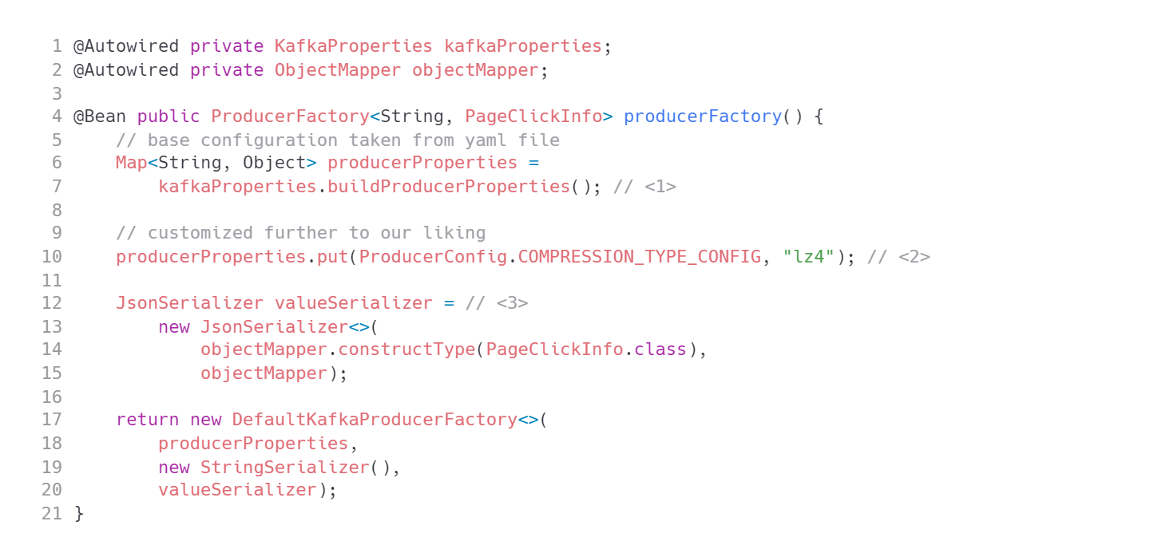
Custom KafkaTemplate
Spring For Kafka

Slide 18
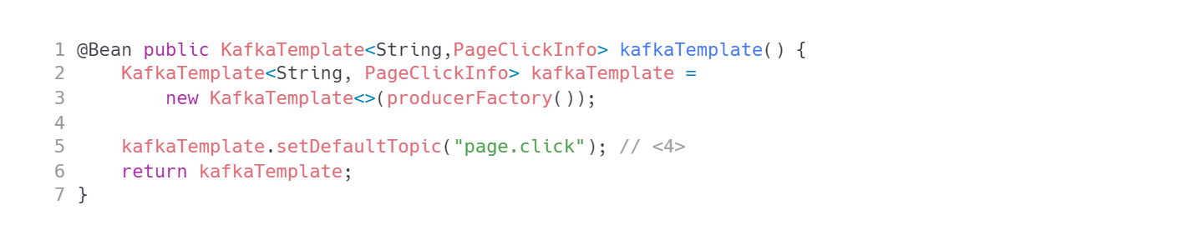
Custom KafkaTemplate
Spring For Kafka
TIP: if you set a default topic at the level of KafkaTemplate you can use kafkaTemplate.sendDefault(message)

Slide 19
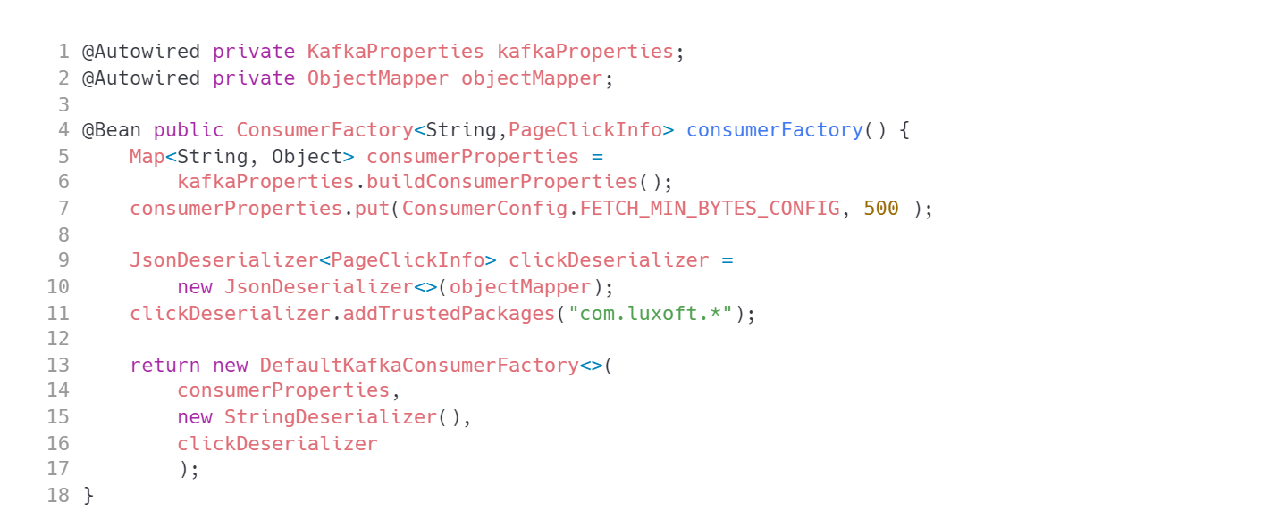
Customizing the listener
Spring For Kafka

Slide 20
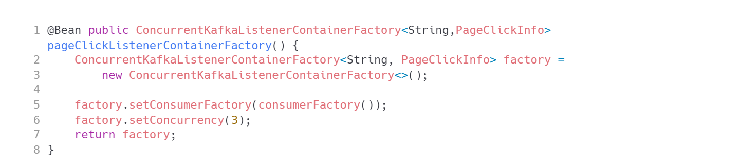
Customizing the listener
Spring For Kafka

Slide 21
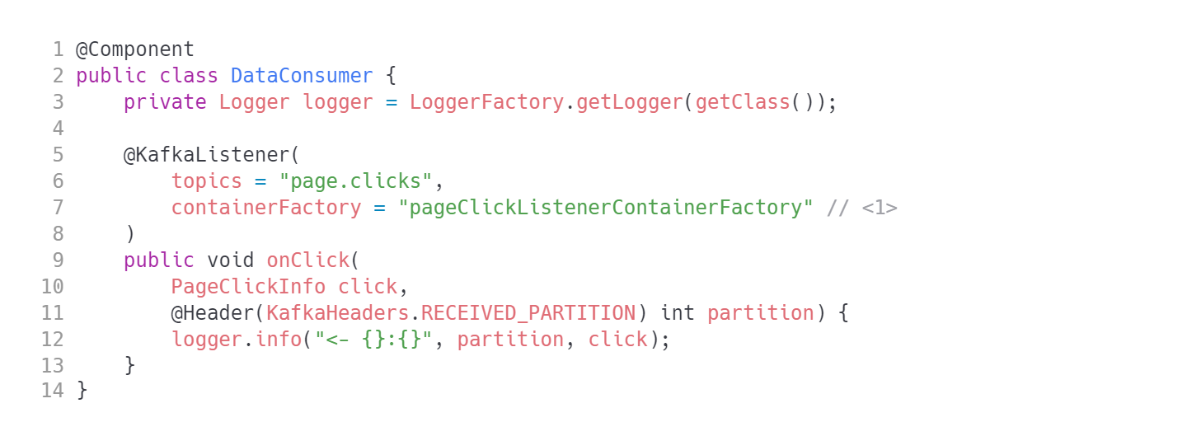
We can listen for strongly typed events
Spring For Kafka
1. Specify name of the listener container factory

Slide 22
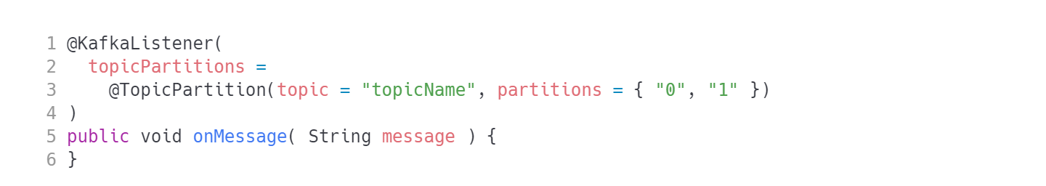
Alternative configs
Spring For Kafka

Slide 23
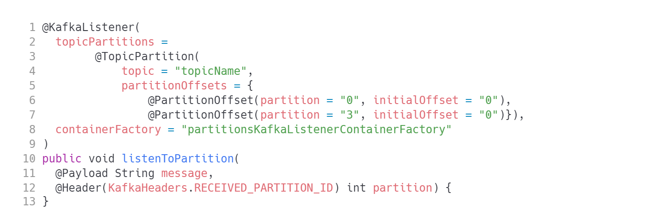
Alternative configs
Spring For Kafka
TIP: this config will reread same data over and over (initialOffset being static)
TIP: Check KafkaHeaders what other fields can you inject.

Slide 24
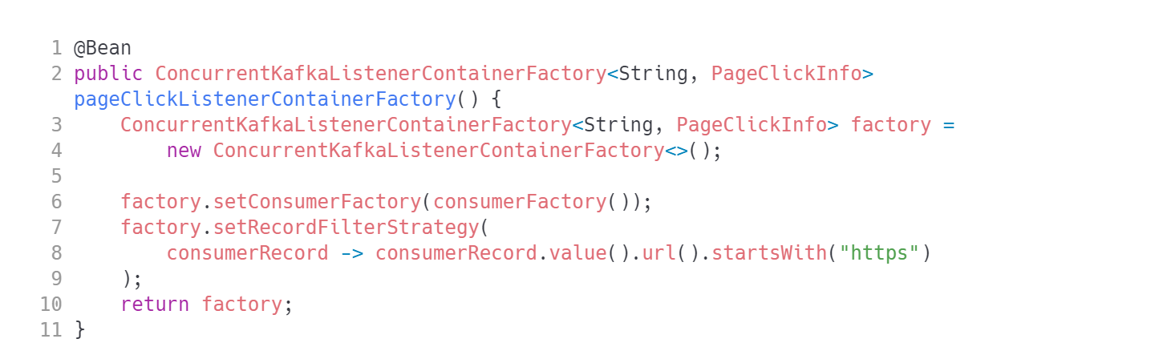
Filtering messages
Spring For Kafka

Slide 25
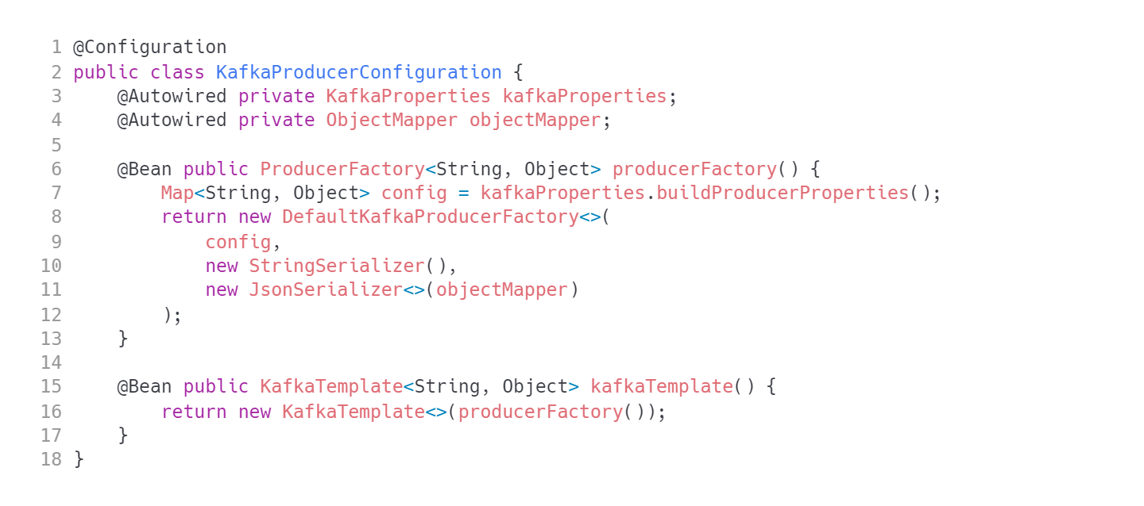
Handling multiple data types in one topic
Spring For Kafka
Nothing fancy on the producing side…

Slide 26
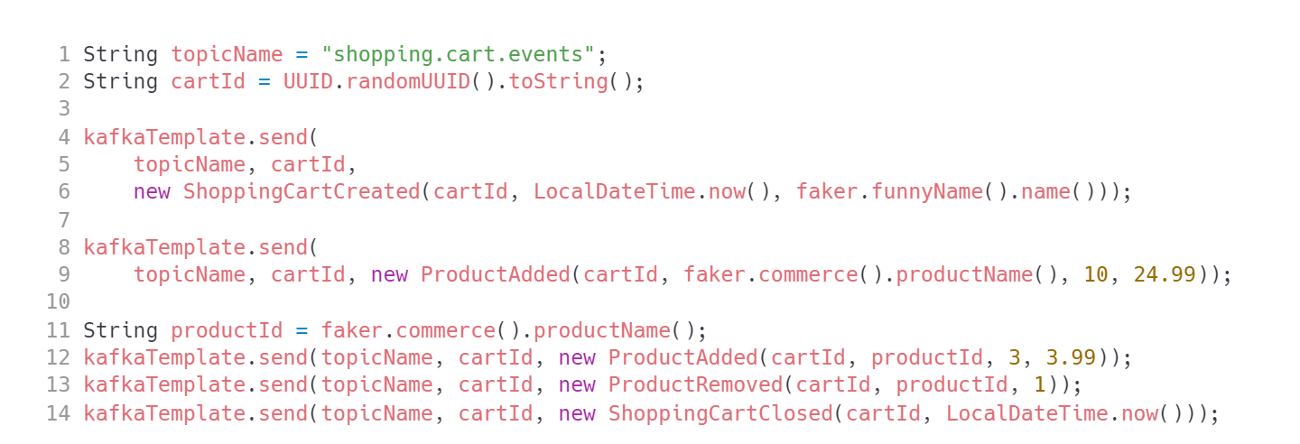
Handling multiple data types in one topic
Spring For Kafka

Slide 27
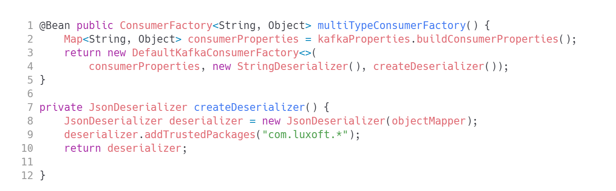
Handling multiple data types in one topic
Spring For Kafka
Consumer configuration

Slide 28
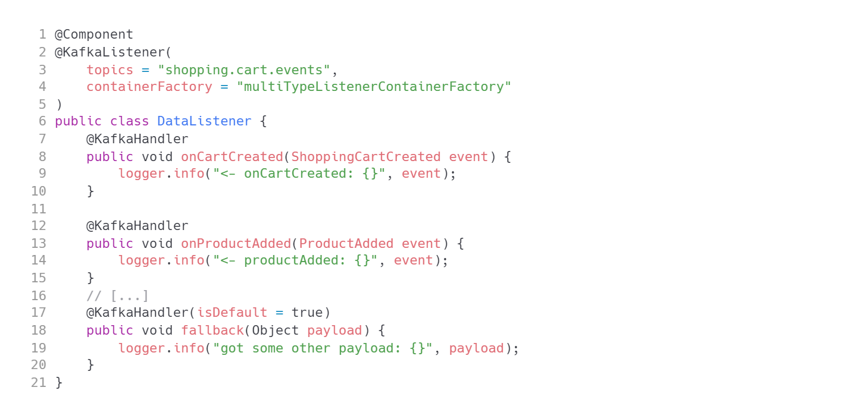
Handling multiple data types in one topic
Spring For Kafka
@KafkaListener at class level
Multiple @KafkaHandler annotated methods

Slide 29
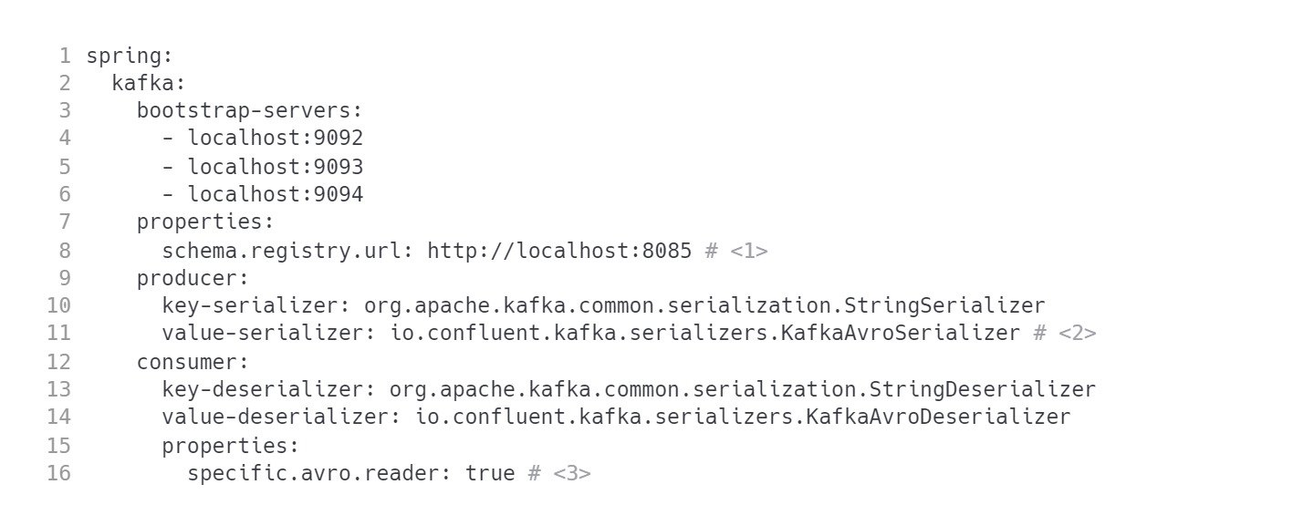
Avro support
Spring For Kafka
Configure the location of Schema Registry.
Use proper serializers and deserializers.
Reading side usually wants to use SpecificRecord subclasses instead of GenericRecord.

Slide 30
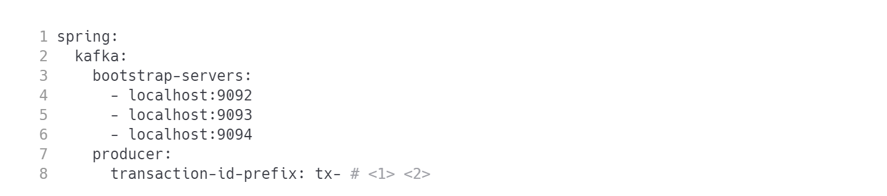
Transactional producer
Spring For Kafka
Finally easy with Spring
Managing transactional.id in Java Client API has it's challenges. It has been changed to transaction-id-prefix in Spring for Kafka.
This automatically introduces KafkaTransactionManager and allows to use well known @Transactional.

Slide 31
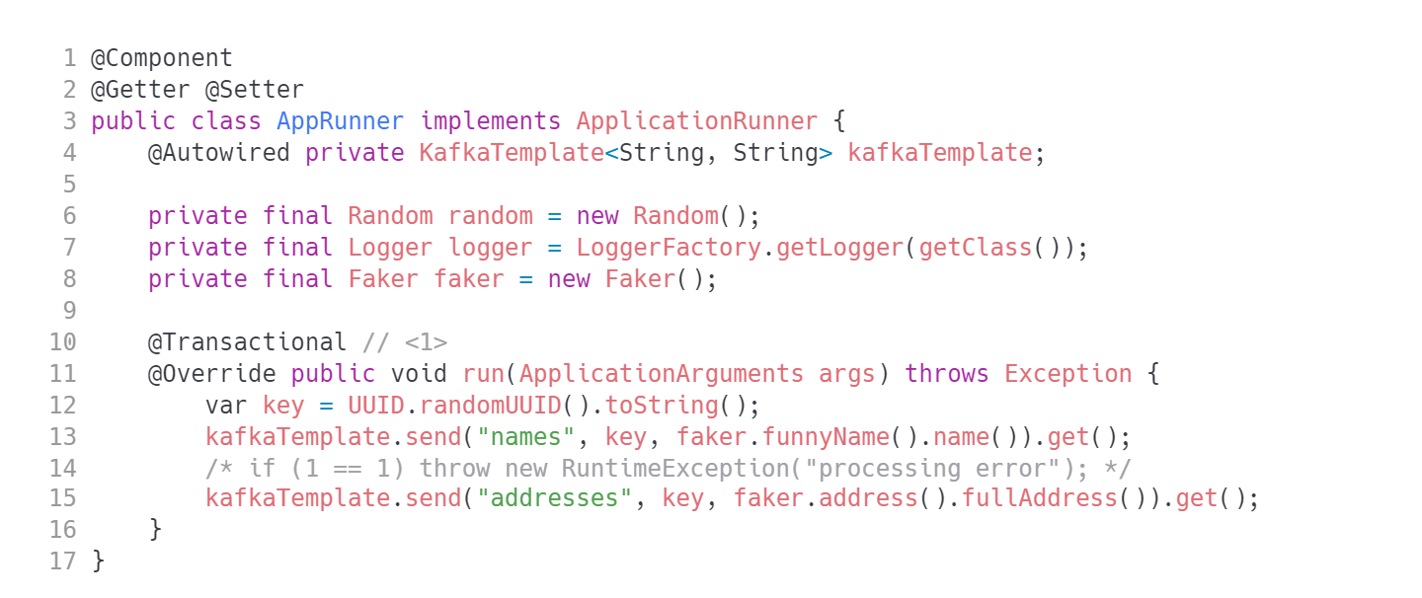
Transactional producer
Spring For Kafka
That is it. Use well known pattern for managing transactions in Spring apps
CAUTION: What if you need both a database and Kafka commit?

Slide 32
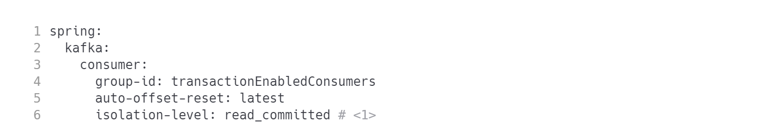
Transactional aware consumer
Spring For Kafka
application.yml
Remember that you consumer needs to know if records are published using transactions or else you will encounter dirty reads.

Slide 33
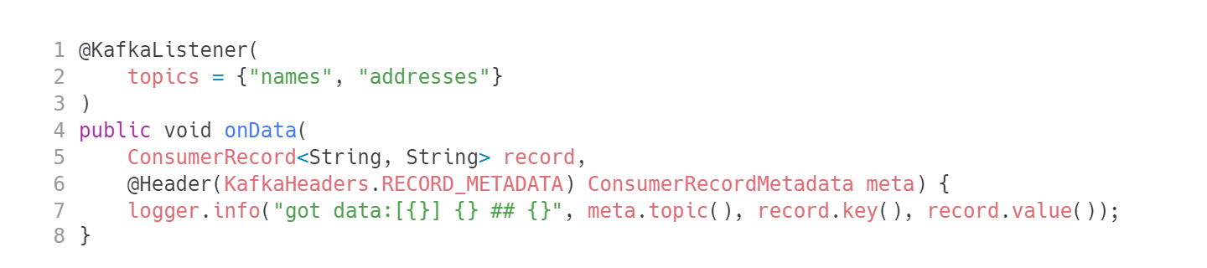
Transactional aware consumer
Spring For Kafka
No difference in Java code though.
WARNING: check out what happens if you don't set a proper isolation.level. Why is that?

Slide 34
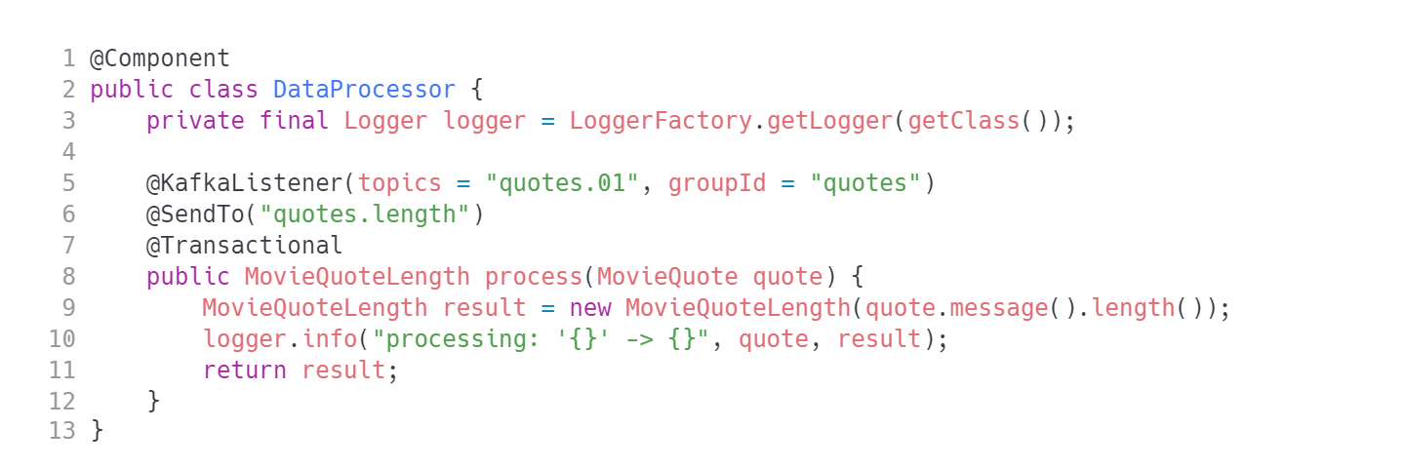
Transactional processor
Spring For Kafka
If you want to use @SendTo in more elaborate setups configure the ConcurrentKafkaListenerContainerFactory.replyTemplate with a KafkaTemplate to perform the send.
Simple setups work out of the box.

Slide 35
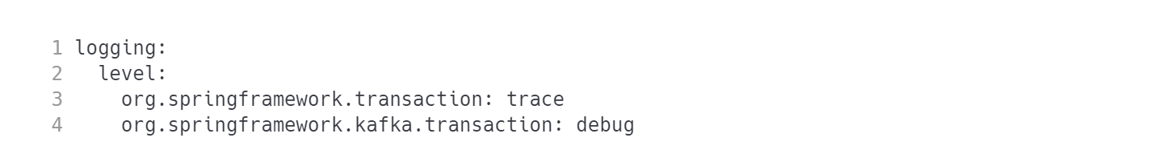
Debugging transactions
Spring For Kafka
application.yml

Slide 36
ReplyingKafkaTemplate
Spring For Kafka
An automatic request/response infrastructure. Let's set it up.

Slide 37
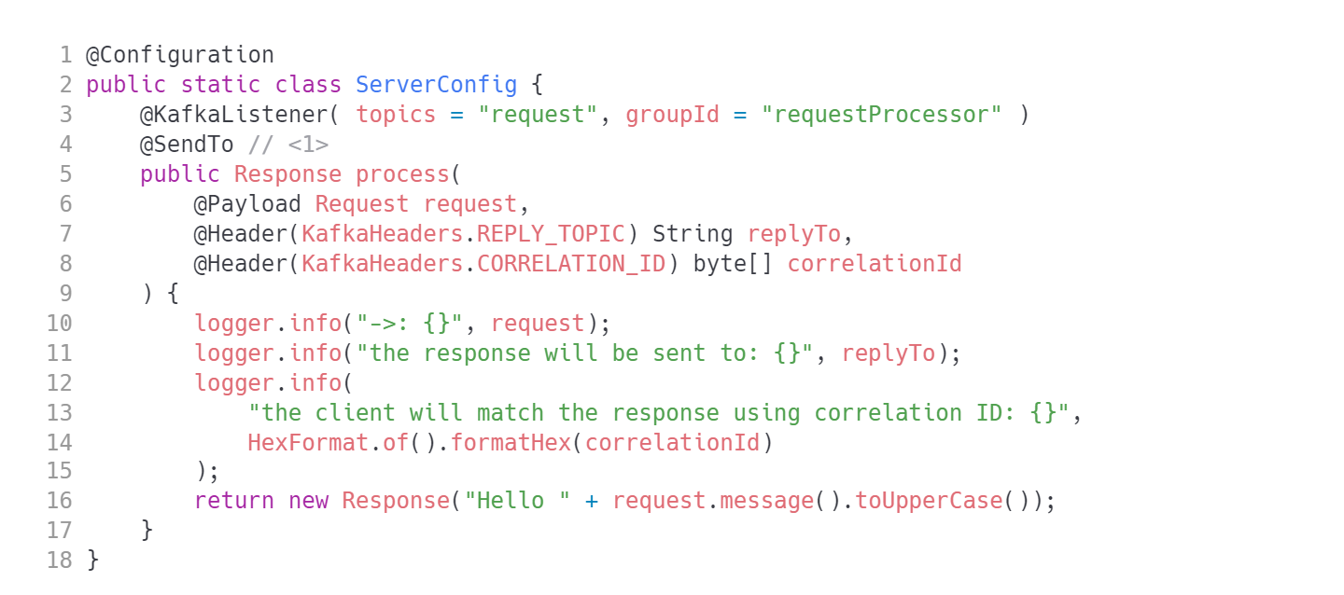
ReplyingKafkaTemplate
Spring For Kafka
CAUTION: watch out for concurrent access. Make sure your apps are co-partitioned.
TIP: Yes, you can make it transactional. Probably you should!

Slide 38
ReplyingKafkaTemplate
Spring For Kafka
The client side requires more preparation.
The client is both:
the producer (produces Request events)
the consumer of ` events.
We need to configure a special KafkaTemplate variant that has a listening container attached. This is org.springframework.kafka.requestreply.ReplyingKafkaTemplate.

Slide 39
ReplyingKafkaTemplate
Spring For Kafka
The client side requires more preparation.
The client is both:
the producer (produces Request events)
the consumer of ` events.
We need to configure a special KafkaTemplate variant that has a listening container attached. This is org.springframework.kafka.requestreply.ReplyingKafkaTemplate.

Slide 40
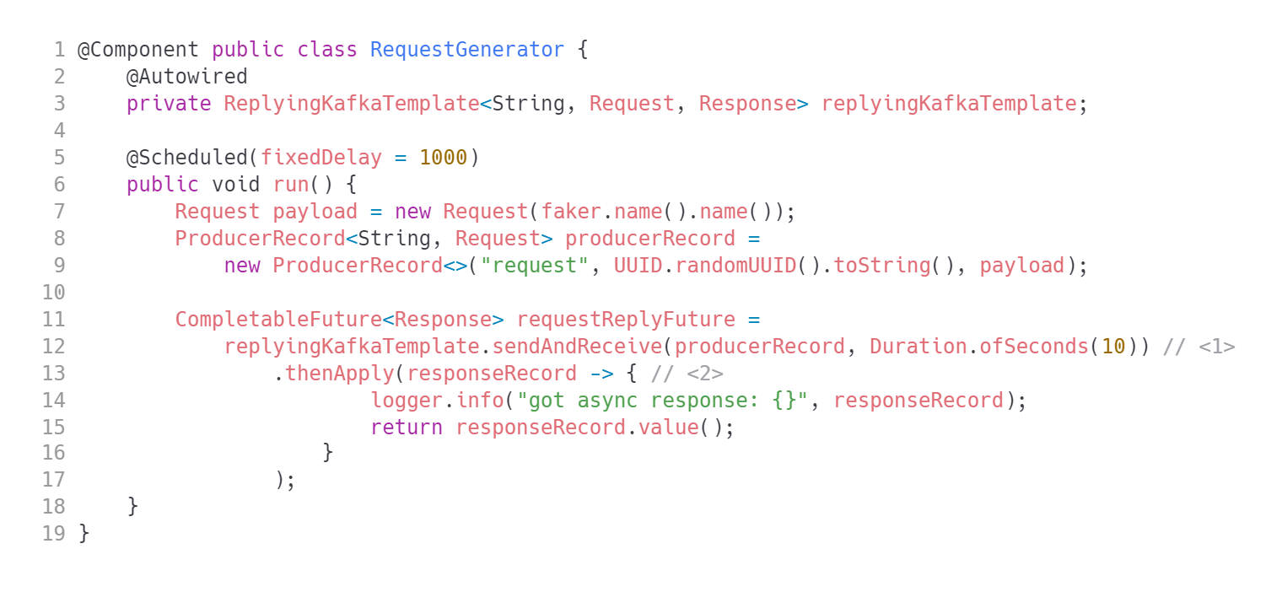
ReplyingKafkaTemplate
Spring For Kafka
We can wait only this much for response.
The result is a ListenableFuture. You can use thenApply to chain result processing.

Slide 41
ReplyingKafkaTemplate
Spring For Kafka
You need to setup the ReplyingKafkaTemplate itself.
The code is too lengthy for a slide.
Let’s inspect the configuration in example project directly.

Slide 42
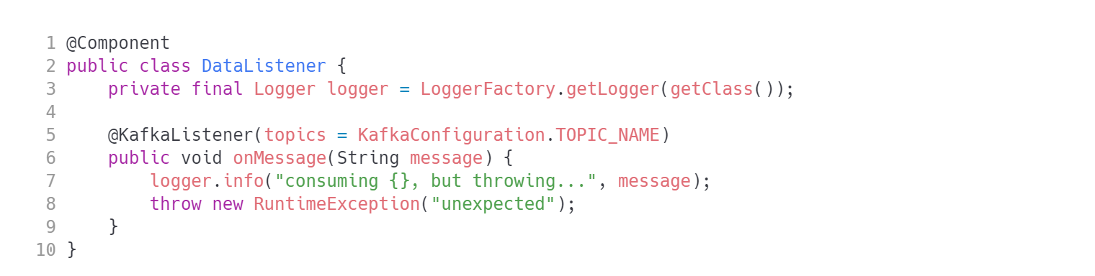
Error handling
Spring For Kafka
There are multiple causes of exceptions in event processing. The most common is the processing logic itself.

Slide 43
Error handling
Spring For Kafka
Spring is managing exceptions using an error handler attached to a listener container.
Historically there were two different error handlers (one for single messages, one for batches). Currently all error handling logic starts from org.springframework.kafka.listener.CommonErrorHandler interface.
org.springframework.kafka.listener.DefaultErrorHandler is the default implementation.

Slide 44
Error handling
Spring For Kafka
Default configuration
If you do not specify custom error handling logic, the default behavior boils down to:
the record is redelivered to the application 10 times,
there is no delay between redeliveries,
the record which failed to get processed is logged and dropped,
error handling logic is preventing subsequent records to be processed.

Slide 45
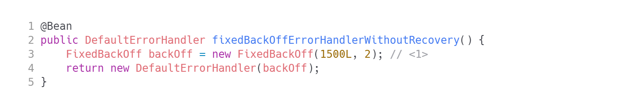
Error handling
Spring For Kafka
Basic configuration
For basic customization register a @Bean implementing CommonErrorHandler
2 retries with 1.5s delay

Slide 46
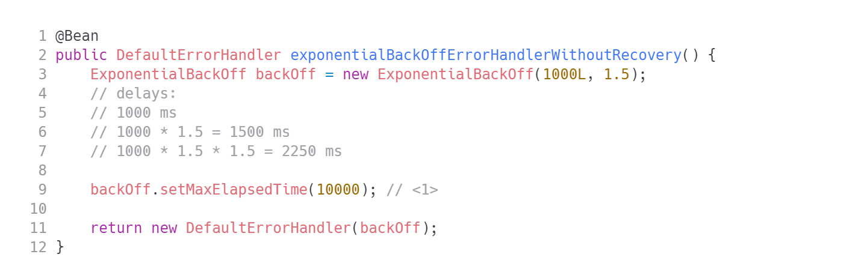
Error handling
Spring For Kafka
Exponential backoff
No more than 10s for all message retries. You can also use backOff.setMaxInterval for controlling max wait time between retries.
TIP: What is exponential back off good for?

Slide 47
Error handling
Spring For Kafka
Custom recovery
Message logging and dropping might not be acceptable for your use case. You may implement a custom recovery logic.
A common pattern is using a dead letter topic - you publish the problematic record to a new topic and skip it.
The follow up is to analyze the problematic message (enriched with cause, stacktrace) in dead letter topic later on and keep event processing not interrupted.

Slide 48
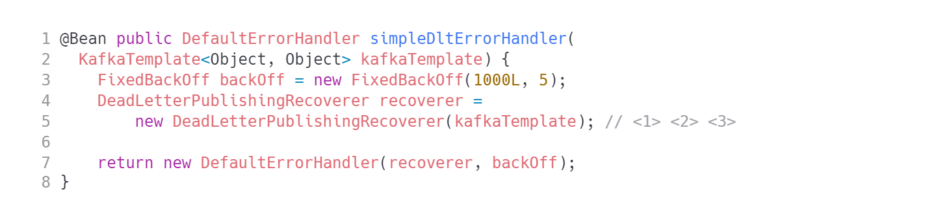
Error handling
Spring For Kafka
DeadLetterPublishingRecoverer
The recoverer is a producer, so it needs a KafkaTemplate instance.
The topic name will be <originalTopicName>.DLT
The message will be published to the same partition number, so DLT needs to have at least the same number of partitions as original topic.
TIP: The recoverer publishes the record to DLT wit a lot of additional metadata helping to pinpoint the problem.

Slide 49
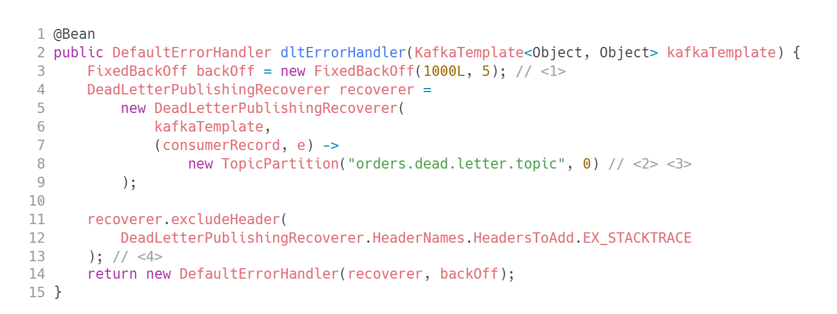
Error handling
Spring For Kafka
DeadLetterPublishingRecoverer – more control

Slide 50
Links
Spring For Kafka
Good demo: https://github.com/eugenp/tutorials/tree/master/spring-kafka
Kafka transactions: https://piotrminkowski.com/2022/10/29/kafka-transactions-with-spring-boot/
Outbox pattern: https://debezium.io/blog/2019/02/19/reliable-microservices-data-exchange-with-the-outbox-pattern

Slide 51


Questions?
51
Notes:
The final slide of the course is for answers to any remaining questions of participants.
Font requirements:
Title font: Arial (Headings), bold, white, 60 size.

Slide 52
Thank you!
Please share your feedback. Your opinion is important to us!
Notes:
The final slide of the course is for answers to any last questions of the participants.
Font requirements:
Title font: Arial (Headings), bold, white, 54 size.

