Slide 1

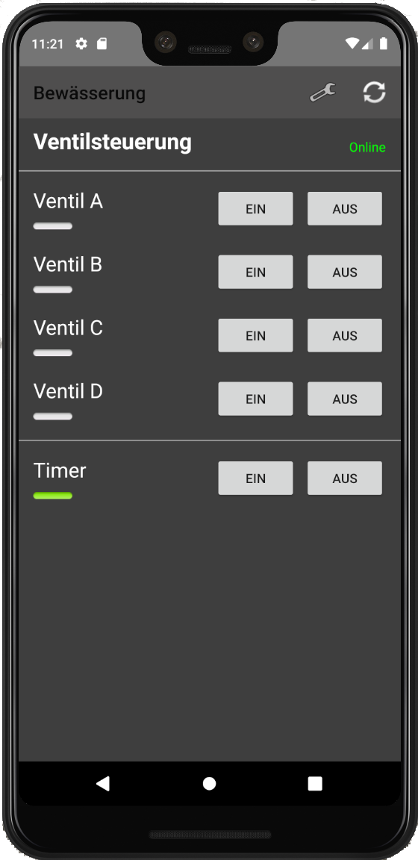
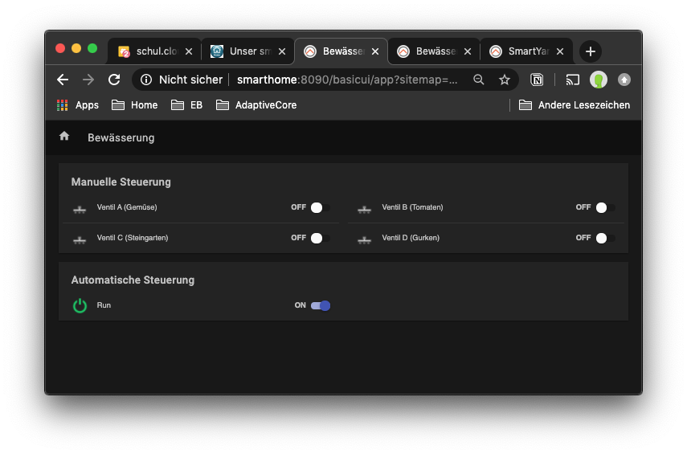
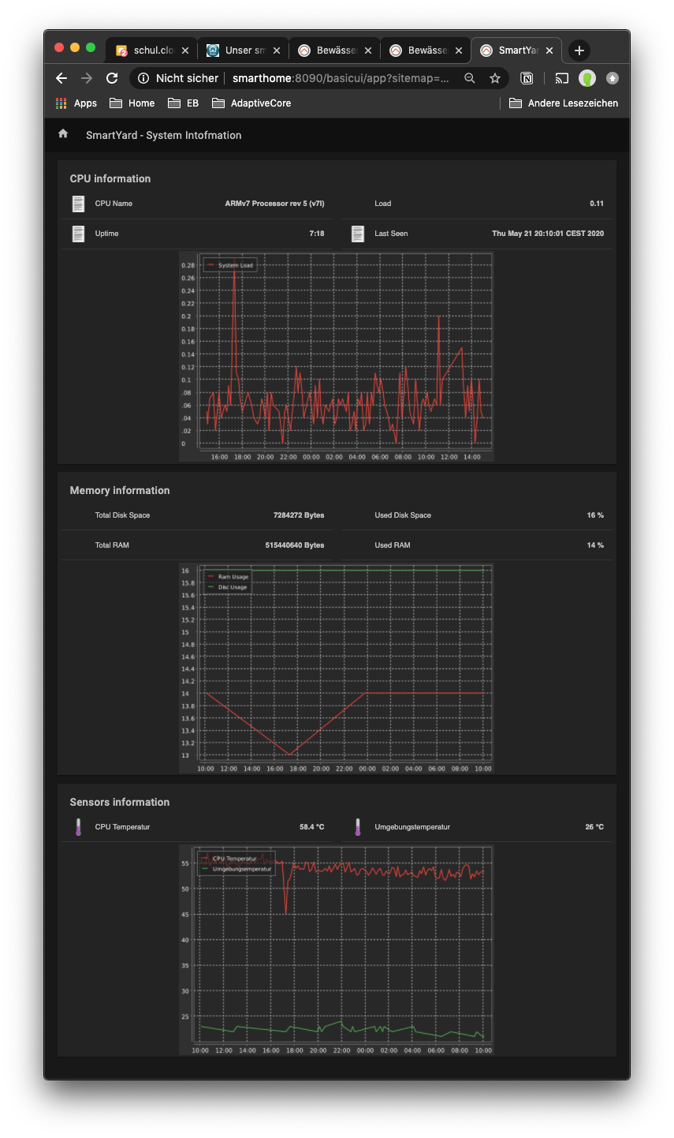
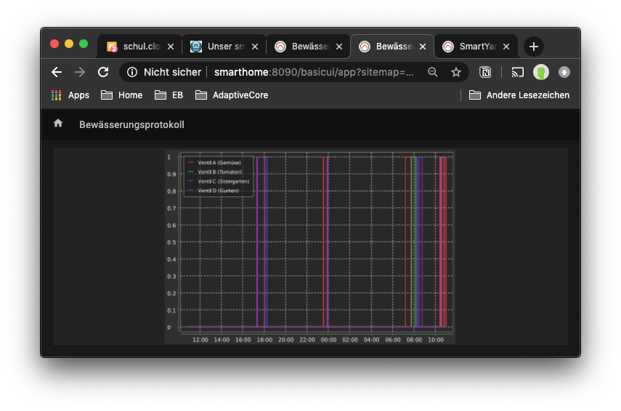
Android App
Remote control of irrigation valves
Secure Connection
(4G/WiFi)
Public MQTT Broker
Private MQTT Broker „Yard“
Private MQTT Broker „Home“
Secure Bridge
(4G)
Secure Bridge
(DSL)
Home Server
Remote control of irrigation valves
Monitoring of operation
Statistics
Yard Server
Switching Valves
Reporting sensor Data
openHAB
valveControl
MariaDB

