Slide 1
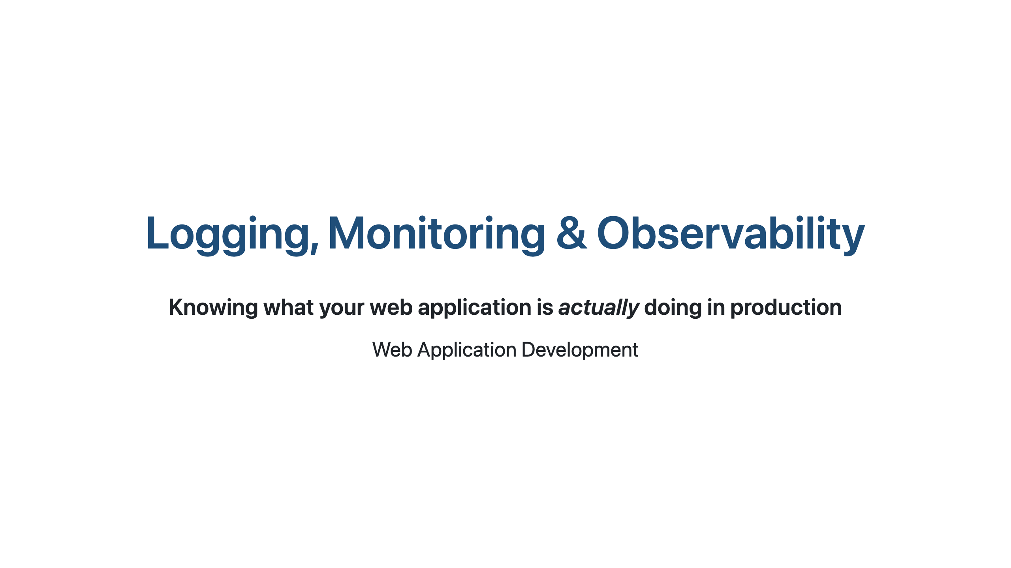
Notes:
Timing guide (≈75–85 min total):
- Part 0 Intro & motivation: 8 min
- Part 1 Logging: 20 min
- Part 2 Metrics & Monitoring: 15 min
- Part 3 Tracing & OpenTelemetry: 12 min
- Part 4 Alerting, SLOs, dashboards: 10 min
- Part 5 Frontend observability, privacy, wrap-up: 8 min
- Q&A / in-class exercise: 5–15 min (flexible)

Slide 2
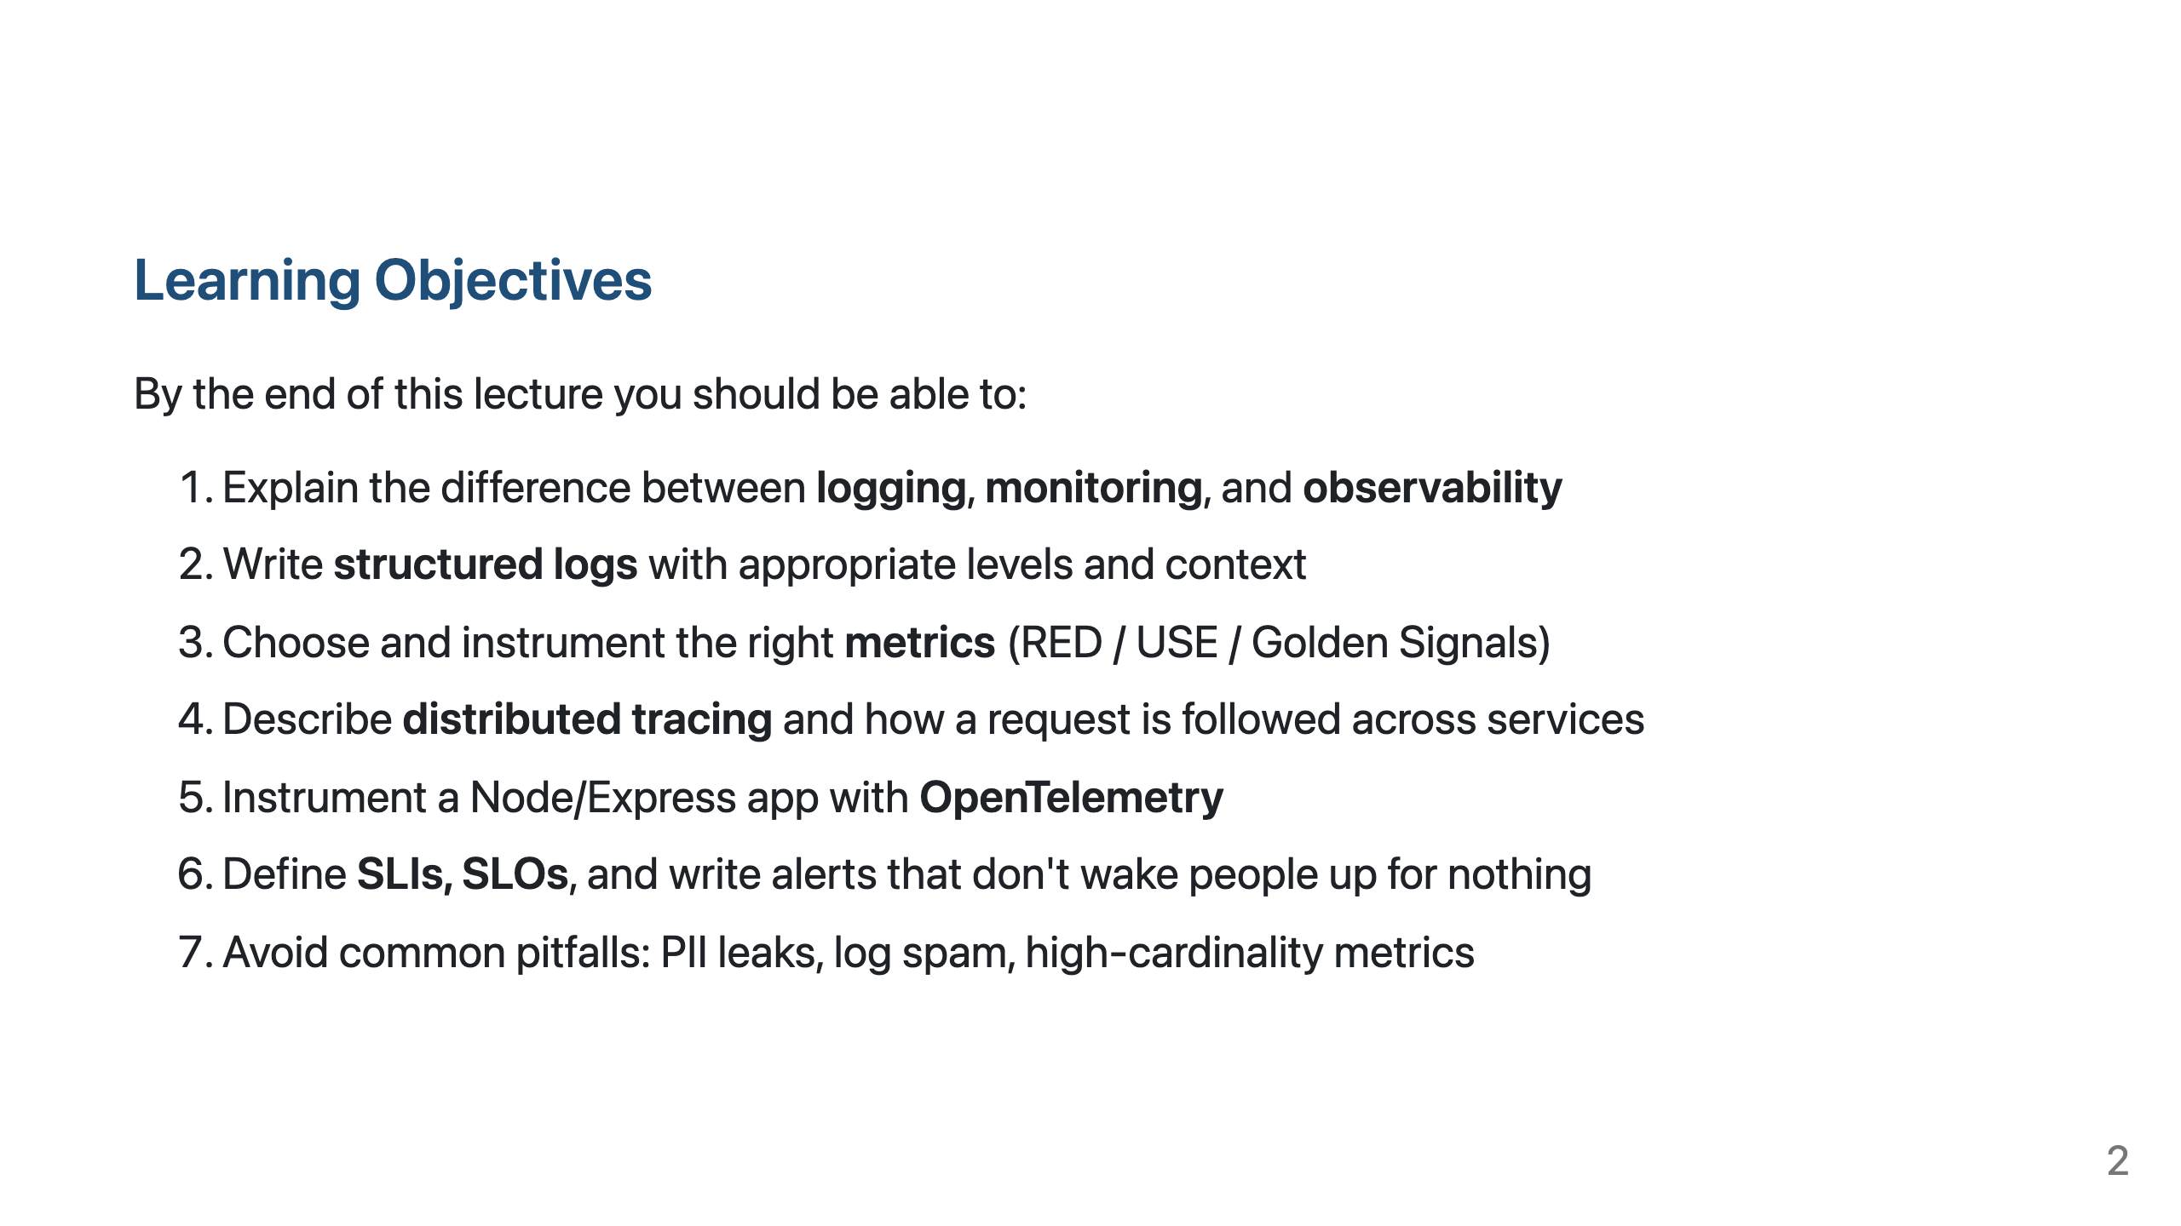

Slide 3
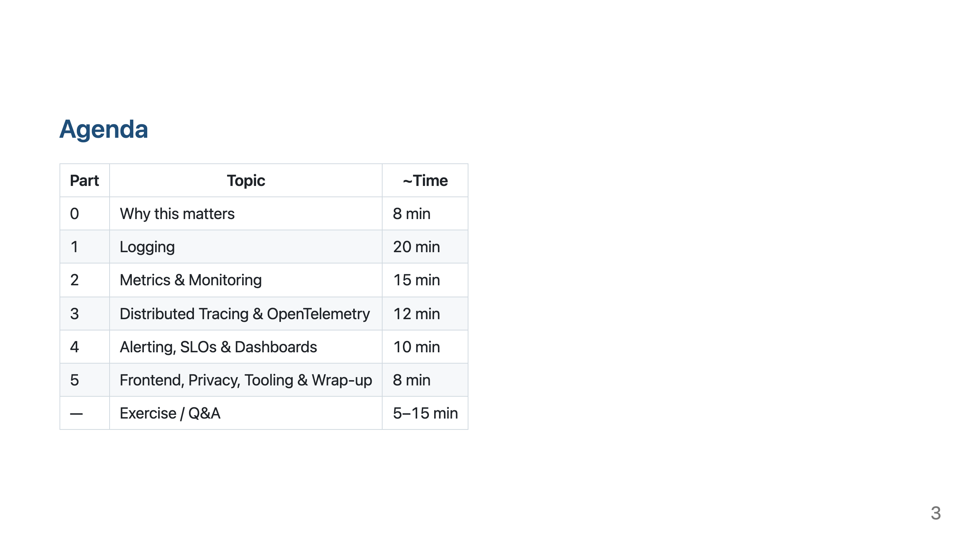

Slide 4
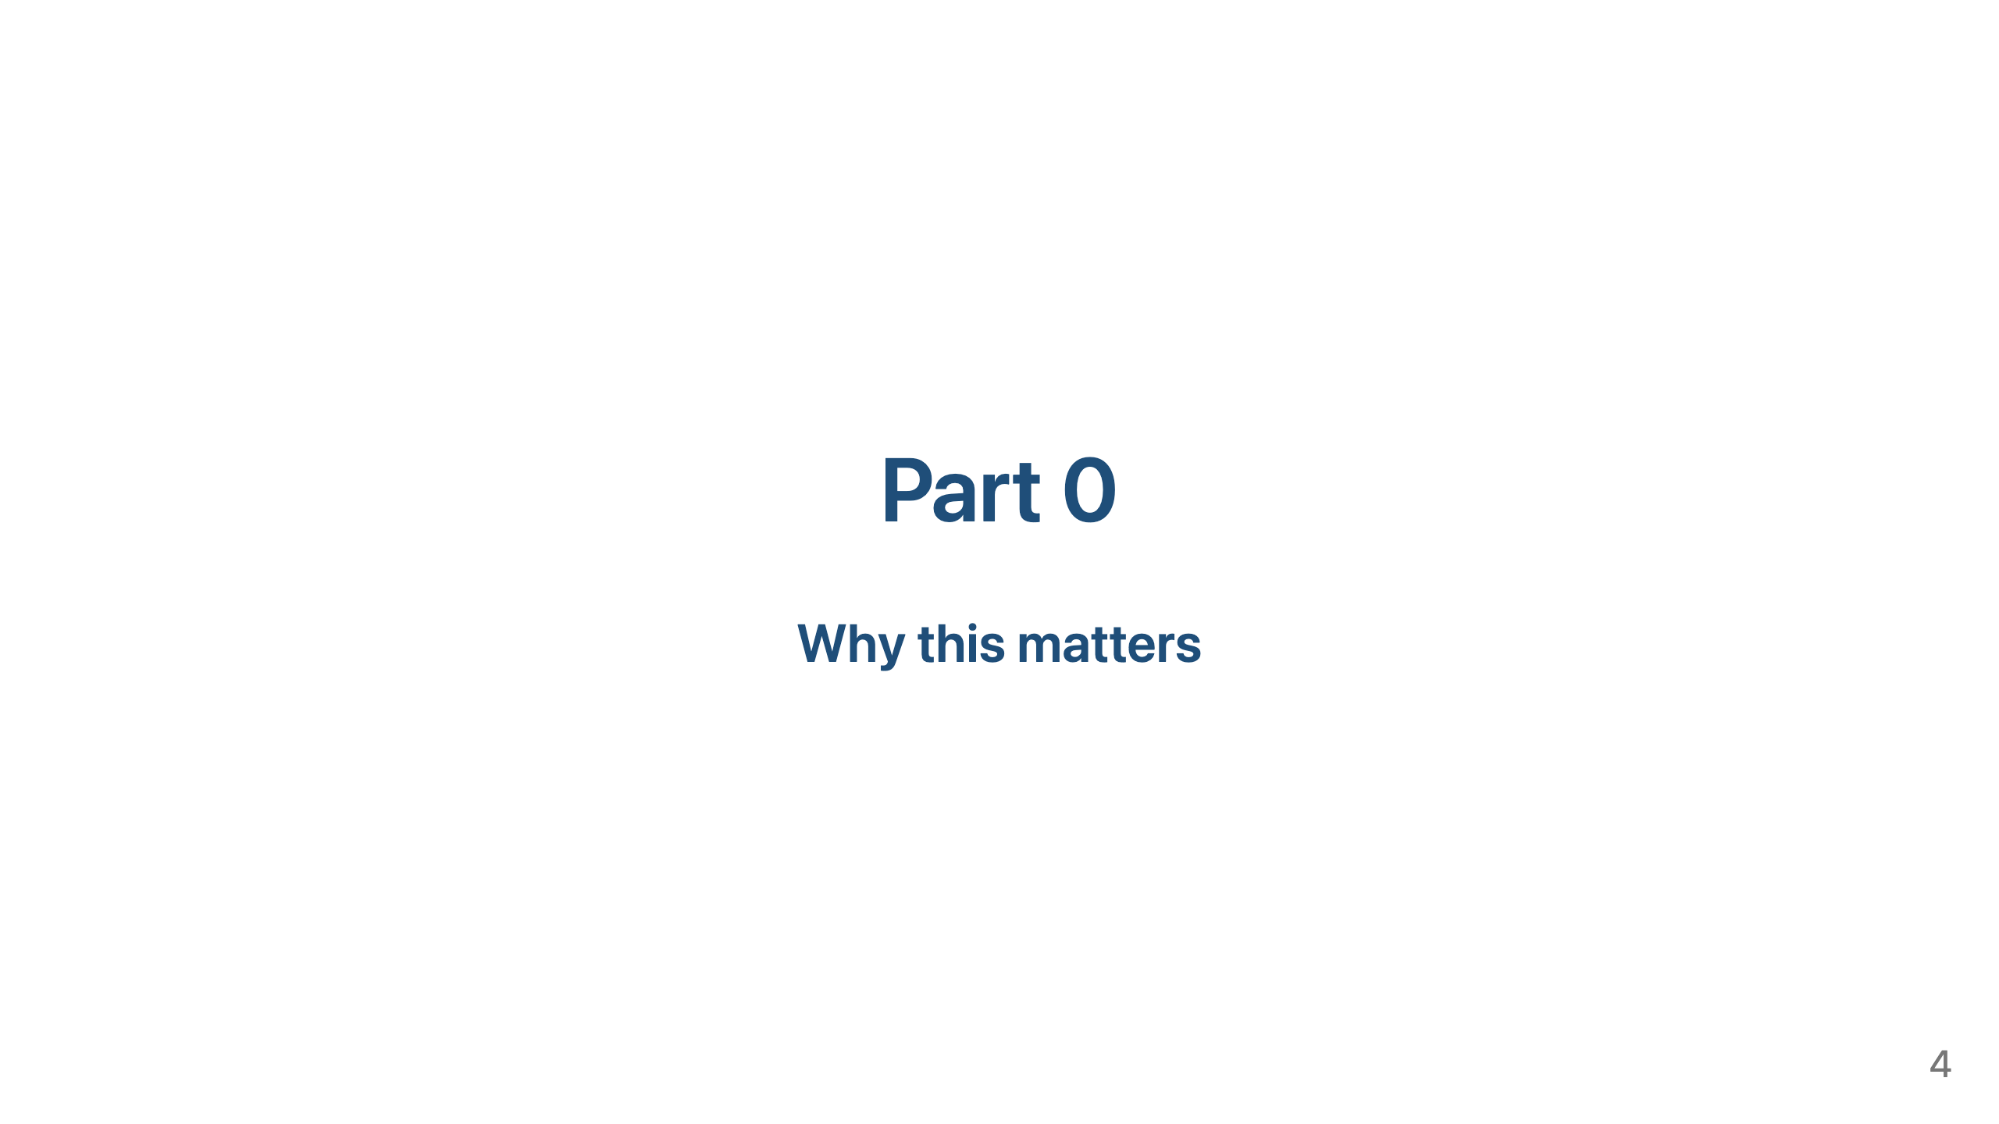

Slide 5
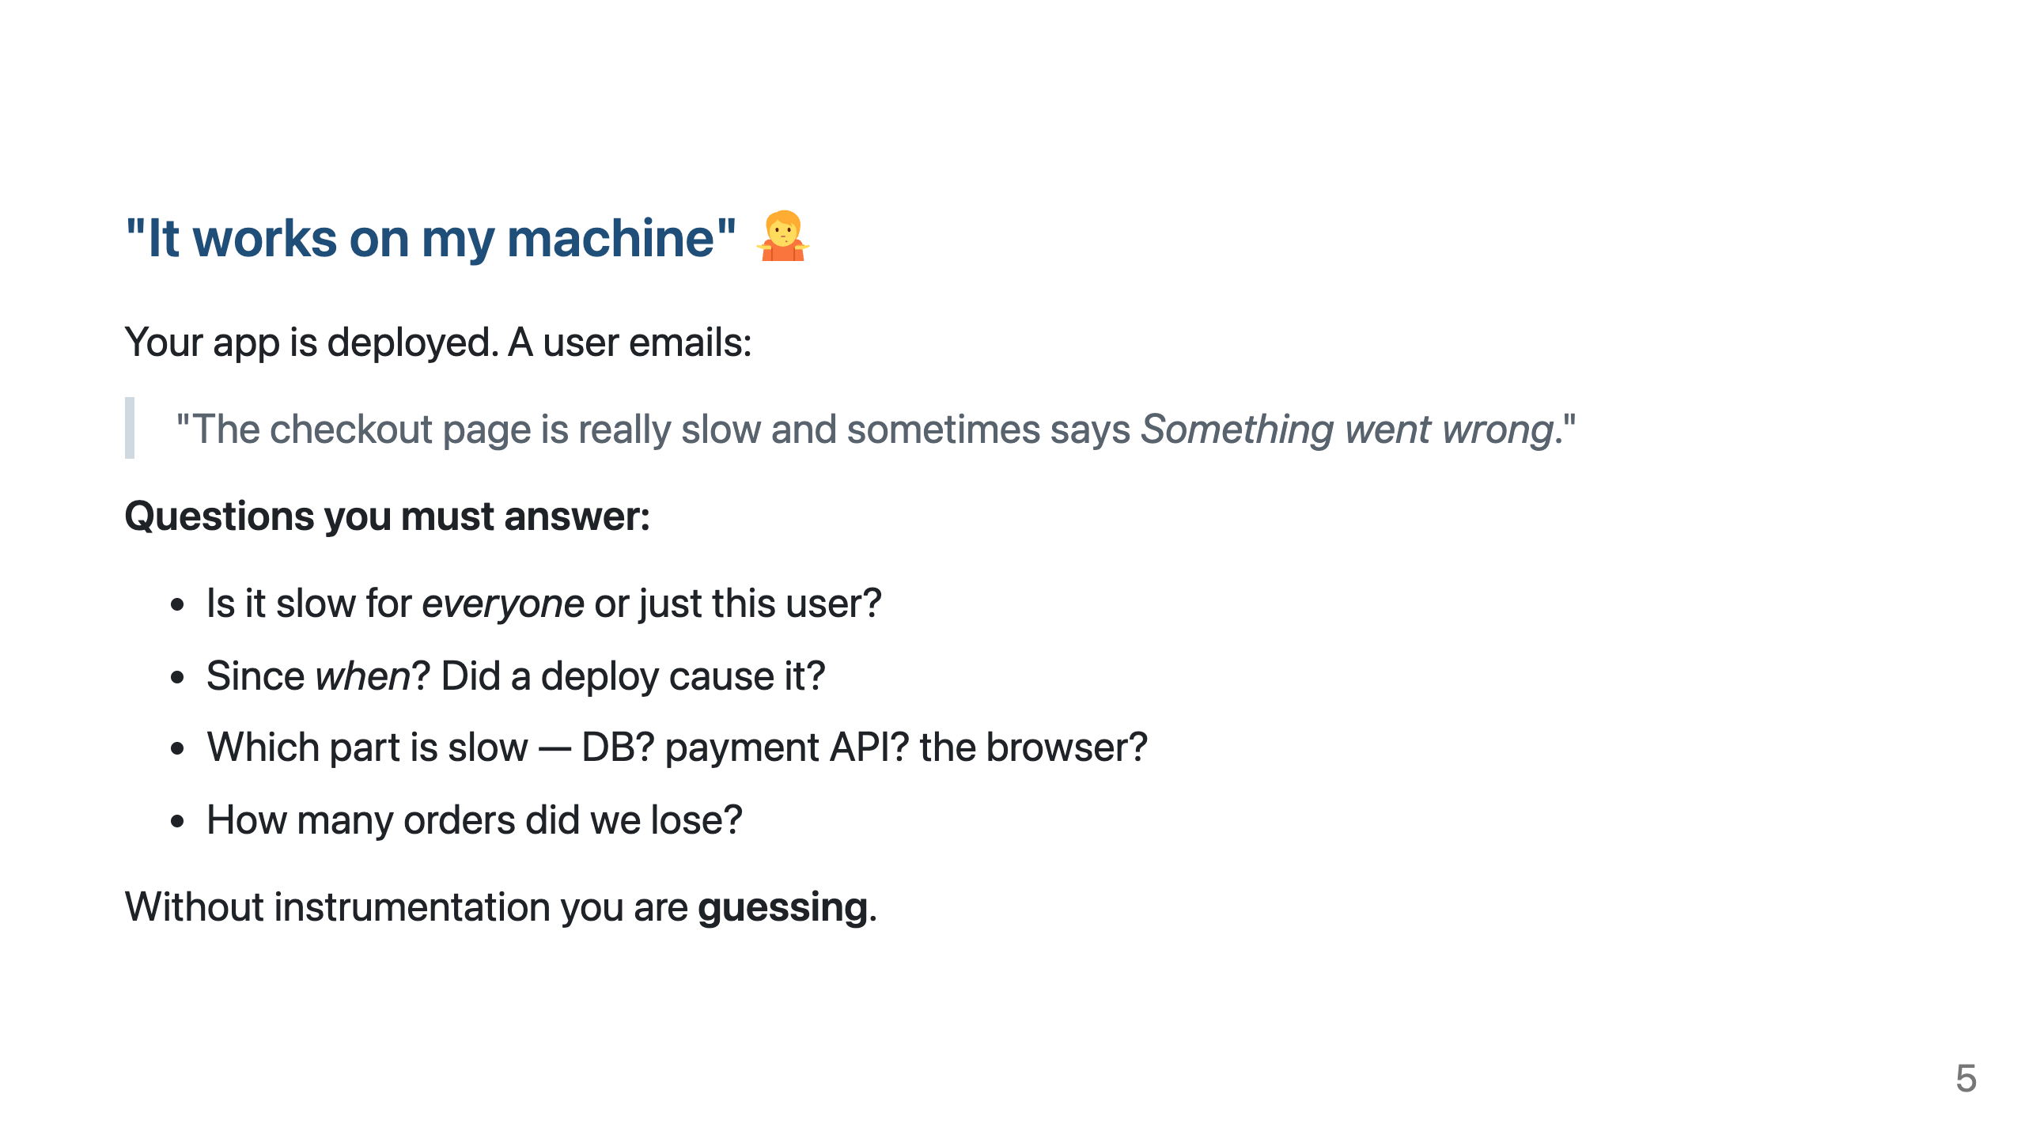
Notes:
Ask the class: "What would you do right now to debug this?" Collect answers — most will say "look at the code" or "try to reproduce". Point out: production differs from local (data volume, concurrency, network, third parties).

Slide 6
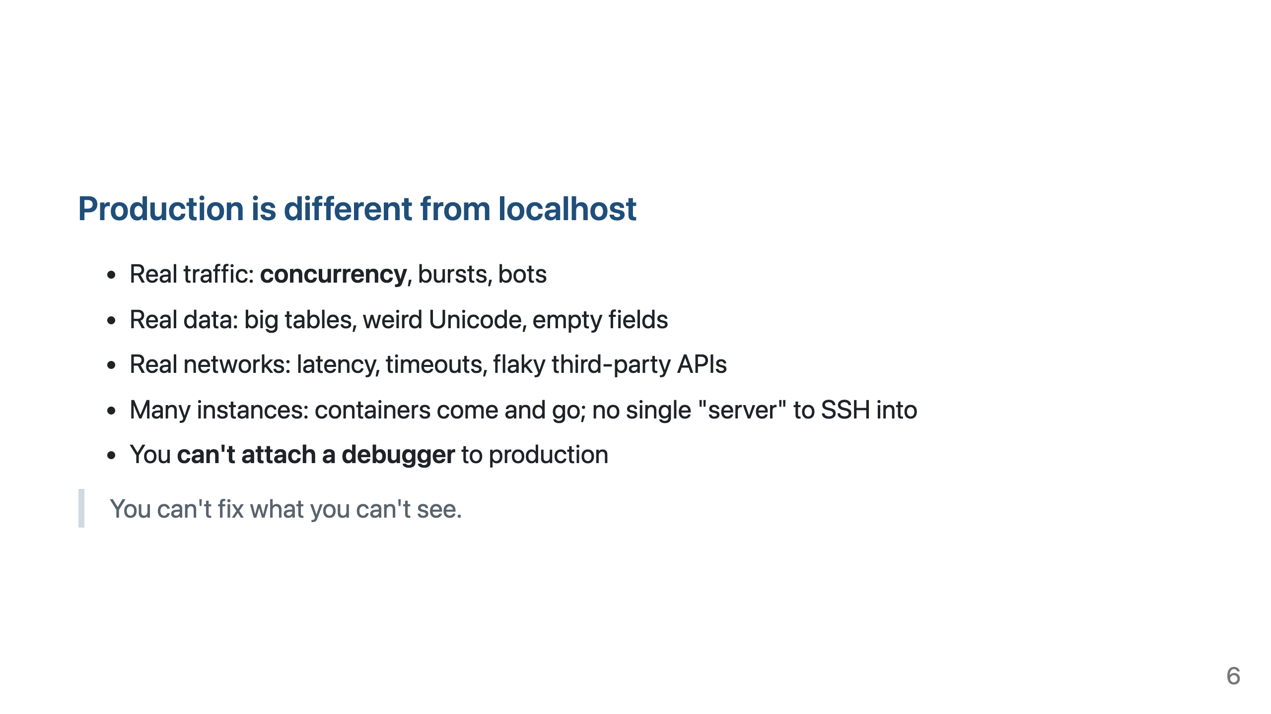

Slide 7
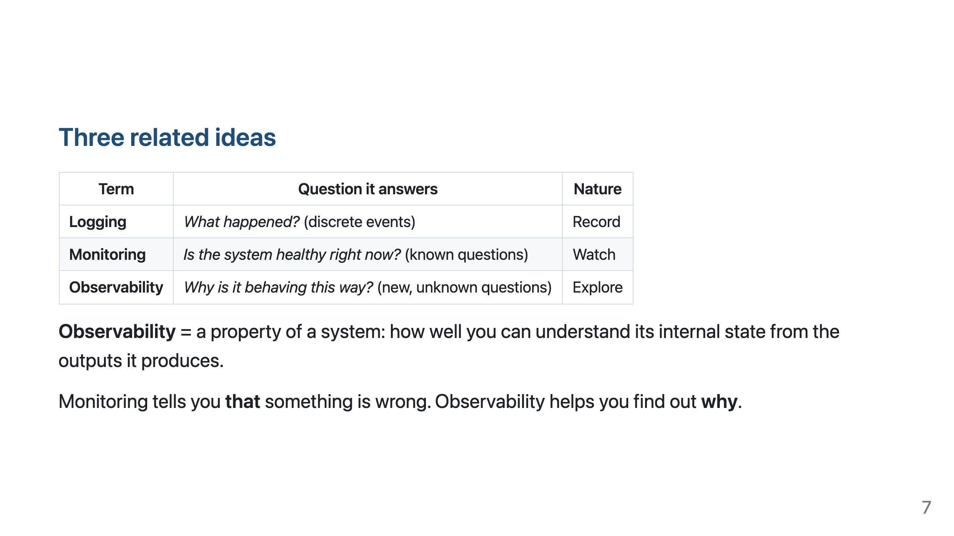

Slide 8
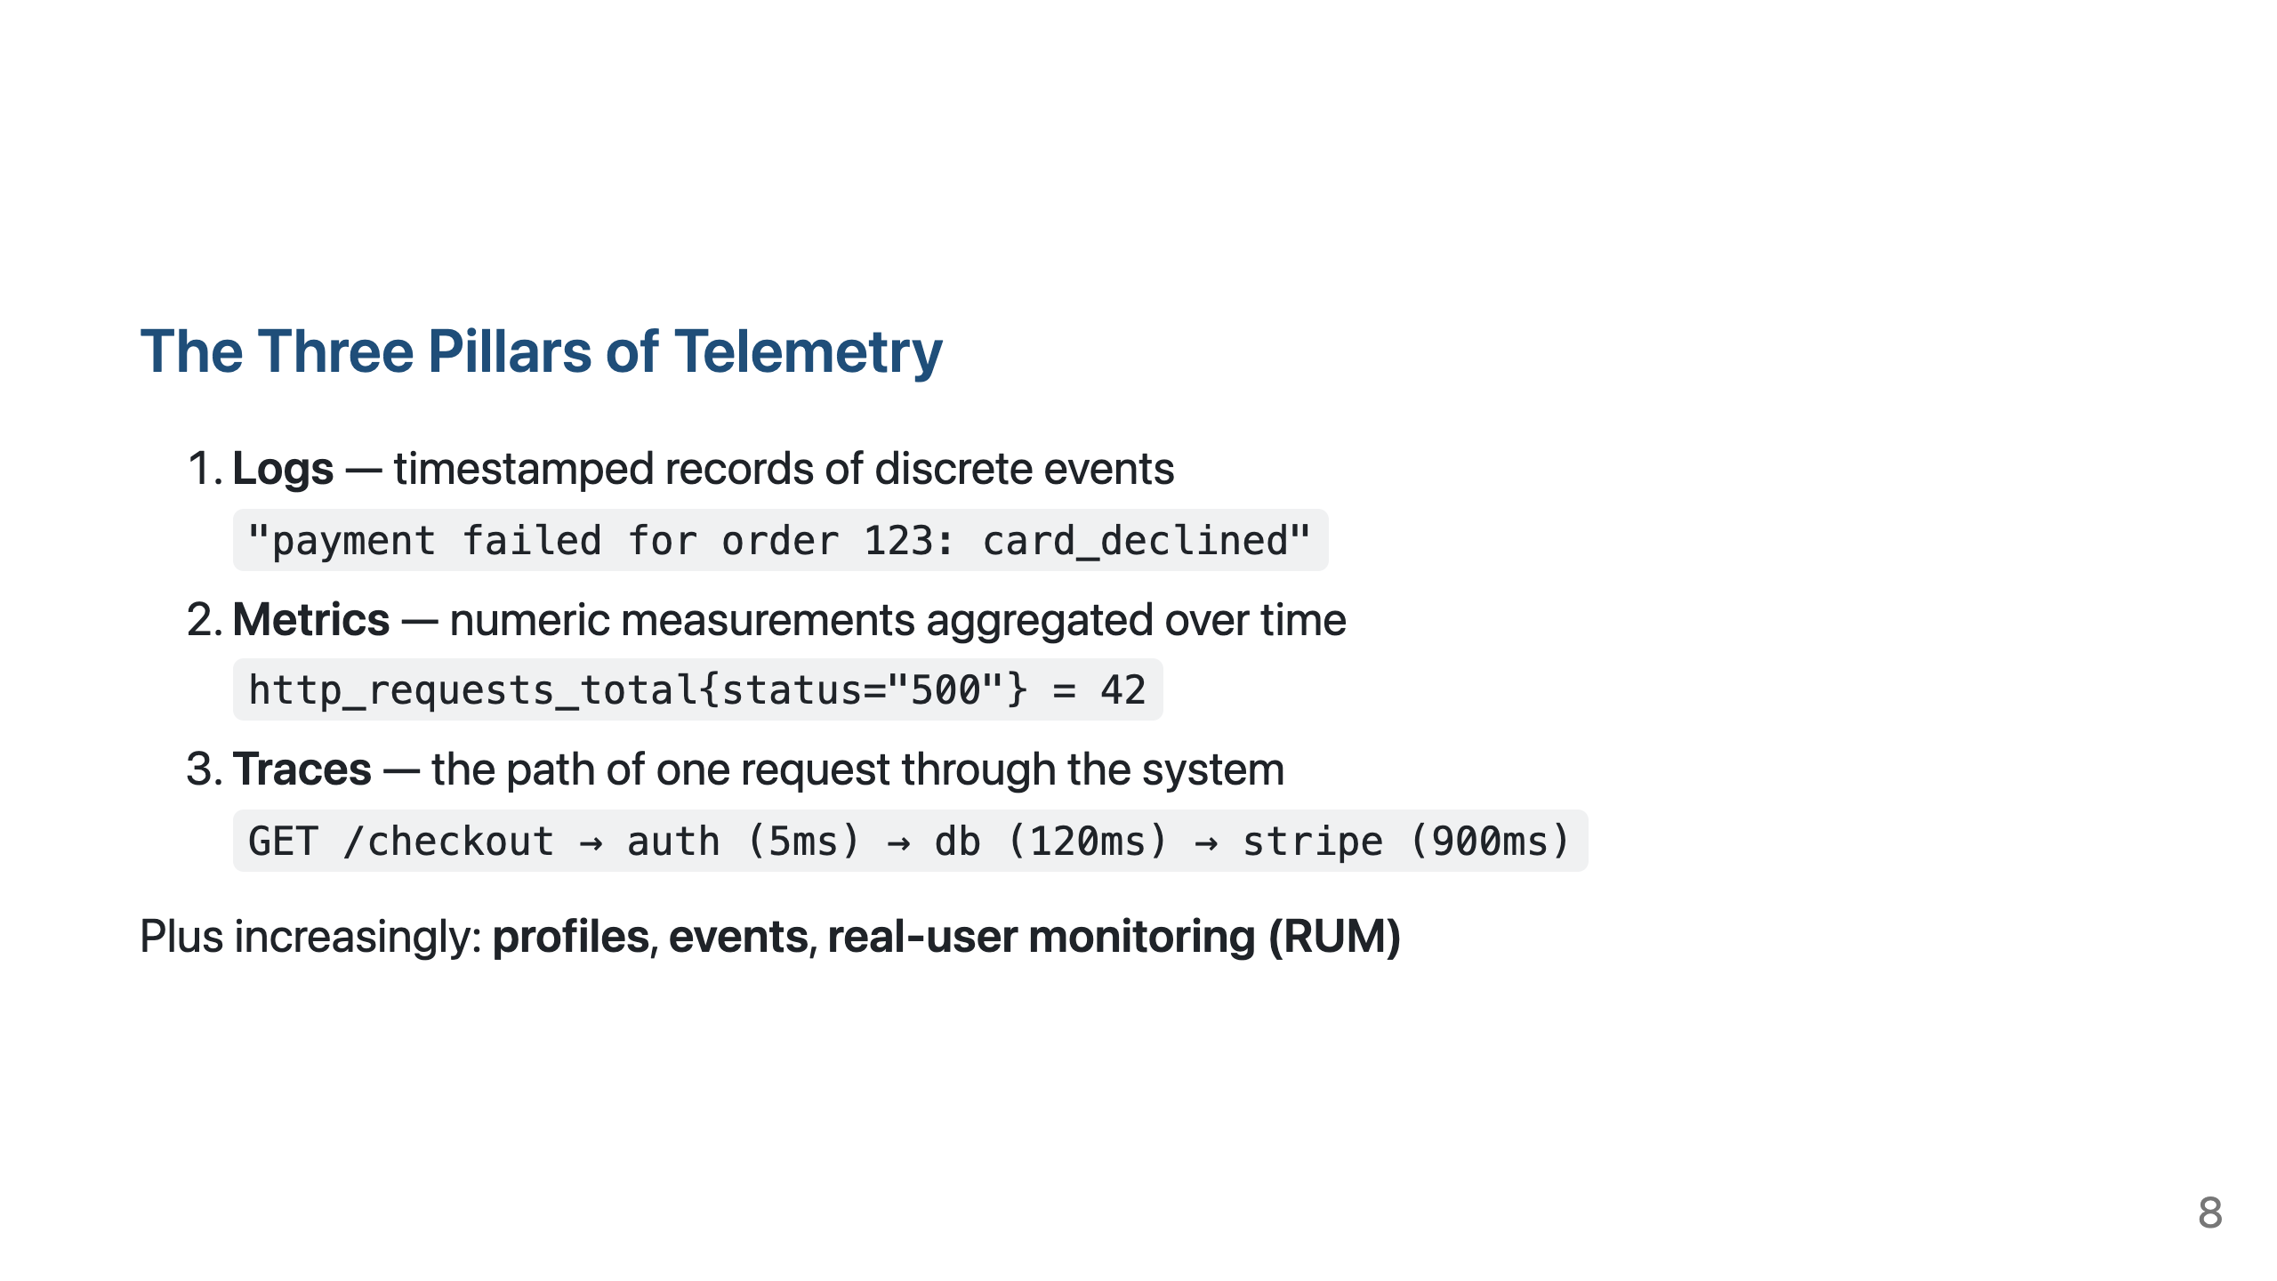
Notes:
The pillars are complementary, not alternatives.

Slide 9
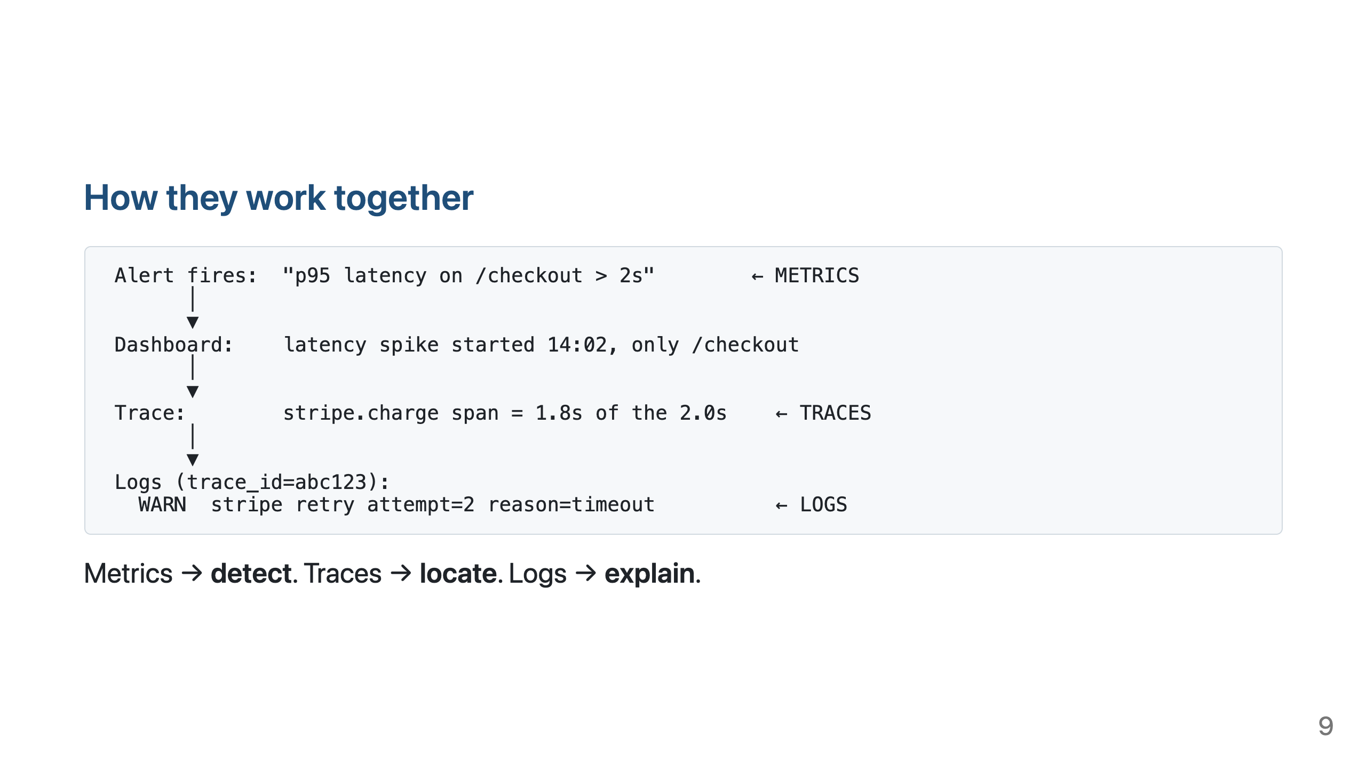

Slide 10
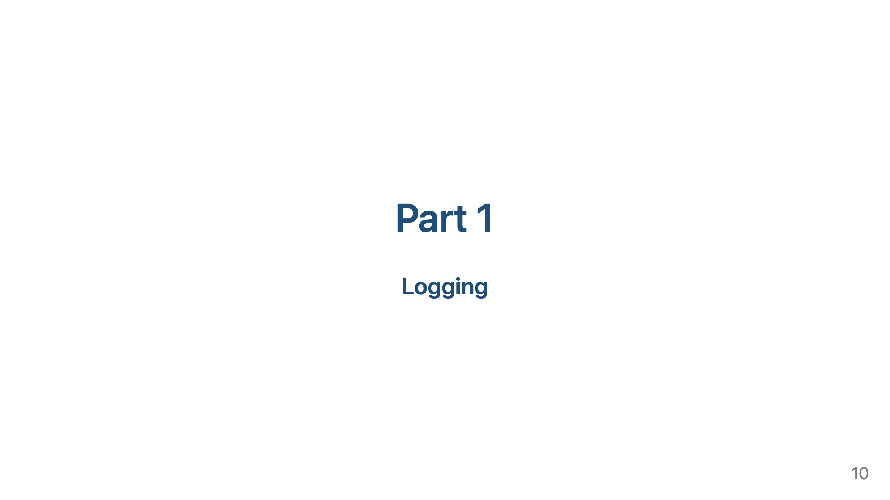

Slide 11
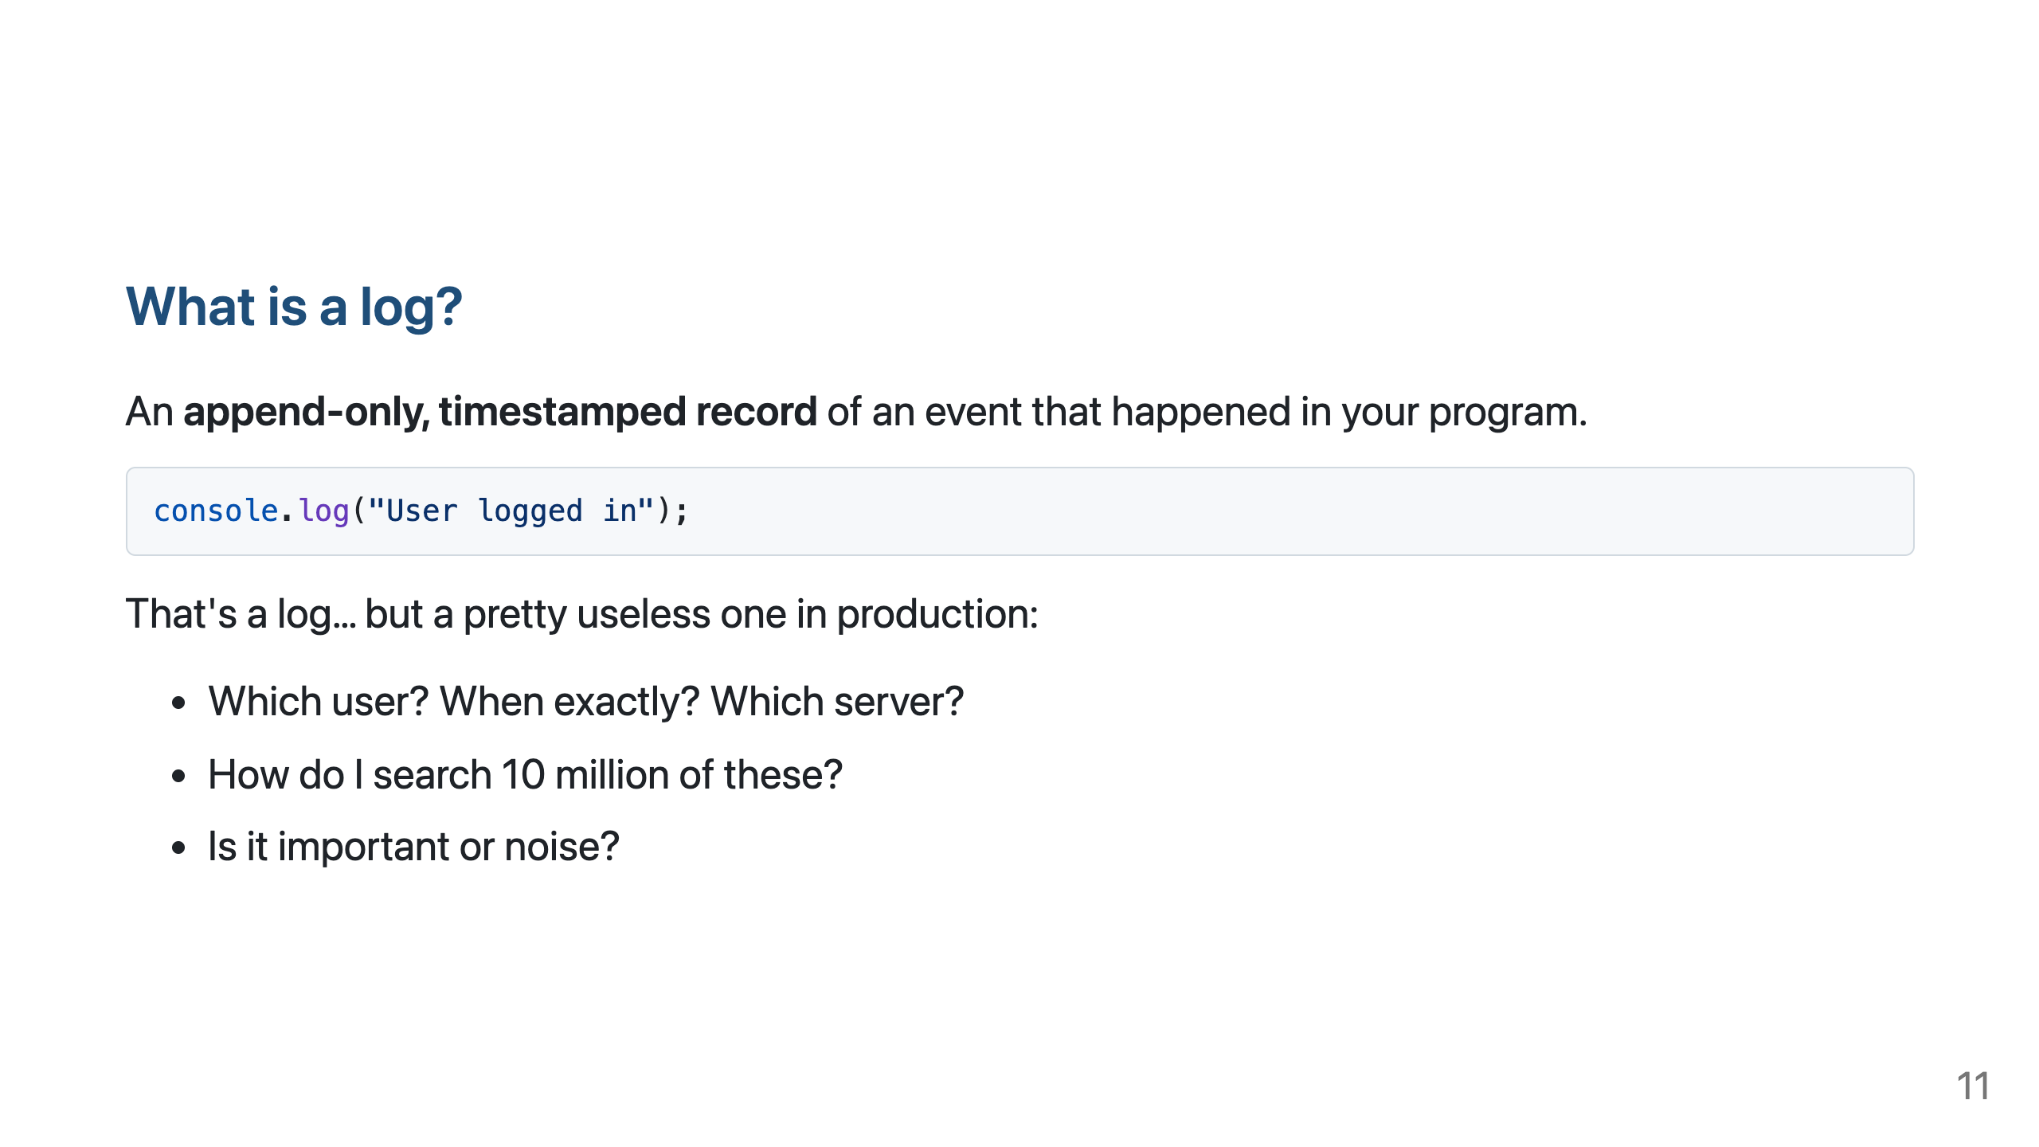

Slide 12
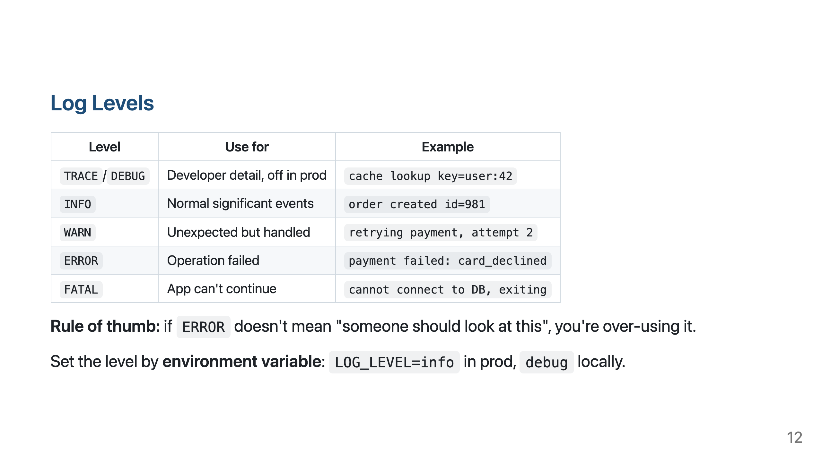

Slide 13
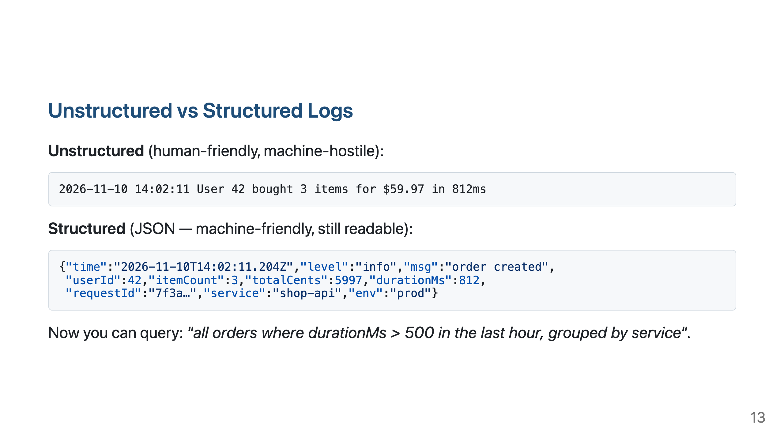

Slide 14
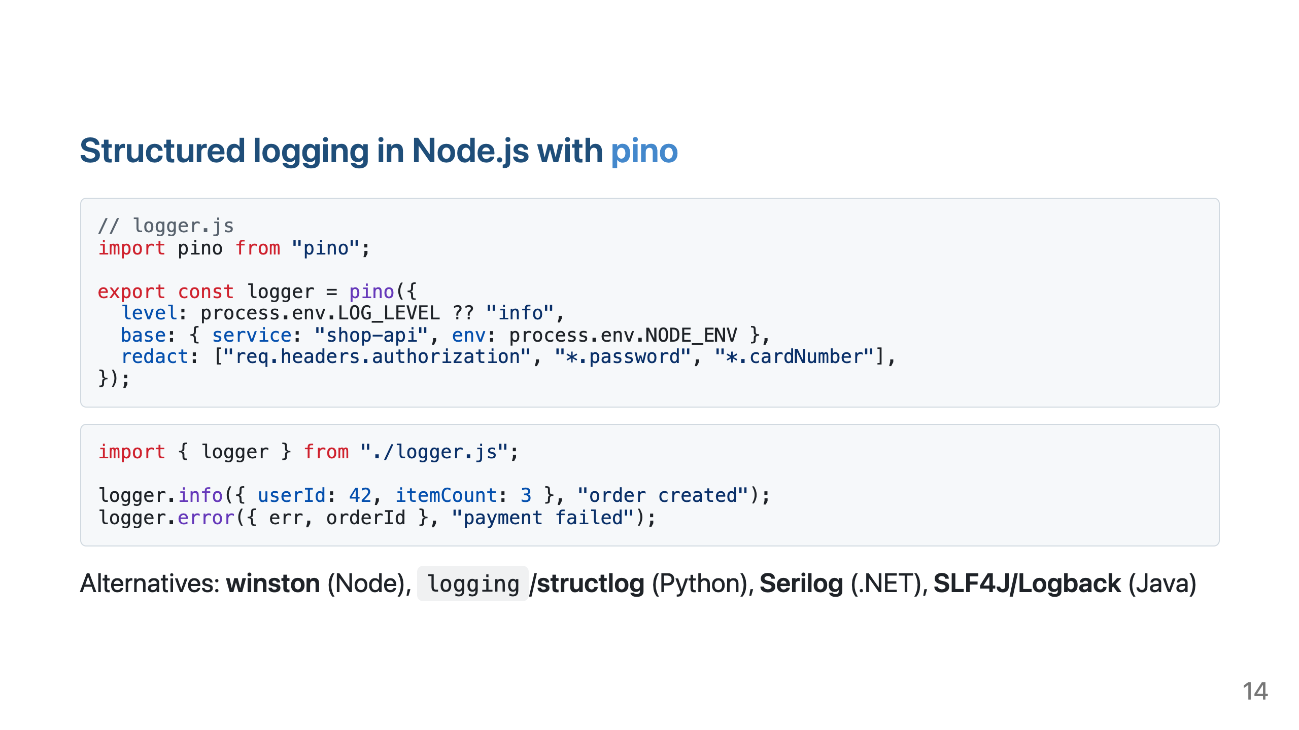
Notes:
pino is fast because it writes JSON and defers formatting. Use pino-pretty locally for readable output: `node app.js | npx pino-pretty`.

Slide 15
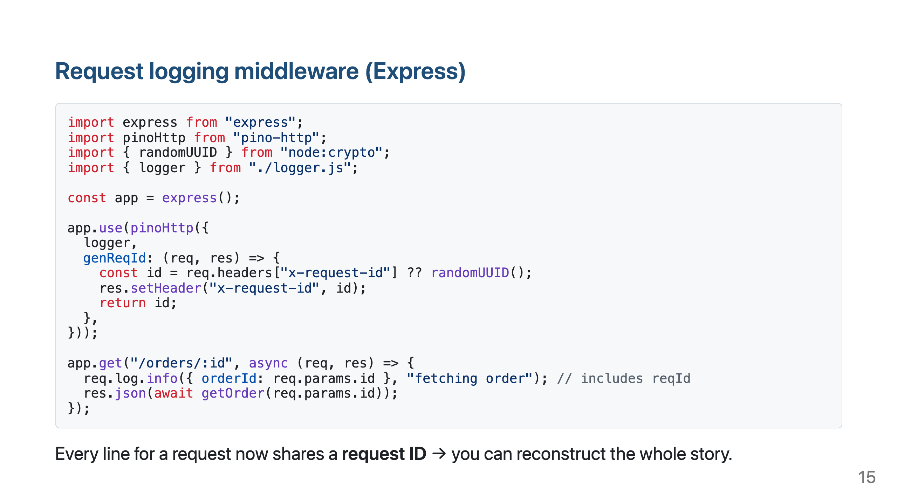

Slide 16
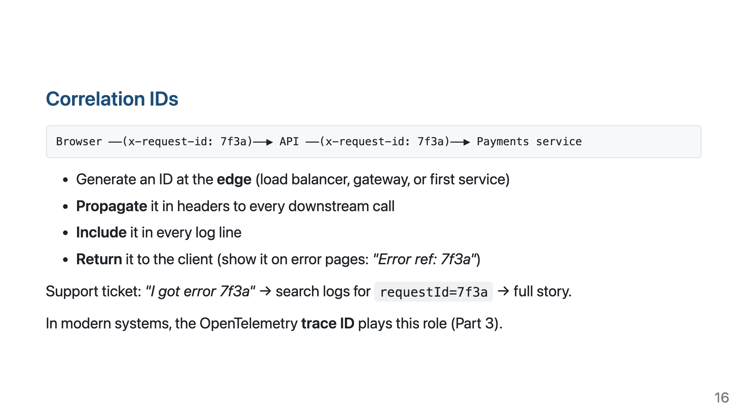

Slide 17
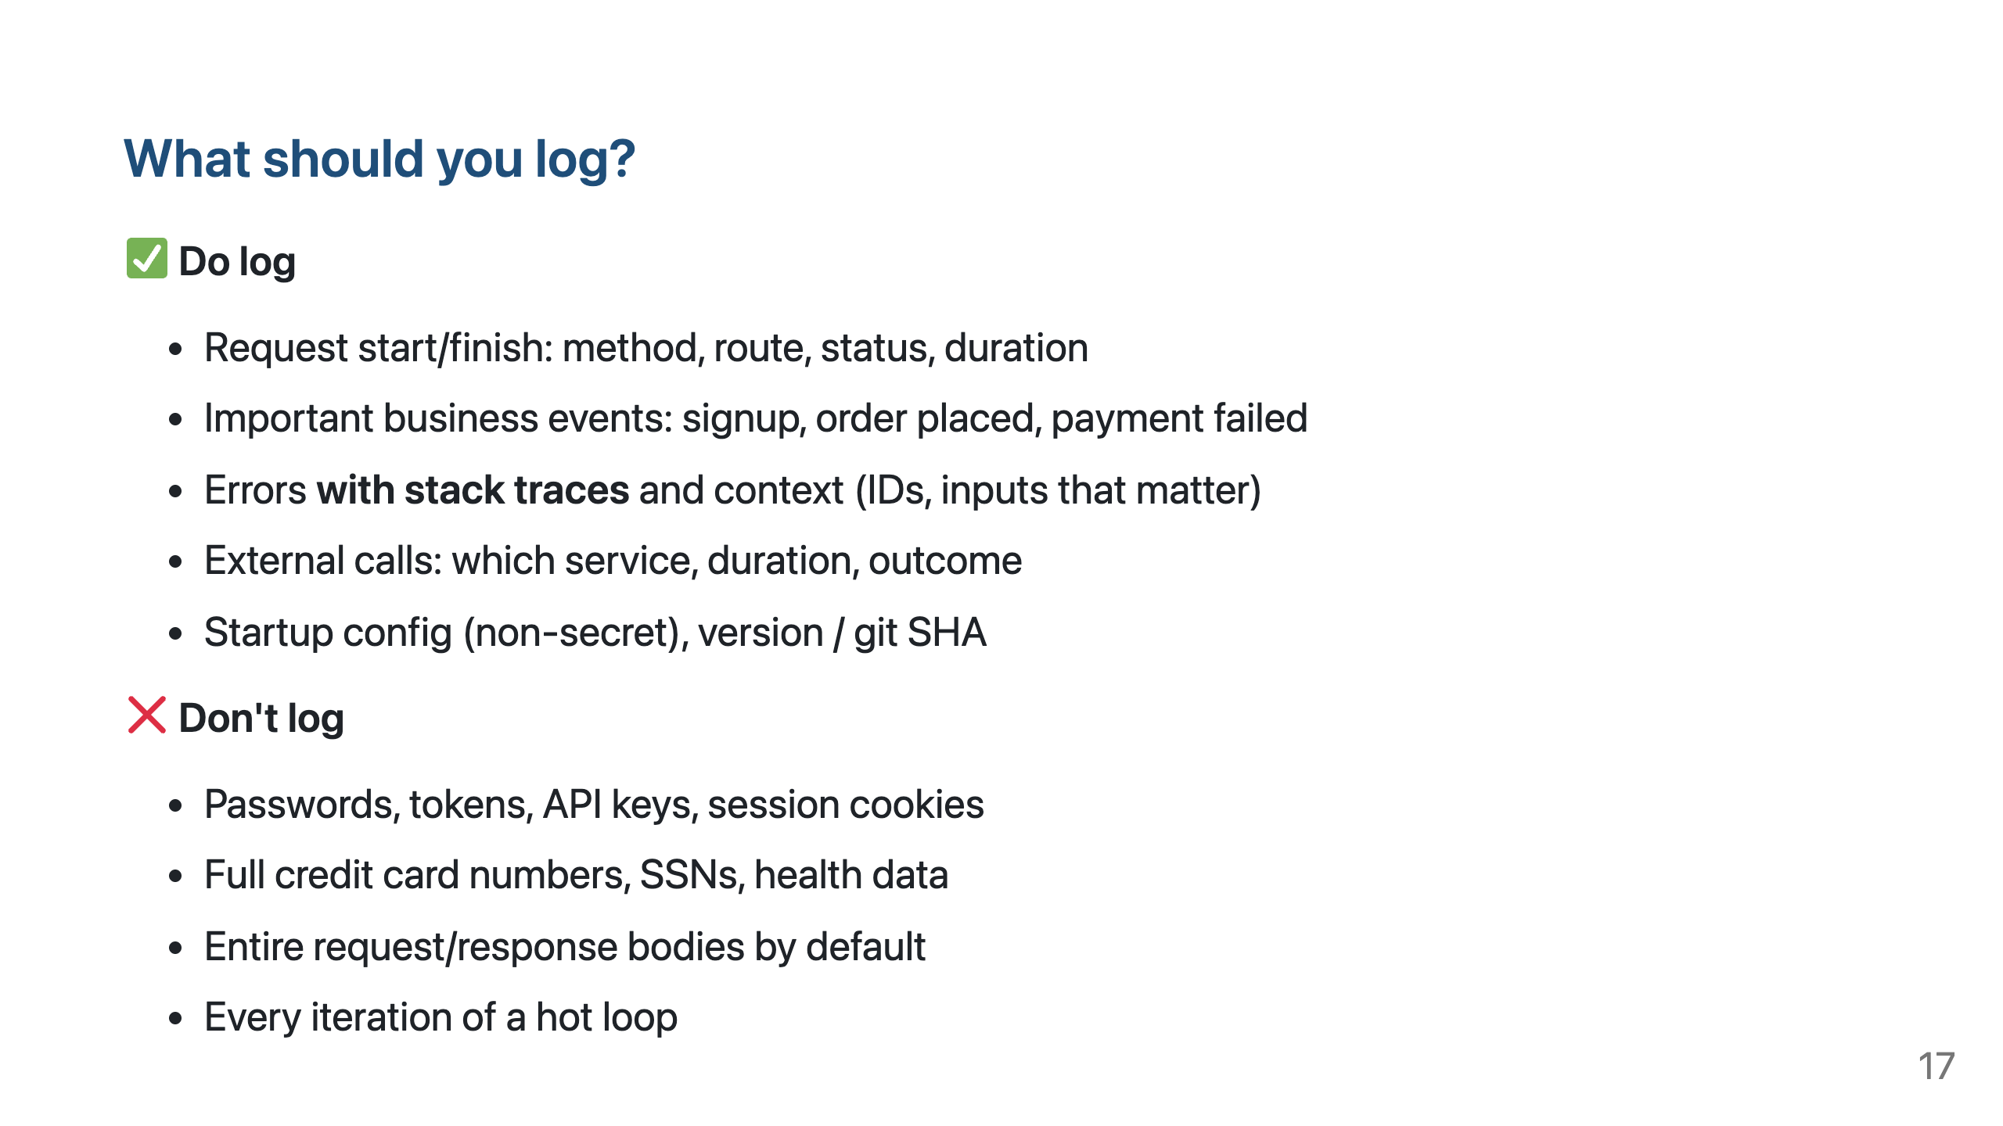

Slide 18
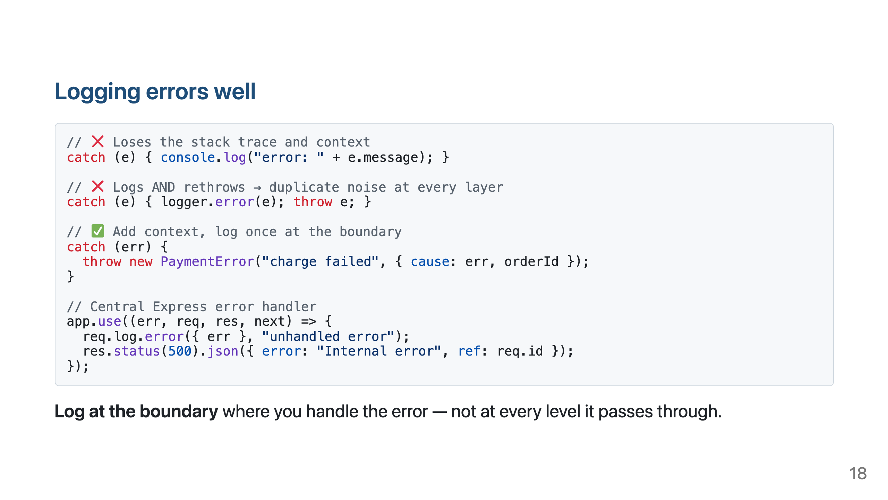

Slide 19
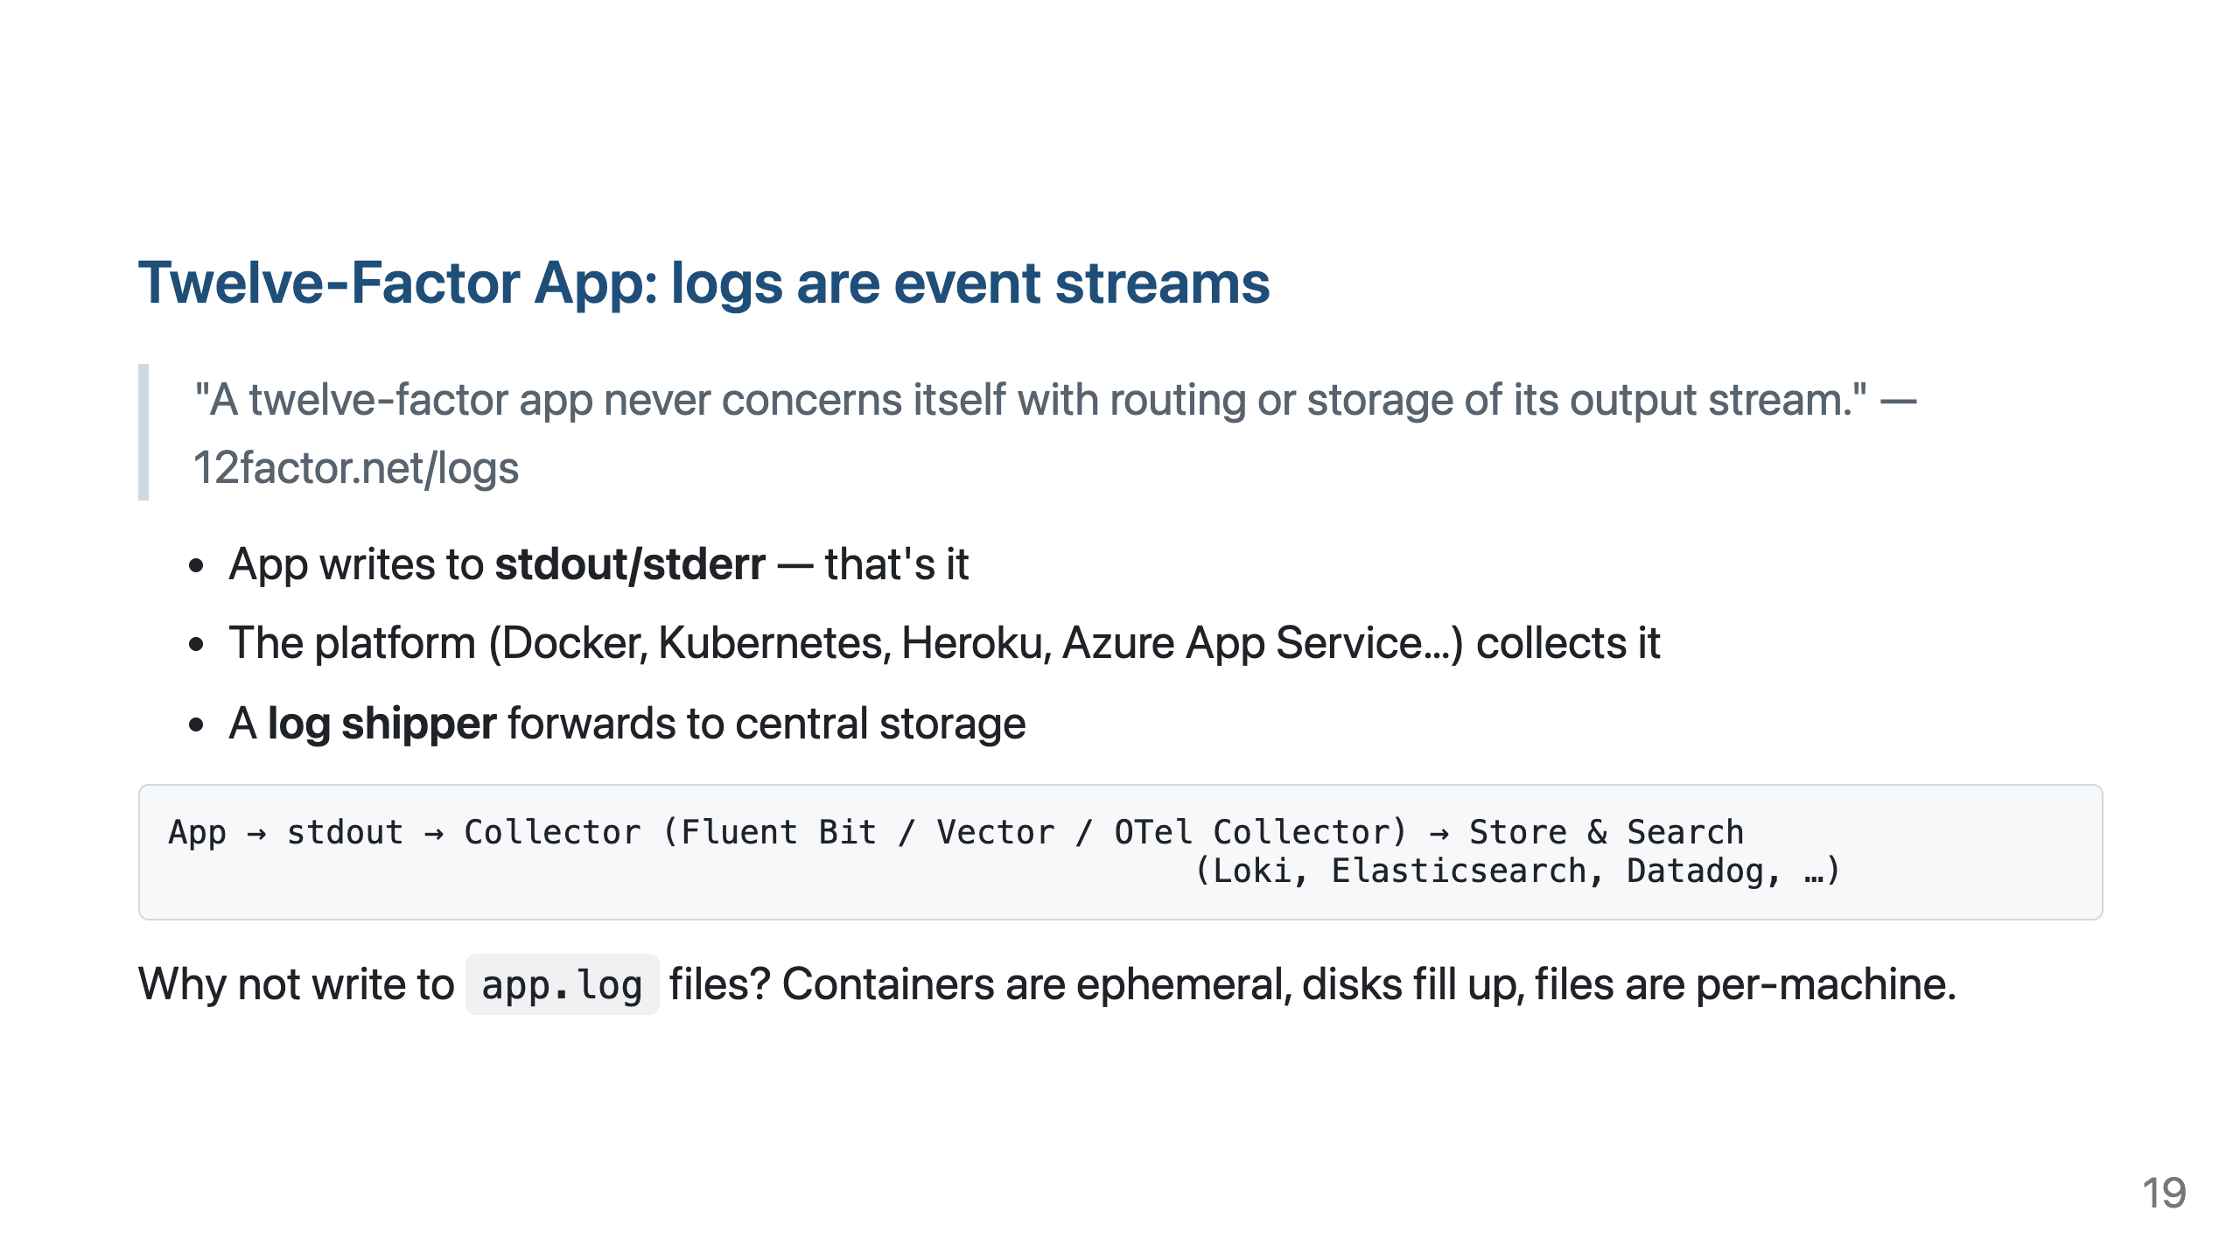

Slide 20
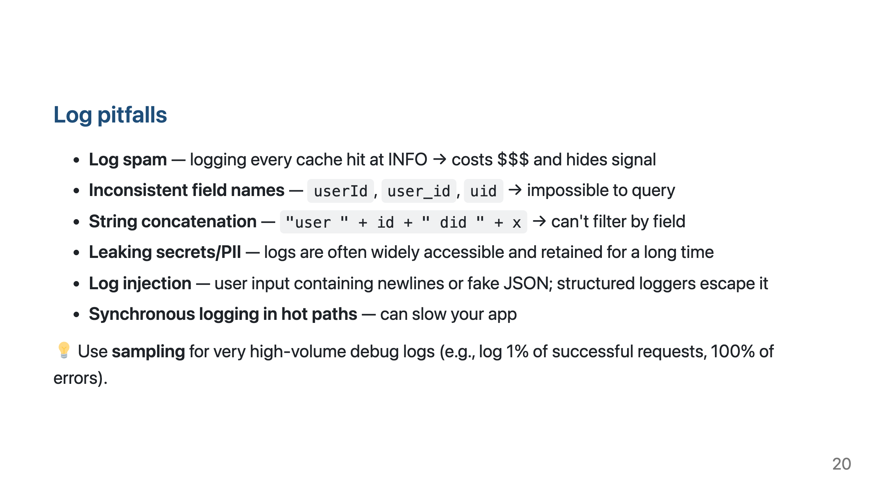

Slide 21
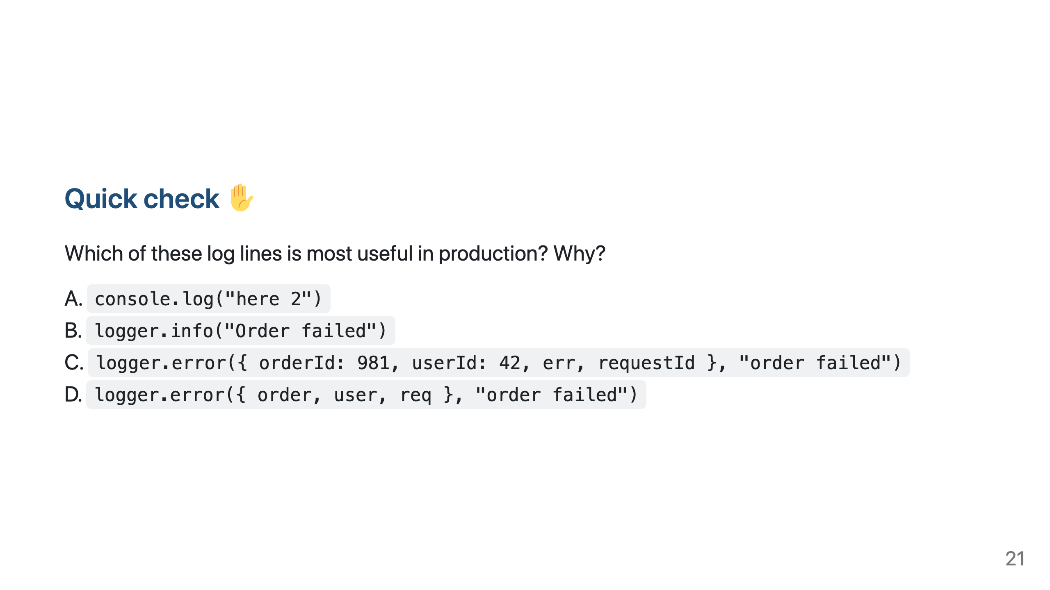
Notes:
Answer: C. D dumps entire objects (may include PII, huge, inconsistent). B lacks context. A is debugging residue.

Slide 22
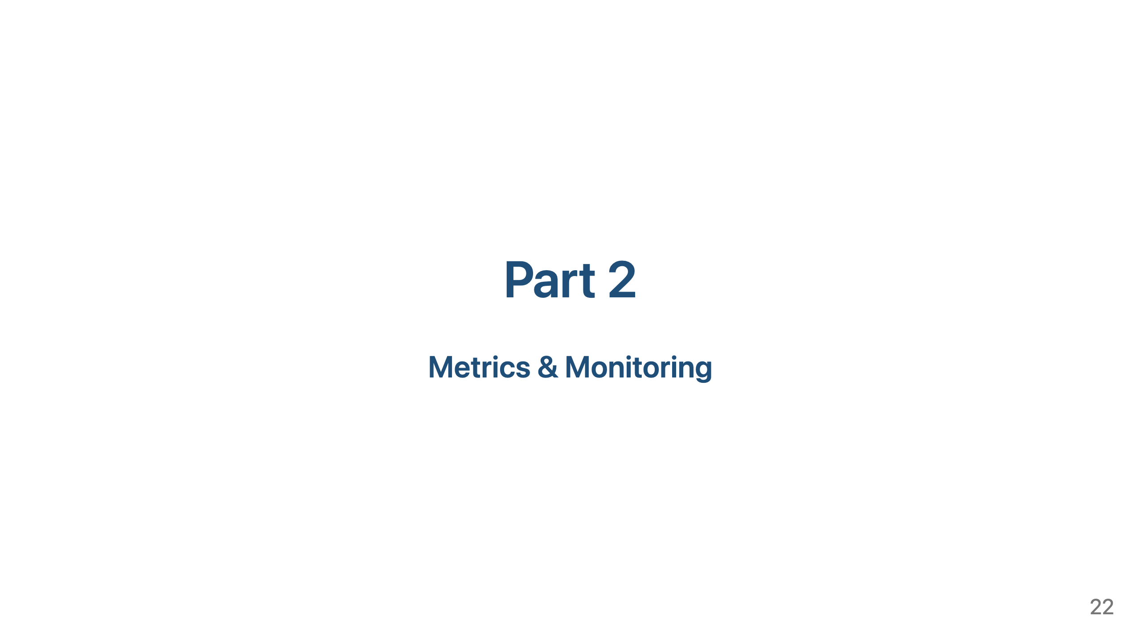

Slide 23
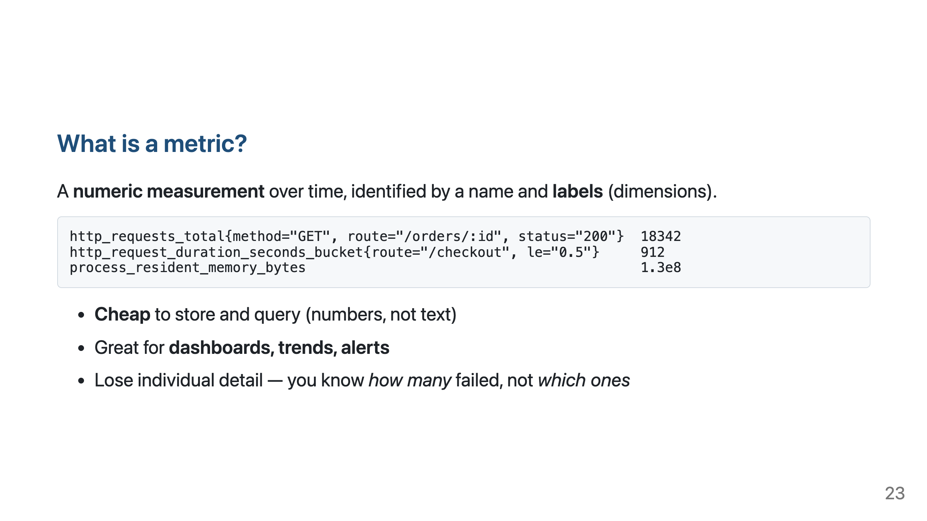

Slide 24
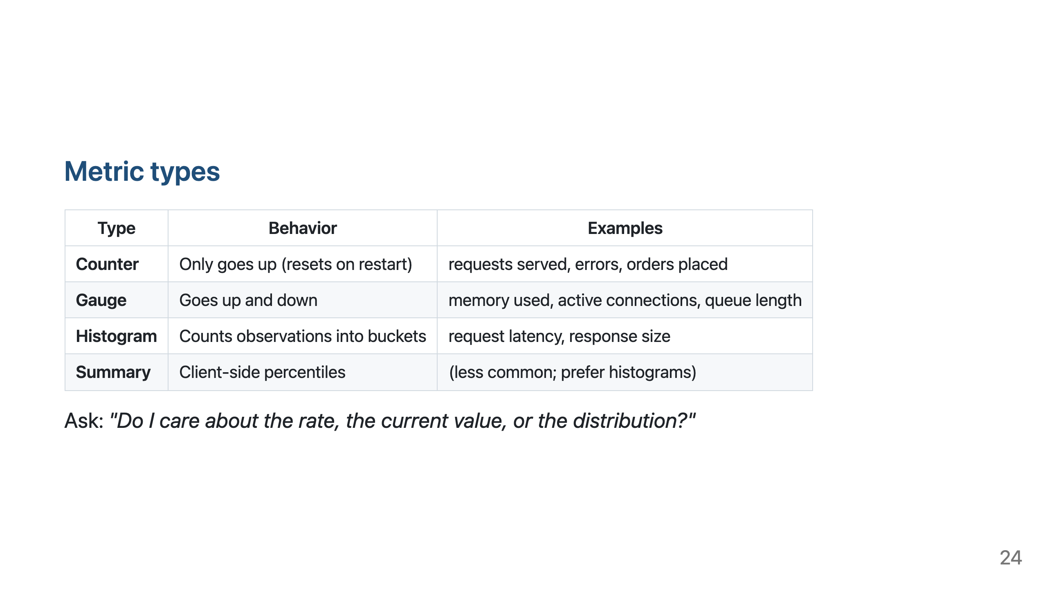

Slide 25
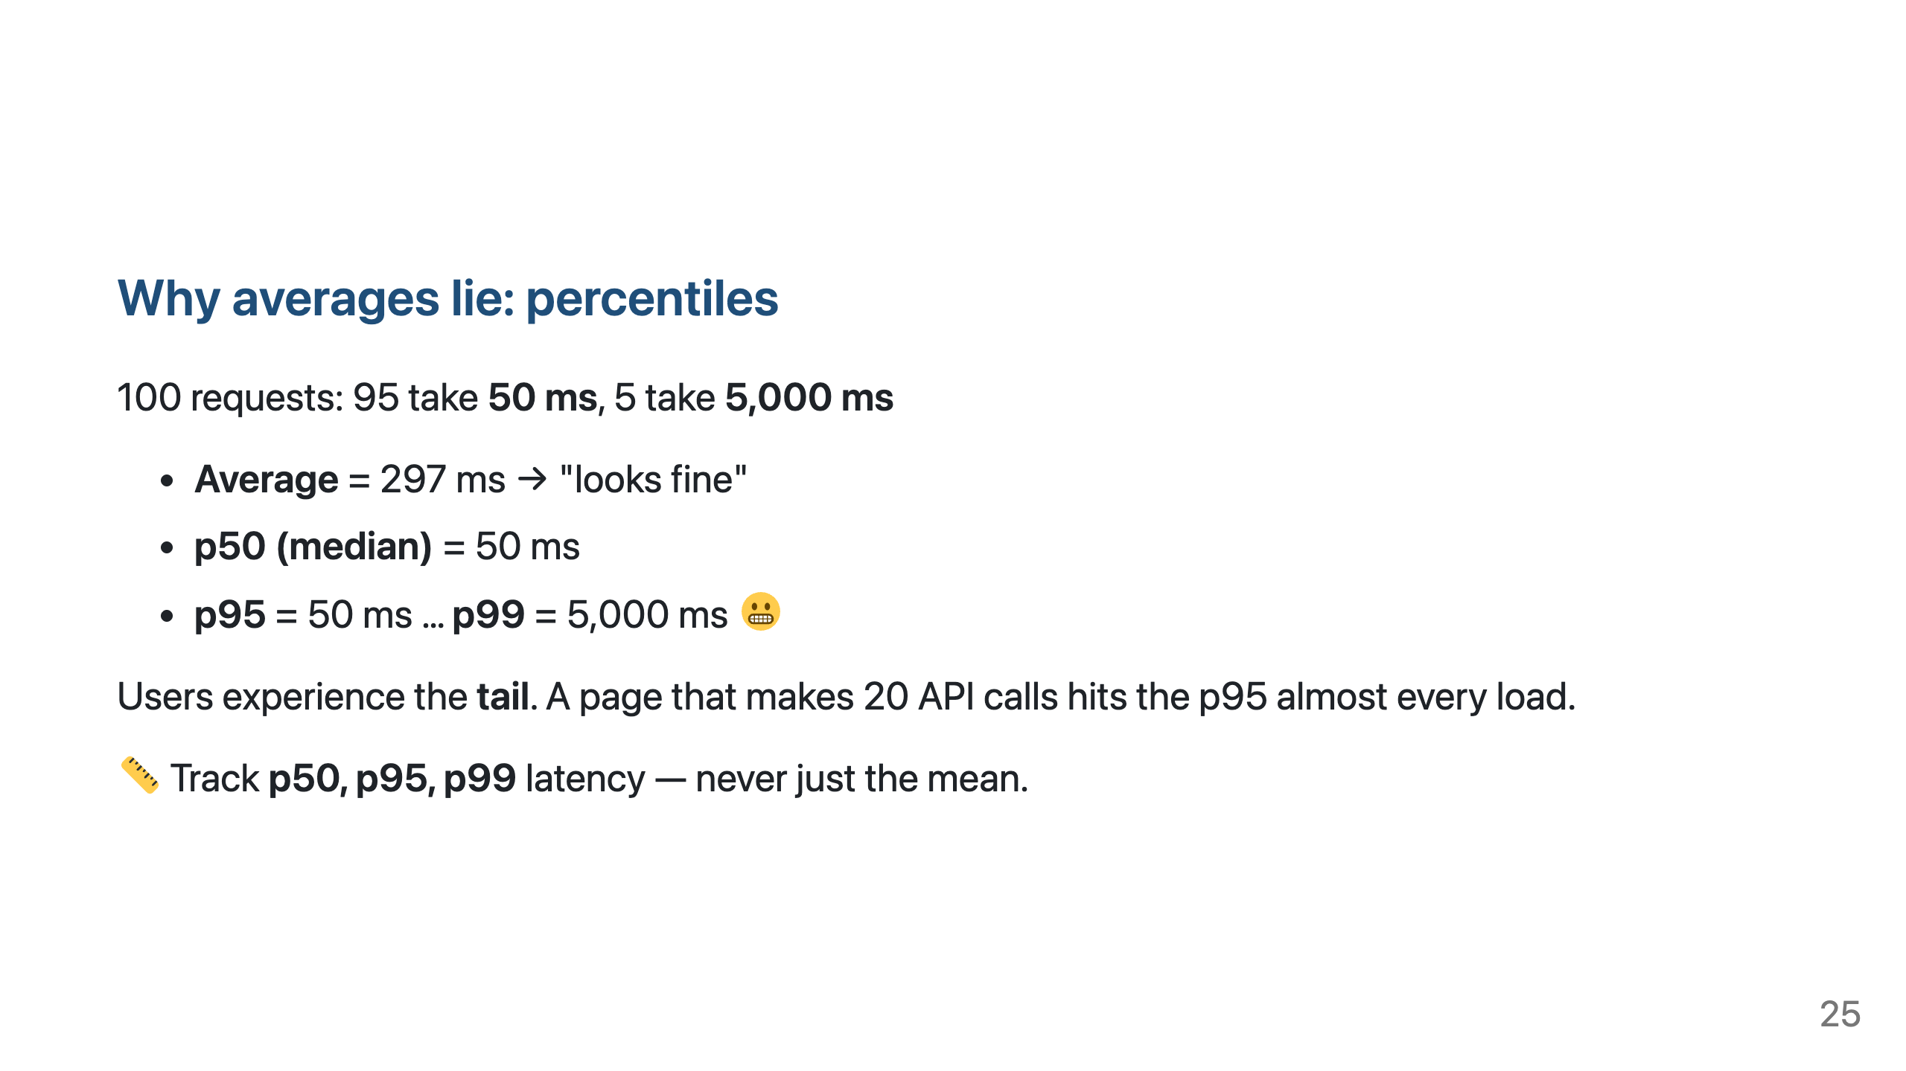

Slide 26
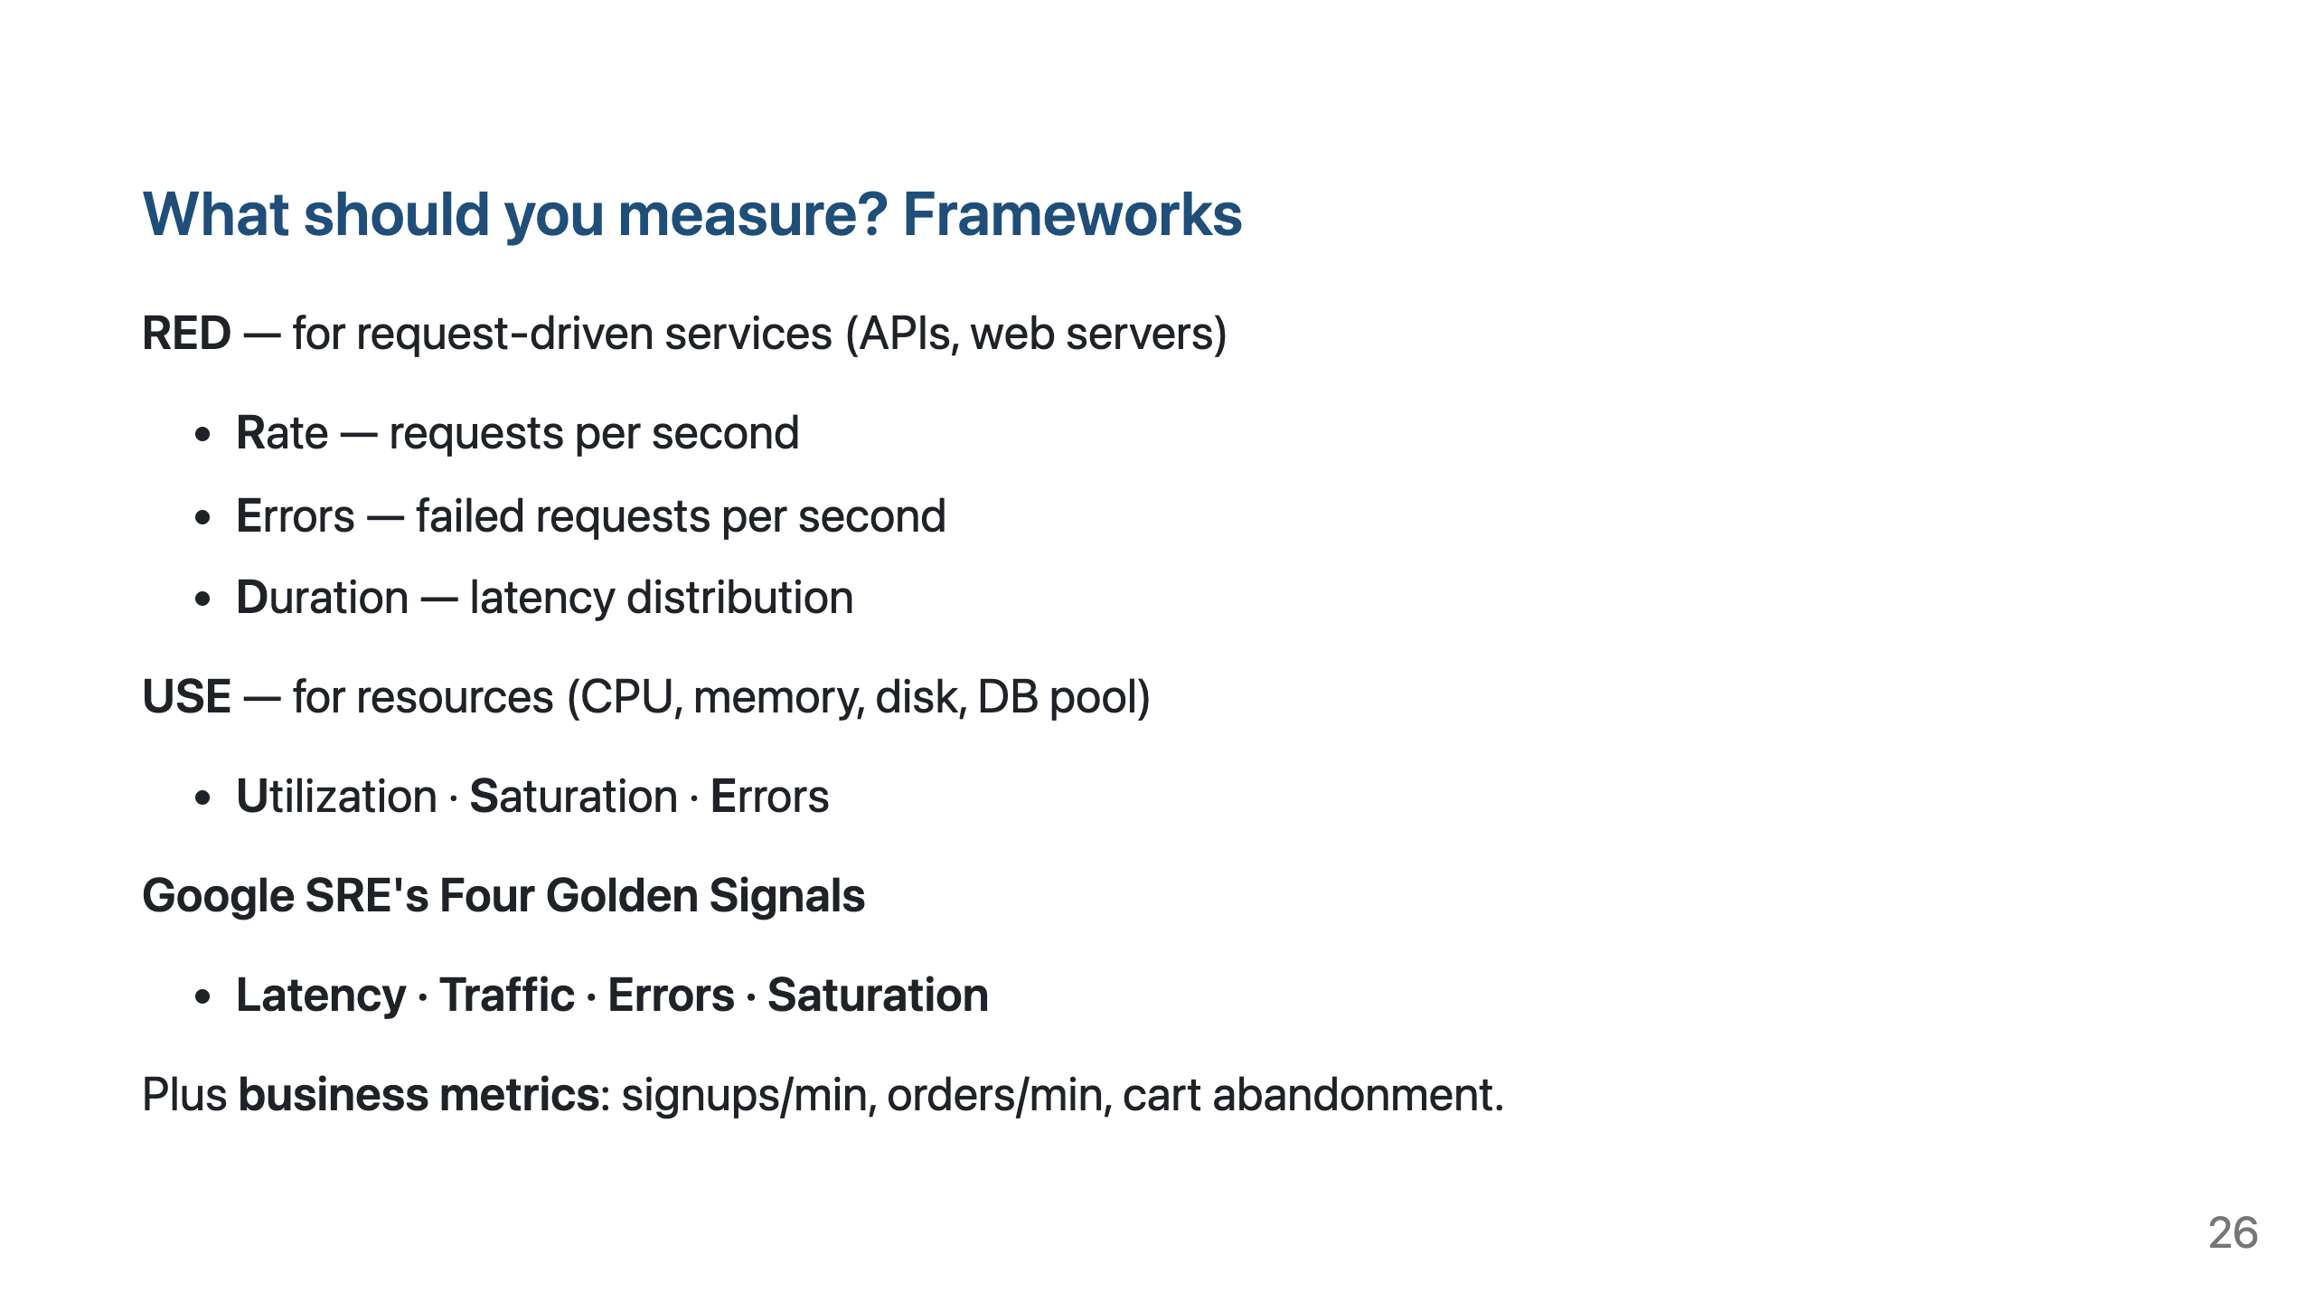

Slide 27
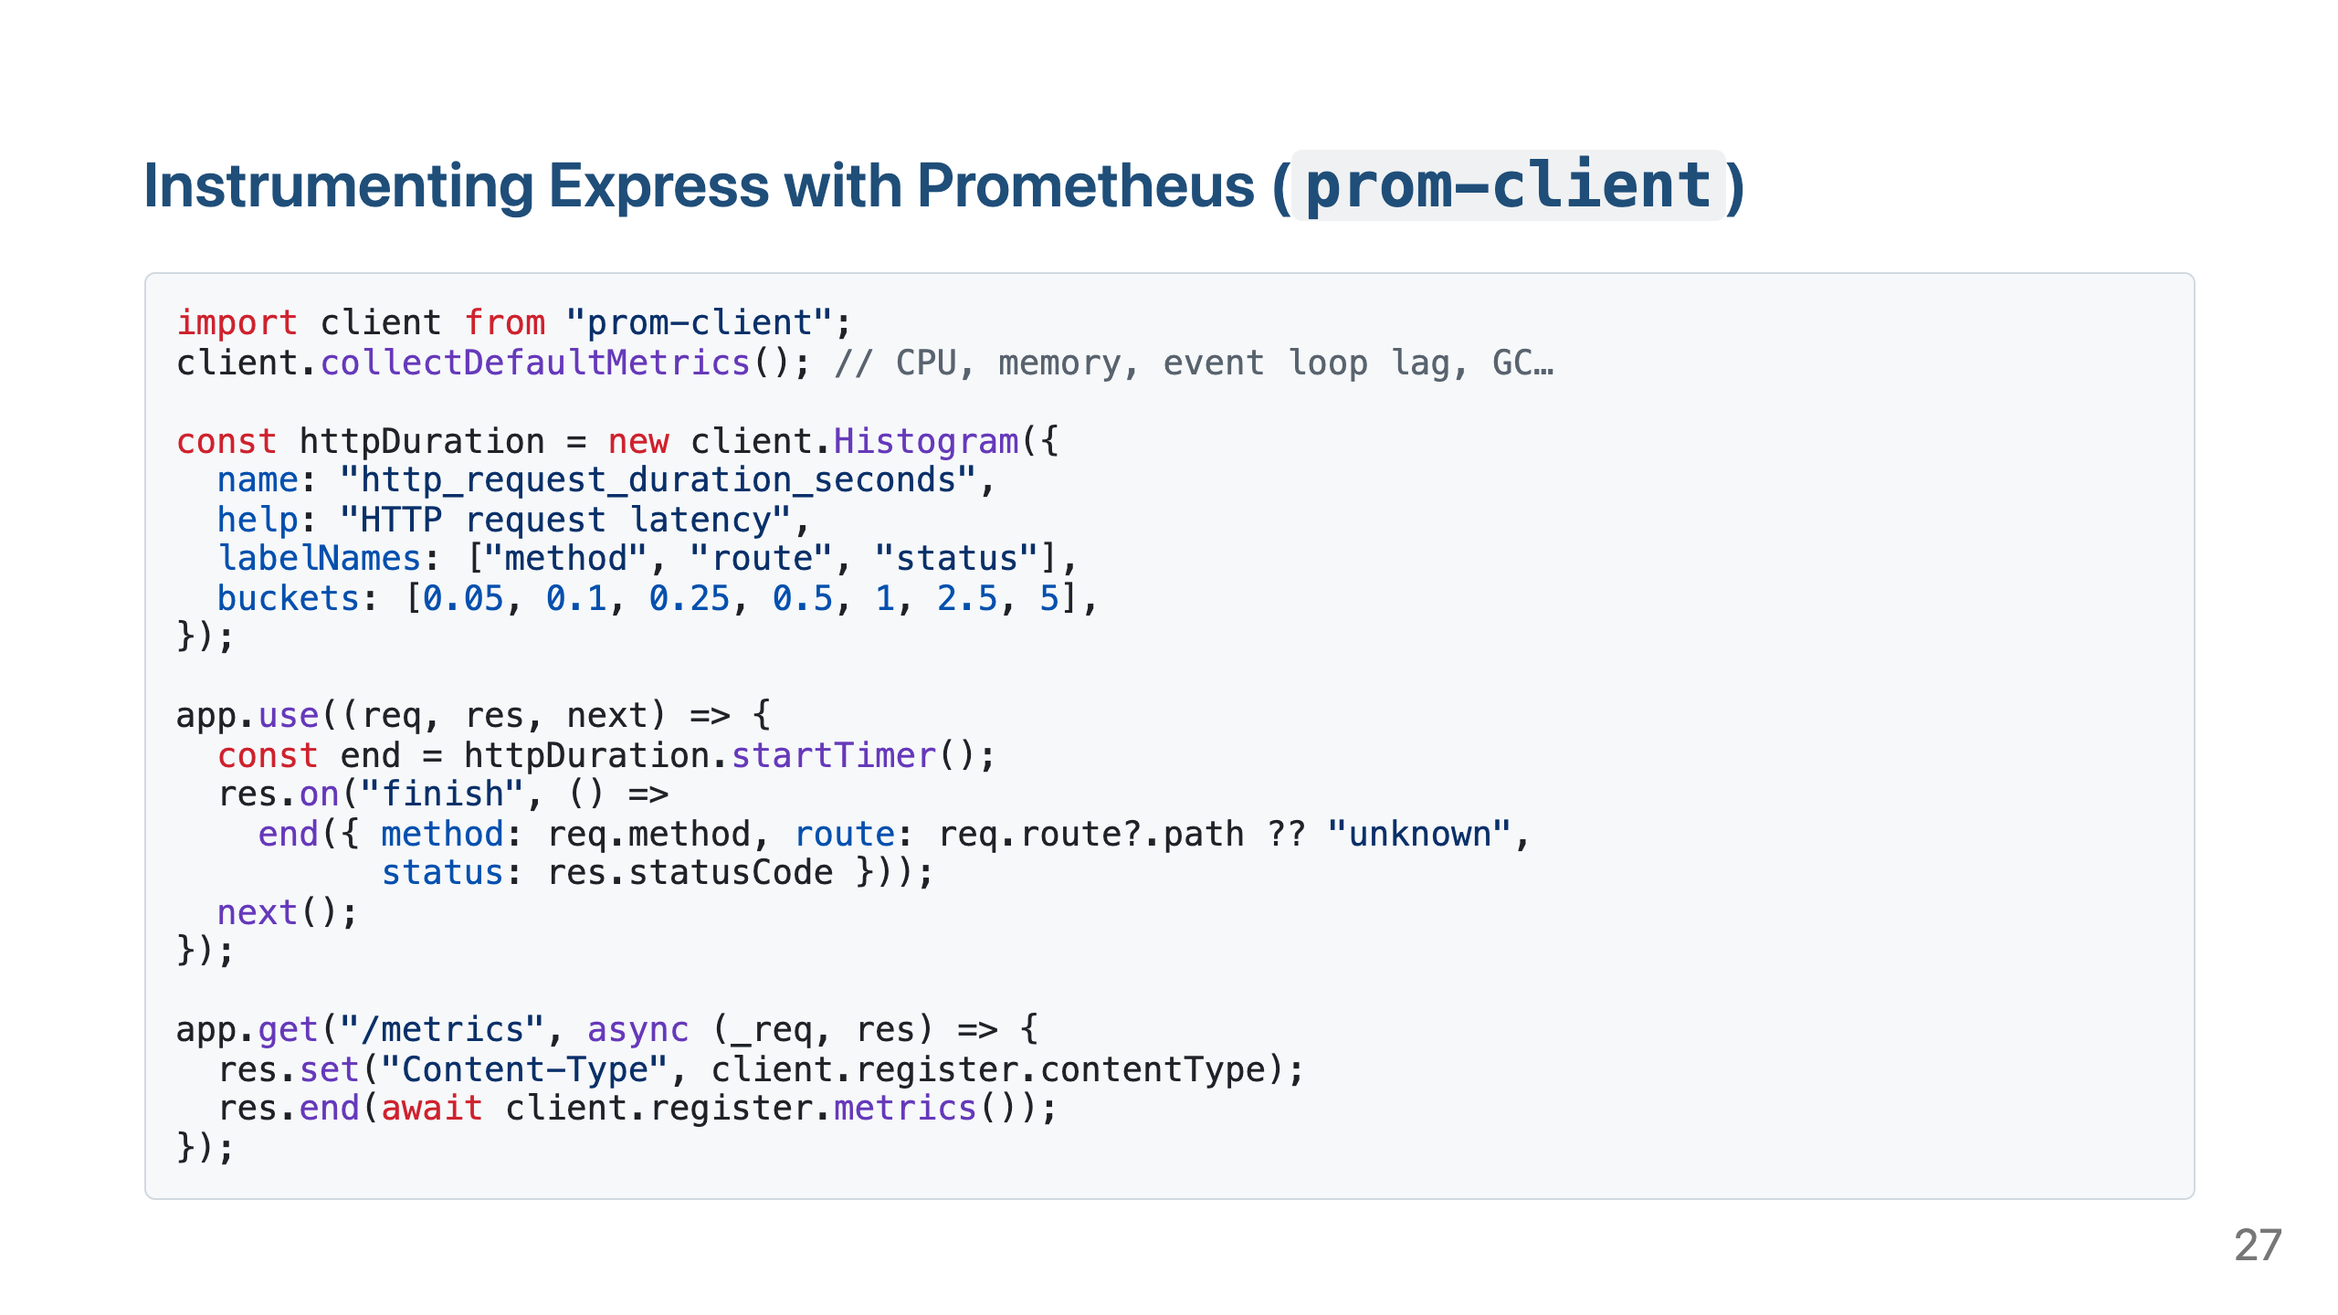

Slide 28
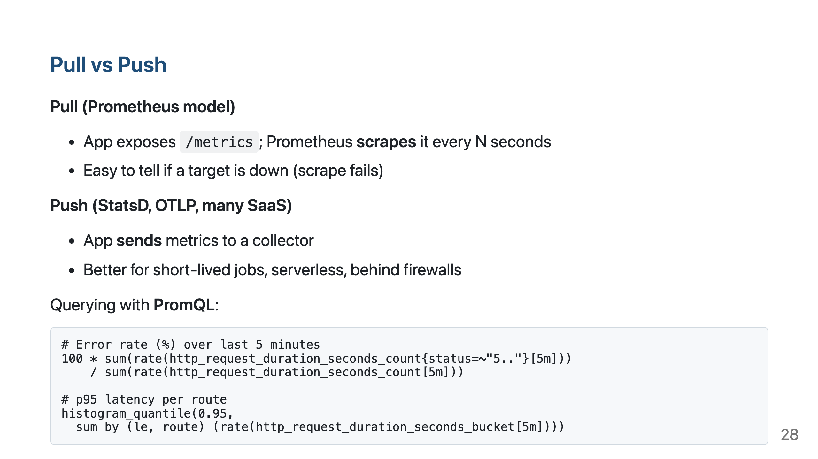

Slide 29
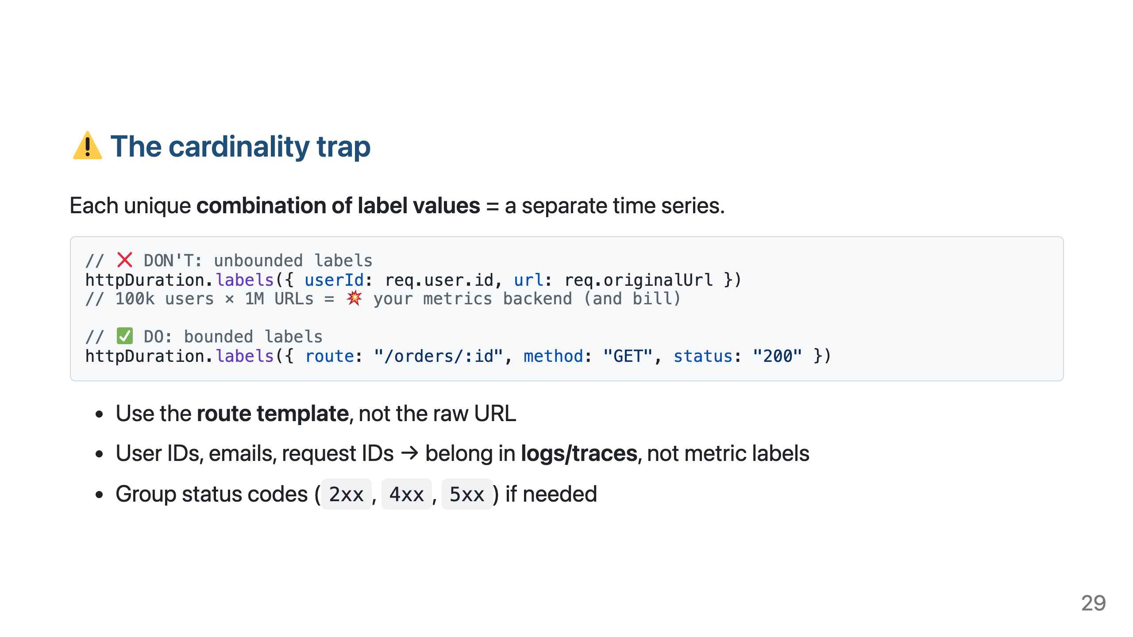

Slide 30
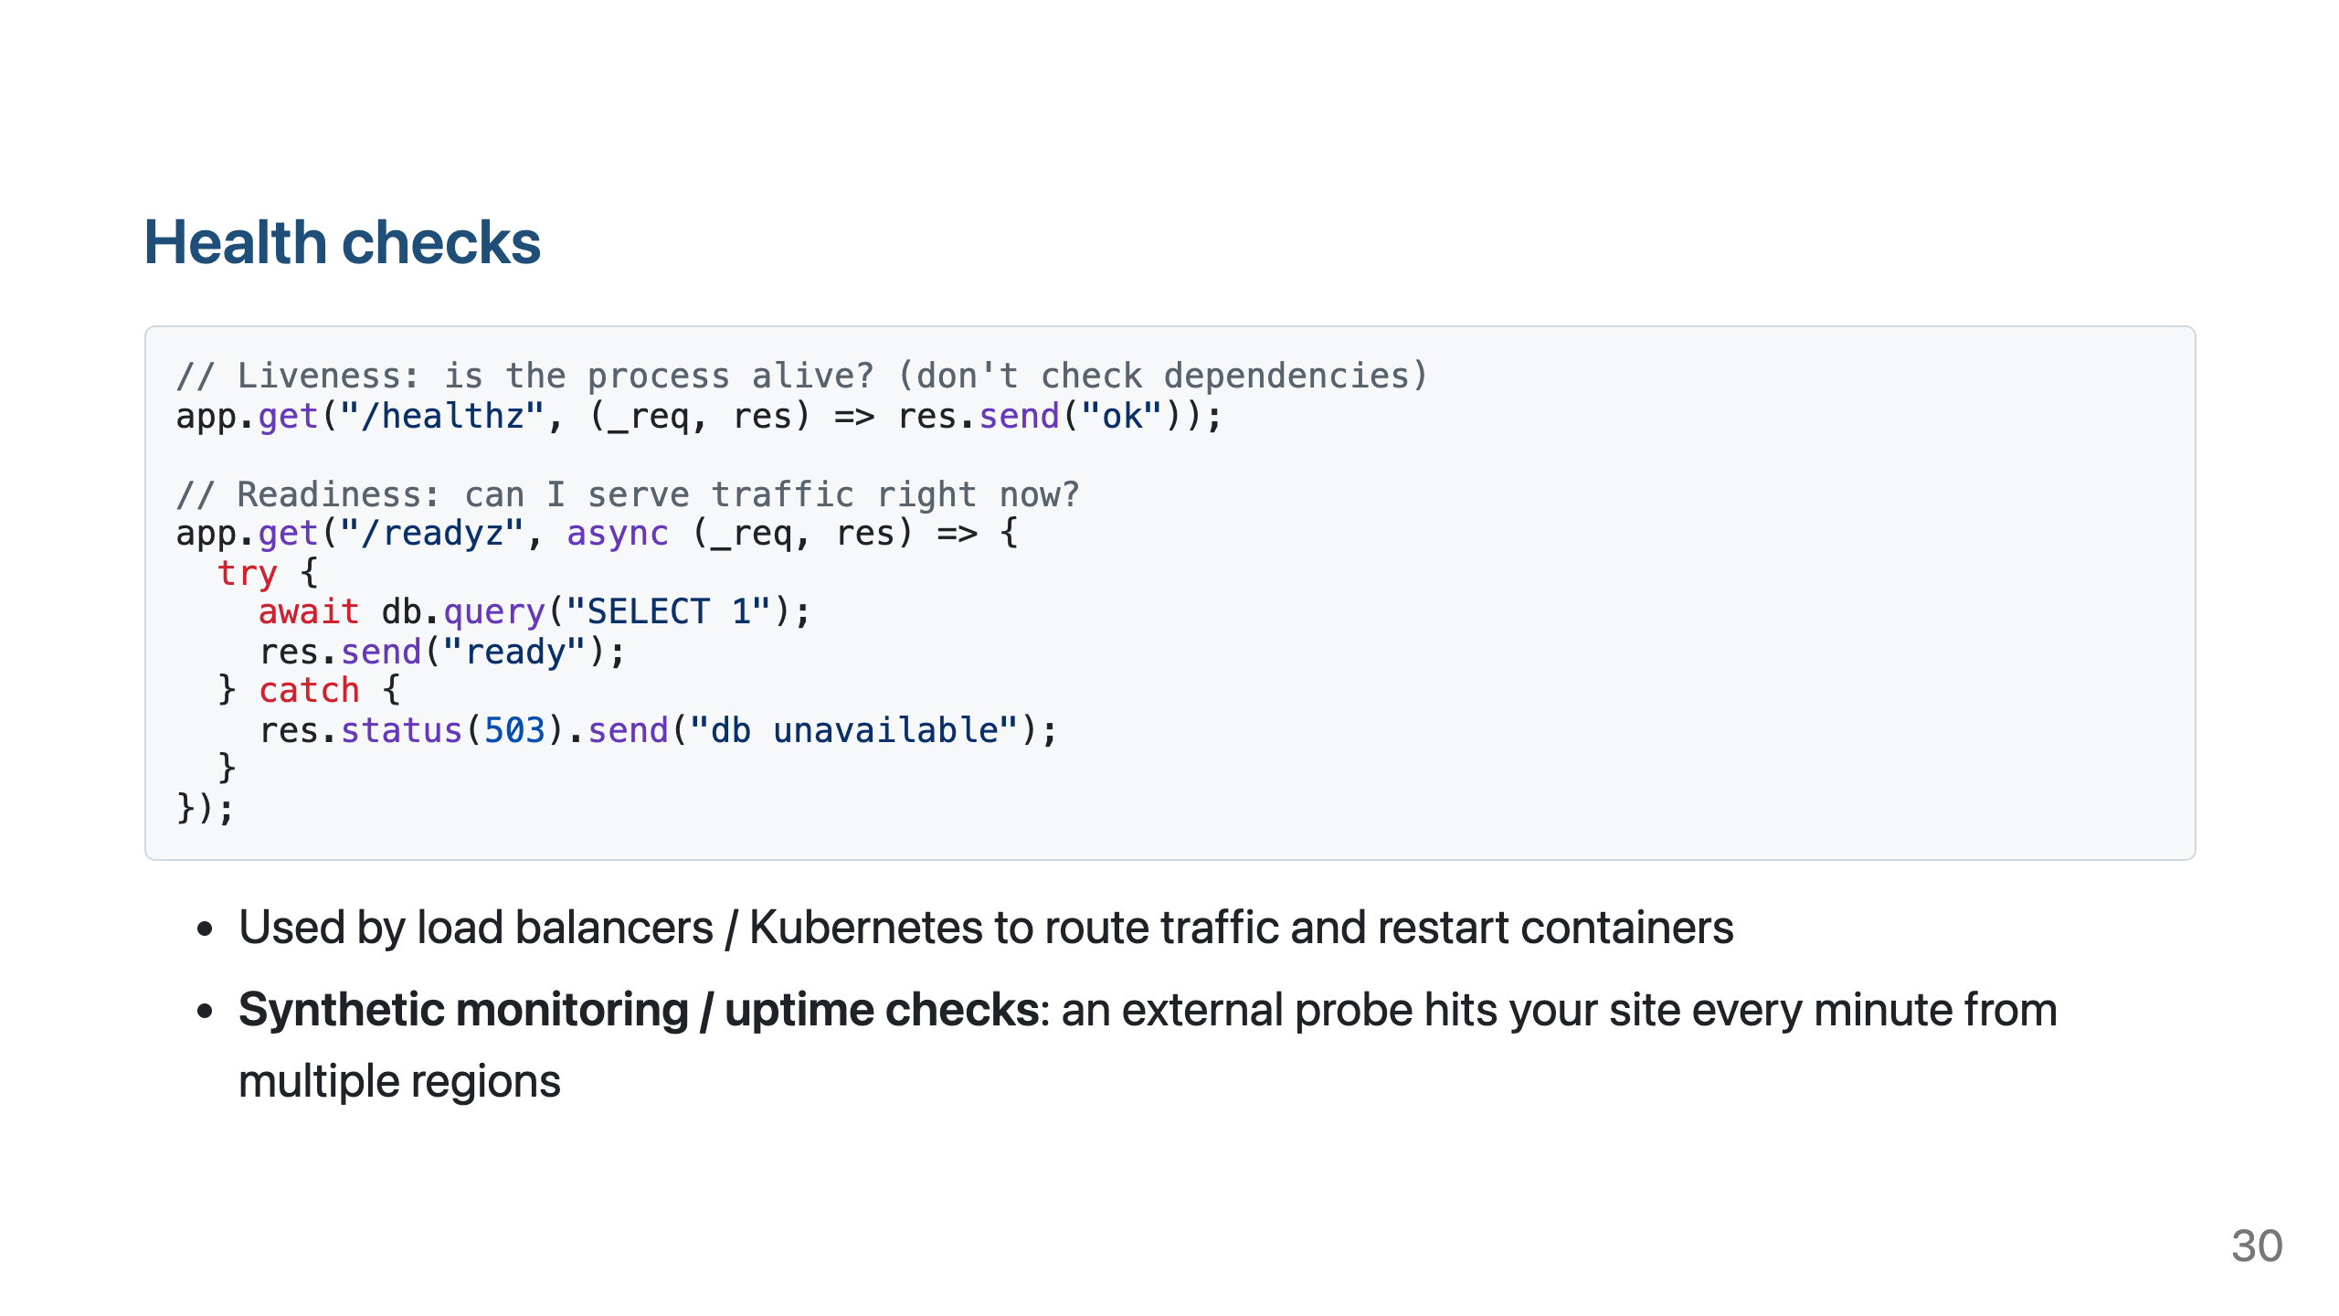

Slide 31
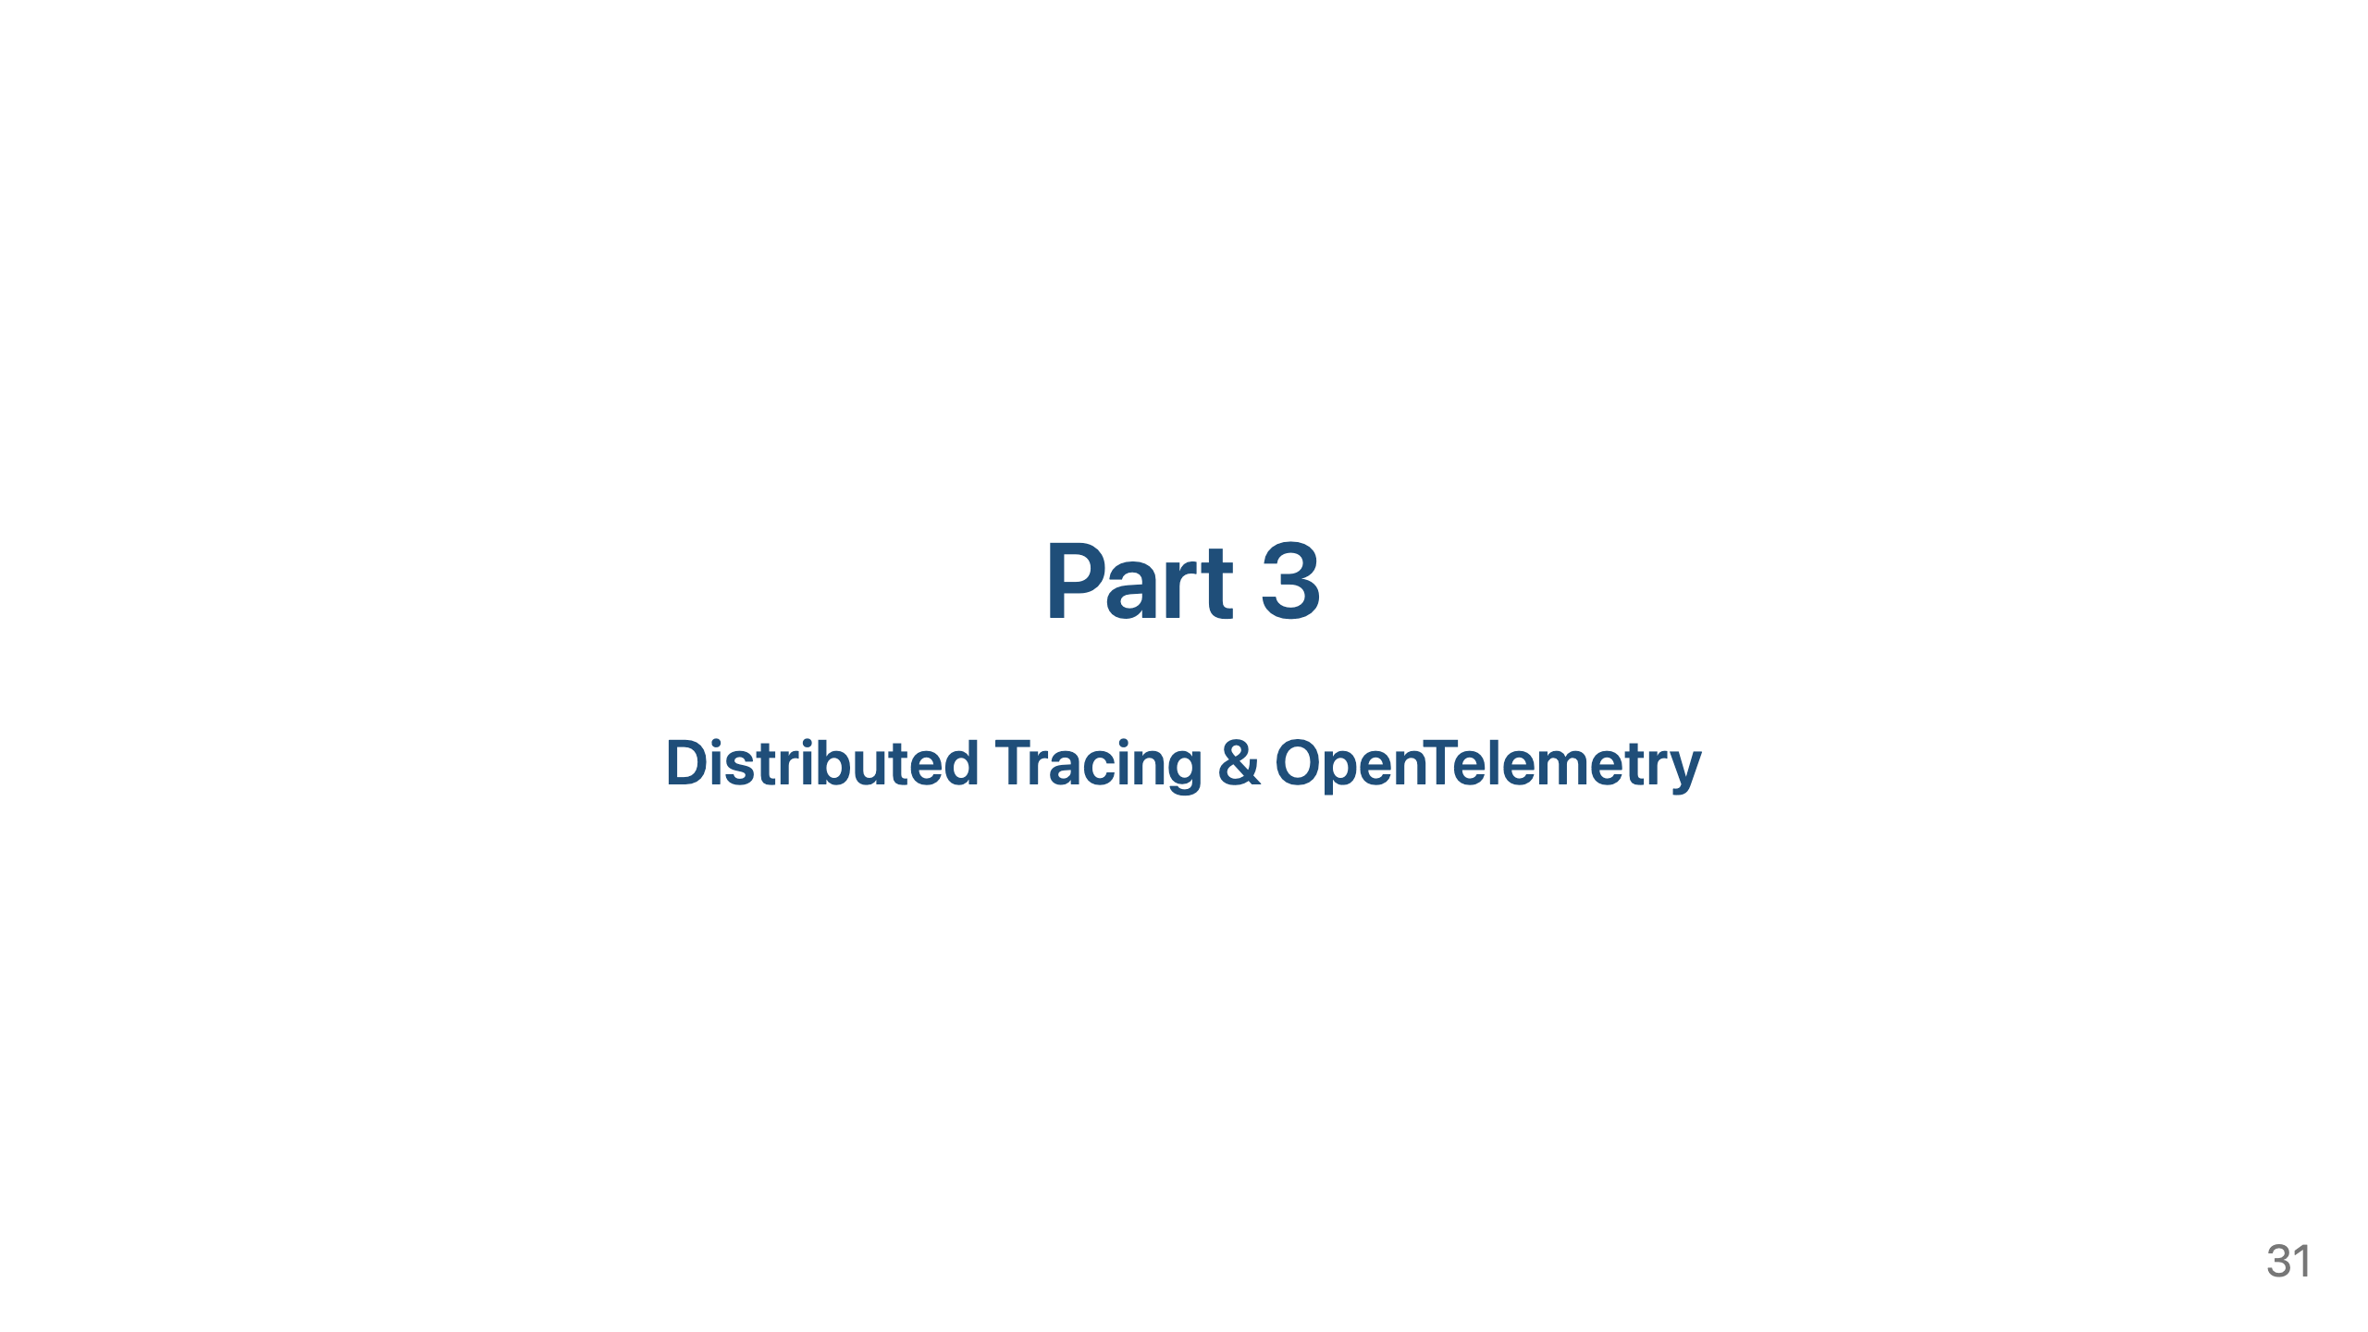

Slide 32
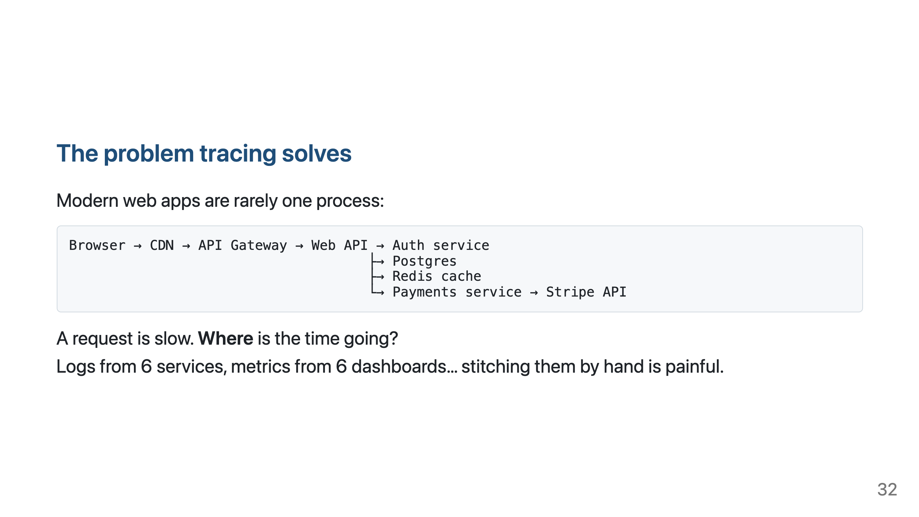

Slide 33
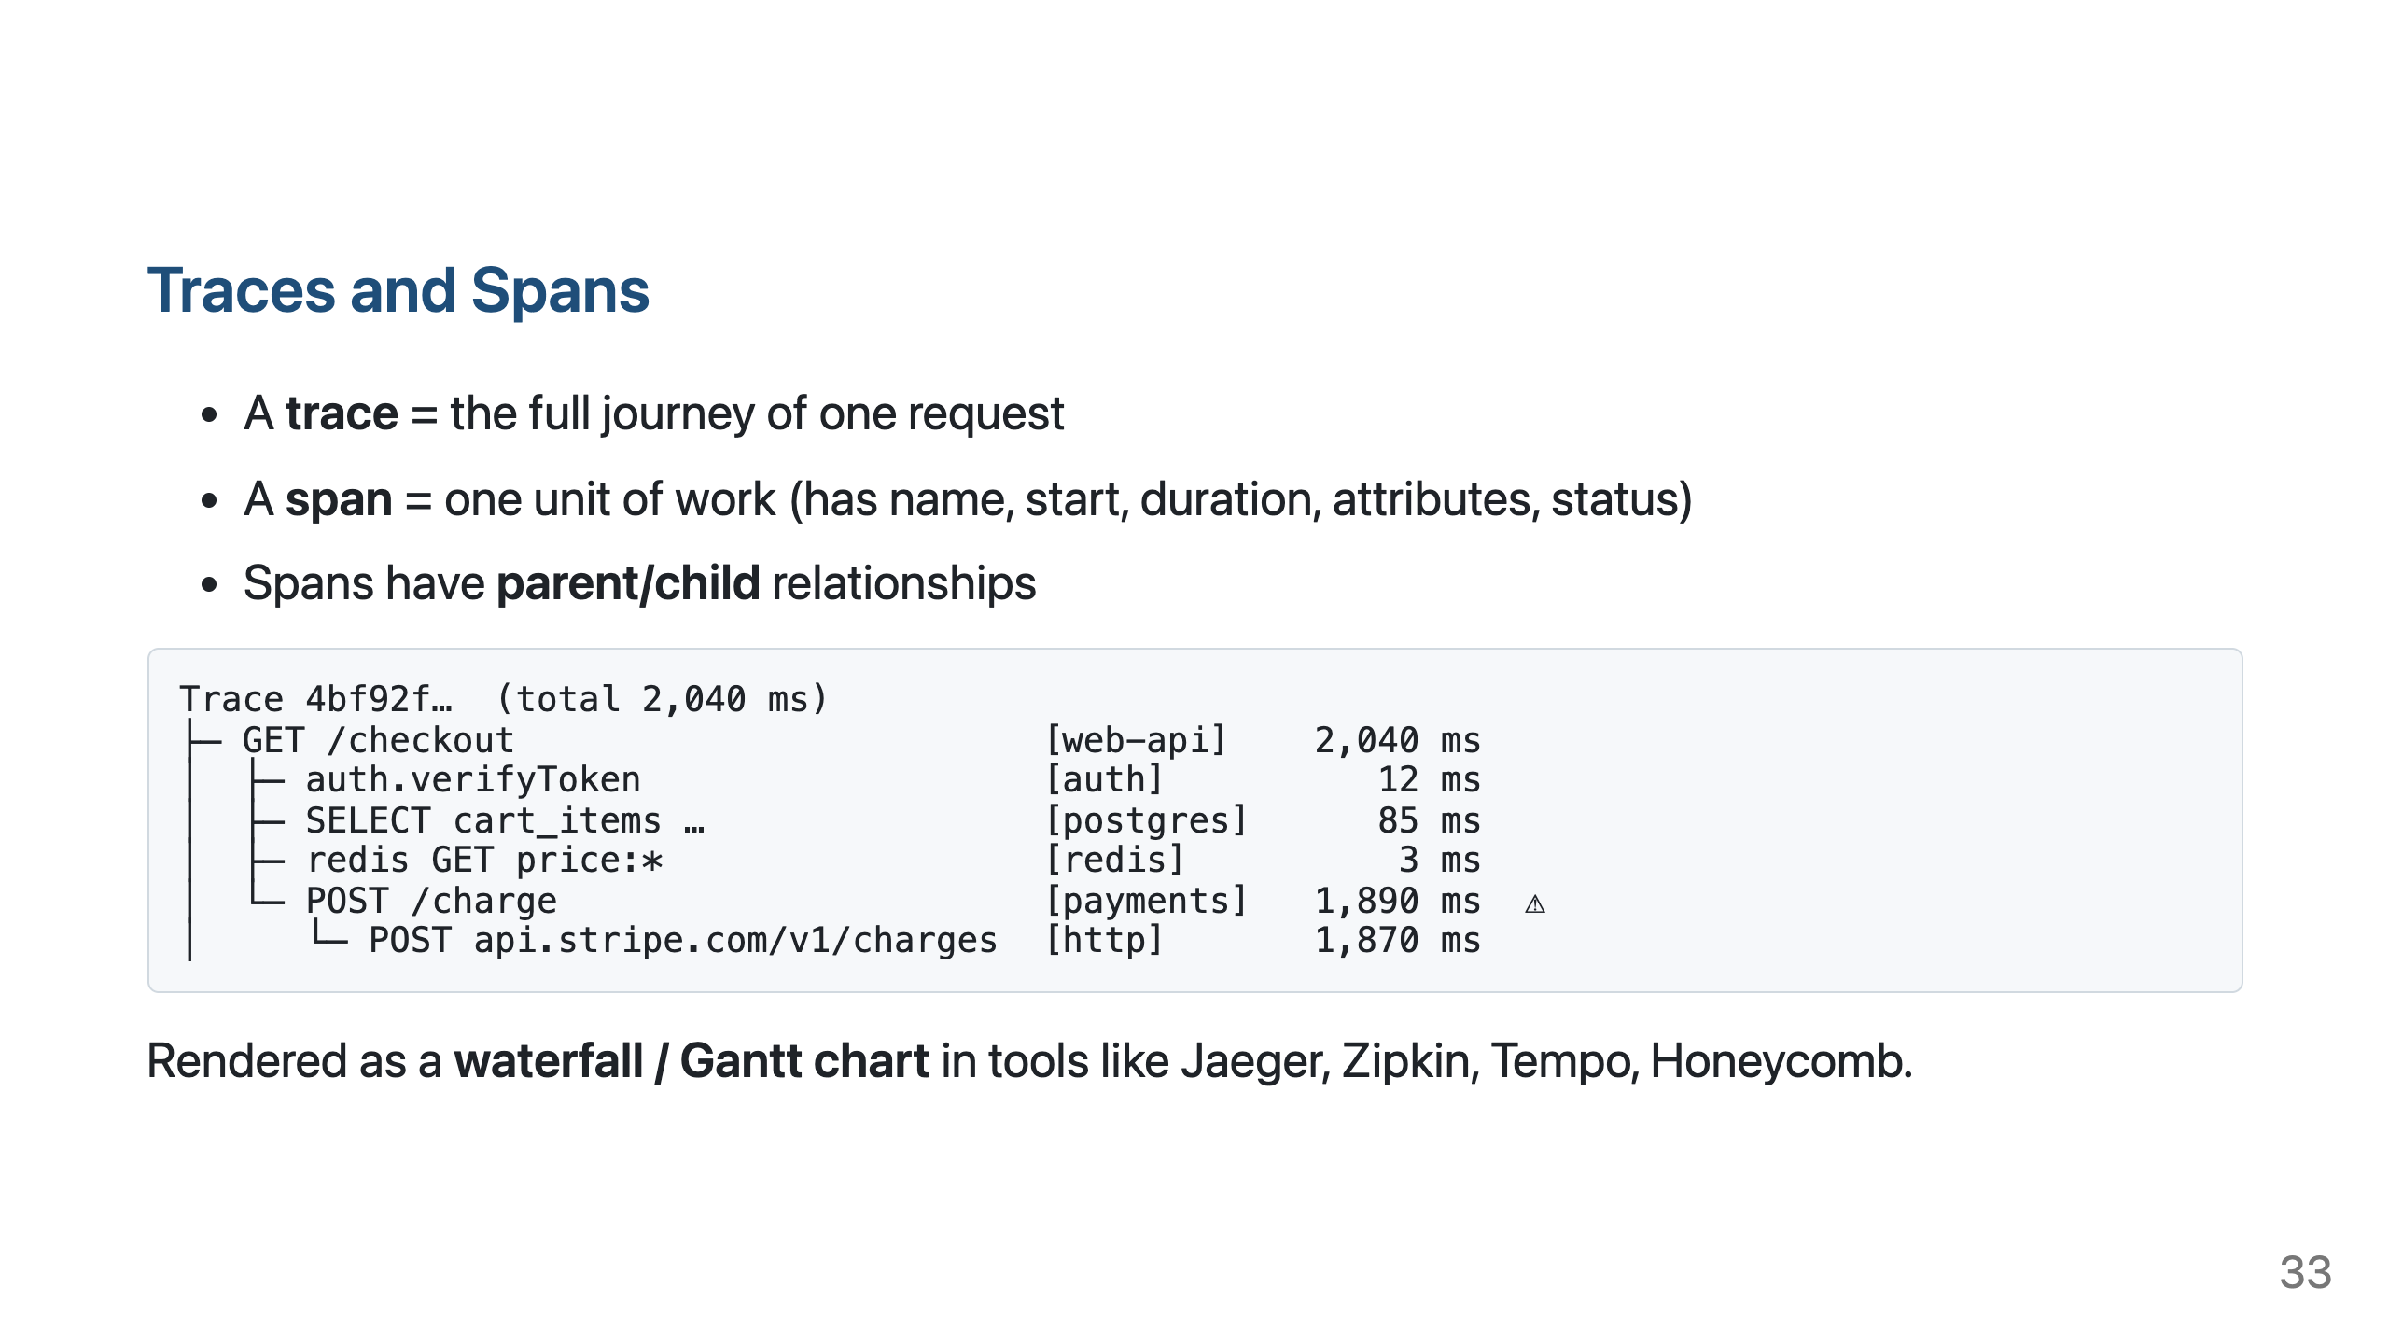

Slide 34
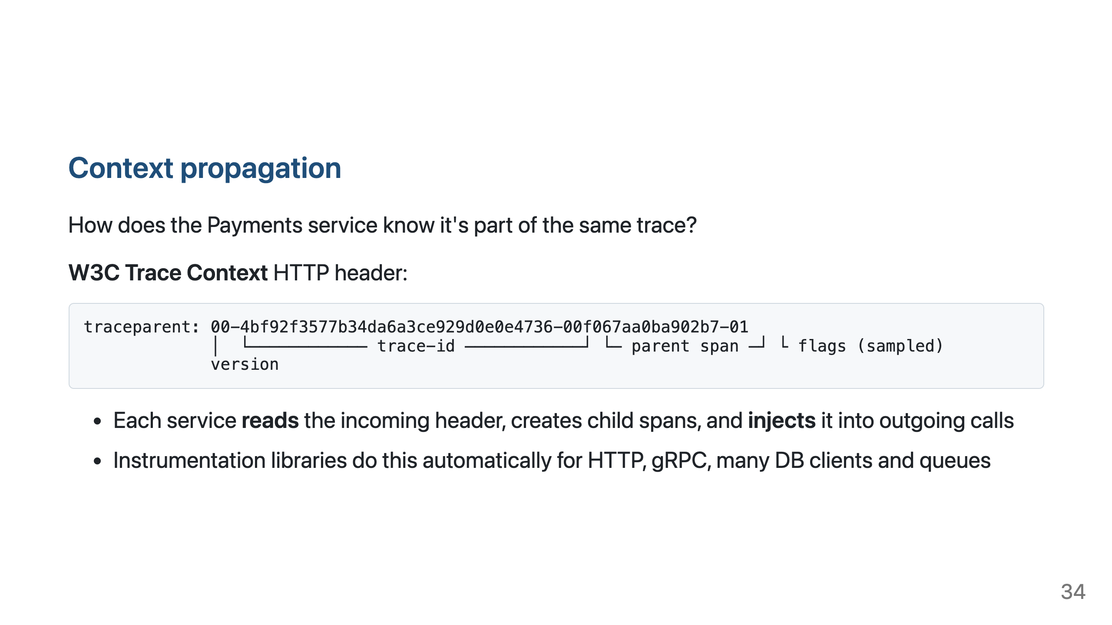

Slide 35
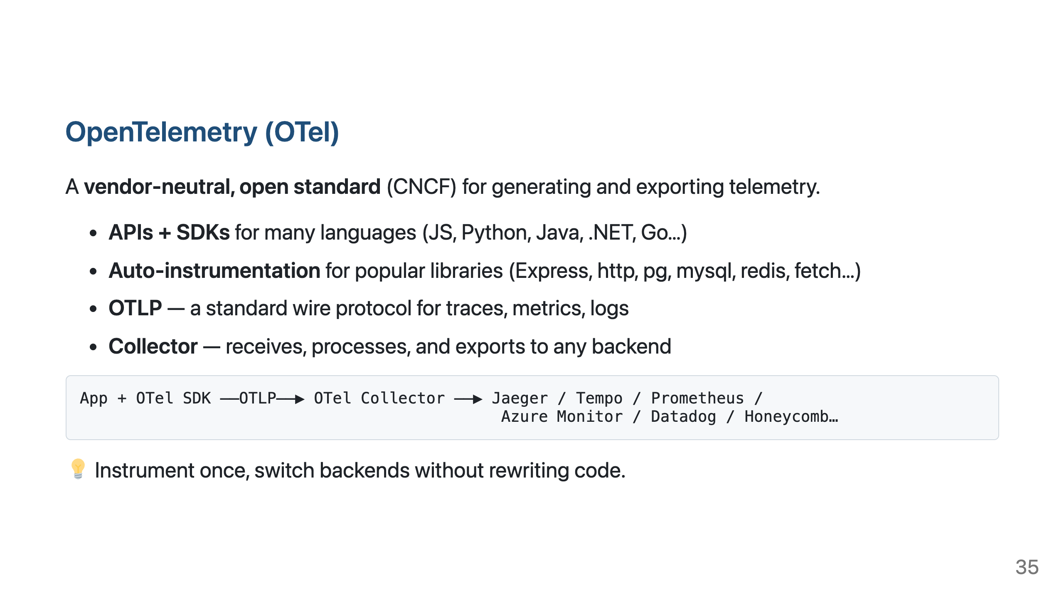

Slide 36
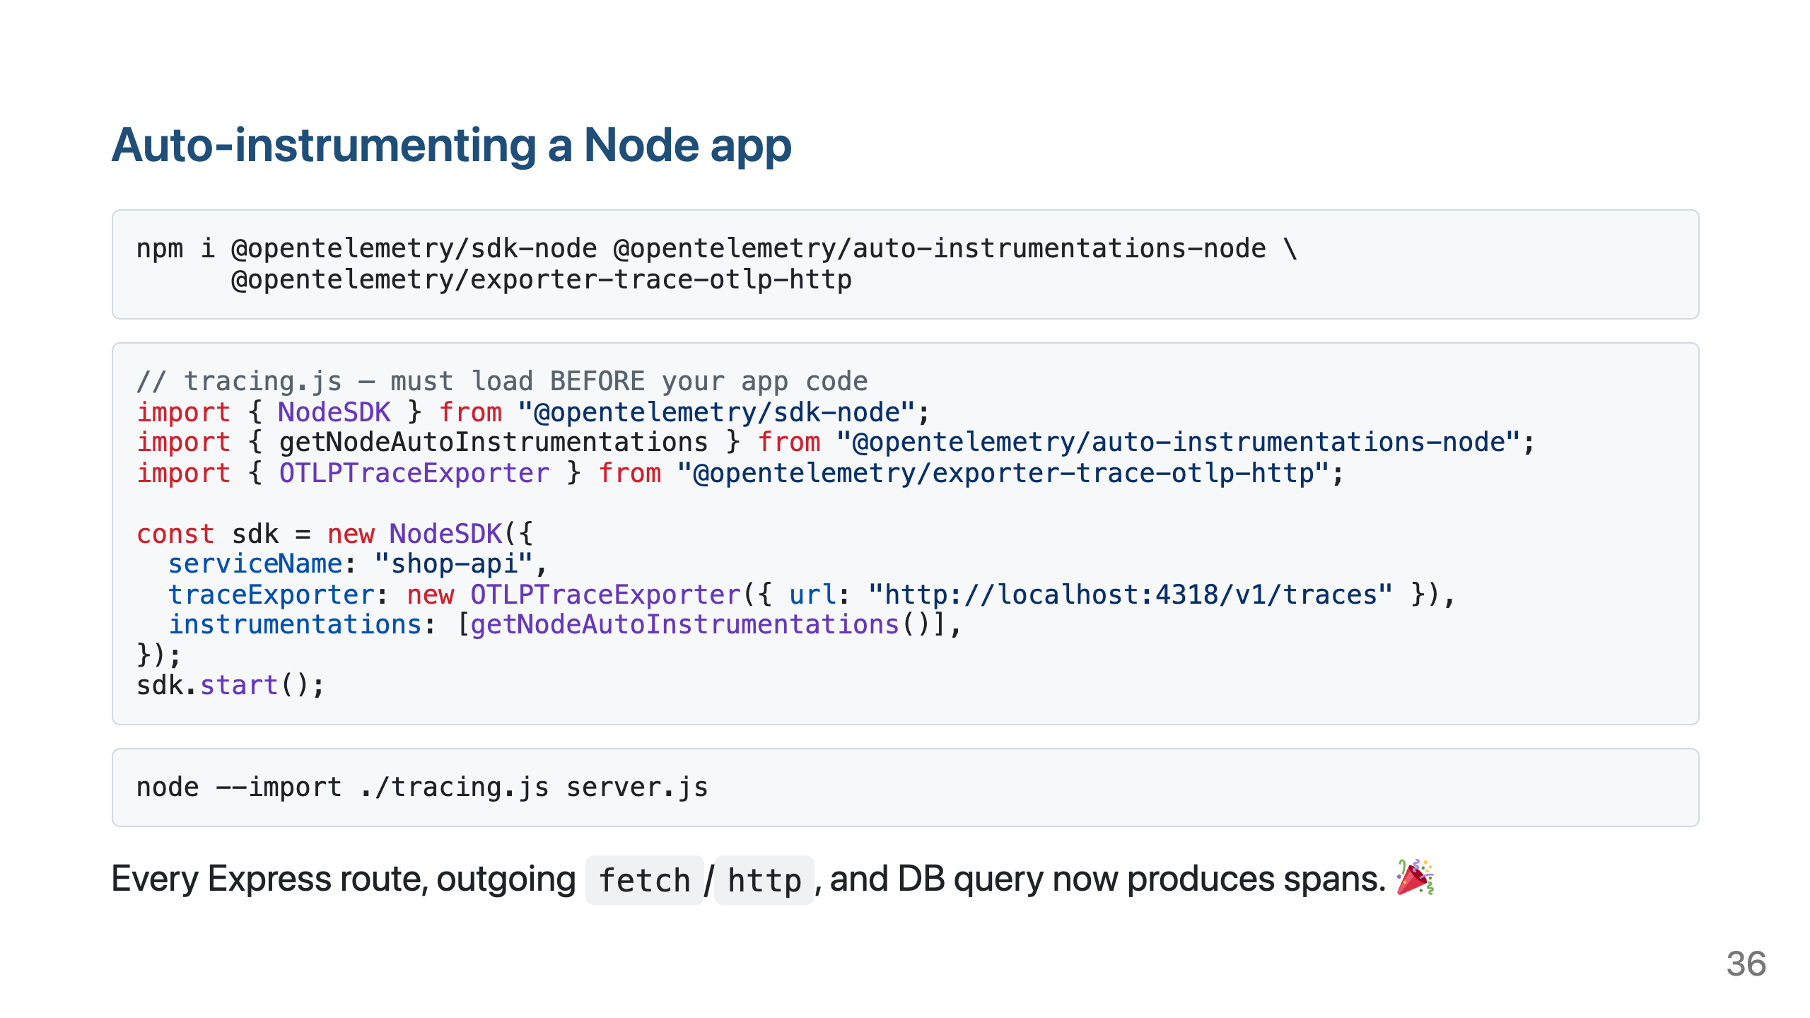

Slide 37
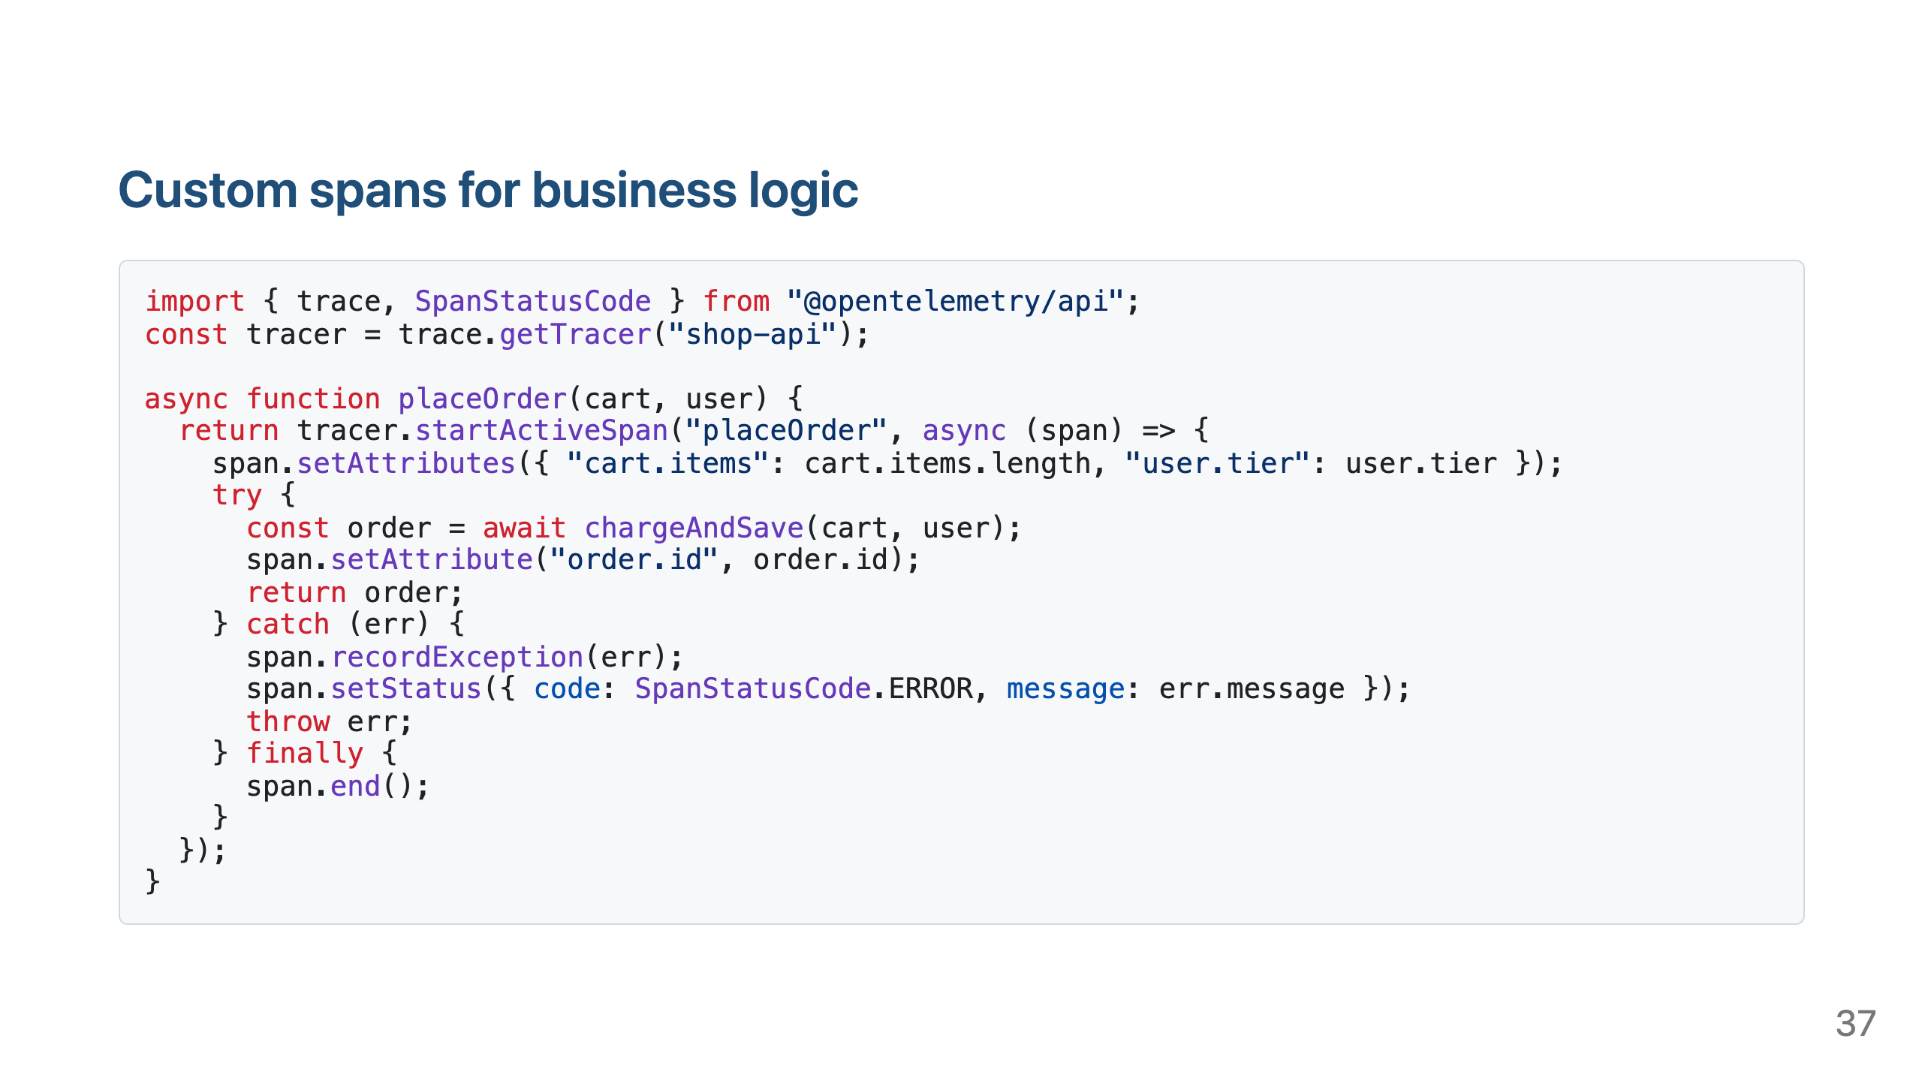

Slide 38
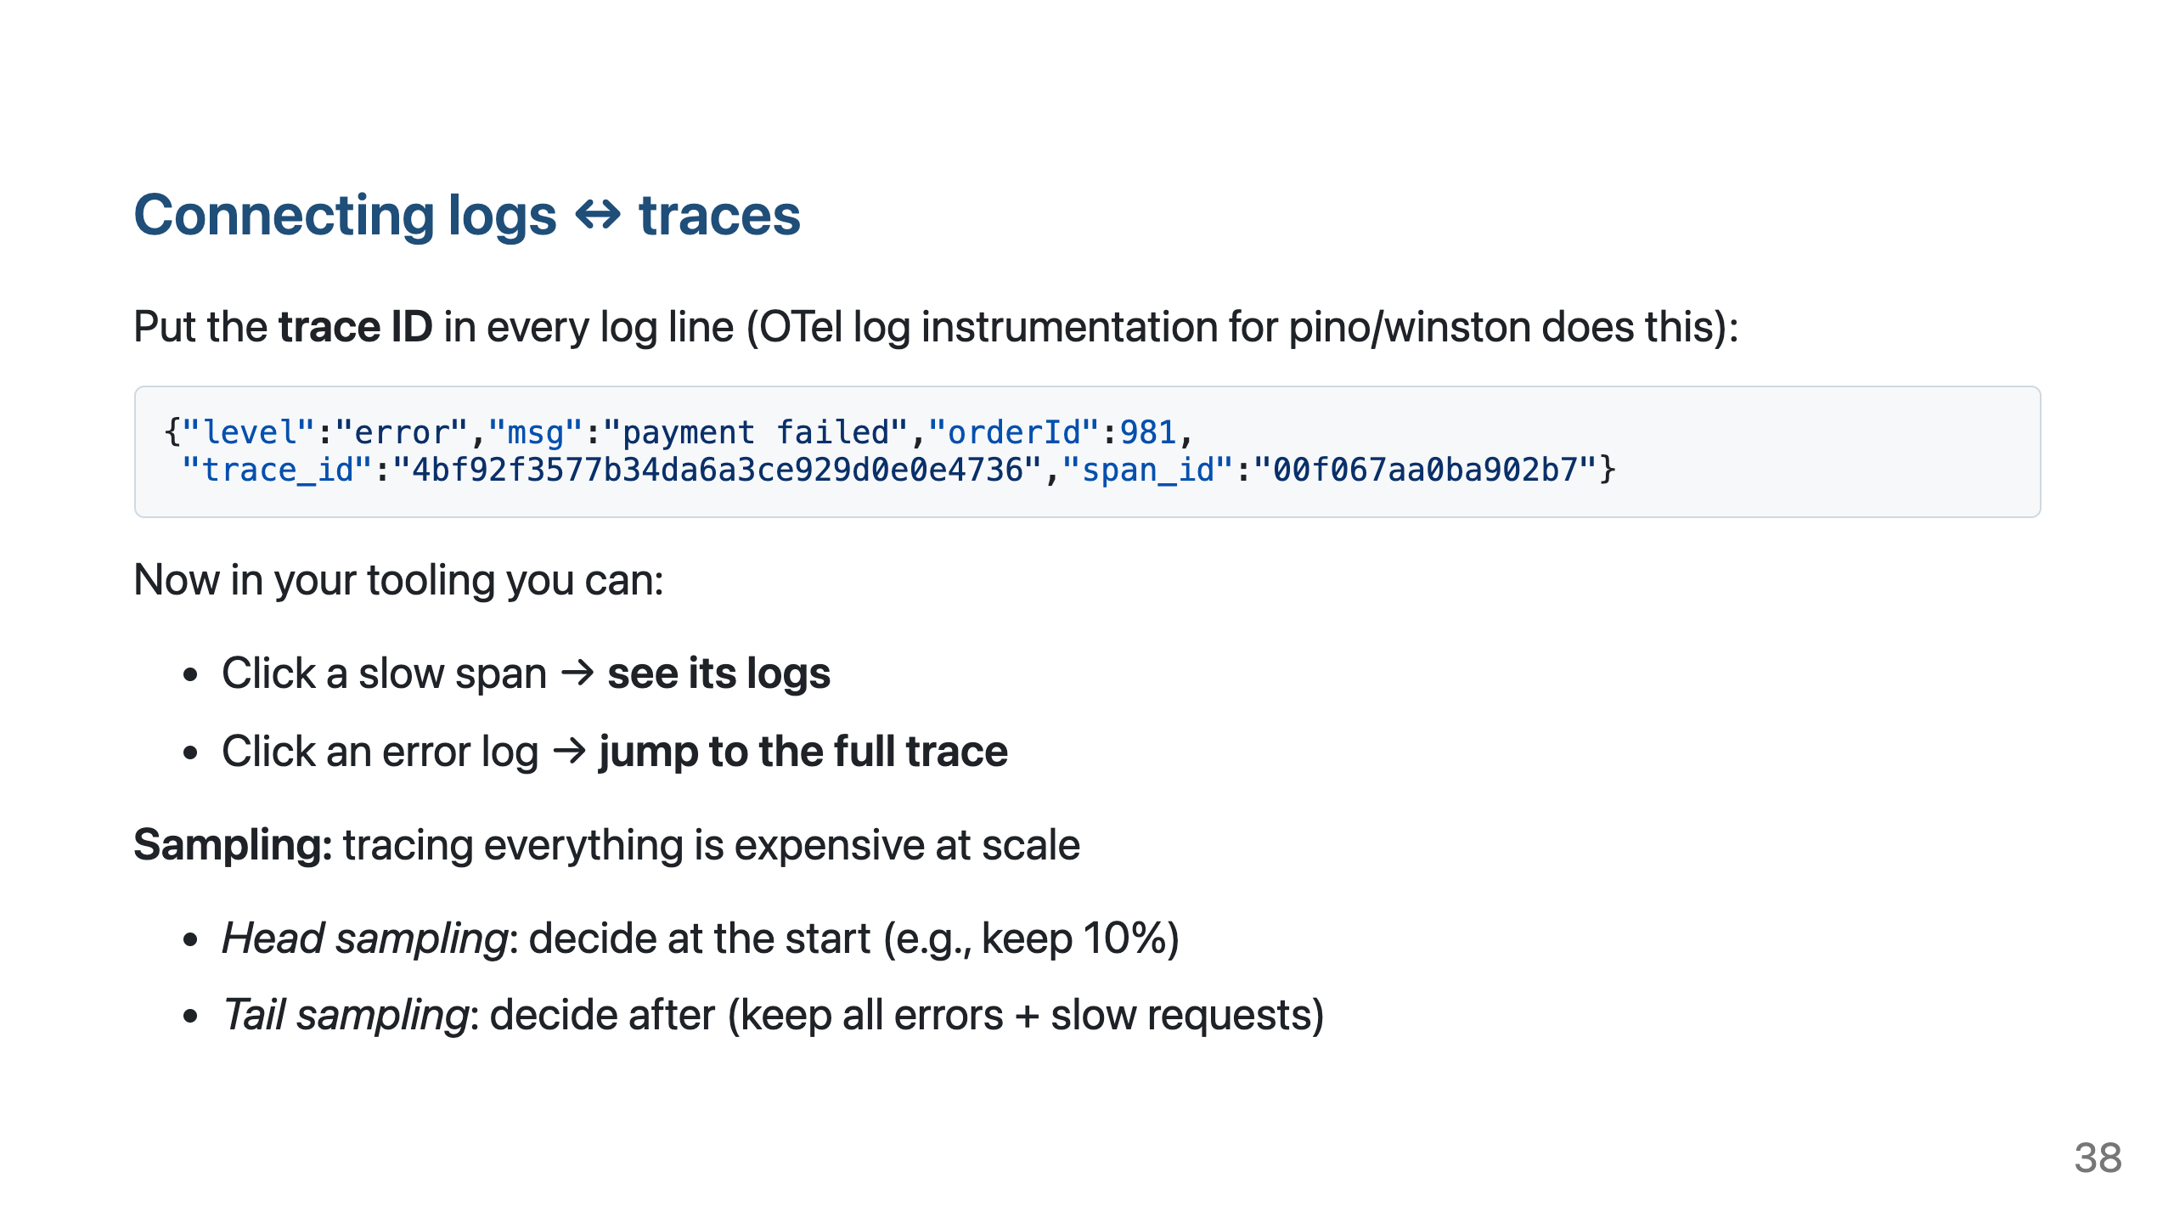

Slide 39
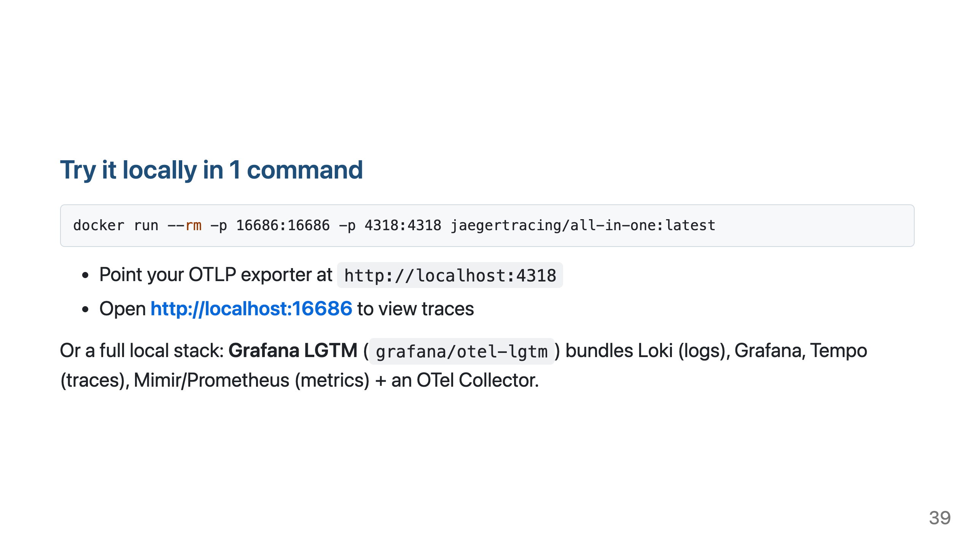
Notes:
Live demo opportunity (5 min): run the Jaeger container, start the instrumented Express app, curl a few endpoints including one with an artificial delay, and show the waterfall.

Slide 40
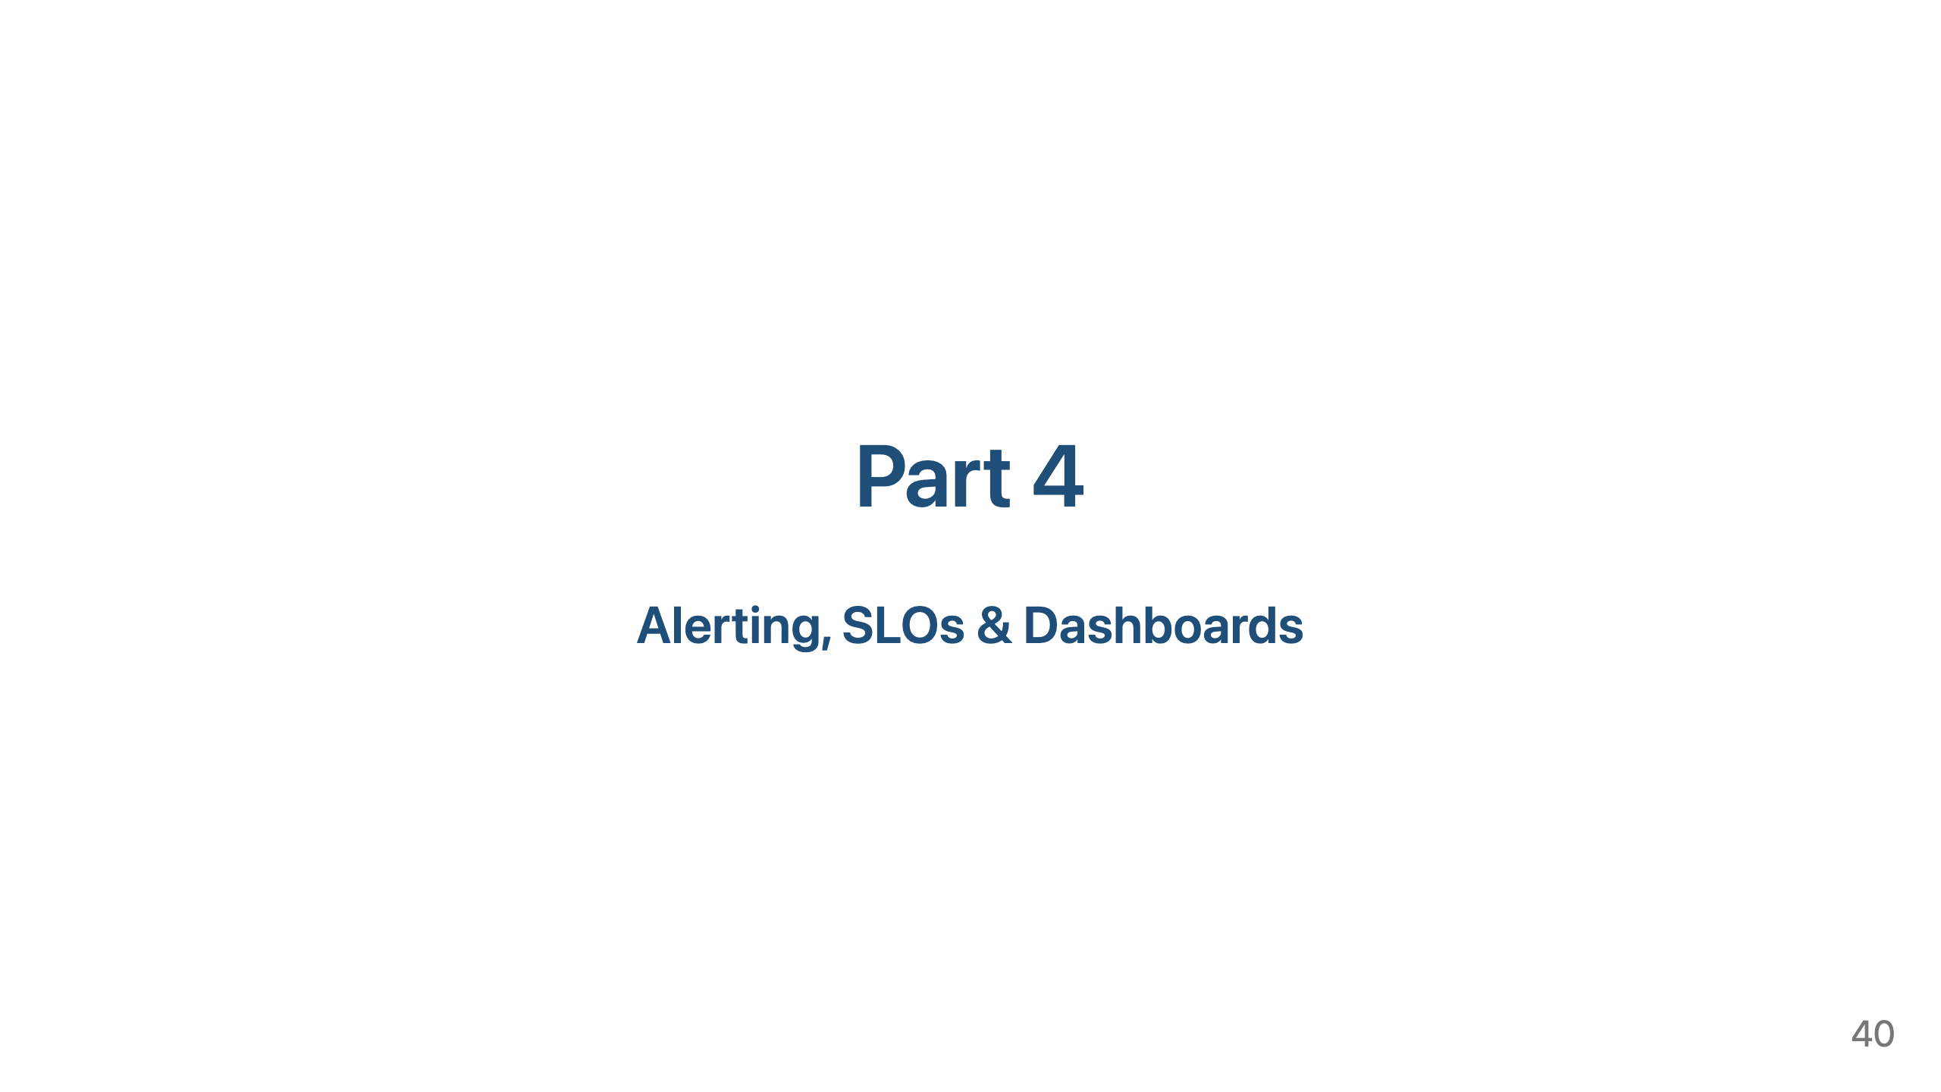

Slide 41
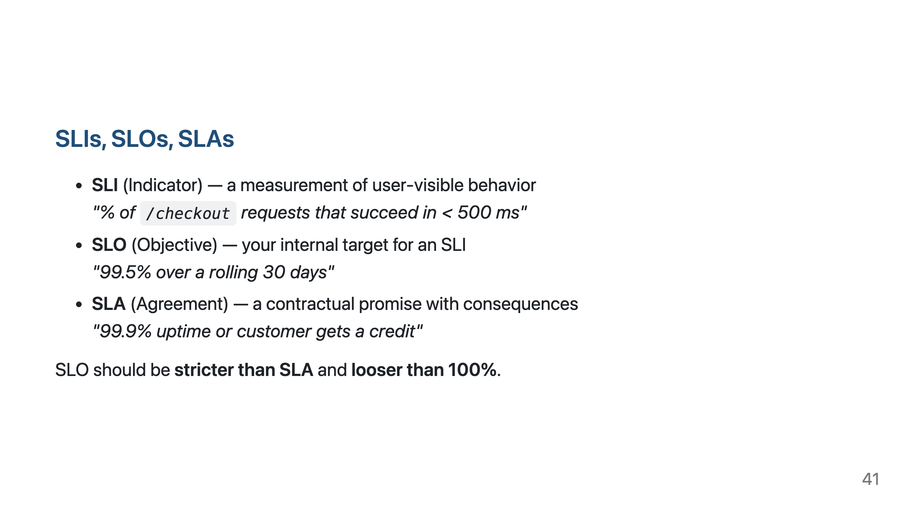

Slide 42
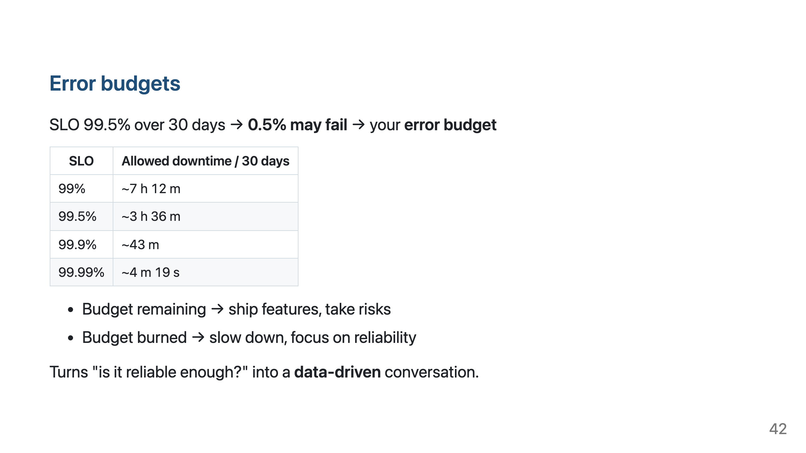

Slide 43
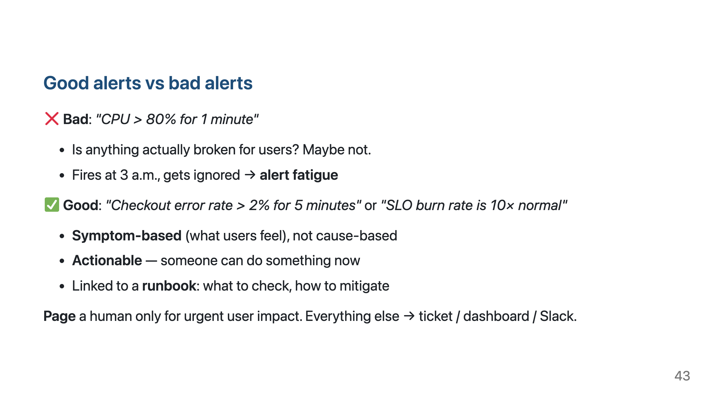

Slide 44
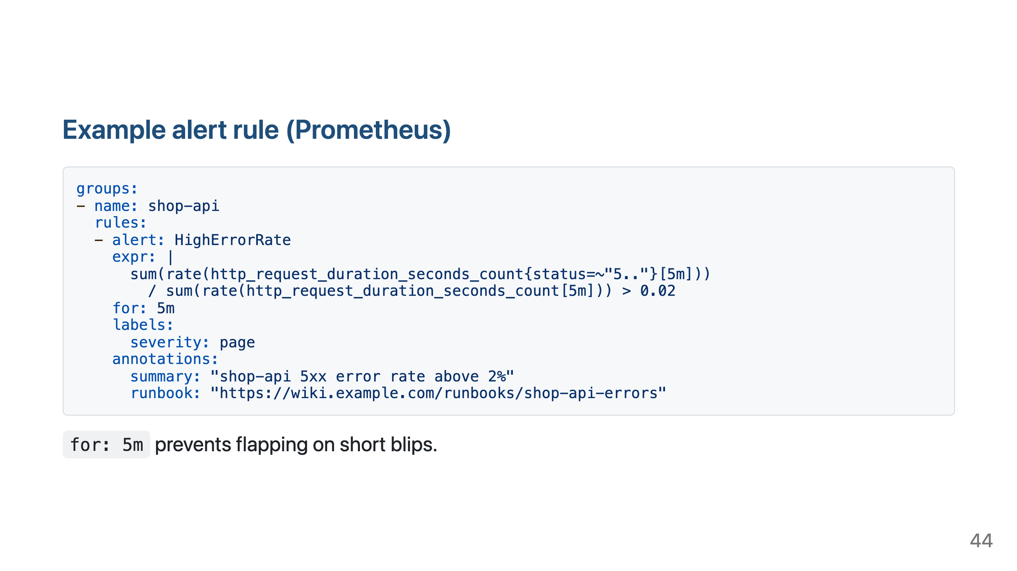

Slide 45
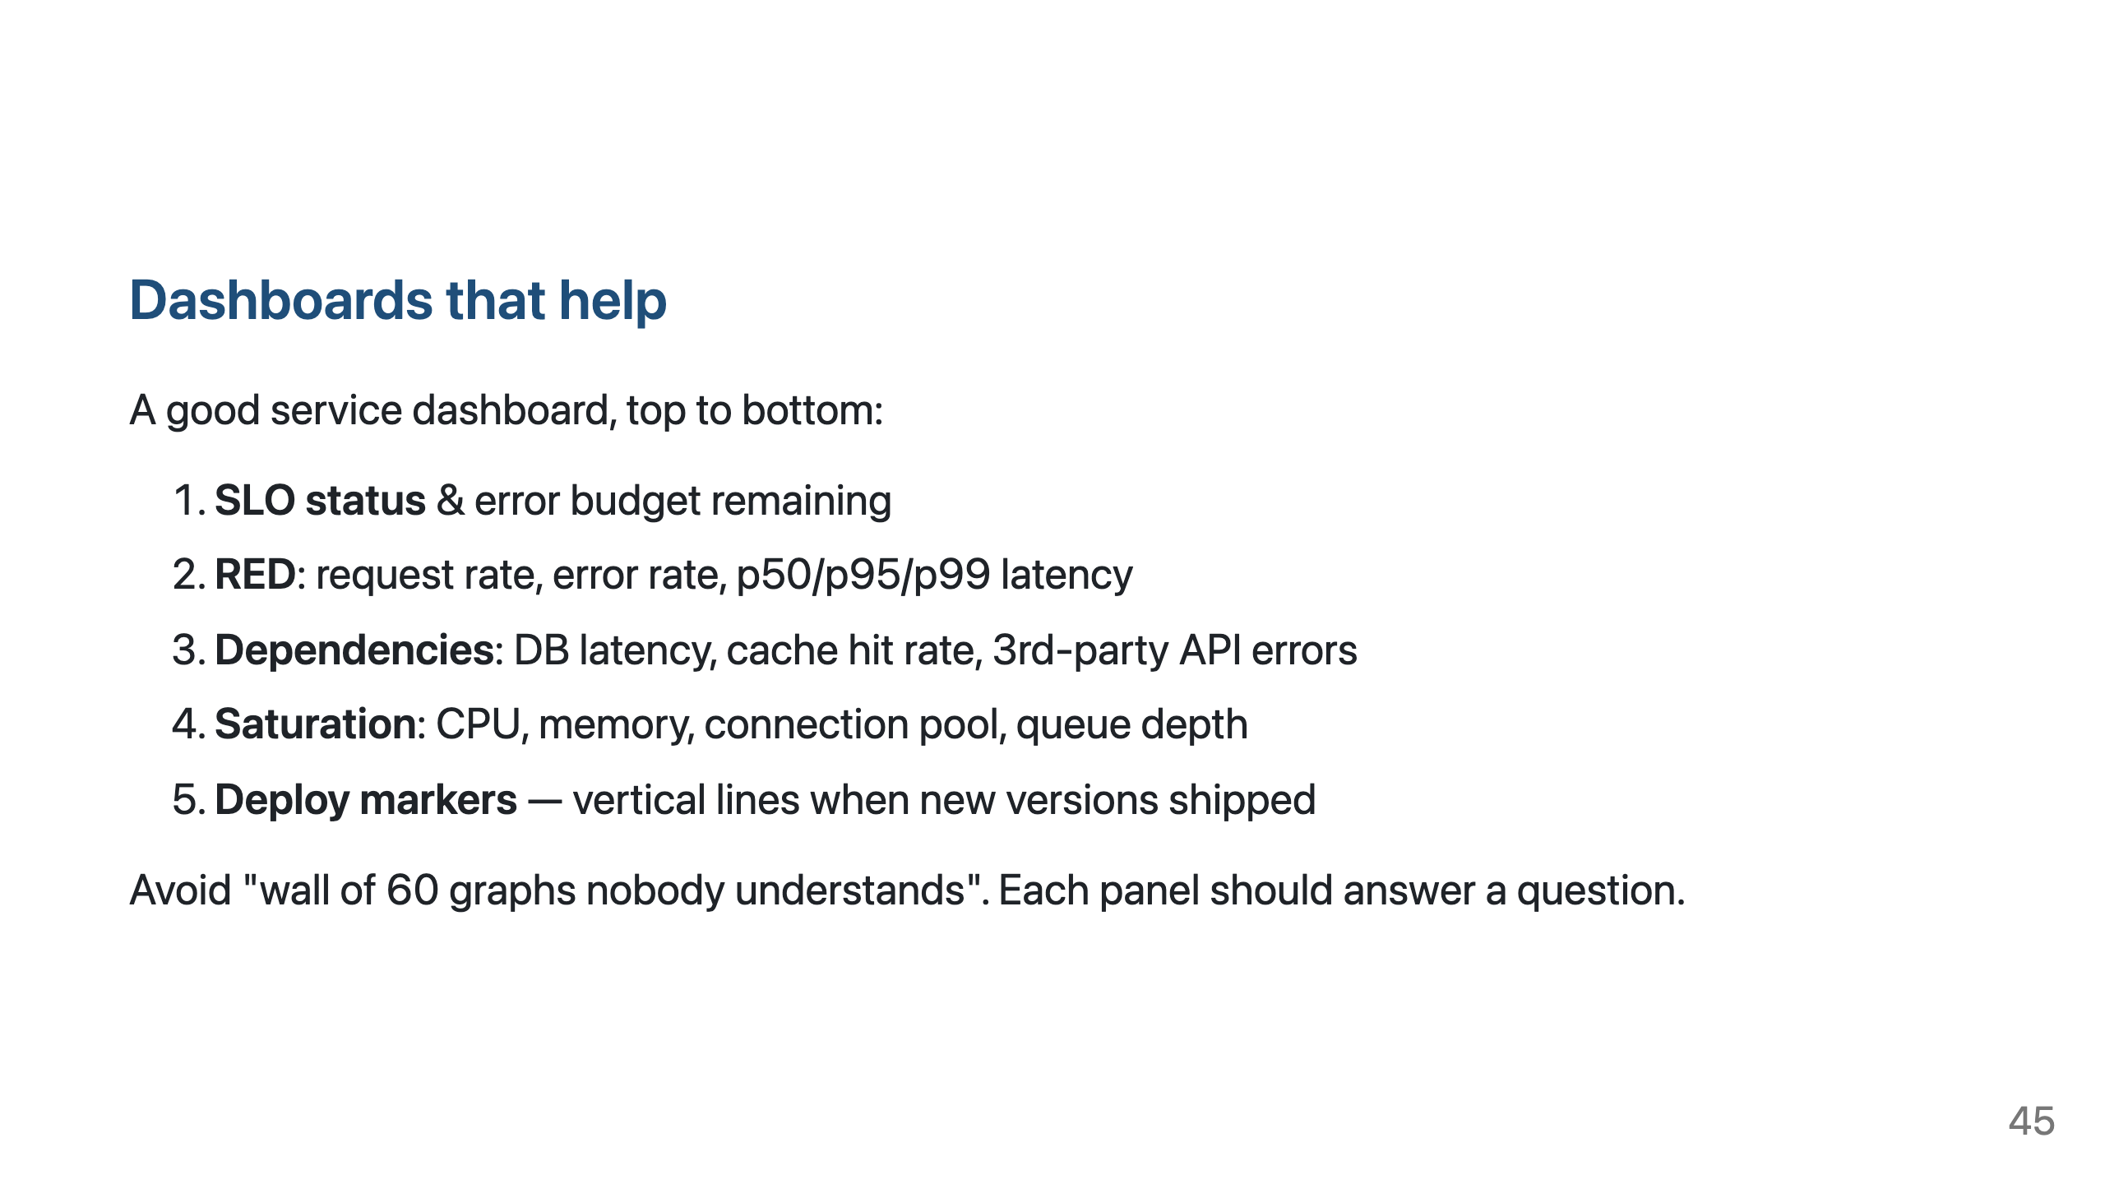

Slide 46
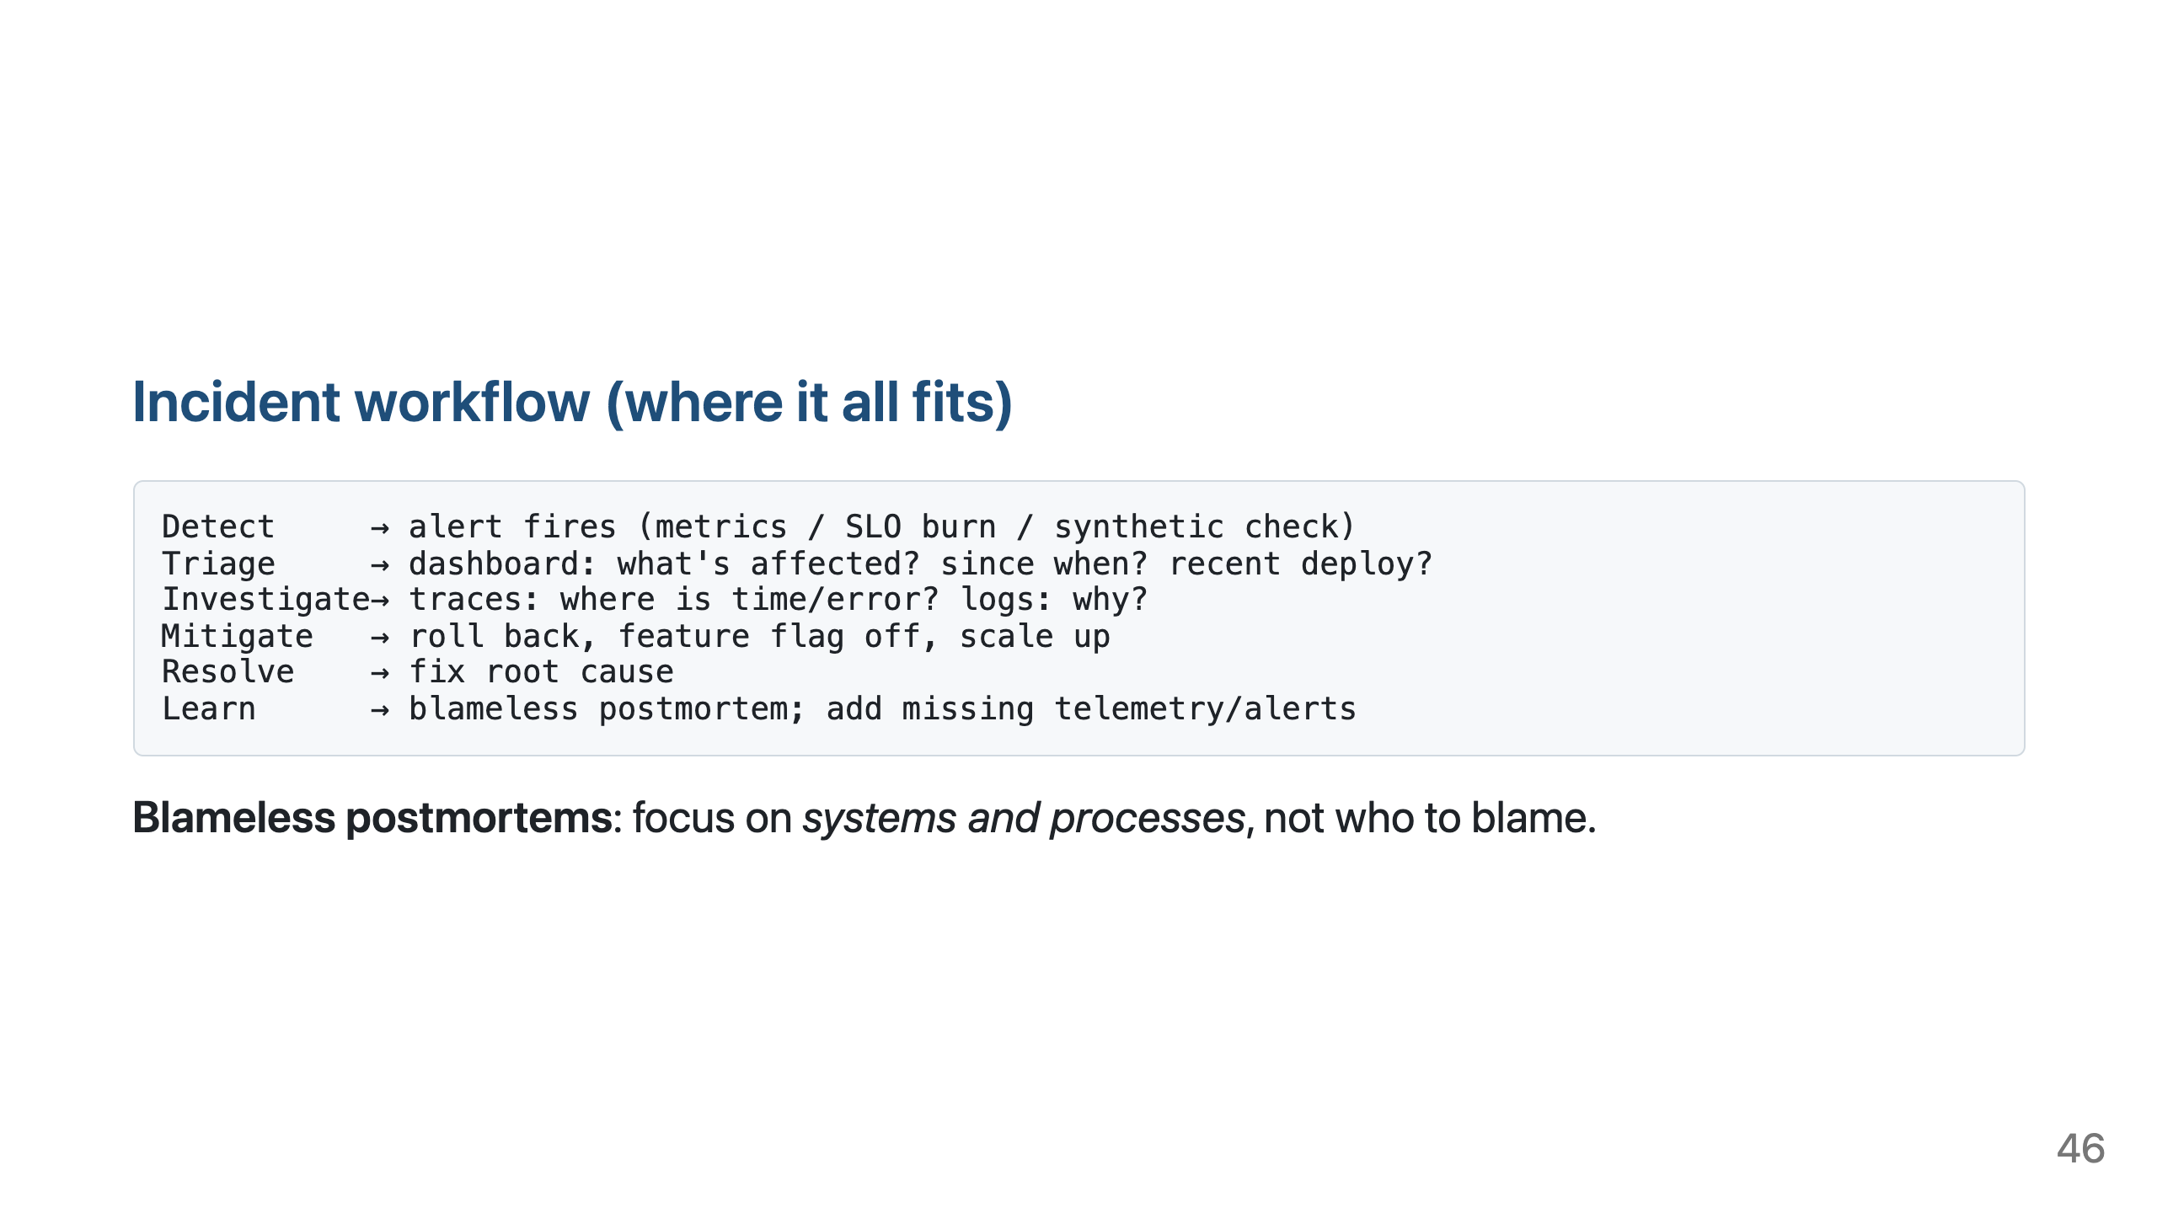

Slide 47
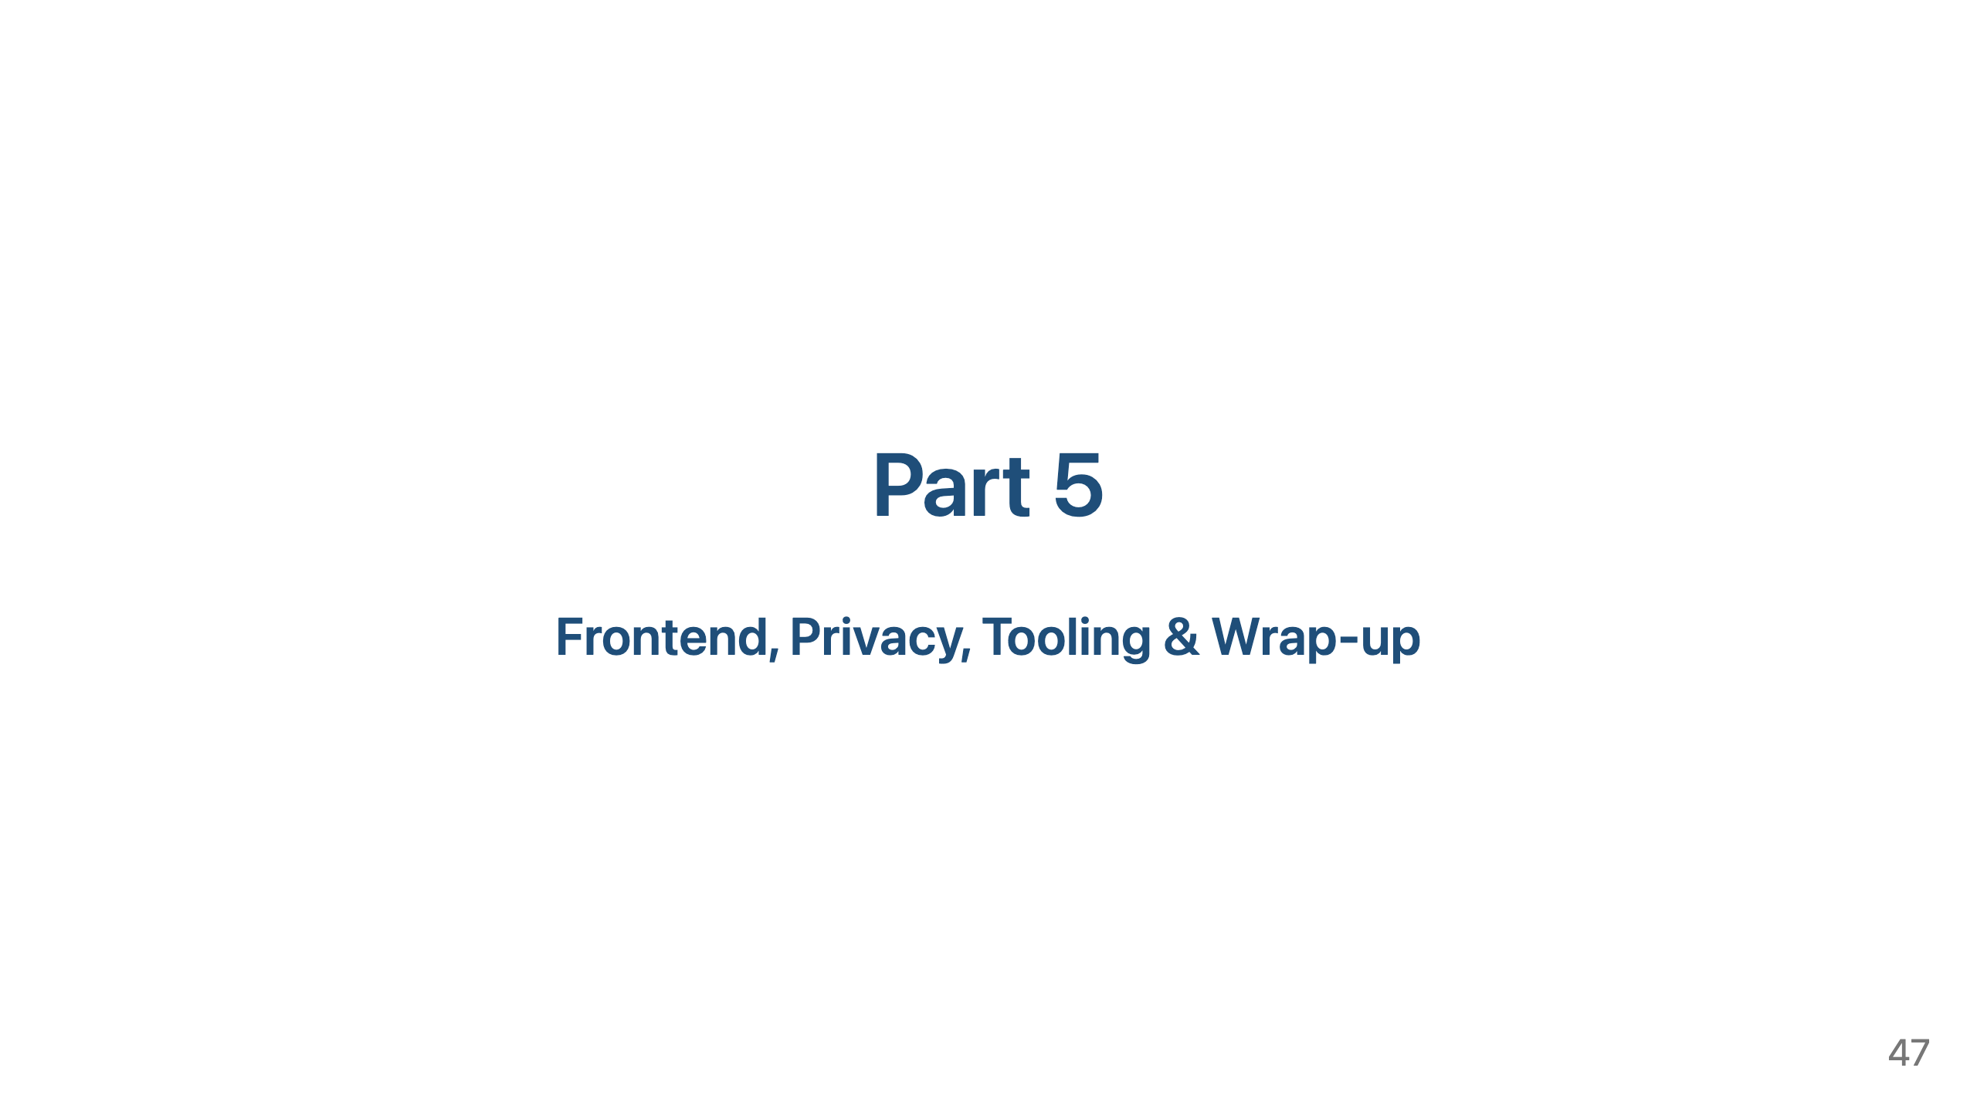

Slide 48
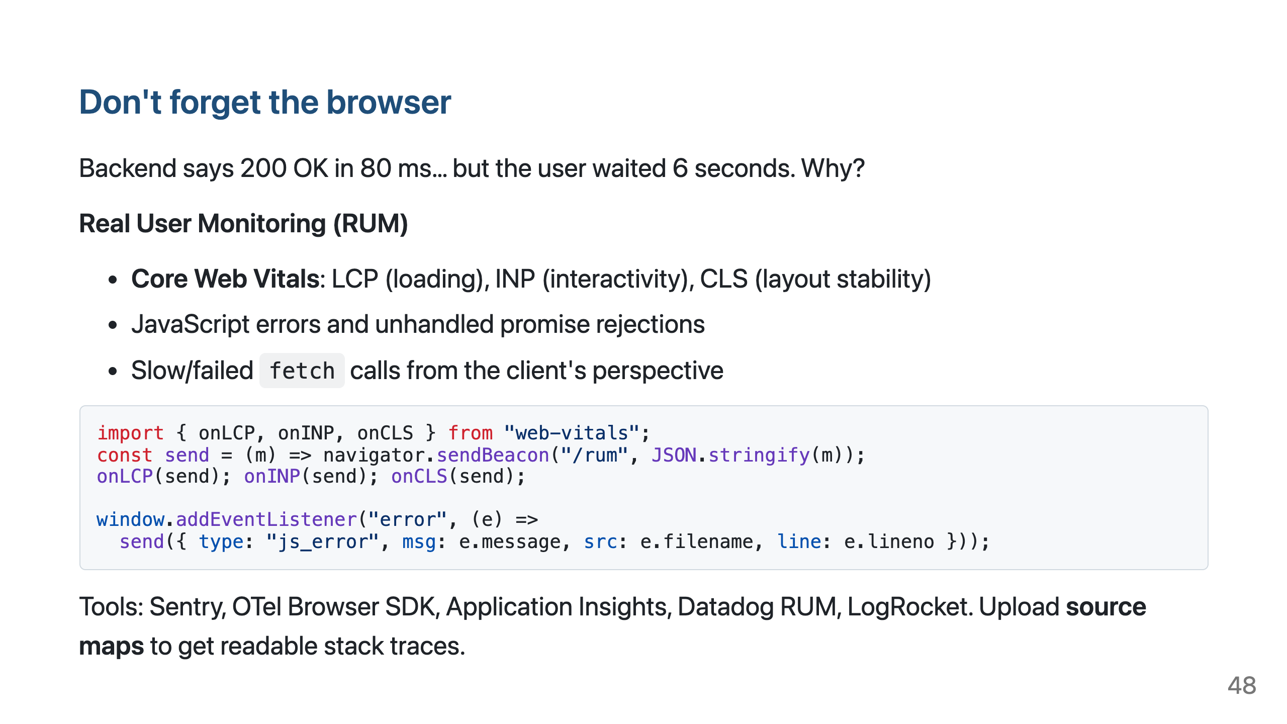

Slide 49
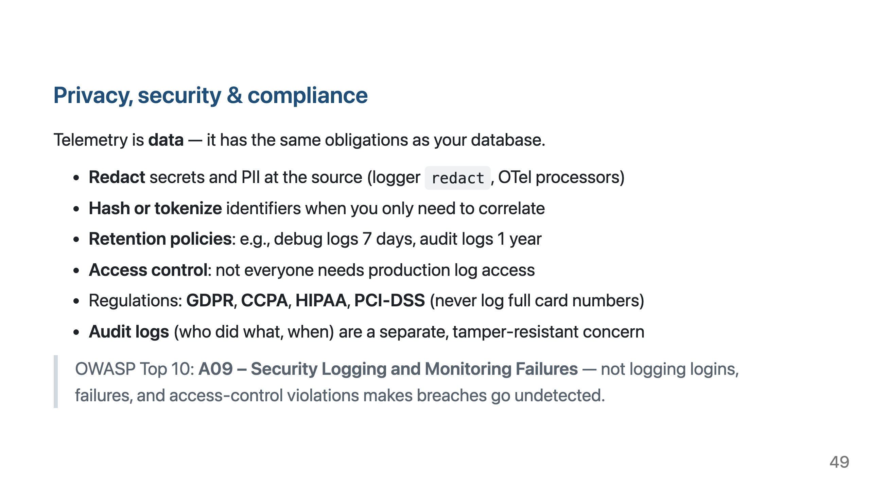

Slide 50
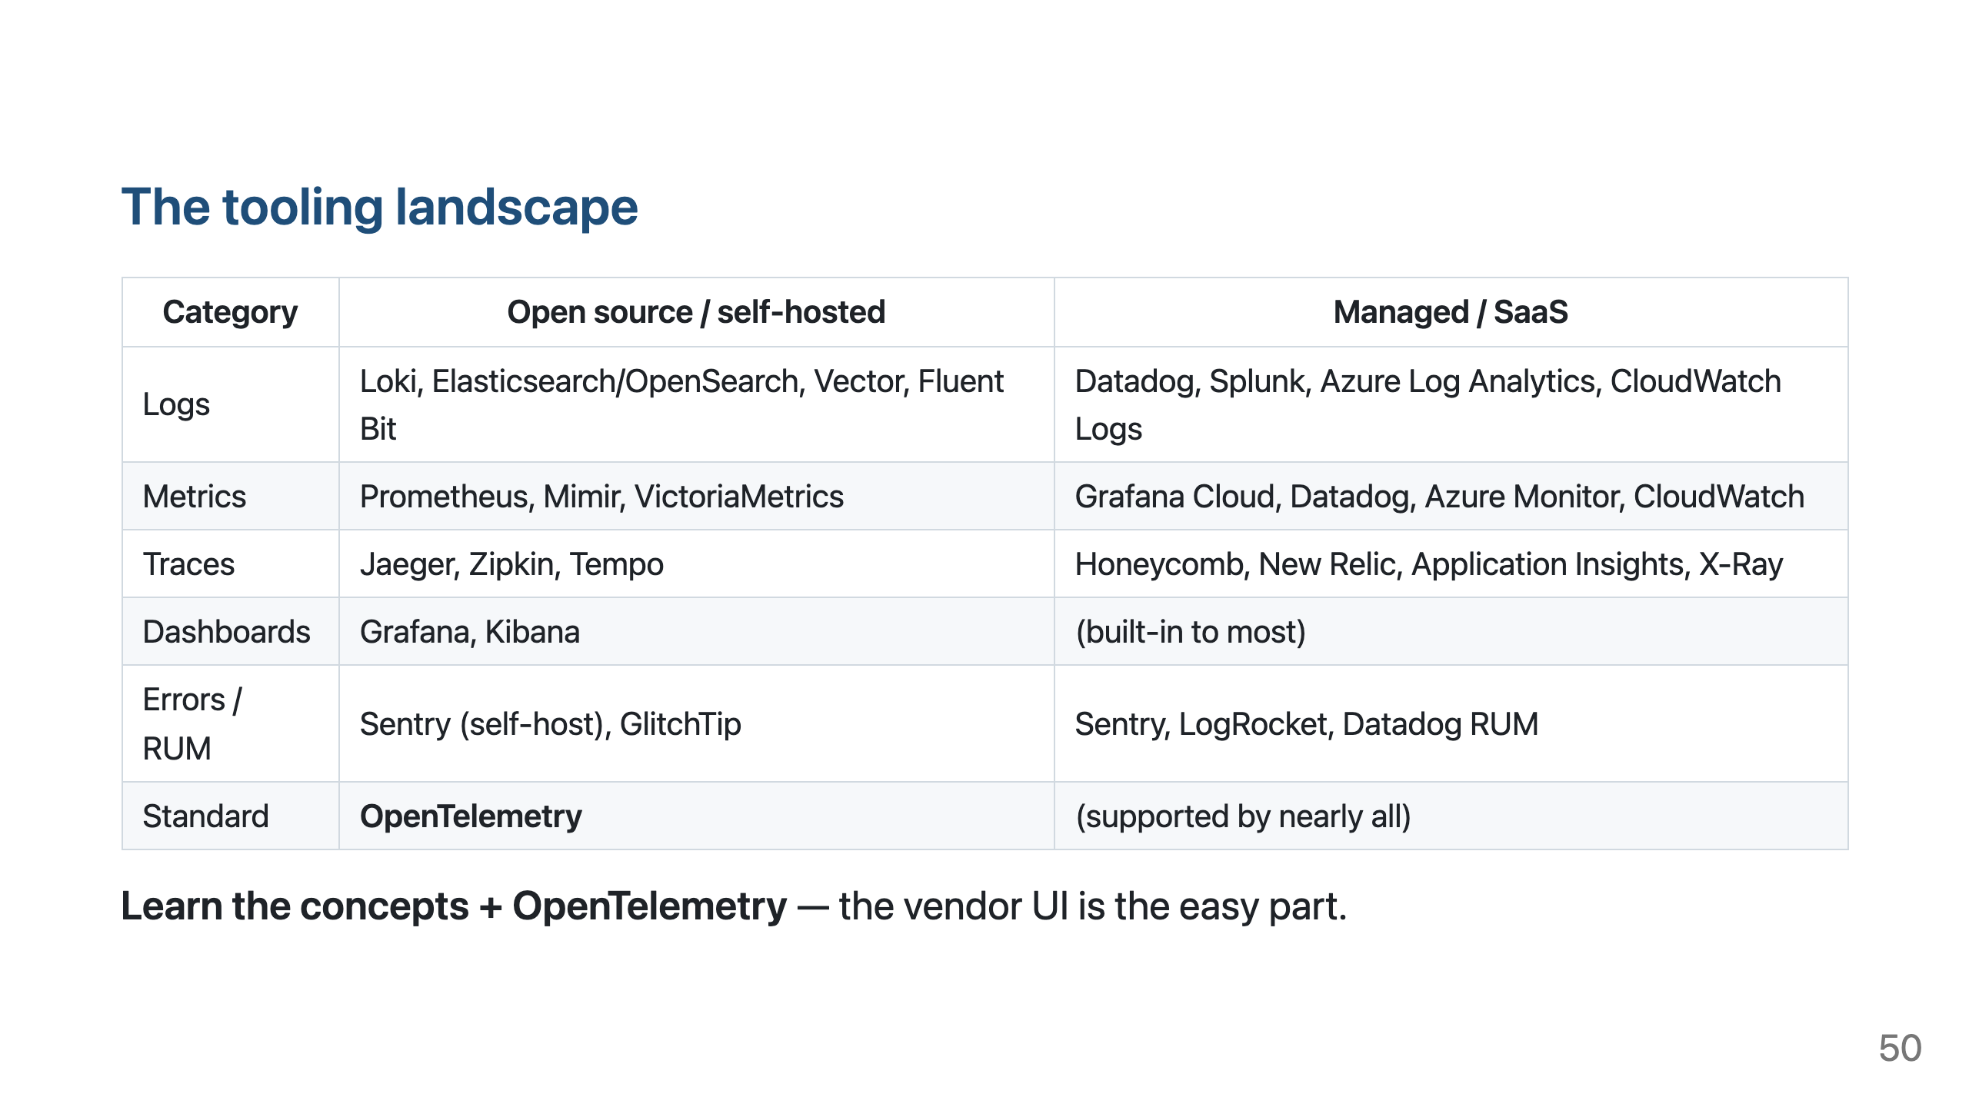

Slide 51


Slide 52


Slide 53

Notes:
Debrief (5 min): likely root cause is the shipping-rate API timing out with no client timeout. Good answers: log external call duration/outcome; histogram shipping_api_duration_seconds{outcome}; span for shipping.getRates; SLI = % checkouts succeeding < 2s; alert on error-rate or SLO burn; never log card numbers/addresses in full.

Slide 54


Slide 55


Slide 56


