Slide 1
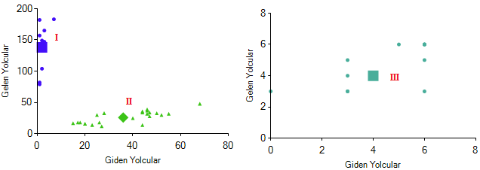

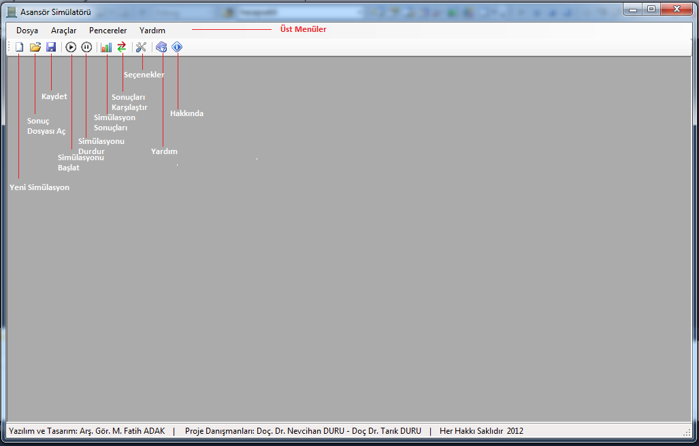
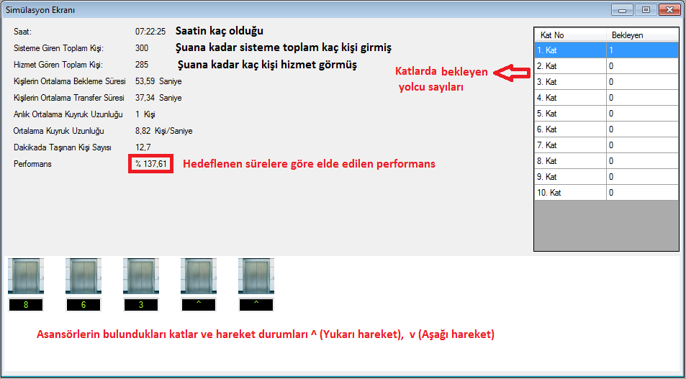
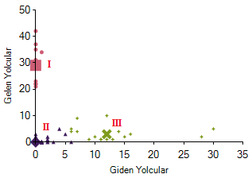
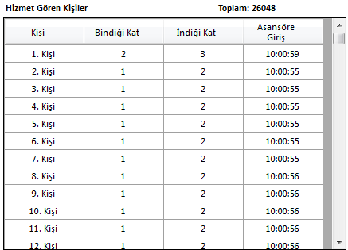
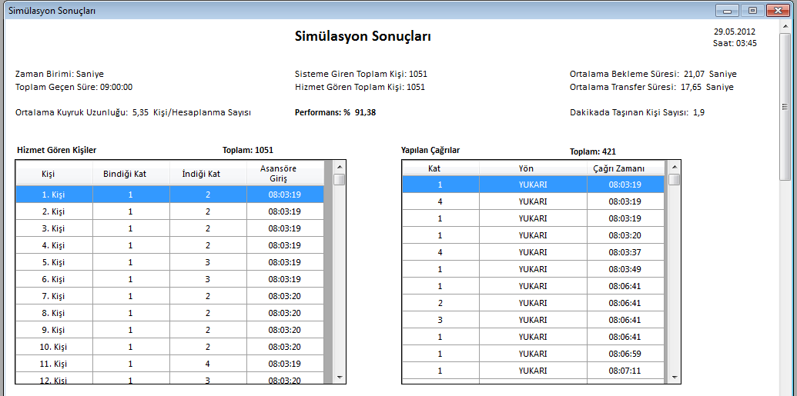
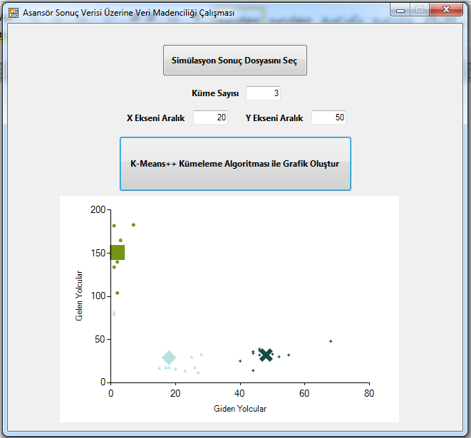
Biyometrik Parmak İzinin Akıllı Kartlarla Kullanımı ve Uygulaması
Ali SÖYLEMEZ
Bilgisayar Mühendisliği Bölümü
Sakarya Üniversitesi
ali.soylemez@sakarya.edu.tr
Veli DUYMAZ, Mehmet UYDURUR
Bilgisayar Mühendisliği Bölümü
Sakarya Üniversitesi
Veli_duymaz@gmail.com, mehmet.uyd@hotmail.com
DANIŞMAN
Prof. Dr. Cemil ÖZ
Giriş
Binalardaki Perhaps the most enjoyable emotion, however, was the sense of personal fulfillment. When it came to hacking, Stallman was a natural. A childhood's worth of late-night study sessions gave him the ability to work long hours with little sleep. As a social outcast since age 10, he had little difficulty working alone. And as a mathematician with built-in gift for logic and foresight, Stallman possessed the ability to circumvent design barriers that left most hackers spinning their wheels. Perhaps the most enjoyable emotion, however, was the sense of personal fulfillment. When it came to hacking, Stallman was a natural. A childhood's worth of late-night study sessions gave him the ability to work long hours with little sleep. As a social outcast since age 10, he had little difficulty working alone. And as a mathematician with built-in gift for logic and foresight, Stallman possessed the ability to circumvent design barriers that left most hackers spinning their wheels. Perhaps the most enjoyable emotion, however, was the sense of personal fulfillment. When it came to hacking, Stallman was a natural. A childhood's worth of late-night study sessions gave him the ability to work long hours with little sleep. As a social outcast since age 10, he had little difficulty working alone. And as a mathematician with built-in gift for logic and foresight, Stallman possessed the ability to circumvent design barriers that left most hackers spinning their wheels.
Oluşabilecek Durumlar
Perhaps the most enjoyable emotion, however, was the sense of personal fulfillment. When it came to hacking, Stallman was a natural. A childhood's worth of late-night study sessions gave him the ability to work long hours with little sleep. As a social outcast since age 10, he had little difficulty working alone. And as a mathematician with built-in gift for logic and foresight, mvent design barriers that left most hackers spinning their wheels.
Şekil 5: Kümeleme sonucunda oluşabilecek durumlar.
Çizelge 1: analiz sonuçları
Bir Okul Örneği
Perhaps the most enjoyable emotion, however, was the sense of personal fulfillment. When it came to hacking, Stallman was a natural. A childhood's worth of late-night study sessions gave him the ability to work long hours with little sleep. As a social outcast since age 10, he had little difficulty working alone. And as a mathematician with built-in gift for logic and foresight, Çizelge 2: Saat dilimlerine göre trafik türleri ve yolcu dağılımları
Geliştirilen Yazılım
Saat Dilimi | Trafik Türü | Dağılımdaki Yolcu Sayısı
8:00 – 9:00 | Yukarı Yoğun | 20
9:00 – 10:00 | Yukarı Yoğun | 1
10:00 – 11:00 | Yok | -
11:00 – 12:00 | Yok | -
12:00 – 13:00 | İki Yönlü Trafik | 12
13:00 – 14:00 | Yok | -
14:00 – 15:00 | Yok | -
15:00 – 16:00 | Aşağı Yoğun | 20
16:00 – 17:00 | Aşağı Yoğun | 1
Şekil 1: Simülatörün ana ekranı.
Şekil 2: Simülasyon ekranı.
Asansör Perhaps the most enjoyable emotion, however, was the sense of personal fulfillment. When it came to hacking, Stallman was a natural. A childhood's worth of late-night study sessions gave him the ability to work long hours with little sleep. As a social outcast since age 10, he had little difficulty working alone. And as a mathematician with built-in gift for logic and foresight, Stallman possessed the ability to circumvent design barriers that left most hackers spinning their wheels. Perhaps the most enjoyable emotion, however, was the sense of personal fulfillment. When it came to hacking, Stallman was a natural.
Kullanılan Yöntem
Perhaps the most enjoyable emotion, however, was the sense of personal fulfillment. When it came to hacking, Stallman was a natural. A childhood's worth of late-night study sessions gave him the ability to work long hours with little sleep. As a social outcast since age 10, he had little difficulty working alone. And as a mathematician with built-in gift for logic and foresight, Stallman possessed the ability to circumvent design barriers that left most hackers spinning their wheels.
Şekil 6: Okulun asansör trafiği için kümeleme sonucu
Perhaps the most enjoyable emotion, however, was the sense of personal fulfillment. When it came to hacking, Stallman was a natural. A childhood's worth of late-night study sessions gave him the ability to work long hours with little sleep. As a social outcast since age 10,
Sonuçlar
Perhaps the most enjoyable emotion, however, was the sense of personal fulfillment. When it came to hacking, Stallman was a natural. A childhood's worth of late-night study sessions gave him the ability to work long hours with little sleep. As a social outcast since age 10, he had little difficulty working alone. And as a mathematician with built-in gift for logic and foresight, Stallman possessed the ability to circumvent design barriers that left most hackers spinning their wheels.
Şekil 3: Üretilen veri örneği.
Ek A
Perhaps the most enjoyable emotion, however, was the sense of personal fulfillment. When it came to hacking, Stallman was a natural. A childhood's worth of late-night study sessions gave him the ability to work long hours with little sleep. As a social outcast since age 10, he had little difficulty working alone. And as a mathematician with built-in gift for logic and foresight, Stallman possessed the ability to circumvent design barriers that left most hackers spinning their wheels.
Geliştirilen Ek Program
he had little difficulty working alone. And as a mathematician with built-in gift for logic and foresight, Stallman possessed the ability to circumvent design barriers that left most hackers spinning their wheels.
Şekil 4: Ek program görüntüsü.

