Slide 1
Revisiting Spacetrack Report #3
David A. Vallado, Paul Crawford, Richard Hujsak, and T. S. Kelso
Analytical Graphics Inc.
Center for Space Standards and Innovation
Paper Presented at the AIAA Astrodynamics Specialist Conference, Keystone, Colorado, 21-24 August 2006

Slide 2
Outline
Introduction
  Program History
  Program Description
Computer Code Development
  STR#3 to GSFC
  GSFC to revised
Test Cases
  Verification
  Expected Code Updates
  Suggested Technical Changes
Comparison Analyses
  Complete Catalog tests
Availability
Conclusions

Slide 3
History
Theoretical basis
  Brouwer / Kozai theory (1959)
Development of SGP4 specific theory
  1960s
    Mathematical technique origination
      Kozai
      Brouwer
      Lyddane
      Other
  1970s
    Development / Modification for NORAD
      Cranford
      Lane
      Hujsak
      Hoots
      Other

Slide 4
History
Distribution of the Theory
  Hoots and Roehrich Spacetrack Report #3 (1980)
    Baseline the theory
      Many versions existed
      Equations, Source Code, and Test Cases
  Hoots Spacetrack Report #6 (1986)
    HANDE
    Often assumed to be correction of Deep Space
  1997 GSFC release of updated code (1990 version)
    Implementation updates
      Merge of SGP4 / SDP4
      Re-look at resonances
      Re-look at deep space
      Many Others
  Hoots (1998, 2004)
    Equations

Slide 5
History
Since 1980
  No official comprehensive update of STR#3
  STR#3 caveat:
    The most important point to be noted is that not just any prediction model will suffice… The NORAD element sets must be used with one of the models described in this report in order to retain maximum prediction accuracy
  AFSPC Instructions indicate multiple official versions within DoD
Independent efforts using released code
  Variety of applications
  Many changes
  Lack of documentation and configuration control
No common baseline exists today

Slide 6
Objectives
Provide consolidated update
  Make widely available
  “Close” to official standalone version
    Closer than 1980 and other derivative versions
  Fully documented test cases
  Modern computer code
    Structured programming
    Multiple languages
      C++
      MATLAB
      FORTRAN
      Pascal

Slide 7
Primary References
Original documentation (1980)
  Hoots, Felix R., and Roehrich, R. L. 1980. Spacetrack Report #3, Models for Propagation of the NORAD Element Sets. U.S. Air Force, CO.
Updated Equations and History
  Hoots, Felix R. “Spacetrack Report #6: Models for Propagation of Space Command Element Sets.” Space Command, U. S. Air Force, CO.
  Hoots, Felix R., P. W. Schumacher, and R. A. Glover. 2004. History of Analytical Orbit Modeling in the U. S. Space Surveillance System. Journal of Guidance, Control, and Dynamics. 27(2):174-185.
Updated source code (~1990)
  http://seawifs.gsfc.nasa.gov/SEAWIFS/SOFTWARE/src/bobdays/sgp4sub.f
Many other references
  Listed in this paper, and in Hoots, et al. (2004)

Slide 8
Program Description
SGP4 is an analytical theory
  Must use proper mathematical technique
  Using different mathematical technique adds significant error
    Part of original need for 1980 publication
  Structure in STR#3
    (SGP4) Near Earth (Periods less than 225 min)
    (SDP4) Deep Space (Periods greater than 225 min)
Two-line element sets (TLE)
  Data for use with SGP4
  TLEs produced through Orbit Determination (OD) of satellite observations
  TLE data released publicly for over 20 years
  TLE accuracy is coarse
    Depends on orbit and OD, but in general
      ~1 km accuracy at epoch
      ~1-3 km per day error growth

Slide 9
Program Challenges
Disconnect between available theories in 1980 and today
  Coordinate System
    TEME and current IAU 2000 Resolutions
    TEME “of date” vs. “of epoch”
  Time System
    UTC, Sidereal Time
Configuration Control
  Implementation and documentation of changes

Slide 10
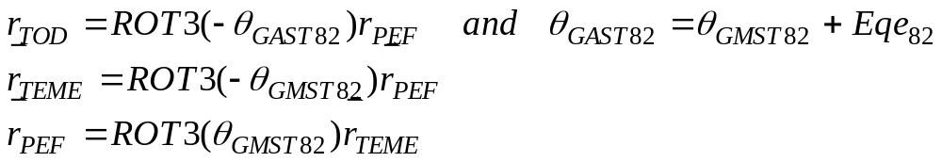
TEME details
Frame in between TOD and PEF
TEME of Date
  Calculate nutation parameters at each propagation time
  We assume as the default
TEME of Epoch
  Calculate nutation parameters at epoch
  Use this value for all propagation times

Slide 11
Configuration Control Challenges
Items requiring configuration control
  Data Formats have changed over time
    Checksum
    Field widths
    Other?
  Operational SGP4 code has changed over time
    1980 – Spacetrack Report Number 3
    1990s – Spacetrack Report Number 6 and GSFC Code
    Other?

Slide 12
Open Issues
Time, coordinate systems, etc.
  How to interface modern programs to older concepts?
Existing historical database of TLE data
  When did data formats change?
  How to synchronize each TLE to the operational version used to create it?
  What was the precise mathematical description of each former version?
    Includes current operational version
  What accuracy can be expected with each version?

Slide 13
Code Development
STR#3 to GSFC Changes
  Merge SGP4 and SDP4 routines
  Double Precision (FORTRAN)
  Update of Deep space variables
  Frequency of Lunar-Solar term computation
  Lunar-Solar perturbation applications
    “Lyddane bug” (see following chart)
  Kepler’s equation (see following chart)
  When to apply Lunar-Solar modifications
    Lyddane choice (see following chart)
  Many Others

Slide 14
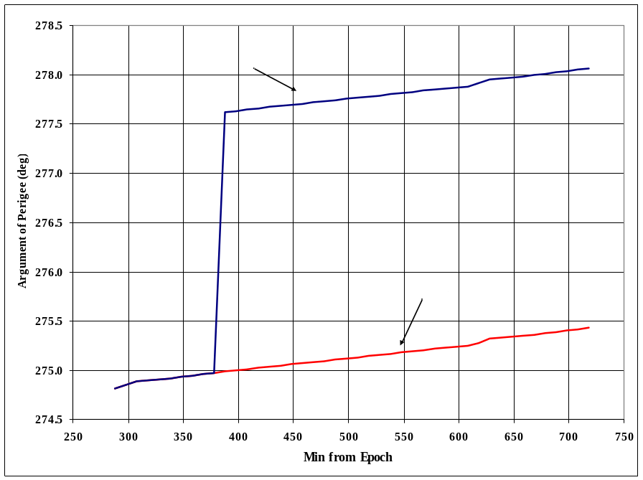
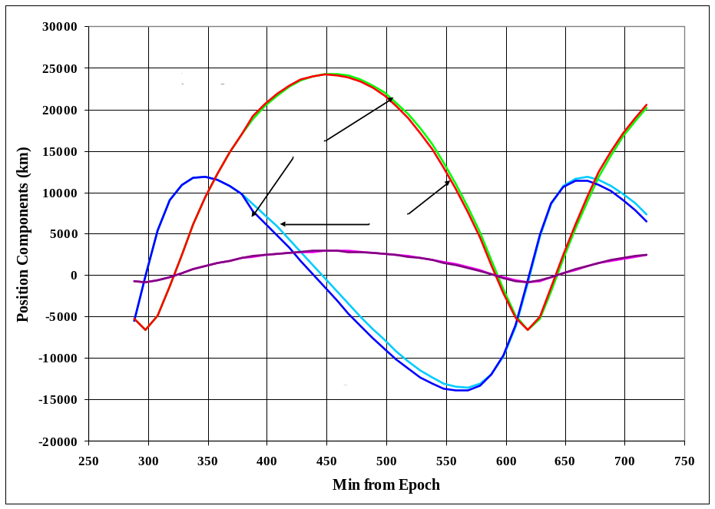
Code Development
Lunar-Solar Modifications (23599)
  Incorrect update of lunar-solar perturbations
  Need to update quadrants in periodic calculations

Slide 15
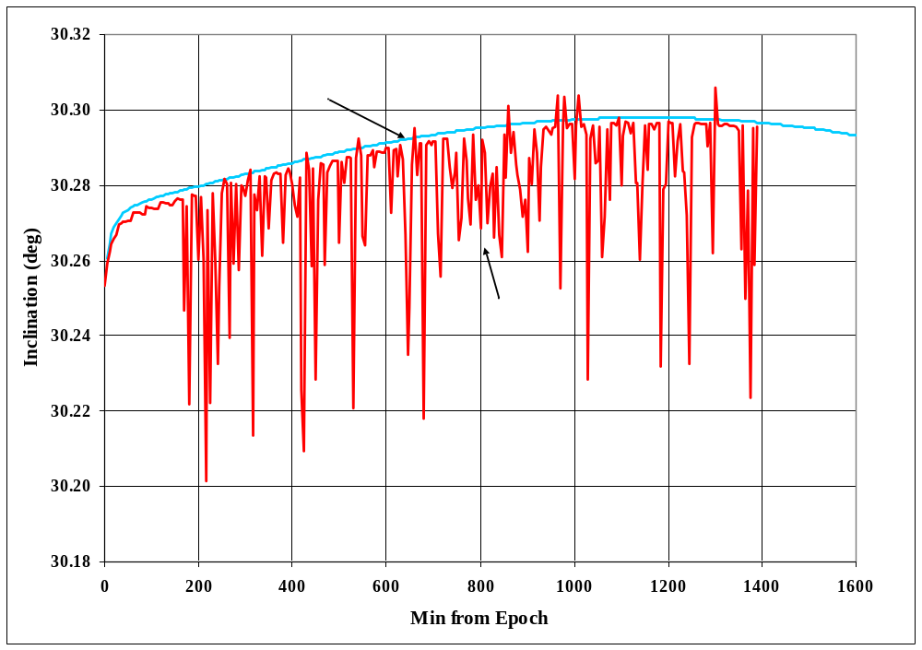
Code Development
Kepler’s Iteration (23333)
  Note the dramatic jumps in inclination
  Choppy behavior before 200 min is from update interval of LS terms

Slide 16
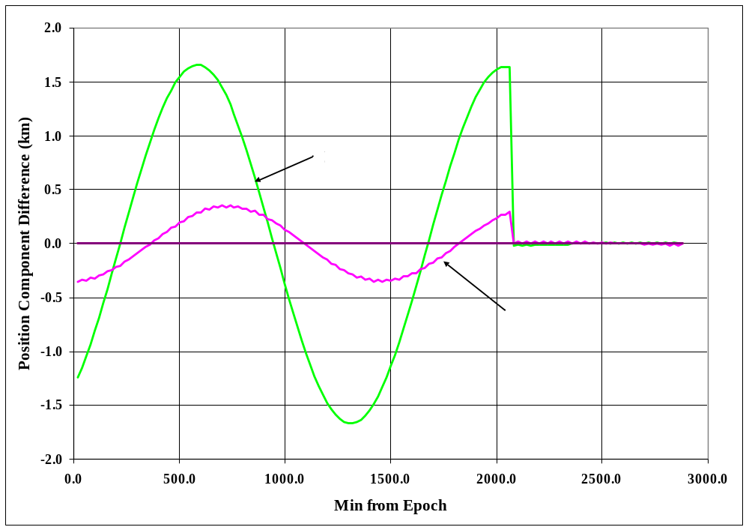
Code Development
Lyddane Choice (14128)
  Decision on applying Lyddane modifications
  Based on inclination value (perturbed or original)
  Small magnitude difference
Best to determine a better crossover point

Slide 17
Code Modernization
Highlights
  GOTOs eliminated
  Structures
    Permit multiple satellite use at one time
    Better organization of the code
  Initialization
    Consolidate functions in one routine
    Call once
  Variable names
    Consistent names
      No limit of 8 characters
    No implicit typing
  Use of intrinsic functions

Slide 18
Structural Organization (existing - GSFC)
if method
if method
SGP4
if init
if initds
DSPACE
if init
DPPER
INITL
SREZ
SREZ
Near Earth
DSCOM
if <225
Deep Space
if init
DPPER
if initds
DSPACE
SREZ
One call each time
Initialization integrated
DSCOM
SREZ

Slide 19
Structural Organization (Revised)
SGP4init
SGP4
if method
INITL
DSPACE
Near Earth
if <225
if method
DPPER
DSCOM
Deep Space
DPPER
One initialization call
Routine calls toSGP4
DSINIT

Slide 20
Program Code Structure
START
Loop to read input file of TLE data
Loop
TwoLine2RVSGP4
SGP4init
INITL
GETGRAVCONST
Days2DMYHMS
if
GSTIME
DSCOM
JDay
if
DPPER
if
Loop
DSINIT
Loop to propagate each tle
SGP4
GETGRAVCONST
GETGRAVCONST
if
SGP4
GETGRAVCONST
DSPACE
DPPER
DSPACE
if
DPPER
Function Locations
Output
SGP4Ext
SGP4IO
SGP4Unit

Slide 21
Test Case Overview
Verification test cases
  Use actual satellites where possible
  Test each “path” through the code
    High eccentricity
    Data formats
    Other
Expected Code Updates
  Error checking
  Constants
    WGS-72, WGS-84, other?
  Negative Inclination
  Integrator problems
    Backwards propagation
  Kepler’s equation
    Limit amount of corrections per step

Slide 22
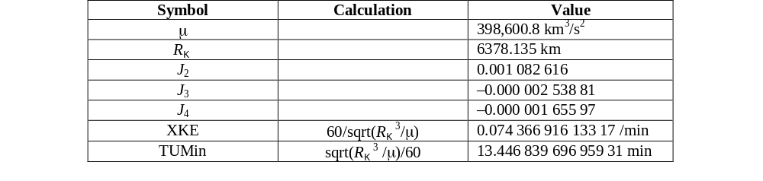
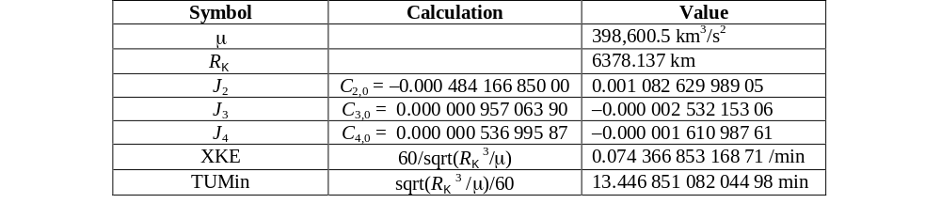
Constants
WGS-72 stated
  We use as default
WGS-84 possible

Slide 23
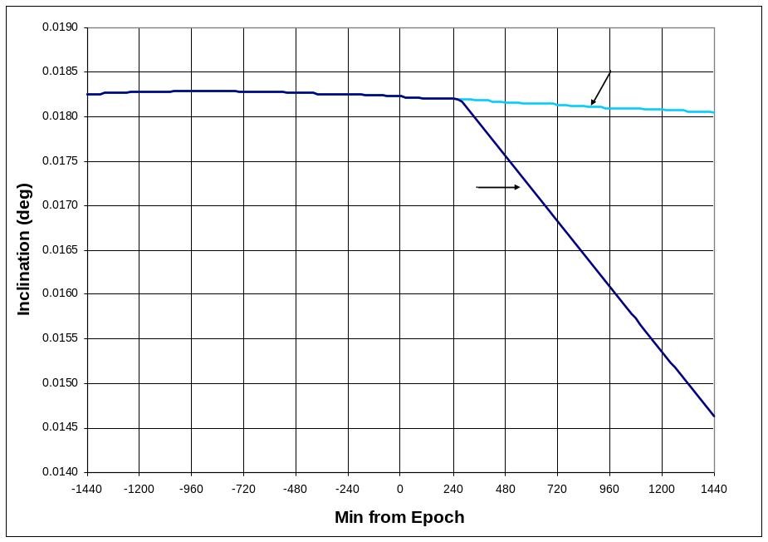
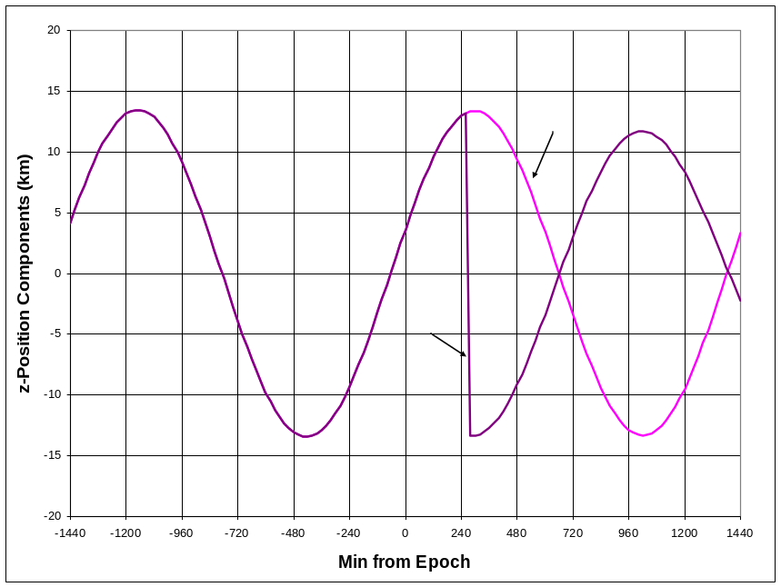
Expected Code Updates
Application of Negative Inclination (25954)
  Deep space resonance, low inclination
  Note the z-axis jump

Slide 24
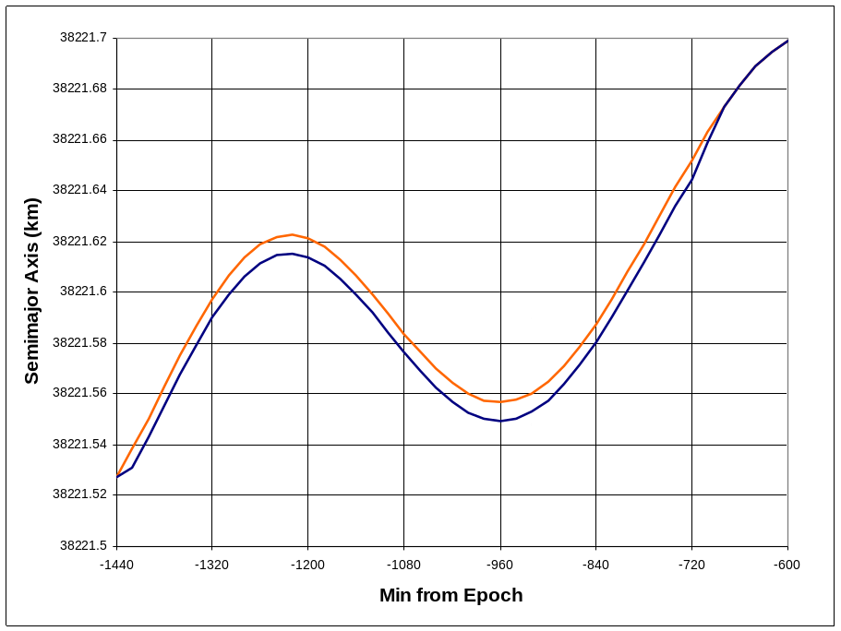
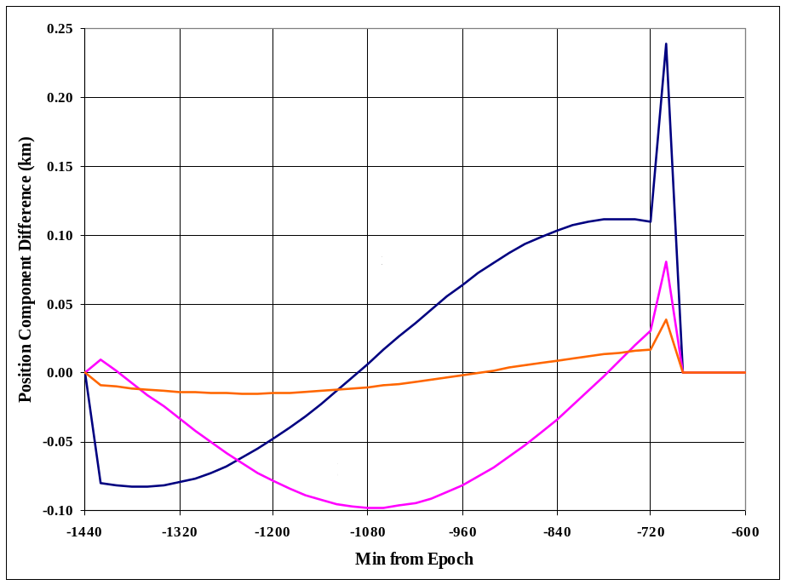
Expected Code Updates
Integrator problems
  Backwards or negative propagation
  Appears to have been in the computer code
  Note the small magnitudes of the differences

Slide 25
Version Comparisons
Several code versions exist
  Original 1980
    http://celestrak.com/NORAD/documentation/spacetrk.zip
  GSFC ~ 1997 (code dated 1990)
    http://seawifs.gsfc.nasa.gov/SEAWIFS/SOFTWARE/src/bobdays/sgp4sub.f
    No longer available, current file is Brouwer theory, but with same name
  JPL –
    ftp://naif.jpl.nasa.gov/pub/naif/toolkit/FORTRAN/PC_Linux/packages/toolkit.tar.Z
    Modified starting from 1980 version
Test versions to establish performance envelope
  Scales are all the same

Slide 26
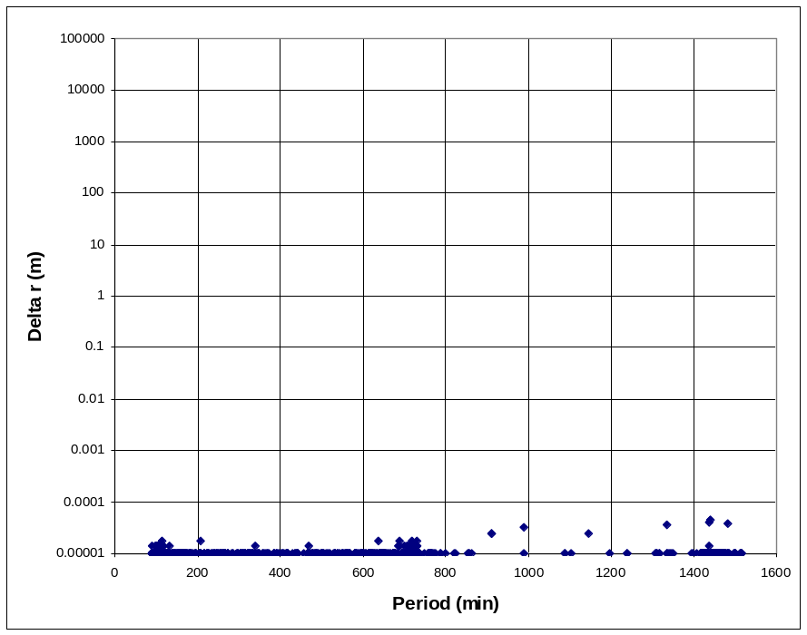
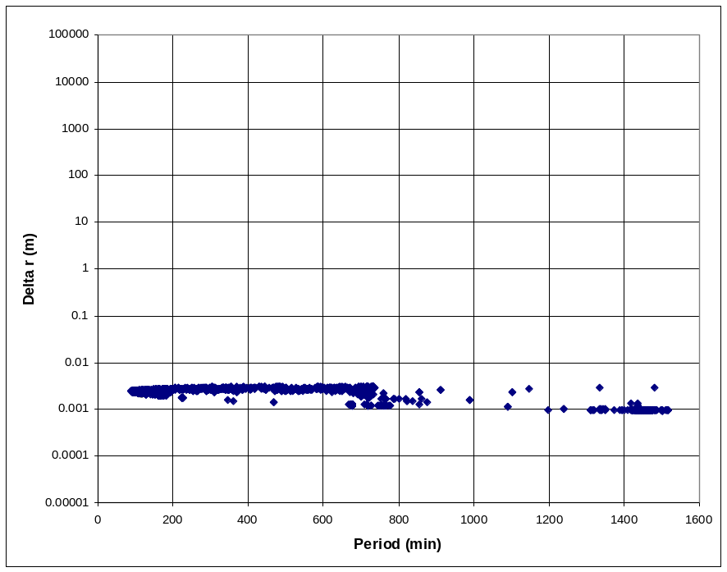
Computer Language Comparisons
Test FORTRAN/CPP/PASCAL
  Sample entire catalog ~9000 satellites
  Pascal uses Extended type (10-bytes) CPP and FOR used double (8-byte)
  CPP vs. FOR CPP vs. PAS

Slide 27
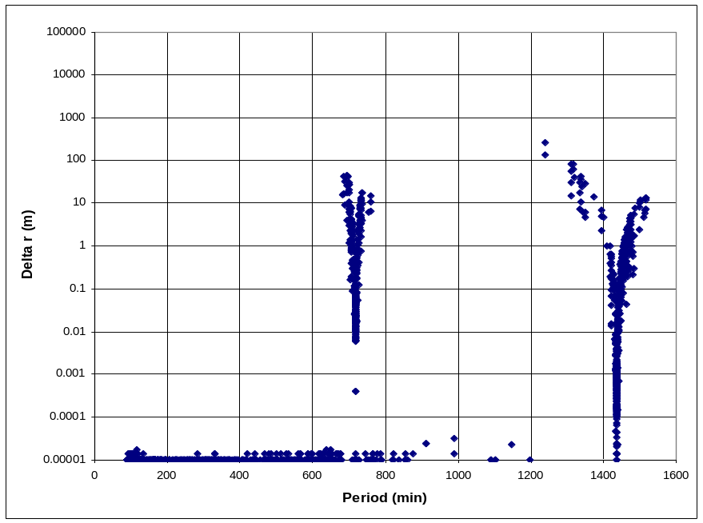
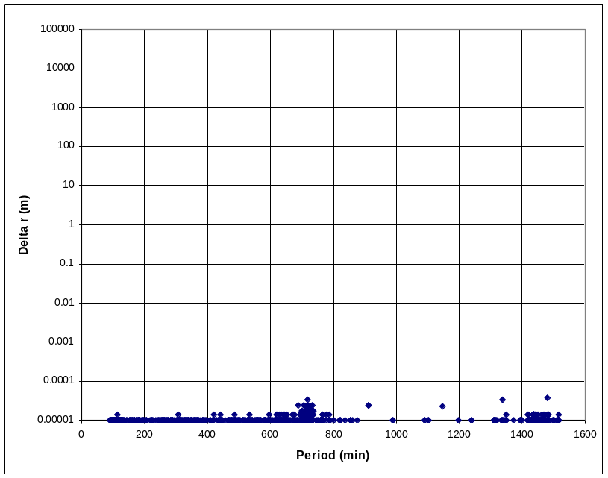
Alternate versions
Test of GSFC version
  Sample entire catalog ~9000 satellites
  GSFC code differences very small if no negative propagations (right)
  Much larger variations if negative times (left)
  CPP vs. GSFC CPP vs. GSFC positive only

Slide 28
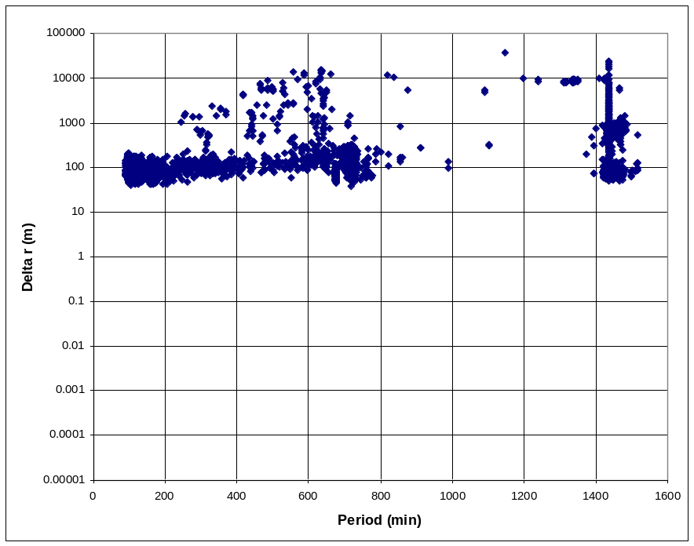
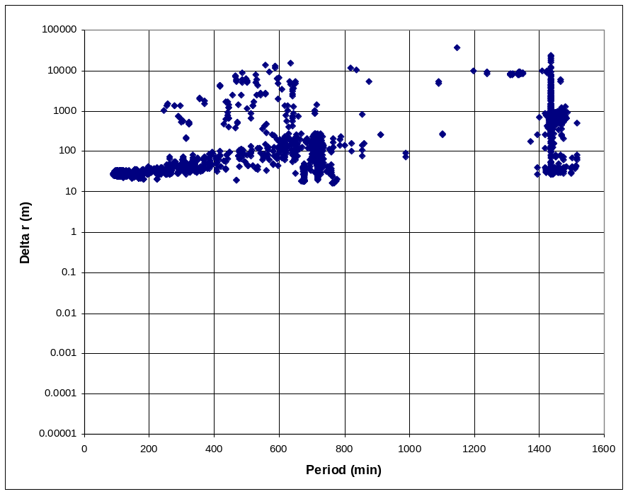
Alternate versions
Test 1980 versions
  Sample entire catalog ~9000 satellites
  CPP vs. AF80 single CPP vs. AF80 double

Slide 29
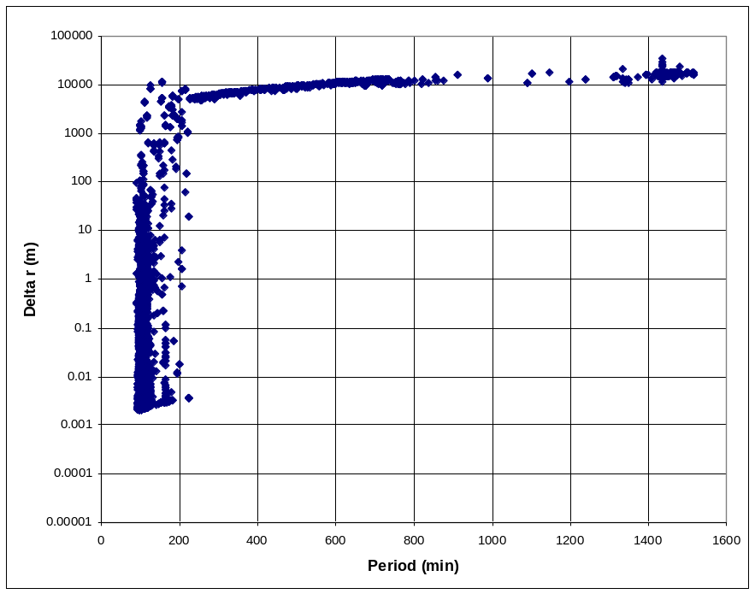
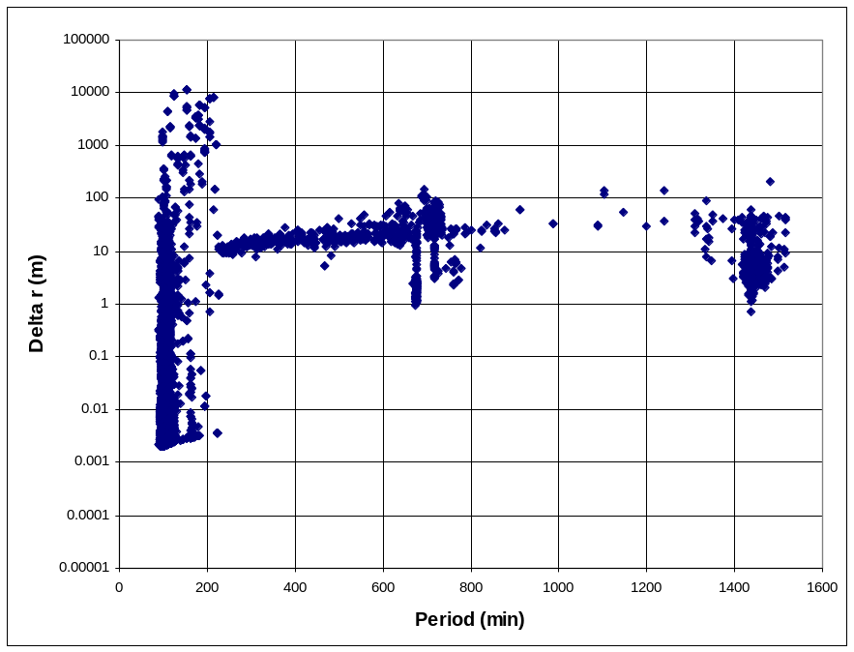
Alternate versions
Test of JPL version
  Sample entire catalog ~9000 satellites
  JPL code improved dramatically for > 225-minute orbits with change of DOPERT variable (control of Lunar-Solar zeroing at epoch)
  CPP vs. JPL original CPP vs. JPL modified

Slide 30
Conclusions
Updated version of SGP4
  Incorporates all known changes and updates
  Documented
    Technical equations in the literature
    Code in several languages
    Test cases and results
  Widely available
    Hardcopy in this paper
    Softcopy: http://www.centerforspace.com/downloads/

