Slide 1
Sample 00106 Summary
NV | Echo (us) | XY8-32 (us) | XY8-64 (us) | Depth
17 | 9 | 81 | 99 | 8 nm
20 | 58 | 35 | 81 | > 12 (almost no signal)
16 | 18 | 82 | 154 | 11
15 | 4 | 8 | - (T2 too short) | - (T2 too short)
18 | 27 | 68 | 142 | > 12 (small signal)
21 | 10 | 67 | 88 | 9
22 | 25 | 64 | 131 | 12
12 | 5 | 32 | --(Missing) | 6

Slide 2
NVs:
NV 20, 16, 15, 17, 18, 21, 22, 12
For the most part, have ESR, Hahn echo, depth, xy8-4, xy8-8
Some were too short for xy8-8 so have xy8-2 instead

Slide 3
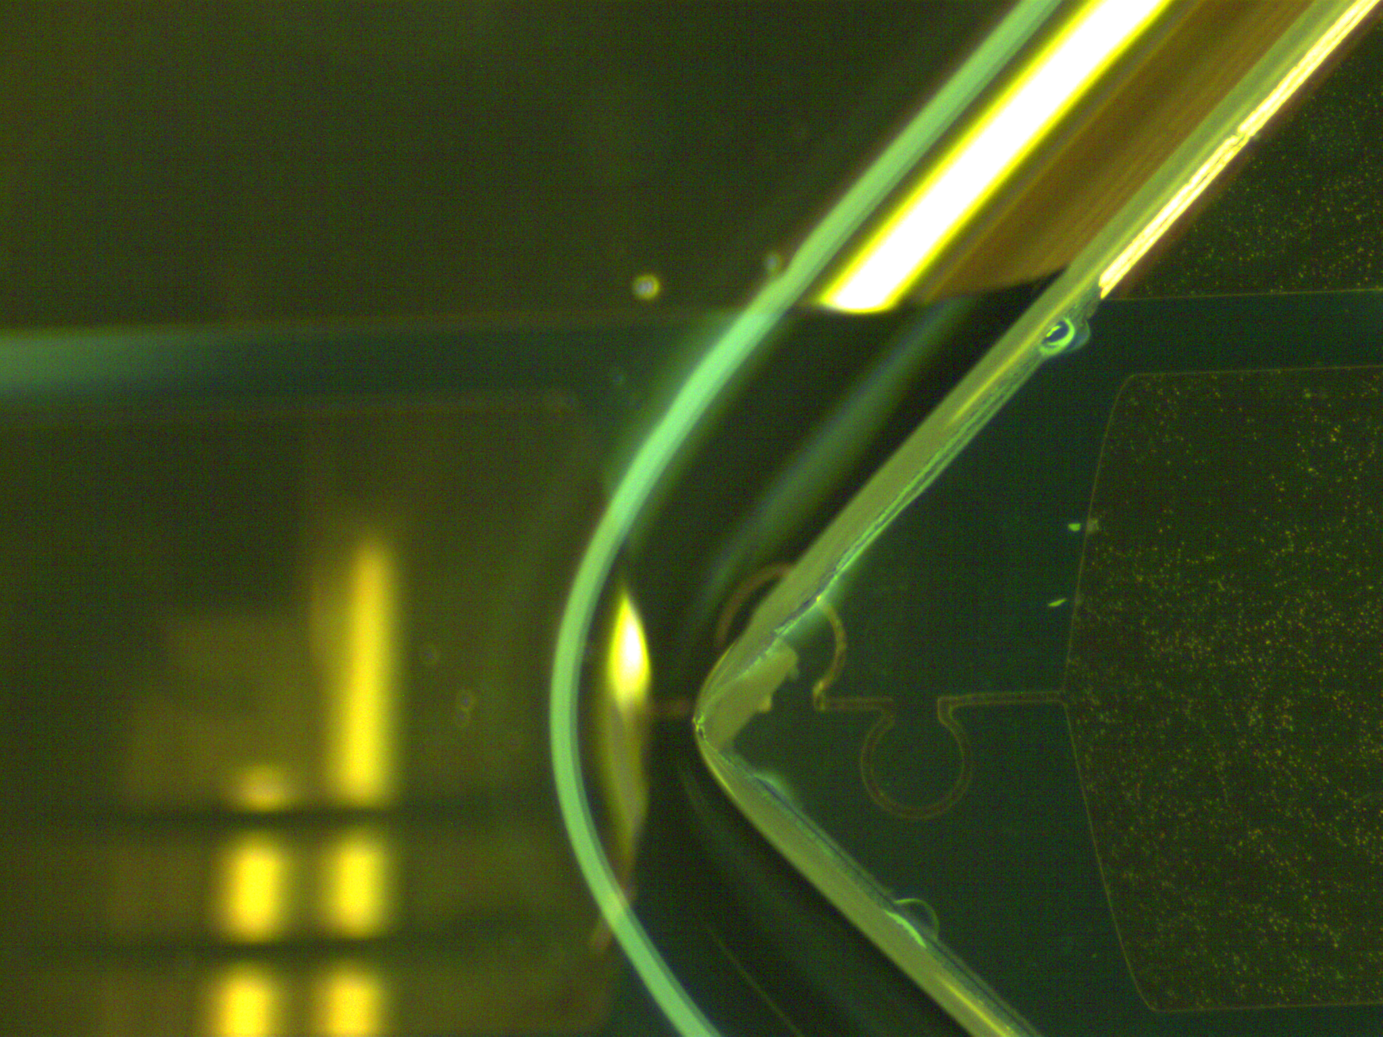

Slide 4
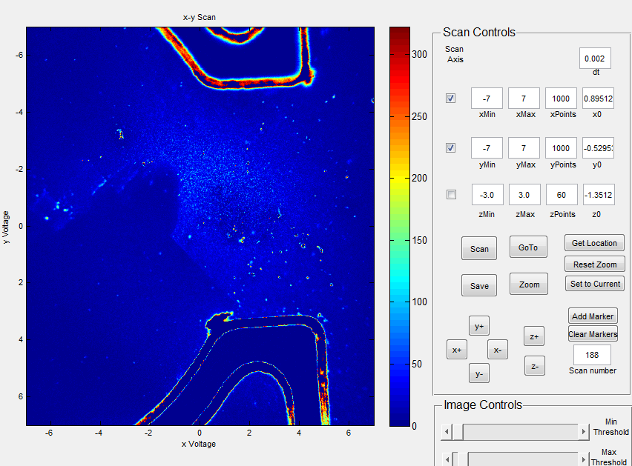

Slide 5
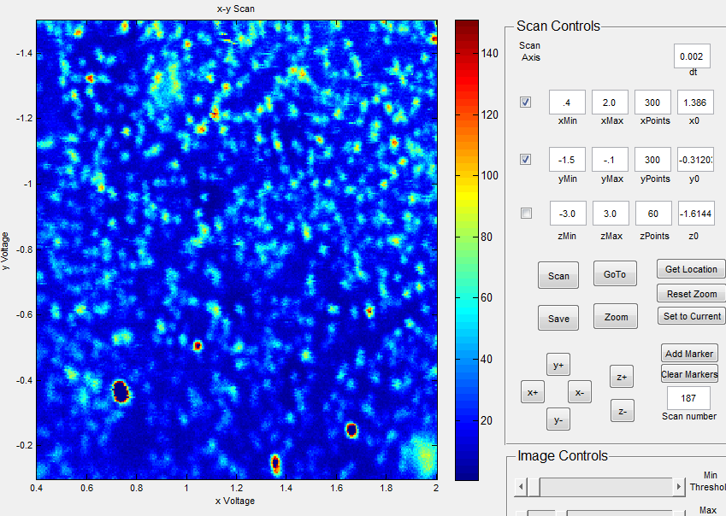
Region of NVs

Slide 6
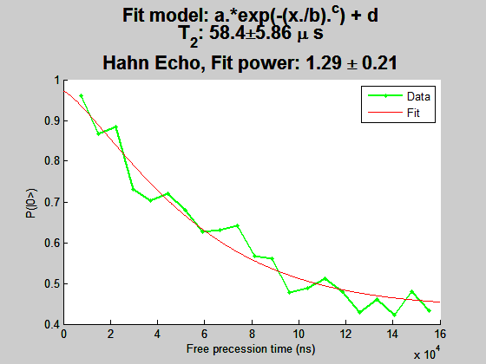
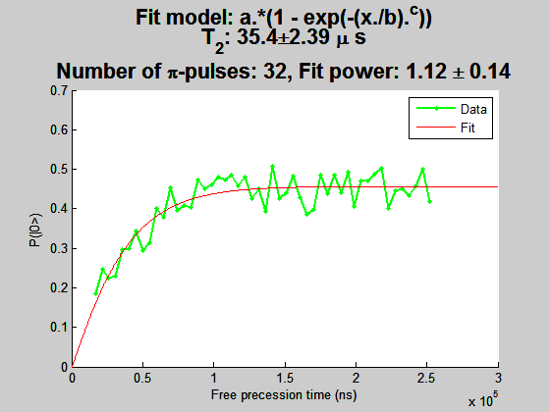
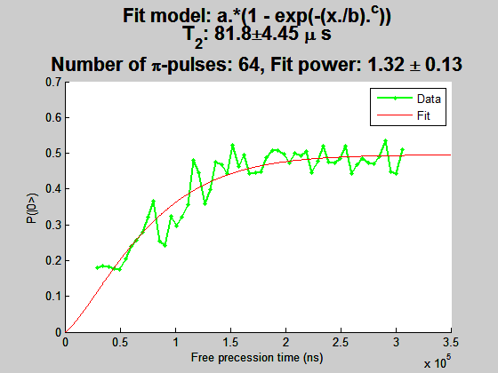
NV20
ESR 2.1479 GHz
B = 258 G
ESR contrast 18%

Slide 7
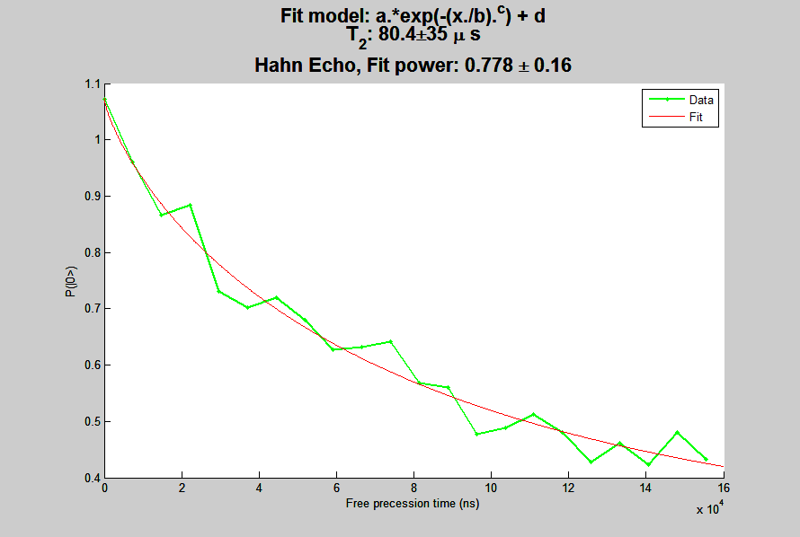

Slide 8
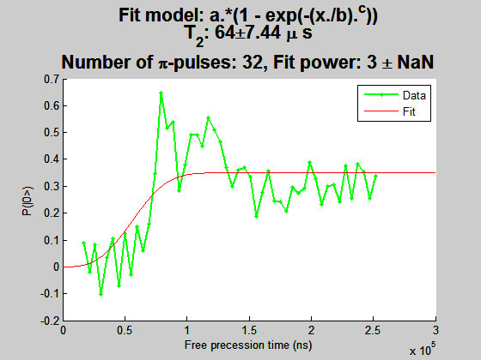
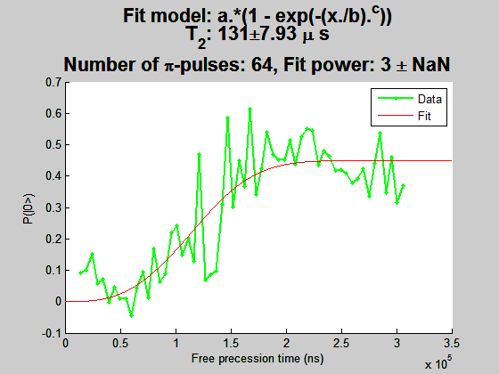
NV22

Slide 9
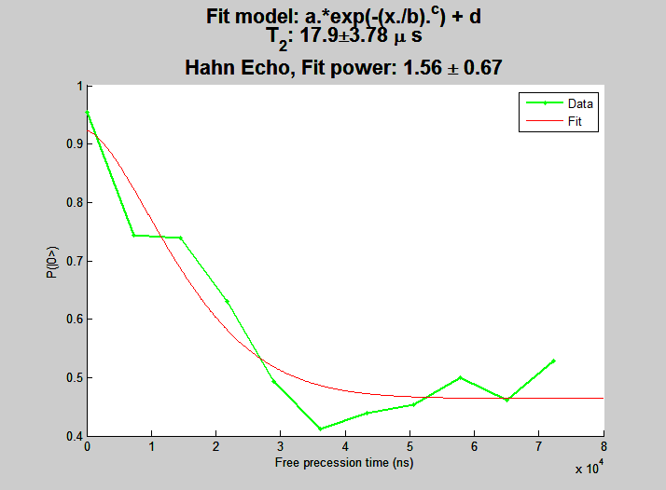
NV16
B = 258 G
ESR contrast 15%

Slide 10
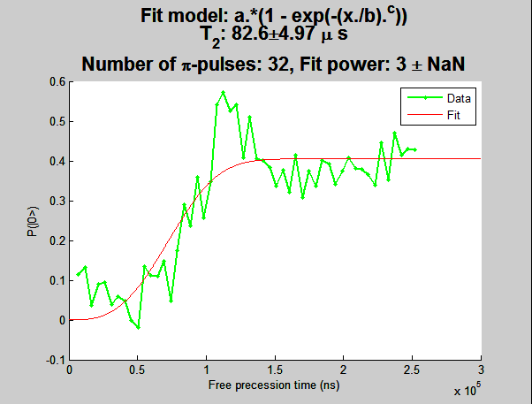
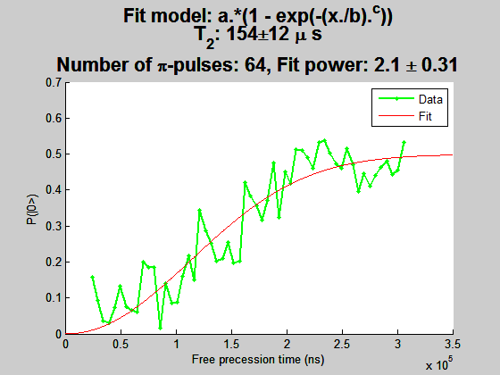
NV16

Slide 11
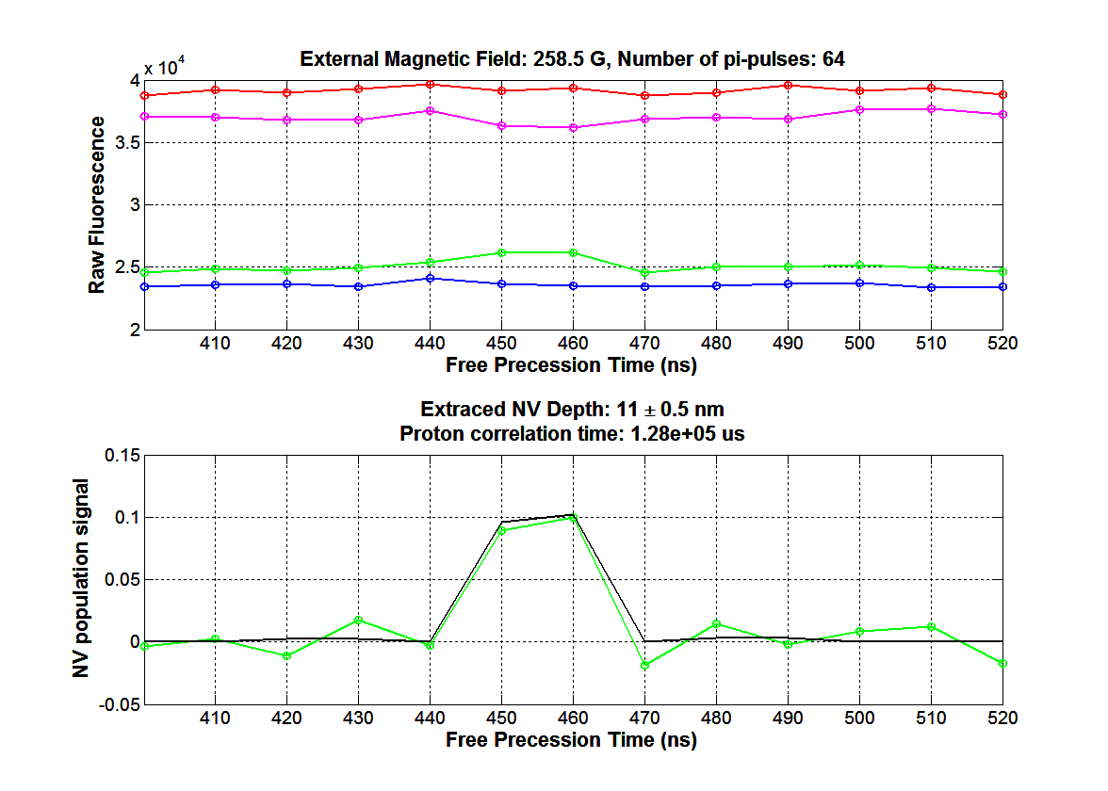

Slide 12
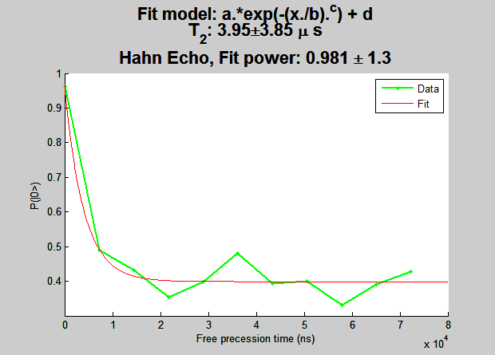
NV15
B = 258
ESR contrast 8%

Slide 13
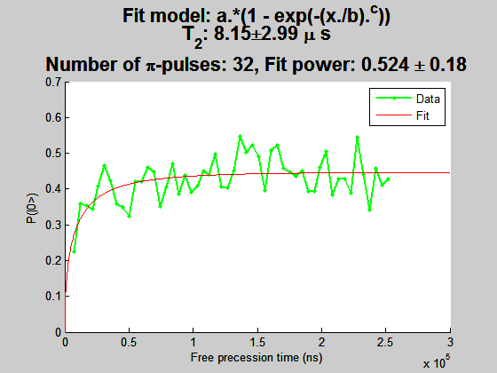
NV15
Still need depth, at DD sequence with fewer pulses

Slide 14
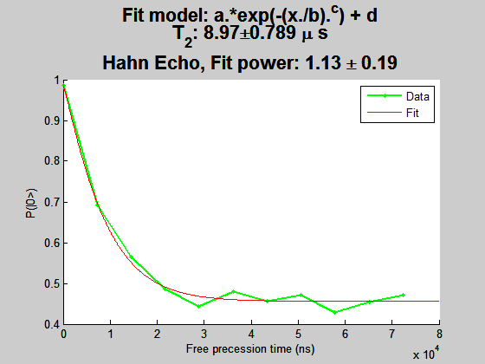
NV17
ESR contrast 16%

Slide 15
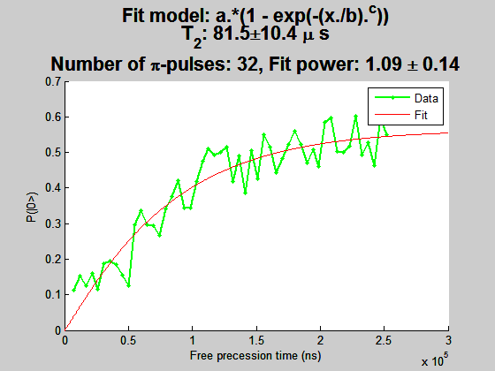
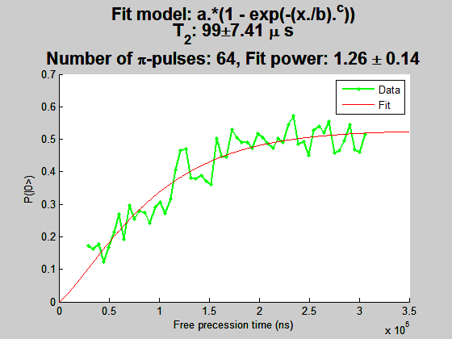
NV17

Slide 16
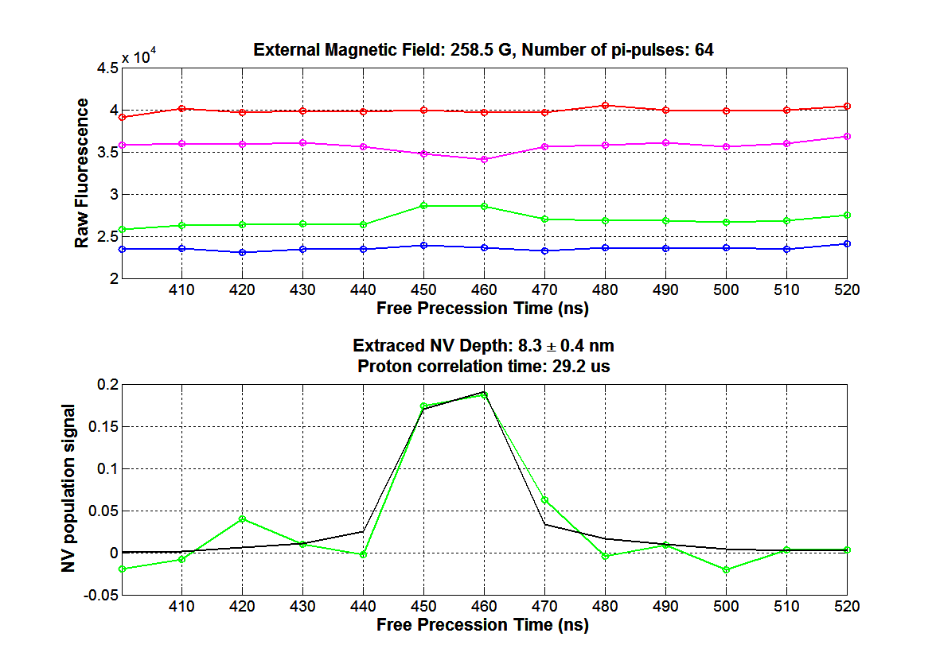

Slide 17
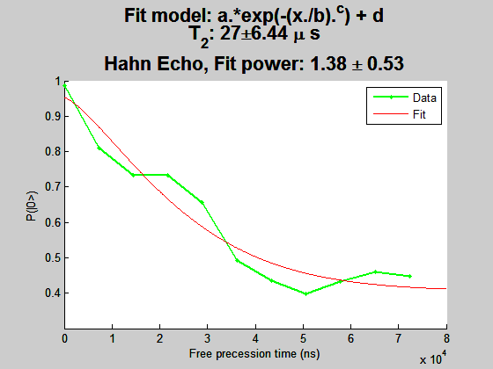
NV18
ESR Contrast 6%

Slide 18
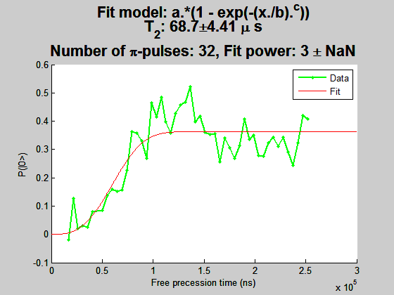
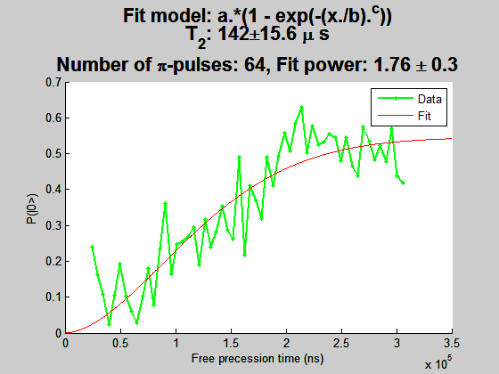
NV18

Slide 19
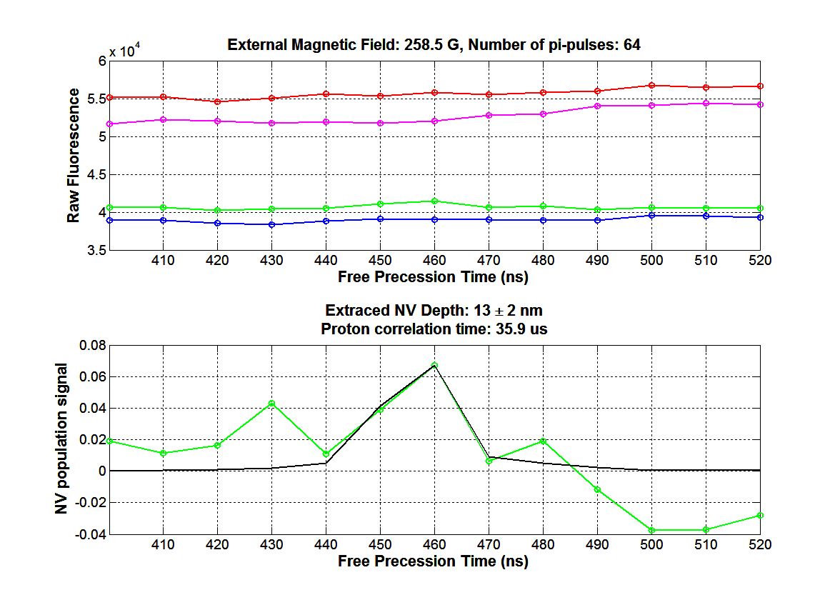

Slide 20
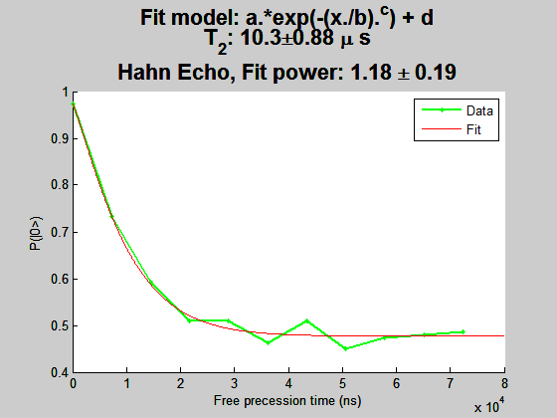
NV21
ESR contrast 10%

Slide 21
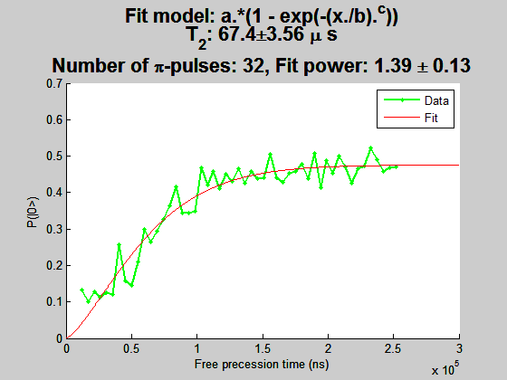
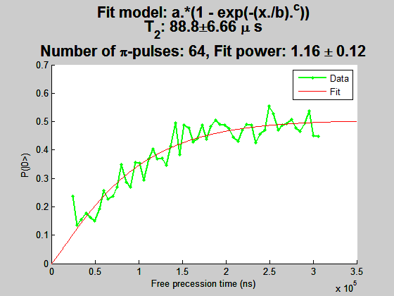
NV21

Slide 22
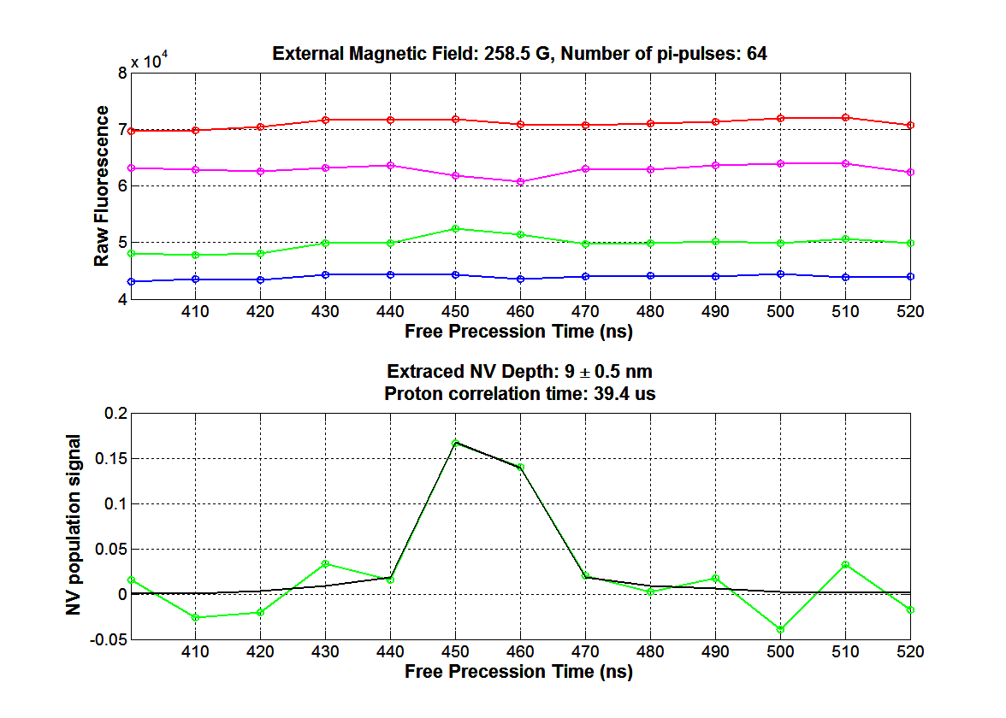

Slide 23

NV22
ESR contrast 10%

Slide 24
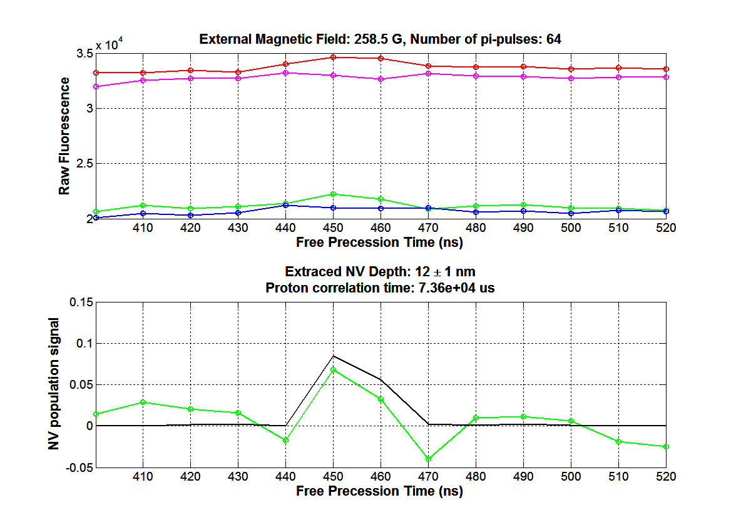

Slide 25
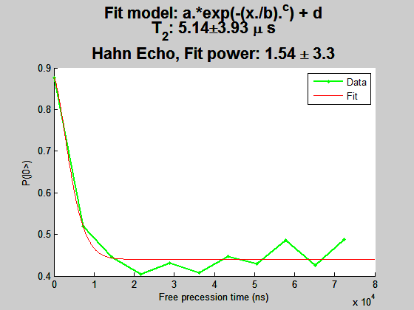
NV12
ESR contrast 14%

Slide 26
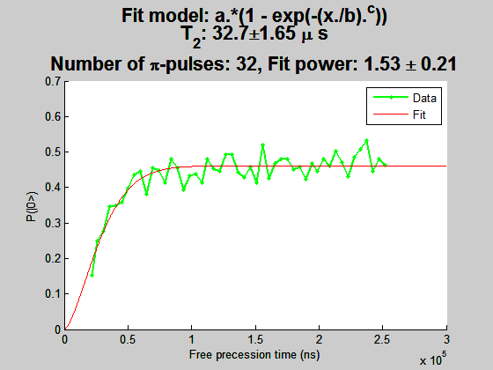
NV12

Slide 27


