Slide 1
Sample 00108
Bo Dwyer
12/1/2014

Slide 2
Summary
NV name | Contrast | Spin echo | XY8-1 | XY8-2 | XY8-4 | XY8-8 | XY8-12 | XY8-16 | Depth
NV1 | 40% | 12us | None | None | None | 123 us | None | 141 | 6 nm
NV2 | 35% | 1.3 us | None | None | 32 us | 33 us | None | None | 2.8 nm
NV3 | 30% | 1.3 us | 3.6 us | 5.7 us | None | None | None | None | Need
NV4 | 22% | 11 us | None | None | 82 us | 135 us (bad fit) | 78 us | None | 5.1 nm
NV5 | 26% | 1.6 us | 4.25us | 6.5 us | 16 us | None | None | None | Need
NV8 | 28% | 830 ns | 3.8 us | need | None | None | None | None | Need
NV9 | 31% | 3us | None | 10us | 8 us (\pm 2) | None | None | None | 2.6 nm

Slide 3
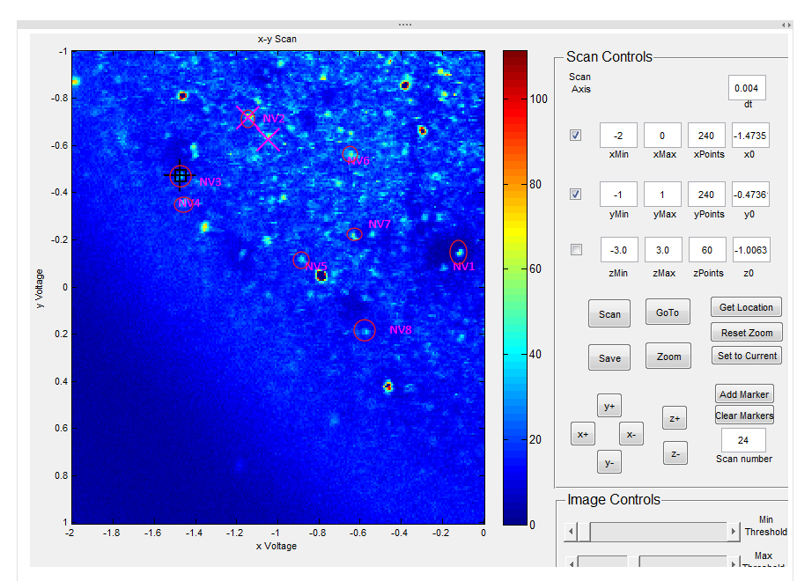

Slide 4
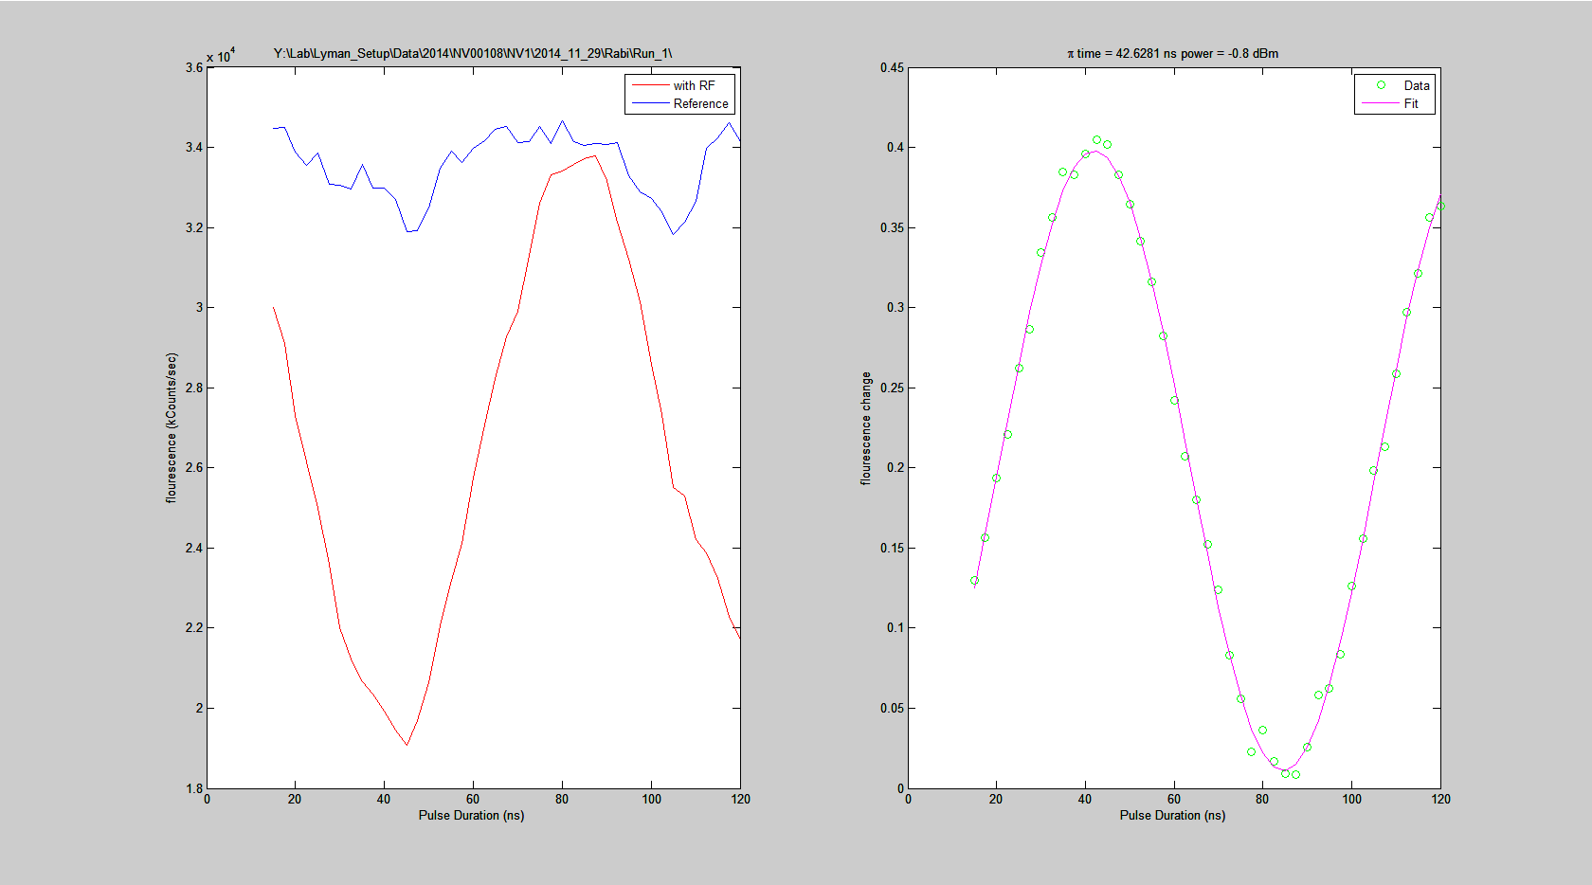
NV1

Slide 5
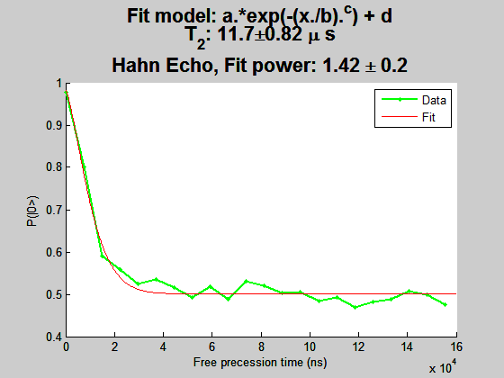
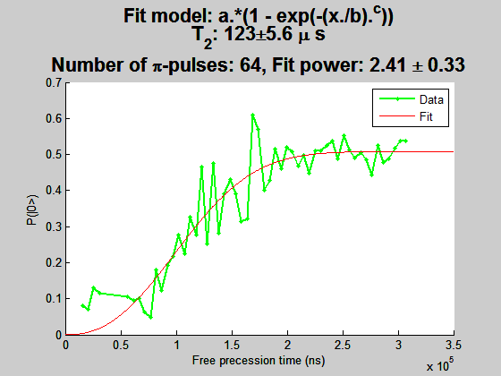
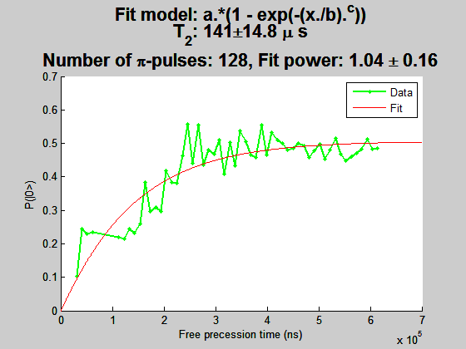
NV1

Slide 6
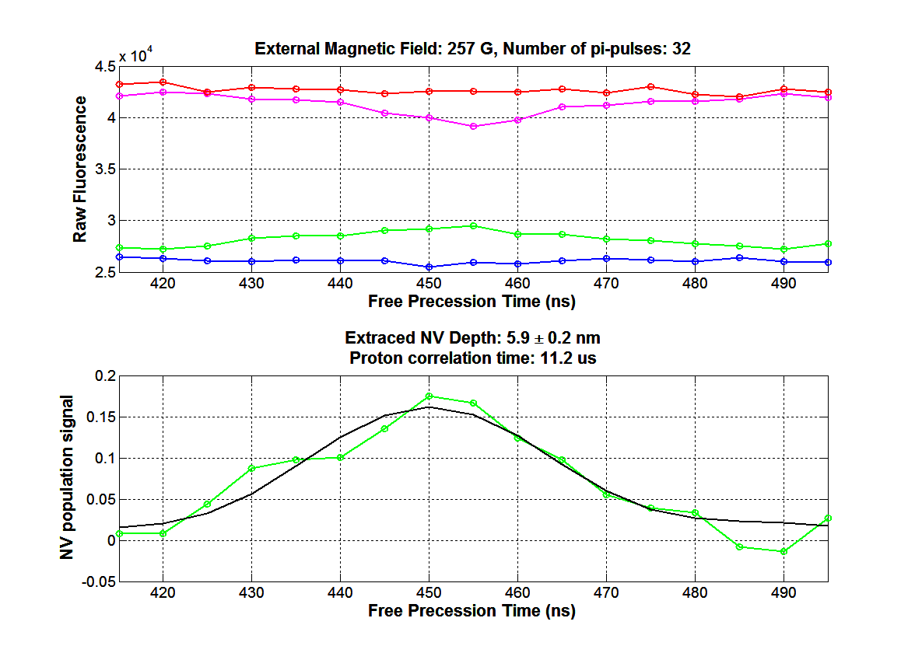
NV1 Depth

Slide 7
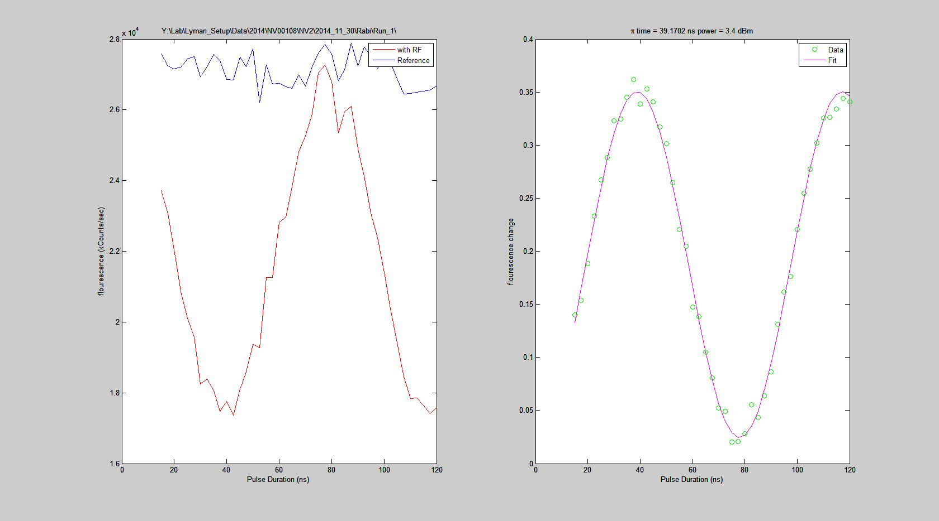
NV2

Slide 8
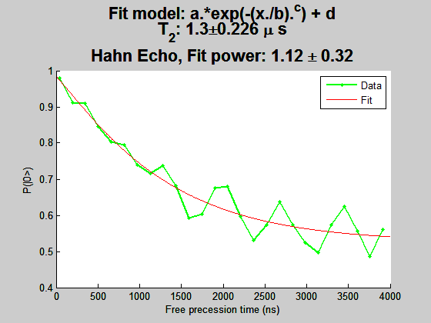
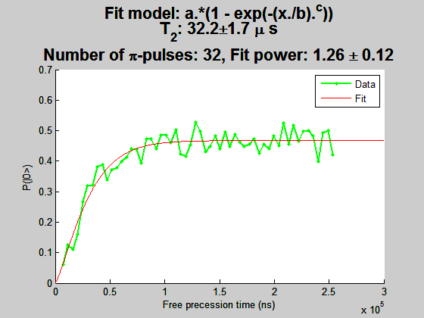
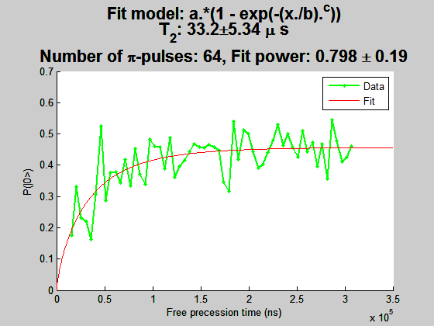
NV2

Slide 9
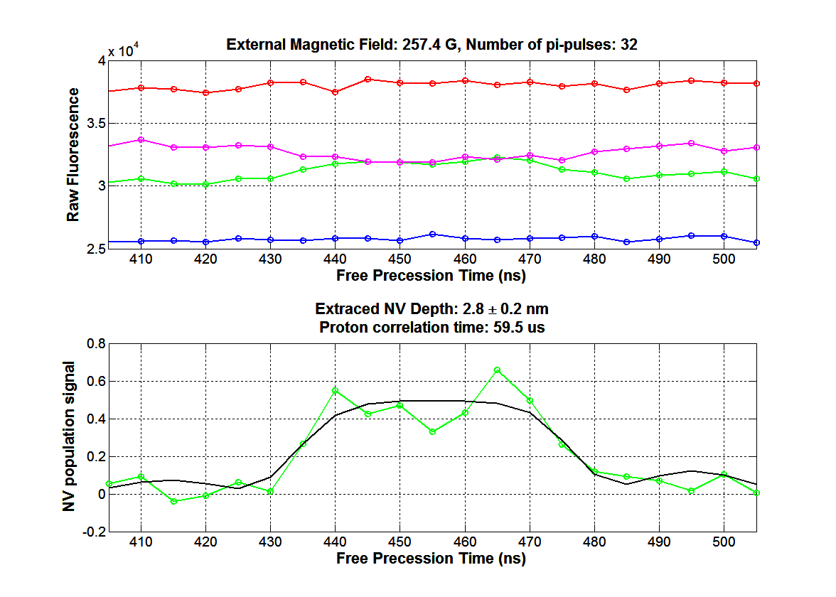

Slide 10
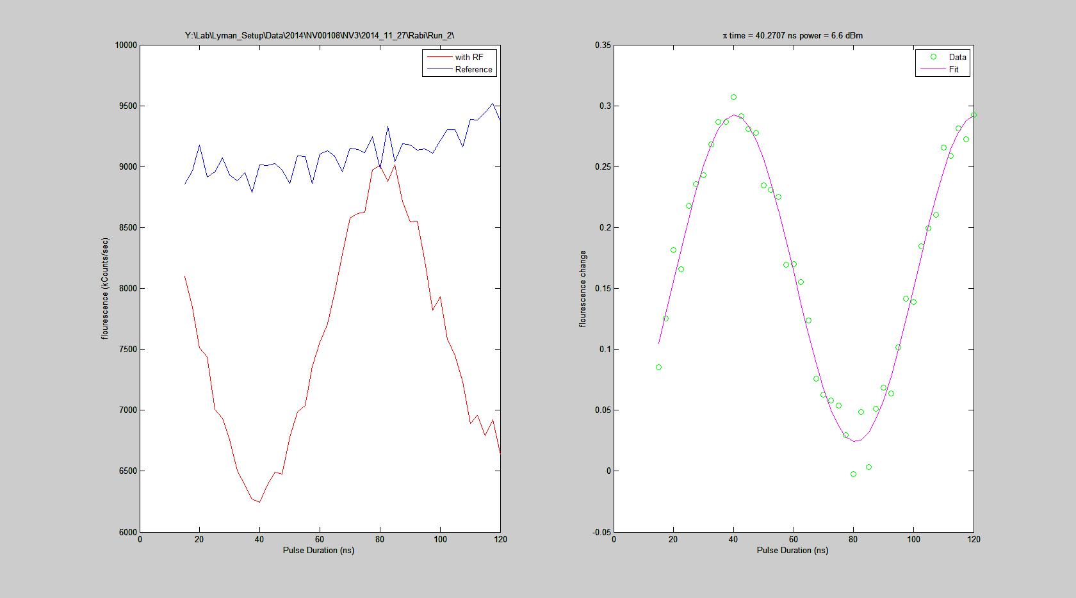
NV3

Slide 11
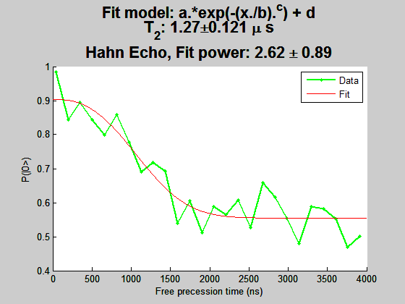
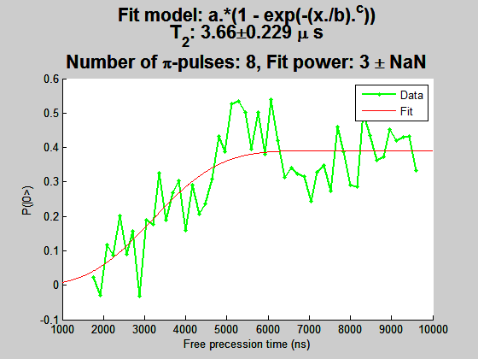
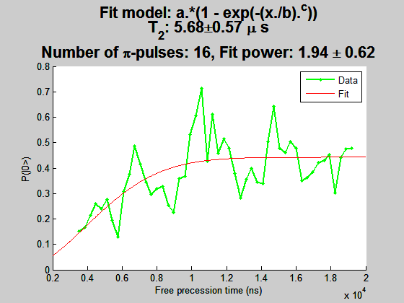
NV3
Need Spin depth

Slide 12
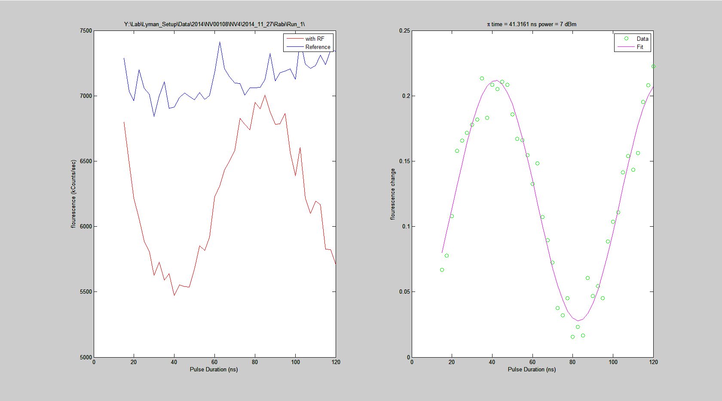
NV4

Slide 13
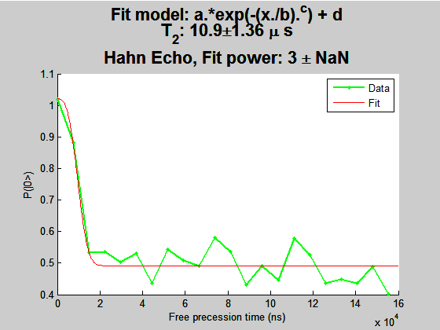
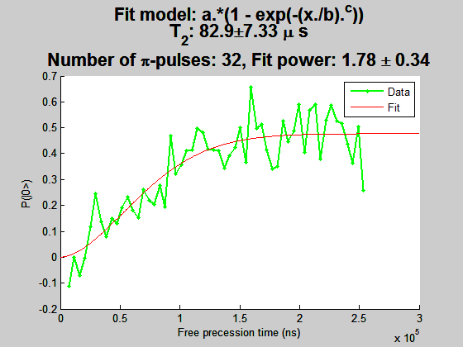
NV4

Slide 14
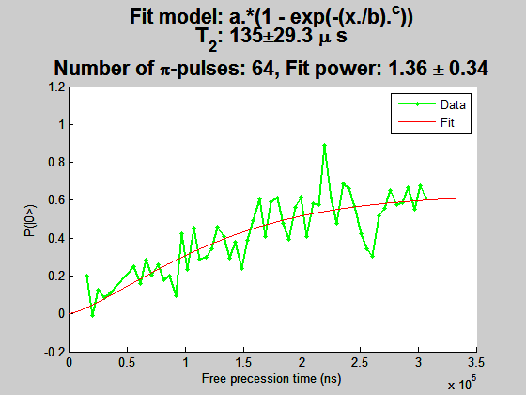
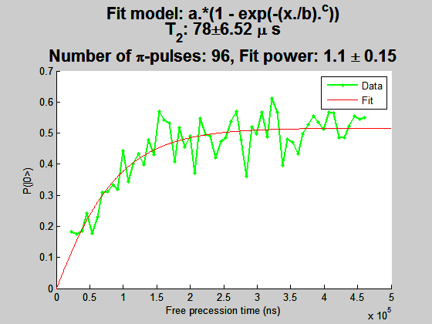
NV4
Bad fit. Actually looks saturated.

Slide 15
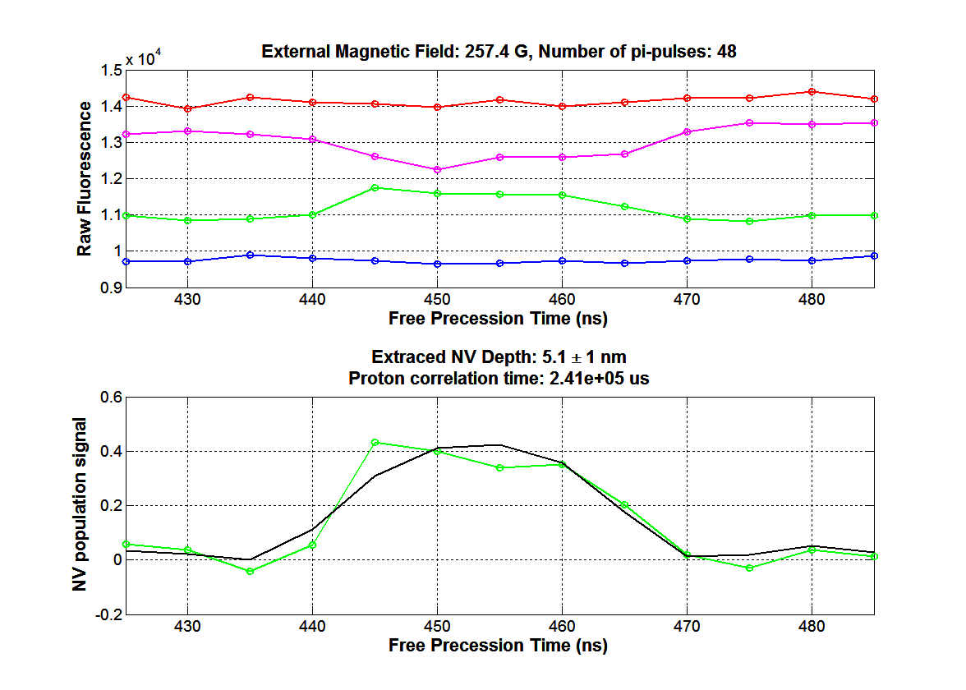

Slide 16
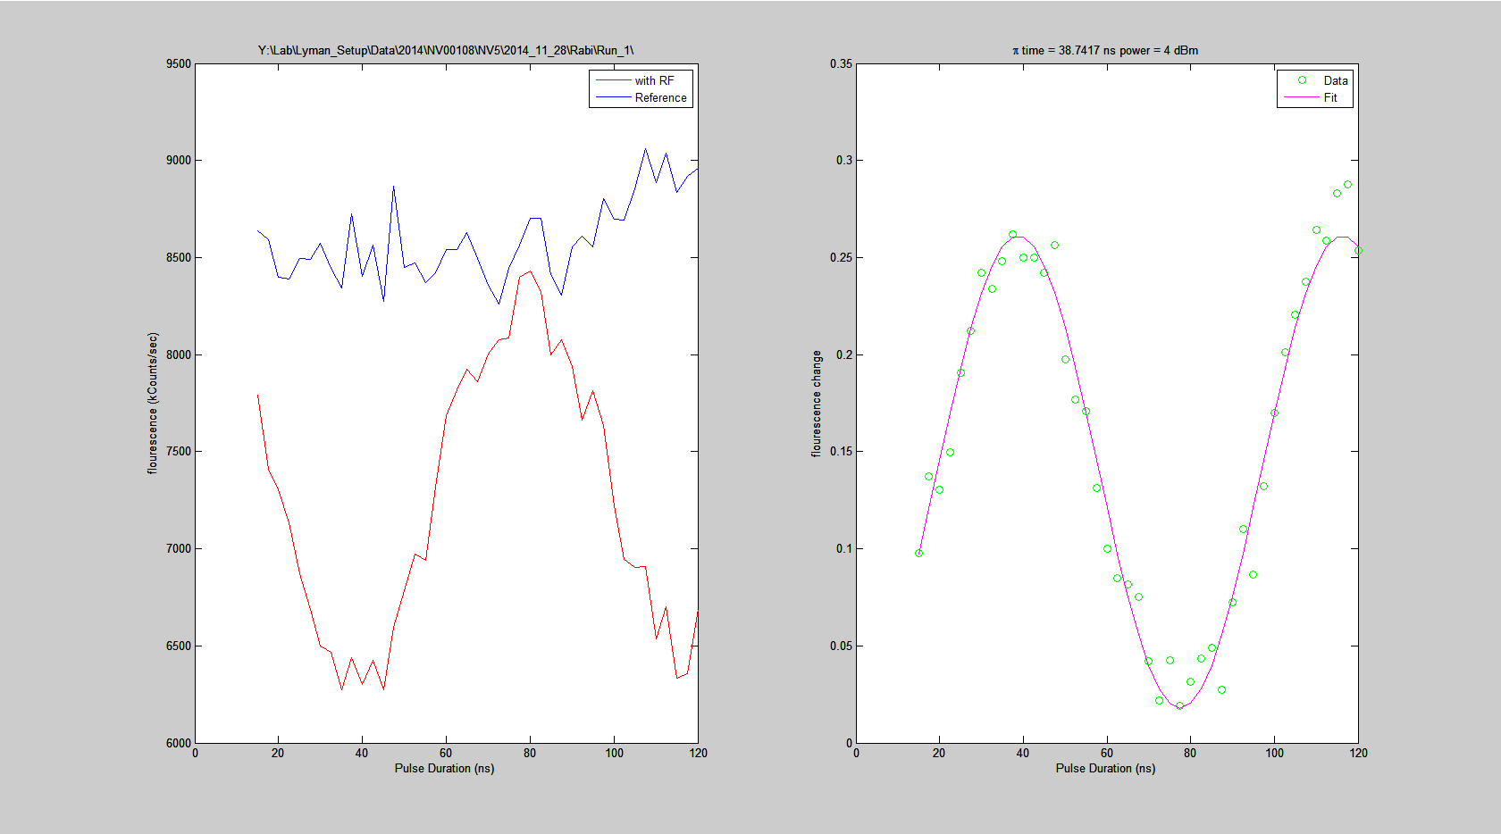
NV5

Slide 17
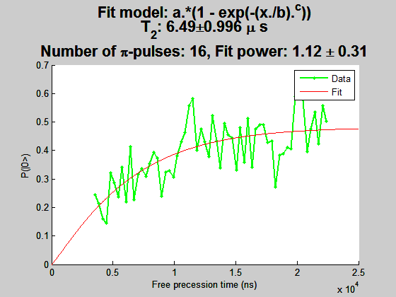
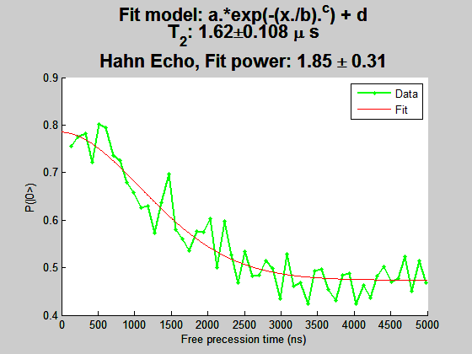
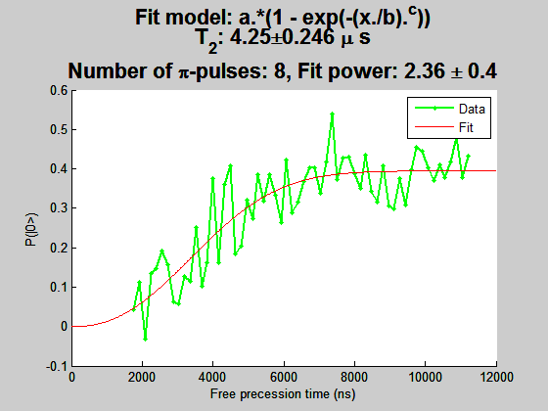
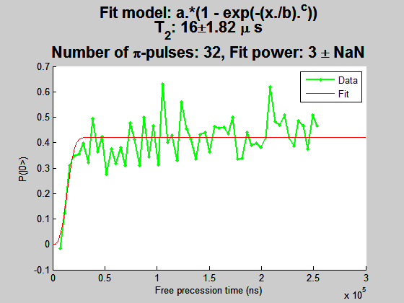
NV5

Slide 18
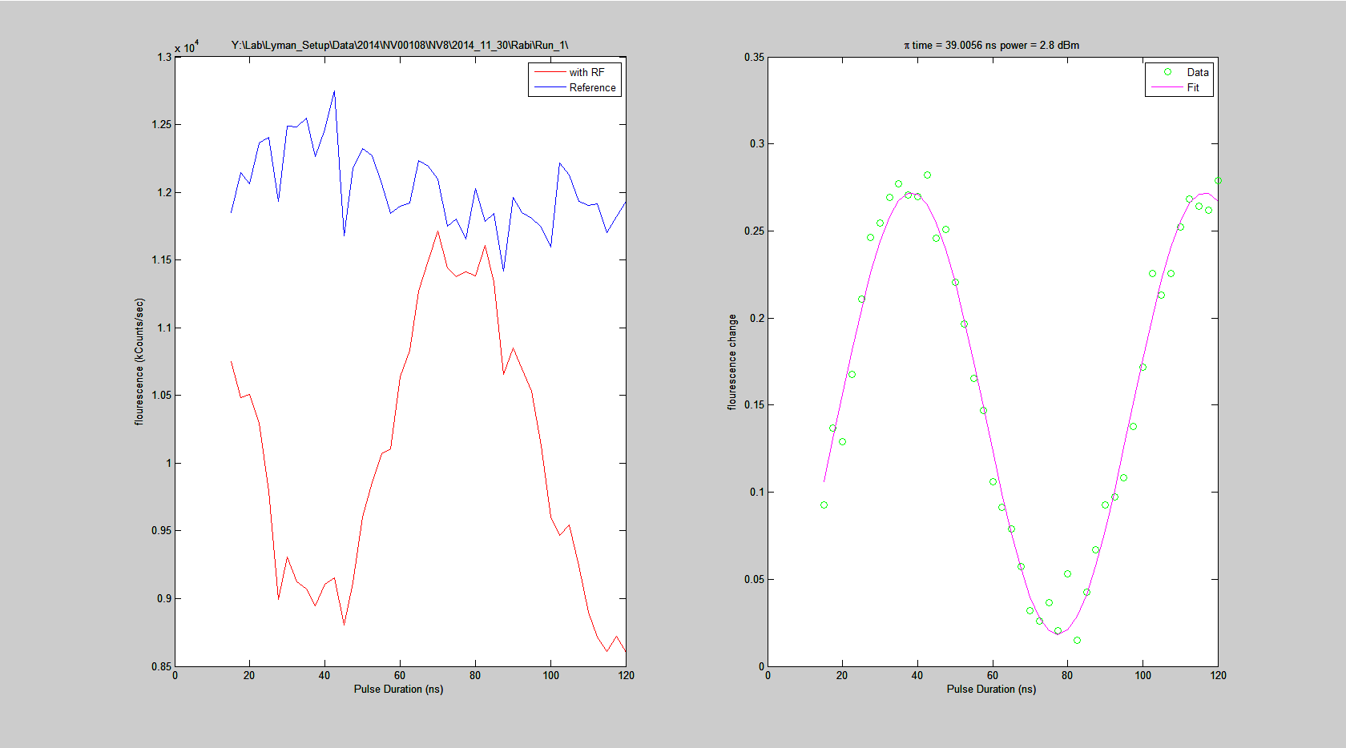
NV8

Slide 19
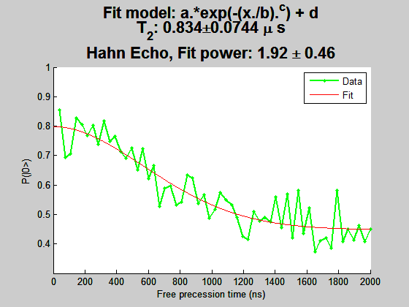
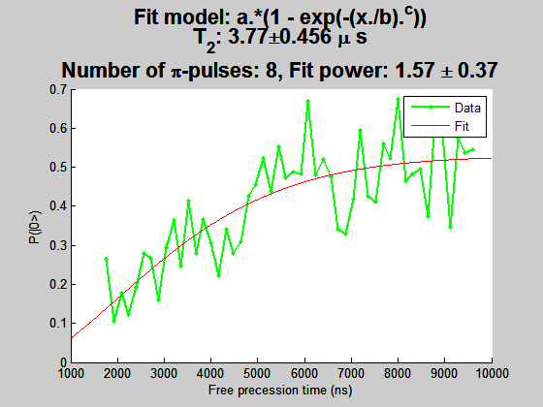
NV8
Need depth, xy4?

Slide 20
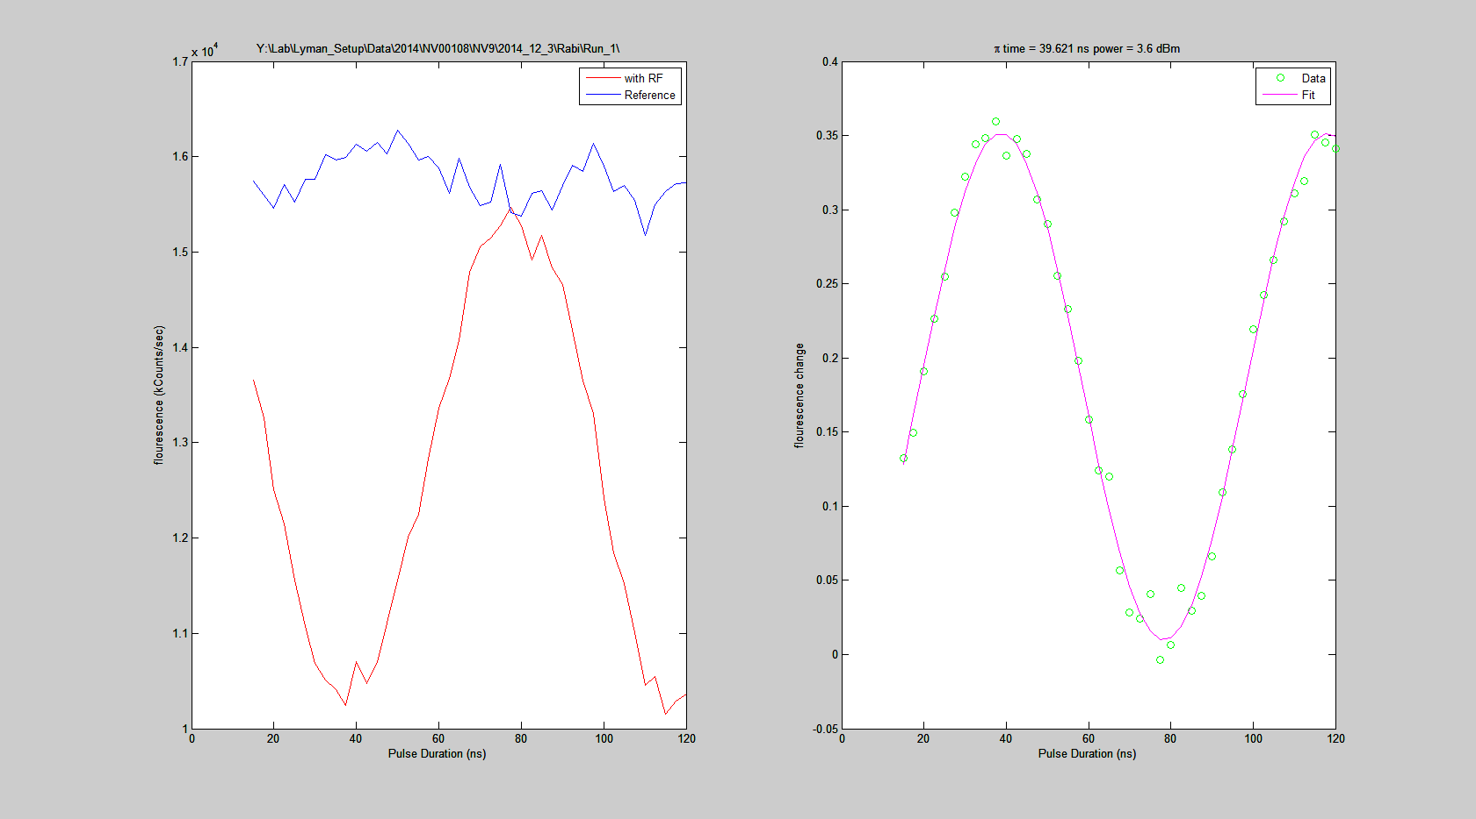
NV9

Slide 21
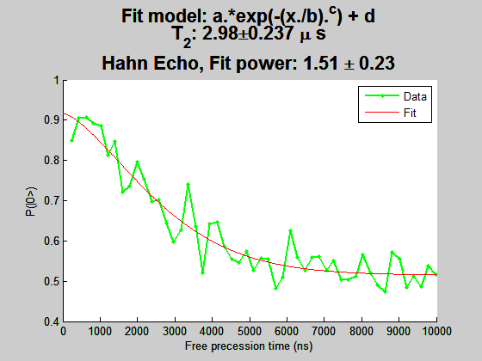
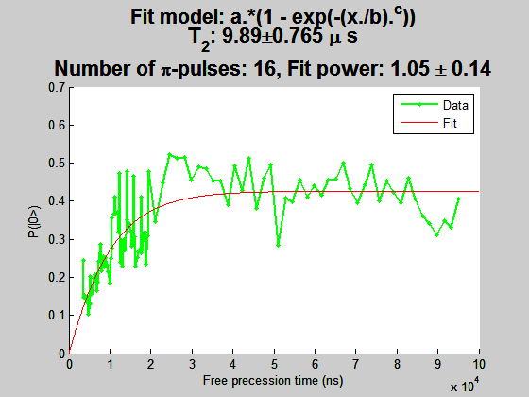
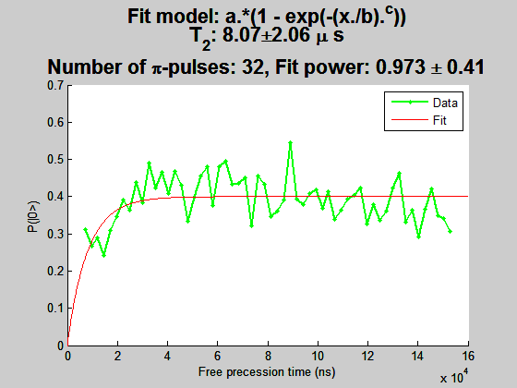
NV9

Slide 22
