Slide 1
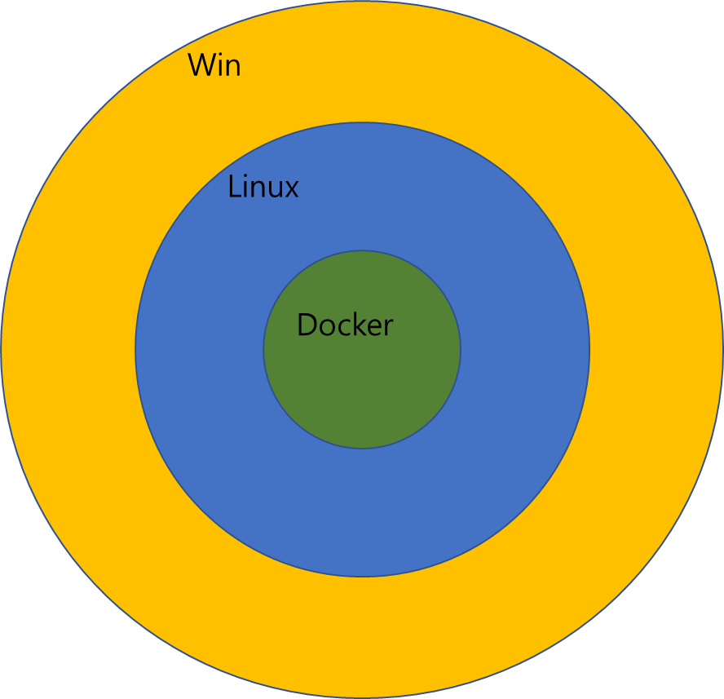
Win
Linux
Docker

Slide 2
DBMS
Data
(CRUD)
Data
(CRUD + etc)
Data
(CRUD + etc)
Data etc
Data etc
Process
Process
Process
Process

Slide 3
DBMS
DBMS
Data
(CRUD)
Data
(CRUD)
ODBC JDBC
Data Connection
Data connection + etc
Data connection + etc
Data etc
Data etc
Process
Process
Process
Process

Slide 4
A AND B
A
B

Slide 5
A OR B
A
B

Slide 6
Between A and B
A
B
Between A and B

