Slide 1
Gen AI demystified
It is not magic just a lot of matrix multiplication.
Quick workshop showing of a very basic model that can name your future baby.

Slide 2
Introduction

Slide 3
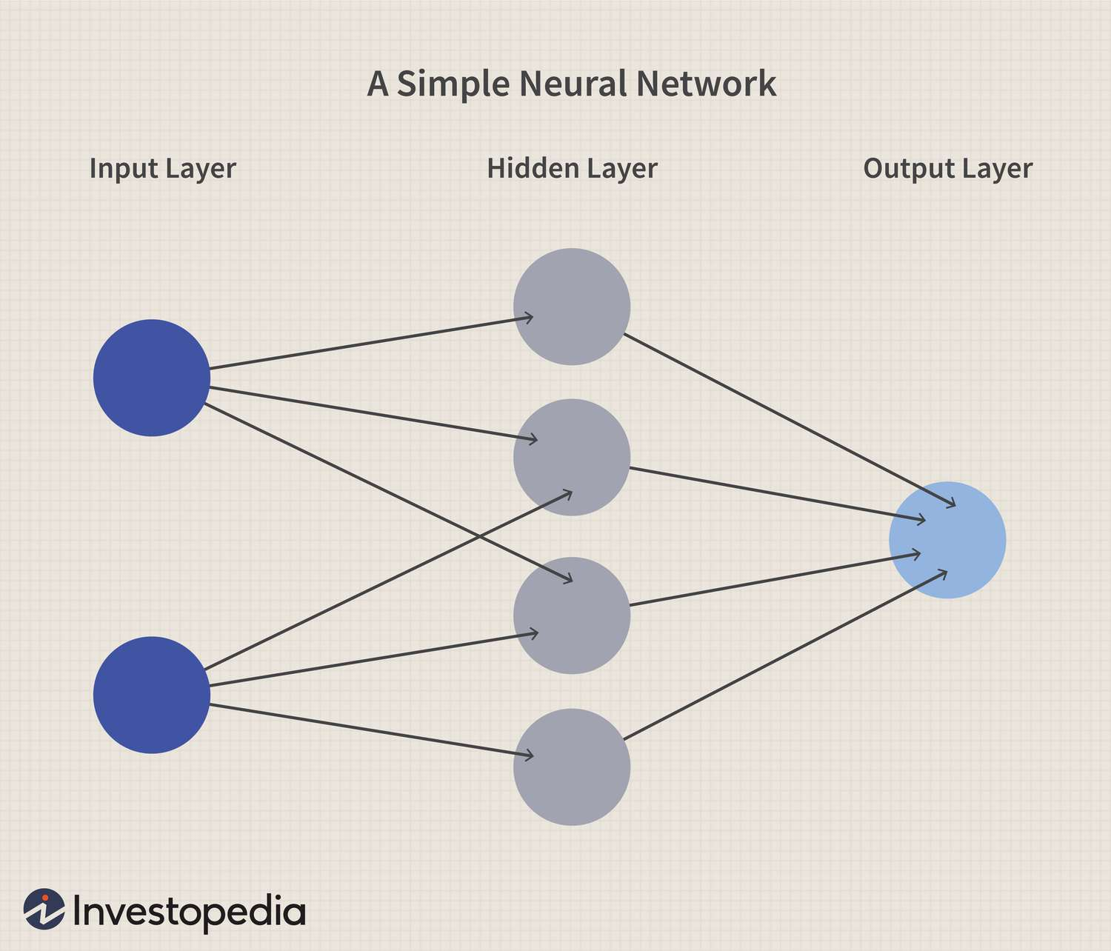
Neural network

Slide 4
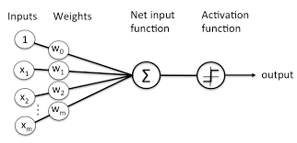
One of the neurons

Slide 5
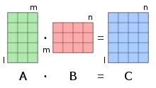
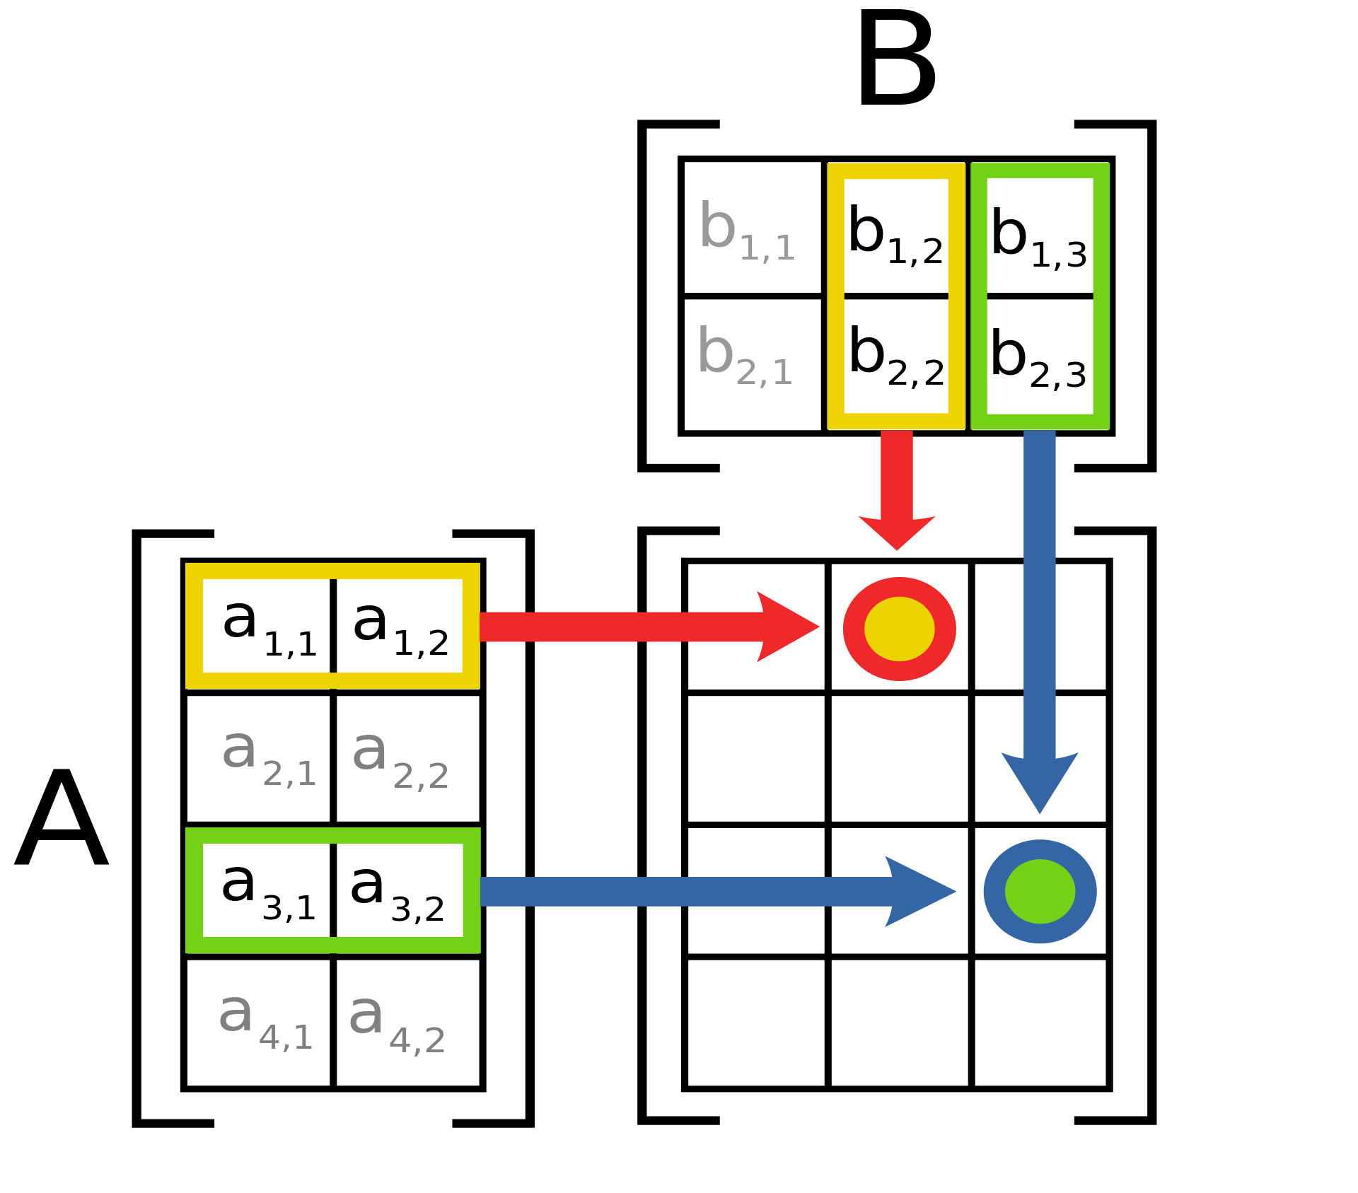
Matrix multiplication
For matrix multiplication, the number of columns in the first matrix must be equal to the number of rows in the second matrix. The result matrix has the number of rows of the first and the number of columns of the second matrix.

Slide 6
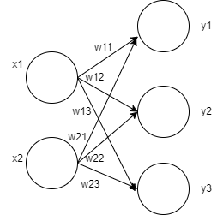
Why matrix mutliplication is usefull
Y1=x1w11*x2w21
Y2=x1w12+x2w22
Y3=x1w13+x2w23
X=[x1,x2]
W=[w11,w12,w13;
w21,w22,w23]
Y=X*W
Notes:
Y1=x1w11*x2w21
Y2=x1w12+x2w22
Y3=x1w13+x2w23

Slide 7
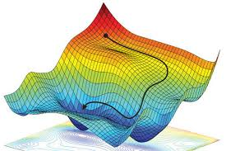
Gradient decent

Slide 8
Bigram model

Slide 9
Multilayer perceptron (MLP)

Slide 10
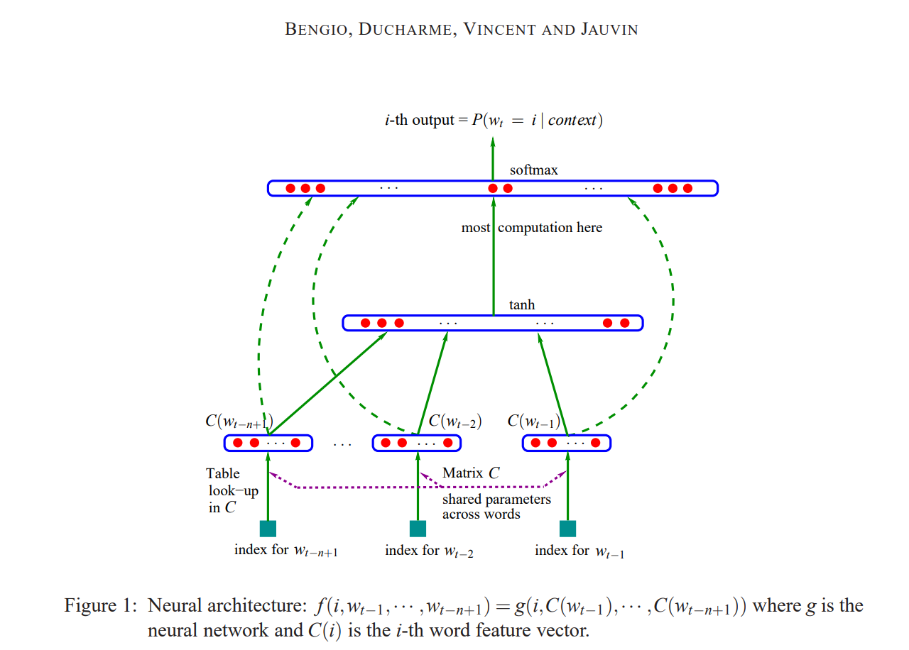
Multilayer perceptron structure

Slide 11
Algorithm for our MLP
Associate with each token(for us a character) in the vocabulary a distributed word feature vector(in simple words each integer that represents our letter is assigned a vector of length EMBEDING_DIMENSION)
Express the joint probability function of token sequences in terms of the feature vectors of these token in the name
Learn simultaneously the word feature vectors and the parameters of that probability function.

Slide 12
Hyperparameters
Hyperparameters in machine learning are parameters that are set prior to the training process. Unlike model parameters, which are learned during training, hyperparameters are not learned from the data. Instead, they control the learning process itself.
For our example we will use:
BLOCK_SIZE = 3
BATCH_SIZE = 32
EMBEDING_DIMENSION=10
HIDDEN_LAYER_SIZE=200

Slide 13
Building data sets
Important to remember to split the data so we use most of the data for learning however some of the data need to be `hidden` from the model while learning so it can be used for verification.
build_dataset in the code

Slide 14
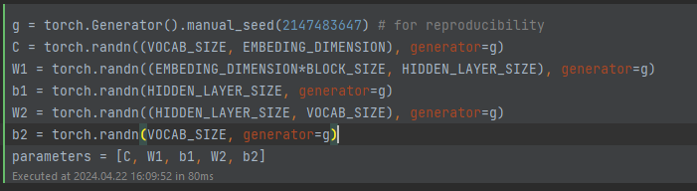
Define the matrixes for the neural net

Slide 15
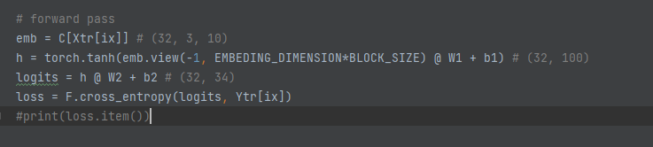
Forward pass (inference)

Slide 16
Pytorch magic
Indexing in Pytorch:
You can do C[1] you get row 1
You can do C[1,2] you get row 1 and 2
Finally, you can also do C[X] where X is a multidimensional and you
.view() you can read more here: http://blog.ezyang.com/2019/05/pytorch-internals/
Cross entropy:
counts = logits.exp()
prob = counts / counts.sum(1, keepdims=True)
loss = -prob[torch.arange(32), Y].log().mean()

Slide 17
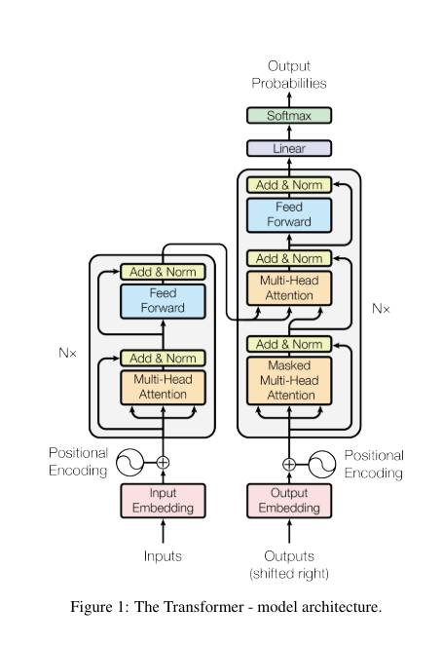
GPT

Slide 18
Reference list
Data:https://dane.gov.pl/pl/dataset/1667,lista-imion-wystepujacych-w-rejestrze-pesel-osoby-zyjace
Base neural network info: https://www.youtube.com/playlist?list=PLZHQObOWTQDNU6R1_67000Dx_ZCJB-3pi
Andrej Karpathy series on neural networks: https://www.youtube.com/playlist?list=PLAqhIrjkxbuWI23v9cThsA9GvCAUhRvKZ
MLP:https://www.jmlr.org/papers/volume3/bengio03a/bengio03a.pdf
Attention Is All You Need: https://arxiv.org/pdf/1706.03762.pdf
Sample pics taken from:
https://www.investopedia.com/terms/n/neuralnetwork.asp
https://wiki.pathmind.com/neural-network

