Slide 2
Generowanie certyfikatu
Wymagane
Windows Drivers Kit
  Makecert.exe (C:\Program Files (x86)\Windows Kits\10\bin\x64)
  Pvk2Pfx.exe
makecert -r -pe -n "CN=%1" -b 01/01/2015 -e 01/01/2020 -eku 1.3.6.1.5.5.7.3.3 -sky signature -a sha256 -len 2048 -ss my -sr LocalMachine

Slide 3
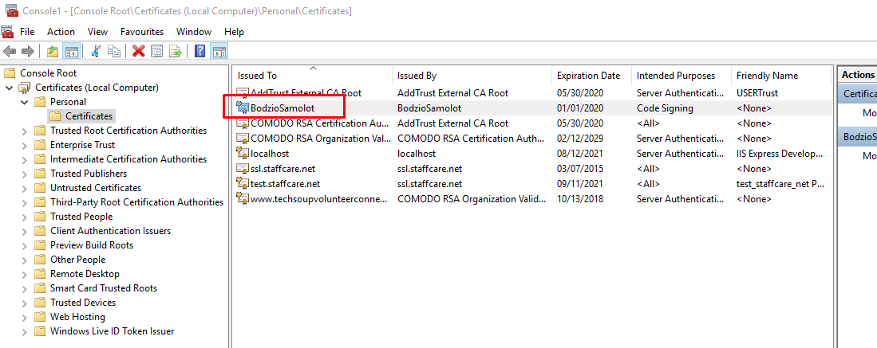
MakeCert
makecert -r -pe -n "CN=BodzioSamolot" -b 01/01/2015 -e 01/01/2020 -eku 1.3.6.1.5.5.7.3.3 -sky signature -a sha256 -len 2048 (-ss my -sr LocalMachine ) (/sv MyKey.pvk MyKey.cer)

Slide 4
Makecert
makecert -r -pe -n "CN=BodzioSamolot" -b 01/01/2015 -e 01/01/2020 -eku 1.3.6.1.5.5.7.3.3 -sky signature -a sha256 -len 2048 -ss my -sr LocalMachine
r - Creates a self-signed root certificate
pe -Configures MakeCert to make the private key that is associated with the certificate exportable.
n - Specifies a name for the certificate
B & e – lifetime

Slide 5
Makecert
Sets the Enhanced Key Usage (EKU) values for the certificate.
  1.3.6.1.5.5.7.3.3 indicates that the certificate is valid for code signing. Always specify this value to limit the intended use for the certificate.
Sky - Specifies the name of the subject's key container that holds the private key
A – algorithm
ss & sr – store
Sv – subject key file

Slide 6
Pvk2Pfx
Pvk2Pfx /pvk MyKey.pvk /pi pvkPassword /spc MyKey.cer /pfx MyKey.pfx [/po pfxPassword]

