Slide 1
Präsentation CS1 Task 7 Domain Model & Sequence Diagram
ch.bfh.bti7081.s2013.yellow
19.04.2013

Slide 2
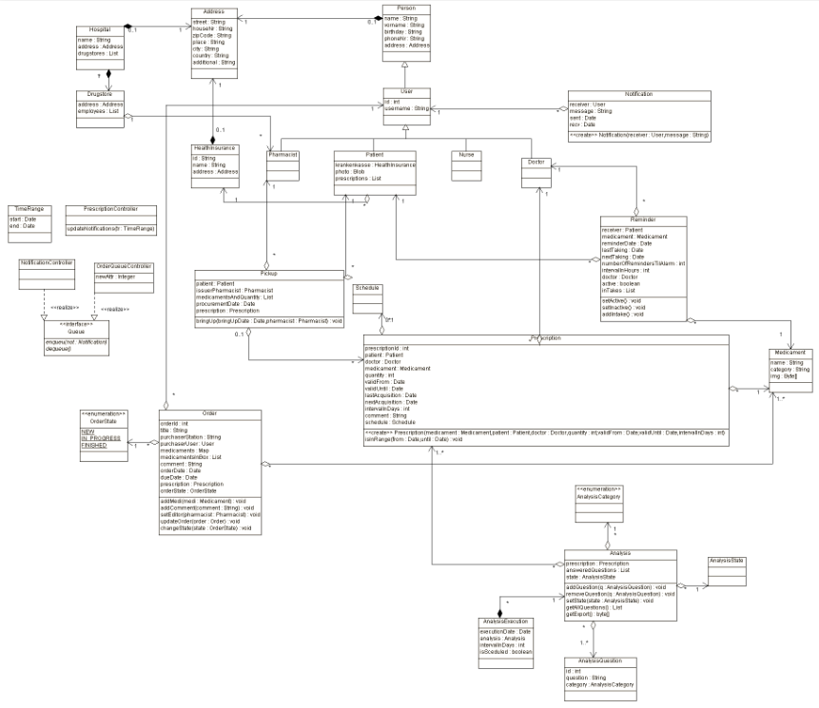
Domain Model / Class Diagram

Slide 3
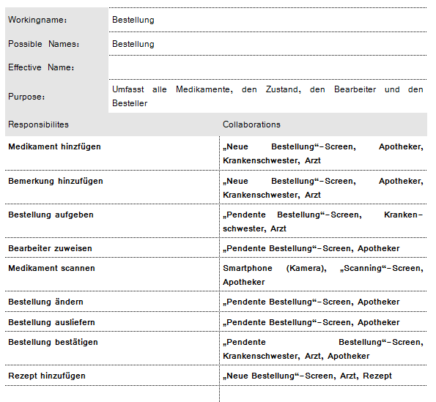
CRC Card - Order

Slide 4
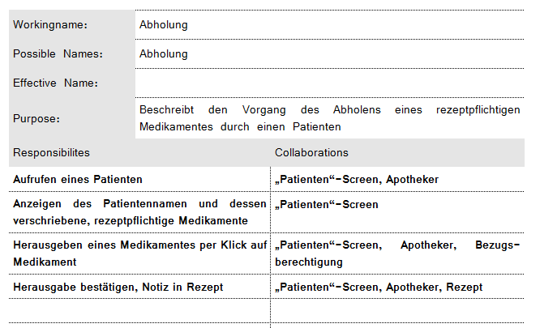
CRC Card - PickUp

Slide 5
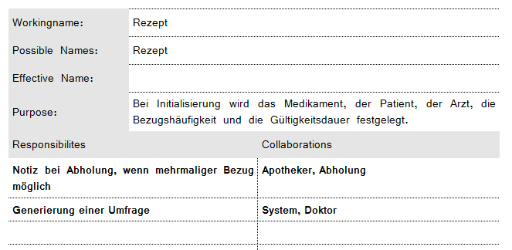
CRC Card - Prescription

Slide 6
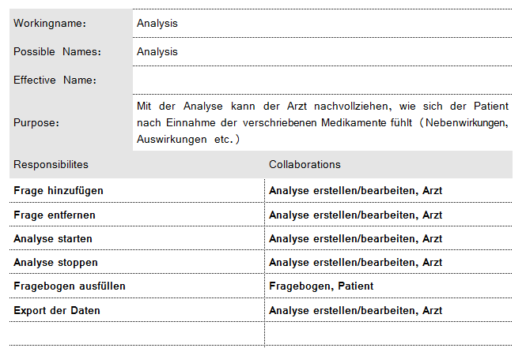
CRC Card - Analysis

Slide 7
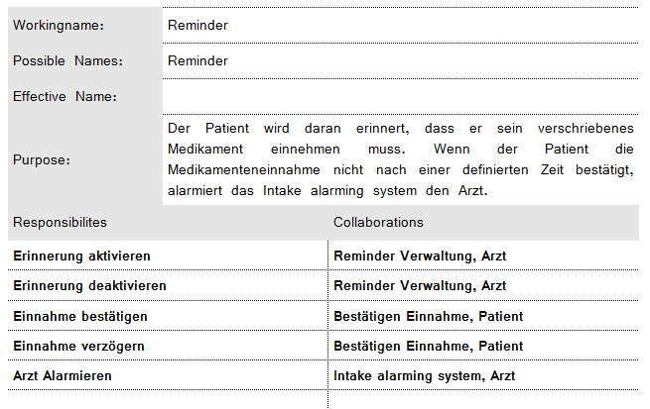
CRC Card - Reminder

Slide 8
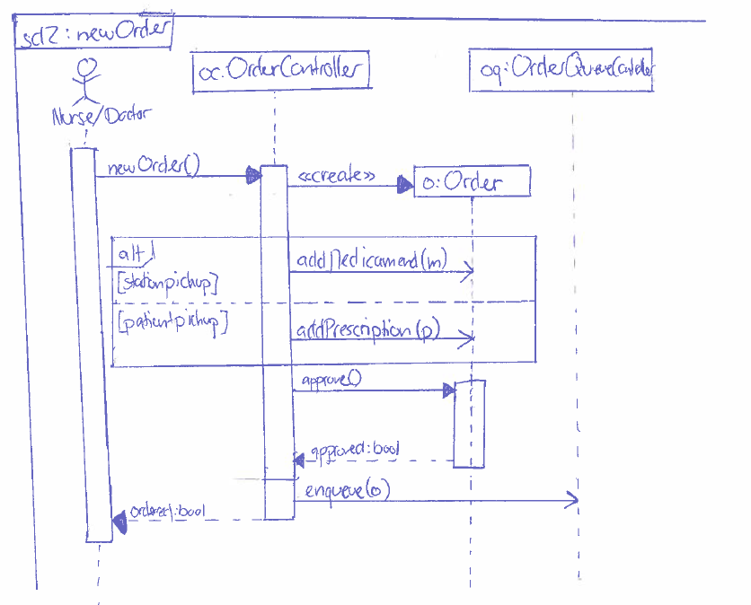
UML Sequence Diagram – User update

Slide 9
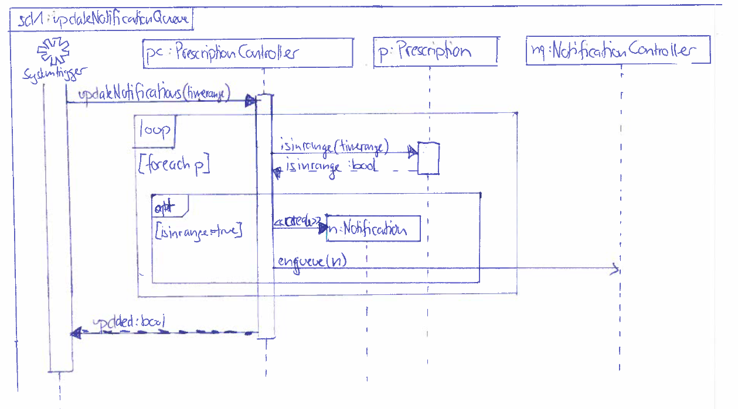
UML Sequence Diagram – System alert

