Slide 1
AIB

Slide 2
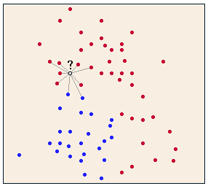
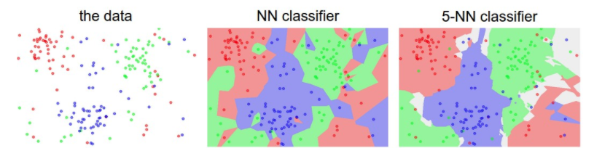
KNN – algorithm
Supervised
Controlled by one main parameters k, (next is distance function)

Slide 3
AI with JS

