Slide 1
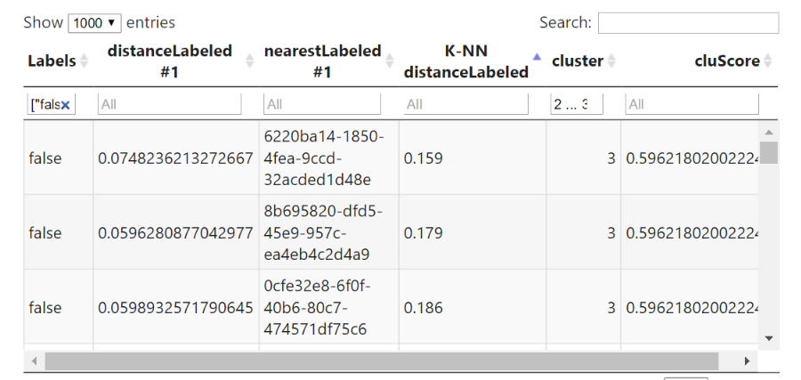
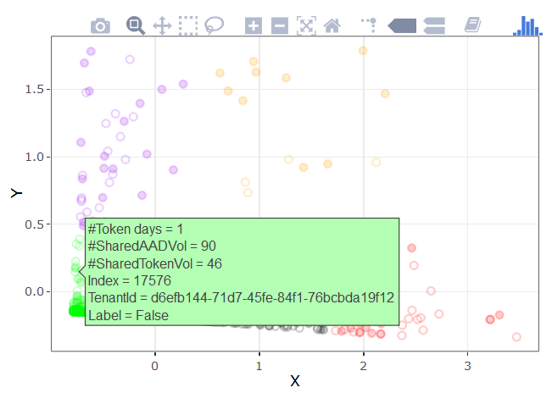
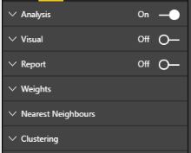
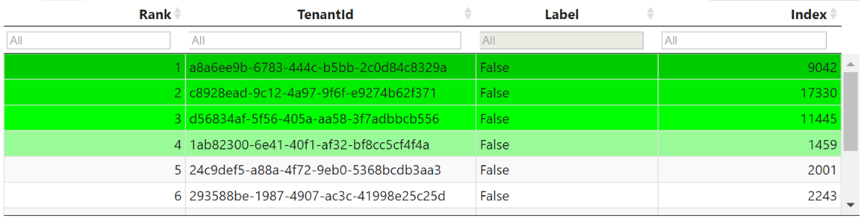
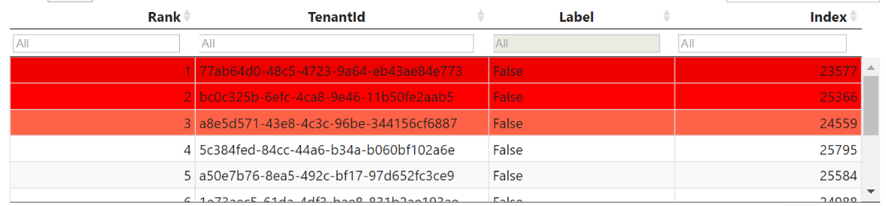
Quantitative analysis
Visual inspection
Report (engagement / churn )
Hyperparameters of algorithms

Slide 2
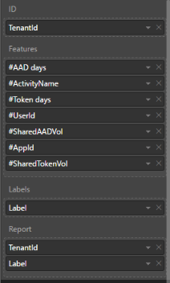
UI: inputs
Tenant ID or unique name
Any numeric features
True/false or 1/0 column of true labels for known engaged or churn
Information for report table: telephones, names, country etc.

Slide 3


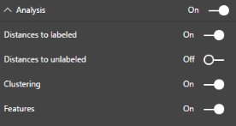
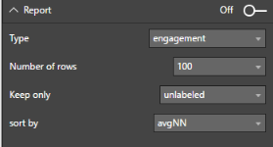

UI: parameters
Algorithm parameters
2
Type of visual output
1
Configuration of visual output
3a
3b
3c

