Slide 1
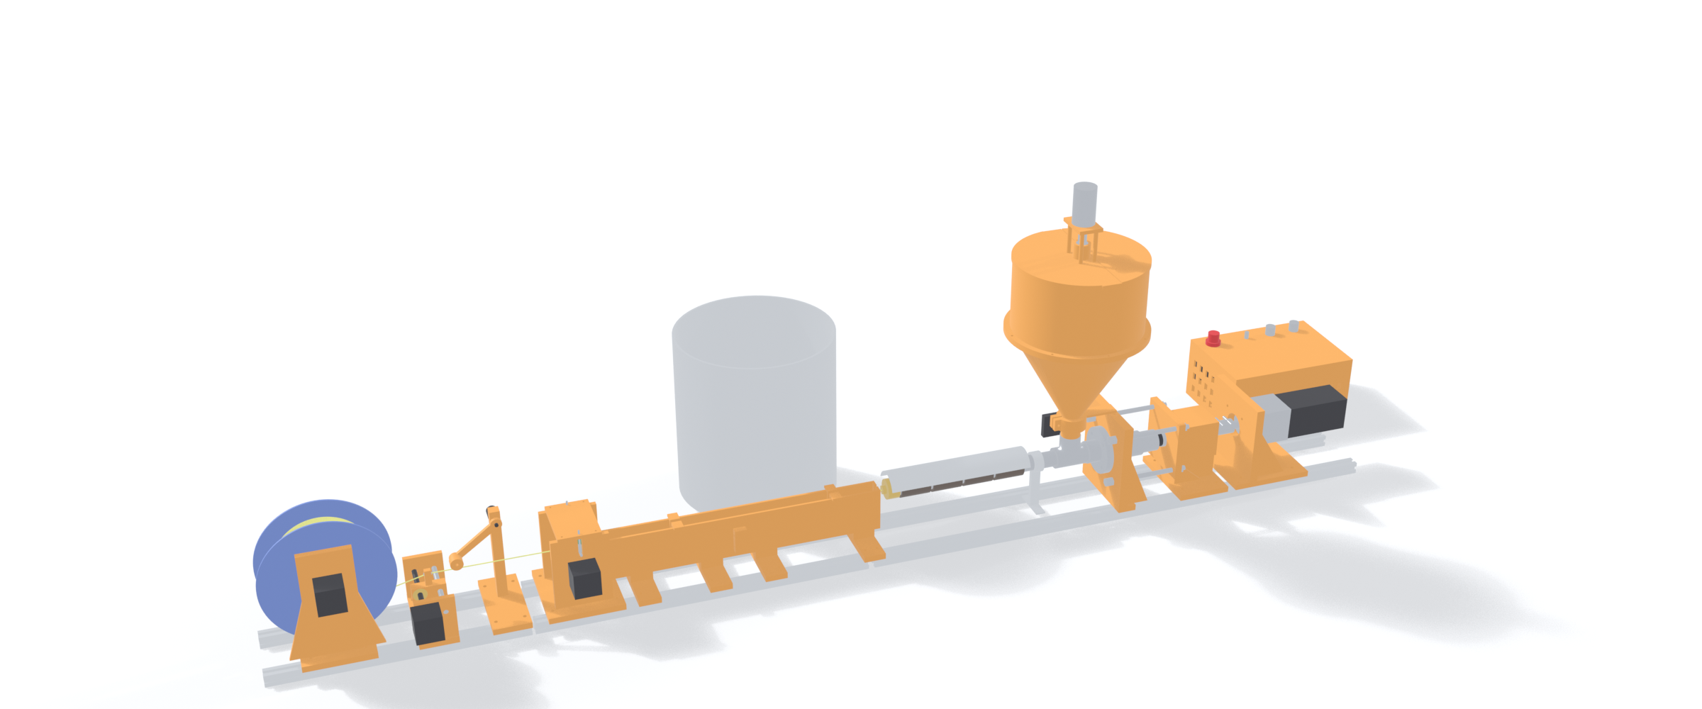
DIY FILAMENT MAKER – BLUEPRINT SET (REV B)
FULL LINE – 1 kg hopper, extruder, water bath, puller, dancer, level-wind spooler
1 kg → 1 kg
≈ 3.4 h / kg
a 6.4 L hopper takes 1 kg of flakes; the spool takes 1 kg (≈ 335 m of PLA)
at 4 rpm: ≈ 1.6 m/min, ≈ 295 g/h (estimate, calibrate)
6.4 L
18 → 0 FAIL
hopper: 60° cone + agitator, holds ≥ 1 kg of flakes down to 0.17 g/cm³
Rev A vs Rev B checks; Rev B: 41 PASS, 1 WARN
SHEET INDEX
1 Overview
2 What changed in Rev B
3 Verification report
4 Assembly views + overall size
5 Exploded view + part numbers
6 1 kg hopper
7 Process + material settings
8 Screw + barrel (section)
9 Die + filter
10 Drive train + thrust loop
11 Printed parts: wall, housing, head plate
12 Water bath
13 Puller, dancer, level-wind, spooler
14 Print list
15 Electrical + safety
16 Speeds + dial-in
17 Bill of materials
18 Tools + workarounds
19 Assembly order + design checks
20 Open items (VERIFY) + roadmap
Models: filament_maker_assembly.fbx (Blender) · Print files: filament_maker_stl.zip · Generator + checker: filament_maker_generator.zip
Rev B = Rev A + a geometric check of every part against every other (2926 part pairs), the fixes that check forced, and three upgrades that were roadmap items: the 1 kg hopper, the water bath and the level-wind spooler.
In practice 1 kg of scrap gives a little less than 1 kg of filament: purge, start-up and the tail left in the barrel cost roughly 3–10 % (estimate). Load ≈ 1.05–1.1 kg if you want a full 1 kg spool.
Dimensions marked VERIFY come from catalogue-typical sizes, not from parts in hand – see sheets 19 and 20.
All dimensions in mm | Printed parts PETG/ASA + off-the-shelf hardware, hand-tool assembly | Name: Ryan Boe
1

Slide 2
REV B – WHAT CHANGED AND WHY
Area | Rev A | Rev B | Found by
Hopper (your request) | 2.8 L, 32° cone: 0.5 kg at 0.2 g/cm³, would bridge | 6.4 L, 60° cone, 2 printed pieces + lid, agitator, stay to the head plate: 1.15 kg at 0.2 g/cm³ | capacity + angle + 9 Nm lateral check
Cooling | 425 mm of air; PLA needs ≈ 1 m (0.67 m/min max) | 474 mm water bath; strand runs 485 mm under water (needs 52 mm); pump + 10 L bucket | cooling-length check
Spooler | gearmotor, no level-wind: all filament lands in one 2 mm band | stepper-driven spool + NEMA 17 / T8 level-wind: 1.75 mm per spool turn, ± 28 mm stroke | spool-pack check
Dancer arm / spool hub | arm cuts the spool (8046 mm³); hub cones cut the plates (3025 mm³) | arm re-placed and swept 15–60°: clear; spring-loaded hub cone, 12 mm retract | mesh-vs-mesh interference
Puller | idler arm passes through the side plates (1024 mm³) | slot cut, pressure bridge sits on the plates | mesh-vs-mesh interference
Bearing housing | flange ±26 mm: tie-rod nuts float 1.5 mm in air | flange ±52 mm: nuts bear on it, 7.8 mm edge distance | load-path gap check
Gearbox / hopper joint | gearbox 2 mm off the wall; hopper sleeve 8 mm above the tee | 38.1 mm pilot seat; sleeve rests on the tee | load-path gap check
Screw torque | 19.4 Nm at 1.6 A = 193 MPa core shear (yield 150–170) | 1.2 A limit: 14.6 Nm = 145 MPa | stress check
Printing | fan duct 360 mm does not fit the bed | ducts removed (one throat fan); 28 part files all fit 245 × 245 × 260 | bed-fit check
Size | 1845 mm, 52 parts, 16 print files | 1945 mm, 77 parts, 28 print files
FOUNDATION STAYS THE SAME
Drive train, screw, barrel, die and heaters are unchanged apart from the lower driver current and the fixes above – the Rev A parts you already ordered still apply. Roadmap items M2 (level-wind), M3 (water bath) and M5 (hopper agitator) moved into the foundation.
All dimensions in mm | Printed parts PETG/ASA + off-the-shelf hardware, hand-tool assembly | Name: Ryan Boe
2

Slide 3
VERIFICATION – DO THE PARTS WORK TOGETHER?
18 FAIL
0 FAIL
2926
Check group | Method | Rev B
Interference | boolean volume of every pair of meshes (trimesh + manifold3d) | 1 pass
Load path | nearest-surface gap on every force-carrying contact | 12 pass
Printing | each part in print orientation vs 245 × 245 × 260 bed | 1 pass
Screw / barrel | radial clearance, cantilever sag | 1 pass, 1 warn
Drive | torque, thrust, rod stress, edge distance | 4 pass
Process | die pressure at 4 rpm | 1 pass
Cooling | length in water, strand path vs notches, bath heat | 4 pass
Hopper | cone angle, capacity at 0.2 / 0.3 / 0.4 g/cm³, agitator torque | 5 pass
Spooler | pack radius, dancer sweep, level-wind travel, cone friction, stepper speed | 9 pass
Electrical | mains current | 1 pass
Stability | hopper lateral load | 1 pass
Barrel | NPT thread engagement | 1 pass
Rev A: 2 WARN; the same checker run on the Rev A model
Rev B: 41 PASS, 1 WARN
part pairs tested for solid overlap (77 parts, 17 intended fits whitelisted)
Rev A finding | Rev B fix
Spool disc cuts the dancer arm (8046 mm³) | dancer moved, swept 15–60° – no contact
Hub cones cut the spooler plates (3025 mm³) | hub cones redesigned, plates re-spaced
Puller idler arm passes through the side plates | arm slot cut, plates rebuilt
Strand clips the trough walls | sheaves carry strand under the water; notches clear
Housing flange ±26 instead of ±52; rod nuts float 1.5 mm | flange ±52, nuts seat (gap 0.0)
Gearbox 2 mm off the wall | pilot seat Ø38.1 × 2 mm, gap 0.0
Hopper sleeve 8 mm above the tee | sleeve rests on the tee, gap 0.0, stay added
Fan duct 360 mm will not print | ducts removed; everything fits the bed
Screw core 193 MPa at 1.6 A | 1.2 A limit: 145 MPa
Air path 425 mm, needs 1041 mm | water bath: 485 mm under water
Cone 32°, 2.8 L | cone 60°, 6.4 L
No level-wind: 1 kg cannot be wound | NEMA 17 / T8 level-wind, 700 µsteps per turn
WHAT THIS DOES NOT PROVE
ONE WARNING LEFT
These are geometry and hand-calculation checks, not FEA or a test run. Bought parts are modelled at catalogue sizes (VERIFY list, sheet 20).
Screw self-weight sag 0.92 mm vs 0.46 mm clearance: the flights rest on the barrel floor – expect slow wear, keep the barrel lubricated with the first purge. Acceptable for a foundation build; M1 (hardened barrel liner) fixes it.
All dimensions in mm | Printed parts PETG/ASA + off-the-shelf hardware, hand-tool assembly | Name: Ryan Boe
3

Slide 4
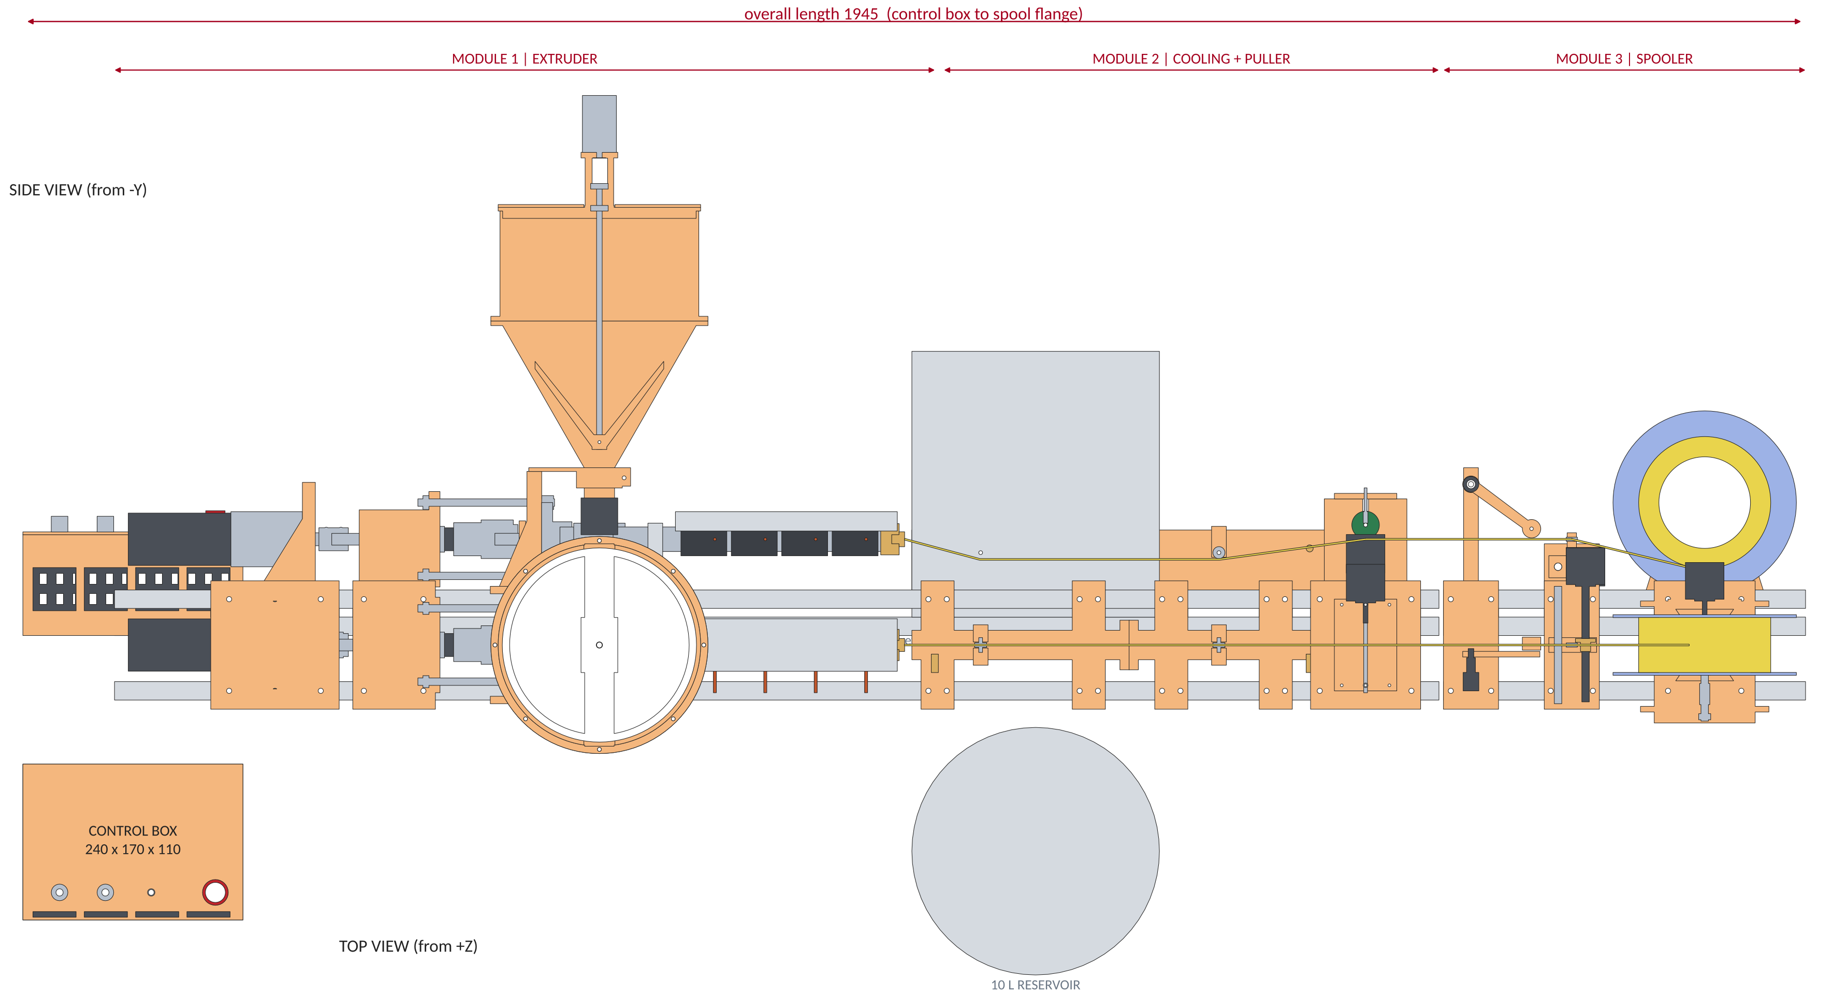
ASSEMBLY VIEWS – OVERALL SIZE
The line is modular: rails of module 1 (895), 2 (540) and 3 (395) are separate pieces, so the machine can be set up in an L-shape or folded later (M7).
The control box can sit anywhere; only the four heater leads, motor cables and the dancer pot lead have to reach it.
All dimensions in mm | Printed parts PETG/ASA + off-the-shelf hardware, hand-tool assembly | Name: Ryan Boe
4

Slide 5
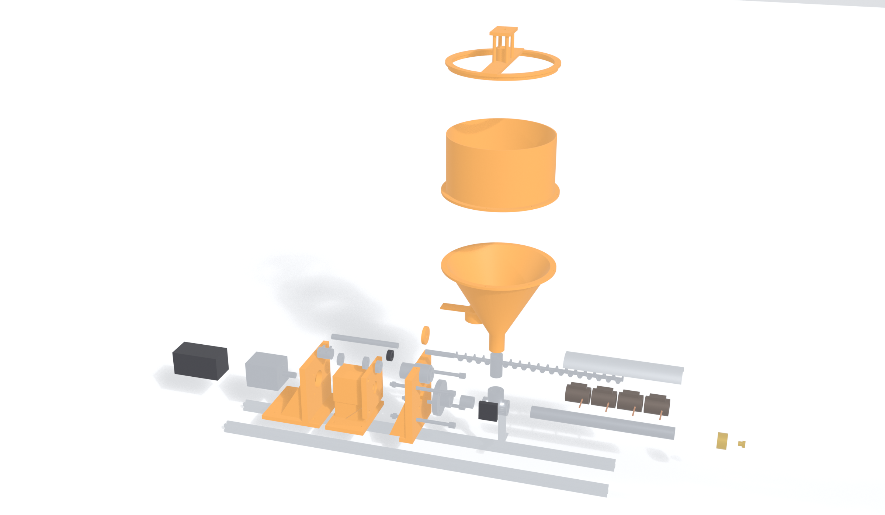
EXPLODED VIEW – PART NUMBERS
PARTS
20
1 NEMA 23 stepper
2 Planetary gearbox 20:1
3 Motor wall (printed)
4 Clamp coupler
5 Spindle ½ in
6 R8 bearings (2)
7 Bearing housing + thrust flange
8 Thrust bearing
9 Shaft collar
10 13 mm chuck
11 M8 tie rods (4)
12 Head plate (printed)
13 Auger screw Ø20
14 Floor flange 3/4 NPT
15 Close nipple
16 Pipe tee (feed port)
17 Feed nipple 2 in
18 Hopper cone + sleeve
19 Hopper drum
20 Lid frame + agitator mount
21 Stay clamp to head plate
22 Barrel nipple 12 in SS
23 Cap (die body)
24 Die plug Ø2.2
25 Band heaters (4)
26 Thermocouples (4)
27 Heat guard
28 Barrel strap + post
29 Feed-throat fan
30 Dust slinger
31 2020 rails
Not shown: control box, water bath, puller, dancer, level-wind, spooler (sheets 12, 13, 15).
19
21
18
5
30
1
4
6
9
17
13
27
2
3
8
10
7
12
11
14
15
16
29
28
25
22
26
31
23
24
Exploded along the screw axis; the hopper is lifted in three pieces (cone, drum, lid frame), heater bands, guard and screw are lifted for clarity.
Orange = 3D-printed, grey = bought hardware, dark = heaters / motors. Thrust is carried by 8-9-10-5-7-11-12 and the four rods (sheet 10).
All dimensions in mm | Printed parts PETG/ASA + off-the-shelf hardware, hand-tool assembly | Name: Ryan Boe
5

Slide 6
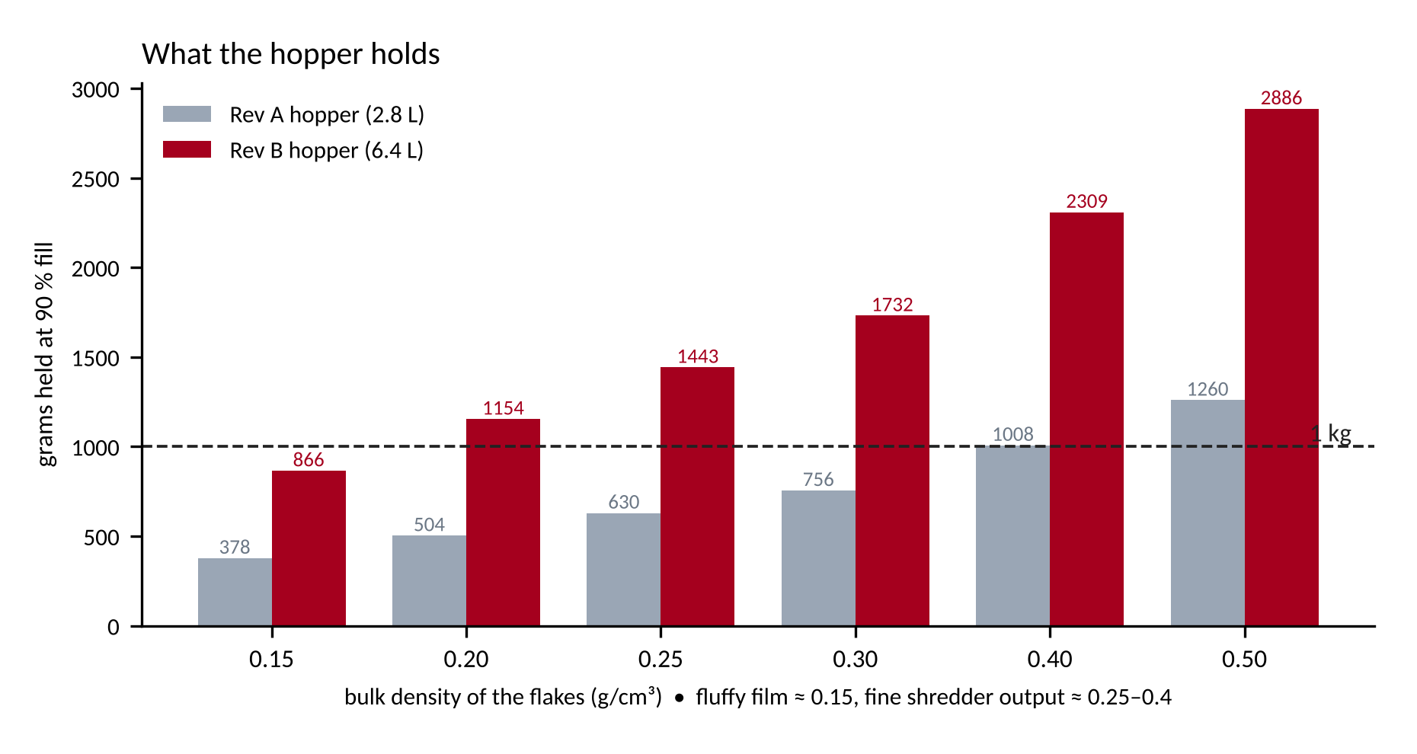
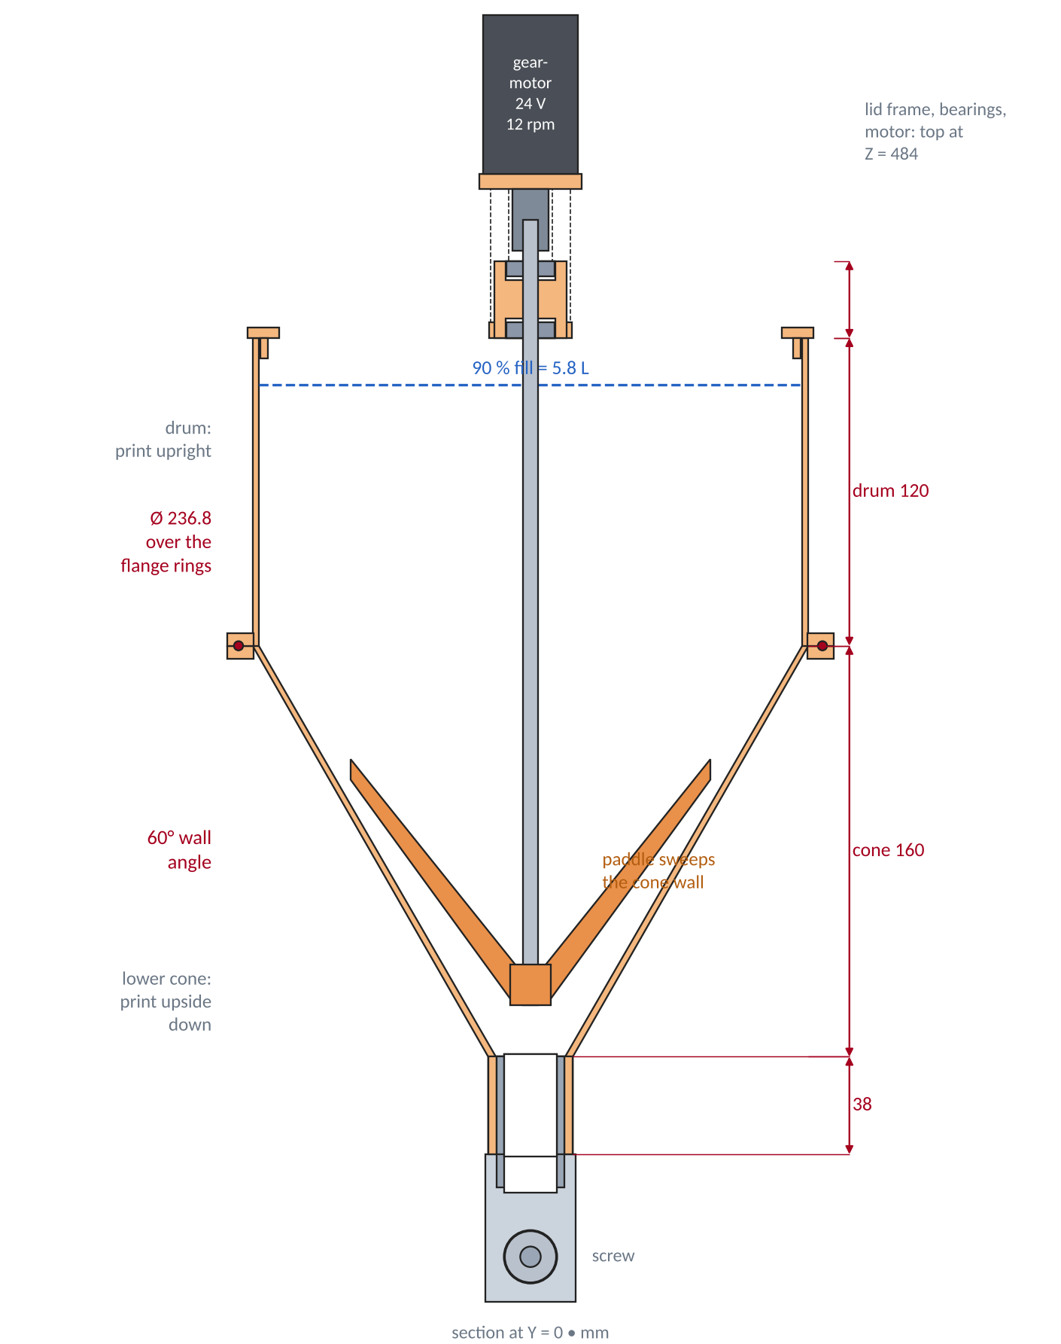
1 KG HOPPER – 1 KG OF SCRAP IN, 1 KG ON THE SPOOL
6.4 L
gross volume; 90 % fill = 5.8 L = 1.0 kg at 0.174 g/cm³
60°
cone wall angle from horizontal (Rev A: 32°) – flakes slide instead of bridging
WHY IT HOLDS 1 KG
PRINTING
• Fluffy ground bottles / film flake is 0.15–0.25 g/cm³; dense chips 0.3–0.4. At 90 % fill the hopper holds 1.15 kg at 0.2, 1.7 kg at 0.3, 2.3 kg at 0.4 g/cm³.
• Ø236.8 × 120 drum over a 160 mm, 60° cone.
• The paddle agitator sweeps the cone wall at 12 rpm (24 V gearmotor, ≈ 0.2 Nm needed) to break bridges.
• Two ears bolt the sleeve to the head plate – the hopper no longer levers on the NPT tee (9 Nm → 0).
• P05 lower cone: print upside down, 3 walls.
• P06 drum: upright, 3 walls.
• P07 lid frame upright; P08 lid halves ×2.
• 8 × M4 bolts join drum and cone; add a gasket of 1 mm foam tape.
• P09 stay clamp upside down; P10 agitator paddle.
• Keep the lid on: it stops flakes from being sucked into the motor and keeps dust down.
All dimensions in mm | Printed parts PETG/ASA + off-the-shelf hardware, hand-tool assembly | Name: Ryan Boe
6

Slide 7
PROCESS + MATERIAL SETTINGS
Scrap
flakes ≤ 4 mm
Dry
(per material)
Hopper 6.4 L
+ agitator
Screw + barrel
4 PID zones
Die Ø2.2
+ filter screen
Water bath
+ puller
Dancer arm
+ level-wind
Spool stepper
1 kg spool
≈ 335 m
STARTING SETPOINTS (°C) – tune with the first test strand; thermocouples read under the band, so the melt is a few degrees cooler
Material | Z1 (feed) | Z2 | Z3 | Z4 / die | Dry before | Cooling | Notes
PLA | 150 | 170 | 185 | 190 | 45–50 °C, 4 h if damp | bath | easiest first run; mixes of colours give a muddy but fine filament
PETG | 190 | 215 | 230 | 235 | 65 °C, 4–6 h | bath | wet PETG foams and breaks – dry it; slightly stringy
ABS / ASA | 190 | 210 | 225 | 230 | 80 °C, 2–4 h | bath, short | fumes: ventilate. Print-scrap ABS shrinks – keep drawdown low
TPU 95A | 160 | 185 | 200 | 205 | 60 °C, 4 h | bath, slow (≤ 0.6 m/min) | soft: use the puller pressure spring lightly; screw ≤ 3 rpm
PET (bottles) | 230 | 250 | 265 | 270 | 120–160 °C, ≥ 4 h | bath + fast quench | hard mode: needs drying + fast quench or it turns brittle / hazy
PP / HDPE | 165 | 185 | 200 | 205 | none | bath | slippery on the screw; shrinks on cooling – wide tolerance
RULES THAT SAVE A RUN
HARD LIMIT FOR PHASE 1: 280 °C
• Flakes ≤ 4 mm, no dust. Fines melt first and clog the screen; sieve them out or mix back in small amounts.
• One material and one colour family per batch. Mixed polymers (PLA + PETG) will not make good filament.
• Dry what you can. 1 kg of damp PETG is the #1 reason for bubbles and diameter swings.
• Purge between materials with the lower-temperature one, then raise the zones.
• Band heaters, thermocouples and PTFE/silicone wiring are all chosen for ≤ 280–300 °C.
• Printed parts must stay below ≈ 70 °C (PETG) – check the head plate and bearing housing with an IR thermometer on the first PET run.
• PC, nylon 66, PEI and the like need ≥ 290 °C: not in scope.
• Temperatures here are typical extrusion values, not measured on this machine – VERIFY on the first run.
All dimensions in mm | Printed parts PETG/ASA + off-the-shelf hardware, hand-tool assembly | Name: Ryan Boe
7

Slide 8
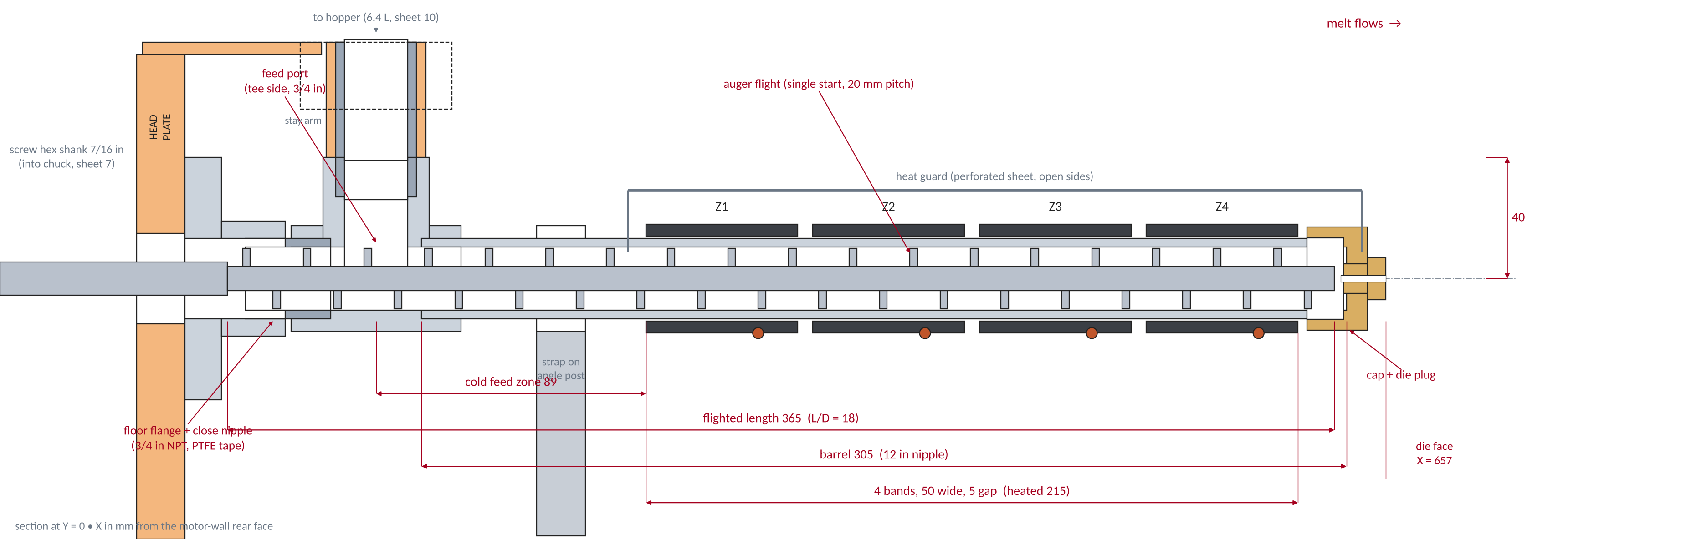
SCREW + BARREL – SECTION THROUGH THE SCREW AXIS
DESIGN NOTES
Zone | X (mm) | Power | Job
Z1 | 413–463 | 200 W | soften, still solid-conveying
Z2 | 468–518 | 200 W | melt
Z3 | 523–573 | 200 W | homogenise
Z4 | 578–628 | 200 W | die zone, sets output temp
• Barrel: 3/4 in Sch 40 stainless nipple (ID 20.93) over a Ø20.0 screw – 0.47 mm radial clearance; a wood-type auger wears, so plan on replacing it (M1).
• Everything is threaded pipe: flange → close nipple → tee → 12 in nipple → cap. PTFE tape on the cold joints, nickel anti-seize on the hot end; re-tighten once after the first heat cycle.
• Screw prep with hand tools: hacksaw ~30 mm off the lead tip, file the end round, polish the flights 400 → 2000 grit so plastic does not stick. Confirm 7/16 in hex shank and ≈ 8 mm core (VERIFY).
• Heat: bands are 28 mm ID on a 26.67 mm OD barrel – wrap 0.2 mm aluminium shim for contact; clamp each thermocouple under the band edge. Cold feed zone (89 mm) + small fan keeps flakes from melting in the throat.
Total heater power 800 W at 120 V = 6.7 A. Ideal warm-up 112 kJ → ≈ 2.5 min; plan on 8–12 min with losses.
Steady running needs only ≈ 150–250 W (melt load is 20–40 W, the rest is loss).
All dimensions in mm | Printed parts PETG/ASA + off-the-shelf hardware, hand-tool assembly | Name: Ryan Boe
8

Slide 9
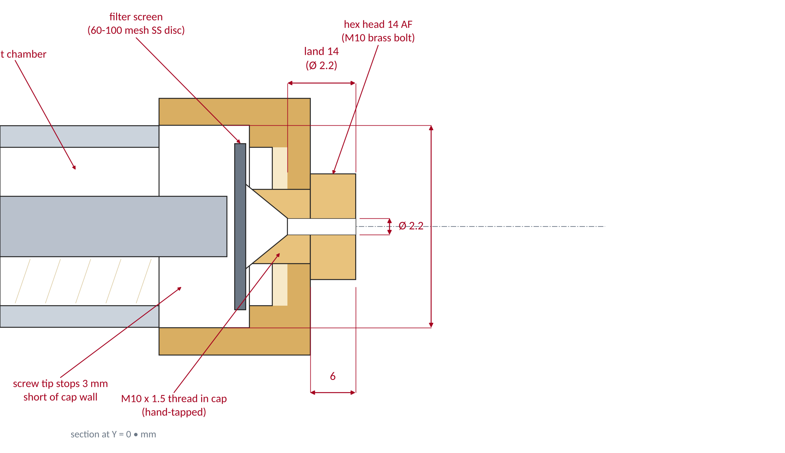
DIE + FILTER
1.6 MPa
1.58 ×
estimated die pressure at 4 rpm (η = 1000 Pa·s, Ø2.2 × 14 land); ×2–3 with a loaded screen
draw-down: puller runs 1.6× faster than the strand leaves the Ø2.2 die (plus die swell)
BUILDING THE DIE WITH HAND TOOLS
• Die plug: M10×1.5 brass hex bolt, 16 mm long. Centre-punch the shank, clamp it in a vice, drill 2.0 mm all the way along the axis with a hand drill, then 2.2 mm. Use cutting oil.
• Entry cone: a 6 mm drill, 6 mm deep, in the inside end – the plastic must funnel into the ×2.2 land.
• Cap: drill 8.5 mm through the middle of a brass 3/4 NPT cap, tap M10×1.5, screw the plug in with high-temp paste. A machine shop can do the plug + cap for a few dollars if the hand-drilling wanders.
• Filter: 60–100 mesh stainless disc cut with scissors, sandwiched against the cap wall – stops grit and un-melted flakes from plugging the die.
• Spares: make three plugs (×2.0, 2.2, 2.5). Small die = less swell, more pressure; big die = more draw-down.
• Safety: never open a hot, pressurised die. Stop the screw, let it cool until the plug can be touched, then unscrew. Clean a blocked die by drilling the plastic out with the same bit.
Why 14 mm of land? A longer land evens out the flow and straightens the strand. Pressure scales with L/D⁴, so shorten it (8 mm) if the motor skips steps.
Target diameter 1.75 ± 0.05 mm is set by the puller speed, not the die; measure with calipers every 10 cm for the first metre.
All dimensions in mm | Printed parts PETG/ASA + off-the-shelf hardware, hand-tool assembly | Name: Ryan Boe
9

Slide 10
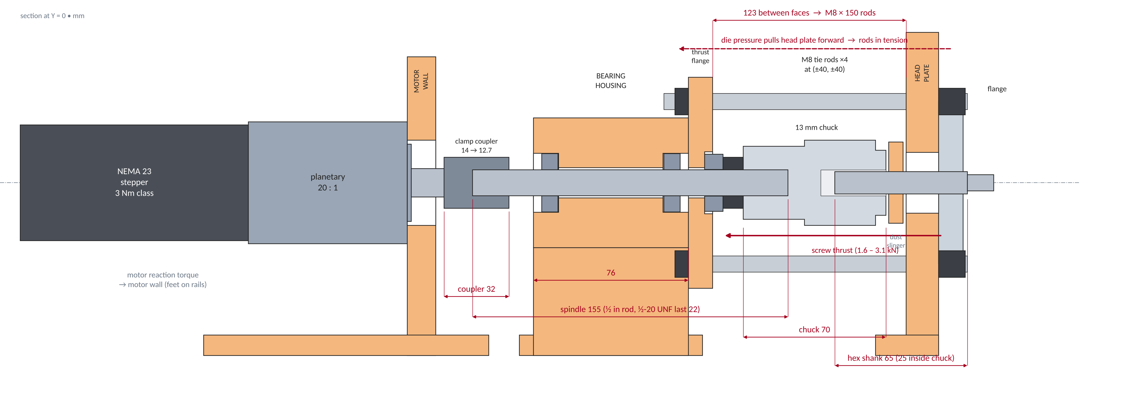
DRIVE TRAIN + THRUST LOOP
20 : 1
≈ 14.6 Nm
1.6–3.1 kN
DIRECTION + COUPLING (the one trap)
planetary: 2–30 rpm at the screw for 40–600 rpm at the motor
stall limit at 1.2 A driver current = 145 MPa in the 8 mm core (Rev A: 19 Nm, 193 MPa)
thrust at 5–10 MPa melt pressure, carried by the thrust bearing, not the gearbox
A drill auger pumps chips toward the shank when turned clockwise, so we spin the screw counter-clockwise (seen from the motor) to push plastic toward the die.
That direction tends to unscrew the chuck from its ½-20 spindle: Loctite 638 on the thread, tighten the chuck against the collar, and fit the chuck retaining screw (left-hand) – VERIFY. Fallback: file a square drive on the spindle and use a 7/16 in socket.
All dimensions in mm | Printed parts PETG/ASA + off-the-shelf hardware, hand-tool assembly | Name: Ryan Boe
10

Slide 11
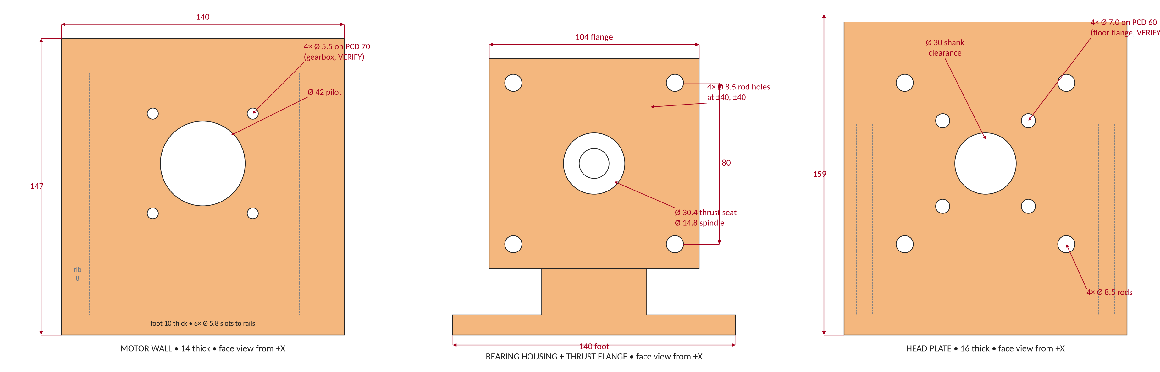
PRINTED PARTS – MOTOR WALL, BEARING HOUSING, HEAD PLATE
Setting | Value | Why
Material | PETG (ASA near hot parts) | PLA softens at ≈ 55 °C – do not use it for these
Walls / infill | 6 perimeters, 60 % gyroid | load goes through bolts and rods, not infill
Layer / nozzle | 0.2 mm / 0.4 mm | fine enough for bearing seats
Orientation | plate face down (X up); wall on its side | layers lie in the thrust plate instead of across it
FIT NOTES
• Bearing seats print ×28.8 for a ×28.575 R8 – test-print a 10 mm slice first and ream with a rolled sandpaper if tight.
• Foot slots: M5 T-nuts into the 2020 rails, two per foot minimum.
• Press the thrust washer into the ×30.4 seat, not the bearing balls.
All dimensions in mm | Printed parts PETG/ASA + off-the-shelf hardware, hand-tool assembly | Name: Ryan Boe
11

Slide 12
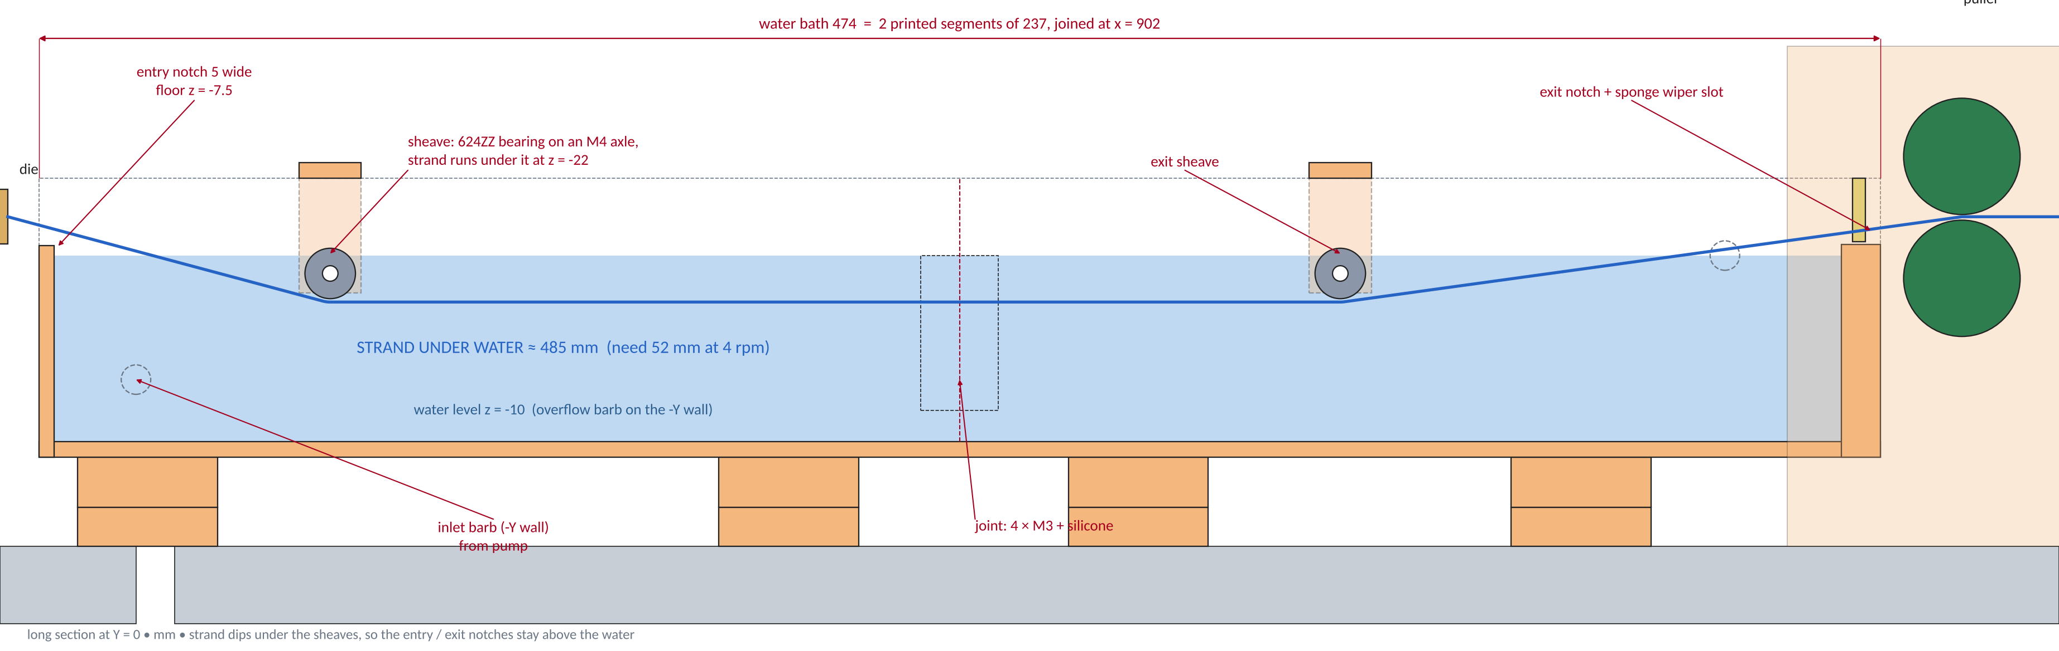
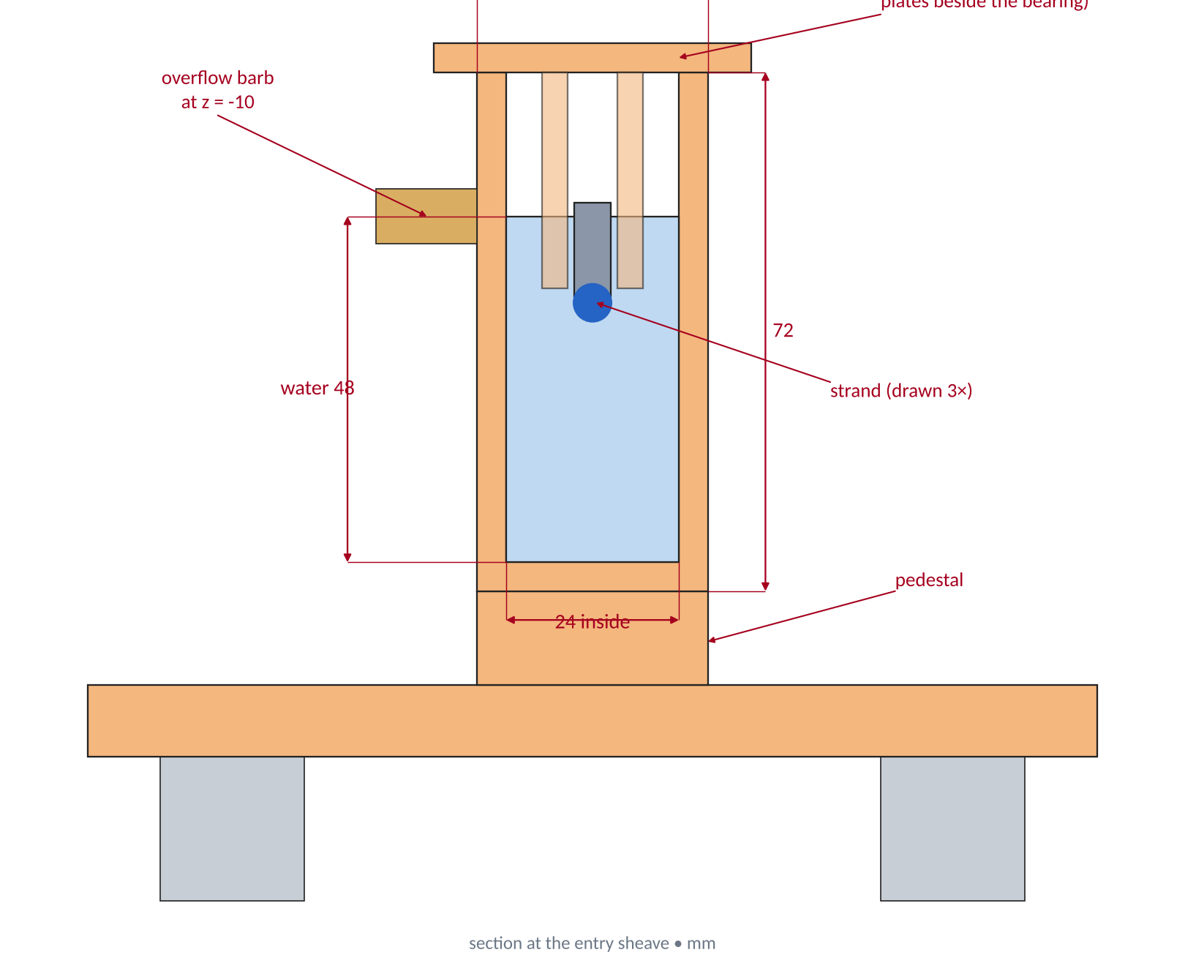
WATER BATH – COOLING THAT KEEPS UP
485 mm
HOW IT WORKS
BUILD NOTES
of strand under water vs 52 mm needed at 4 rpm (PLA 190 → 60 °C)
• The strand enters through a 5 mm notch above the water line, dips under a 624ZZ sheave, runs straight, then rises over a second one – so it never touches a wall.
• A pump fills from the bucket; an overflow barb on the −Y wall sets the level at Z = −10.
• Two 237 mm segments (P11, P12), joined by 4 × M3 and silicone.
• Print with 5 walls and seal with aquarium silicone – water-test over a tray before wiring anything.
• The sponge wiper in the exit slot dries the strand before the puller.
+7 K / kg
bath warm-up over a full kilogram with the 10 L circulating reservoir
All dimensions in mm | Printed parts PETG/ASA + off-the-shelf hardware, hand-tool assembly | Name: Ryan Boe
12

Slide 13
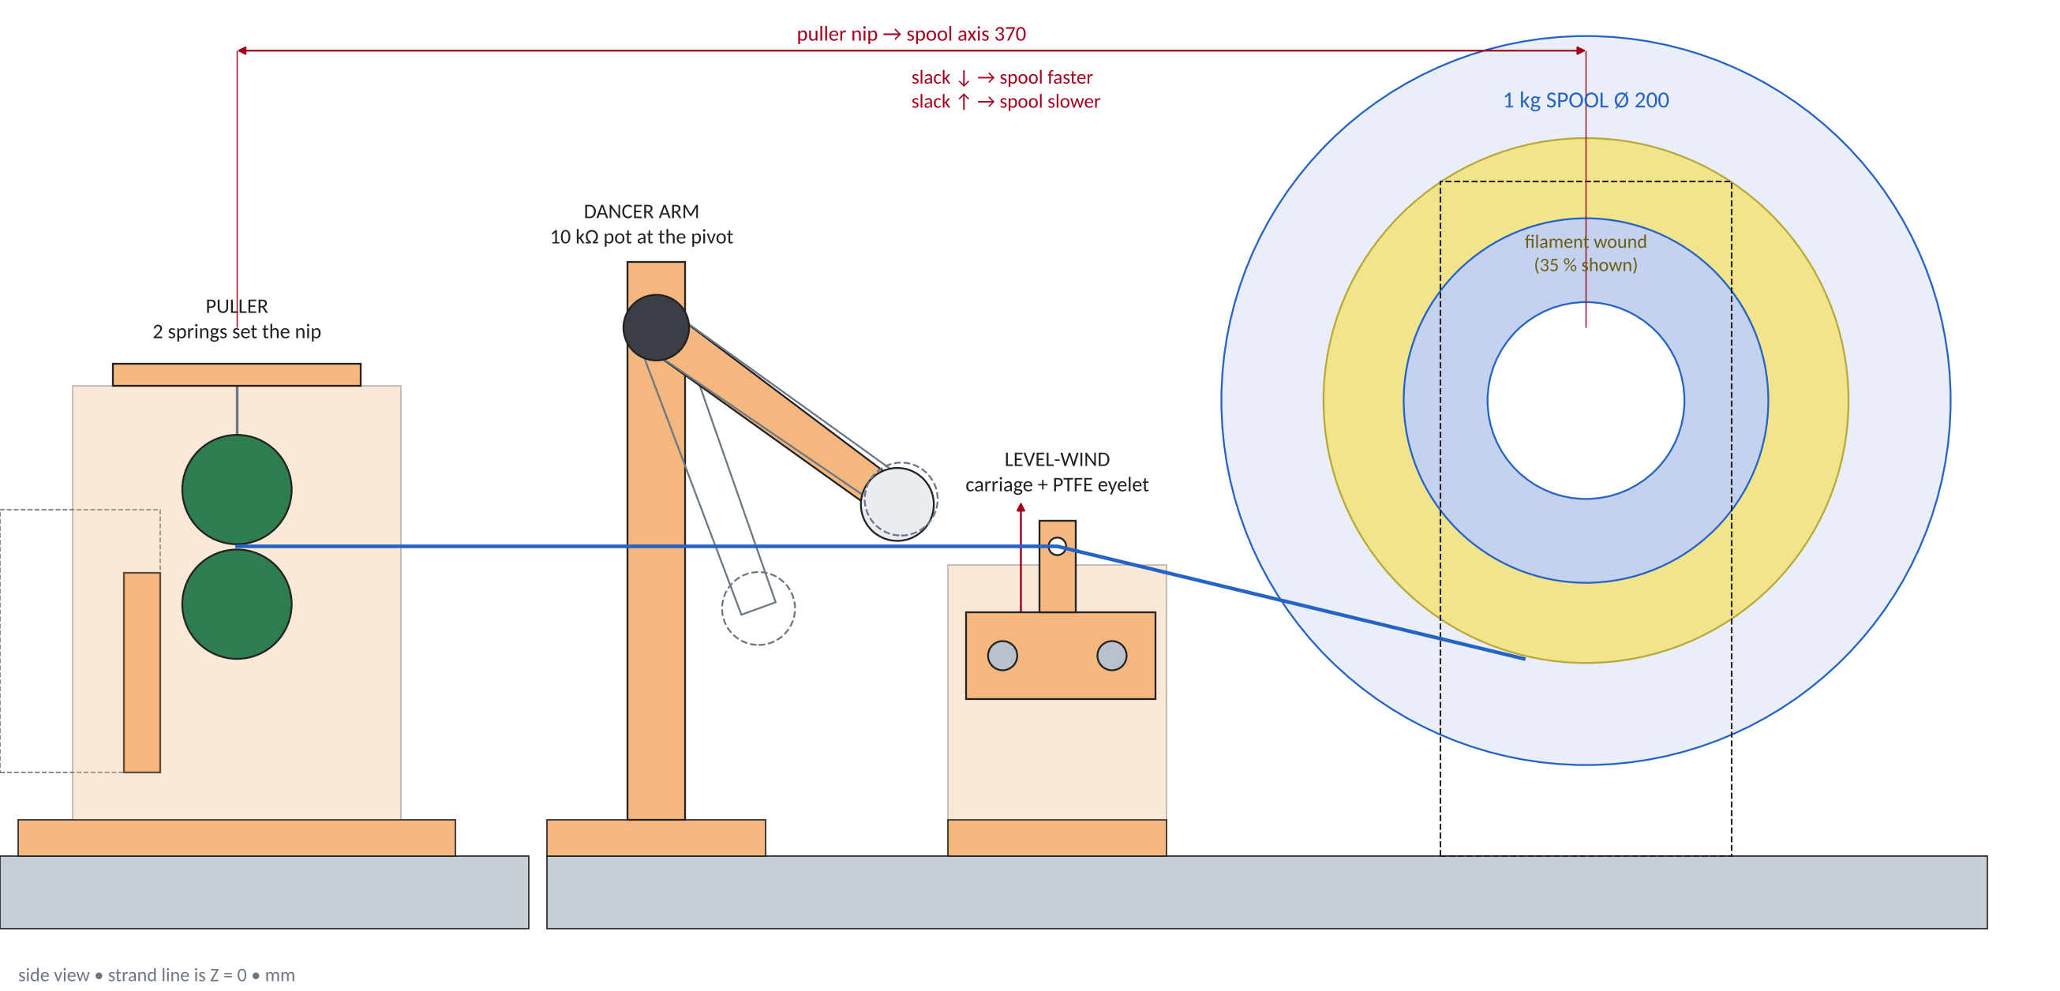
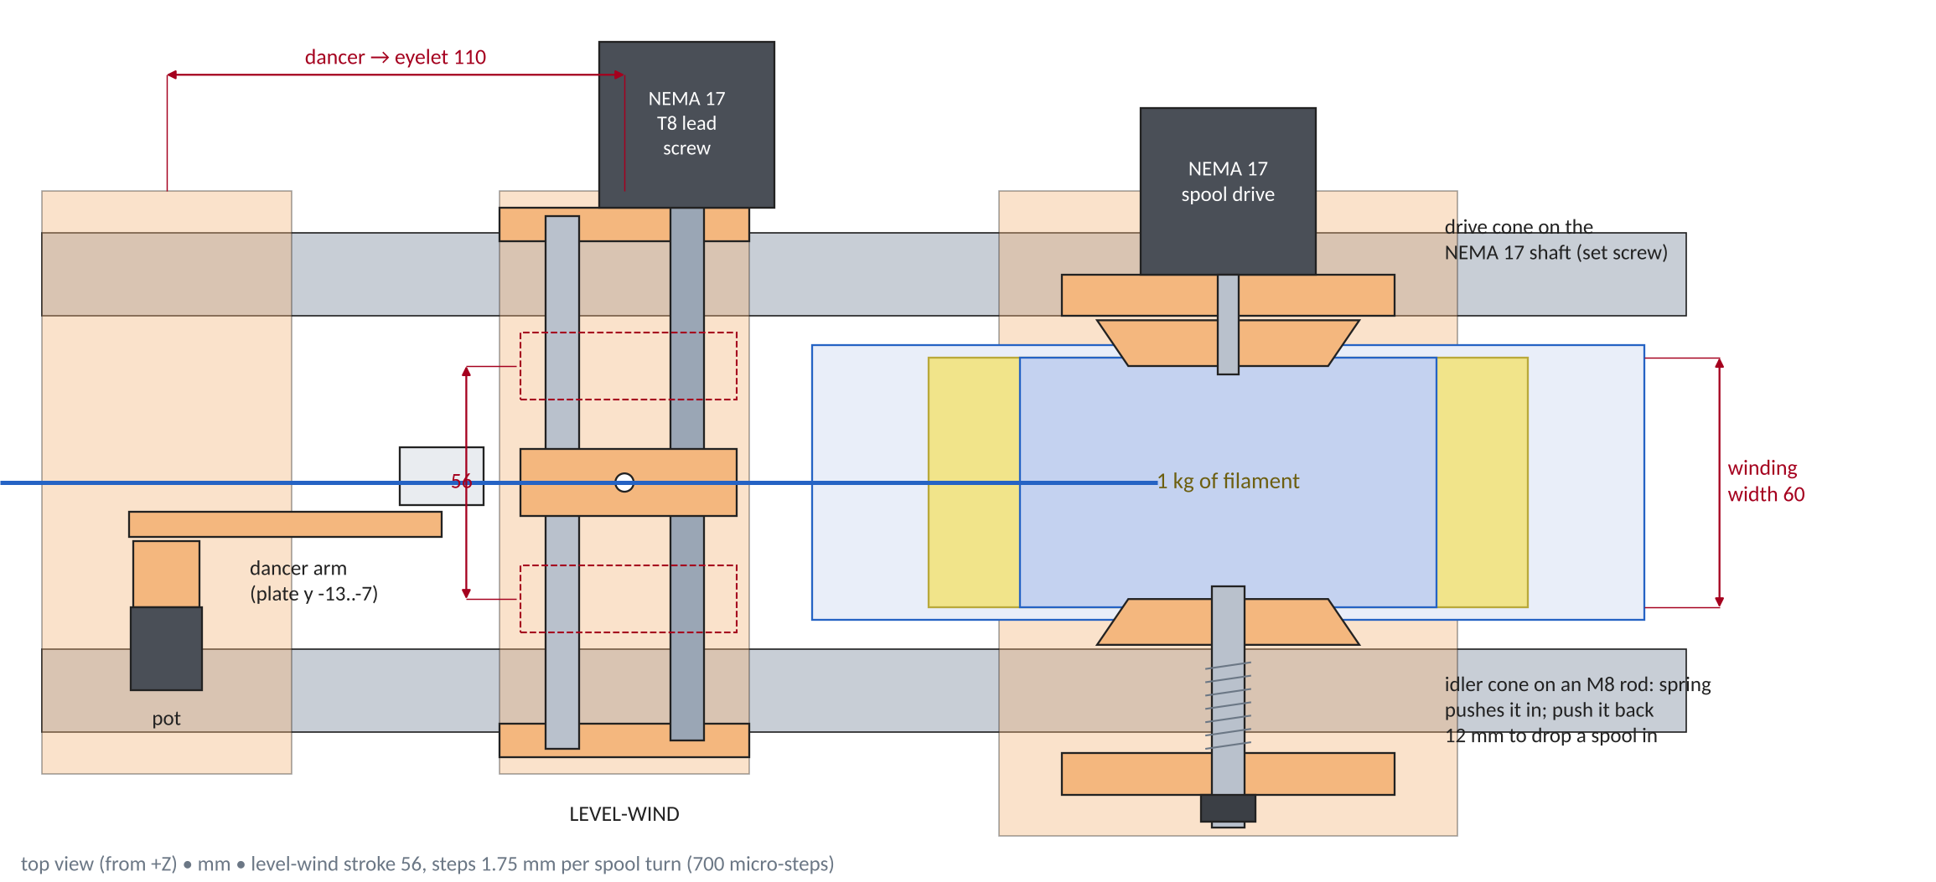
PULLER, DANCER, LEVEL-WIND + 1 KG SPOOLER
700
335 m
PULLER + DANCER
LEVEL-WIND + SPOOL
micro-steps of level-wind per spool turn = 1.75 mm of travel
1 kg PLA reaches R 89 of the 100 mm flange, 60 mm wide
• Two ×30 TPU rollers, drive roller on a NEMA 17 (1/16 micro-step): 0.3–4 m/min. Pressure bridge with two springs sets the nip.
• The strand loops under the dancer roller; a 10 kΩ pot at the pivot reads the arm angle and the Nano trims the spool speed to keep it mid-travel (swept 15–60°, nothing in the way).
• A NEMA 17 turns a T8 lead screw; the carriage with a PTFE eyelet runs ± 28 mm inside the 60 mm winding width and reverses at each end.
• The spool is driven by a second NEMA 17 through a spring-loaded cone: the idler cone retracts 12 mm (68 mm tip gap vs 66 mm spool) to drop a spool in.
• Because the level-wind steps follow the spool steps, the layers stay in step without a sensor.
3.0–5.3 rpm
×3.2
spool stepper at 1.65 m/min (full → empty core)
cone friction margin: 0.29 Nm vs 0.09 Nm at 1 N strand tension
All dimensions in mm | Printed parts PETG/ASA + off-the-shelf hardware, hand-tool assembly | Name: Ryan Boe
13

Slide 14
PRINT LIST – 28 FILES, ALL FIT THE 245 × 245 × 260 BED
File | X × Y × Z (mm) | Qty | Material
P01_motor_wall.stl | 140 × 147 × 140 | 1 | PETG
P02_bearing_housing_thrust_flange.stl | 137 × 140 × 95 | 1 | PETG
P04_dust_slinger_on_the_screw_shank.stl | 40 × 40 × 7 | 1 | PETG (3 walls)
P03_head_plate_barrel_anchor.stl | 159 × 140 × 56 | 1 | PETG
P05_hopper_lower_sleeve_cone.stl | 237 × 237 × 198 | 1 | PETG (3 walls)
P06_hopper_drum.stl | 237 × 237 × 120 | 1 | PETG (3 walls)
P07_hopper_lid_frame_agitator_mount.stl | 221 × 221 × 72 | 1 | PETG
P08_hopper_lid_half.stl | 93 × 218 × 3 | 2 | PETG
P09_hopper_stay_clamp.stl | 111 × 50 × 22 | 1 | PETG
P10_agitator_paddle_two_cone_sweep_arms.stl | 140 × 96 × 16 | 1 | PETG
P11_water_bath_segment_a_entry.stl | 237 × 140 × 95 | 1 | PETG, 5 walls, seal
P12_water_bath_segment_b_exit_wiper.stl | 237 × 140 × 95 | 1 | PETG, 5 walls, seal
P13_sheave_hanger.stl | 16 × 44 × 34 | 2 | PETG
File | X × Y × Z (mm) | Qty | Material
P14_puller_frame_base_side_plates.stl | 120 × 140 × 129 | 1 | PETG
P15_puller_drive_roller_tpu_tyre.stl | 30 × 58 × 30 | 1 | TPU 95A
P16_puller_idler_roller.stl | 30 × 40 × 30 | 1 | TPU 95A
P17_puller_pressure_bridge.stl | 68 × 100 × 6 | 1 | PETG
P18_spooler_plates_base.stl | 140 × 155 × 185 | 1 | PETG
P19_hub_cone_drive_side.stl | 63 × 11 × 63 | 1 | PETG
P20_hub_cone_idler_side_spring_loaded.stl | 63 × 11 × 63 | 1 | PETG
P21_dancer_post_base.stl | 60 × 140 × 163 | 1 | PETG
P22_dancer_arm_roller.stl | 85 × 22 × 68 | 1 | PETG
P23_level_wind_frame_base_2_brackets.stl | 60 × 140 × 80 | 1 | PETG
P24_level_wind_carriage_eyelet_arm.stl | 52 × 16 × 49 | 1 | PETG
P25_control_box_shell.stl | 240 × 170 × 110 | 1 | PETG
P26_control_box_lid_top_panel.stl | 240 × 170 × 3 | 1 | PETG
Total printed mass ≈ 2.4 kg of PETG (+ TPU tyres). Print order: P02, P03, P05 first – test-fit the bearings, the chuck flange and the NPT tee before printing the rest.
Orientation is as exported: the STL already lies the way it should print (hopper cone upside down, lid frame and drum upright).
All dimensions in mm | Printed parts PETG/ASA + off-the-shelf hardware, hand-tool assembly | Name: Ryan Boe
14

Slide 15
ELECTRICAL BLOCK DIAGRAM + SAFETY CHAIN
POWER + E-STOP (hardware path)
SAFETY CHAIN
Mains 120 V AC
15 A circuit, GFCI
Breaker / fuse
10 A, IEC inlet
E-stop (NC)
mushroom, front panel
Contactor
coil on the E-stop loop
• E-stop and contactor are pure hardware: the contactor drops both the heaters and the 24 V supply – no software in the loop.
• Thermal fuse (280 °C) sits in the heater feed; it cuts power even if an SSR welds shut.
• The Nano refuses to start the screw until Z3 and Z4 are within ±10 °C of setpoint (wire the PID alarm output to an input – VERIFY the REX-C100 variant has an ALM relay).
• Driver current limit (1.2 A ≈ 14.6 Nm) lets the stepper skip steps on a jam instead of twisting the screw.
HEATERS (120 V AC, 800 W)
Thermal fuse 280 °C
in series, on barrel Z3
4 × SSR-25DA
zero-cross, heat-sinked
4 × band heater
200 W each
4 × REX-C100 PID
SSR output
4 × K thermocouple
under each band
MOTION + LOGIC (24 V DC)
24 V 10 A PSU
after contactor
DM542T → NEMA 23
screw, 1.2 A limit
Arduino Nano
5 V from buck
STEP/DIR/EN, PWM
Inputs
2 pots, FWD/OFF/REV,
dancer pot, driver ALM,
PID ready (AL)
DO THIS FIRST
3 × TMC2209 → NEMA 17
puller, spool, level-wind
• Have the 120 V side wired or checked by someone who does mains work. This sheet is a plan, not a certified design.
• Keep mains and 24 V wiring in separate bundles; use ferrules and a ground lug on the barrel.
• Never leave it heating unattended until you trust the thermal fuse and the PIDs. Water + mains: GFCI, bucket and pump away from the control box and below its level, drip loop on every cable.
MOSFET → gearmotor
hopper agitator
MOSFET → pump
water circulation
40 mm fan
feed throat, 24 V
CONTROL (NANO)
Screw: STEP rate from knob 1 (40–600 motor rpm). Puller: STEP rate = ratio × screw rate, knob 2 trims ±15 %. Spool stepper: rpm = strand speed ÷ pack circumference, trimmed by the dancer pot. Level-wind: 700 micro-steps per spool turn, reverses at ±28 mm.
Jam: driver ALM → stop, reverse 2 s, stop. Heat-not-ready → screw disabled. Pump runs whenever the line is on; keep it on a GFCI outlet.
All dimensions in mm | Printed parts PETG/ASA + off-the-shelf hardware, hand-tool assembly | Name: Ryan Boe
15

Slide 16
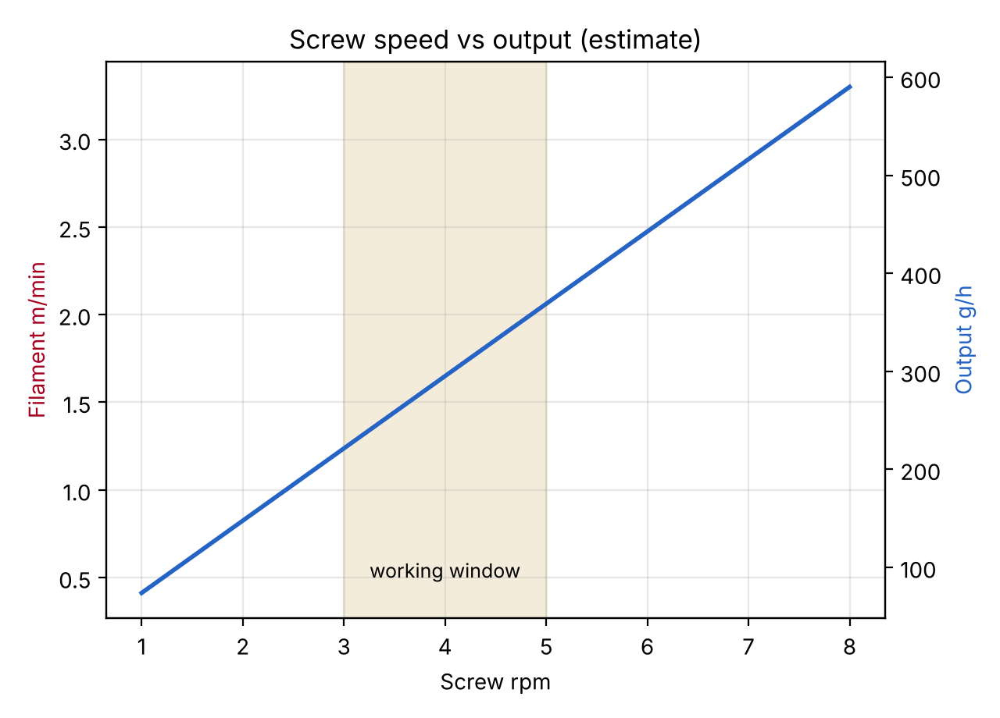
SPEEDS + DIAL-IN
Screw rpm | Motor rpm | Output g/h | Filament m/min | Hours per kg
2 | 40 | 148 | 0.82 | 6.8
3 | 60 | 221 | 1.24 | 4.5
4 | 80 | 295 | 1.65 | 3.4
5 | 100 | 369 | 2.06 | 2.7
6 | 120 | 443 | 2.47 | 2.3
8 | 160 | 590 | 3.30 | 1.7
Estimate: drag flow × 0.35 for pressure back-flow and leakage, PLA density. Calibrate once: weigh 1 m of strand at a known rpm and scale.
DIAL-IN PROCEDURE (first run, ≈ 30 min)
1 Heat to the setpoints on sheet 7, soak 10 min after the PIDs settle.
2 Set screw to 3 rpm; load a handful of virgin pellets or flakes.
3 Fill the bath to the overflow barb, start the pump; pull the first strand by hand through the notches, under both sheaves, to the puller.
4 Set puller so the strand reads 1.75 mm; adjust ±5 % at a time every minute.
5 Hang the strand under the dancer, wind 3 turns on the spool core, start the spool + level-wind.
6 Log rpm, puller speed and diameter every 5 min for the first spool.
READING THE STRAND
• Bubbles / foam → wet material. Hazy / rough → too cool or too fast. Oval → uneven cooling, add fan time.
• Diameter wave with the screw turn → feed starving (bridge in hopper) or worn flights.
• Motor skipping → die too small or too cold; open the die or add 5 °C.
All dimensions in mm | Printed parts PETG/ASA + off-the-shelf hardware, hand-tool assembly | Name: Ryan Boe
16

Slide 17
BILL OF MATERIALS
# | Part | Qty | Size / note | Est. $
 | DRIVE
1 | NEMA 23 stepper, 3 Nm class, 4.2 A | 1 | 57 × 57 × 112, 8 mm shaft | 35–50
2 | NEMA 23 planetary gearbox 20:1 | 1 | 60 mm flange, Ø14 output (VERIFY) | 50–90
3 | Stepper driver DM542T (or TB6600) | 1 | 24–36 V, set to 1.2 A | 15–25
4 | Clamp coupler 14 → 12.7 mm | 1 | ≈ Ø25 × 32 (VERIFY bores) | 8–12
5 | Spindle: ½ in steel rod or Gr.8 ½-20 bolt | 1 | 160 mm, last 22 mm threaded ½-20 | 5–8
6 | R8-2RS bearing | 2 | ½ × 1⅛ × 5/16 in | 8–12
7 | Thrust bearing ½ in bore + washers | 1 | OD 28 × 9 (VERIFY) | 8–15
8 | Shaft collar ½ in (set screw) | 1 | OD 25 | 4–6
9 | Keyless chuck 13 mm, ½-20 UNF | 1 | closes on 7/16 in hex | 12–20
10 | M8 threaded rod, nuts, washers | 4 | M8 × 150 + 3 nuts each | 8–12
 | SCREW & BARREL
11 | Ship auger bit Ø20 × 460, 7/16 hex shank | 1 | solid-core / continuous flight | 15–25
12 | 3/4 NPT 304 SS nipple, 12 in | 1 | Sch 40: OD 26.67, ID 20.93 | 20–35
13 | 3/4 NPT floor flange | 1 | 4 holes (VERIFY bolt circle) | 10–15
14 | 3/4 NPT pipe tee | 1 | feed port on the side | 6–12
15 | 3/4 NPT nipples: close ×1, 2 in ×1 | 2 | close = flange link, 2 in = feed | 8–14
16 | 3/4 NPT cap, brass or SS | 1 | die body | 5–10
17 | M10×1.5 brass bolt + SS mesh 60–100 | 1+ | die plug (spares) + filter discs | 3–8
18 | Band heater 120 V, 150–200 W | 4 | 28 mm ID × 50 wide (VERIFY) | 40–70
19 | K thermocouple, ring or bayonet | 4 | M4 ring lug, 1 m lead | 10–16
20 | REX-C100 PID, SSR output | 4 | 48 × 48 mm panel | 40–60
21 | SSR-25DA | 4 | DC in, AC out, with heat sink | 16–28
22 | Thermal fuse 280 °C (or 300 °C stat) | 2 | in the heater feed | 3–6
23 | Strap, aluminium angle, guard sheet | 1 set | support + heat guard | 10–15
# | Part | Qty | Size / note | Est. $
 | HOPPER (1 KG)
24 | 37 mm gearmotor 24 V 12 rpm, 6 mm D-shaft | 1 | agitator, ≥ 1.5 Nm (VERIFY) | 12–20
25 | 6 mm steel rod 150 mm + 2 × 626ZZ bearing | 1 set | agitator shaft + lid bearings | 5–10
26 | M4 × 16 bolts + nuts, M4 × 30 + nuts | 1 set | 8 drum/cone bolts, stay clamp, lid | 4–8
27 | 40 mm fan 24 V | 1 | feed throat | 3–6
 | WATER BATH + COOLING
28 | Small 12/24 V DC pump (aquarium type) | 1 | ≥ 300 L/h, 1 m head | 10–20
29 | 10 L bucket + silicone tube + 2 hose barbs | 1 set | reservoir, inlet + overflow | 12–20
30 | 624ZZ bearing + M4 × 20 bolt | 2 | sheaves under the water | 3–6
31 | Sponge, PTFE tube Ø4 / Ø2, aquarium silicone | 1 set | wiper, eyelet, tank joints | 8–14
 | PULLER, LEVEL-WIND, SPOOLER
32 | NEMA 17 stepper | 3 | puller, spool drive, level-wind (donor Vyper?) | 0–45
33 | TMC2209 (or A4988) driver | 3 | 1/16 micro-step | 18–30
34 | T8 × 8 lead screw 150 mm + brass nut | 1 | level-wind, 1.75 mm per spool turn | 6–10
35 | 8 mm smooth rod 100 mm + 8 mm LM8UU | 1 | carriage guide (sleeve or bronze) | 4–8
36 | M8 rod 120 mm, spring 2 N/mm, nuts | 1 | idler hub cone (spool drive) | 4–8
37 | 10 kΩ linear pot | 1 | dancer sensor | 2–4
38 | Empty 1 kg spool Ø200, 54 mm bore, 66 wide | 1 | VERIFY your spool (reuse a spent one) | 0–10
 | ELECTRONICS & FRAME
39 | Arduino Nano | 1 | 5 V logic | 6–15
40 | 24 V 10 A PSU | 1 | 240 W | 20–30
41 | MOSFET PWM board | 2 | agitator + pump | 5–10
42 | Contactor 24 V coil + E-stop NC | 1 set | hardware safety chain | 15–30
43 | Breaker, IEC inlet, wire, terminals | 1 set | 120 V side, ferrules, GFCI outlet | 20–40
44 | Knobs, toggle, lamp | 1 set | front panel | 6–12
45 | 2020 extrusion + T-nuts + screws | 6 rails | 895 ×2, 540 ×2, 395 ×2 | 50–85
46 | Hose clamp, PTFE tape, Ni anti-seize | 1 set | hopper joint, NPT threads | 8–15
47 | Printed parts, PETG / ASA / TPU | ≈ 2.4 kg | sheet 14 | 0–40
Estimated purchase total ≈ $560–$1,060 (typical online listings, not quotes; shipping and tax excluded). Printed parts use your own filament.
Rev B adds ≈ $60–160 over Rev A ($497–899): 2 steppers + drivers, lead screw, pump + bucket, agitator motor, bearings. Reuse the donor Vyper's NEMA 17 and PSU parts to cut it.
All dimensions in mm | Printed parts PETG/ASA + off-the-shelf hardware, hand-tool assembly | Name: Ryan Boe
17

Slide 18
TOOLS + WORKAROUNDS (no lathe, no drill press)
Tool / skill | Used for | If you do not have it
Hacksaw + files + vice or clamps | 2020 rails, M8 rods, spindle, auger tip, heat-guard sheet | buy rails and rods cut to length; auger tip: Dremel cut-off wheel
Hand drill + 2.0 / 2.2 / 6 / 8.5 mm bits | die hole + entry cone, cap pilot hole | machine shop or maker space drills the plug + cap (≈ $10–20)
M10 × 1.5 tap + wrench | thread for the die plug in the cap | buy a cap with a threaded centre, or a ready 1.75 mm die nozzle
½-20 UNF die + stock | thread on the spindle for the chuck | use a Grade 8 ½-20 bolt/rod cut to length – no die needed
2 pipe wrenches (or adjustable) | NPT stack: flange, nipples, tee, cap | none – borrow; do not hammer on stainless threads
Hex keys, spanners, screwdrivers | M5 / M8 hardware, coupler, collar | –
Calipers (0.01 mm) | screw, bore, strand diameter | 1.75 mm drill bit as a go/no-go gauge until you buy them
Multimeter + IR / contact thermometer | wiring checks, calibrating the PIDs | –
Soldering iron, wire stripper, crimper | pots, fans, thermocouple leads | ferrules + screw terminals avoid soldering mains wires
Aquarium silicone + a tray | seal and water-test the bath (P11, P12) | let it cure 24 h; test with water over a tray, away from electronics
THE PARTS THAT REALLY WANT A MACHINE
PRINTING + FINISHING
• Spindle thread and die hole are the two jobs where hand tools are marginal – both have a bought-part workaround above.
• A local makerspace or machine shop can drill the die plug, tap the cap, and thread the spindle in 15 minutes – bring the parts and the sheet-9 drawing.
• Printer: your Vyper (245 × 245 × 260). Print the housing and head plate first and test-fit bearings before printing the rest.
• Sandpaper rolls for the bearing seats, a 8.5 mm drill to clean rod holes, heat-set M3/M5 inserts if you want the electronics box to open often.
All dimensions in mm | Printed parts PETG/ASA + off-the-shelf hardware, hand-tool assembly | Name: Ryan Boe
18

Slide 19
ASSEMBLY ORDER, DESIGN CHECKS + OPEN ITEMS
ASSEMBLY ORDER
1 Cut rails to length, square the frame, drop in T-nuts for every foot.
2 Print P02, P03, P05 first; test-fit bearings, chuck and NPT tee; clean the seats.
3 Thread the spindle (or cut the ½-20 bolt); fit R8 bearings, thrust bearing, collar.
4 Mount motor + gearbox on the wall; couple to the spindle; set the driver to 1.2 A.
5 Tie the housing to the head plate with the M8 rods; check the spindle spins free by hand.
6 Prep the screw (cut tip, polish); seat it in the chuck, tighten with threadlocker.
7 Build the NPT stack on the floor flange; PTFE the cold joints; bolt to the head plate.
8 Fit barrel, cap, die plug, filter; shim + bands; clamp thermocouples.
9 Bolt the hopper cone to the sleeve and the stay; fit the drum, lid frame, agitator and gearmotor.
10 Seal and water-test the bath; mount sheaves, pump, bucket, sponge wiper.
11 Mount puller, dancer, level-wind and spooler; thread a test string through the notches.
12 Wire heaters and PIDs off the machine; test each zone to 100 °C empty.
13 Dry-run the screw at 5 rpm empty for 5 min; then first heat with PLA and dial in (sheet 16).
DESIGN CHECK | RESULT
Screw output at 4 rpm | 0.066 cm³/s = 295 g/h (est.)
Thrust at 5 / 10 MPa | 1571 N / 3142 N
Screw torque at 5 / 10 MPa | 6.1 / 12.2 Nm (+ friction)
Torque at the 1.2 A driver limit | 14.6 Nm = 145 MPa core shear (Rev A: 193)
Thrust bearing seat | 6.5 MPa on printed PETG (limit 15)
Warm-up to 270 °C | 112 kJ → 2.5 min ideal, 8–12 real
Heater power / mains | 800 W; 7.6 A total on a 15 A circuit
Hopper vs 1 kg of flakes | 6.4 L: 1.15 kg at 0.2 g/cm³ (90 % fill)
Cooling in the water bath | 52 mm needed, 485 mm available
Spool | 1 kg PLA = 335 m, R 89 of 100 mm
Spool speed | 3.0 → 5.3 rpm at 1.65 m/min
Draw-down | 1.58× (×2.2 die → 1.75 mm)
WHAT THE CHECKS SAY
• Mechanically comfortable: bearings and rods have large margin; the screw core is the weak link, so the driver current is the fuse.
• Water bath and 1 kg hopper both have ≥ 3× margin on the numbers that matter.
• The one WARN is screw sag on the barrel floor (wear, not failure).
• Throughput numbers are estimates until calibrated with a weighed metre.
All dimensions in mm | Printed parts PETG/ASA + off-the-shelf hardware, hand-tool assembly | Name: Ryan Boe
19

Slide 20
OPEN ITEMS (VERIFY) + MODIFICATION ROADMAP
# | VERIFY before ordering / printing | Why it matters
1 | Auger bit: 20 mm OD, ≈ 8 mm core, 7/16 in hex, continuous flights | sets clearance, torque limit, screw length
2 | Gearbox output shaft (12 vs 14 mm), flange PCD, pilot Ø38.1 | coupler bores, wall holes
3 | Chuck thread ½-20 UNF and retaining screw; spindle thread fit | reverse rotation can loosen it
4 | Thrust bearing ½ in bore, OD ≤ 28; floor flange bolt circle | housing seat, head-plate holes
5 | Band heater ID (27–28 mm) and watt rating; REX-C100 alarm relay | contact, warm-up, heat-ready interlock
6 | Agitator gearmotor ≥ 1.5 Nm and 6 mm D-shaft | needs ≈ 0.2 Nm to sweep the cone
7 | Pump flow / head, hose barb size, silicone sealing of P11/P12 | printed tank must not leak
8 | Your spool: Ø200, 54 mm bore, 66 wide; T8 nut size | hub cones, winding width
9 | Printed-part temperatures near Z1 / head plate on PET | creep above 70 °C
10 | Real throughput (weigh 1 m) and yield per kg of scrap | sets puller ratio table
ROADMAP (M2, M3, M5 are now in the foundation)
 | Mod | What it adds
M1 | Compression screw | ground screw + hardened barrel liner; fixes wear, sag and surge
M2 | Level-wind ✔ Rev B | done: NEMA 17 + T8 on the spooler base
M3 | Water bath ✔ Rev B | done; next: air knife + chiller for hot days
M4 | Closed-loop diameter | optical or Hall gauge after the bath drives the puller (PID)
M5 | Hopper agitator ✔ Rev B | done; next: heated drying hopper, side feeder
M6 | Melt sensing | die pressure transducer + melt thermocouple; auto-stop
M7 | Folded drive + enclosure | belt drive saves ≈ 250 mm, fan-cooled housing, quieter
M8 | Shredder hand-off | chute from the DIY shredder, pellet cutter option
NEXT STEPS
SAFETY IN ONE PARAGRAPH
• Confirm the auger bit and gearbox listings (items 1–2) – they fix the most dimensions.
• Print P02, P03 and P05 first; test-fit bearings, chuck and the hopper sleeve on the tee.
• Tell me what changes (your parts, bed size, scrap type) and I will re-run the generator and the checker: every drawing and file follows fm_params.py.
Hot barrel (up to 280 °C), pressurised melt, mains wiring next to water, and two rotating parts (screw, agitator). Use the guard, the E-stop, the thermal fuse and a GFCI; never reach into the hopper while the screw or paddle turns; ventilate for ABS/PET fumes; wear glasses when clearing a die.
All dimensions in mm | Printed parts PETG/ASA + off-the-shelf hardware, hand-tool assembly | Name: Ryan Boe
20

