Slide 1
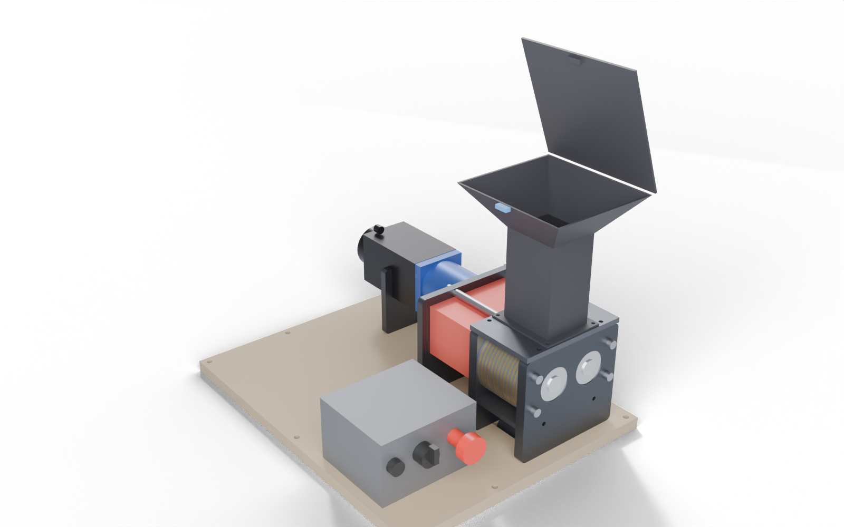
DIY DUAL-SHAFT SHREDDER – BLUEPRINT SET
ASSEMBLY – lid open, controller box on base plate
26 + 26
18 teeth
blades + spacers (Ø76 / Ø58)
hooked, per blade – fine strips, not chunks
68 mm
70 Nm
shaft spacing; 1:1 gears sync the shafts
jam torque cap (driver set to 3.7 A); gearbox 45 Nm nominal
SHEET INDEX
1 Overview
2 Assembly views + overall size
3 Exploded view + part numbers
4 Cutter blade + spacer
5 Cutter stack (section)
6 Comb, wall + top plate
7 End plates (far / drive / motor)
8 Gear sync + drive chain
9 Drive-train stack-up
10 Motor cradle + plywood base
11 Calculations 1: torque, speed, cutting
12 Calculations 2: gears, bearings, mass
13 Safety + electrical
14 Bill of materials
15 Print / cut / buy
16 Assembly order + checks
Models: shredder_assembly.fbx (Blender) · Cut files: shredder_dxf.zip
Dimensions marked VERIFY come from listings or photos, not drawings – see sheet 16.

Slide 2
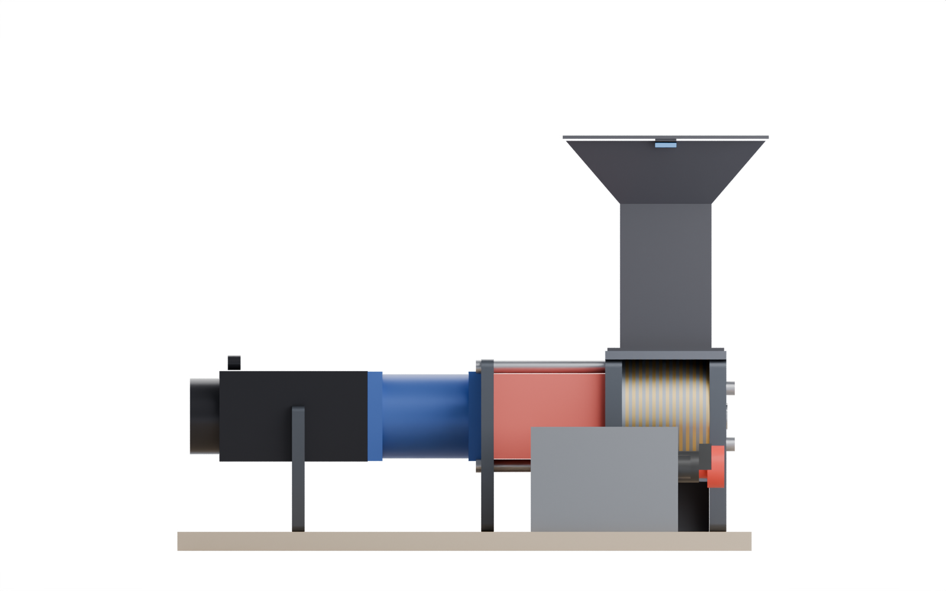
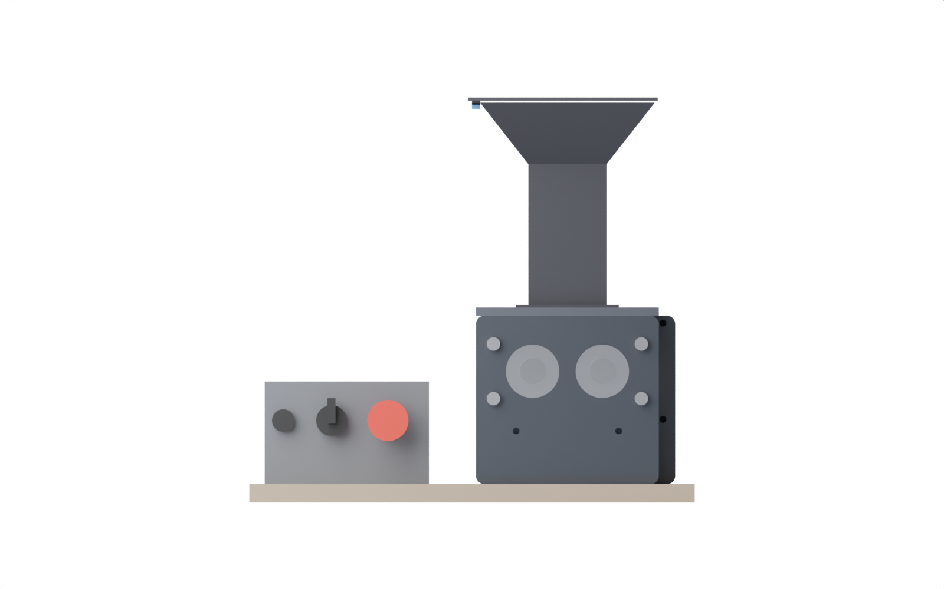
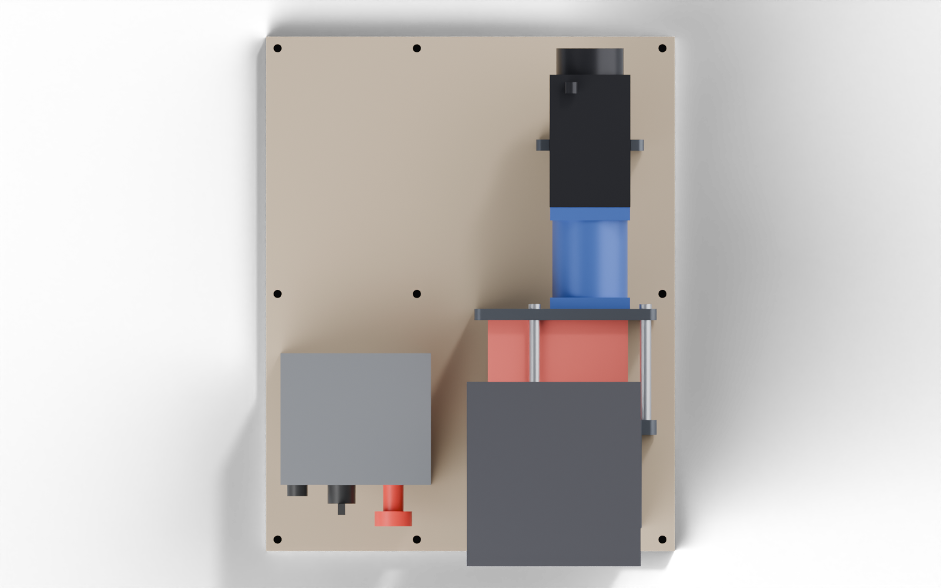
ASSEMBLY VIEWS – OVERALL SIZE
SIDE (from +X) – lid closed
FRONT (far end)
393 height
434 base plate
TOP – 434 × 546 base plate
518 overall length
DESIGN NOTES
Base plate 434 × 546 carries the machine, the motor cradle and the controller box; a cut-out lets the discharge chute drop through.
Funnel overhangs the end plates by ≈ 33 mm each way – the 140 mm throat keeps hands away from the blades.

Slide 3
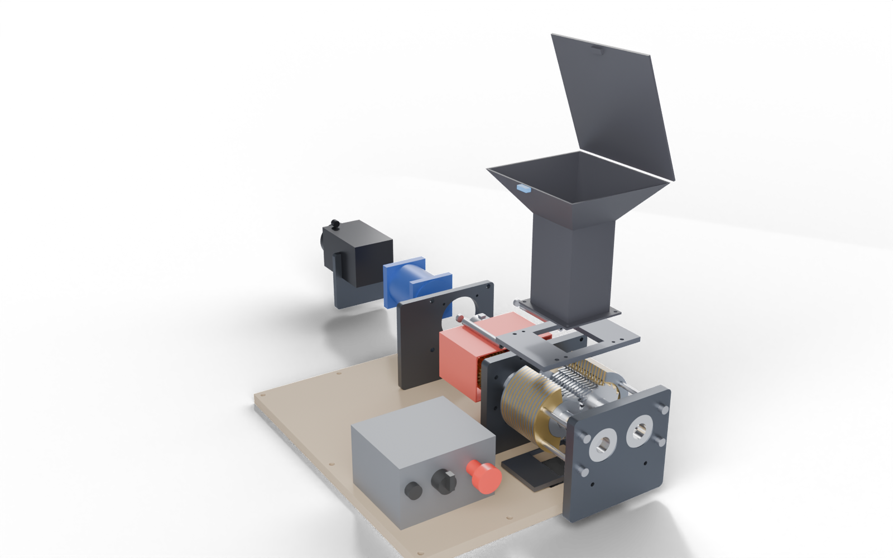
EXPLODED VIEW – PART NUMBERS
PARTS
1 Far end plate (16 mm)
2 Tie rods M8 × 110 (4)
3 Cutter stack: 26 blades, 26 spacers
4 Combs + wall plates (52)
5 Drive end plate (16 mm)
6 Sync gears m2 × 34 T × 20 (2)
7 Gear guard (printed PETG)
8 Standoffs Ø12 × 106 (4)
9 XL2 jaw coupler D54 × 78
10 Motor mount plate (12 mm)
11 10:1 planetary gearbox
12 NEMA 34 closed-loop motor
13 Motor cradle (12 mm)
14 Throat + funnel + lid
15 Top plate (inlet 70 × 81)
16 Discharge chute
12
14
13
11
10
8
9
15
7
6
5
3
4
2
1
16
Not shown: bearings (4 × 6205), M6/M8 hardware, plywood base, controller box.
Exploded along the shaft axis; the hopper and top / bottom plates are also lifted / dropped for clarity.

Slide 4
CUTTER BLADE + SPACER – 3.0 AND 3.4 MM STEEL
BLADE (×26, 3.0 mm) – shaft A orientation
SPACER (×26, 3.4 mm)
DESIGN NOTES
Hook shape is traced from your Fusion “Shredi V2” blade and compressed to 18 fine teeth.
Tooth pitch at the tips ≈ 13.3 mm; each blade shears a 3.2 mm wide strip (estimate of bit size).
One blade file: cut 26, then turn 13 over so the hooks mirror on shaft B.
Cheapest start: mild steel plate. Move to 3 mm AR400 / AR500 only if the teeth dull on abrasive scrap.
Hex bore = 1 in hex bar (25.4 AF) + 0.25 mm slip fit.
Spacers are 0.4 mm thicker than blades – this leaves 0.1 mm each side for the stationary plates.
steep face leads
(shaft A turns CW)
hex bore 25.65 AF
(1 in bar + 0.25)
Ø58
Ø66 root circle
(tooth depth 5.0)
hex bore 25.65 AF (same as blade)
Blade tip clears the opposing spacer by 1.08 mm
Ø76 (tooth tips)

Slide 5
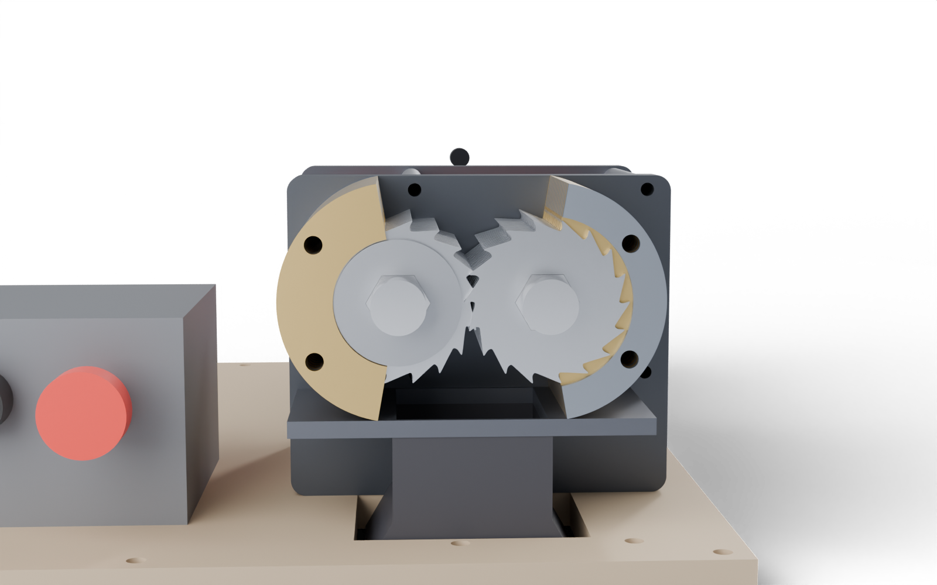
CUTTER STACK – SECTION THROUGH BOTH SHAFT AXES
SHAFT A
68 shaft spacing
SHAFT B
far end plate
83.2
Blade hooks meshing – view from the far end
DESIGN NOTES
Every layer is 3.2 mm: A and B blades alternate, 13 each = 26 layers = 83.2 mm.
Each blade sits in the other shaft’s spacer layer and shears against its neighbours (0.2 mm axial).
Stationary combs touch the spacer zone; wall plates close the blade layers.
Gaps: 0.1 mm blade ↔ plate, 1.0 mm tip ↔ spacer, 1.5 mm tip ↔ wall.
drive end plate
blade (3.0)
spacer (3.4)
comb (3.2)
wall plate (3.2)
hex shaft

Slide 6
STATIONARY PLATES – COMB, WALL AND TOP PLATE
COMB (×26, 3.2 mm)
WALL (×26, 3.2 mm)
TOP PLATE (×1, 8 mm)
R29.6 edge
(spacer R29 + 0.6)
R39.5 edge
(tip R38 + 1.5)
70 inlet
2× Ø8.5 rod holes
on R46.5
81
115.2
108.3
178
DESIGN NOTES
Comb and wall plates alternate: comb at the spacer layers, wall where the blades run – 26 of each.
Plates stack flush on the four M8 tie rods (≥ 4 mm web at the rod holes).
Top plate: slot 70 × 81 (spec inlet 8.1 × 7 cm), 4× Ø5.5 for the throat flange, 4× Ø6.6 into the end-plate top edges.
Bottom plate is the same size with a 70 × 78.4 discharge slot (DXF 10).
R55 outer, sector 100°–260°
Right side = same parts turned 180°

Slide 7
END PLATES – FAR (16 MM), DRIVE (16 MM), MOTOR MOUNT (12 MM)
FAR END PLATE (×1)
DRIVE END PLATE (×1)
MOTOR MOUNT PLATE (×1)
68 c–c
164.2
178
194
194
2× Ø52.0 bearing bores (6205)
4× Ø6.8 = M8 tap (rods thread in)
Ø80.1 gearbox pilot seat (80 H7)
4× Ø8.5 tie-rod holes
4× Ø6.8 M8 tap (standoffs)
4× M6 tap (Ø5.0 drill) on 69.6 sq
2× Ø6.6 bottom-plate screws
Bores + rod pattern as the far plate
4× Ø8.5 standoff screws
NOTES
Press bearings into the Ø52 bores (laser bores run slightly loose: retain with bearing compound). Bottom edges get 2× M8 taps per plate for the base plate. Motor plate: gearbox bolts (M6 × 20) go in from the gearbox side.

Slide 8
GEAR SYNC PAIR + DRIVE TRAIN
SYNC GEAR (×2, 20 mm) – m2, 34 T, 20°
POWER PATH
NEMA 34 closed-loop
12 Nm hold, 6 A
10:1 planetary
D20 × 40, 45 Nm nom.
XL2 jaw coupler
D54 × 78, 70 Nm
Shaft A
1 in hex / D25
Ø68 pitch circle
(= shaft spacing 68)
Counter-rotating: A turns CW, B turns CCW, viewed from the drive end
Gear A (34 T) ⟷ Gear B (34 T)
Shaft B
70 Nm
45 Nm
1.85 kN
60 rpm
jam torque cap at 3.7 A driver current (10 × 0.95 × 7.4 Nm)
gearbox nominal; the continuous working limit
blade-tip force at the cap
at 600 rpm motor; tip speed 0.239 m/s
hex bore 25.65 AF
DESIGN NOTES
A 1:1 gear pair is the “part for counter-rotation”; the second shaft takes no motor of its own, so one gearbox is enough.
Gears: buy pre-hardened 4140 plate (≈ 300 HB as bought, no heat treat) and have it waterjet cut. Mild steel fails the contact-stress check (sheet 12).
Without a current limit the motor stalls at 114 Nm – above the gearbox peak (90) and the coupler (70). Set the driver peak to 3.7 A.
Torque-vs-speed fractions are assumptions – check the motor curve at 60 V.
Ø72 tip
Mesh check: no overlap, 0.09 mm backlash at 68.0 centres

Slide 9
DRIVE-TRAIN STACK-UP – GEAR TO MOTOR
SECTION THROUGH SHAFT A – w measured from the far end plate (mm)
STACK-UP
106 = 1.0 + 20 (gear) + 4.0 + 78 (coupler) + 3.0.
Shaft A ends 1.0 short of the hub bore bottom (29 engaged); the gearbox shaft is 28 engaged, 2.0 short.
Shaft tips sit 21 apart inside the 18 mm spider zone.
Gearbox shaft length is taken from the pilot tip. If the seller means the flange face, engagement drops to 25 mm.
Clamp heads clear the gear guard by 7 mm.
106 standoff length
108 gearbox (behind flange face)
DRIVE PLATE
MOTOR PLATE
GEAR A
XL2
PU
XL2
GEARBOX 10:1
MOTOR 169 long →
SHAFT A (hex → D25)
Ø20 h6
29
21 tip gap
28
78 coupler
40 shaft
16
20
4.0
3.0
12

Slide 10
MOTOR CRADLE + PLYWOOD BASE
MOTOR CRADLE (×1, 12 mm)
BASE (×1, 18 mm plywood) – plan, drive end at the bottom
NOTES
Plywood base (18 mm): 2.77 kg; whole machine ≈ 36.8 kg (the 10 mm steel base was 18.6 kg).
The base is the one big part you cut yourself: print the DXF at 1:1 (tiled) or use it as a CNC file.
Centre of gravity: u 13.7, w 158.2, 90.9 mm above the base – 137.7 mm inside the nearest edge (static tip angle 56.6°).
Motor + gearbox (7.9 kg) hang up to 280 mm off the motor plate = 11.7 N·m. The cradle carries the weight; the gearbox bolts only see 84 N each.
Dashed outlines: blue = machine, red = cradle, gray = controller box.
86.8 notch
MOTOR
CRADLE
120
GEARBOX
546.2
GEAR GUARD
CONTROLLER
114.8
CUTTER
Notch floor sits 0.4 mm below the motor underside; the motor drops in from the top. Two M8 screws go through the base into the bottom edge (u = −74, +6).
434

Slide 11
CALCULATIONS 1 – TORQUE CHAIN, SPEED, POWER, CUTTING
TORQUE CHAIN
SPEED POINTS (motor torque fraction is assumed)
Step | Value | Basis
Motor holding torque | 12.0 Nm | 6.0 A → 2.0 Nm / A
Gearbox ratio × efficiency | 10 × 0.95 = 9.5 | listing: ≥ 95 %
Gearbox nominal / peak | 45 / 90 Nm | listing
Coupler nominal | 70 Nm | XL2 table
Weakest link on a jam | 70 Nm (coupler) | min of the above
Motor torque for 70 Nm | 7.37 Nm | 70 ÷ 9.5
Driver peak current (set) | 3.7 A = 62 % of 6.0 A | → 70.3 Nm out
Current for 45 Nm continuous | 2.37 A | 45 ÷ 9.5 ÷ 2.0
Stall with no limit | 114 Nm | exceeds gearbox peak!
Motor rpm | Shaft rpm | Torque avail. | Out Nm | Out W | Tip m/s
300 | 30 | 75 % of hold | 70.3 | 221 | 0.119
600 | 60 | 60 % of hold | 68.4 | 430 | 0.239
1000 | 100 | 40 % of hold | 45.6 | 478 | 0.398
Supply: 60 V × 10 A = 600 W; × 55 % stepper-system efficiency (assumed) × 0.95 gearbox ≈ 314 W at the shaft = 50 Nm at 60 rpm.
Pulse rate for the Nano at 1600 pulses/rev: 16 kHz at 600 rpm, 26.7 kHz at 1000 rpm – well inside the driver limit.
CUTTING: tooth force = T ÷ R_blade = 1184 N at 45 Nm, 1850 N at the cap
WHAT TO SET / ASSUME
CL86T: peak current 3.7 A (jam torque ≈ 70 Nm); continuous draw follows the load.
One tooth can shear PLA up to ≈ 8.8 mm thick, HDPE ≈ 17.9 mm at 45 Nm.
Shear strengths are handbook values; thick prints will stall long before the bottles do.
Torque fractions at 300 / 600 / 1000 rpm are assumed for an 86 mm closed-loop stepper at 60 V – check the motor curve.
Material (thickness) | Shear τ MPa | Force to shear (τ × t × 3 mm) | Margin at 45 Nm
PET bottle wall 0.3 mm | 50 | 45 N | 26.3 ×
HDPE 2 mm | 22 | 132 N | 9 ×
PLA print 4 mm | 45 | 540 N | 2.2 ×
ABS 5 mm | 35 | 525 N | 2.3 ×
Acrylic 6 mm | 55 | 990 N | 1.2 ×

Slide 12
CALCULATIONS 2 – GEARS, SHAFTS, BEARINGS, MOUNTING
GEAR MESH (Lewis Y = 0.371, Kv = 1.035; allowable: 4140 HT 248 / 840 MPa, A36 133 / 336 MPa)
MASS + BALANCE
Total ≈ 36.8 kg: base 2.77, plates 9.86, motor 5.5, controller 3, gearbox 2.4.
Centre of gravity 90.9 mm above the base; static tip angle 56.6°.
Motor mass (5.5 kg) and the controller box (3 kg) are estimates.
The gear pair is the part to watch: if shaft B jams, all of the torque goes through the mesh.
Stresses are hand calculations (Lewis / Hertz, no life factor) – a screening check, not a certified design.
Load case | Face mm | Tooth force N | Bending MPa | Contact MPa | 4140 HT | A36
nominal 45 Nm | 12 | 1324 | 154 | 855 | over | fails
nominal 45 Nm | 20 | 1324 | 92 | 662 | OK | fails
jam at current cap 70 Nm | 12 | 2068 | 240 | 1069 | over | fails
jam at current cap 70 Nm | 20 | 2068 | 144 | 828 | OK, tight | fails
unlimited peak 90 Nm | 12 | 2647 | 308 | 1209 | over | fails
unlimited peak 90 Nm | 20 | 2647 | 185 | 936 | over | fails
Mesh: no overlap, 0.0947 mm clearance, contact ratio ≈ 1.68. Chosen: 20 mm face, hardened, driver cap 3.7 A.
SHAFTS, BEARINGS, MOUNTING
Check | Result | Limit / note
Torsion, D25 seat at 70 Nm | 22.9 MPa | allow ≈ 202 MPa (1018) → SF 8.8
Hex drive, whole torque on 1 blade | 89 MPa | AR400 ≥ 1000, mild ≈ 250
Drive bearing (gear + blade force) | 4487 N | 6205 static C0 7800 N → ×1.7
Gearbox flange bolts (M6 × 20) | 84 N tension | 357 N shear from torque reaction
Motor shaft in gearbox bore | 37 in 41.5 | D14 F7 clamp, remove the key

Slide 13
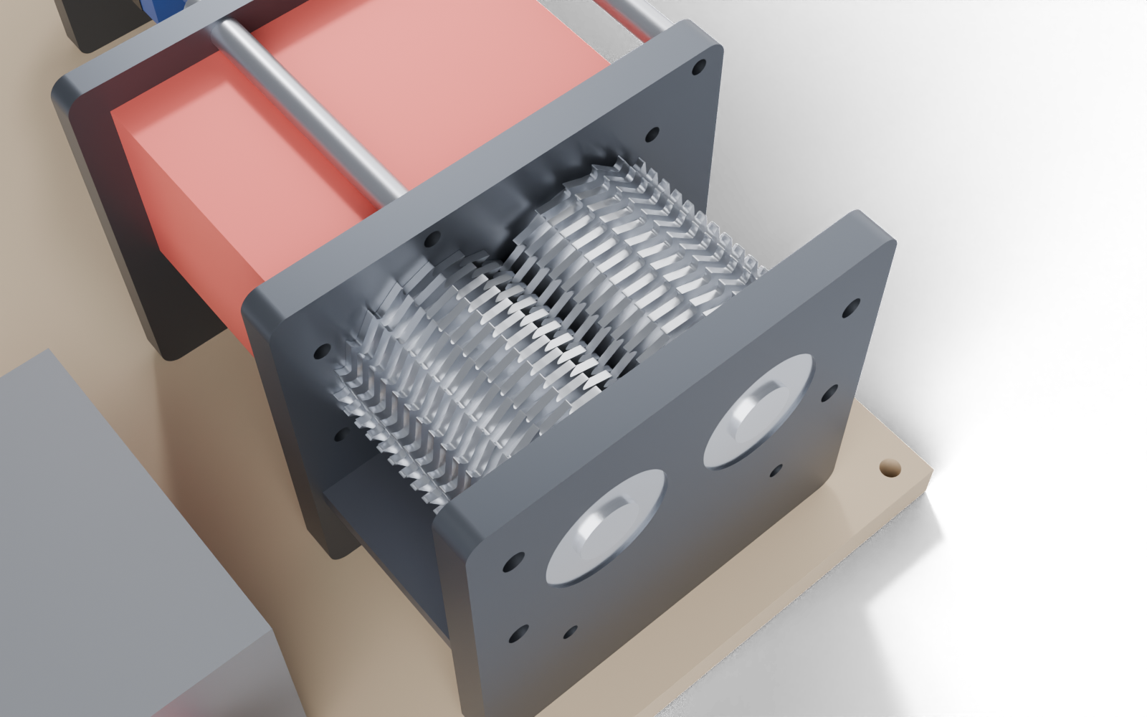
SAFETY CHAIN + ELECTRICAL BLOCK DIAGRAM
POWER + E-STOP (hardware path)
Mains
120 V AC
Fuse /
breaker
E-stop + lid reed
in series (NC)
Contactor
(coil on that loop)
60 V 600 W
PSU
CL86T driver
24–80 V
NEMA 34
motor + encoder
Contactor drops the PSU feed on E-stop or lid open – no software in the loop.
CONTROL (logic)
FWD / OFF / REV switch
Cutter chamber with the top plate, hopper and side walls hidden
Start button
Arduino Nano
5 V logic
PUL / DIR /
ENA to CL86T
GUARDS + SAFETY NOTES
Throat 70 × 81 × 140 mm tall plus a hinged lid with a reed-switch interlock.
Red gear guard (printed PETG, 2.4 mm walls) closes the gear zone between the plates; E-stop is on the controller front.
Set the CL86T peak current to 3.7 A: it caps the jam torque at the coupler rating (70 Nm).
Counter-rotating steel blades pull in anything – never reach into the throat; always stop and wait.
Have mains wiring checked by a qualified person; this is not a certified guard design.
Lid reed (read-only)
Driver ALM (jam)
Nano auto-reverses on a jam (ALM) and holds ENA low whenever the interlock is open.

Slide 14
BILL OF MATERIALS
# | Part | Qty | Size / material | Source
1 | Blade | 26 | Ø76 × 3.0 mm steel, 18 teeth | DXF 01 (turn 13 over)
2 | Spacer | 26 | Ø58 × 3.4 mm steel | DXF 02
3 | Comb plate | 26 | 3.2 mm steel | DXF 03
4 | Wall plate | 26 | 3.2 mm steel | DXF 04
5 | Hex shaft | 2 | 1 in hex bar; A = 170 mm, B = 139 mm; ends turned Ø25 h6 | bar stock + one machine-shop job
6 | Sync gear | 2 | m2 × 34 T, 20 mm, hex bore, pre-hard 4140 (≈ 300 HB) | DXF 05, waterjet, no heat treat
7 | End plates + motor plate | 3 | 16 / 16 / 12 mm steel | DXF 06–08
8 | Top + bottom plate | 2 | 8 mm steel | DXF 09–10
9 | Base | 1 | 434 × 546 × 18 mm plywood | DXF 11 as template, jigsaw
10 | Motor cradle | 1 | 12 mm steel U-saddle, 114.8 × 120 | DXF 12
11 | Bearing 6205-2RS | 4 | 25 × 52 × 15 | bearing supplier
12 | Tie rod (M8 SHCS) | 4 | M8 × 110, threads into drive plate | hardware
13 | Standoff + screw | 4 | Ø12 × 106 tube, M8 × 130 SHCS | hardware
14 | Shaft coupler | 1 | Sinoblu XL2 D54 × L78, 1045 steel, bores 25 / 20, 70 Nm | listing $18.94 (selected)
15 | 10:1 planetary gearbox | 1 | YEJMKJ, 85 sq, Ø20 × 40 shaft, 45 / 90 Nm; + 4× M6 × 20 SHCS | listing $89.99 (selected)
16 | NEMA 34 closed-loop kit | 1 | 34HS59-6004D-E1000 12 Nm + CL86T V4.1 + cables | listing $155.00
17 | 60 V 10 A PSU | 1 | 600 W, 110 V in | listing $31.99
18 | Arduino Nano | 1 | 3-pack, USB-C | listing $15.99
19 | E-stop, contactor, switches, fuse | 1 set | NC mushroom, reed switch, FWD/OFF/REV | electrical supplier
20 | Hopper, throat, lid, chute | 1 set | 3D-printed (PETG) – models in the FBX | print
21 | Gear guard | 1 | 148.8 × 80.8 × 106 shell, 2.4 mm walls, PETG | print
Listed purchases: $311.91 (motor kit 155.00, gearbox 89.99, PSU 31.99, coupler 18.94, Nano 15.99). Gearbox and coupler are selected, not yet ordered.

Slide 15
WHAT TO PRINT, WHAT TO CUT, WHAT TO BUY
WHO MAKES WHAT
CUT ORDER SUMMARY (for quotes)
Route | Parts | Why
3D print (PETG / ASA) | Hopper flange, throat guard, lid, discharge chute, gear guard, controller box | Carry no cutting or drive load; free and fast to change
Laser cut (mild steel) | Blades, spacers, combs, walls, 5 plates, motor cradle | 110 flat parts: not practical by hand
Waterjet (4140 pre-hard) | Two sync gears, 20 mm | Hardened teeth with no heat treat; the only hard-to-source part
Plywood, jigsaw | Base 434 × 546 × 18 mm | Replaces the 18.6 kg steel base; 15.8 kg lighter
Machine shop, one job | Turn 4 hex-bar ends to Ø25 h6 | Needs a lathe; the round coupler bore means a hex bearing cannot replace it
Buy | Motor kit, gearbox, coupler, PSU, Nano, 6205 bearings, hex bar, M6 / M8 hardware, E-stop set | Listed purchases are $311.91
Part | Qty | Thk | Size mm | Cut m
Blade | 26 | 3.0 | 75.8 × 74.7 | 10.9
Spacer | 26 | 3.4 | 58 × 58 | 7
Comb plate | 26 | 3.2 | 49.9 × 108.3 | 8.9
Wall plate | 26 | 3.2 | 48.1 × 108.3 | 9.1
Sync gear | 2 | 20.0 | 72 × 71.8 | 1.1
Far end plate | 1 | 16.0 | 178 × 164.2 | 1.1
Drive end plate | 1 | 16.0 | 194 × 164.2 | 1.2
Motor plate | 1 | 12.0 | 194 × 164.2 | 1.1
Top plate | 1 | 8.0 | 178 × 115.2 | 1
Bottom plate | 1 | 8.0 | 170 × 83.2 | 0.8
Motor cradle | 1 | 12.0 | 114.8 × 120 | 0.6
Laser total | 110 |  |  | 41.7
WHAT CHANGED IN THIS REVISION (COST CUTS)
Base: 10 mm steel → 18 mm plywood. That was the biggest laser part (2 371 cm², 2.8 m of cut); total machine mass goes from 52.5 kg to 36.8 kg.
Gear guard: 2 mm sheet metal → printed PETG, so no sheet-metal work. Gears: pre-hard 4140 bought as plate, so no heat treat or warping.
Blades and plates: start in mild steel. 104 thin parts are 36 of the 41.7 m of laser cut, so ask for one nested quote rather than 11 separate ones.
26 blades, 26 spacers, the gears, the plates and every purchased part are unchanged. Thickness note: 3.0 / 3.2 / 3.4 mm are not stock sizes everywhere; tell me what the supplier carries and I will re-pitch the stack.

Slide 16
ASSEMBLY ORDER, DESIGN CHECKS AND OPEN ITEMS
ASSEMBLY ORDER
Cut and deburr all plates; take the two hex bars to a machine shop to turn the ends to Ø25 h6 (far seat 17 long; shaft A drive end 15 + round to the coupler).
Press 6205 bearings into the far and drive plates.
Stack shaft A (blade first) and shaft B (spacer first) on their hex bars.
Lay the far plate flat; drop in both shafts, then alternate comb / wall plates on the four rods.
Fit the drive plate; thread the rods into it and snug evenly.
Slide on the gears (set the tooth phase), then fit the gear guard.
Bolt the gearbox to the motor plate from behind (4× M6 × 20), then the motor to the gearbox (remove its key, clamp the collar).
Standoffs (M8 × 130) join the motor plate to the drive plate; slide the coupler on and clamp it 4.0 mm from the gear.
Motor cradle, base, top / bottom plates, throat, lid + reed switch, chute.
Wire the E-stop loop first; set 3.7 A; first spin with no load, then jog.
DESIGN CHECK | RESULT
Blade tip ↔ opposing spacer | 1.08 mm
Blade ↔ stationary plate (axial) | 0.10 mm
Blade tip ↔ wall plate | 1.50 mm
Gear backlash at 68.0 centres | 0.09 mm
Gear back face ↔ coupler | 4.0 mm
Shaft engagement A / gearbox | 29 / 28 mm of 30
Gear stress at the cap (hardened) | 144 bend / 828 contact MPa
Bearing static factor (worst case) | × 1.7
Mesh-vs-mesh interference, 142 parts | none (rods thread into drive plate)
OPEN ITEMS – CHECK ON ARRIVAL
Motor: 169 mm is treated as overall incl. the encoder (+28 mm if it is the body only); weight 5.5 kg is assumed.
Gearbox: shaft length is taken from the pilot tip; ratings and the 235 g / 2.4 kg weight come from the listing – confirm the key and input clamp.
Coupler: ask the seller whether the bores are keyed; shaft A end needs no key for the clamp type.
Motor torque-vs-speed curve at 60 V is assumed (75 / 60 / 40 % of hold).
Gears: pre-hard 4140 only (mild steel fails the contact check); bearing retention and hex tolerances are not drawn.
Stack tolerance: 26 layers of stock vary by ±0.05 mm; measure the plate and re-sort parts so the blades do not rub the combs.
Plate stock: 3.0 / 3.2 / 3.4 mm set; bit size and speeds are estimates – test with scrap PLA / PETG.

