Slide 1
Financial Data Analysis in R Using “quantmod”
library(quantmod)
Boemo Seboni
DSS 665 - R Statistical Programming Language
Fall 2026
Notes:
Today I'm presenting quantmod, which stands for Quantitative Financial Modelling. It's an R package for financial analysis. It pulls financial and economic data straight from the internet, makes professional-style stock charts, and calculates returns in one line of code.

Slide 2
What is quantmod?
01 / About
Created by Jeffrey A. Ryan; first released in August 2007
Stands for Quantitative Financial Modelling Framework
Built for traders and analysts to develop, test and chart financial models
Used to quantitatively analyze financial time series data
Used for
Downloading stock and economic data from Yahoo and FRED
Creating professional-style Financial Charts
Allows adding technical indicators (such as moving averages) to charts
Calculating returns, dividends, volatility, etc.
Notes:
quantmod was created by Jeffrey Ryan and first released on CRAN in August 2007; Joshua Ulrich maintains it today. It's built for traders and analysts who want to get, chart and analyze financial data quickly. It does four main things: downloads data, charts prices, adds indicators, and calculates returns.

Slide 3
The Data
02 / Data & Example
Yahoo Finance
Example
Microsoft (MSFT)
Daily prices, 2007 to 2026
Open, High, Low, Close, Adjusted, Volume
“How did Microsoft's stock hold up during COVID compared with the job market?”
FRED
U.S. Unemployment Rate (UNRATE)
Monthly rate, 2016 to 2026
Notes:
Here's an everyday question quantmod can answer: how did Microsoft's stock hold up during COVID compared with the job market? I pulled Microsoft's daily prices from Yahoo Finance and the unemployment rate from FRED, the Federal Reserve's database, then explored, charted and calculated returns.

Slide 4
Key Functions
03 / How it works
Function | What it does
getSymbols() | Downloads data from Yahoo Finance (default) or FRED
Cl() / Ad() | Extract the closing or adjusted price column (can also extract others)
chartSeries() | Draws line, bar or candlestick charts
addSMA() | Adds a moving average to the chart
yearlyReturn() / monthlyReturn() | Turns prices into percentage returns
Notes:
These are the functions I used. getSymbols downloads the data; auto.assign = F lets me name it, and src, from and to set the source and dates. Cl and Ad pull out columns. summary shows the range and missing values. chartSeries draws the charts, addSMA adds moving averages, and yearlyReturn and monthlyReturn calculate returns.

Slide 5
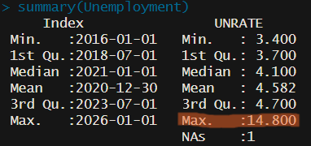
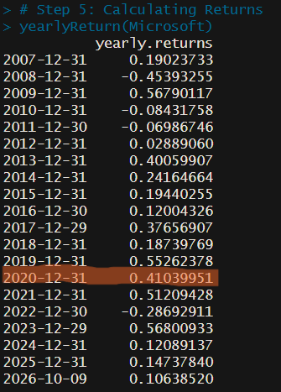
What the Data Showed
04 / Results
Microsoft stock returned 41% during 2020
Unemployment peaked at 14.8% in April 2020
2020 was one of Microsoft’s best years in the stock market since its inception on the market.
Meanwhile, unemployment shot up to the worst it has been in the past 10 years
Notes:
A few observations. The adjusted price accounts for dividends, so it's better for long-term growth. Unemployment peaked at 14.8 percent in April 2020, and October 2025 is missing from FRED. Microsoft lost 45 percent in 2008 but gained 41 percent in 2020. In April 2020 the stock was up 13.6 percent while unemployment hit its peak: the stock market and job market moved in opposite directions.

Slide 6
Key Takeaways
05 / Takeaways
quantmod provides a simple way to import financial data from several sources for deep financial analysis
Provides professional financial charts and indicators using a simple line of code
Allows you to use basic R functions in order to easily analyze the data such as ways to extract data column by column.
It is a very powerful tool for individuals interested in investing, trading or just looking for knowledge on the stock market.
Thank you!
Notes:
To sum up: one function pulled data from two different sources, one line made professional charts, one line added indicators, and one line calculated returns. Things to watch for: check for missing values, and the package depends on Yahoo and FRED being available. quantmod turns financial analysis that would take a lot of manual work into a few readable lines of code. Thank you.

