Slide 1
Problem Statements on Agentic AI
Project Title: Research Agent

Slide 2
A Research Agent is an AI system designed to assist with academic and scientific research tasks. It can autonomously search for literature, summarize papers, and organize references. Using natural language processing, it understands research questions and retrieves relevant information. The agent can generate reports, suggest hypotheses, and even draft sections of research papers. It saves time by automating repetitive tasks like citation management and data extraction. Research Agents enhance efficiency, accuracy, and innovation in both academic and industrial R&D.
An AI agent designed to assist faculty with NAAC accreditation processes, powered by RAG (Retrieval-Augmented Generation). It retrieves institutional data, past reports, and NAAC guidelines to provide precise, context-aware support. Faculty can interact with the agent to generate SSR drafts, criteria-wise inputs, and best practice documentation. The RAG approach ensures answers are grounded in trusted sources and tailored to the institution's context. It streamlines documentation, enhances accuracy, and reduces time spent on repetitive tasks. This AI assistant empowers faculty to focus on quality improvement while ensuring NAAC compliance

Slide 3
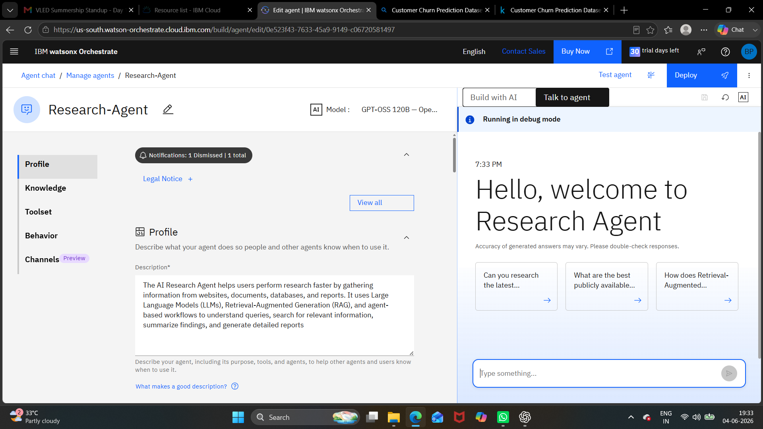

Slide 4
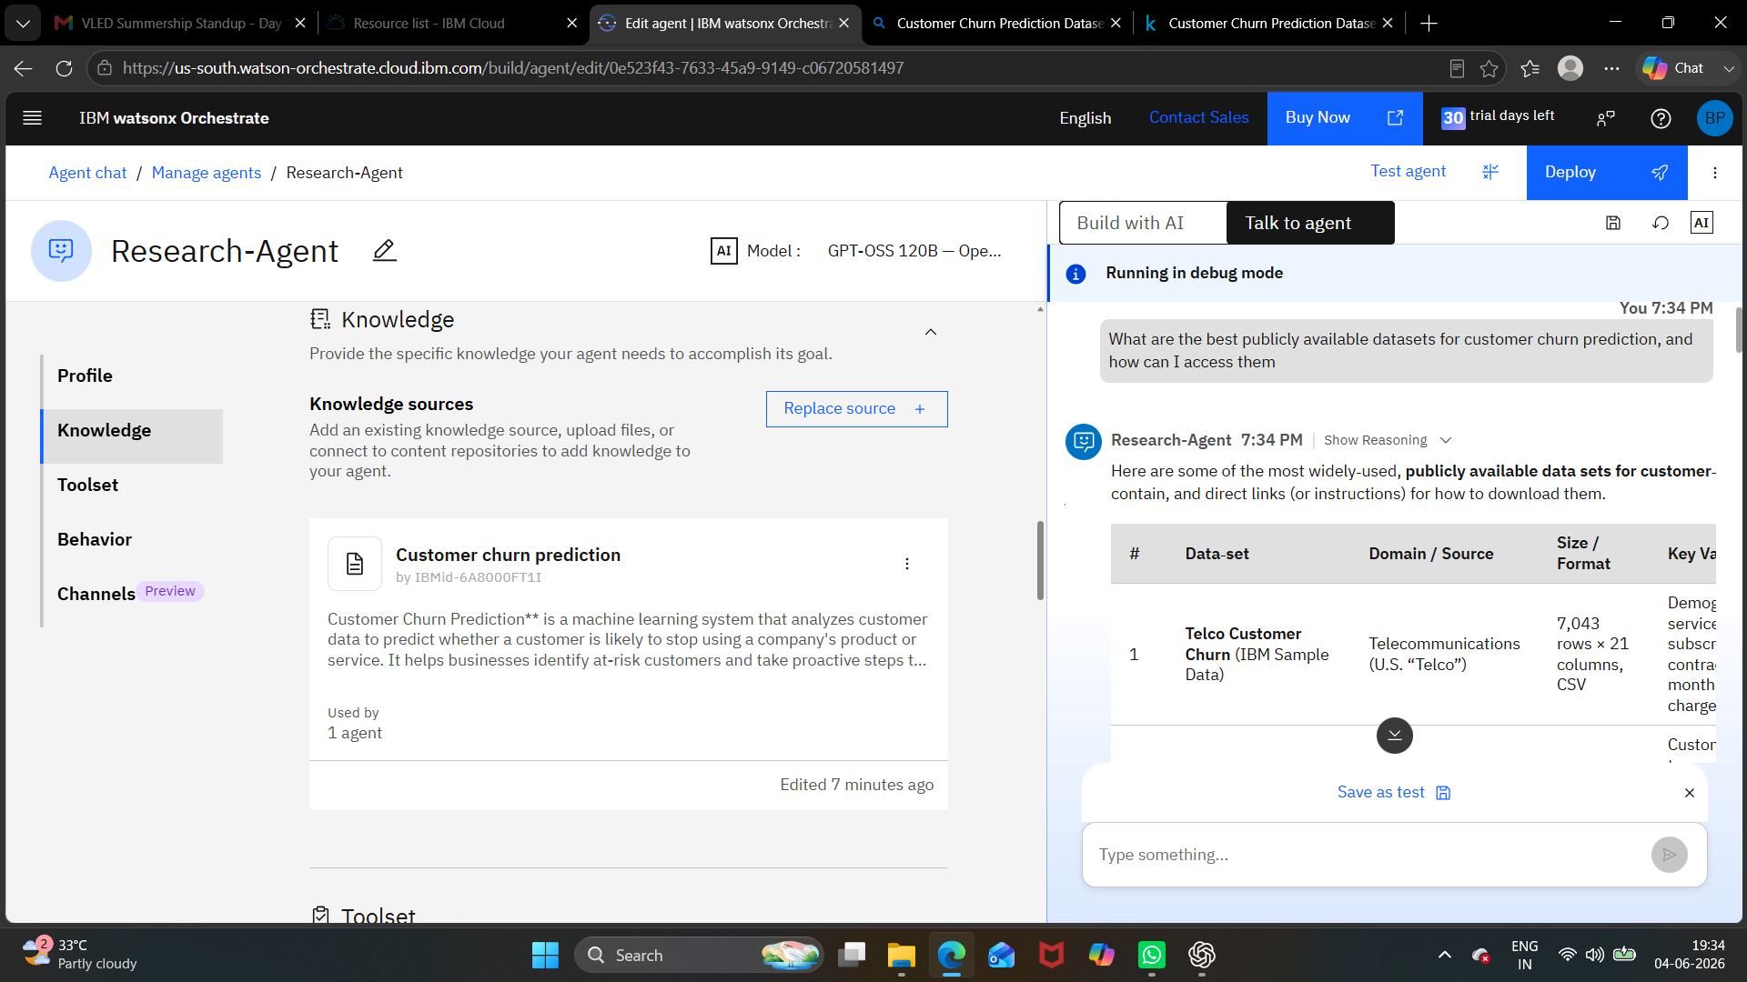
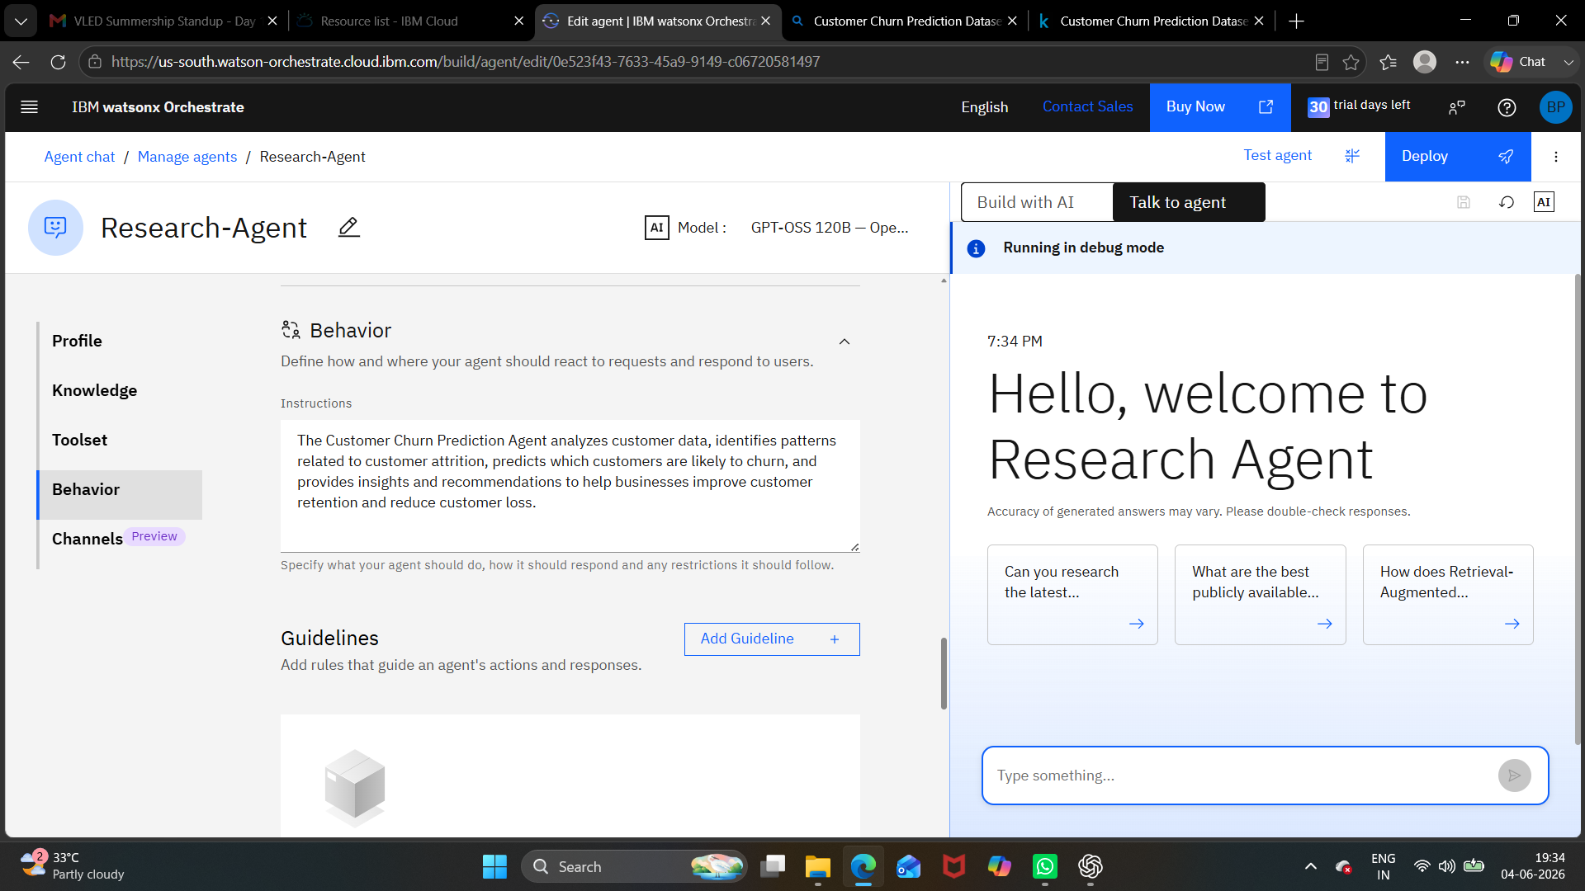
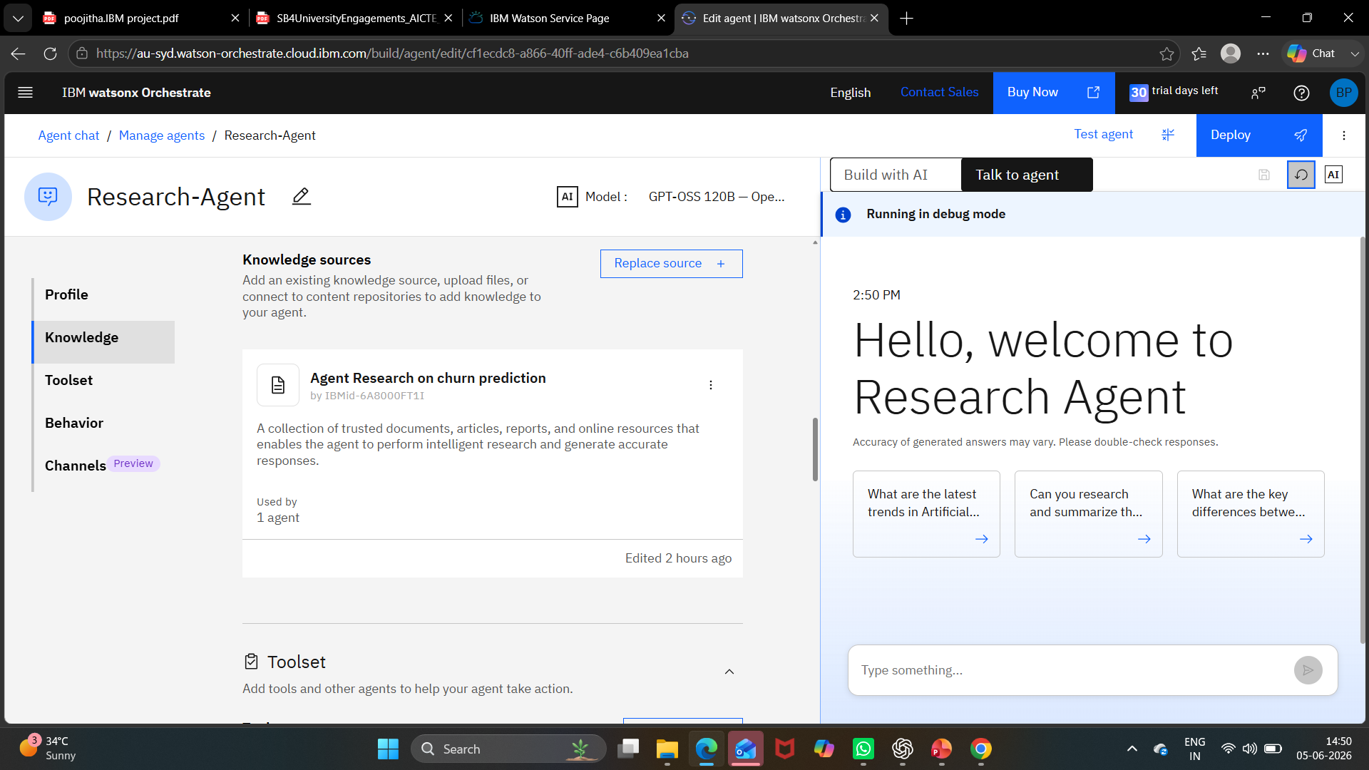

Slide 5
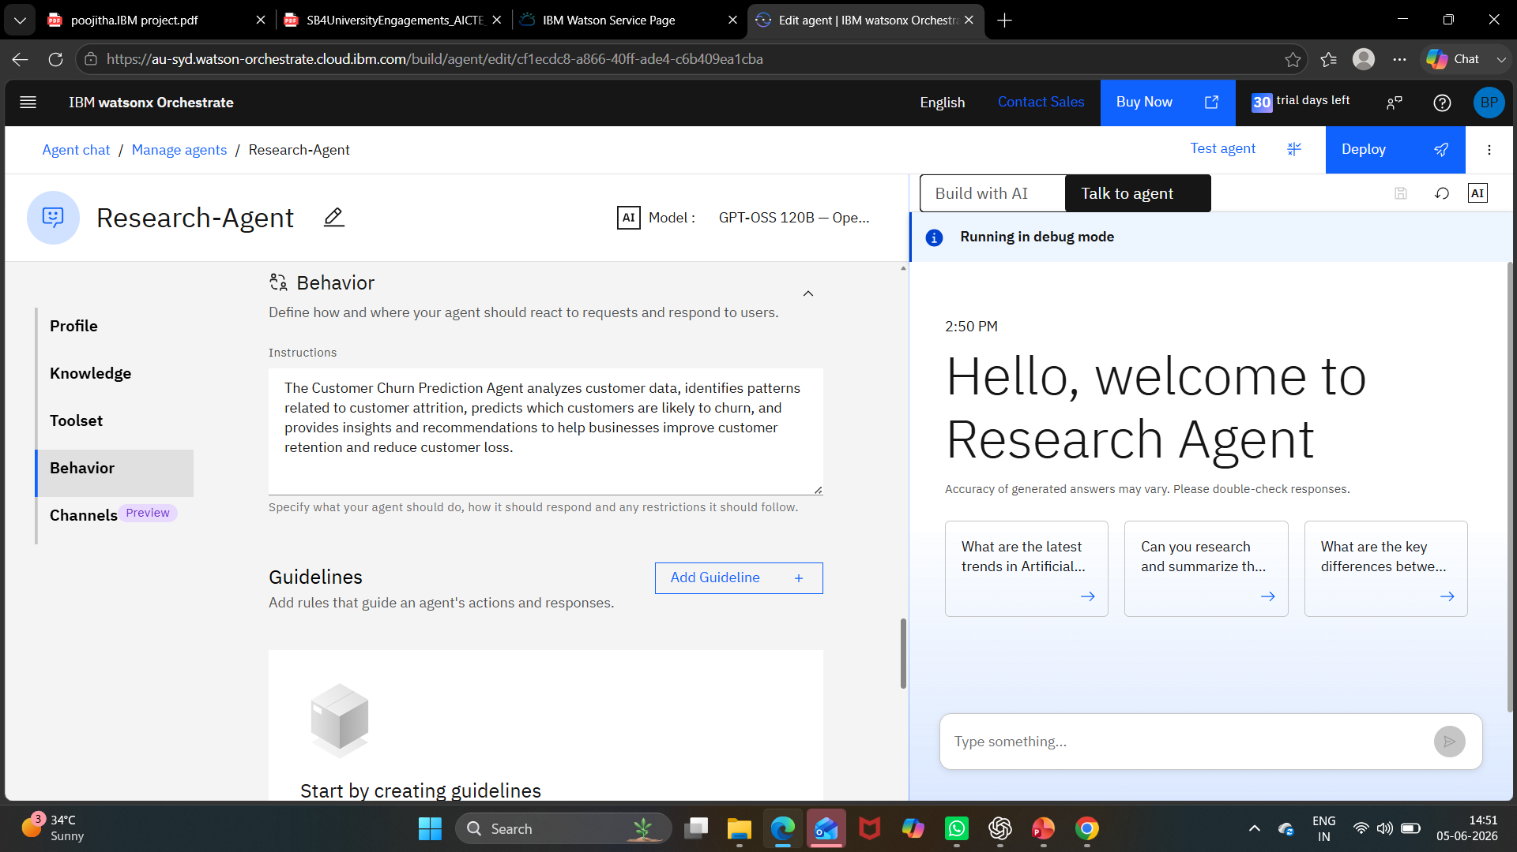

Slide 6
