Slide 1

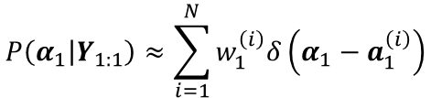

Forward filter
$$P\left(\left.α_{1}\right|Y_{1:1}\right)≈\sum_{i=1}^{N}{w_{1}^{\left(i\right)}δ\left(α_{1}−a_{1}^{\left(i\right)}\right)}$$
$$\begin{matrix}a_{1}^{\left(1\right)} \\ a_{1}^{\left(2\right)} \\ ⋮ \\ a_{1}^{\left(N\right)}\end{matrix}$$
$$a_{1}\sim q\left(⋅\right)$$

Slide 2
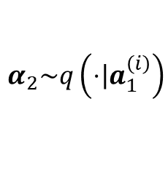
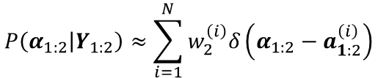

Forward filter
$$P\left(\left.α_{1}\right|Y_{1:1}\right)≈\sum_{i=1}^{N}{w_{1}^{\left(i\right)}δ\left(α_{1}−a_{1}^{\left(i\right)}\right)}$$
$$P\left(\left.α_{1:2}\right|Y_{1:2}\right)≈\sum_{i=1}^{N}{w_{2}^{\left(i\right)}δ\left(α_{1:2}−a_{1:2}^{\left(i\right)}\right)}$$
$$\begin{matrix}a_{1}^{\left(1\right)} \\ a_{1}^{\left(2\right)} \\ ⋮ \\ a_{1}^{\left(N\right)}\end{matrix}$$
$$\begin{matrix}a_{2}^{\left(1\right)} \\ a_{2}^{\left(2\right)} \\ ⋮ \\ a_{2}^{\left(N\right)}\end{matrix}$$
$$a_{1}\sim q\left(⋅\right)$$
$$α_{2}\sim q\left(\left.⋅\right|a_{1}^{\left(i\right)}\right)$$

Slide 3


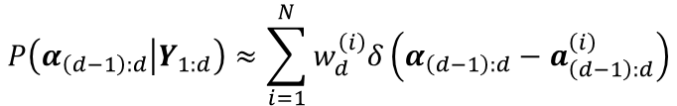

Forward filter
$$P\left(\left.α_{1}\right|Y_{1:1}\right)≈\sum_{i=1}^{N}{w_{1}^{\left(i\right)}δ\left(α_{1}−a_{1}^{\left(i\right)}\right)}$$
$$P\left(\left.α_{1:2}\right|Y_{1:2}\right)≈\sum_{i=1}^{N}{w_{2}^{\left(i\right)}δ\left(α_{1:2}−a_{1:2}^{\left(i\right)}\right)}$$
$$P\left(\left.α_{\left(d−1\right):d}\right|Y_{1:d}\right)≈\sum_{i=1}^{N}{w_{d}^{\left(i\right)}δ\left(α_{\left(d−1\right):d}−a_{\left(d−1\right):d}^{\left(i\right)}\right)}$$
$$\begin{matrix}a_{1}^{\left(1\right)} \\ a_{1}^{\left(2\right)} \\ ⋮ \\ a_{1}^{\left(N\right)}\end{matrix}$$
$$\begin{matrix}a_{2}^{\left(1\right)} \\ a_{2}^{\left(2\right)} \\ ⋮ \\ a_{2}^{\left(N\right)}\end{matrix}$$
$$\begin{matrix}a_{d}^{\left(1\right)} \\ a_{d}^{\left(2\right)} \\ ⋮ \\ a_{d}^{\left(N\right)}\end{matrix}$$
$$a_{1}\sim q\left(⋅\right)$$
$$α_{2}\sim q\left(\left.⋅\right|a_{1}^{\left(i\right)}\right)$$
$$⋯$$
$$⋯$$

Slide 4


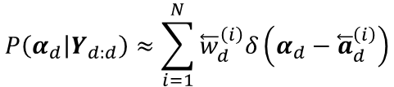
Forward filter
$$P\left(\left.α_{1}\right|Y_{1:1}\right)≈\sum_{i=1}^{N}{w_{1}^{\left(i\right)}δ\left(α_{1}−a_{1}^{\left(i\right)}\right)}$$
$$P\left(\left.α_{1:2}\right|Y_{1:2}\right)≈\sum_{i=1}^{N}{w_{2}^{\left(i\right)}δ\left(α_{1:2}−a_{1:2}^{\left(i\right)}\right)}$$
$$P\left(\left.α_{\left(d−1\right):d}\right|Y_{1:d}\right)≈\sum_{i=1}^{N}{w_{d}^{\left(i\right)}δ\left(α_{\left(d−1\right):d}−a_{\left(d−1\right):d}^{\left(i\right)}\right)}$$
$$\begin{matrix}a_{1}^{\left(1\right)} \\ a_{1}^{\left(2\right)} \\ ⋮ \\ a_{1}^{\left(N\right)}\end{matrix}$$
$$\begin{matrix}a_{2}^{\left(1\right)} \\ a_{2}^{\left(2\right)} \\ ⋮ \\ a_{2}^{\left(N\right)}\end{matrix}$$
$$\begin{matrix}a_{d}^{\left(1\right)} \\ a_{d}^{\left(2\right)} \\ ⋮ \\ a_{d}^{\left(N\right)}\end{matrix}$$
$$a_{1}\sim q\left(⋅\right)$$
$$α_{2}\sim q\left(\left.⋅\right|a_{1}^{\left(i\right)}\right)$$
$$⋯$$
$$⋯$$
Backward filter
$$P\left(\left.α_{d}\right|Y_{d:d}\right)≈\sum_{i=1}^{N}{{\overset{⃖}{w}}_{d}^{\left(i\right)}δ\left(α_{d}−{\overset{⃖}{a}}_{d}^{\left(i\right)}\right)}$$
$$\begin{matrix}{\overset{⃖}{a}}_{d}^{\left(1\right)} \\ {\overset{⃖}{a}}_{d}^{\left(2\right)} \\ ⋮ \\ {\overset{⃖}{a}}_{d}^{\left(N\right)}\end{matrix}$$
$$a_{d}\sim \tilde{q}\left(⋅\right)$$

Slide 5
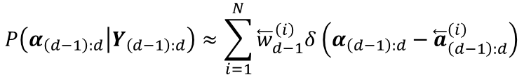

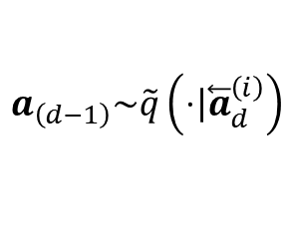
Forward filter
$$P\left(\left.α_{1}\right|Y_{1:1}\right)≈\sum_{i=1}^{N}{w_{1}^{\left(i\right)}δ\left(α_{1}−a_{1}^{\left(i\right)}\right)}$$
$$P\left(\left.α_{1:2}\right|Y_{1:2}\right)≈\sum_{i=1}^{N}{w_{2}^{\left(i\right)}δ\left(α_{1:2}−a_{1:2}^{\left(i\right)}\right)}$$
$$P\left(\left.α_{\left(d−1\right):d}\right|Y_{1:d}\right)≈\sum_{i=1}^{N}{w_{d}^{\left(i\right)}δ\left(α_{\left(d−1\right):d}−a_{\left(d−1\right):d}^{\left(i\right)}\right)}$$
$$\begin{matrix}a_{1}^{\left(1\right)} \\ a_{1}^{\left(2\right)} \\ ⋮ \\ a_{1}^{\left(N\right)}\end{matrix}$$
$$\begin{matrix}a_{2}^{\left(1\right)} \\ a_{2}^{\left(2\right)} \\ ⋮ \\ a_{2}^{\left(N\right)}\end{matrix}$$
$$\begin{matrix}a_{d}^{\left(1\right)} \\ a_{d}^{\left(2\right)} \\ ⋮ \\ a_{d}^{\left(N\right)}\end{matrix}$$
$$a_{1}\sim q\left(⋅\right)$$
$$α_{2}\sim q\left(\left.⋅\right|a_{1}^{\left(i\right)}\right)$$
$$⋯$$
$$⋯$$
Backward filter
$$P\left(\left.α_{\left(d−1\right):d}\right|Y_{\left(d−1\right):d}\right)≈\sum_{i=1}^{N}{{\overset{⃖}{w}}_{d−1}^{\left(i\right)}δ\left(α_{\left(d−1\right):d}−{\overset{⃖}{a}}_{\left(d−1\right):d}^{\left(i\right)}\right)}$$
$$P\left(\left.α_{d}\right|Y_{d:d}\right)≈\sum_{i=1}^{N}{{\overset{⃖}{w}}_{d}^{\left(i\right)}δ\left(α_{d}−{\overset{⃖}{a}}_{d}^{\left(i\right)}\right)}$$
$$\begin{matrix}{\overset{⃖}{a}}_{d−1}^{\left(1\right)} \\ {\overset{⃖}{a}}_{d−1}^{\left(2\right)} \\ ⋮ \\ {\overset{⃖}{a}}_{d−1}^{\left(N\right)}\end{matrix}$$
$$\begin{matrix}{\overset{⃖}{a}}_{d}^{\left(1\right)} \\ {\overset{⃖}{a}}_{d}^{\left(2\right)} \\ ⋮ \\ {\overset{⃖}{a}}_{d}^{\left(N\right)}\end{matrix}$$
$$a_{\left(d−1\right)}\sim \tilde{q}\left(\left.⋅\right|{\overset{⃖}{a}}_{d}^{\left(i\right)}\right)$$
$$a_{d}\sim \tilde{q}\left(⋅\right)$$

Slide 6


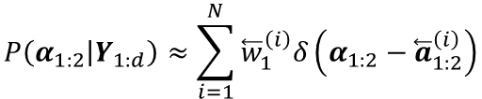

Forward filter
$$P\left(\left.α_{1}\right|Y_{1:1}\right)≈\sum_{i=1}^{N}{w_{1}^{\left(i\right)}δ\left(α_{1}−a_{1}^{\left(i\right)}\right)}$$
$$P\left(\left.α_{1:2}\right|Y_{1:2}\right)≈\sum_{i=1}^{N}{w_{2}^{\left(i\right)}δ\left(α_{1:2}−a_{1:2}^{\left(i\right)}\right)}$$
$$P\left(\left.α_{\left(d−1\right):d}\right|Y_{1:d}\right)≈\sum_{i=1}^{N}{w_{d}^{\left(i\right)}δ\left(α_{\left(d−1\right):d}−a_{\left(d−1\right):d}^{\left(i\right)}\right)}$$
$$\begin{matrix}a_{1}^{\left(1\right)} \\ a_{1}^{\left(2\right)} \\ ⋮ \\ a_{1}^{\left(N\right)}\end{matrix}$$
$$\begin{matrix}a_{2}^{\left(1\right)} \\ a_{2}^{\left(2\right)} \\ ⋮ \\ a_{2}^{\left(N\right)}\end{matrix}$$
$$\begin{matrix}a_{d}^{\left(1\right)} \\ a_{d}^{\left(2\right)} \\ ⋮ \\ a_{d}^{\left(N\right)}\end{matrix}$$
$$a_{1}\sim q\left(⋅\right)$$
$$α_{2}\sim q\left(\left.⋅\right|a_{1}^{\left(i\right)}\right)$$
$$⋯$$
$$⋯$$
Backward filter
$$P\left(\left.α_{1:2}\right|Y_{1:d}\right)≈\sum_{i=1}^{N}{{\overset{⃖}{w}}_{1}^{\left(i\right)}δ\left(α_{1:2}−{\overset{⃖}{a}}_{1:2}^{\left(i\right)}\right)}$$
$$P\left(\left.α_{\left(d−1\right):d}\right|Y_{\left(d−1\right):d}\right)≈\sum_{i=1}^{N}{{\overset{⃖}{w}}_{d−1}^{\left(i\right)}δ\left(α_{\left(d−1\right):d}−{\overset{⃖}{a}}_{\left(d−1\right):d}^{\left(i\right)}\right)}$$
$$P\left(\left.α_{d}\right|Y_{d:d}\right)≈\sum_{i=1}^{N}{{\overset{⃖}{w}}_{d}^{\left(i\right)}δ\left(α_{d}−{\overset{⃖}{a}}_{d}^{\left(i\right)}\right)}$$
$$\begin{matrix}{\overset{⃖}{a}}_{1}^{\left(1\right)} \\ {\overset{⃖}{a}}_{1}^{\left(2\right)} \\ ⋮ \\ {\overset{⃖}{a}}_{1}^{\left(N\right)}\end{matrix}$$
$$\begin{matrix}{\overset{⃖}{a}}_{d−1}^{\left(1\right)} \\ {\overset{⃖}{a}}_{d−1}^{\left(2\right)} \\ ⋮ \\ {\overset{⃖}{a}}_{d−1}^{\left(N\right)}\end{matrix}$$
$$\begin{matrix}{\overset{⃖}{a}}_{d}^{\left(1\right)} \\ {\overset{⃖}{a}}_{d}^{\left(2\right)} \\ ⋮ \\ {\overset{⃖}{a}}_{d}^{\left(N\right)}\end{matrix}$$
$$⋯$$
$$⋯$$
$$a_{\left(d−1\right)}\sim \tilde{q}\left(\left.⋅\right|{\overset{⃖}{a}}_{d}^{\left(i\right)}\right)$$
$$a_{d}\sim \tilde{q}\left(⋅\right)$$

