Slide 1

Norwegian development of high head Francis turbines - a brief historic review and some open question
Bjarne Børresen, PhD
Senior Hydro Turbine Engineer

Slide 2
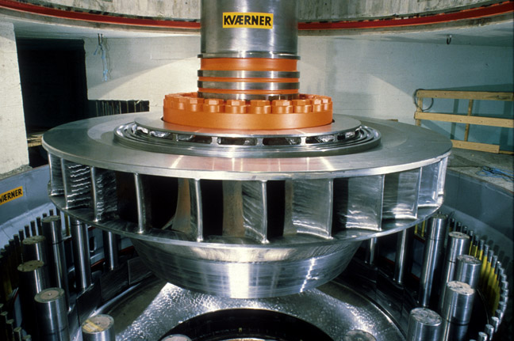
Outline
The «Norwegian tradition»
Open questions

Slide 3
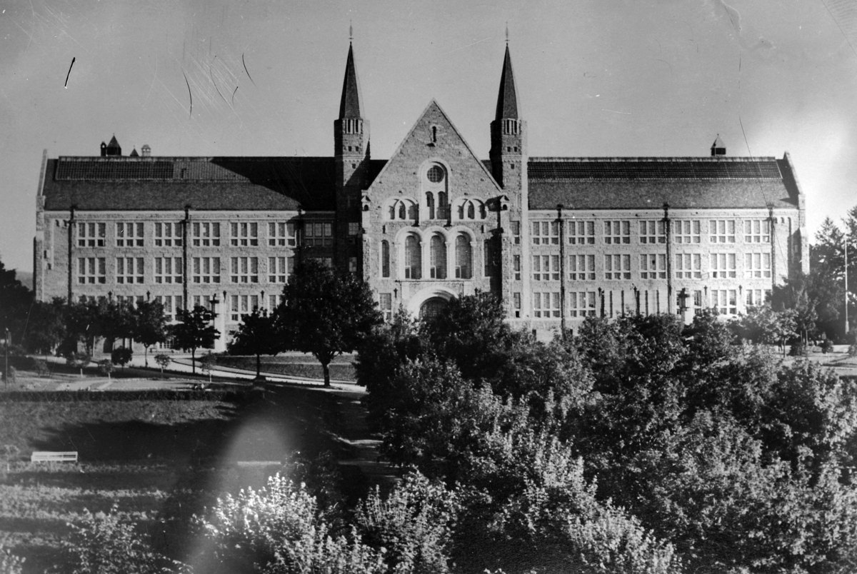
A small detour
1905 Independence
1906 Temporary licencing law (“the panic law”)
1910 NTH established

Slide 4
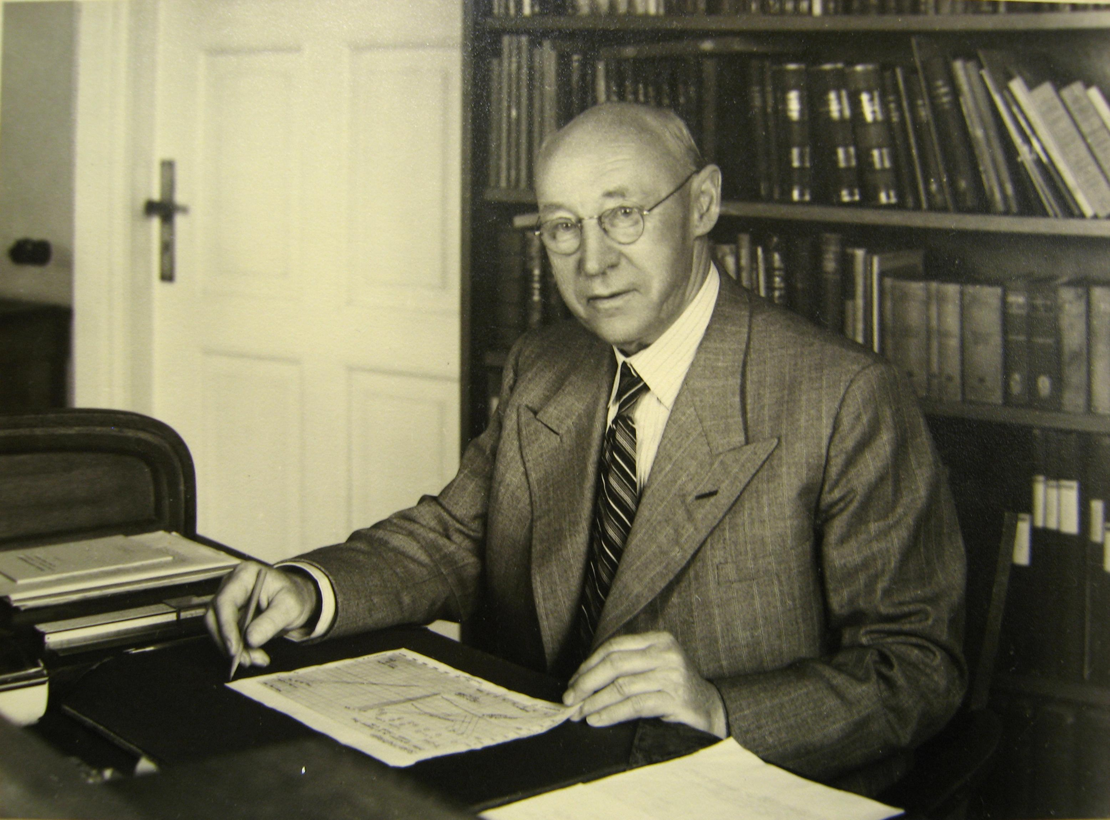
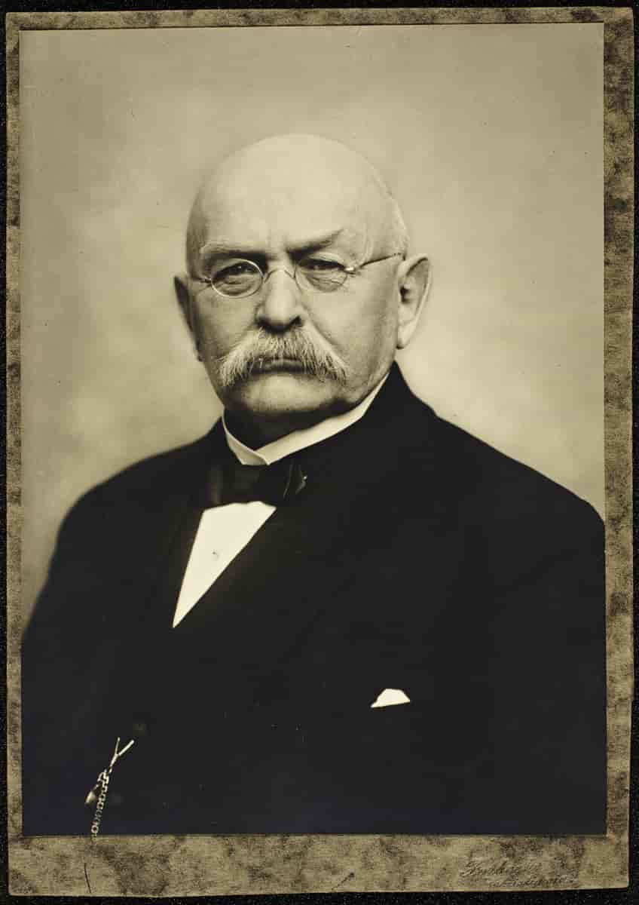
Two key players
Prof Gudmund Sundby
PM Gunnar Knudsen

Slide 5
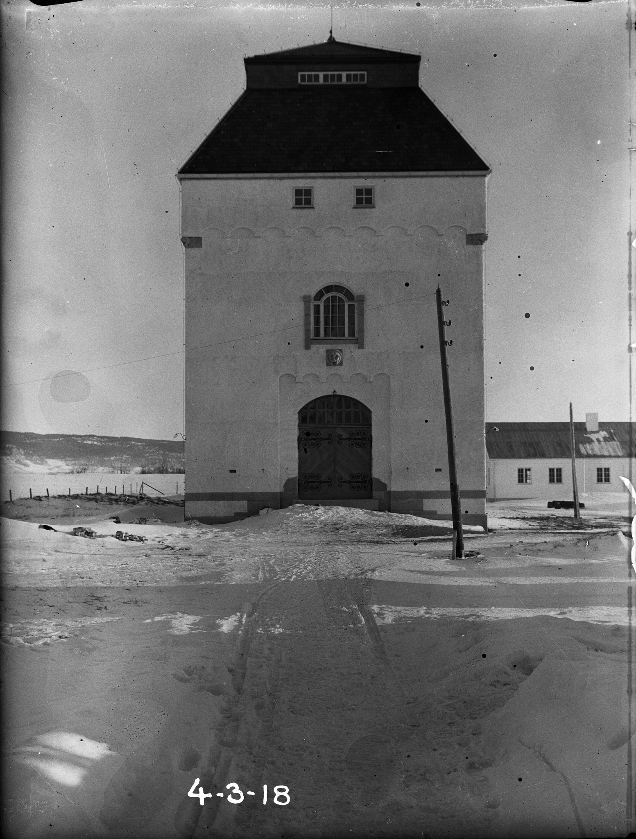
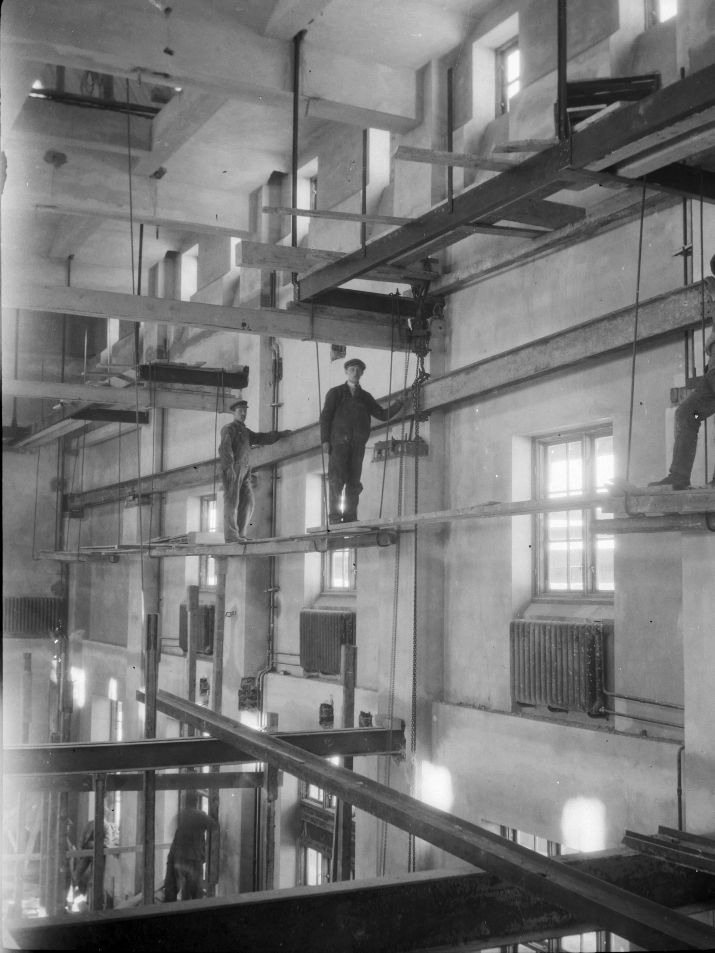
1917 Hydropower laboratory finished

Slide 6
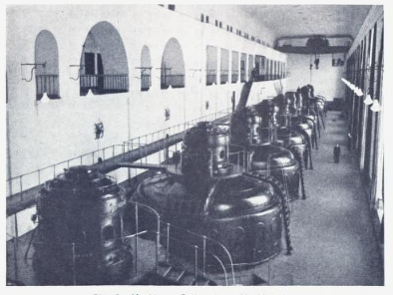
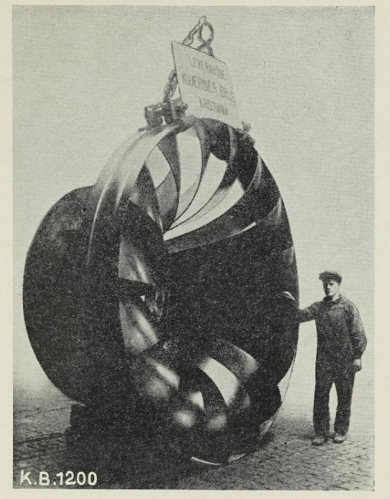
Solbergfoss hydro power plant
Notes:
Mariana Mazzucato

Slide 7
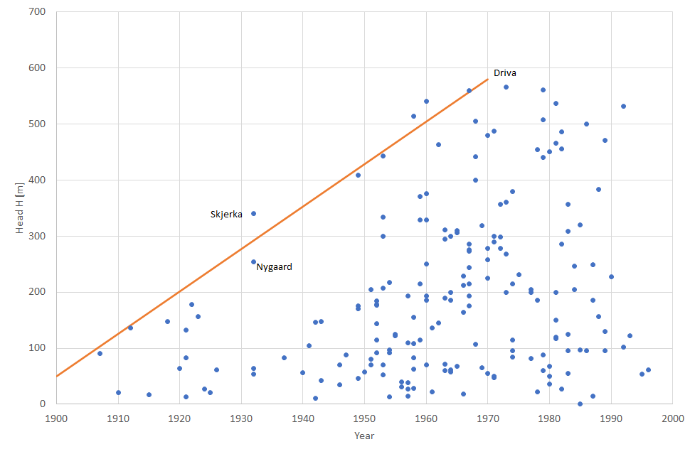
High head Francis turbines

Slide 8
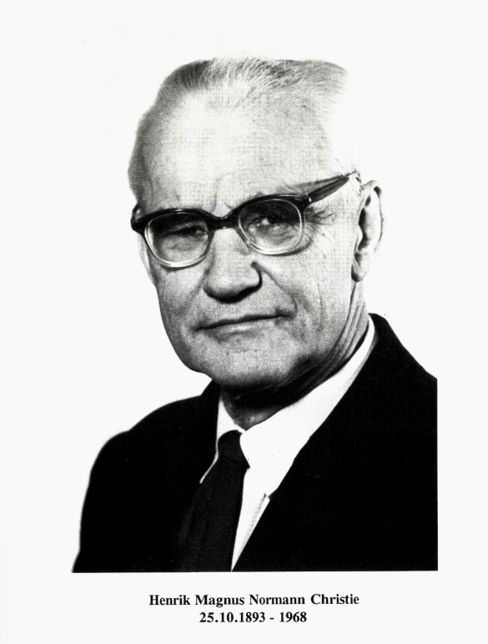
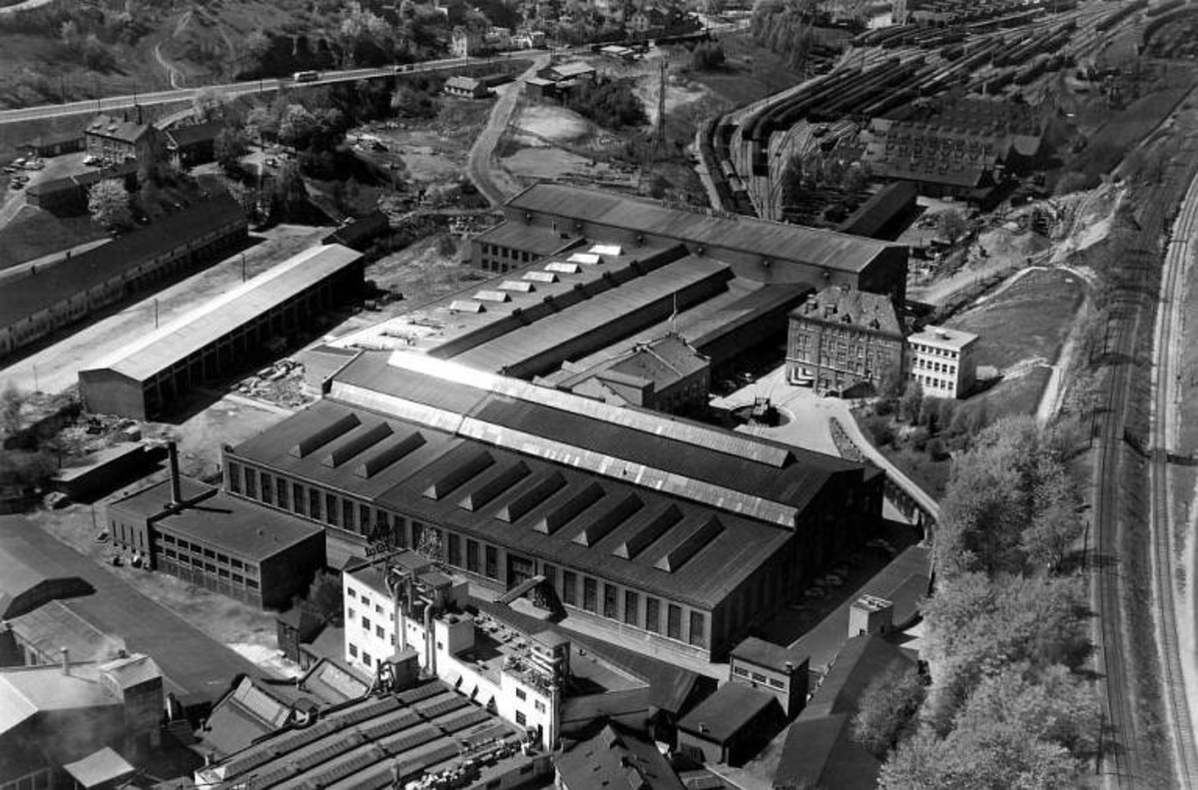
The Norwegian tradition
Oslo byarkiv: image no. A-20027/Ua/0011/136, via digitaltmuseum.no.

Slide 9
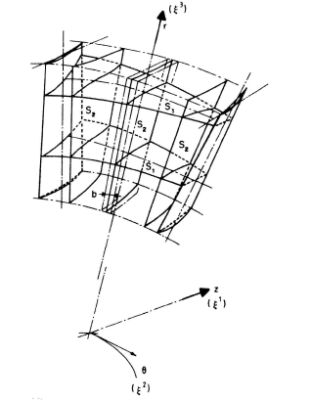
Computational method

Slide 10
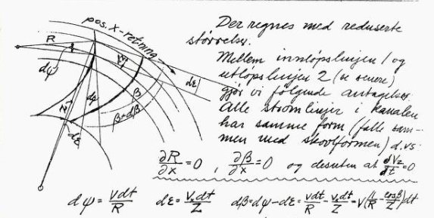
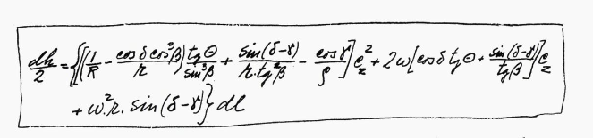
Graphical integration of flow equations

Slide 11
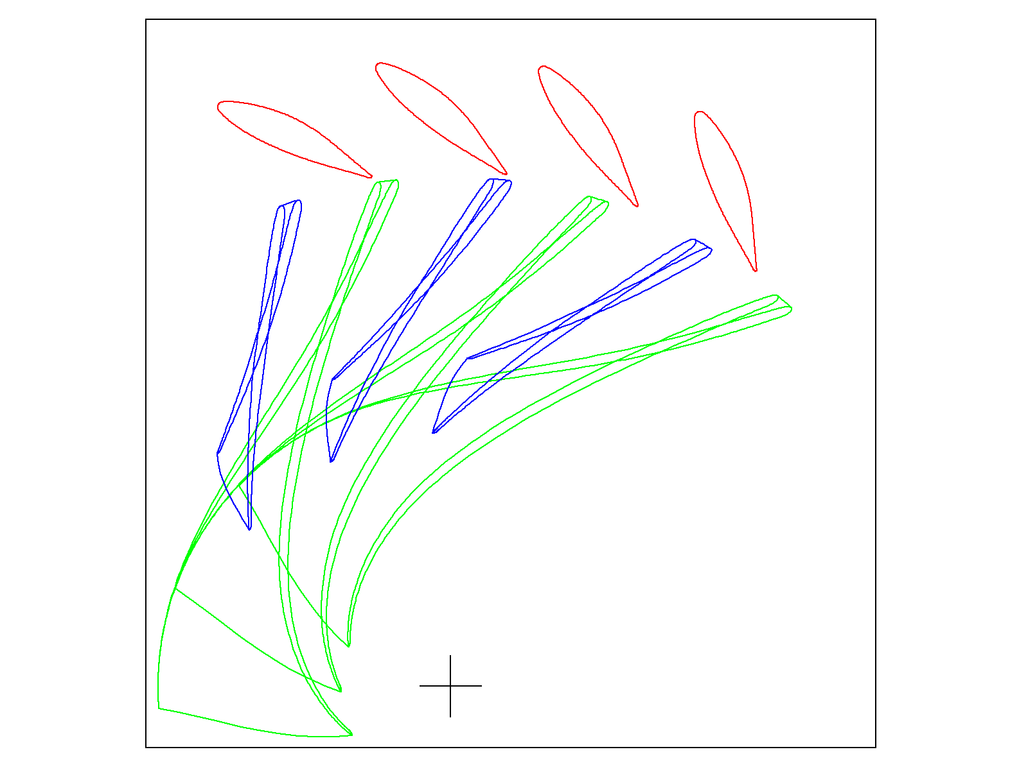
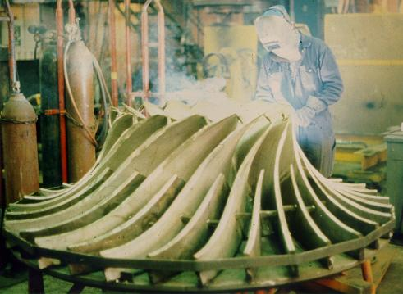
Splitter blades

Slide 12
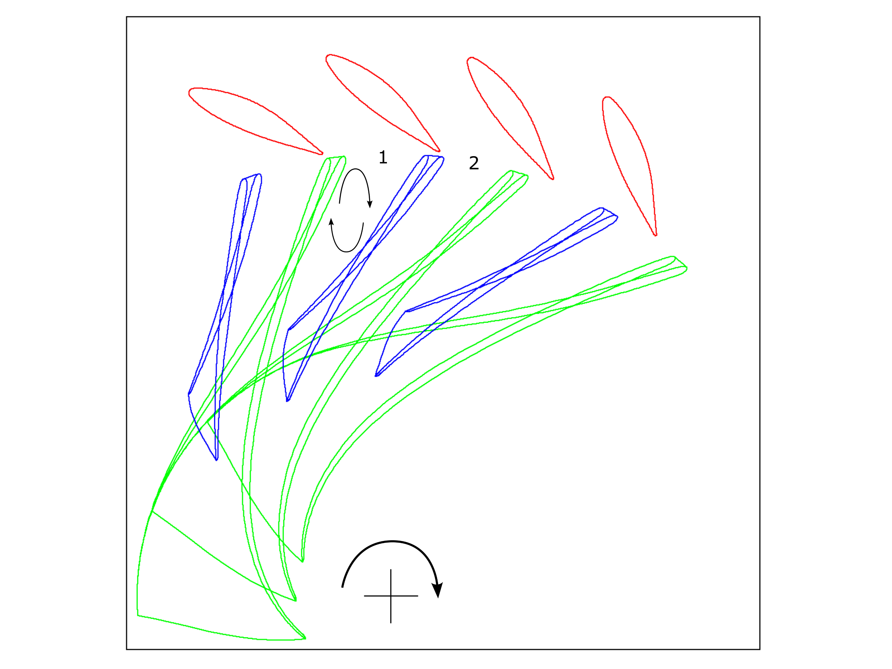
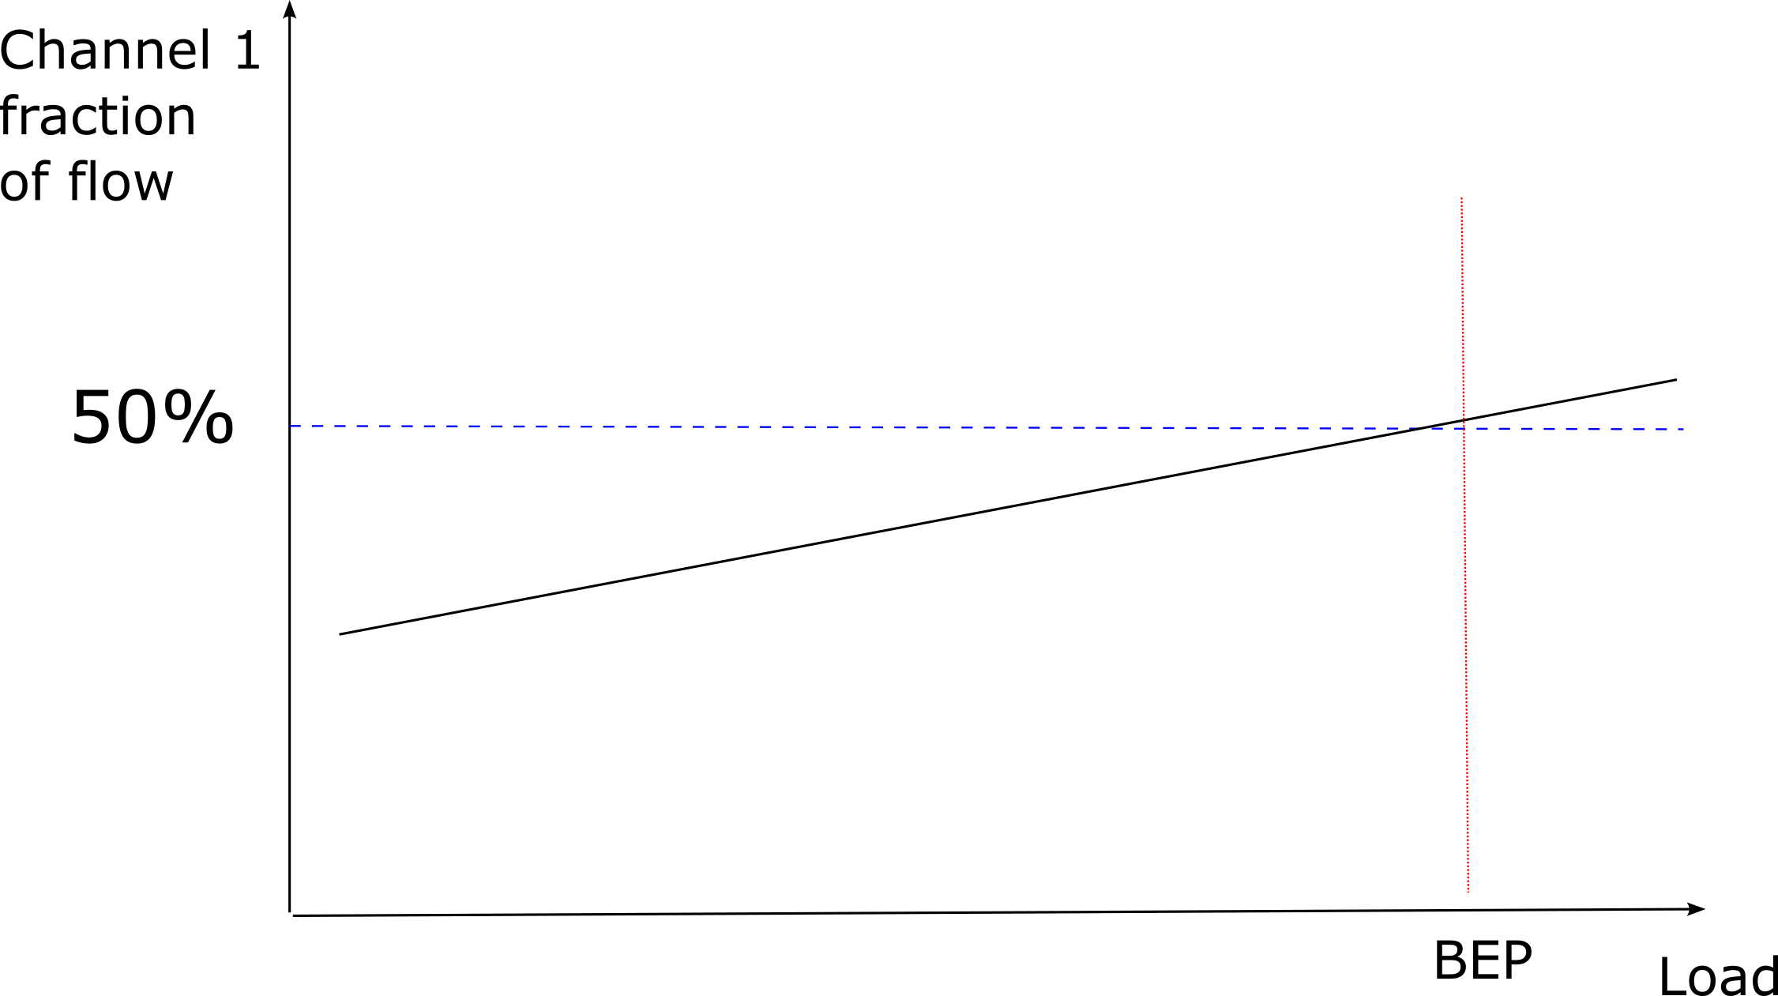
Splitter blades

Slide 13
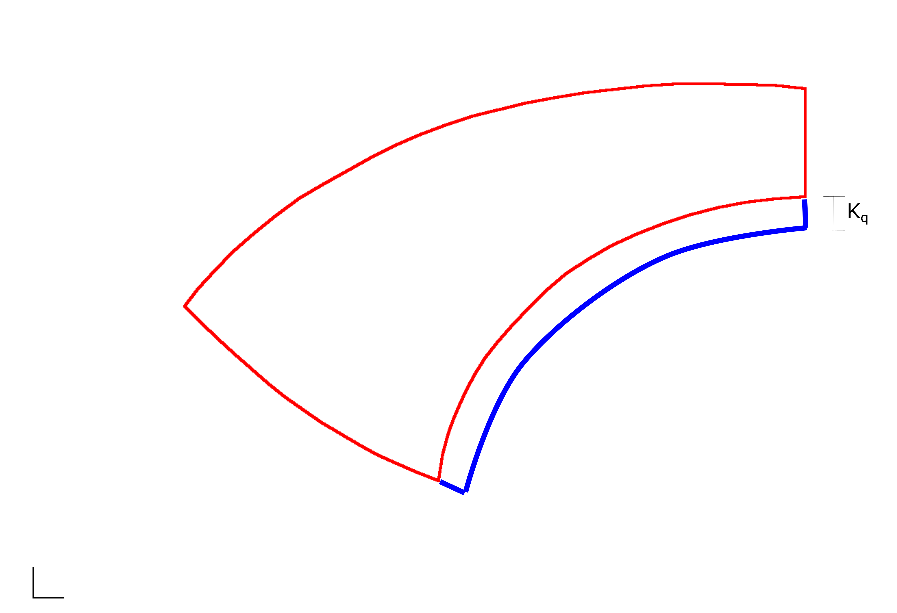
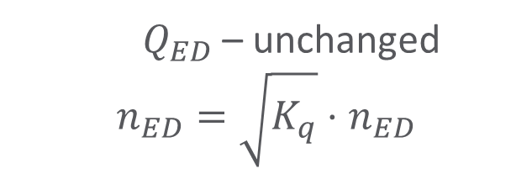
Water path scaling
$Q_{ED}$ – unchanged
$$n_{ED}=\sqrt{K_{q}}⋅n_{ED}$$

Slide 14
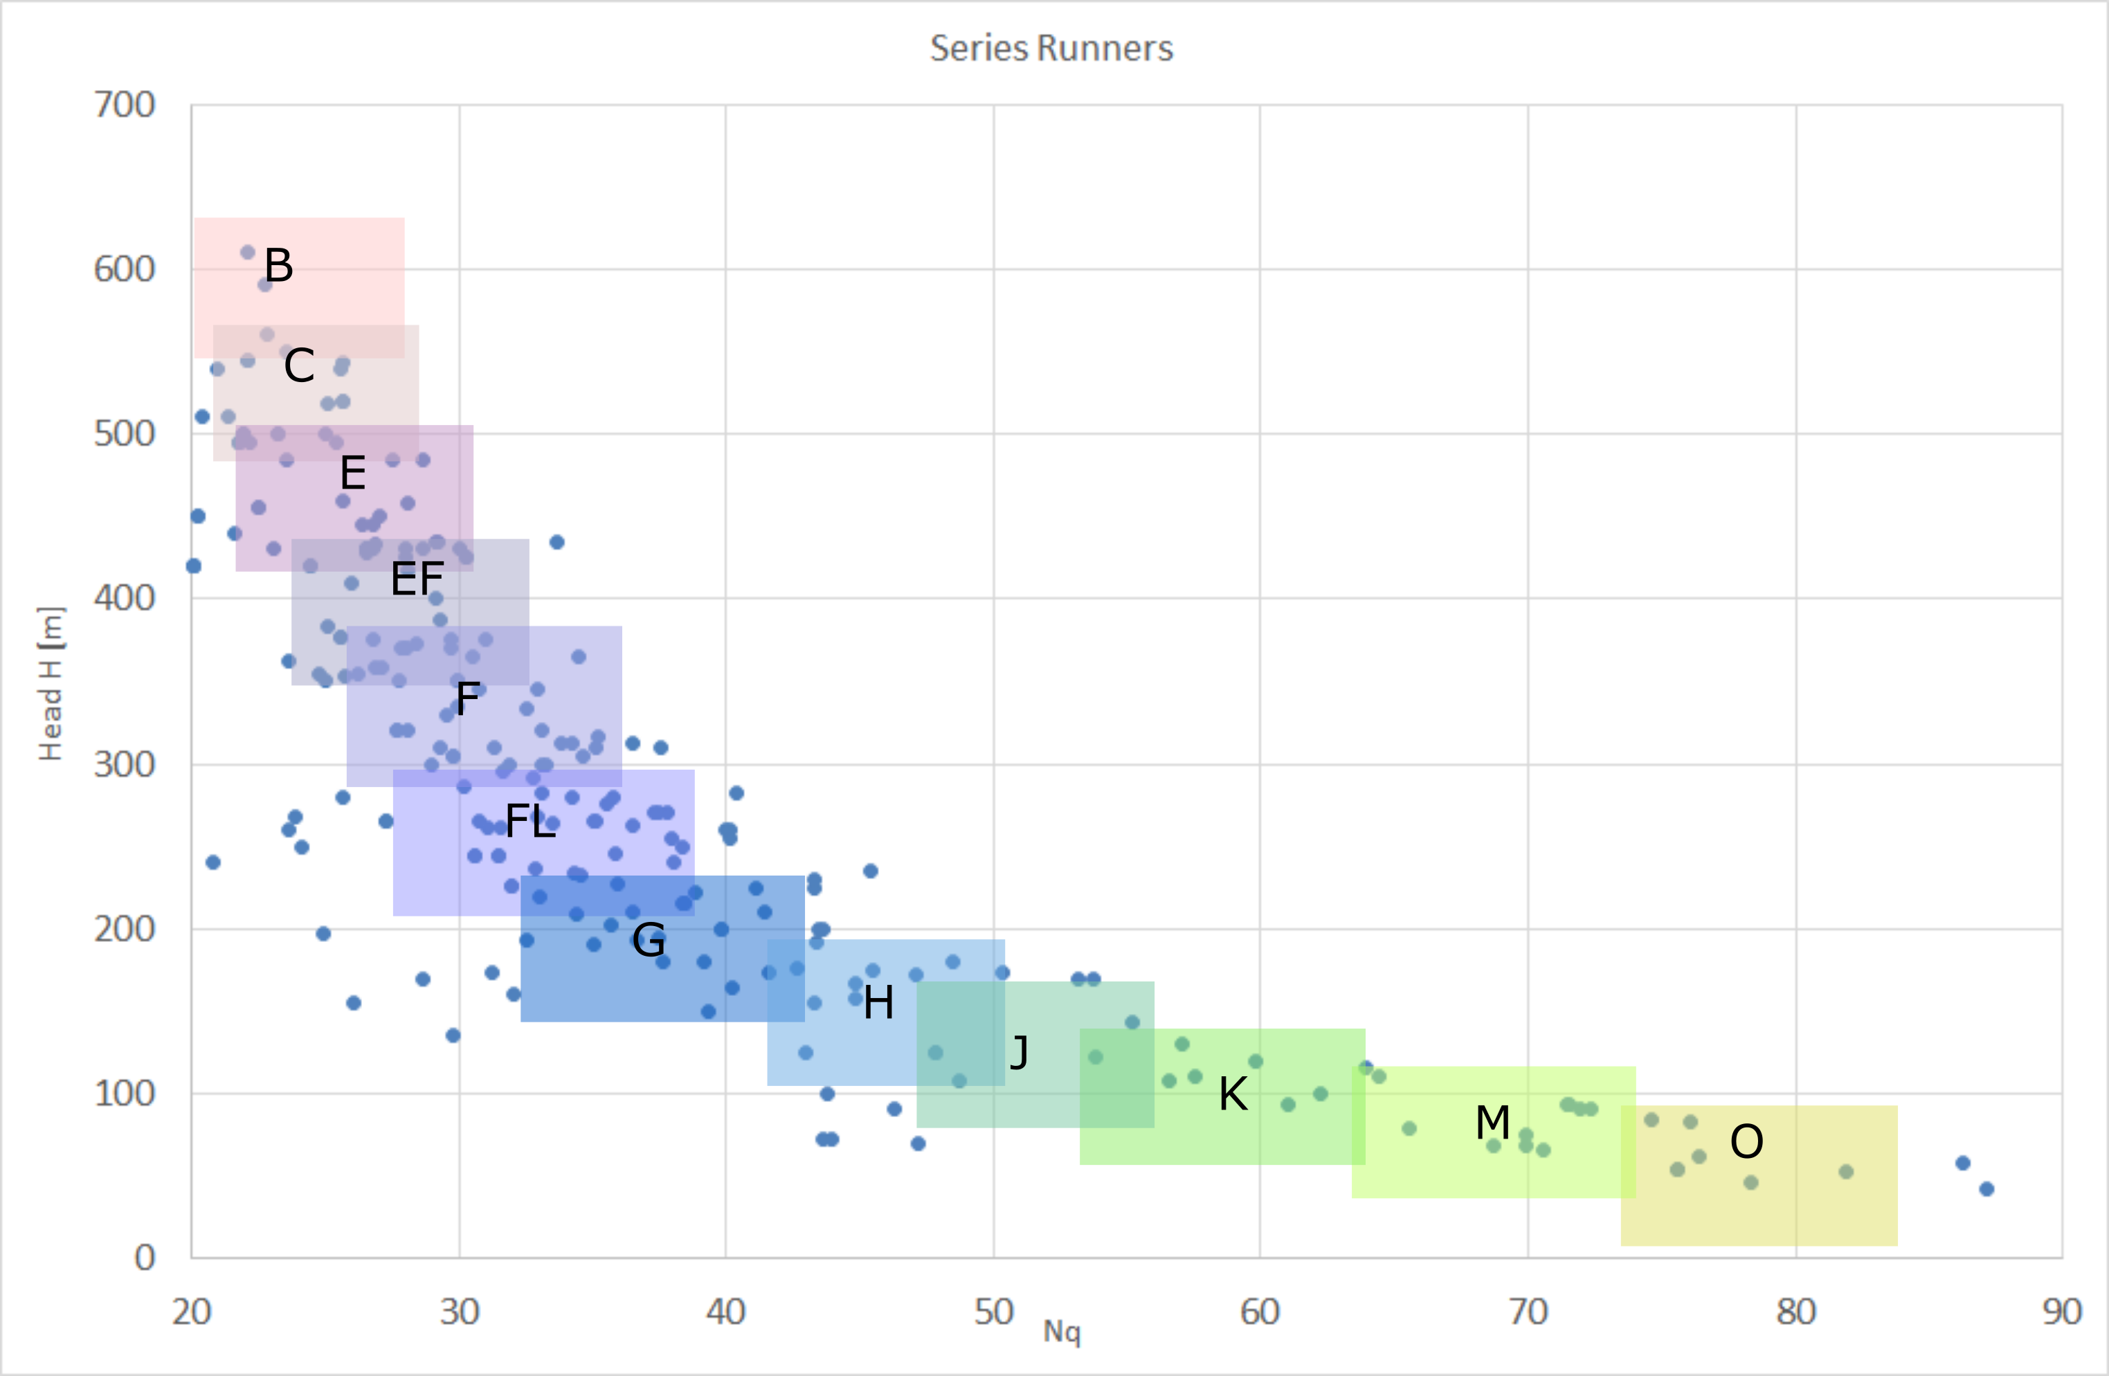
Series runner

Slide 15
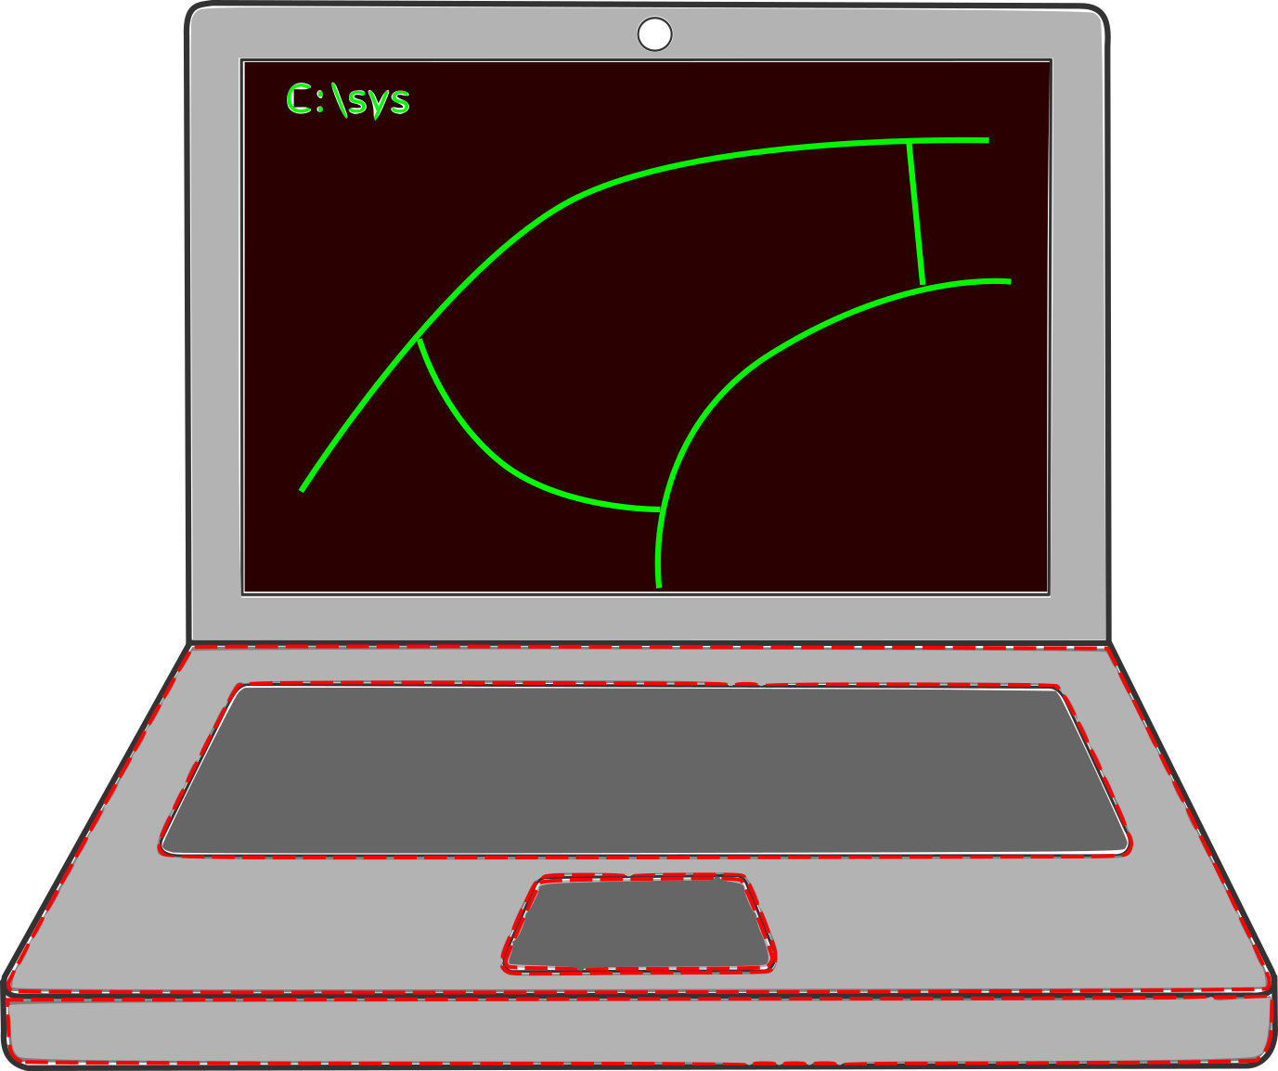
HP CAD / VK DAK

Slide 16
Slutt – episode 1

Slide 17
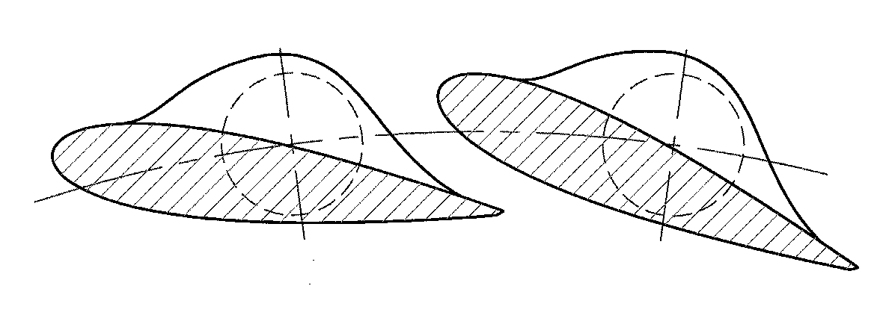
Off-set guide vanes

Slide 18
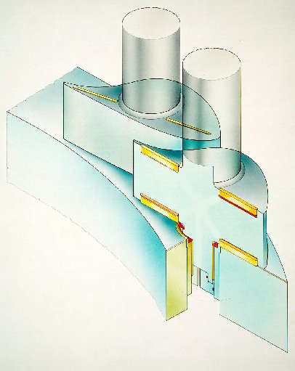
Guide vane end seals

Slide 19
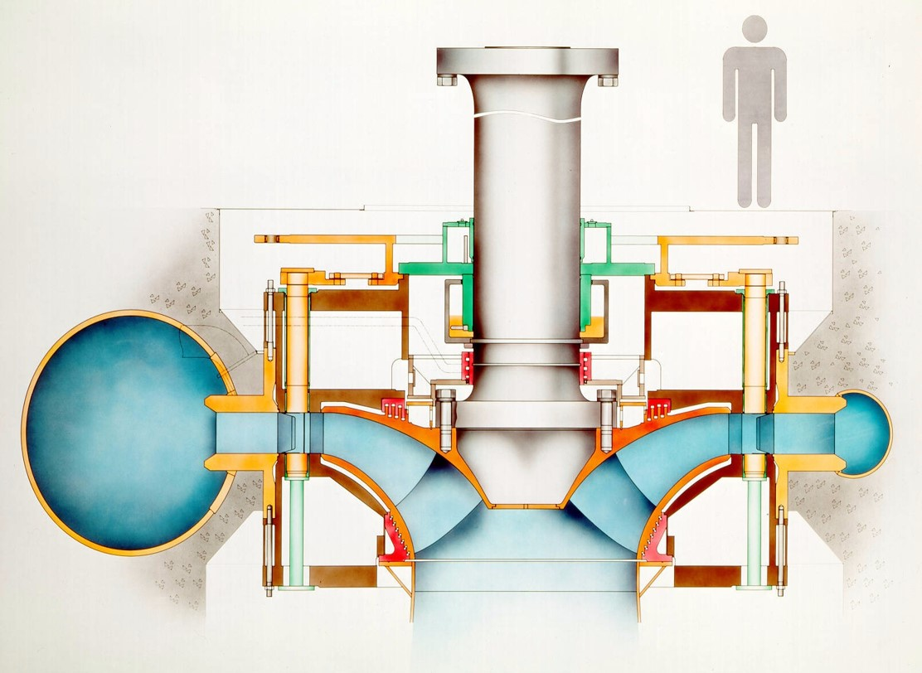
Pre-stressed covers

Slide 20
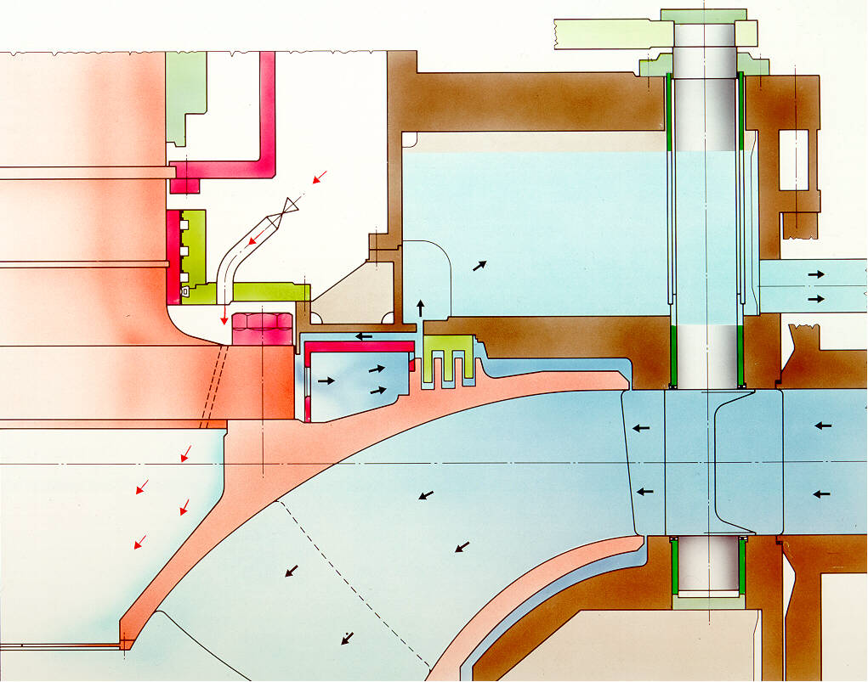
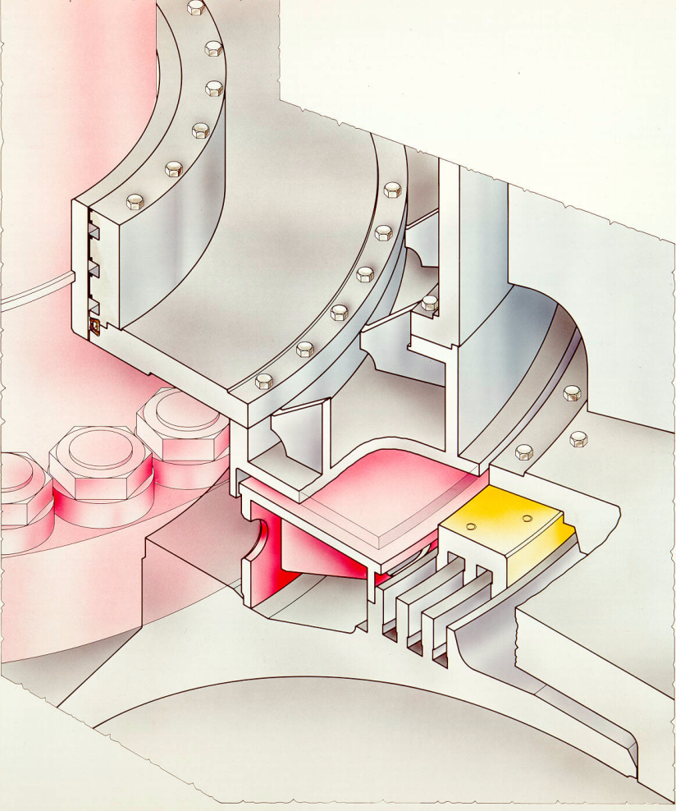
Pumping plates & non-contact shaft seal

Slide 21
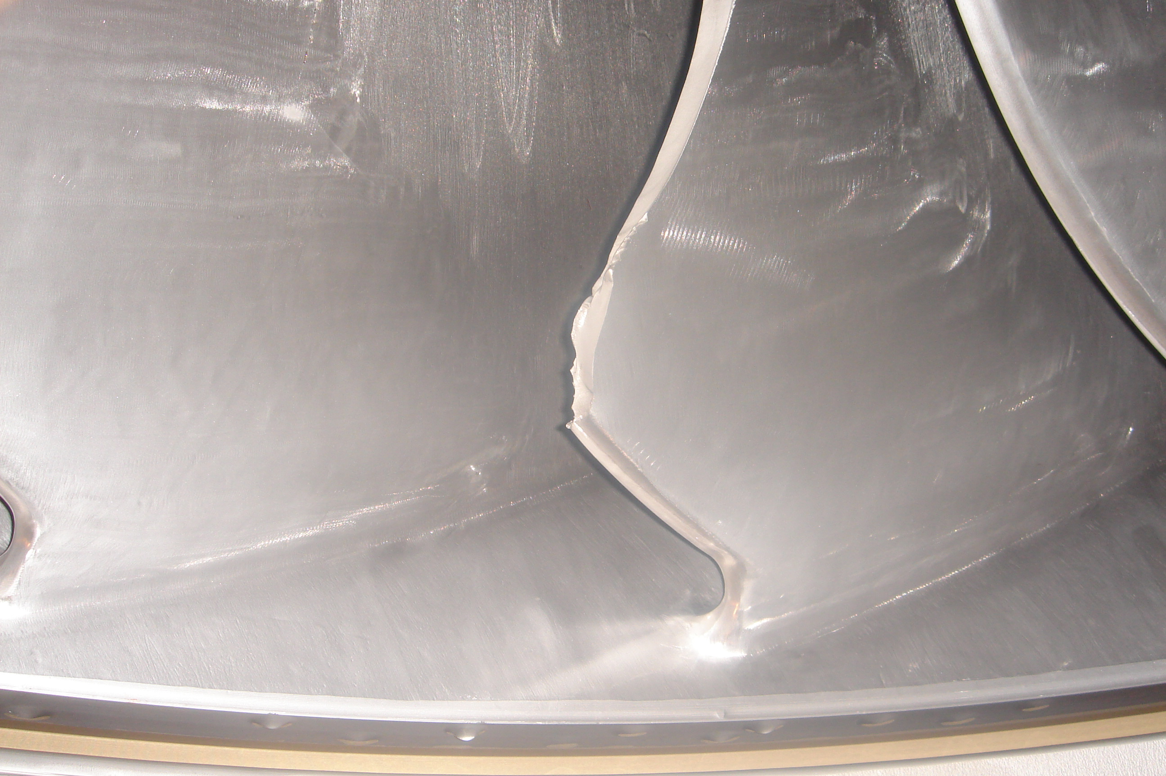
Open questions

Slide 22
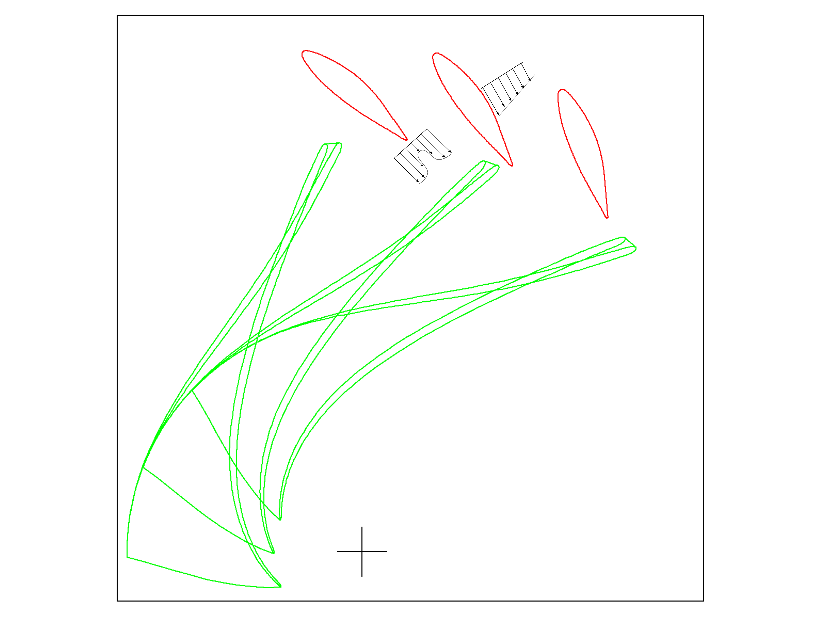
RSI – potential effect vs viscous wake

Slide 23
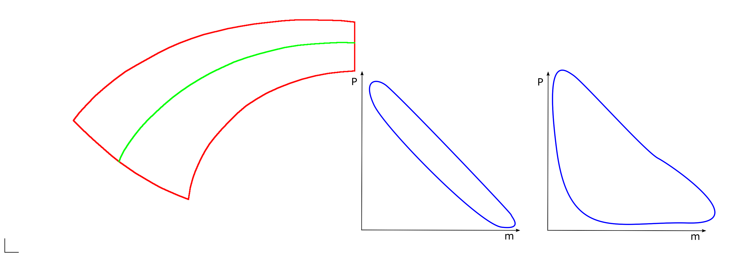
RSI – importance of blade profile

Slide 24
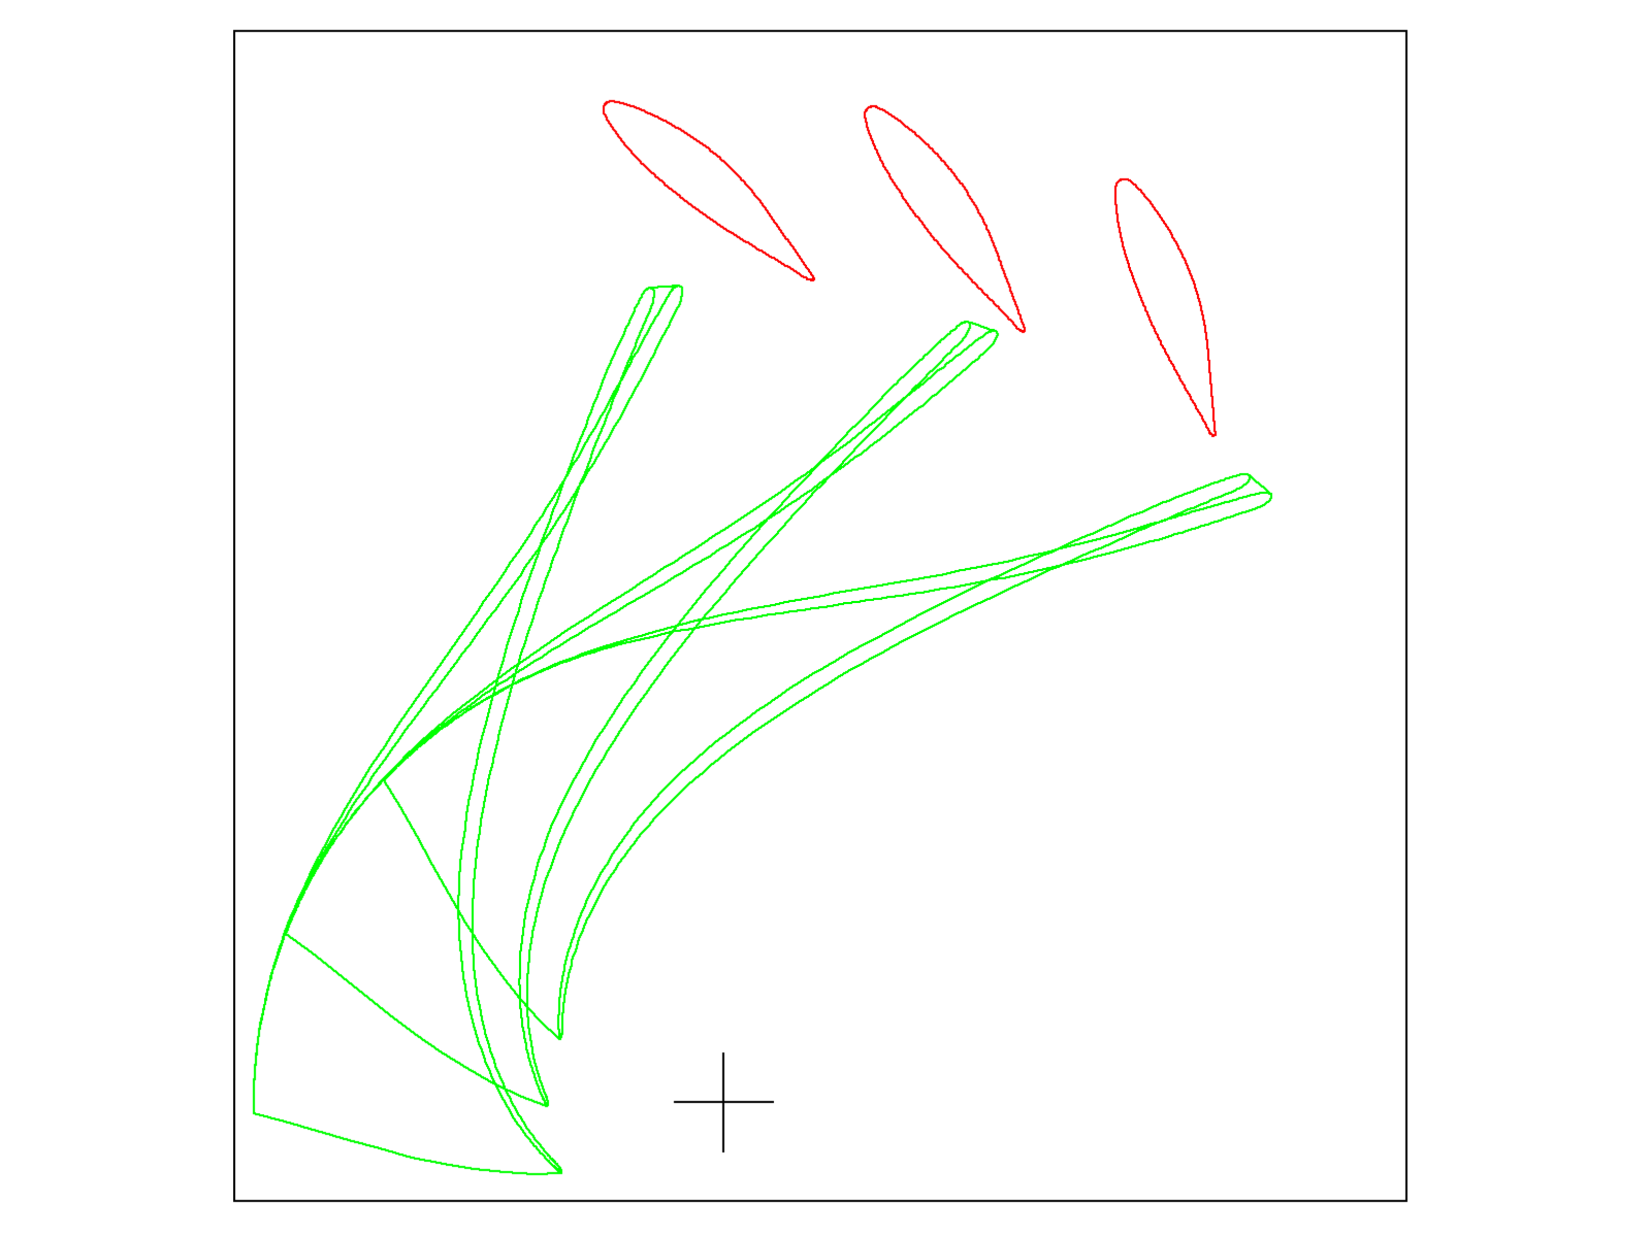
RSI – resonance mechanisms
Standing acoustic wave in rotor/stator void
Phase relation ship between unsteady guide vane and runner flow
Couple fluid and structure modes

Slide 25
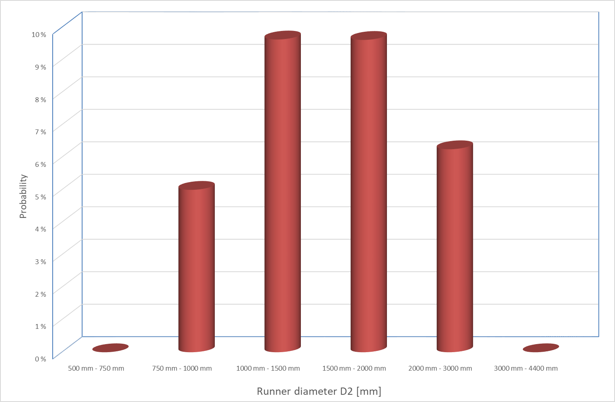
RSI – question of size

Slide 26

Splitter blades vs single blades

Slide 27

Spiral casing vs guide vanes

Slide 28
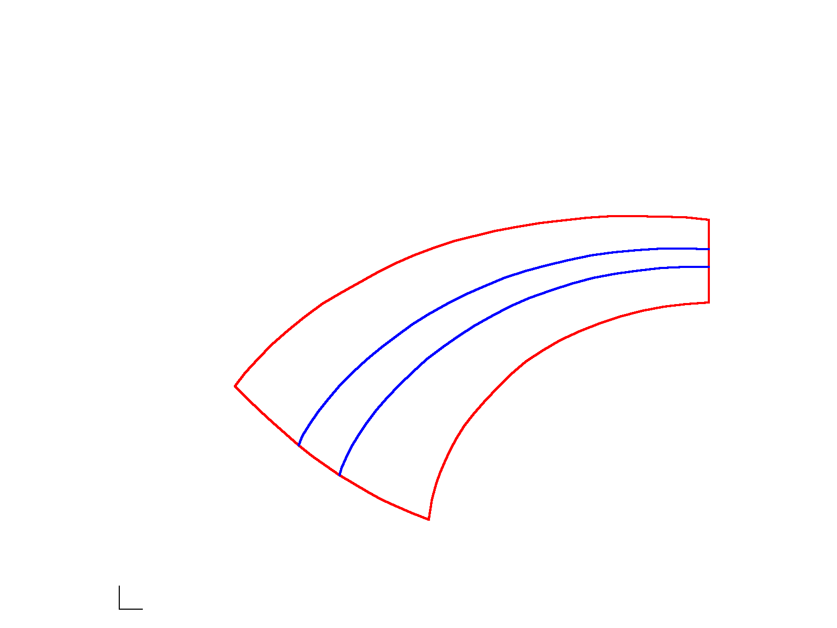
RVR – importance of energy distribution

Slide 29
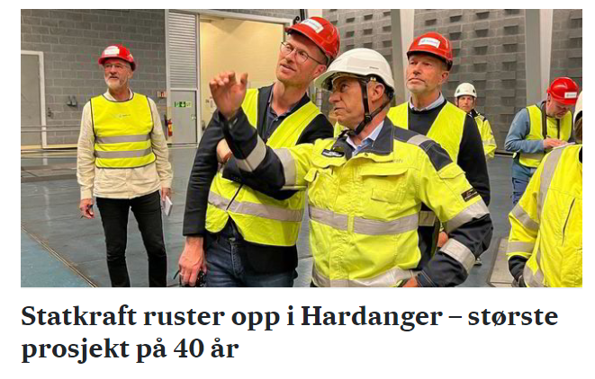
Conclusion
Statkraft uprating in Hardanger – largest project in 40 years. Increasing from 250 MW to 880 MW

