Slide 1





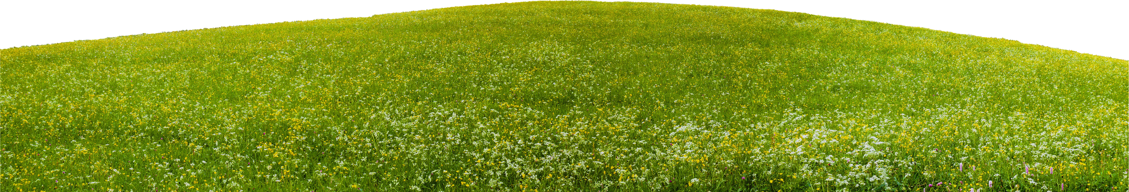
CS102 Project - G1 T3
Presented By: Fang Kaicong, Nicholas Boey, William Hansel, Kayra Zalfa, Su Myat Myat Htay, Gabriel Tan
ByteGrade: AutoGrader
Why you should use this for every Java assessment
1
Notes:
Good morning everyone, today we're here to present BYTEGRADE: our Java AutoGrader, and why you should use this to grade every Java assessment

Slide 2
01
Overview & Architecture
02
GUI & Core Features
03
Bonus Features
Overview
04
Demo
05
Parallel Grading
06
Limitations
2
Notes:
today, we'll go through overview of our proejct, features, and a demo.

Slide 3

ByteGrade Results
Parallel Speed
Robustness
Automation
Automation
1 click
2m 30s
Run never crashes
Handles
100 students, 8 workers
Compile errors
Zip files in, marks out, and you will get:
Infinity loops
Report
7m 07s
Messy submissions
Feedback
eLearn CSV
100 students, 1 worker
3
Notes:
We're proud to share the results of ByteGrade. It graded 100 students, a whole cohort, in 2 and a half minutes with 8 workers, against 7 minutes with 1 worker.
We made sure ByteGrade is robust: our run never crashes, and handles compile errors, infinite loops, and messy submissions elegantly.
We also strive for automation: just 1 click and you get a report, the eLearn CSV, and feedback per student ready to share.

Slide 4



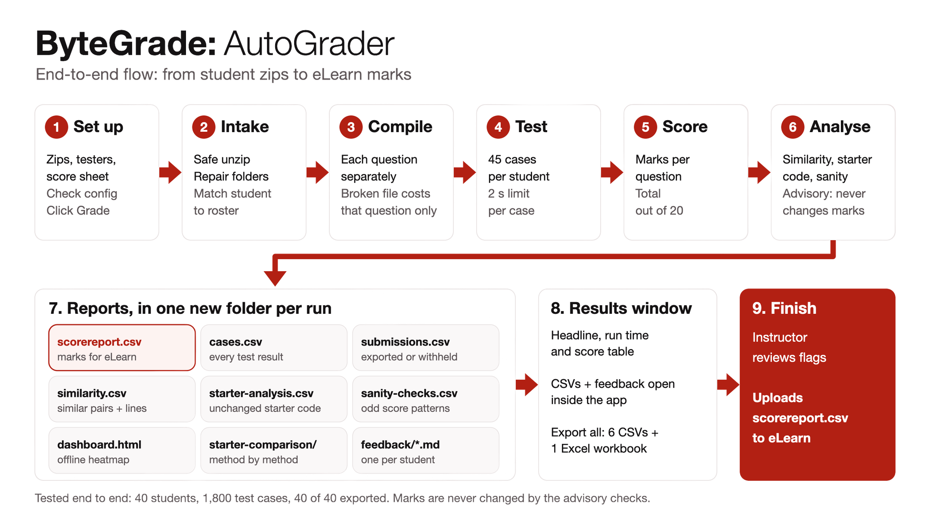
Tech stack
Frontend
Backend/Algo
Userflow
4
Notes:
Our backend and grading logic are pure Java, with a Swing desktop app as the frontend, and JavaScript for the offline HTML reports.
Our userflow is simple to make it as seamless as possible. The instructor adds the zips and score sheet, then clicks Grade. ByteGrade checks each student's identity, compiles each question separately, and runs 45 tests per student with a two-second limit per case. It scores out of 20, then flags similarity and other issues without changing marks. Everything goes into one folder, ready to review and upload to eLearn.

Slide 5
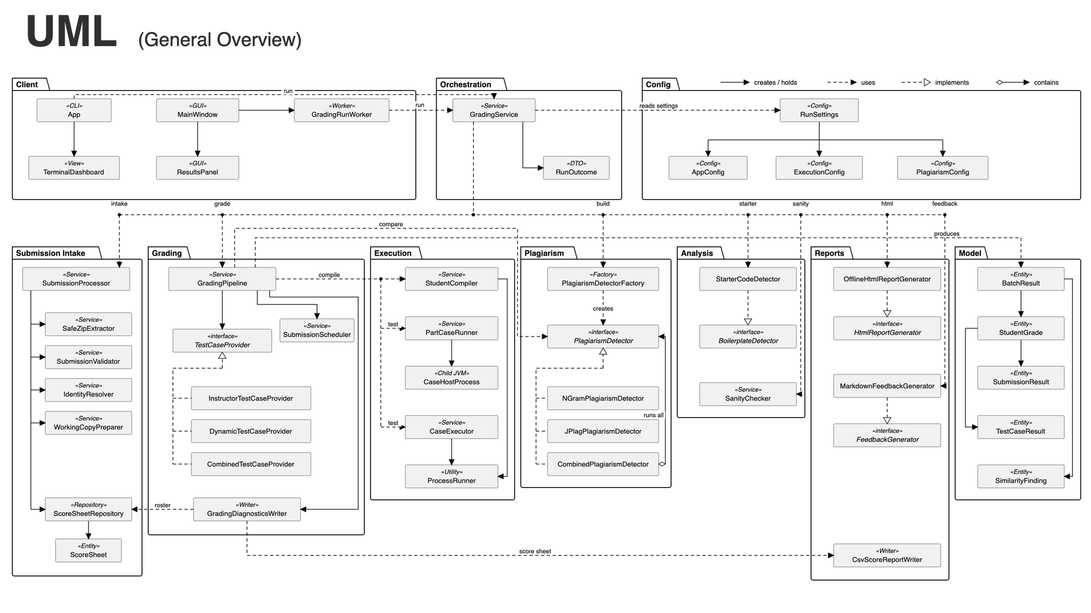
System Architecture (UML General Overview)
5
Notes:
This is a large project, so this UML is only a high-level overview. We'll go through each feature's design in more detail as we cover them.

Slide 6




One open-source library, chosen over two alternatives
Dependencies
Why JPlag
The rest is the JDK
JPlag 4.3.0 (GPL-3.0): similarity detection.
slf4j-nop 2.0.7: silences JPlag’s logging.
JUnit 5.11.4: 359 automated tests (test only).
Offline: runs on the instructor’s machine; an academic standard.
MOSS: uploads code to an external server.
Dolos: needs a separate install.
Swing for the GUI.
javac via ToolProvider.
Processes for running code.
Build: Maven Wrapper.
6

Slide 7
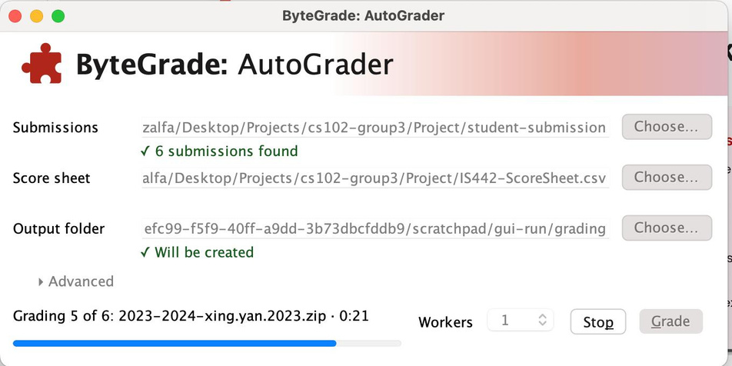
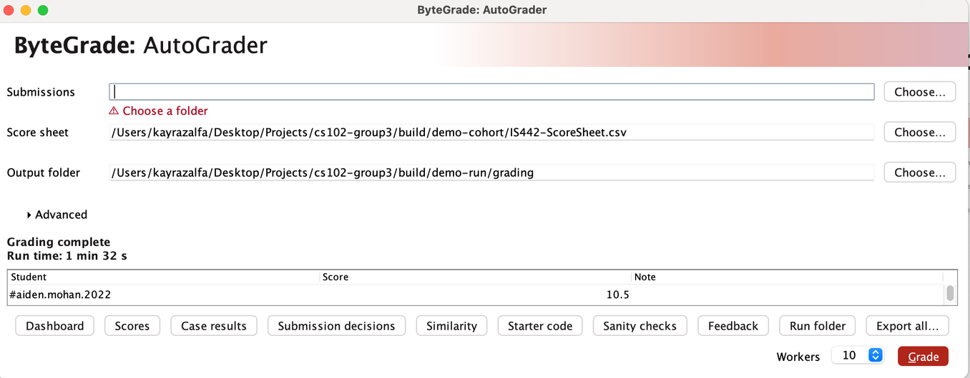
The instructor runs everything from one window
  Pick the folders (config file under Advanced) and the worker count, then press Grade.
  Live progress and a run timer.
  A results table with scores and flags.
  CSV reports and feedback open inside the window; the HTML dashboard opens in the browser.
In the window
7

Slide 8
Every core requirement in the brief is met
Requirement
How it is met
Batch grading
: One click or one command grades every zip.
Validate structure and naming
: Intake checks folders, files and header names against the roster.
Anomalies never stop the run
: A broken submission costs only its own marks.
Auto-correct
: Extra wrapper folders unwrapped; blank name and email headers filled from the roster; mismatched names flagged, never overwritten.
Time limits
: Each case stopped after 2 s; compile stopped after 15 s.
Scores
: Per question and per student, out of 20.
CSV export
: scorereport.csv in the provided eLearn format.
OOP, one job per class
: 199 types in 22 packages.
UI
: GUI, terminal dashboard and console show progress, errors and results.
8

Slide 9
Features
General Features
Bonus Features (Unique Selling Points)
  GUI, Terminal, Offline HTML
  Batch grading of every zip
  eLearn CSV export
  Error handling for messy submissions
  Offline HTML dashboard
  Starter code comparison
  Hard-coding resistant grading
  Similarity report
  Student feedback
  Terminal dashboard
  Parallel grading
Output: GUI (Swing) + Terminal → CSV, Offline HTML
9
Notes:
Here's everything we built. The core grader marks every zip in one run, with a GUI and the eLearn CSV export.
On top of that, we built seven bonus features. We'll present them in this order: the offline HTML dashboard, starter code comparison, hard-coding resistant grading, the similarity report, student feedback, the terminal dashboard, and finally parallel grading, which gives the biggest speed-up.
Instructors can see results in the GUI, in the terminal, or in the offline HTML dashboard.

Slide 10


Boey: Offline HTML dashboard
Offline HTML dashboard and sanity checks
What it does
Why it matters
  One dashboard.html per run; it works offline.
  Per-question score cells are shaded by credit.
  Click a score to jump to its test evidence.
  Search, filter and sort students.
  Five sanity checks flag abnormal cohort results without changing marks, for example 90% of students scoring zero on a question, clustered timeouts, or every submission failing to compile. They need at least 5 graded students.
  The instructor reviews a whole cohort in one page.
  Abnormal results are caught before marks go to eLearn.
10

Slide 11
Sera: Starter code comparison
Starter Code Comparison
An evidence-based way to see what the students changed from the starter project
What it does
Why it matters
• Compares submitted Java files against starter code.
• Flags unchanged or minimally edited files.
• Identifies unchanged, modified, added and removed methods.
• Exports CSV findings and a navigable offline HTML report.
• Raw file diffs overreact to whitespace and comments.
• Manual method-by-method checks are slow.
• Reviewers need explainable evidence, not just a similarity score.
• Warnings are advisory: student grades are not automatically reduced.
11
Notes:
I'll be presenting our third feature, Starter Code Comparison.
This feature compares students' Java submissions against the original starter code to identify how much they've actually changed.
The problem with traditional file comparison is that even whitespace and comments can make two files appear different. Manually checking each method is also time-consuming.
Our solution detects unchanged or minimally edited files, while also identifying methods that are added, removed, modified or unchanged.
It then generates CSV findings and an offline HTML report, giving lecturers clear evidence for review.
Importantly, these findings are only advisory and never automatically affect students' grades.

Slide 12
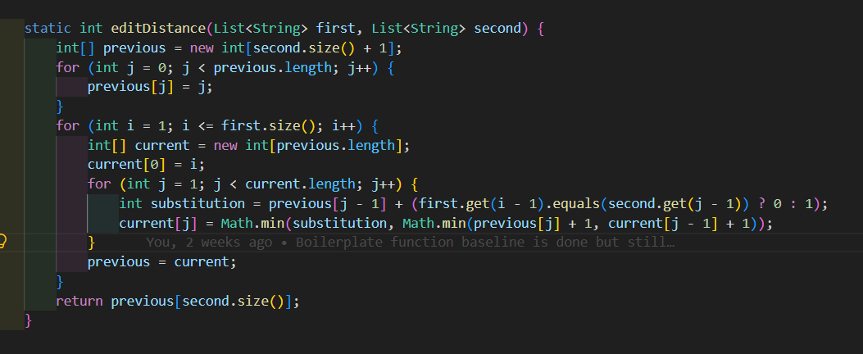
Sera: Starter code comparison
Whole-File Similarity Detection
Compare meaningful Java tokens instead of raw characters.
Implementation Steps
  Read starter and student sources safely.
  Tokenise Java, ignoring whitespace and comments.
  Compute Levenshtein token edit distance.
  Normalise by the longer token sequence
  Emit UNCHANGED_STARTER or MINIMAL_STARTER_CHANGES if appropriate
Default Threshold
98% similarity for minimal-change warnings; exact token match means unchanged.
12
Notes:
Now, let's look at the algorithm behind this feature.
First, we safely read the starter code and the student's submission, then tokenise both Java files, ignoring whitespace and comments.
Next, we use Levenshtein distance to calculate the minimum number of token insertions, deletions or substitutions required to transform one file into another.
We normalise this distance using the longer token sequence to obtain a similarity percentage.
If the tokens match exactly, the file is flagged as unchanged. Otherwise, if similarity reaches our default threshold of 98 percent, it's flagged as minimally modified.
Overall, this makes starter-code reviews faster, more consistent and explainable.

Slide 13
William: Hard-coding resistant grading
Hard-coding resistant grading
Adds seeded, question-specific test inputs alongside the instructor’s fixed tests to catch solutions hard-coded to known examples.
What it does
Why it matters
Runs the instructor’s fixed test cases and dynamically generated ones
Increase robustness by generating random seeded new inputs
BEFORE
AFTER
VALUE to BYTEGRADE
Grading used only the instructor’s fixed test cases
Adds seeded, question-specific test inputs alongside the fixed cases.
Broader input coverage makes hard-coded solutions less likely to pass
13

Slide 14
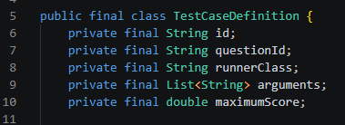
William: Hard-coding resistant grading
We create a list of test cases (both fixed and dynamic).
For each submission, the pipeline processes each question, then runs that question’s fixed and dynamic cases.
Fixed Test Case is an instance of a TestCaseDefinition. It is based on the instructor provided test case adapted to fit our system. Each question has a corresponding Adapter file. The argument specifies which input set to use.
Fixed Test Case
Q1aAdapter
TestCaseDefinition
id: “Q1a-1”
questionId: “Q1a”
runnerClass: “Q1aAdapter”
arguments: [“1”]
maximumScore: 0.375
-id: String
-questionId: String
-runnerClass: String
-arguments: List<String>
-maximumScore: double
+main(args: String[]) : : void
-evaluate(testCase: int)::String
DynamicRunner
+getId():: String
+getQuestionId():: String
+getRunnerClass():: String
+getArguments():: List<String>
+getMaximumScore():: double
Dynamic Test Case
-TRIALS: int
...
id: “Q1a-dynamic-1”
questionId: “Q1a”
runnerClass: “DynamicRunner”
arguments: [“Q1a”, “265443571]
maximumScore: 0.375
-main()
-trialQ1a(random) : : String
-trialQ1b(random) : : String
-trialQ2a(random) : : String
-trialQ2b(random) : : String
-trialQ3(random) : : String
...
Dynamic Test Case is an instance of a TestCaseDefinition. All questions uses the DynamicRunner class. Based on the seed in the argument to dynamically generate input sets
14

Slide 15
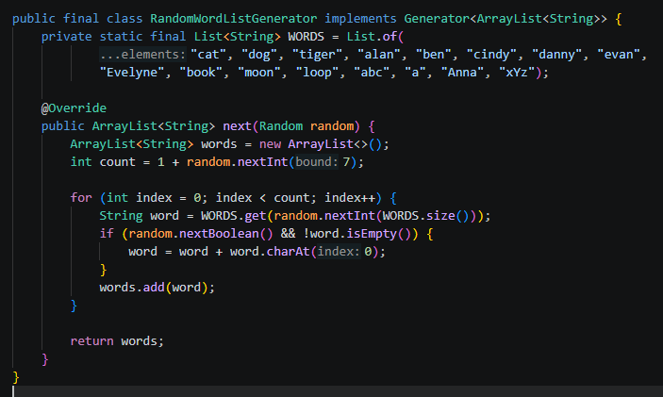
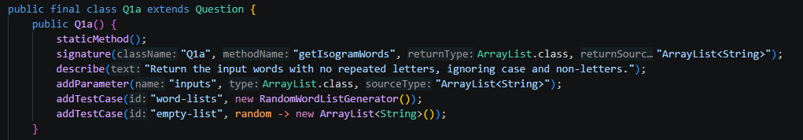
William: Bonus Feature hard-coding resistant grading alternative
Question Object system
Specify it once, and we’ll handle the rest
<<record>>
Parameter
<<abstract>> Question
+name: String
+type: Class
+sourceType: String
- className: String
- methodName: String
- returnType: Class<?>
- parameters: List<Parameter>
- testCases: List<RandomTestCase>
...
<<record>>
RandomTestCase
+ answerKey(arguments: List<Object>): Object
....
+id: String
+generators: List
<<interface>>
Generator
+next(random) : : T
15

Slide 16
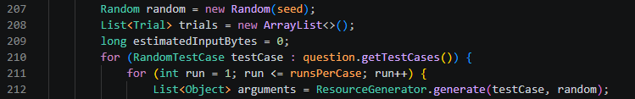
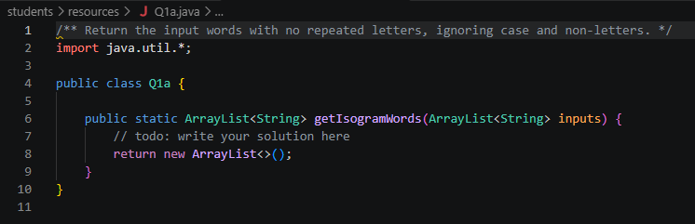
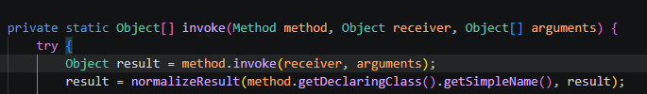
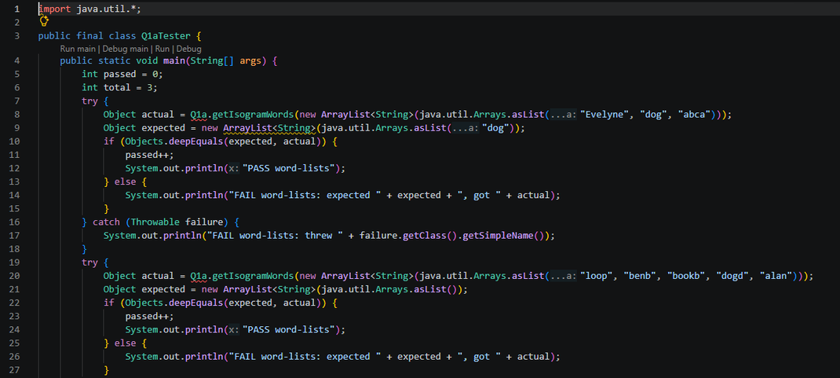
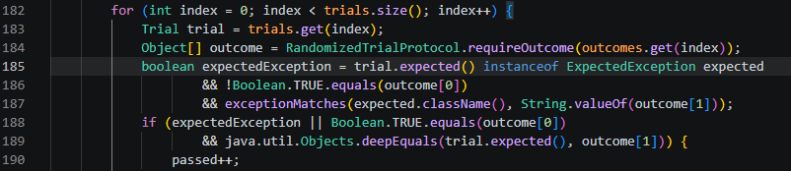
Grade a Student’s Question
Generate Student Resources
1. Generate seeded inputs
Use the same question definition to create a code stub, tester with example cases, and any required support files for the instructor to distribute to the students
2. Calculate expected answers
students\resources\Q1a.java
3. Run the student’s method
students\resources\Q1aTester.java
4. Compare the results
A Trial is one specific test run, holding its generated input and the expected answer for comparison with the student’s output.
16
Notes:
For screenshots, open these files at the listed lines:
1. Generate inputs: [RandomizedGrader.java (line 245)]
2. Calculate expected answer: [Q1a.java (line 26)]
3. Run the student’s method: [RandomizedStudentRunner.java (line 102)]
4. Compare results: [RandomizedGrader.java (line 211)].
java -jar target/auto-grading-system-1.0-SNAPSHOT.jar --randomized-resources Q1a config.properties

Slide 17


Kayra: Similarity report
Library | Advantages | Disadvantages
JPlag | Runs locally Industry standard | Distribution license Short answer mis-match
MOSS | Supports excluding starter code | Code uploaded to external server
Dolos | Open source Many languages | instructor needs to install
Similarity / Plagiarism Grading Report
Advisory-only: flags pairs of students whose answers to same questions look too alike
Algorithms & Libraries
Engineering tradeoffs
• Two algorithms: Token N-gram (implemented algo) & JPlag 4.3.0 (library)
• N-gram: Code turned into tokens, overlapping 5-token sequence are compared with Jaccard Similarity
• JPlag: Parses each answer into Java syntax tokens and matches long shared blocks using Greedy String Tiling
Decision: JPlag & implemented own N-gram (requires 0 dependency)
17
Notes:
One of the bonus features we implemented is similarity grading report, which flags pairs of students whose answers to questions look too alike. It is advisory only: findings never change marks or decide whether a student's score is exported.
We implemented two algorithms: token N-gram (made ourselves) and used JPlag library
We considered other algorithms and libraries, such as MOSS and Dolos, however, we chose JPlag since it is a widely used academic standard and runs offline, which is important for the project.
We decided to also design our own N-gram for the challenge, and it requires no dependency. However we acknowledge that our algorithm may not be as strong when code is reordered or restructured, and we can consider other forms in the future such as RNN.

Slide 18
Kayra: Similarity report
Similarity Grading Report: Design
One interface, many algorithms: the Factory picks them from the config, Combined runs them together.
GradingPipeline
DetectorFactory
Runs the grading
uses
creates
Reads the config
<<interface>>
PlagiarismDetector
runs all
implements
N-gram detector
JPlag detector
Combined detector
our own algo!
open-source library
runs both, merge results
18
Notes:
Our similarity checker is built around one interface, PlagiarismDetector. The grading pipeline only talks to that interface, so it never needs to know which algorithm is running.
NGramPlagiarismDetector and JPlagPlagiarismDetector both implement that interface. PlagiarismDetectorFactory reads plagiarism.algorithms from the config and creates the detectors. It always returns a CombinedPlagiarismDetector, a Composite that wraps the selected ones and runs all of them, merging their findings into similarity.csv.
How it works
Per question: each question (Q1a … Q3) is compared on its own, using the student's answer file plus any helper classes they wrote. Comparing whole submissions would let one copied question disappear among four original ones.
Two algorithms, run side by side:
Token n-gram similarity (our own implementation). Code is turned into tokens: variable and method names become ID; numbers, strings and characters become NUM, STR and CHR; keywords and symbols are kept; comments and spacing are dropped. Overlapping 5-token sequences are compared with Jaccard similarity.
JPlag 4.3.0 (open-source library). It parses each answer into Java syntax tokens and matches long shared blocks using Greedy String Tiling.
Starter code is excluded: code every student was given (Project/RenameToYourUsername) doesn't count as copying. For n-grams, the starter's sequences are removed before comparing. For JPlag, the starter files are passed in as its "base code".
Evidence for the instructor: each finding goes into similarity.csv and the HTML dashboard with the question, the algorithm, both students, the score, and which lines match. For example: "first Q1a.java lines 4-12 matches second Q1a.java lines 5-13 (31 tokens)".
Fault tolerant: if one algorithm fails, or a submission doesn't compile, the other results are kept and grading still finishes. JPlag skips any question with fewer than two answers it can parse.

Slide 19
Gabriel: Student feedback
Markdown Student Feedback
One readable file per student that explains every lost mark
What it does
Why it matters
• Writes one .md feedback file per student after grading
• Marks per question, with a reason for each failed case
• Shows compiler errors, with workspace paths removed
• Lists submission problems and auto-corrections
• A bare score like 0.5 / 20 tells a student nothing
• Fewer "why did I lose marks?" queries to answer by hand
• Markdown reads cleanly as plain text or rendered
• Feedback only explains marks, it never changes them
19
Notes:
A plain score like 0.5 out of 20 tells a student nothing
so they email you they email prof to ask why this why that
so we generate an individualised Markdown file for each student.
It will have a full breakdown of thier marks and reasons for any failed cases.
Compile errors are shown with folder paths removed.
Any submission issues and automatic corrections made, are also listed at the end.

Slide 20
Gabriel: Student feedback
What a Student Receives
Excerpt from xing.yan.2023.md in the sample run
# Feedback: CS102 Java Project 2023-2024
- Student: XING YAN (xing.yan.2023)
- Archive: 2023-2024-xing.yan.2023.zip
- Total: 0.5 / 20
| Q2a-dynamic-2 | Timed out | 0 / 0.5 |
- **Q2a-2**: the program did not finish within the 2000 ms time limit and was stopped. Possible causes include a loop whose exit condition is never reached or a program waiting for input.
## Submission checks
Problems found:
- Q1a: name header does not corroborate the roster
- Q1b: name header does not corroborate the roster
- Q2a: name header does not corroborate the roster
Every file contains
  Header: student and total
  Marks table per question
  Timeout explained in plain English
  Withheld notice when cases did not run
  Submission checks at the end
...
...
...
...
20
Notes:
Heres an example of what a markdown feedback file would look like.
At the top: submission details and the total score.
Then a table of the marks breakdown: here case Q2a-2 timed out.
followed by explanations: the program didn’t finish within 2 seconds,
If any cases dont run, there will be a withheld for review notice.
and submission checks at the end: Xing’s name headers don’t match the roster.

Slide 21
Kai Cong: Terminal dashboard
ANSI Terminal Dashboard
Live progress for every grading stage, and a safe way to stop the run
What it does
Why it matters
• Shows one live progress line per event: intake, grading and reports.
• Colour on real terminals, plain text in logs and IDEs.
• Type q + Enter to cancel the run safely.
• Cleans student file names before printing them.
• A full-class run takes minutes with no sense of progress.
• There was no clean way to stop a run once started.
• A display bug must never change a student's marks.
• File names come from students, so they can't be trusted.
21
Notes:
“I built the terminal dashboard. Grading a class takes minutes, and instructors had no idea how far along it was, or how to stop safely. My feature fixes both.”
“Each line is built defensively. Counts are clamped, and student file names are cleaned so a hidden escape character can’t take over the screen. It’s cyan while working, green when done, and plain text in logs.”

Slide 22
Kai Cong: Terminal dashboard
Drawing One Progress Line
Every event becomes one short, safe, readable line
[ingestion] [############] 6/6 (100%) done: xing.yan.zip
Implementation Steps
[grading] [------------] 0/6 (0%) working: chee.teo.zip
  Clamp counts; a total of 0 is treated as 1.
  Clean labels: control characters → ?, cut at 40 characters.
  Skip an event identical to the last one.
  Bar cells = completed × 12 ÷ total.
  Print cyan while running, green when the stage completes, or plain.
[grading] [##----------] 1/6 (16%) done: chee.teo.zip
[grading] [##----------] 1/6 (16%) working: david.zip
[reporting] [############] 2/2 (100%) done: Reports ready
Example: 1 of 6 → 1 × 12 ÷ 6 = 2 cells, 1 × 100 ÷ 6 = 16%
Colour Rule
auto: colour only on an interactive console without NO_COLOR or TERM=dumb. ansi / plain force it on or off.
22
Notes:
“Instead of a wall of logs, every event becomes one status line: a bar, a count, a percentage and the current student. And q plus Enter stops the run cleanly, with no half-written marks.”

Slide 23
Live Demo
  Open the GUI
  Grade with 4 workers
  Results table: a timeout and a compile error
  Feedback and CSVs
  HTML dashboard
23
Notes:
“The key idea: grading never knows the dashboard exists. It just announces progress through a small interface, ProgressListener. My DashboardRunListener passes each event to the dashboard and the existing console summaries. Every listener is wrapped in a guard, so if the display crashes, grading continues and the marks are identical.”

Slide 24
Edge cases in the sample
  Ping 20.00: all 45 cases pass.
  Jing 0.00: Q1a, Q1b and Q2a do not compile (26 cases); the run carries on.
  Xing 0.50: Q2a loops forever; 9 cases stopped at the 2 s limit; name headers don’t match the roster (flagged).
  Fen 9.88: Q3 does not compile; other questions still score.
  Chee, Jing: missing wrapper folder and blank headers repaired automatically.
  David: name headers don’t match the roster; flagged for review, marks still exported.
24

Slide 25
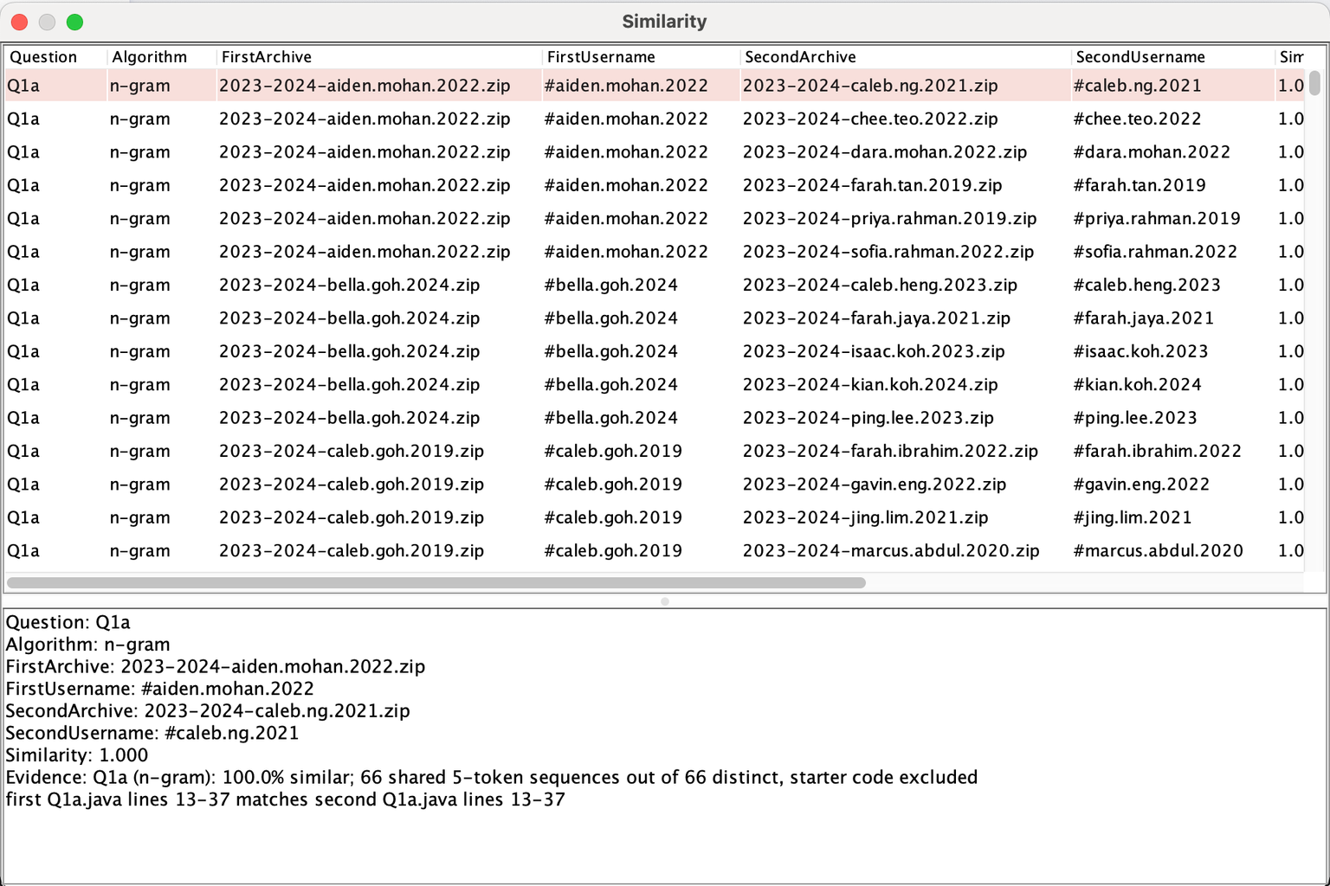
Similarity grading
25

Slide 26
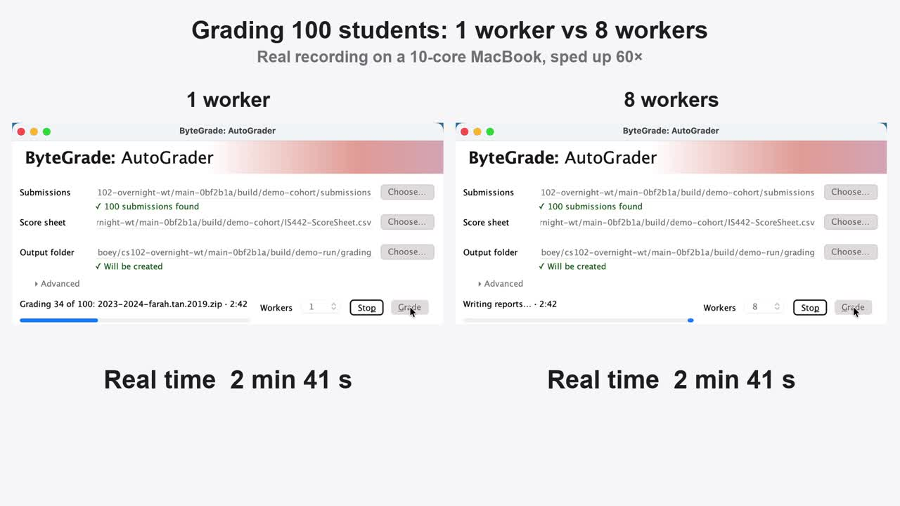
Eight workers grade 100 students 2.8x faster
Measured on a 10-core MacBook, 10 Nov (100 students)
  1 worker: 7 min 07 s
  4 workers: 2 min 44 s (2.6x faster)
  8 workers: 2 min 30 s (2.8x faster)
  6-student sample:
    1 worker: 31.1 s
    6 workers: 23.4 s (1.3x faster)
  No change to scores
Algorithms explored
  Sequential: simplest and predictable, but slowest.
  Thread pool of N workers, results kept in roster order: faster, but limited by the slowest student and by CPU cores; heavy load can push borderline programs past the 2 s limit, so the default stays 1.
  Reused test JVM per question part vs a fresh JVM per test case: far fewer JVM start-ups; a crashed host is replaced and the case retried.
26
Notes:
Grading 100 students takes 7 minutes on 1 worker and 2 minutes 44 seconds on 4 workers, 2.6 times faster. 8 workers only gets to 2 minutes 30 seconds, because this laptop has just 4 performance cores, and scores are identical at every worker count. The video is a real recording of the same comparison in the app, sped up 60 times. We explored sequential grading, a thread pool with results kept in roster order, and reusing one test JVM per question part instead of a fresh JVM per case. The default stays at 1 worker because heavy load can push borderline programs past the 2 second limit.

Slide 27
Limitations and improvements
Limitations
  Windows runs slower: in CI the sample run took 64 s on Windows vs 44 s on macOS (different machines). Likely cause: real-time antivirus scanning each javac/java start and new .class files. With 2 or more workers, passing cases can be wrongly timed out; use 1 worker.
  No OS-level sandbox: student code runs with the instructor’s permissions; use a VM or container.
  Parallel speed bottleneck: Parallel speed-up limited by the slowest student and CPU cores.
  Online maven: First build downloads Maven, so it needs internet once.
  Plagiarism / Similarity: weaker on very short answers and on heavily restructured code.
Improvements
  Sandboxed execution
  ETA in the progress display
  Windows antivirus exclusion guidance
27

Slide 28
Thank you :D
28

Slide 29
Appendix
29

Slide 30
AI Use
  We used AI for high-level guidance on:
    Bonus feature ideas
    Project structure
    Class responsibilities
    Complex debugging
      We attempted debugging ourselves first and turned to AI when needed.
The team wrote the code by hand.
30

