Slide 1
Pipeline Comparison

Slide 2
Current Workflow
Raw scRNA-seq reads quantified by Salmon¹.
Reference transcriptome [Homo_Sapiens.GRCh38.cdna.all.fa] from ensemble.
Default settings [--validateMapping not enabled].
Bash file to run through all FASTA files within set folder.
Quantified files are imported to DESeq2² with TXimport³.
TXimport integrates transcript abundance into DESeq2.
Annotated GFF file [ensembl release 95] to connect transcripts to genes.
Differential Expression analysis with DESeq2
Differentiation design based on condition.
Raw .csv file that includes log2foldchange and adjusted P-values.
-> Dispersion, MA plots, PCA plots, Volcano plots, histograms produced.
Gene Set Analysis (GSA) with Piano⁴
Search for enriched gene sets (Hallmark⁵ and KEGG).
-> geneLevelStat file (filtered, sorted, and annotated gene list), network plots, heatmaps, and boxplots produced.
Literature search for hits.

Slide 3
Workflow from SciLifeLab Single Cell Facility
MULTo (Storvall et al 2013) for unique alignable positions
Ramsköld et al (2009) for generating RPKM (expression values).

Slide 4
Salmon Specifics
Alignment and quantification in single tool
Supplementary Algorithm 1: Laissez-faire SCVB0
Supplementary Algorithm 2: Gibbs sampling algorithm
1. Patro, R., Duggal, G., Love, M. I., Irizarry, R. A. & Kingsford, C. Salmon provides fast and bias-aware quantification of transcript expression. Nat. Methods 14, 417–419 (2017).
Sup. Fig. 1, Patro et al, 2017, Nat Methods

Slide 5
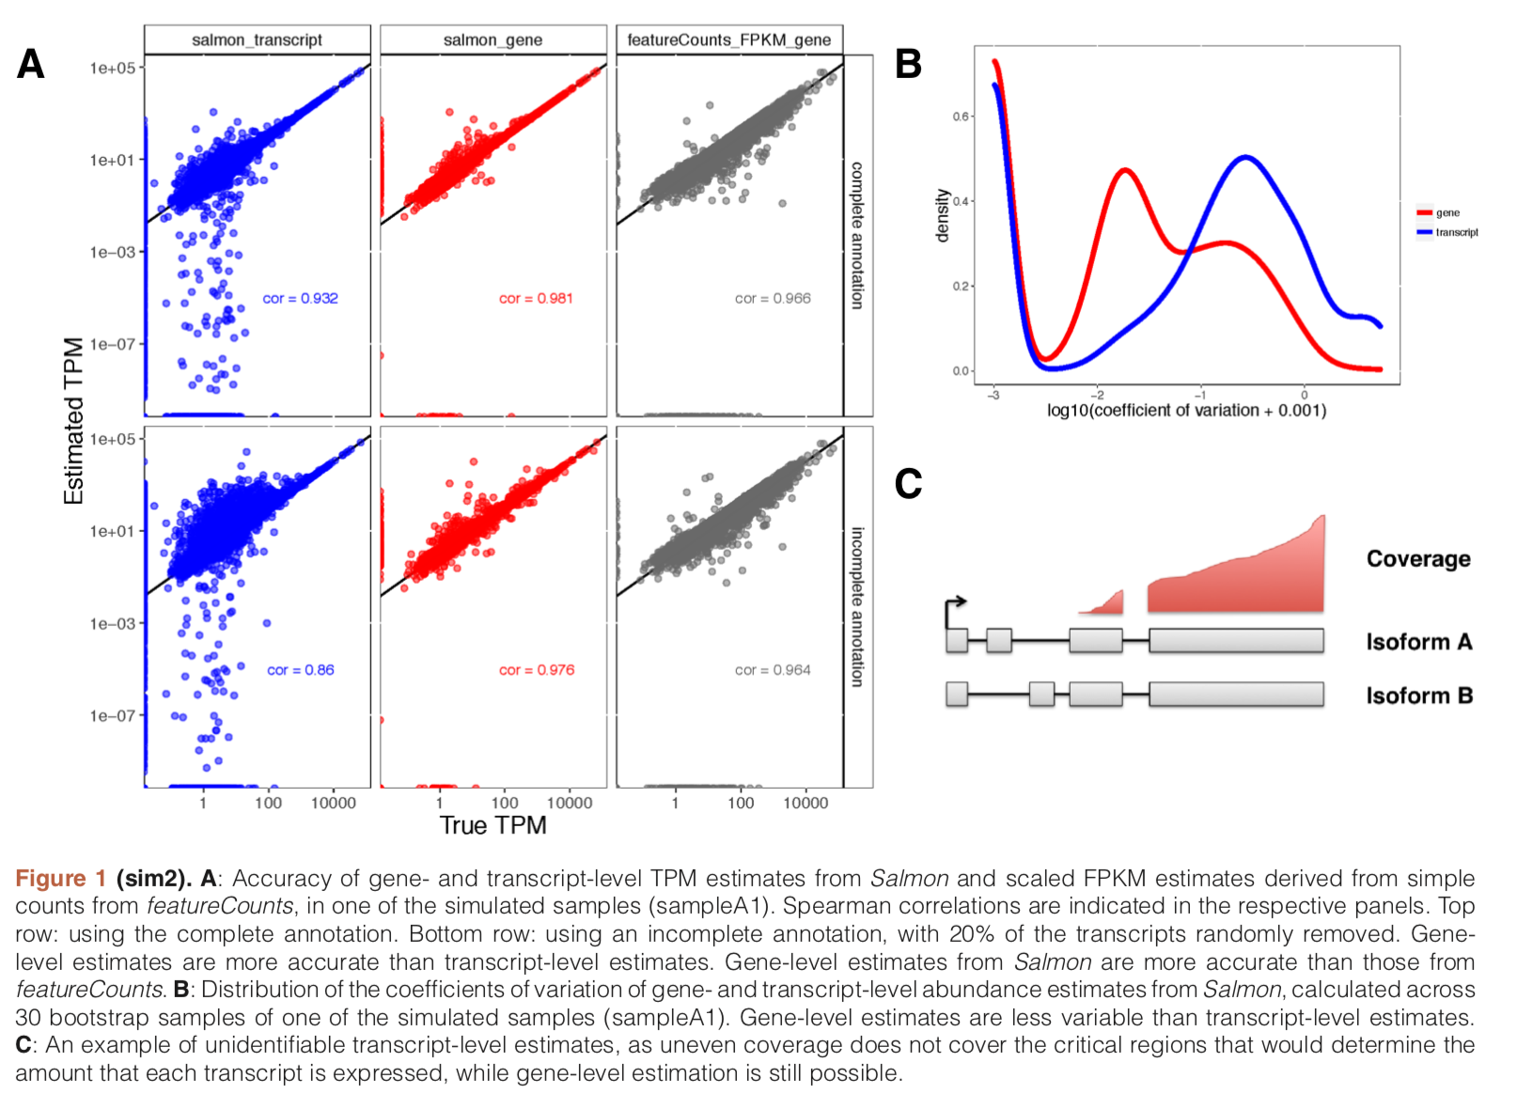
TXImport
Combines transcript lengths and abundance estimates to produce adjusted estimate count matrices.
This is a gene-level estimate as opposed to transcript-level estimate!
Count matrices imported in DESeq
1. Soneson, C., Love, M. I. & Robinson, M. D. Differential analyses for RNA-seq: transcript-level estimates improve gene-level inferences. F1000Research 4, 1521 (2015).

Slide 6
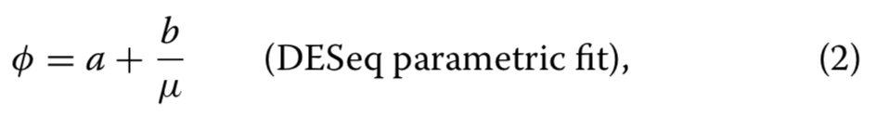
DESeq2¹
Uses a negative binomial distribution instead of Poisson distribution (deemed too restrictive).
“uniquely determined by mean μ and variance s2”
Produces list of genes with log2foldchange (expressional change), and adjusted P-values (based on FDR).
Highly dependent on conditions stipulated in experiment design.
1. Love, M. I., Huber, W. & Anders, S. Moderated estimation of fold change and dispersion for RNA-seq data with DESeq2. Genome Biol. 15, 1–21 (2014).
(2) Robles et al. BMC Genomics 2012, 13:484

Slide 7
Gene Set Analysis specifics
Extracts Gene set statistics from DESeq output
Conversion to obtain P-value for gene set:
“simply the fraction of random gene set statistics that are equal to or more extreme (in general larger) than the original gene set statistic.”
Also includes directionality of each gene set
1. Väremo, L., Nielsen, J. & Nookaew, I. Enriching the gene set analysis of genome-wide data by incorporating directionality of gene expression and combining statistical hypotheses and methods. Nucleic Acids Res. 41, 4378–4391 (2013).

