Slide 1
Hillsborough County Parcel Sales Prediction
Presented by Bo Fethe

Slide 2

Purpose
Leverage analytics to predict property sale values in Hillsborough County, Florida, for supporting damage assessment efforts following natural disasters.

Slide 3
Background →

Slide 4

Current Problems
Property values are misrepresented causing inaccuracies after natural disasters when organizations quantify financial impacts for heuristic federal and state reports.
Save Our Homes Act introduces bias by limiting the annual increase in the assessed value of homesteaded properties to 3% or the change in the Consumer Price Index (CPI), whichever is less
Typical assessments are based on either Market Value or Building Value

Slide 5
Data Sources
All data is publicly available on the Hillsborough County Property Appraiser’s website¹
Market Value
The typical price a willing buyer would pay to a willing seller for the property
Calculated using 3 approaches:
Cost Approach – cost to replace all assets
Market Approach – sell price of other similar properties
Income Approach – amount of potentially generated revenue
Building Value
The value of all buildings on the property
Used for insurance companies to understand what the best policy is
Does not include other factors such as driveway, backyard amenities, or location.
⚠️ Neither accurately reflect purchase price
¹ https://www.hcpafl.org

Slide 6

Key Studies in Real Estate Price Prediction
XGBoost performed the best, but had struggled with overfitting on small samples
Predicting Sales Prices of the Houses Using Regression Methods of Machine Learning. (Viktorovich, 2018),
ANN and Random Forest outperformed hedonic methods
Machine Learning, Deep Learning, and Hedonic Methods for Real Estate Price Prediction. (Yazdani, 2021)
Machine learning models outperformed traditional linear models, particularly boosting algorithms
Housing Price Prediction Using Machine Learning Algorithms in COVID-19 Times. (Mora-Garcia, 2022)

Slide 7
Methodology →

Slide 8

Data Engineering Pipeline
Extract
Unzip raw shapefiles containing parcel and sales data
Read .dbf tables using geopandas and pandas
Transform
Extract and standardize year from sales date and keep only last 10 years
Select relevant fields
Clean and preprocess for modeling (e.g., missing and sentinel values, data types, outlier detection)
Convert to parquet to increase I/O speeds
Load
Merge into unified DataFrame

Slide 9
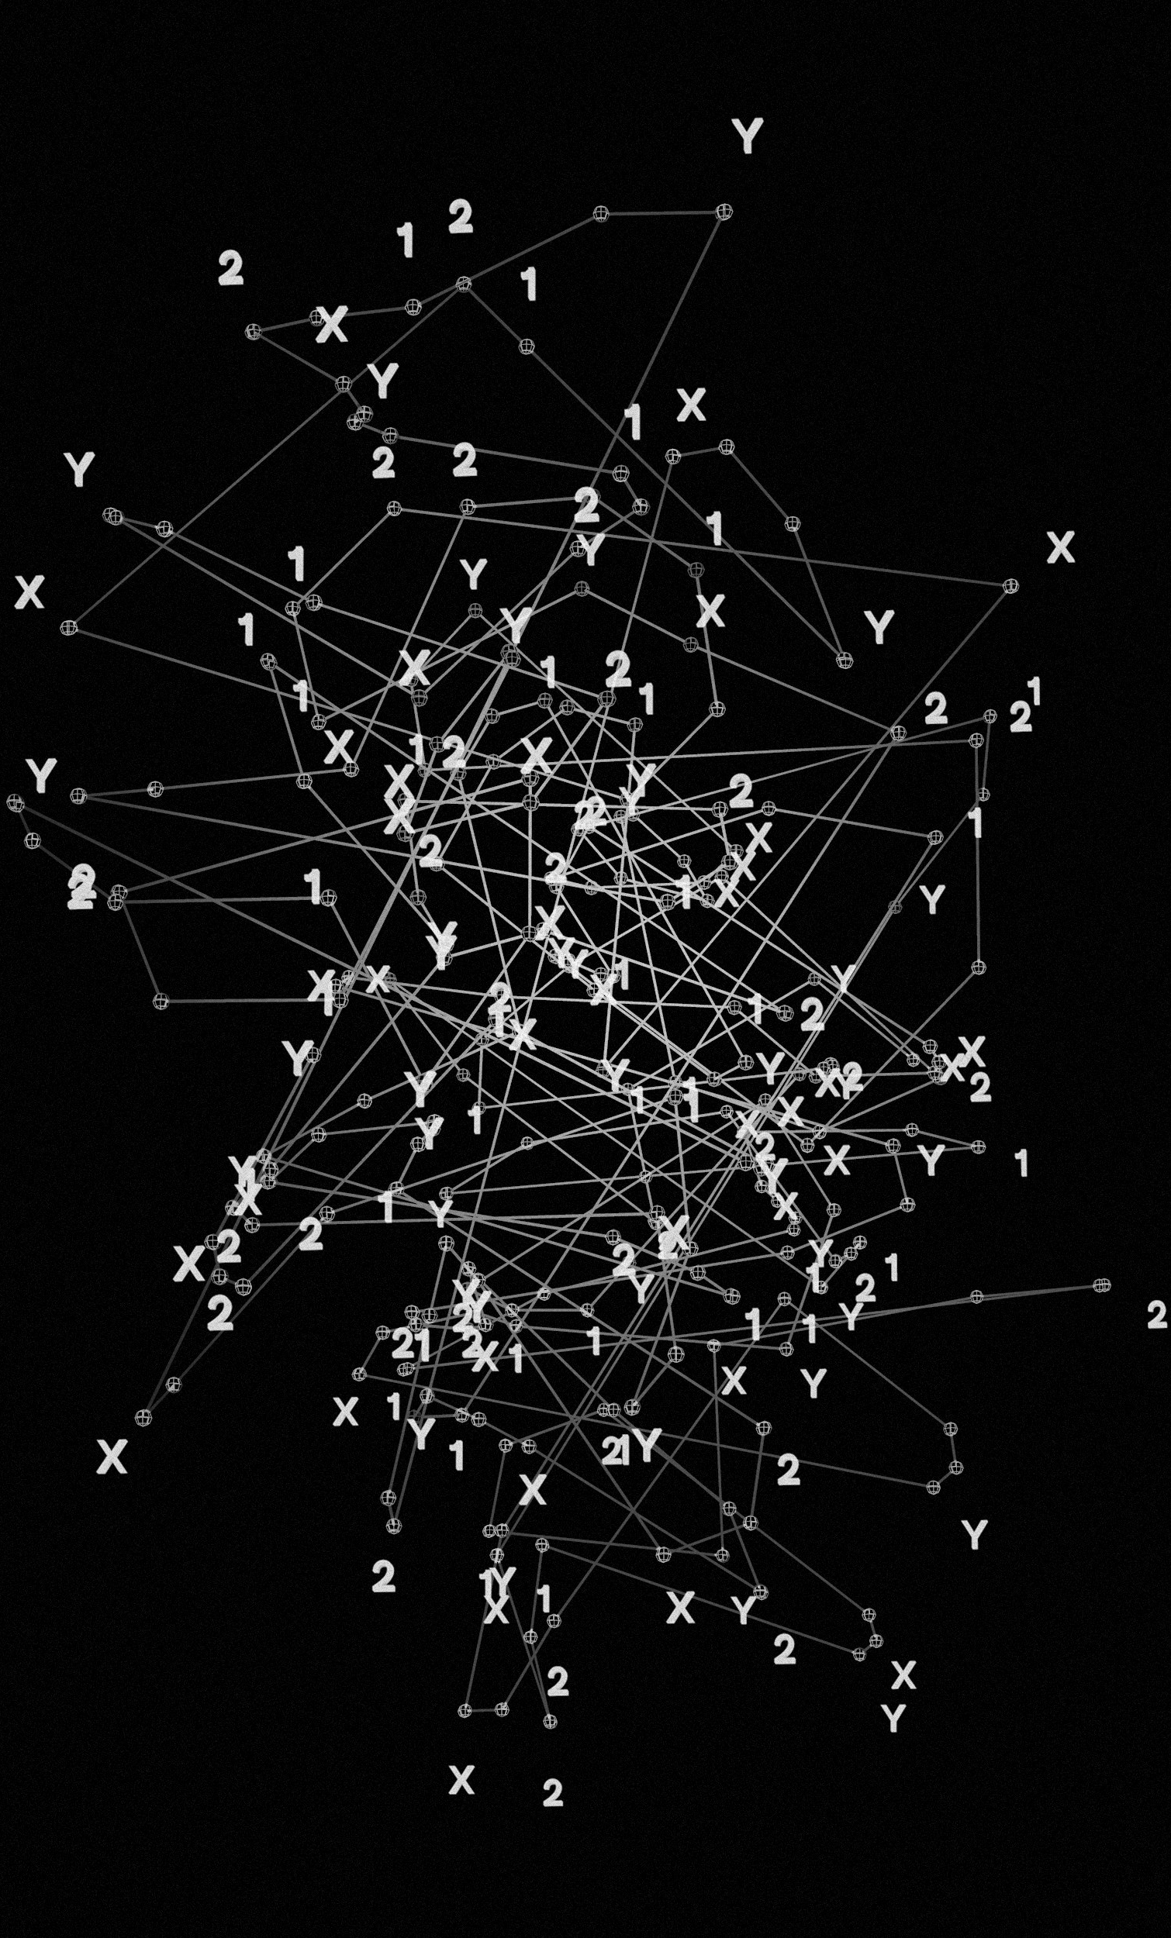
Analytics and Modeling Approach
Modeling Techniques
Linear Regression
Baseline model for interpretability and trend estimation
Elastic Net Regression
Combines L1 (LASSO) and L2 (Ridge) regularization to handle multicollinearity and feature selection
Artificial Neural Network (ANN)
Captures complex non-linear relationships between response and predictor variables
Random Forest
Ensemble method using decision trees that handles nonlinearities and feature interactions
Gradient Boosting
Boosted trees for high predictive performance by using weak learners
Evaluation Strategy
Split data into training (80%) and testing (20%) subsets
Cross-validation (CV) performed on training subset
Ensures robustness and reduces overfitting
5-fold CV used to tune hyperparameters and assess consistency
Select the model with the lowest mean squared error (MSE)
Fit the model to the testing subset

Slide 10
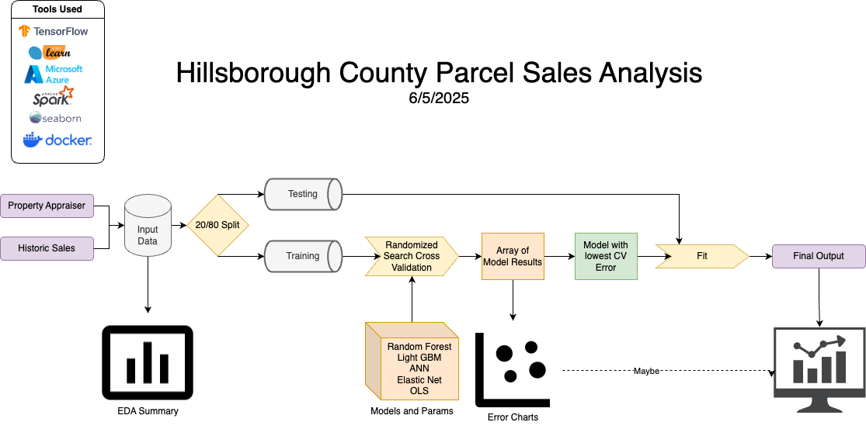

Slide 11
Exploratory Data Analysis →

Slide 12
Fields
Feature | Data Type | Description
FOLIO | object | Folio of parcel. Primary key
SITE_ZIP | category | Postal zip code
tBEDS | float64 | Number of beds
tBATHS | float64 | Number of baths
tSTORIES | float64 | Number of stories
tUNITS | float64 | Number of units
tBLDGS | float64 | Number of buildings
HEAT_AR | float64 | Heating area in sqft
ACREAGE | float64 | Acreage of lot
LU_GRP | category | Generalized land use group
S_YEAR | category | Sale year derived from sale date
S_AMT | float64 | Sale Amount. Response value
Numerical fields are represented as floats due to how these values are stored and permitted

Slide 13
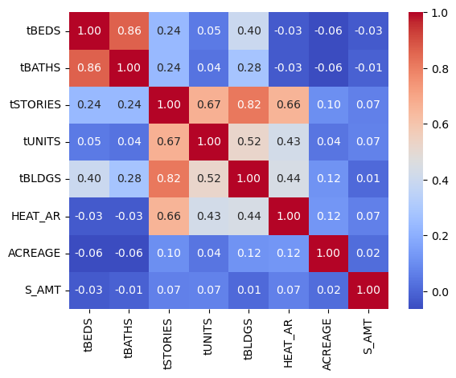
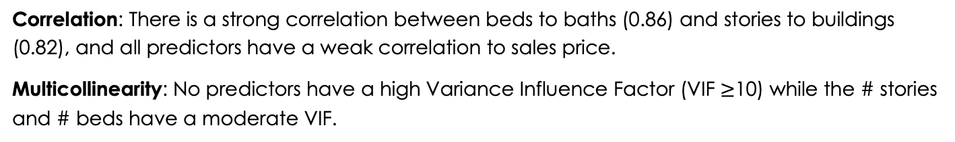
Evaluating Feature Relationships
Correlation
Multicollinearity
Feature | VIF
tSTORIES | 6.24
tBEDS | 5.03
tBATHS | 4.59
const | 4.20
tBLDGS | 4.04
HEAT_AR | 1.96
tUNITS | 1.89
ACREAGE | 1.04
Correlation: There is a strong correlation between beds to baths (0.86) and stories to buildings (0.82), and all predictors have a weak correlation to sales price.
Multicollinearity: No predictors have a high Variance Influence Factor (VIF $≥$10) while the # stories and # beds have a moderate VIF.

Slide 14
Number of Sales by Land Use
Land Use Group | Count | %
SINGLE FAMILY | 1,811,627 | 76.99
MULTI-FAMILY | 241,635 | 10.27
VACANT RESIDENT | 70,837 | 3.01
MOBILE HOMES | 62,889 | 2.67
COMM./OFFICE | 35,423 | 1.51
OTHER: (INVALID CODE, AGRICULTURAL, GOVERNMENT, STORE/SHP CENTE, INSTITUTIONAL, LIGHT INDUS., VACANT COMM., VACANT TOWNHOME, UTILITY, R/W, OFFICE CONDO, SCHOOLS/COLLEGE, VACANT INDUS., HEAVY INDUS., MEDICAL OFFICE CONDO, APT CONDO, COMMERCIAL, INDUSTRAL CONDO, CHURCH PARSONAGES, COOPERATIVE, 1 STY STORE CONDO, VACANT MH/COOP, SFR BLD ARND MH, MINING, MARINAS, CEMETERY, PRIVATE GC, SEMI PRIVATE GC, LANDSCAPE/WALL BUFFER, PARKS, HOA COMMERCIAL, EXEC/PRACTICE GC | 130,731 | 5.56
The vast majority of property sales are residential. Focusing the analysis on single-family and multi-family properties helps reduce potential bias from the imbalance in property types.

Slide 15
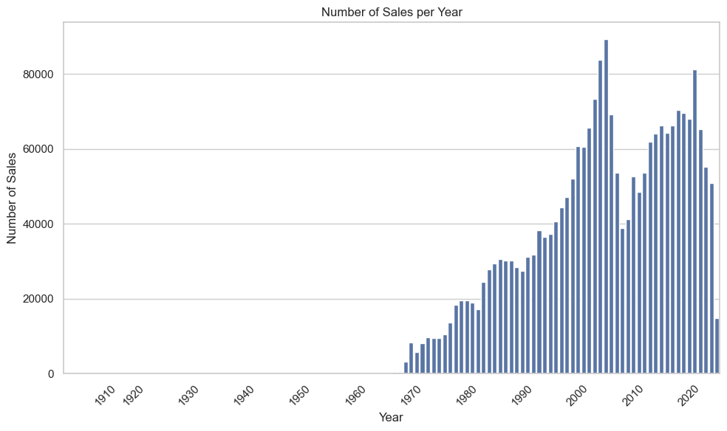
Sales Distribution
Proper records for sales data starts around 1970 and shows a dip in 2008 during the housing market crash. Analyzing 2014-2024 years has enough data to establish trends, avoids the housing market crash, and complete months of data

Slide 16
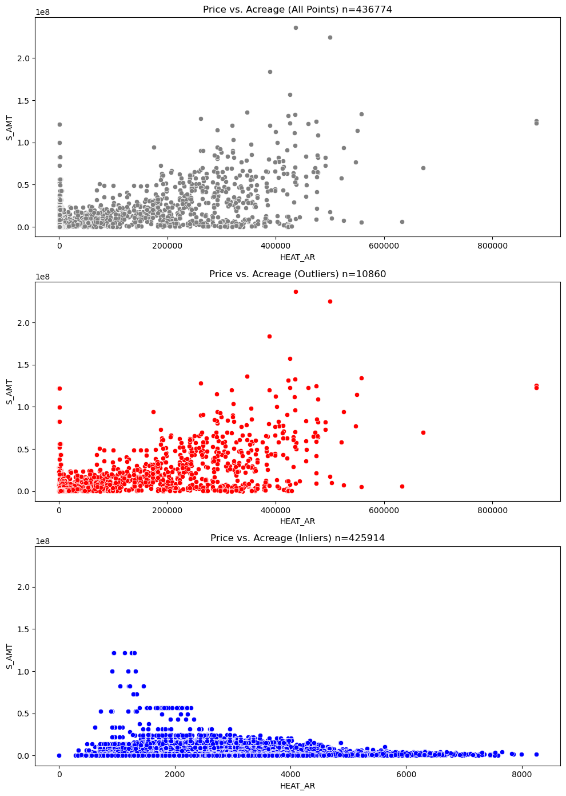
Outlier Detection
Isolation Forest was used by year due to its scalability and high-dimensionality and hyper-tuned to find the best hyper-parameters
contamination = 0.025
n_estimators = 250
max_sample_size = 256
Sentinel values coded as low sales amount for placeholder data
Heating area (ft²) was used for comparison to graphically represent the outlier/inlier relationships and trends
~11,000 data points removed from 2014–2024 on the Outliers plot
Captured both sentinel values in the lower tail and extreme high-value properties in the upper tail which are absent in the Inliers plot

Slide 17

Final data size for 10 years of residential sales without sentinel points
df.shape == (425914, 12)

Slide 18
What’s Next →

Slide 19
Model Training
Training
Train and hyper-tune the training subset using linear regression, elastic net, random forest, gradient boosting, and artificial neural network models
Model Selection and Evaluation
Compare performance metrics (RMSE, MSE, R², AIC) and select the model with the lowest cross-validation error
Fit the best model to the testing subset to assess generalization

Slide 20


Thank you
Scan or Click for
the project’s GitHub
github.com/bofethe/parcel-sales

