Slide 1
Predictive Analysis of Crash Incidents in Hillsborough County
Bo Fethe
Group 123
March 2024

Slide 2
Introduction
Hillsborough
Data source

Slide 3
Crash Locations

Slide 4
Attributes
Name | Description
INCAPACITATING_FLAG | Binary response whether the crash severity resulted in a serious injury/fatality or not derived from S4_CRASH_TYPE_SIMPLIFIED
PEAK | Peak traffic period derived from CRASH_DATE_AND_TIME
TOTAL_NUMBER_OF_VEHICLES | Count of all vehicles involved in the crash
TOTAL_NUMBER_OF_PERSONS | Count of all persons involved in the crash (drivers, passengers, and non-motorists)
RURAL_OR_URBAN | Check if the traffic crash occurred inside the corporate limits of the city
ROAD_SYSTEM_IDENTIFER | This classification is used to identify the primary road system on which the traffic crash occurred
ROAD_SURFACE_CONDITION | This classification is used to identify the surface condition of the street, road or highway at the time of the traffic crash
S4_CRASH_TYPE_SIMPLIFIED | Crash type simplified for practitioners who desire less detailed crash types
S4_DAY_OR_NIGHT | To identify if the crash happened in the daytime or nighttime
S4_IS_AGGRESSIVE_DRIVING | To identify the presence of aggressive driving in the crash
S4_IS_ALCOHOL_RELATED | To identify the presence of alcohol by the driver in the crash
S4_IS_CMV_INVOLVED | To identify the presence of a commercial motor vehicle is involved in the crash
S4_IS_DISTRACTED | To identify the presence of driving distraction in the crash
S4_IS_DRUG_RELATED | To identify if the crash is drug related due to refusal of drug test or positive drug test of driver
S4_IS_HIT_AND_RUN | To identify if the crash is hit and run related
S4_IS_INTERSECTION_RELATED | To identify if the crash is intersection related
S4_IS_LANE_DEPARTURE_RELATED | To identify the presence of lane departure in the crash
S4_IS_SPEEDING_RELATED | To identify if the crash is speed related
S4_TRAILER_COUNT | Number of trailers in the crash
S4_MOTORCYCLE_COUNT | Number of motorcycles in the crash
S4_MOPED_COUNT | Number of mopeds in the crash
S4_BICYCLIST_COUNT | Number of bicyclists in the crash
S4_AGING_DRIVER_COUNT | Number of aging drivers in the crash who are 65 or older
S4_TEENAGER_DRIVER_COUNT | The number of drivers involved in the crash whose age at time of crash is between 15 and 19
S4_UNRESTRAINED_COUNT | Number of motor vehicle occupants not using restraint system(s) at time of crash

Slide 5
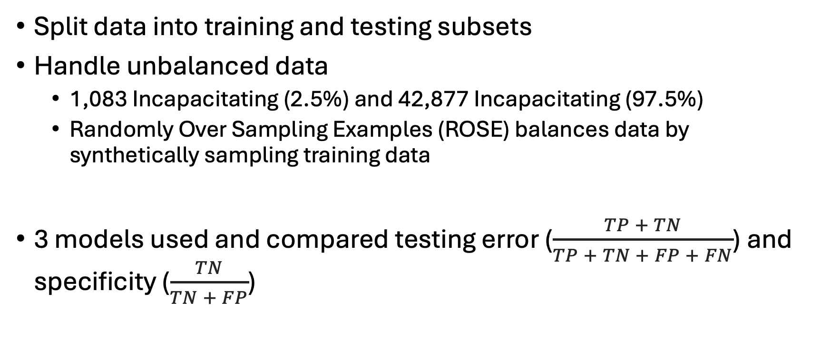
Methodology
Split data into training and testing subsets
Handle unbalanced data
1,083 Incapacitating (2.5%) and 42,877 Incapacitating (97.5%)
Randomly Over Sampling Examples (ROSE) balances data by synthetically sampling training data
3 models used and compared testing error ($\frac{TP + TN}{TP + TN + FP + FN}$) and specificity ($\frac{TN}{TN + FP}$)

Slide 6
Models - 1/3
Logistic Regression
A probabilistic classification model used for binary classification
Suitable for scenarios when you need to understand variable relationships and the probability of a particular outcome
Stepwise variable section via Akaike information criterion (AIC)
step(glm(INCAPACITATING_FLAG~., data = crashtrain_balanced), trace = F)
Selected 16 predictors
TOAL_NUMBER_OF_VEHICLES | S4_CRASH_TYPE_SIMPLIFIED | S4_IS_DRUG_RELATED | S4_MOTORCYCLE_COUNT
TOTAL_NUMBER_OF_PERSONS | S4_IS_AGGRESSIVE_DRIVING | S4_IS_HIT_AND_RUN | S4_MOPED_COUNT
RURAL_OR_URBAN | S4_IS_ALCOHOL_RELATED | S4_IS_INTERSECTION_RELATED | S4_AGING_DRIVER_COUNT
ROAD_SYSTEM_IDENTIFER | S4_IS_CMV_INVOLVED | S4_IS_LANE_DEPARTURE_RELATED | S4_UNRESTRAINED_COUNT

Slide 7
Models - 2/3
Random Forest
An ensemble Bootstrap aggregating (bagging) model that combines many decision trees
Suitable for handling large datasets with high dimensionality and complexity
randomForest(as.factor(INCAPACITATING_FLAG)~., crashtrain_balanced, proximity=T, importance=T)

Slide 8
Models - 3/3
Generalized Boosting Regression
An ensemble gradient boosting model similar to random forest that iteratively builds decision trees and trains weak learners to improve model performance.
Use cross-validation to find the optimal # of iterations
Suitable when you can tolerate longer training times
gbm(INCAPACITATING_FLAG~., data=crashtrain_balanced, distribution = 'bernoulli', n.trees = 5000, shrinkage = 0.01, interaction.depth = 1, cv.folds = 10)

Slide 9
Challenges
Unbalanced data
1,083 Incapacitating (2.5%) and 42,877 Incapacitating (97.5%)
Randomly Over Sampling Examples (ROSE) balances data by synthetically sampling training data

Slide 10
Results
Purpose of analysis
Data source

Slide 11
Conclusion
Purpose of analysis
Data source

