Slide 1
Predictive Analysis of Crash Incidents in Hillsborough County
Bo Fethe
March 2024
Notes:
Hello everyone. My name is Bo and I am a Solutions Engineer at Hillsborough County. Today, I am going to share a project I worked on analyzing and predicting crash data in Hillsborough County.

Slide 2
Introduction
Unintentional accidents were the #3 in leading cause of death in Florida during 2022 (Florida Department of Heath¹)
International programs, like Vision Zero, help communities eliminate traffic fatalities and serious injuries by improving safety measures.
Signal Four Analytics receives tabular and geospatial crash data from Florida Department of Highway Safety and Motor Vehicles (FLHSMV)
Q: How well can machine learning predict incapacitating events?
¹ https://www.flhealthcharts.gov/ChartsReports/rdPage.aspx?rdReport=ChartsProfiles.LeadingCausesOfDeathProfile
Notes:
In 2022, the Florida Department of Heath showed Unintentional accidents were the state’s 3rd highest cause of death. To improve public safety, international programs, such as Vision Zero, exist to help communities eliminate life-threatening events by implementing new roadway safety designs. The University of Florida’s GeoPlan Center hosts and maintains a geospatial crash database called Signal Four Analytics which takes records from the Department of Highway Safety and Motor Vehicles and reporting officers. This raised the question of how well does machine learning predict these incapacitating events.

Slide 3
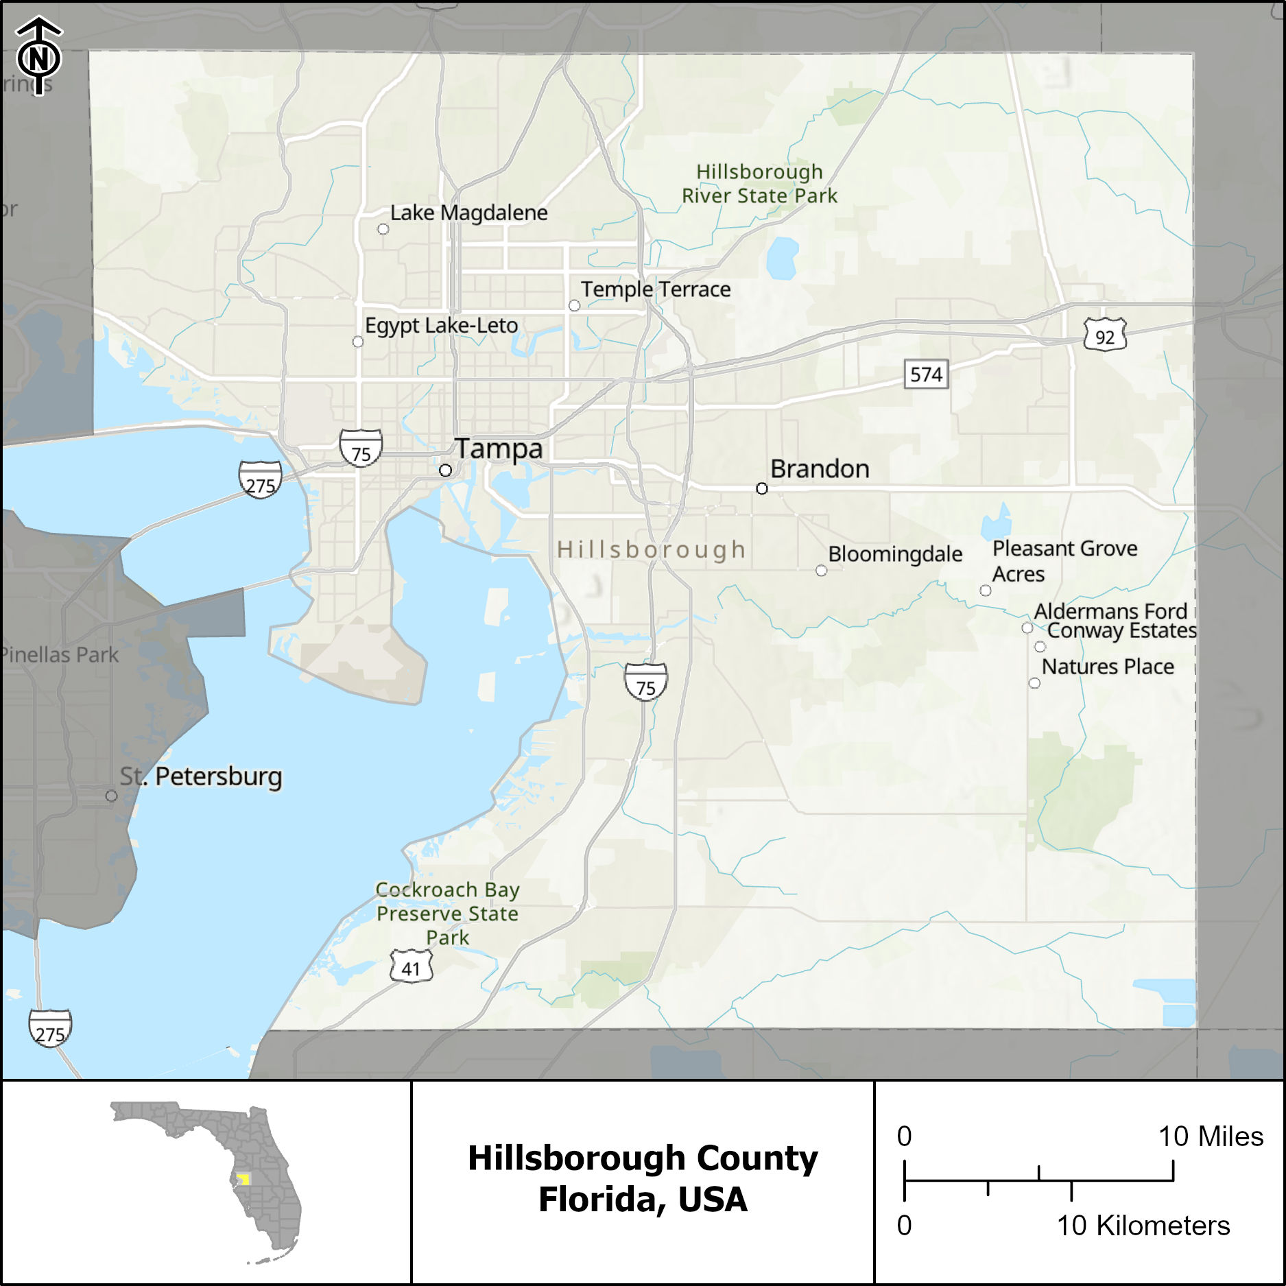
Study Area
Hillsborough County, Florida, USA
3 incorporated cities
Tampa
Plant City
Temple Terrace
Population
July 2023: 1,535,564 (U.S. Census Bureau²)
2050 Estimate: 2,017,294 (Plan Hillsborough³)
² https://www.census.gov/quickfacts/fact/table/hillsboroughcountyflorida/PST045223
³ https://planhillsborough.org/county-to-reach-2-million-residents-and-1-4-million-jobs-by-2050
Notes:
The study area is Hillsborough County located on the coast of southwest Florida. The county has 3 incorporated cities: Tampa, Plant City, and Temple Terrace. In July of 2023, the population was 1.5M with an estimated growth to over 2M by 2050. As the regional density increases, more cars will be on the road which can lead to more accidents.

Slide 4
Data
2023 crash records from Signal Four Analytics
23/117 Signal Four columns + 2 generated columns selected for analysis = 25 columns
Crash Severity simplified into 2 classifications
Fatality or Serious Injury = Incapacitating
No Injury or Injury = Non-incapacitating
Peak traffic hours
AM Peak (M-F; 07:00-10:00)
Mid Peak (M-F; 10:00-16:00)
PM Peak (M-F; 16:00-19:00)
Weekend Peak (Sa-Su; 06:00-20:00)
Off Peak for all other times
Notes:
For the analysis, all 2023 crash events were exported. By default, Signal Four has 117 predictors consisting of a mix of categories, quantities, dates, spatial, and unstructured values. To simplify the the data for analysis, 23 columns from Signal Four were selected with the addition of 2 generated columns for a total of 25 attributes. Crash Severity was classified into a binary repones with fatal or serious injuries represented as Incapacitating and no injury and minor injuries as Non-Incapacitating. The date and time of the events were transformed into 5 peak traffic period bins for AM, Mid, PM, Weekend, and Off peak.

Slide 5
Attributes
Name | Description
INCAPACITATING_FLAG | Binary response whether the crash severity resulted in a serious injury/fatality or not derived from S4_CRASH_TYPE_SIMPLIFIED
PEAK | Peak traffic period derived from CRASH_DATE_AND_TIME
TOTAL_NUMBER_OF_VEHICLES | Count of all vehicles involved in the crash
TOTAL_NUMBER_OF_PERSONS | Count of all persons involved in the crash (drivers, passengers, and non-motorists)
RURAL_OR_URBAN | Check if the traffic crash occurred inside the corporate limits of the city
ROAD_SYSTEM_IDENTIFER | This classification is used to identify the primary road system on which the traffic crash occurred
ROAD_SURFACE_CONDITION | This classification is used to identify the surface condition of the street, road or highway at the time of the traffic crash
S4_CRASH_TYPE_SIMPLIFIED | Crash type simplified for practitioners who desire less detailed crash types
S4_DAY_OR_NIGHT | To identify if the crash happened in the daytime or nighttime
S4_IS_AGGRESSIVE_DRIVING | To identify the presence of aggressive driving in the crash
S4_IS_ALCOHOL_RELATED | To identify the presence of alcohol by the driver in the crash
S4_IS_CMV_INVOLVED | To identify the presence of a commercial motor vehicle is involved in the crash
S4_IS_DISTRACTED | To identify the presence of driving distraction in the crash
S4_IS_DRUG_RELATED | To identify if the crash is drug related due to refusal of drug test or positive drug test of driver
S4_IS_HIT_AND_RUN | To identify if the crash is hit and run related
S4_IS_INTERSECTION_RELATED | To identify if the crash is intersection related
S4_IS_LANE_DEPARTURE_RELATED | To identify the presence of lane departure in the crash
S4_IS_SPEEDING_RELATED | To identify if the crash is speed related
S4_TRAILER_COUNT | Number of trailers in the crash
S4_MOTORCYCLE_COUNT | Number of motorcycles in the crash
S4_MOPED_COUNT | Number of mopeds in the crash
S4_BICYCLIST_COUNT | Number of bicyclists in the crash
S4_AGING_DRIVER_COUNT | Number of aging drivers in the crash who are 65 or older
S4_TEENAGER_DRIVER_COUNT | The number of drivers involved in the crash whose age at time of crash is between 15 and 19
S4_UNRESTRAINED_COUNT | Number of motor vehicle occupants not using restraint system(s) at time of crash
Notes:
Above are the columns used for this analysis along with their descriptions taken from the data dictionary. The top row, Incapacitating flag, represents the response variable used for training and prediction.

Slide 6
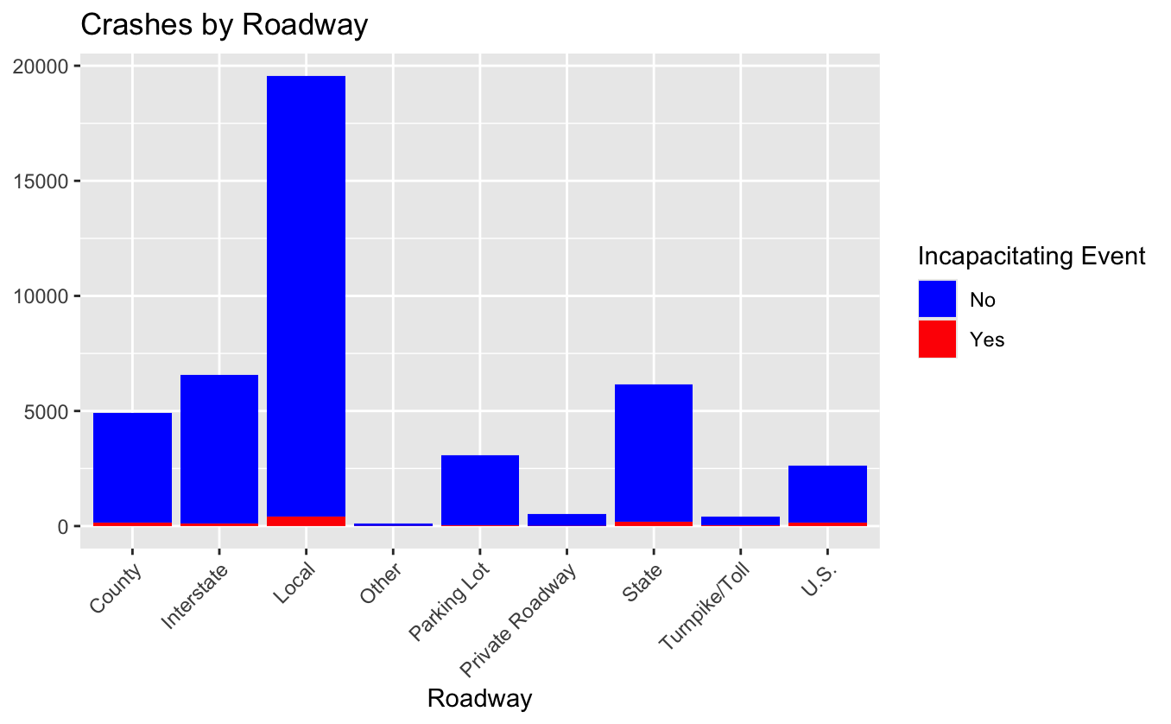
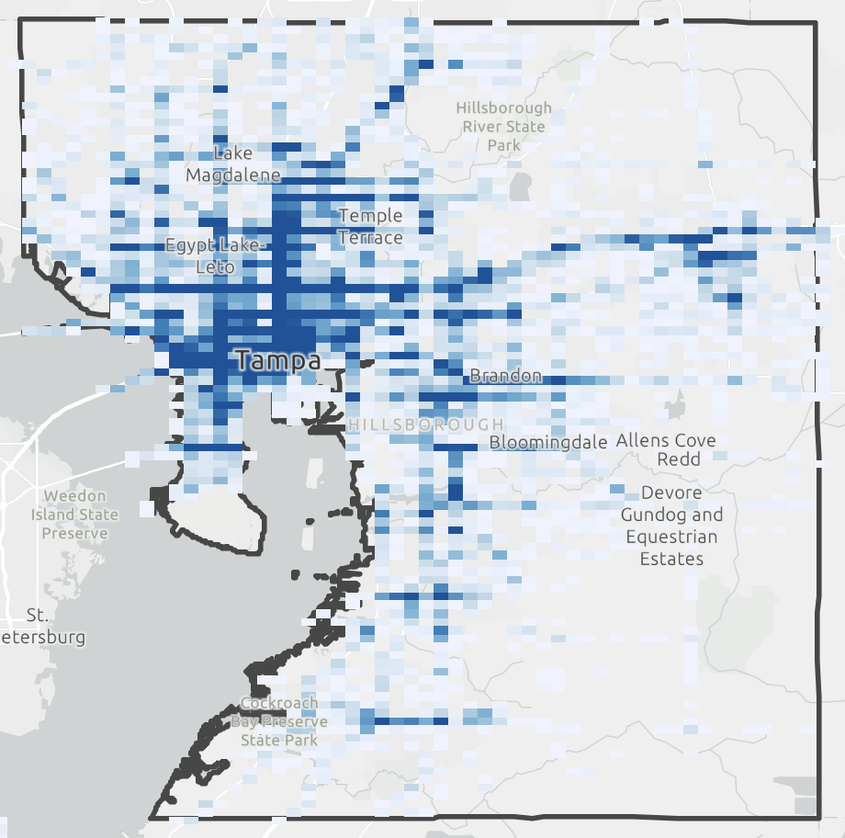
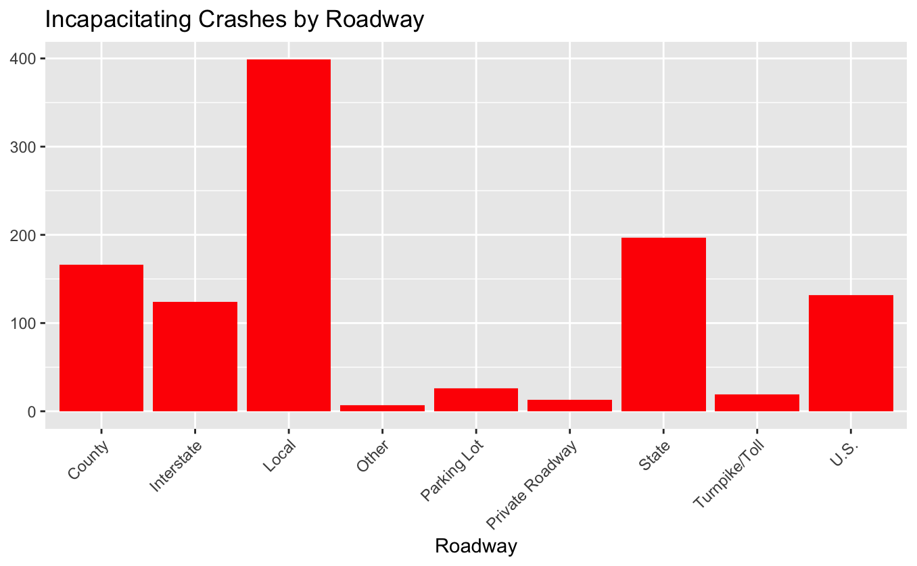
Crash Locations
Notes:
The crash locations in the raw data are shown on this slide. The bin aggregate map, shows that the majority of the crashes occur within city limits with linear tangents along the highways heading east towards Orlando and north towards Gainesville. A significant portion of all crashes occurred on local roadways with almost 3x more events than the next leading roadway system. This trend stays relatively true when considering only incapacitating events with the proportion dropping closer to 2x more than the next leading system. What this means is traffic safety improvements are especially important within the City.

Slide 7
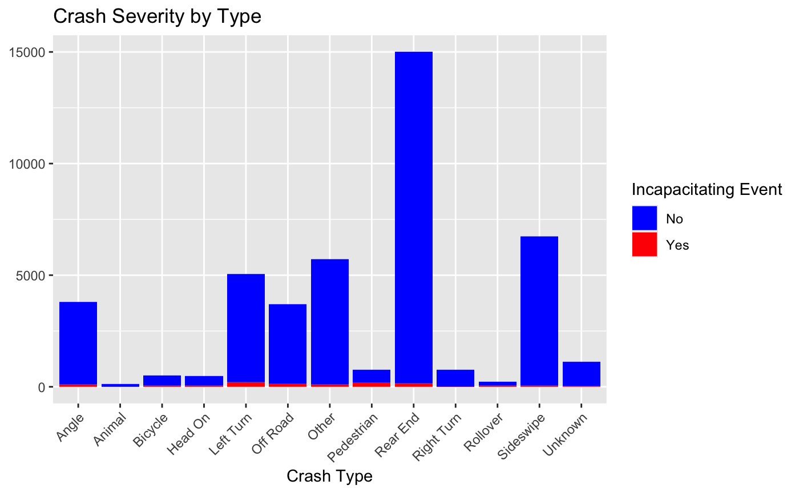
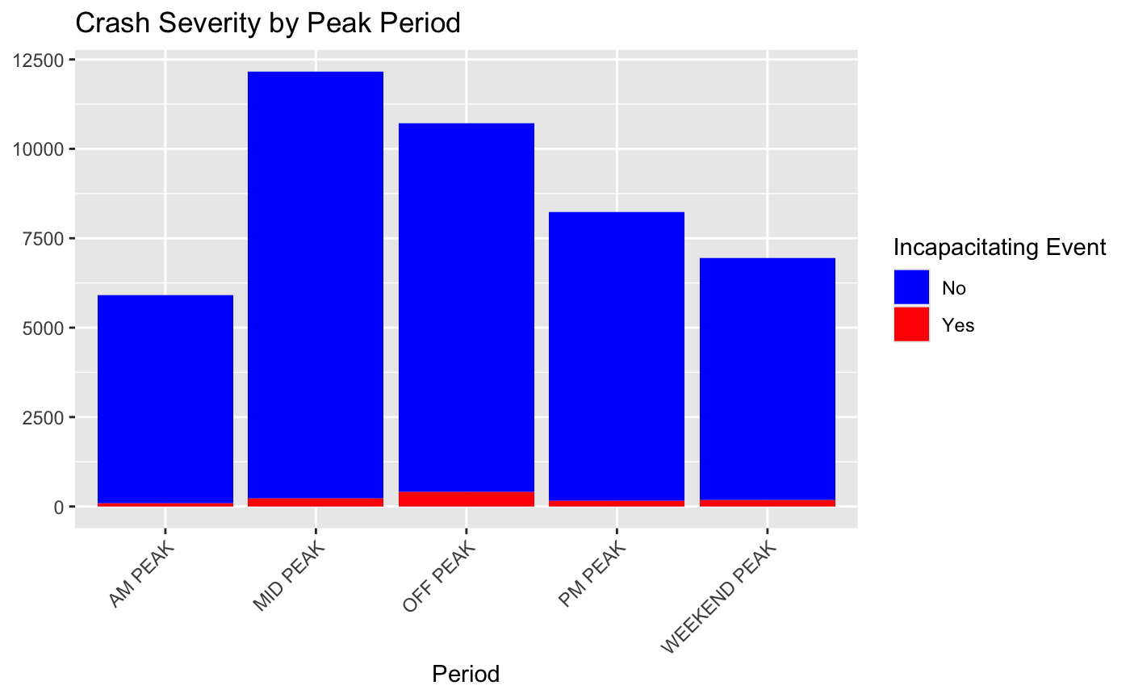
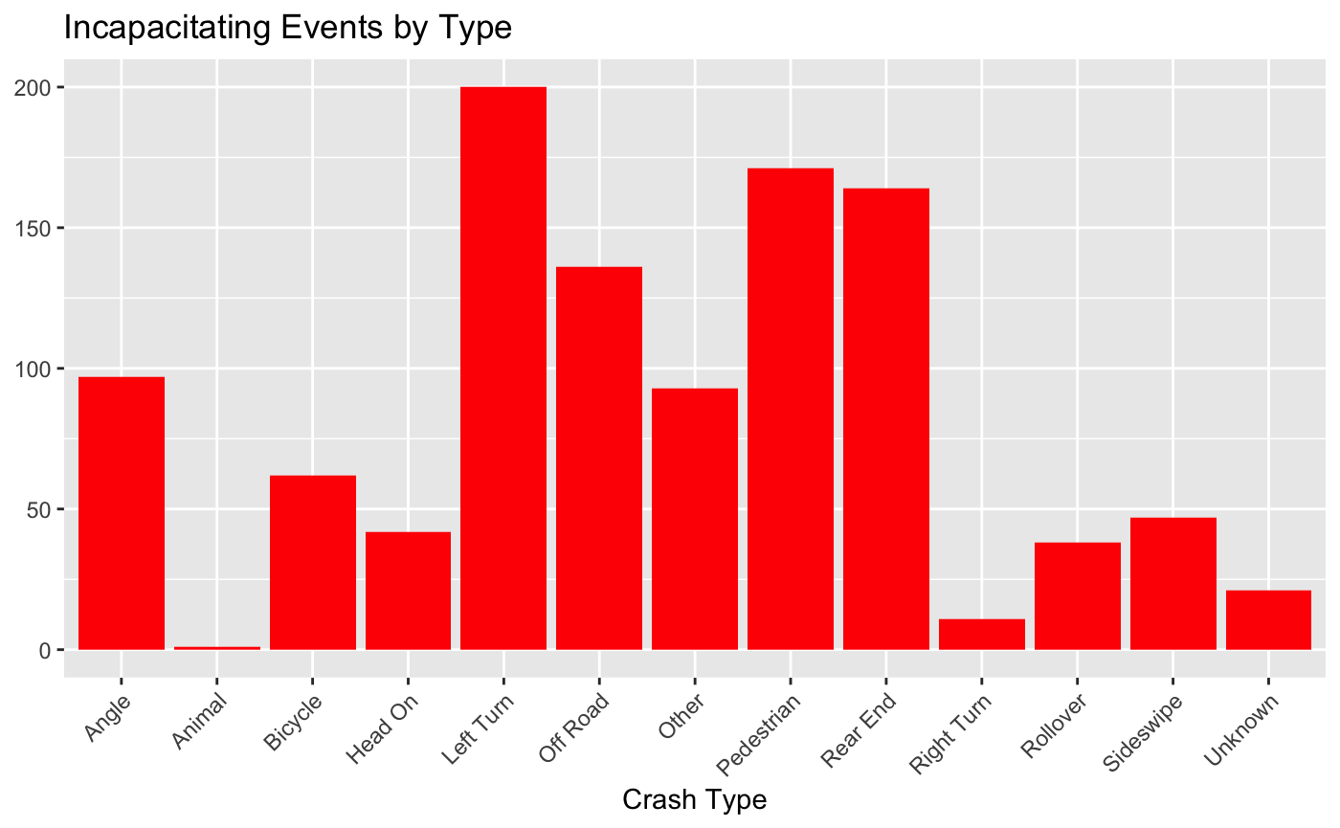
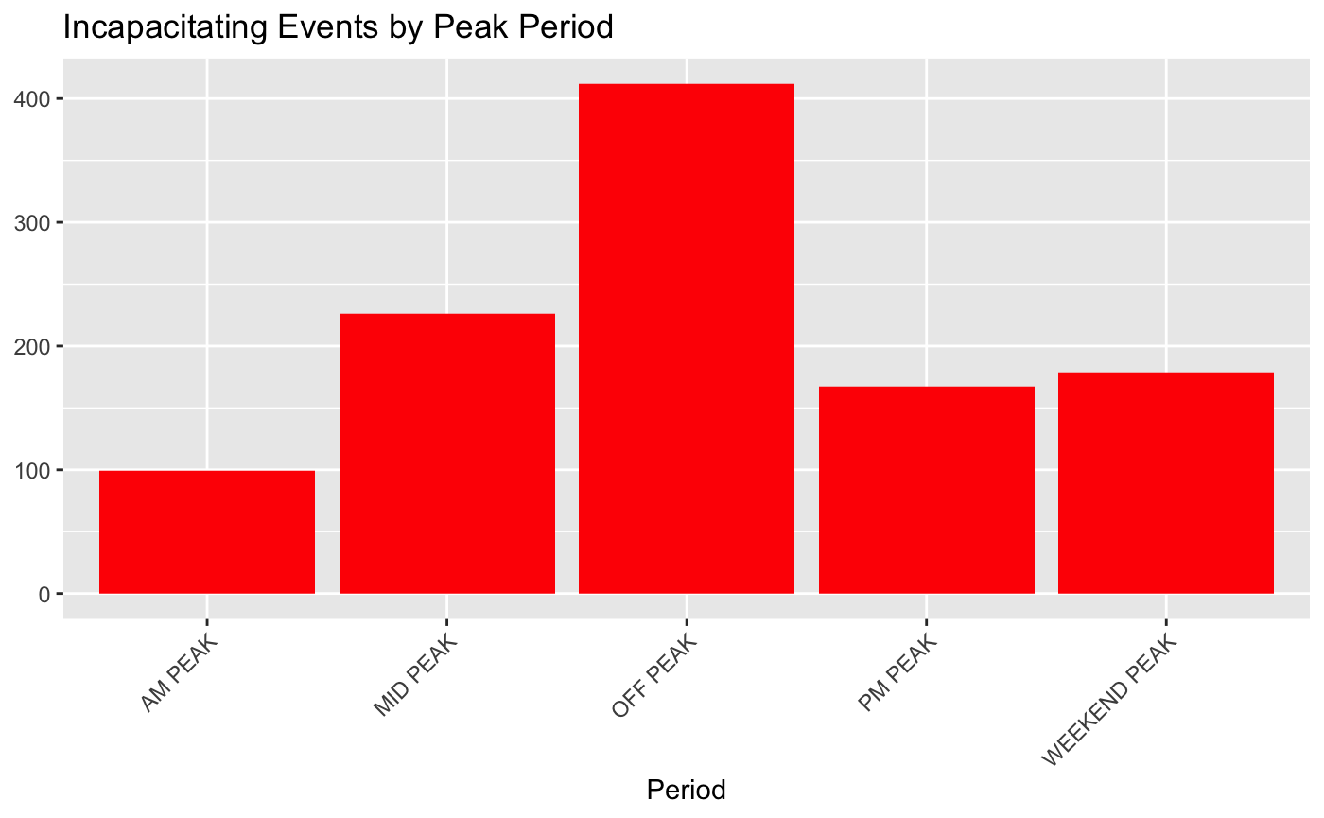
Crash Summary
Notes:
For crash types for all events, accidents involving rear ends were the most common, but a slightly different trend shows when considering only incapacitating events. Taking a left turn over on-coming traffic was the leading crash type, and pedestrians being on the roadside, rear ends, and drivers running off the road were the other leading causes of incapacitating events. As far as peak traffic hours go, the mid-day rush between 10a-4p has the most events and the off peak between M-F 7p-7a and Sa-Su 8p-6a has the most incapacitating events, which could be related to lack of visibility or alcohol.

Slide 8
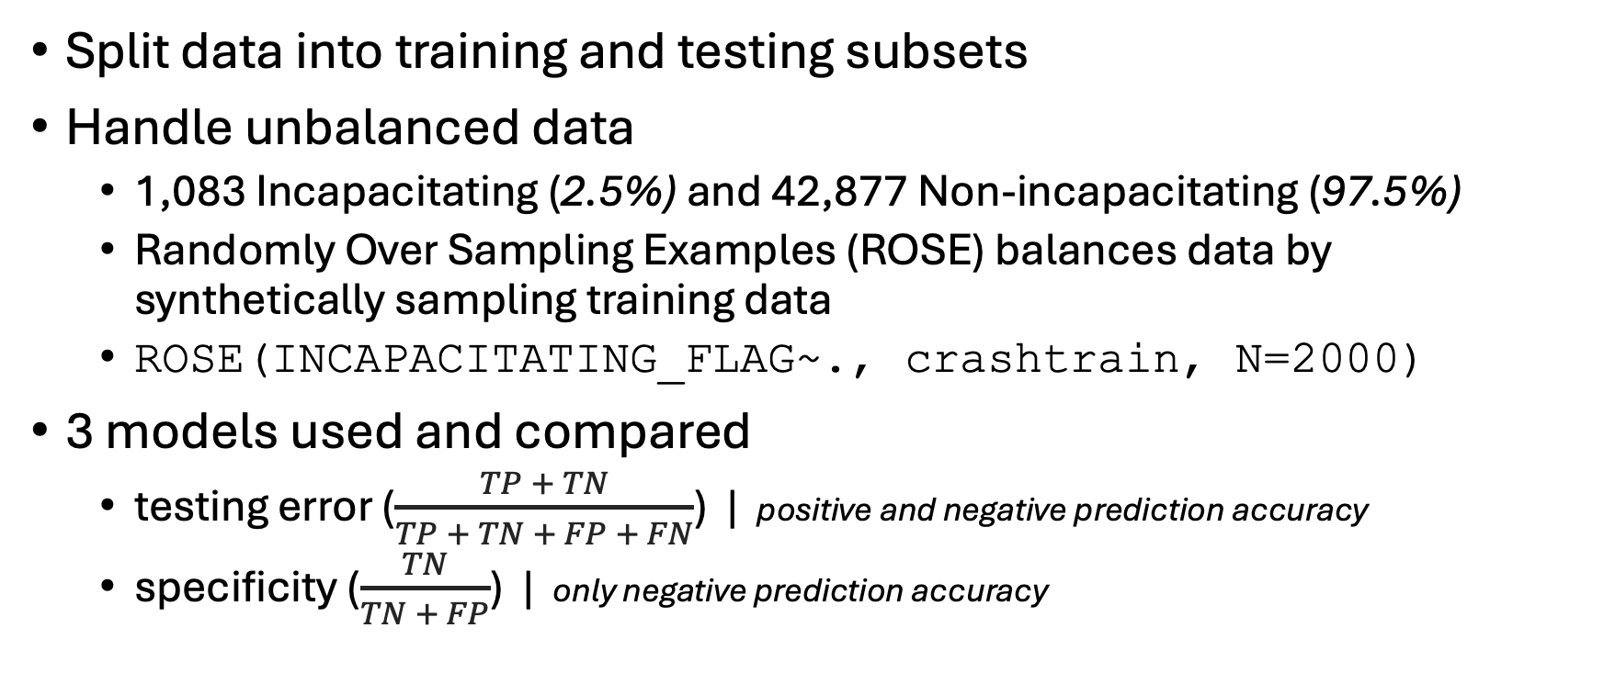
Methodology
Split data into training and testing subsets
Handle unbalanced data
1,083 Incapacitating (2.5%) and 42,877 Non-incapacitating (97.5%)
Randomly Over Sampling Examples (ROSE) balances data by synthetically sampling training data
ROSE(INCAPACITATING_FLAG~., crashtrain, N=2000)
3 models used and compared
testing error ($\frac{TP + TN}{TP + TN + FP + FN}$) | positive and negative prediction accuracy
specificity ($\frac{TN}{TN + FP}$) | only negative prediction accuracy
Notes:
To get started, a subset of the data was reserved for testing while the majority was used for training. The severity of crash data is unbalanced with about 2.5% classified as incapacitating. While this adds a challenge when training a model to successfully make predictions, this is a good problem to have. When I am on the road, I want the odds of my safety strongly skewed in my favor of not experiencing a life-threatening event. Techniques to account for this include under-sampling the majority class, over-sampling the minority class, or synthetically sampling both classes using either ROSE or SMOTE. The code shown here is an example using ROSE to ensure the size of each class is 2,000. 3 different models were trained and the testing error and specificity were compared to measure performance.

Slide 9
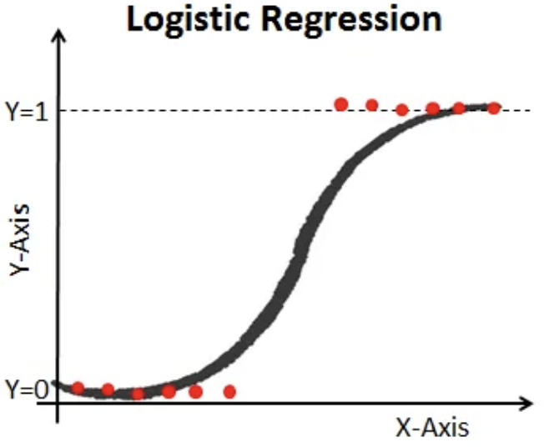
Model – Logit/SW
Logistic Regression
A probabilistic classification model used for binary classification
Suitable for scenarios when you need to understand probability of the response variable
Stepwise variable section via Akaike information criterion (AIC)
Selected 15 predictors as statistically significant
step(glm(INCAPACITATING_FLAG~., data = crashtrain_balanced), trace = F)
TOTAL_NUMBER_OF_VEHICLES | S4_CRASH_TYPE_SIMPLIFIED | S4_IS_DRUG_RELATED | S4_MOTORCYCLE_COUNT
TOTAL_NUMBER_OF_PERSONS | S4_IS_AGGRESSIVE_DRIVING | S4_IS_HIT_AND_RUN | S4_MOPED_COUNT
RURAL_OR_URBAN | S4_IS_ALCOHOL_RELATED | S4_IS_INTERSECTION_RELATED | S4_AGING_DRIVER_COUNT
ROAD_SYSTEM_IDENTIFER | S4_UNRESTRAINED_COUNT | S4_IS_LANE_DEPARTURE_RELATED
Notes:
Logistic regression is a binary classification model, which is suitable when you want to understand the probability of an event occurring. Variable selection can simplify the model by only using variables that contribute to the model’s performance by comparing the AIC values between each iteration. This can be done taking a forward approach and adding variables, a backward approach and removing variables, or a stepwise approach that is a combination of both forward and backwards. One method is the stepwise approach which both adds and removes variables from the model using the step() function in R. This results in 16 variables shown in the table on the bottom of this slide.

Slide 10
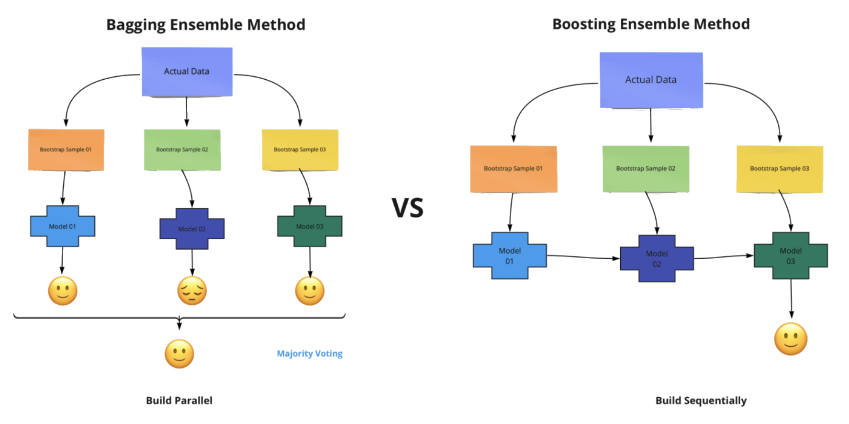
Models - RF
Random Forest
An ensemble Bootstrap aggregating (bagging) model that combines many decision trees
Suitable for handling large datasets with high dimensionality and complexity
randomForest(as.factor(INCAPACITATING_FLAG)~., crashtrain_balanced, proximity=T, importance=T)
Notes:
The next 2 models are called ensemble methods because they combine the results of multiple models into 1 result. Random forests are a bagging algorithm that bootstraps many independent decision trees and aggregates the results by taking the average or mode. This is suitable for handling large datasets with high dimensionality and can be done in R using the randomForest() function.

Slide 11
Models - GBM
Generalized Boosting Regression
An ensemble gradient boosting model similar to random forest but iteratively trains weak learners to improve model performance.
Use cross-validation to find the optimal # of iterations
Suitable when you can tolerate longer training times
gbm(INCAPACITATING_FLAG~., data=crashtrain_balanced, distribution = 'bernoulli', n.trees = 5000, shrinkage = 0.01, interaction.depth = 1, cv.folds = 10)
Notes:
Another ensemble algorithm is boosting, which is similar to random forest that iteratively builds decision trees, but instead of aggregating independent trees, it uses the previous results to train weak learners and improve each iteration. To find the optimal # of iterations for predicting, you can use cross-validation. This can improve accuracy and can be done in R using the gbm() function, but it also increases time spent in computation.

Slide 12
Results
Logit | N | Y |  | RF | N | Y |  | GBM | N | Y
N | 3429 | 38 |  | N | 4164 | 91 |  | N | 4273 | 117
Y | 846 | 83 |  | Y | 111 | 30 |  | Y | 2 | 4
Test Error | 0.201 |  |  | Test Error | 0.046 |  |  | Test Error | 0.027
Specificity | 0.686 |  |  | Specificity | 0.248 |  |  | Specificity | 0.033
Logit-SW | N | Y |  | RF-SW | N | Y |  | GBM-SW | N | Y
N | 3439 | 35 |  | N | 4169 | 87 |  | N | 4260 | 109
Y | 836 | 86 |  | Y | 106 | 34 |  | Y | 15 | 12
Test Error | 0.198 |  |  | Test Error | 0.044 |  |  | Test Error | 0.028
Specificity | 0.71 |  |  | Specificity | 0.281 |  |  | Specificity | 0.099
Testing Error: Proportion of errors overall. Low = good
Specificity: Proportion of correctly IDed negative results. High = good
Notes:
Now for the results. The confusion matrices for each model are shown here with the diagonal showing the amount of correctly identified events. For an overall approach, the boosting model had the lowest testing error, meaning when considering all values for all classes, it performed the best. But there are cases where incorrect negative IDs can be costly, such as life-threatening events. This is where specificity becomes important. While the boosting model had the lowest test error, it really struggled with predicting true incapacitating events and got 12 correct and 109 wrong with the stepwise predictors. Logistic regression had the worst testing error but outperformed the other 2 algorithms when predicting true incapacitating events.

Slide 13
Conclusion
Q: How well can machine learning predict incapacitating events?
Different interpretations
Best for overall accuracy: Generalized Boosting Regression
Best for predicting incapacitating events: Logistic Regression
Dataset challenges
Unbalanced data
Missing/wrong data
Notes:
Back to the question of how well machine learning can predict incapacitating events. Can it? In short - yes. But it’s important to consider how you’re measuring efficiency. Overall, boosting was the preferred method for predicting crashes, but struggled with life-threatening events. Logistic regression did better at predicting those life-threatening events, but overall didn’t do perform the best. This could be due to the handling of unbalanced data, or the lack of stronger predictors. For example: speeding involvement was incorporated as a binary classification, but going 5 mph over is very different than going 50 mph over. Additionally, in situations with costly consequences such as interacting with law enforcement, information may be withheld or fabricated for self protection.

Slide 14


More Details
Scan or click below for more resources about this study
Explore the data using an interactive map on ArcGIS Online
View the code and data used on GitHub
Questions?
Notes:
This concludes the presentation. For more details, scan or click the links shown on this slide to view the data in an interactive map in ArcGIS Online, or view the code used for this analysis in the project’s GitHub repository. Each site also has a reference to the other, so as long as you view one, you can get to the other. Thank you, and please let me know if you have any questions.

