Slide 1
Predictive Analysis of Crash Incidents in Hillsborough County
Bo Fethe
Group 123
March 2024

Slide 2
Introduction
Unintentional accidents were the #3 in leading cause of death in Florida during 2022 (Florida Department of Heath¹)
Federal programs, like Vision Zero, help communities eliminate traffic fatalities and serious injuries by improving safety measures.
Signal Four Analytics receives tabular and geospatial crash data from Florida Department of Highway Safety and Motor Vehicles (FLHSMV)
Q: How well can machine learning predict incapacitating events?
¹ https://www.flhealthcharts.gov/ChartsReports/rdPage.aspx?rdReport=ChartsProfiles.LeadingCausesOfDeathProfile

Slide 3
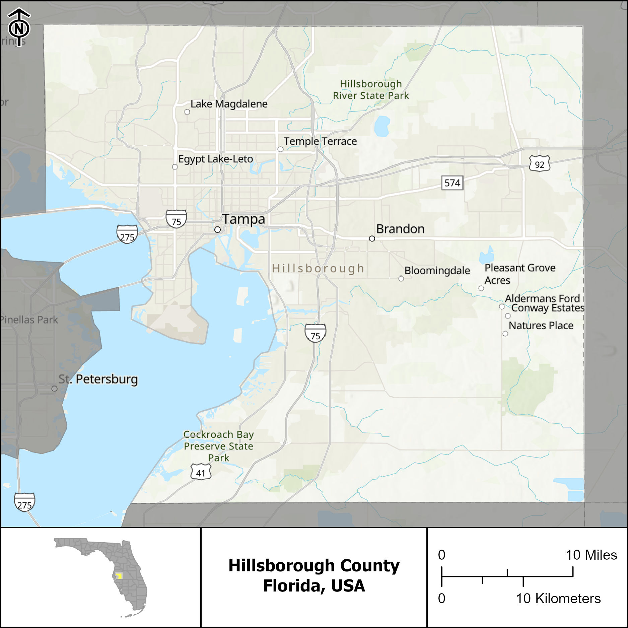
Study Area
Hillsborough County, Florida, USA
3 incorporated cities
Tampa
Plant City
Temple Terrace
Population
July 2023: 1,535,564 (U.S. Census Bureau²)
2050 Estimate: 2,017,294 (Plan Hillsborough³)
² https://www.census.gov/quickfacts/fact/table/hillsboroughcountyflorida/PST045223
³ https://planhillsborough.org/county-to-reach-2-million-residents-and-1-4-million-jobs-by-2050

Slide 4
Data
2023 crash records from Signal Four Analytics
23/117 Signal Four columns + 2 generated columns selected for analysis = 25 predictors
Crash Severity simplified into 2 classifications
Fatality or Serious Injury = Incapacitating
No Injury or Injury = Non-incapacitating
Peak traffic hours
AM Peak (07:00-10:00)
Mid Peak (10:00-16:00)
PM Peak (16:00-19:00)
Weekend Peak (06:00-20:00)
Off Peak for all other times

Slide 5
Attributes
Name | Description
INCAPACITATING_FLAG | Binary response whether the crash severity resulted in a serious injury/fatality or not derived from S4_CRASH_TYPE_SIMPLIFIED
PEAK | Peak traffic period derived from CRASH_DATE_AND_TIME
TOTAL_NUMBER_OF_VEHICLES | Count of all vehicles involved in the crash
TOTAL_NUMBER_OF_PERSONS | Count of all persons involved in the crash (drivers, passengers, and non-motorists)
RURAL_OR_URBAN | Check if the traffic crash occurred inside the corporate limits of the city
ROAD_SYSTEM_IDENTIFER | This classification is used to identify the primary road system on which the traffic crash occurred
ROAD_SURFACE_CONDITION | This classification is used to identify the surface condition of the street, road or highway at the time of the traffic crash
S4_CRASH_TYPE_SIMPLIFIED | Crash type simplified for practitioners who desire less detailed crash types
S4_DAY_OR_NIGHT | To identify if the crash happened in the daytime or nighttime
S4_IS_AGGRESSIVE_DRIVING | To identify the presence of aggressive driving in the crash
S4_IS_ALCOHOL_RELATED | To identify the presence of alcohol by the driver in the crash
S4_IS_CMV_INVOLVED | To identify the presence of a commercial motor vehicle is involved in the crash
S4_IS_DISTRACTED | To identify the presence of driving distraction in the crash
S4_IS_DRUG_RELATED | To identify if the crash is drug related due to refusal of drug test or positive drug test of driver
S4_IS_HIT_AND_RUN | To identify if the crash is hit and run related
S4_IS_INTERSECTION_RELATED | To identify if the crash is intersection related
S4_IS_LANE_DEPARTURE_RELATED | To identify the presence of lane departure in the crash
S4_IS_SPEEDING_RELATED | To identify if the crash is speed related
S4_TRAILER_COUNT | Number of trailers in the crash
S4_MOTORCYCLE_COUNT | Number of motorcycles in the crash
S4_MOPED_COUNT | Number of mopeds in the crash
S4_BICYCLIST_COUNT | Number of bicyclists in the crash
S4_AGING_DRIVER_COUNT | Number of aging drivers in the crash who are 65 or older
S4_TEENAGER_DRIVER_COUNT | The number of drivers involved in the crash whose age at time of crash is between 15 and 19
S4_UNRESTRAINED_COUNT | Number of motor vehicle occupants not using restraint system(s) at time of crash

Slide 6
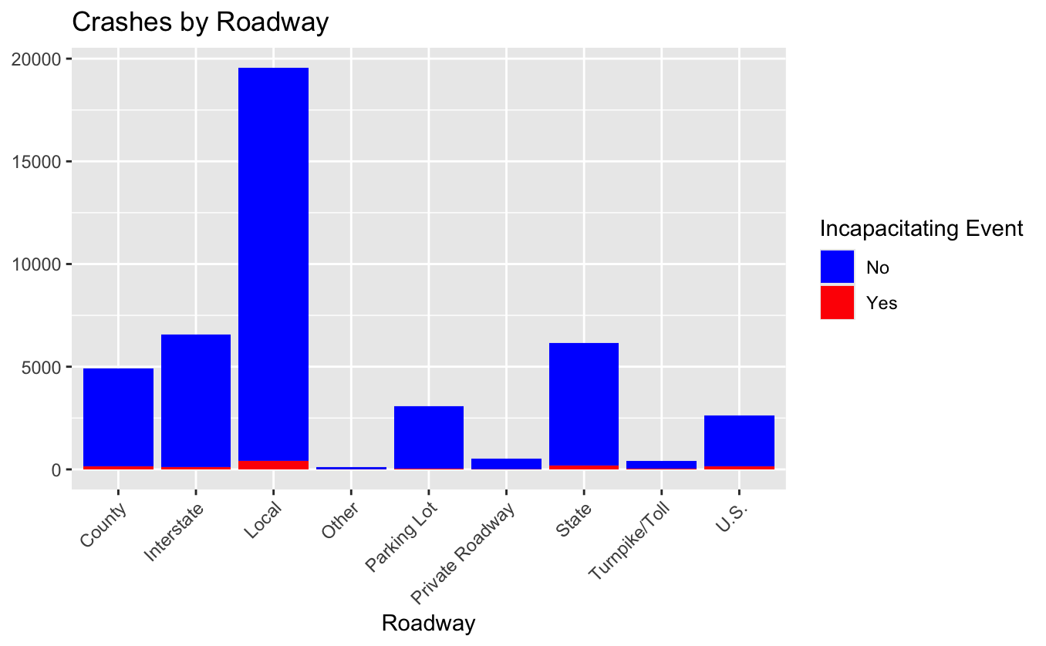
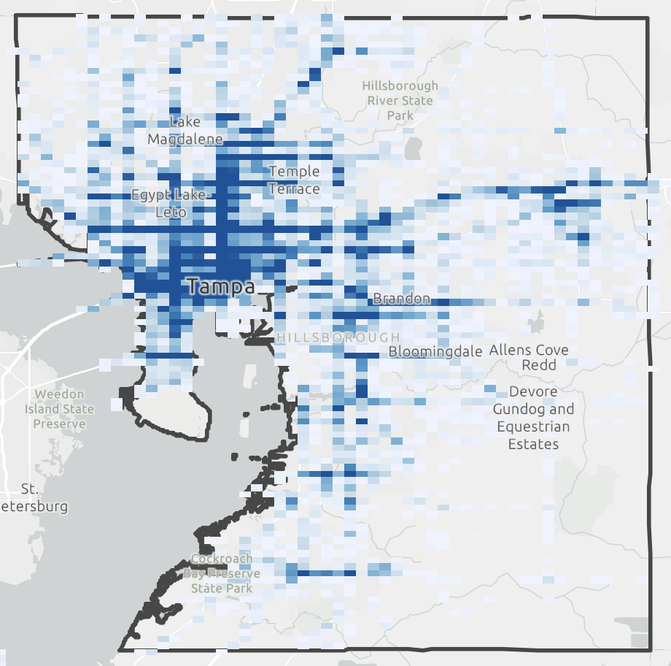
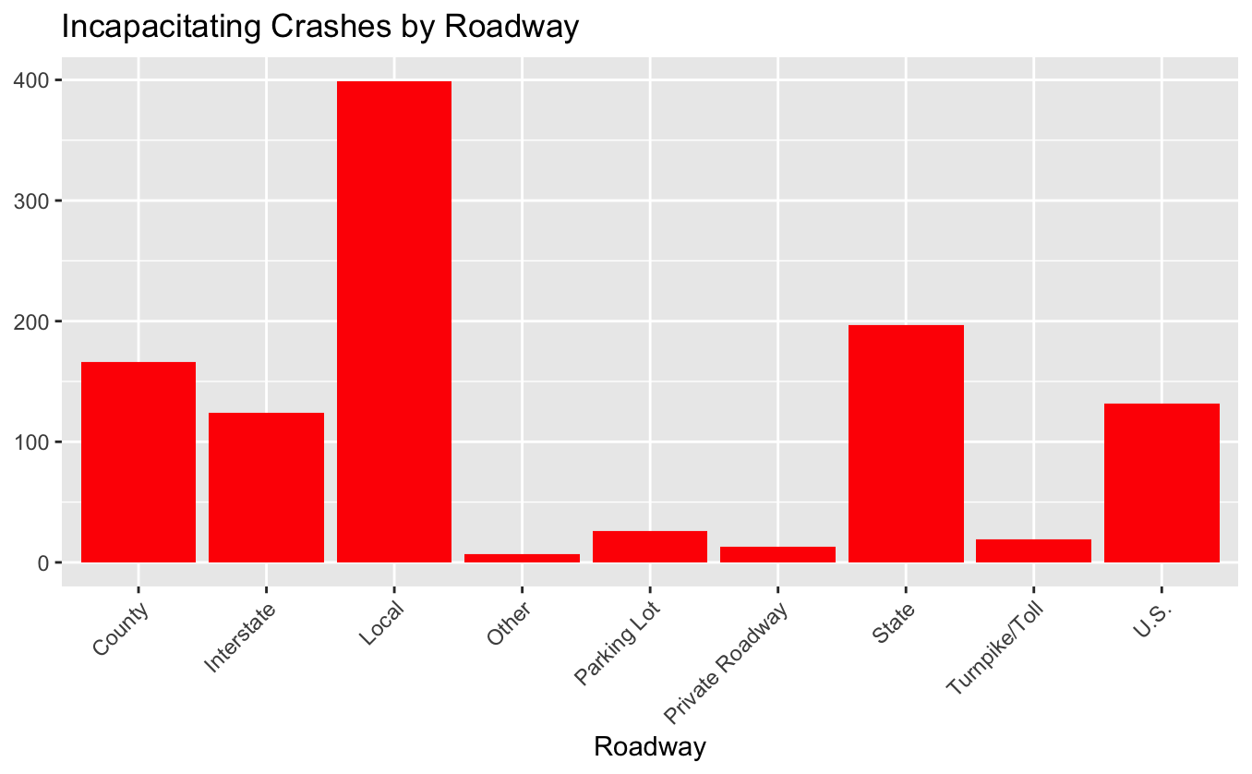
Crash Locations

Slide 7
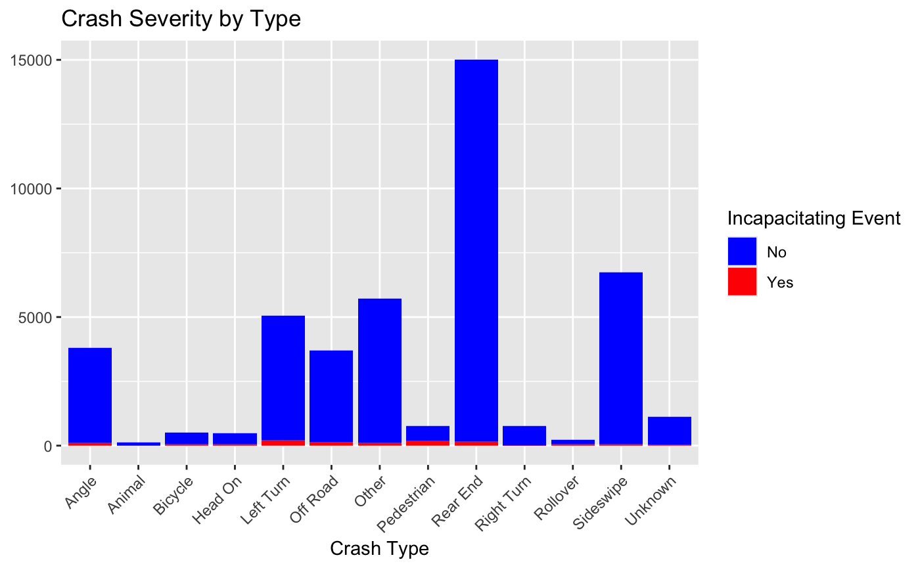
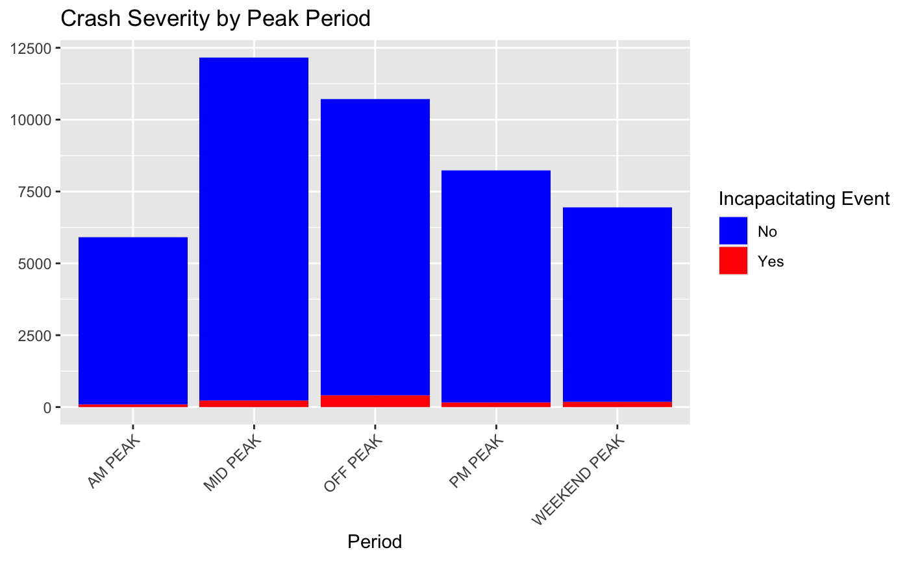
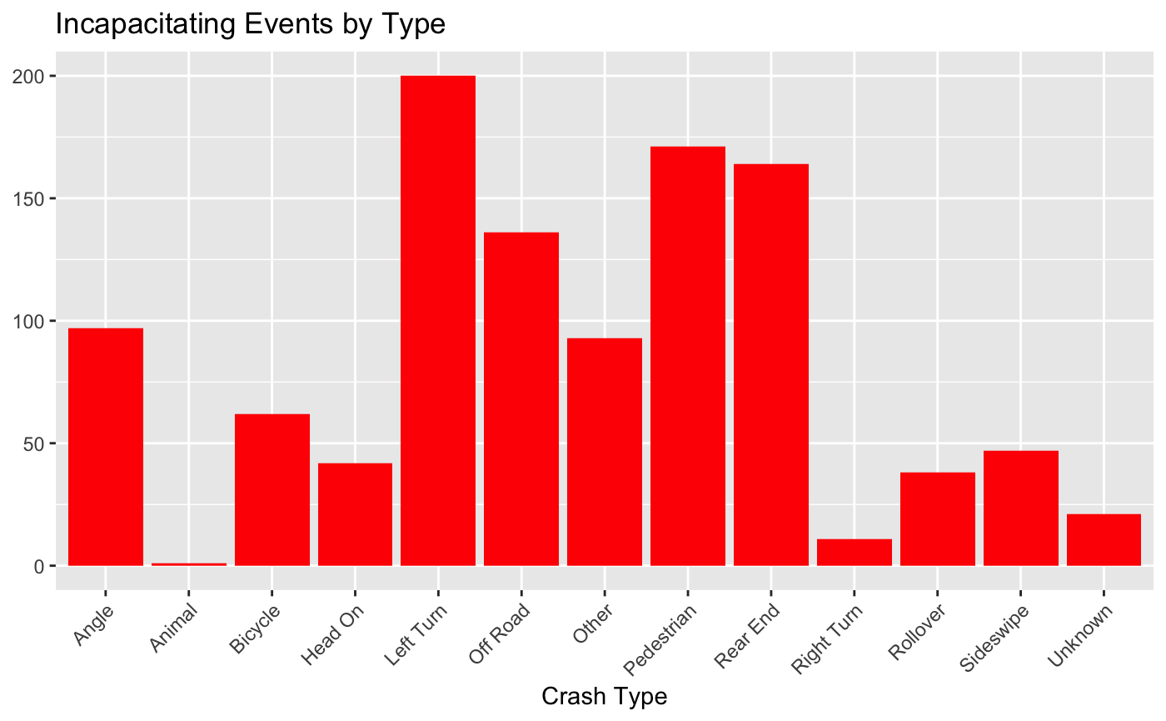
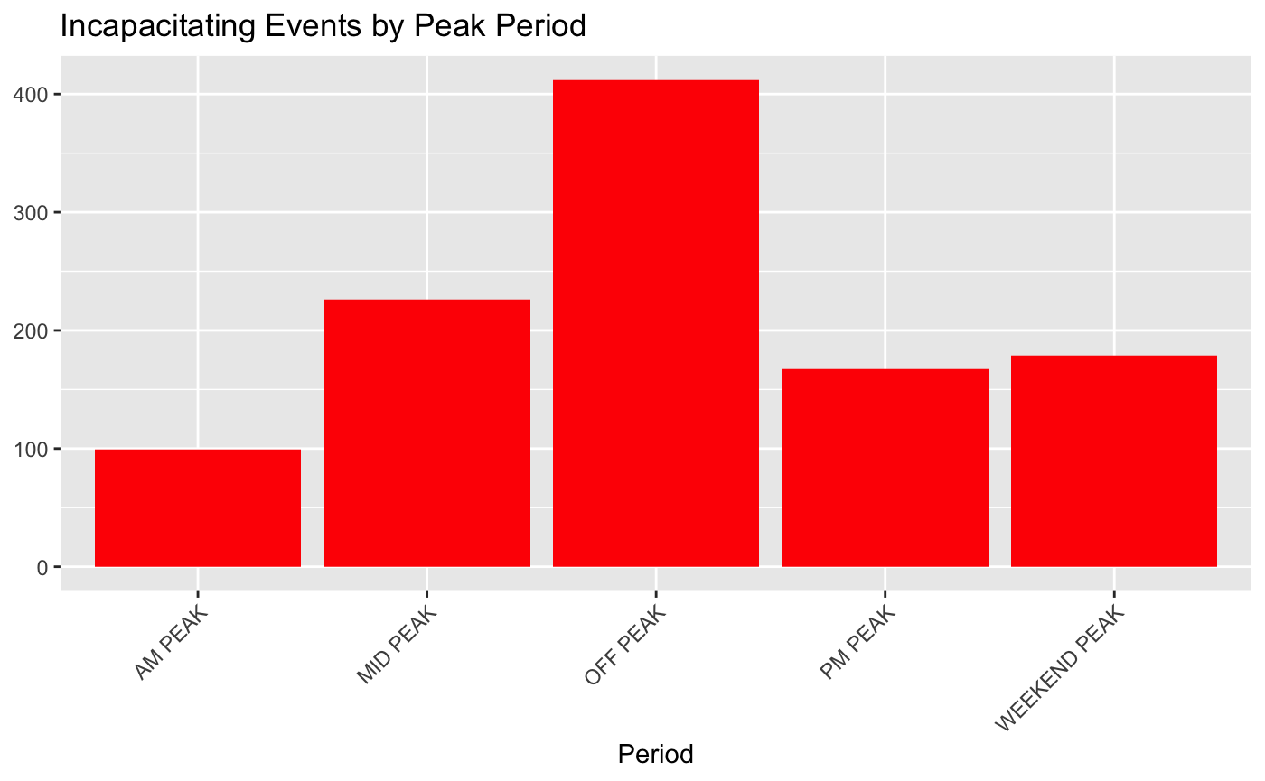
Crash Summary

Slide 8
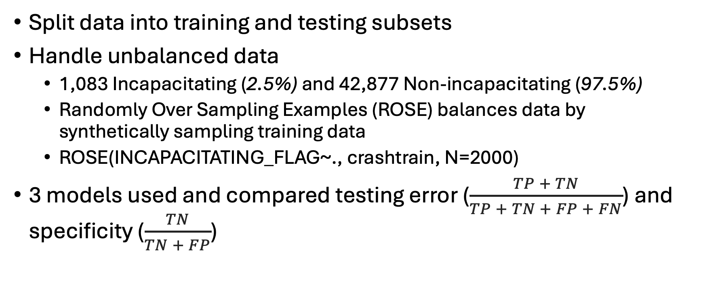
Methodology
Split data into training and testing subsets
Handle unbalanced data
1,083 Incapacitating (2.5%) and 42,877 Non-incapacitating (97.5%)
Randomly Over Sampling Examples (ROSE) balances data by synthetically sampling training data
ROSE(INCAPACITATING_FLAG~., crashtrain, N=2000)
3 models used and compared testing error ($\frac{TP + TN}{TP + TN + FP + FN}$) and specificity ($\frac{TN}{TN + FP}$)

Slide 9
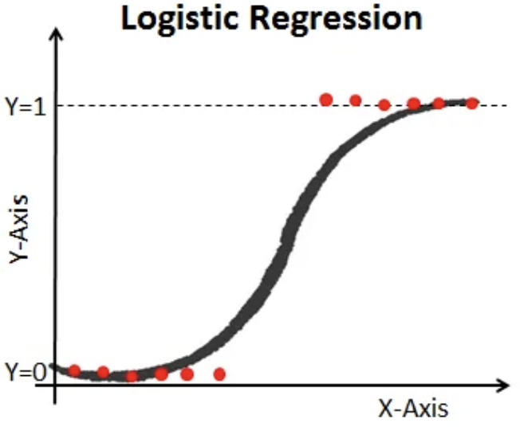
Model - Logit
Logistic Regression
A probabilistic classification model used for binary classification
Suitable for scenarios when you need to understand probability of the response variable
Stepwise variable section via Akaike information criterion (AIC)
step(glm(INCAPACITATING_FLAG~., data = crashtrain_balanced), trace = F)
Selected 16 predictors
TOAL_NUMBER_OF_VEHICLES | S4_CRASH_TYPE_SIMPLIFIED | S4_IS_DRUG_RELATED | S4_MOTORCYCLE_COUNT
TOTAL_NUMBER_OF_PERSONS | S4_IS_AGGRESSIVE_DRIVING | S4_IS_HIT_AND_RUN | S4_MOPED_COUNT
RURAL_OR_URBAN | S4_IS_ALCOHOL_RELATED | S4_IS_INTERSECTION_RELATED | S4_AGING_DRIVER_COUNT
ROAD_SYSTEM_IDENTIFER | S4_IS_CMV_INVOLVED | S4_IS_LANE_DEPARTURE_RELATED | S4_UNRESTRAINED_COUNT

Slide 10
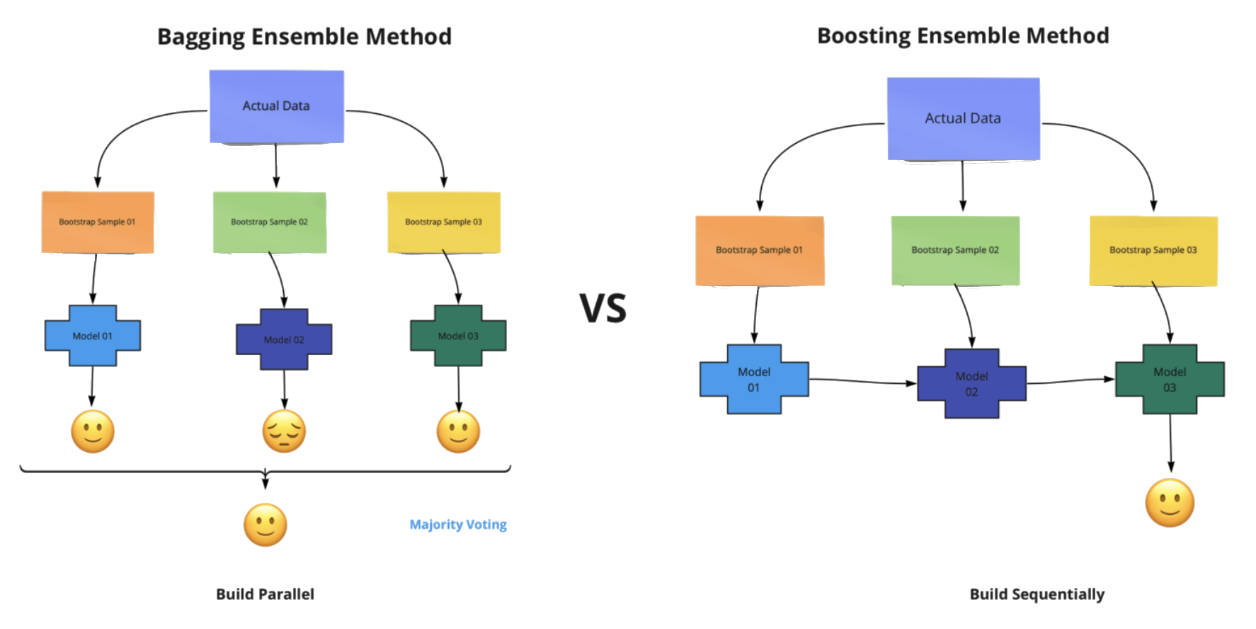
Models - RF
Random Forest
An ensemble Bootstrap aggregating (bagging) model that combines many decision trees
Suitable for handling large datasets with high dimensionality and complexity
randomForest(as.factor(INCAPACITATING_FLAG)~., crashtrain_balanced, proximity=T, importance=T)

Slide 11
Models - GBM
Generalized Boosting Regression
An ensemble gradient boosting model similar to random forest but iteratively trains weak learners to improve model performance.
Suitable when you can tolerate longer training times
Use cross-validation to find the optimal # of iterations
gbm(INCAPACITATING_FLAG~., data=crashtrain_balanced, distribution = 'bernoulli', n.trees = 5000, shrinkage = 0.01, interaction.depth = 1, cv.folds = 10)

Slide 12
Results
Logit | N | Y |  | RF | N | Y |  | GBM | N | Y
N | 3480 | 38 |  | N | 4164 | 91 |  | N | 4273 | 117
Y | 795 | 83 |  | Y | 111 | 30 |  | Y | 2 | 4
Test Error | 0.190 |  |  | Test Error | 0.046 |  |  | Test Error | 0.027
Specificity | 0.686 |  |  | Specificity | 0.240 |  |  | Specificity | 0.033
Testing Error: Proportion of errors overall. Low = good
Specificity: Proportion of correctly IDed negative results. High = good

Slide 13
Conclusion
Dataset challenges
Unbalanced data
Truthful reported values
Different interpretations
Best for overall accuracy: Generalized Boosting Regression
Best for predicting incapacitating events: Logistic Regression

Slide 14


More Details
Scan or click below for more resources about this study
Explore the data using an interactive map on ArcGIS Online
View the code and data used on GitHub

Slide 15
Questions?

