Slide 1
MVP Generator
Under the guidance of Asst Prof. Dr. Sushama Nagpal
Akanshi Gupta (216/CO/12)
Chitrasoma Singh (254/CO/12)
Divjot Singh (262/CO/12)

Slide 2

WHAT ?

Slide 3

introduction
Digital world is experiencing the biggest change in the history.
Increasing use of web and mobile apps, more than ever.
New ideas are evolving to make almost all services just a click away through them.
Numerous new technologies have been introduced just to provide efficiency and ease of use to the people

Slide 4
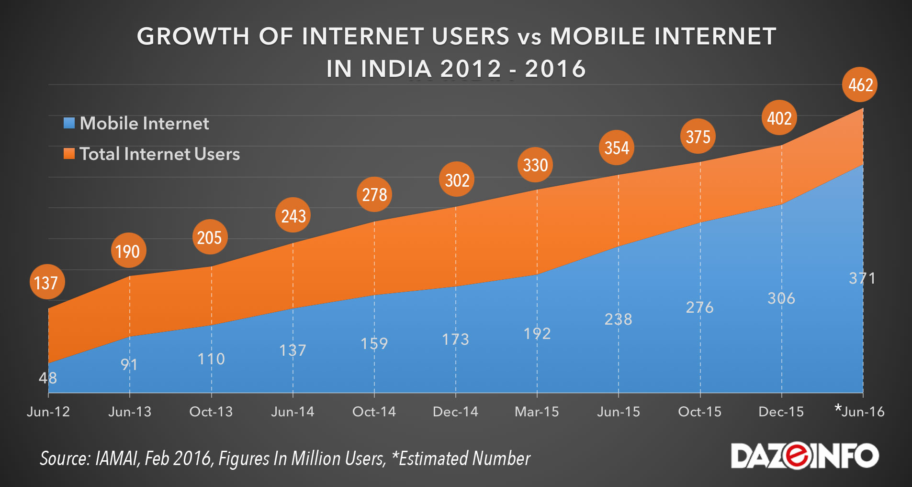
Growth of MOBILE Internet

Slide 5



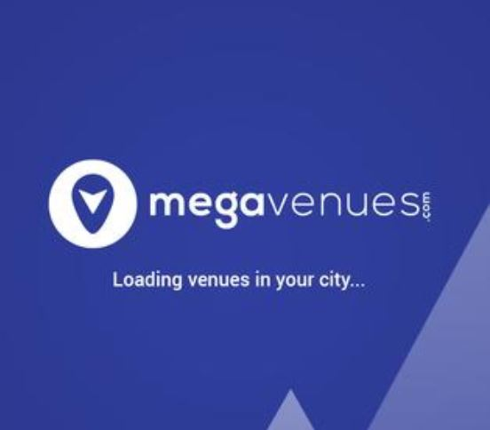

StartupS
Every now and then, applications emerge to provide more services on the backbone of internet and smartphones.
Search engines are a major part of application industry. From finding restaurant, to finding doctors, there’s an app for that.
India is witnessing a startup bubble like the dot com revolution.

Slide 6
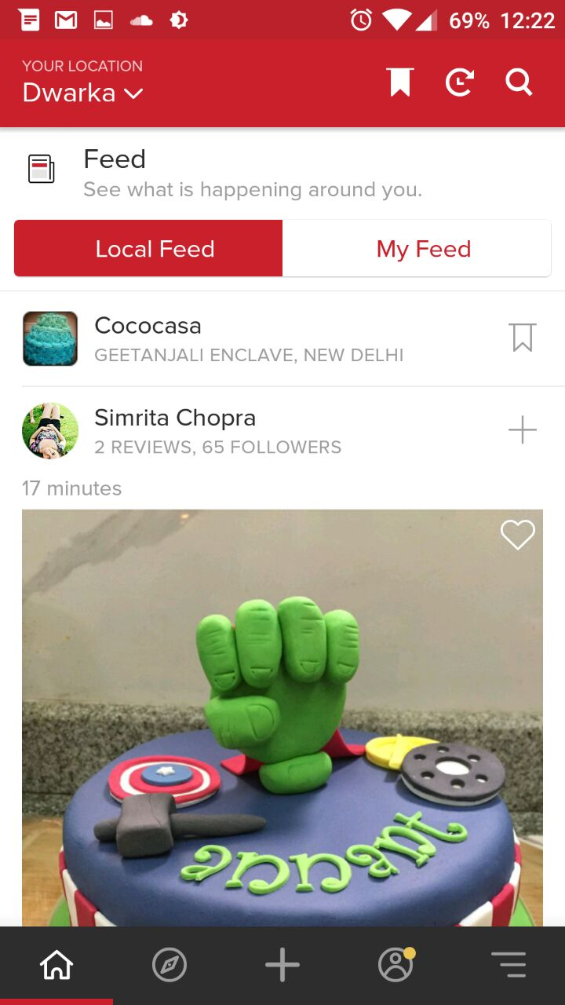
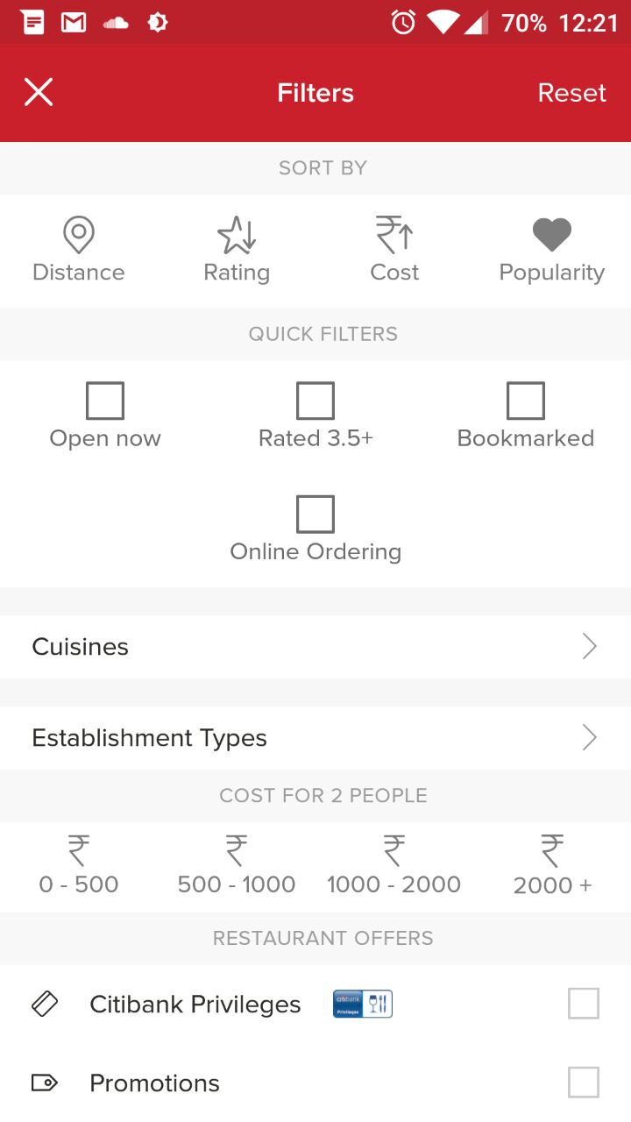
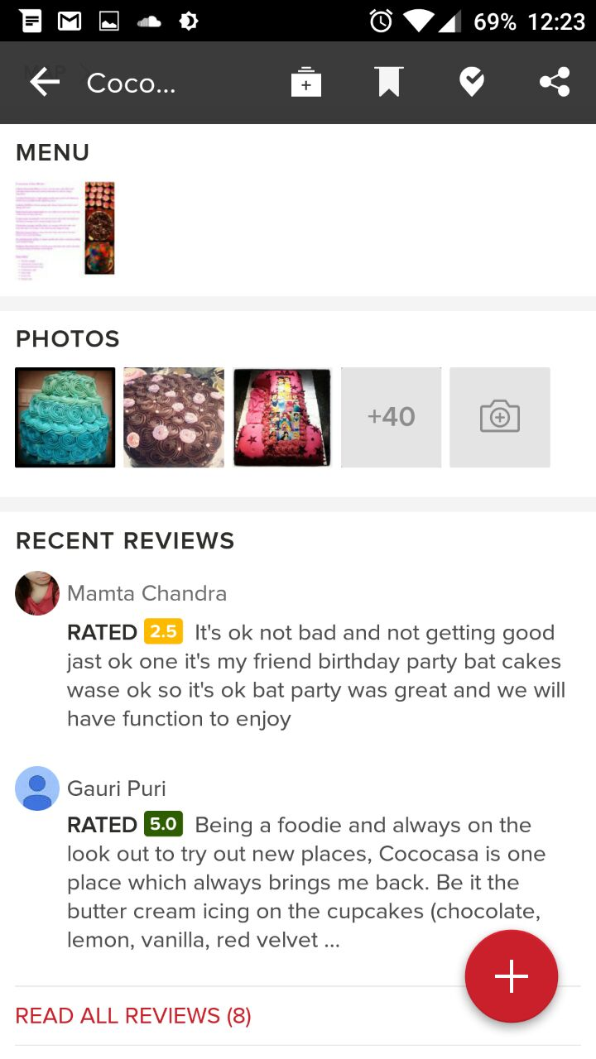
Case Study: Zomato (Restaurant finder)

Slide 7
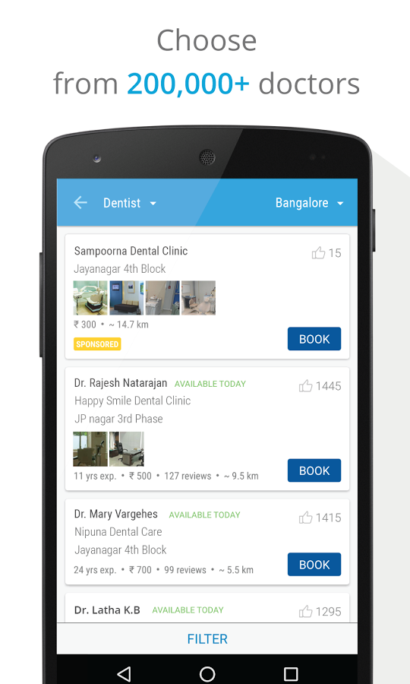
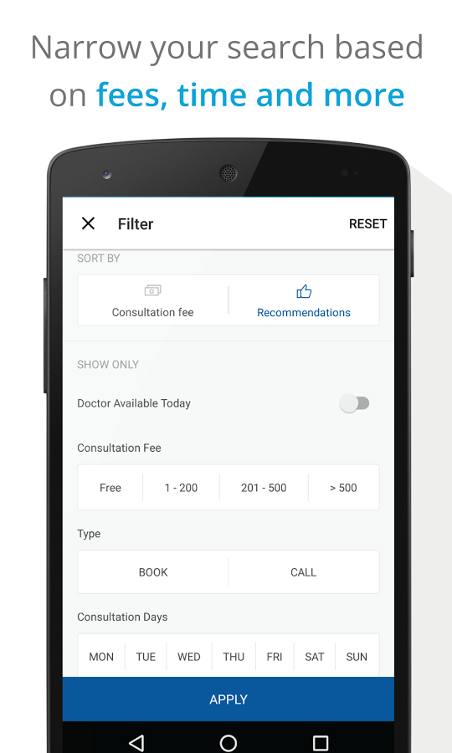
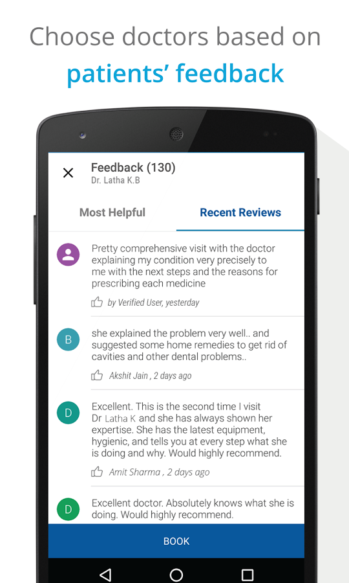
Case Study: Practo (Doctor finder)

Slide 8
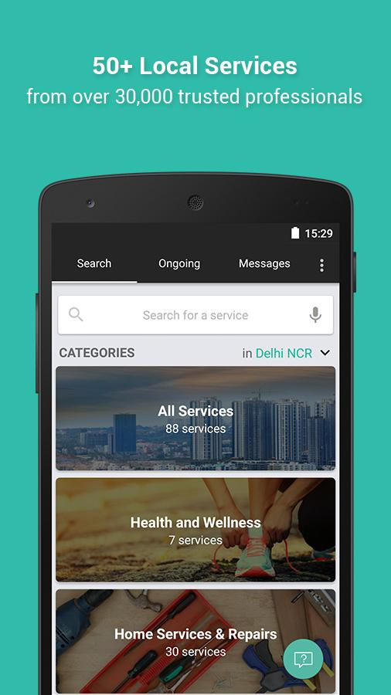
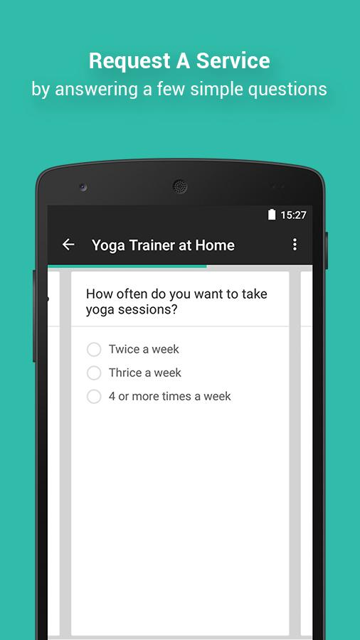
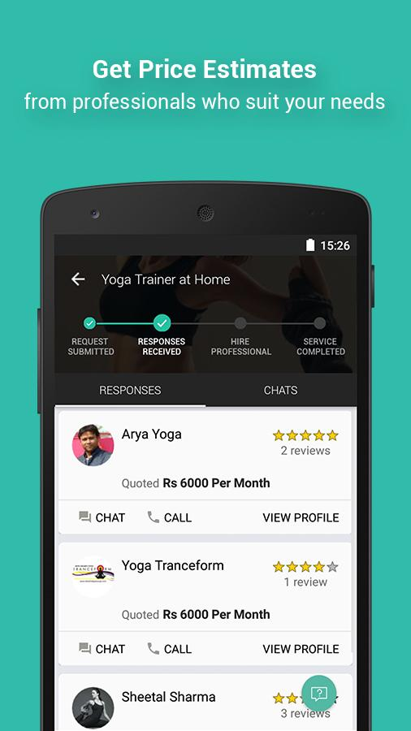
Case Study: Urban Clap (Service Worker Finder)

Slide 9
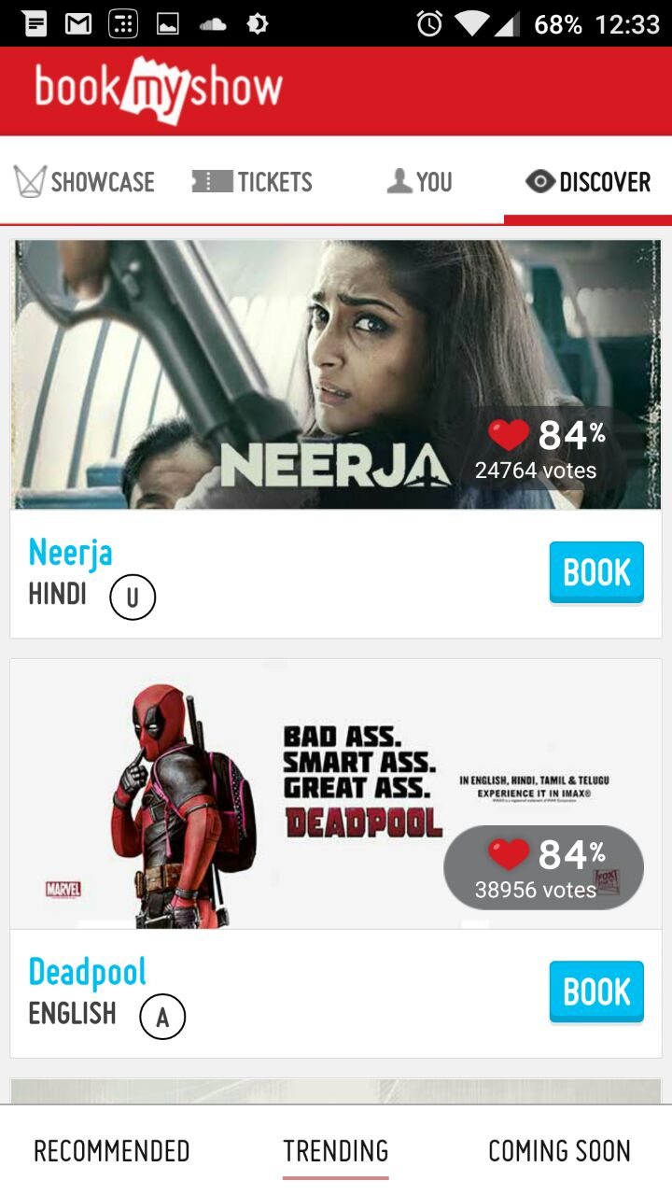
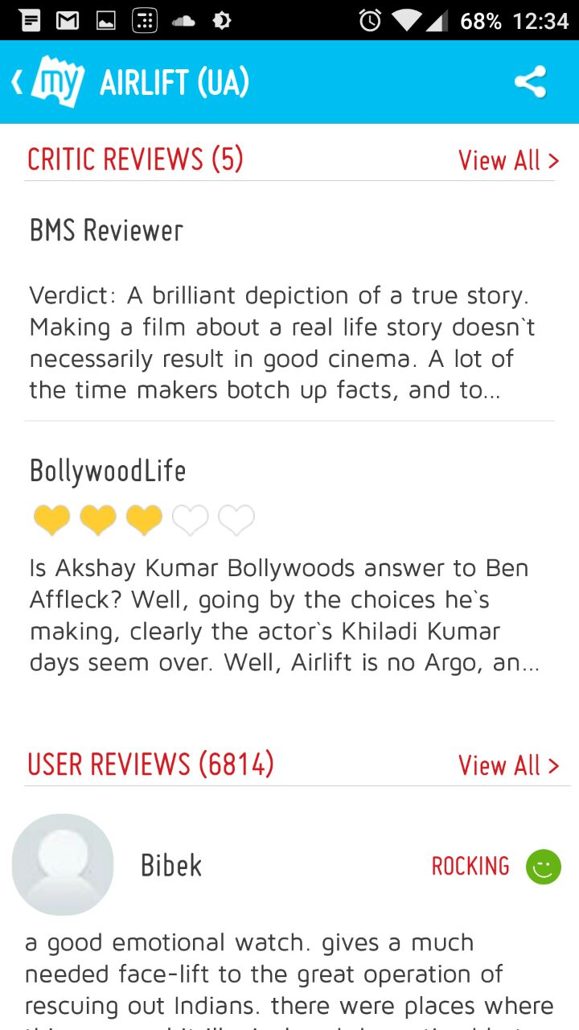
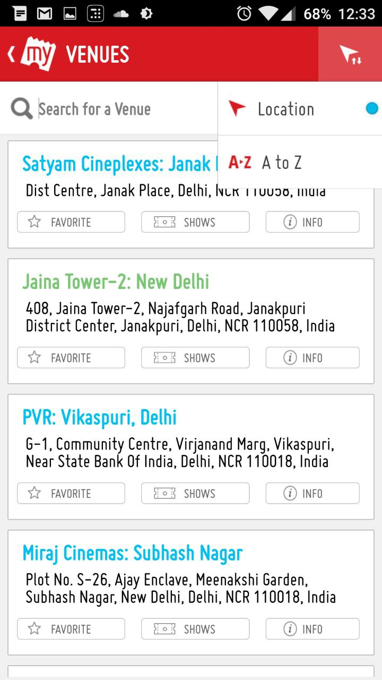
Case Study: BookMyShow (Movie Booking App)

Slide 10
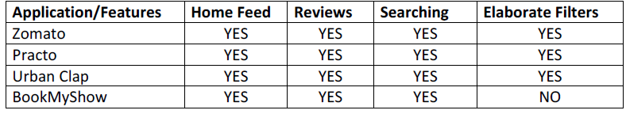
Case Study: Conclusion
Differ only in the entity they allow searching around; share the same functionality and majority of the characteristics as follows:
A home feed where user can look at trending entities
Sort and search entities based on popularity and attributes of the entity itself.
Read and give reviews & comments around the entity.
Contact the entity via email/phone/map directions and other mediums.

Slide 11
Issues faced by startups
Startups are seed funded on basis of quality of Minimum Viable Product (MVP)
Development of MVP requires a team of software engineers working on each part of the software stack, usually frontend, backend, UI expert and data engineer.
Requires a lot of capital and time which competitive industry doesn’t allow.

Slide 12
Motivation
Pattern observed in case study makes room for automation in the development of this huge segment of applications.
More and more applications are following the pattern.
Same implementation is worked out for each application. Cost and time is wasted to achieve something that can be achieved by meta-programming.

Slide 13
GOAL
MVP GENERATOR
options
End-User
Generated application

Slide 14
HOW DO THEY DO IT?

Slide 15
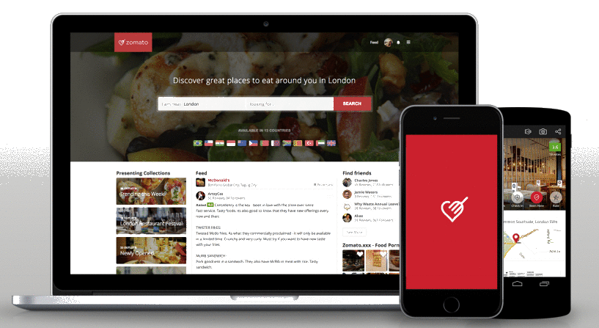
Application Development
DataBase
DB Communication Layer E.g. ORMs
ORM
SERVER
Website Assets (HTML/JS/CSS)
APIs
REST API
HTTP
Application Binary
APP STORE

Slide 16
Component Based Software Engineering
Development with the help of reusable software components.
Ideal off-the-shelf components are chosen and then assembling them using a well-defined software architecture.
Using off-the-shelf components helps reduce software development time and cost substantially.
Supports fault detection by testing the components

Slide 17
Agile Software Development
To overcome the fast changing business needs, agile methods are used in developing solutions quickly and efficiently.
Process is structured into iterations.
Each iteration produces sizeable amount of working code and artifacts of interest to customers

Slide 18
COHESION
Cohesion refers to the degree to which the elements of a module belong together.
Cohesion measures the strength of relationship between pieces of functionality within a given module.
Any software should support high cohesion level.

Slide 19
Pure functions
Mutation isn’t desirable in large systems. It often leads to un-trackable bugs, un-expected behaviour from entire system and also affect code readability.
Pure functions are the functions that don’t mutate state and always return same value for same arguments passed to them.
To avoid coupling, pure functions are preferred in the system.

Slide 20
GOAL
MVP GENERATOR
options
End-User
Generated application

Slide 21
HOW DO WE DO IT?

Slide 22
Implementation
Keeping above principles in mind, we divided development process into 2 phases
Create highly modular and customizable skeleton application
Create working frontend that covers the 3 primary features as discussed in case study
Create working backend to support the frontend.
Create a generator that transforms skeleton into required app using component replacement and configuration modifications
Create a CLI app that accepts input from user
Develop a file system utility to replicate the skeleton
Perform code transformations
Perform component replacements.

Slide 23
Skeleton
Entire application has 4 major layers:
ORM
API
Component Fetch
Component UI
ORM
API
Component fetch
Component UI
Server
Client

Slide 24
SKELETON: ORM
1:n Writes
m:n Likes
Reviews
n:1 Has
User
m:n Likes
1:n Replies
m:n Bookmarks
Person
ISA
Owner
m:n Rates
Entity
1:n Manages
1:1
Updates
Admin
1:n
Manages
*Management involves creating, updating and deleting.

Slide 25
SKELETON: API
Second layer that acts as a controller between requests from client side and the database entities.
NodeJS has largest package repository [11], we make use of reusable modules of Node to speed up the development process using Component Based Development.
Each entity has its own set of APIs, in a separate module. This ensure high cohesion.
Following APIs are developed :
Users: Deals with functions of User, such as login, logout, signup, get profile, edit profile etc.
Entities: Deals with functions of Entity, such as create, search, modify entity.
Reviews: Deals with functions of Reviews, such as adding review, editing review and deleting review.
Ratings: Deals with rating of an entity by a registered user.
Bookmarks: Deals with bookmarking of entity by a registered user.

Slide 26
SKELETON: Server overview
HTTP Listener
GET /users.json
login()
logout()
DELETE /reviews.json
addReview()
Express
Router
API
ORM
DB
db.models .users .find()
db.models .reviews .destroy()

Slide 27
SKELTON: Component Fetch
Deals with communication with the server and update client state data using Redux store.
A fetch call is HTTP request to server with payload
Redux Store has user authentication and current entity data.
Rest of the state is stored by internal states of Components.
State (defines)
UI (triggers)
Action (sent to)
Reducer (updates)
Store (contains)

Slide 28
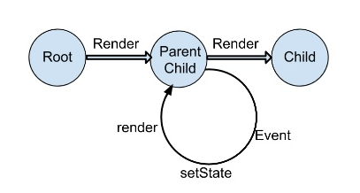
SKELETON: Component UI
React helps in encapsulating the UI logic into composable components.
Change in state leads to updating of node sub tree from the affected component’s node.
Each component has 3 parts
Properties: Data passed by parent component
State: The memory of each component
Render Function: Contains UI logic of the component. It’s called on initial paint and on change of state or props.
A component can be composed with other components.

Slide 29
SKELETON: Client overview
App
Header
Entity Header
Entity Bookmark
Entity Rating
Entity
Login
Entity Body
Search Bar
Photo Gallery
ReviewList

Slide 30
SKELETON: Putting everything together
Redux causes state change of registered components
React Components: State change causes re-render
Store
App
Header
Entity Header
Entity Bookmark
Entity Rating
Entity
Login
Entity Body
SearchBar
PhotoGallery
ReviewList
Next State
Current State
REDUCER
Action (Payload)
DISPATCHER
ACTION CREATOR
Event
HTTP Response
HTTP Request
app
Route1
API1
API2
Route2
API3
Express
Router
API
ORM
DB
query1
query2
Other API Calls

Slide 31
Generator
getInputs
copySkeleton
showInstruction
cleanUp
copyFiles
injectClientCode
injectServerCode
updateSchema
Data flow in Generator

Slide 32
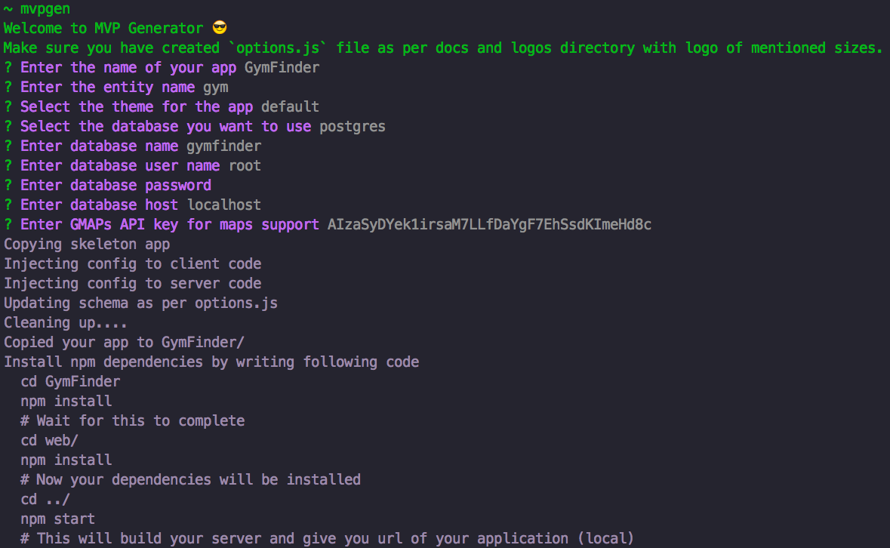
Screenshots: CLI

Slide 33
Screenshots – Gym Finder

Slide 34
Screenshots – School Finder

Slide 35
Screenshots – Tutor Finder

Slide 36
Future scope
It can support custom plugins that intercept the building process to inject, modify or even remove components to allow custom functionality provided to generator.
It can not only generate but update existing applications built using the generator to perform transformations to code like removal of certain components, replacement of component with some other alternative, etc.
With proper funding, native mobile applications can be developed using React Native technology to provide better functionality set by the generator.
Windows support can be added once dependencies support Windows

Slide 37

DEMO & Q/A

Slide 38
References
Mobile Internet Users In India 2016: 371 Mn by June, 76% Growth In 2015 - http://dazeinfo.com/2016/02/08/mobile-internet-users-in-india-2016-smartphone-adoption-2015/
India Restaurants - Find the best restaurants, cafés and bars in India on ... http://zomato.com/
Find & book appointments with doctors, diagnostic labs, salons, gyms & spas. Ask free health questions to doctors or get free tips from health experts. https://www.practo.com/
CarWale - Search New, Used Cars http://carwale.com/
Ivica Crnkovic, Michel Chaudron, Stig Larsson,“Component-based Development Process and Component Lifecycle”,2006
Kuda Nageswara Rao, G. Kavita Naidu, Praneeth Chakka, “A Study of the Agile Software Development Methods, Applicability and Implications in Industry”,2011
A B M Moniruzzaman, Dr Syed Akhter Hossain, “Comparative Study on Agile software development methodologies”,[4] Beck, Kent; et al. (2001).
"Principles behind the Agile Manifesto". Agile Alliance. Archived from the original on 14 June 2010. Retrieved 6 June 2010
IEEE. IEEE Std 830-1998 IEEE Recommended Practice for Software Requirements Specifications. IEEE Computer Society, 1998.
The web's scaffolding tool for modern webapps. http://yeoman.io/
npm now the largest module repository http://alexandros.resin.io/npm-now-the-largest-module-repository

