Slide 1
MVP Generator
Under the guidance of Asst Prof. Dr. Sushama Nagpal
Akanshi Gupta (216/CO/12)
Chitrasoma Singh (254/CO/12)
Divjot Singh (262/CO/12)

Slide 2


introduction
Digital world is experiencing the biggest change in the history
Increasing use of web and mobile apps, more than ever
New ideas are evolving to make almost all services just a click away through them.
Numerous new technologies have been introduced just to provide efficiency and ease of use to the people

Slide 3
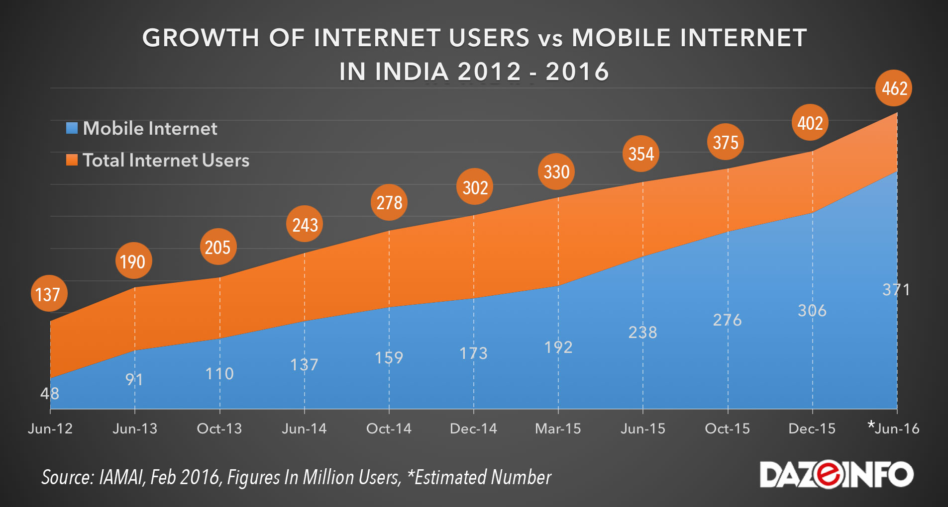
Growth of Internet and applications

Slide 4


StartupS
New startup ideas are evolving to provide more services on the backbone of internet and smartphones.
Search engines are a major part of application industry. From finding restaurant, to finding doctors, there’s an app for that.
Application stores show that a good share of applications follow a common pattern in terms of functionality.
Focused search engines for entities like restaurants, doctors, service workers etc.

Slide 5
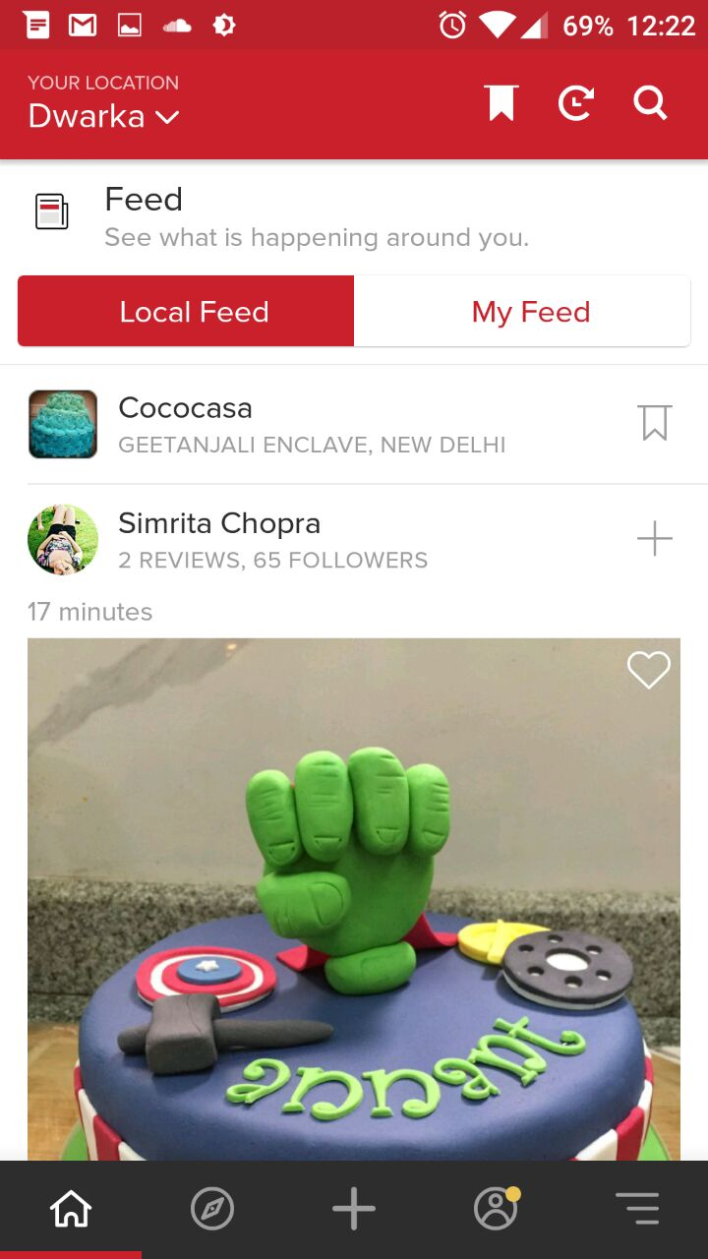
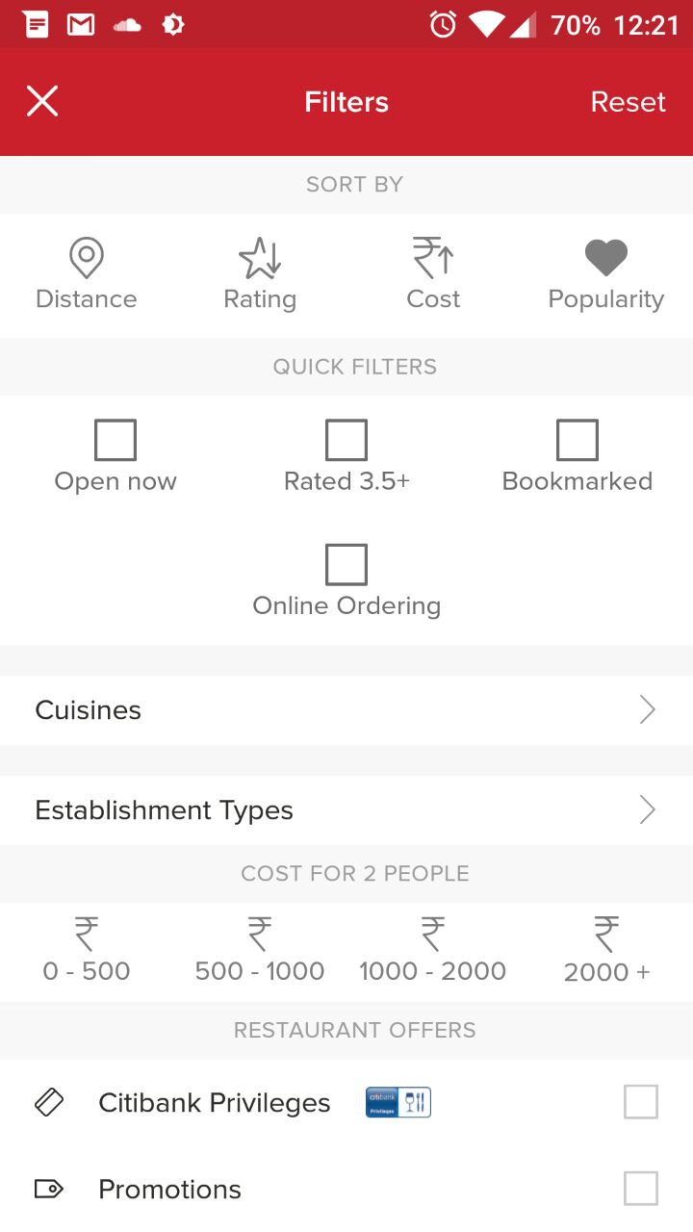
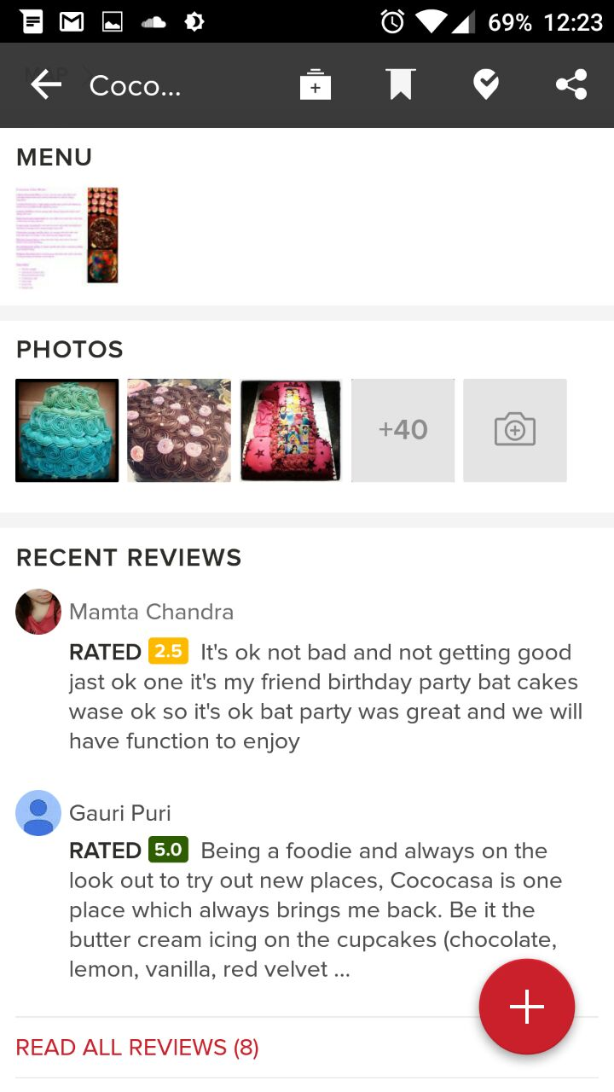
Case Study: Zomato (Restaurant finder)

Slide 6
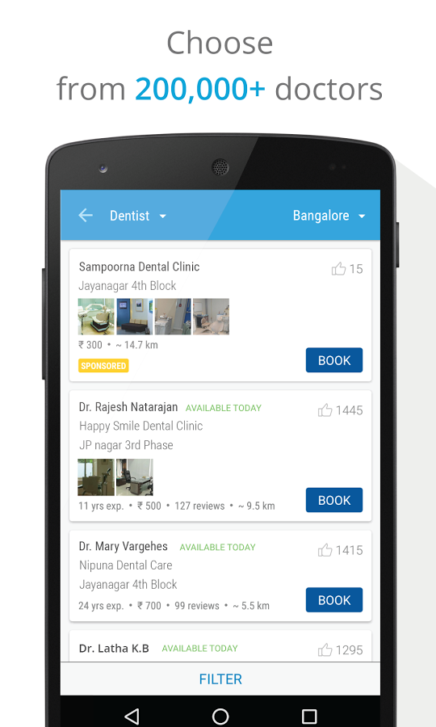
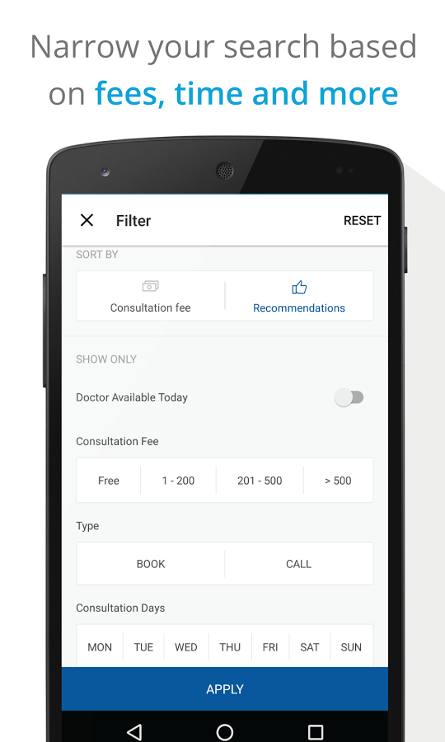
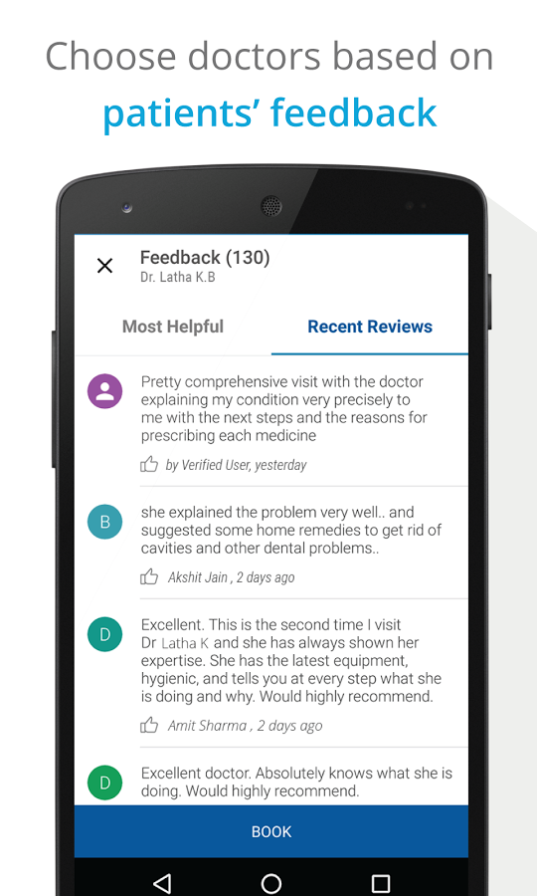
Case Study: Practo (Doctor finder)

Slide 7
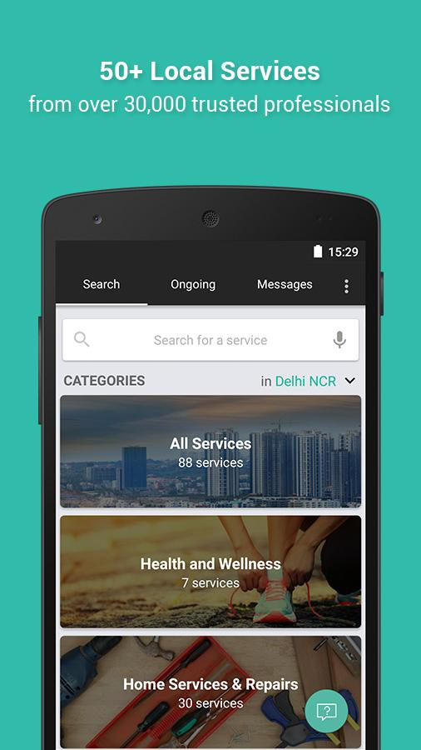
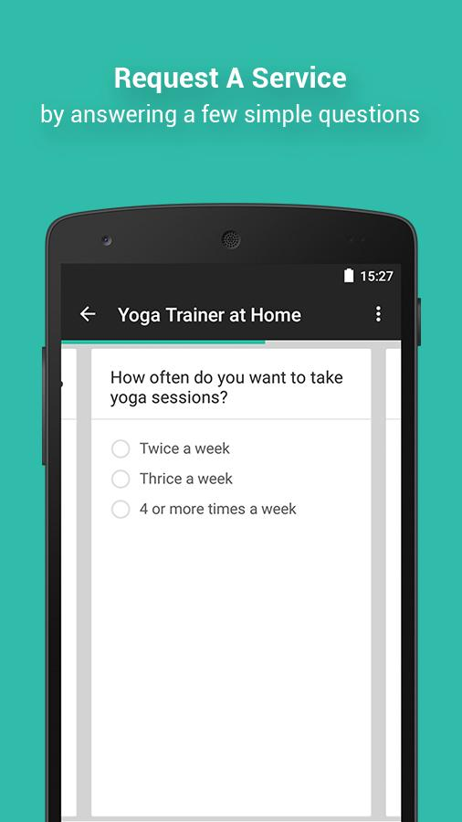
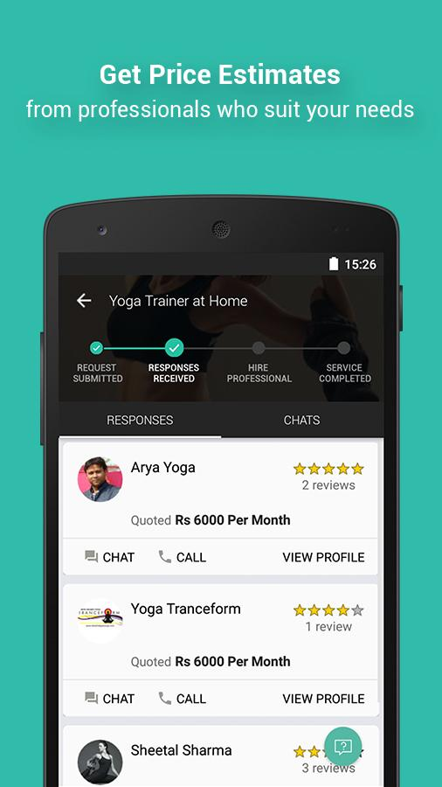
Case Study: Urban Clap (Service Worker Finder)

Slide 8
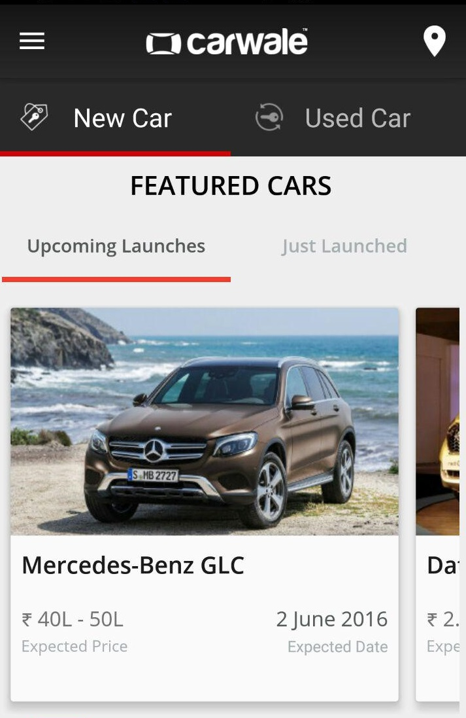
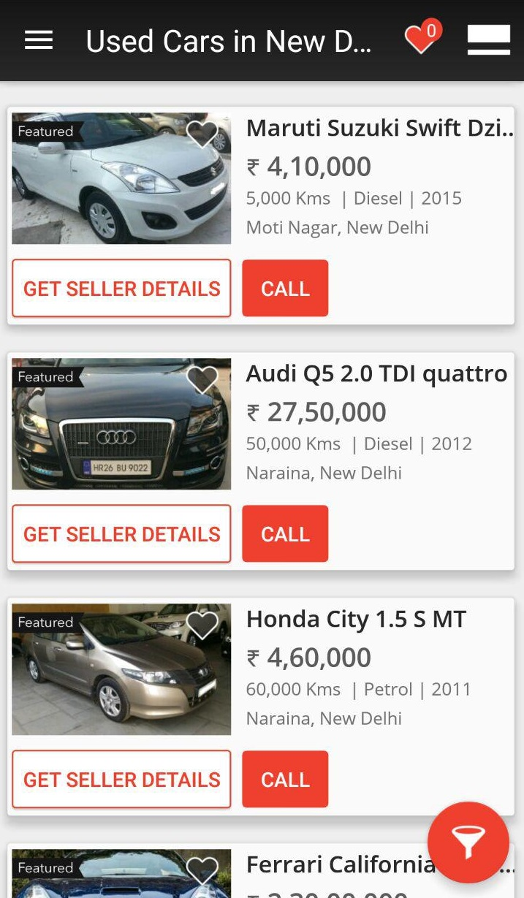
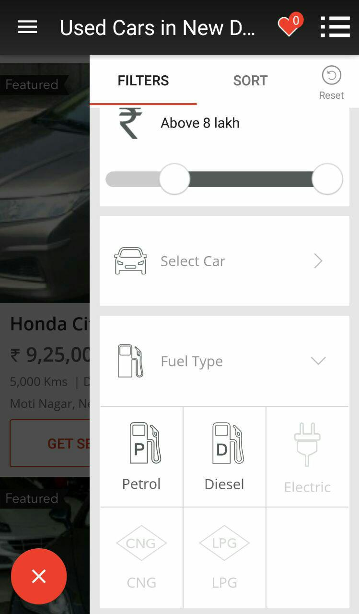
Case Study: CarWale (Car Purchasing)

Slide 9
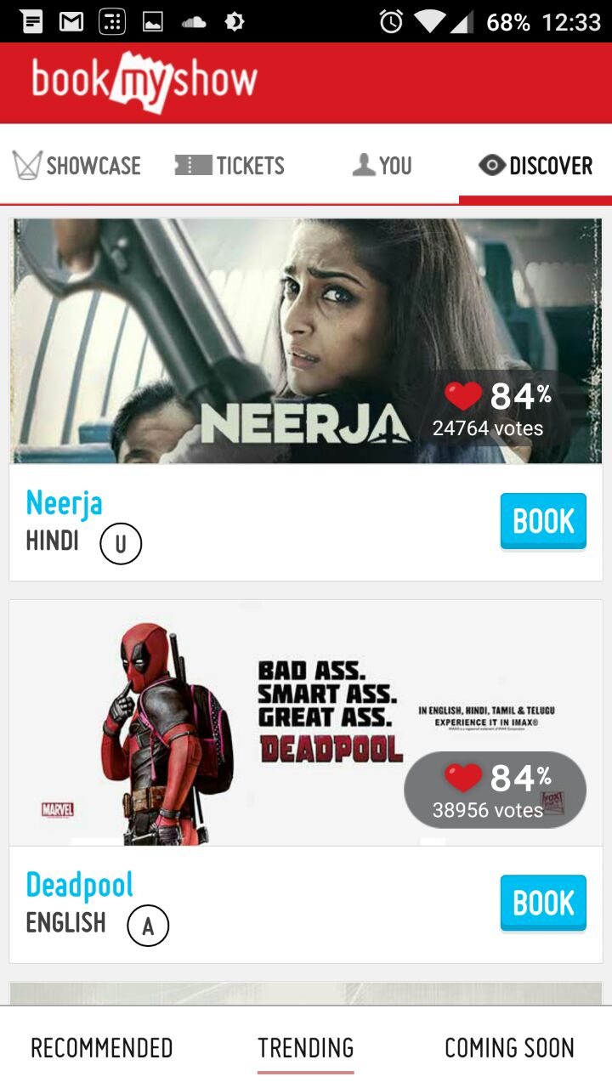
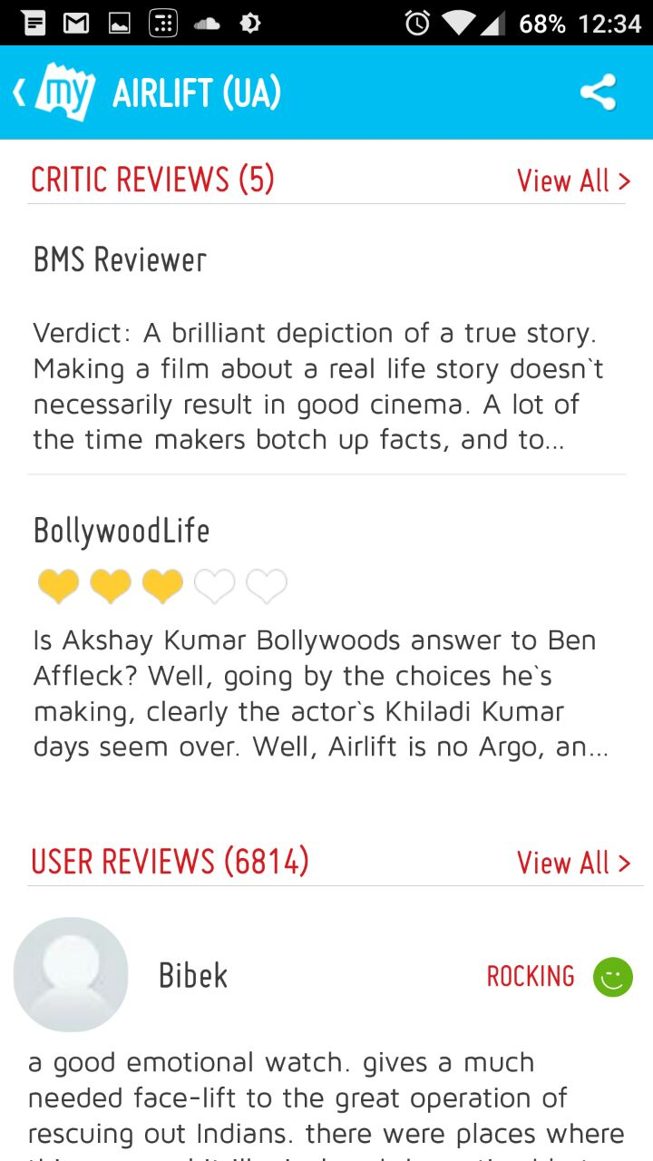
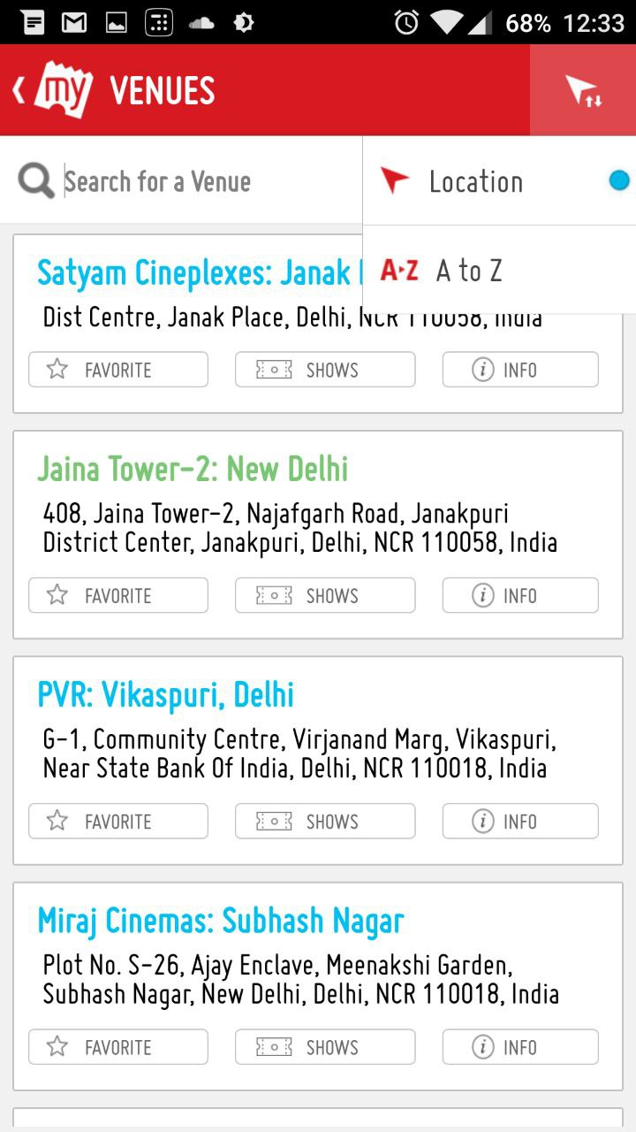
Case Study: BookMyShow (Movie Booking App)

Slide 10
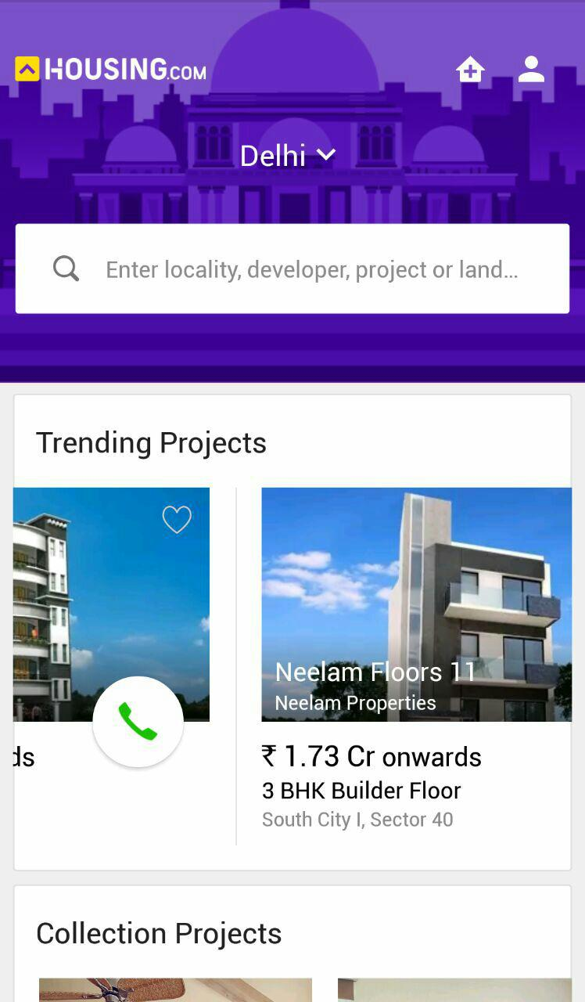
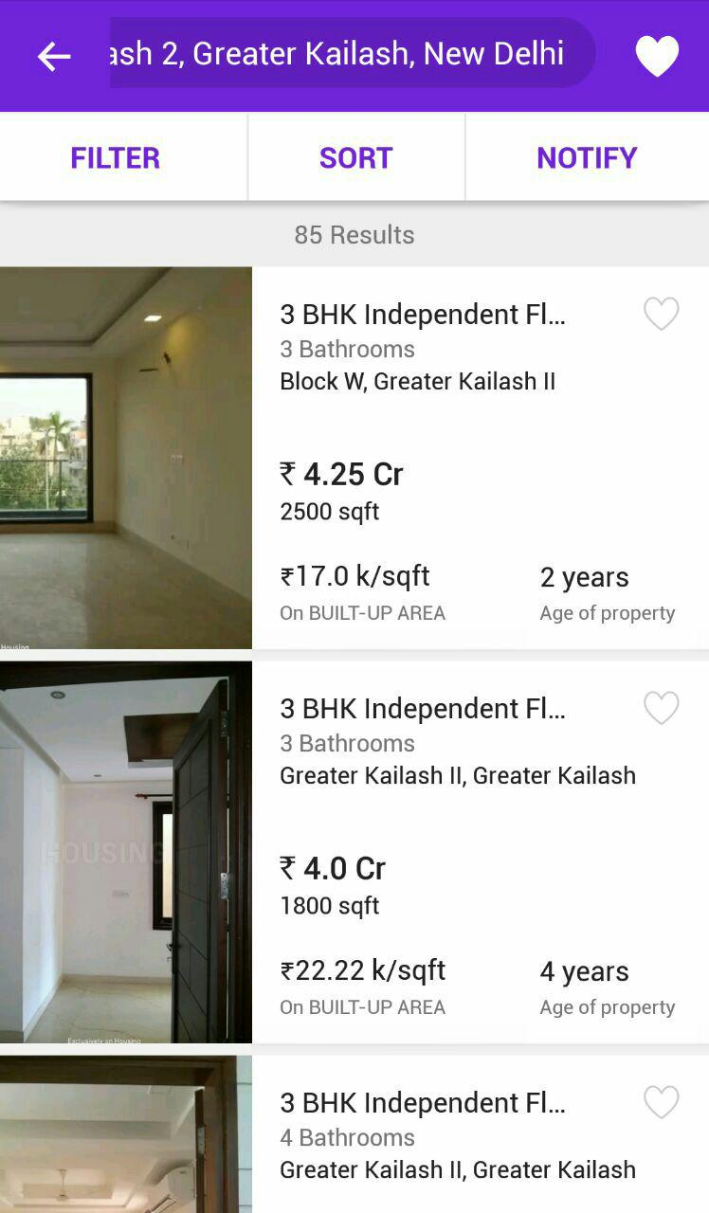
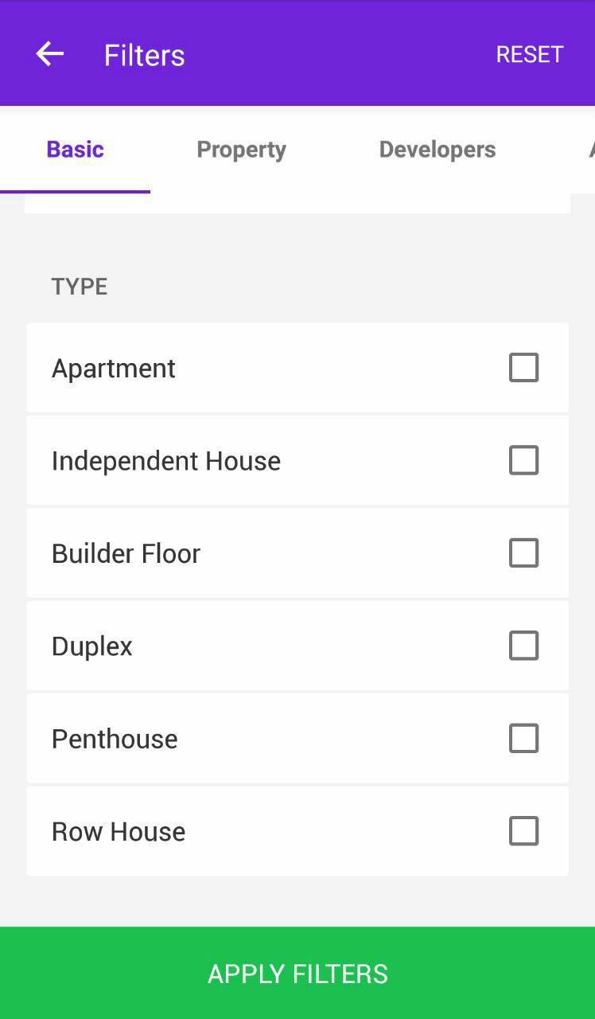
Case Study: Housing (House Finder)

Slide 11
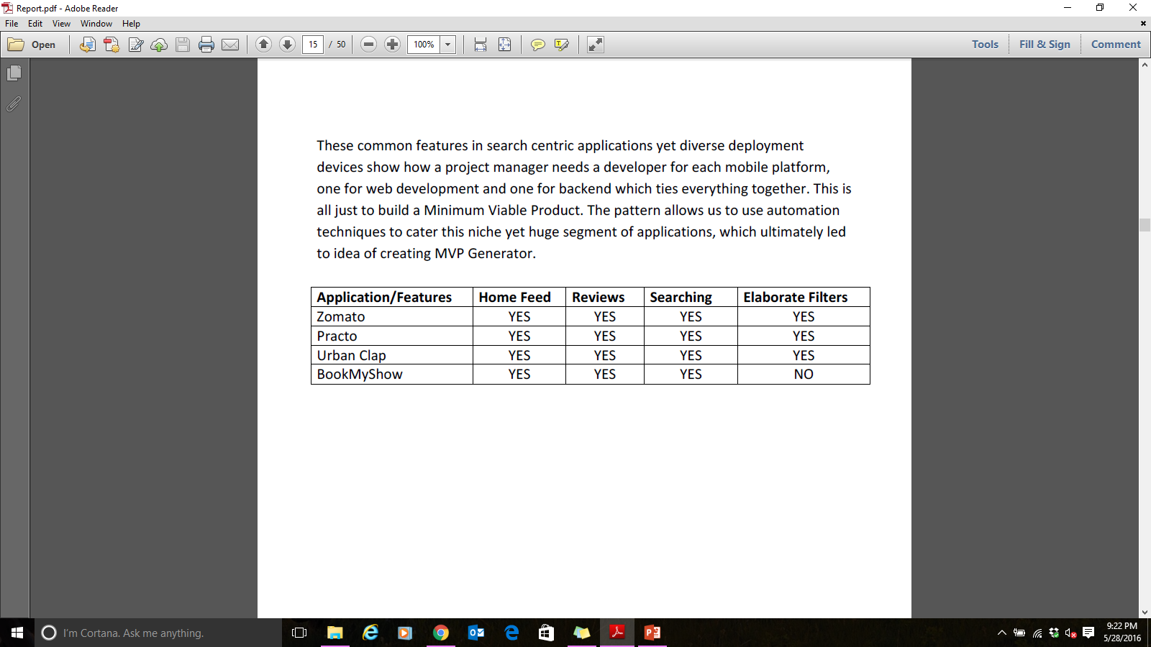
Case Study: Conclusion
Differ only in the entity they allow searching around; share the same functionality and majority of the characteristics as follows:
A home feed where user can look at trending entities
Sort and search entities based on popularity and attributes of the entity itself.
Read and give reviews & comments around the entity.
Contact the entity via email/phone/map directions and other mediums.

Slide 12
Issues faced by startups
Startups are seed funded on basis of quality of Minimum Viable Product (MVP)
These applications aren’t as simple as static websites of 2000s
Development of MVP requires a team of software engineers working on each part of the software stack
Requires a lot of capital that is not available with the startups initially.

Slide 13
Solution !!!
Pattern observed in case study makes room for automation in the development of this huge segment of applications.
Not only help startups to get funded early, but also assist experienced teams with some boilerplate code to work on.
Ultimately led to idea of creating MVP Generator
MVP Generator aims to use component driven and agile software development, along with industry’s best practices and latest technology stacks
Generates MVPs based on descriptions given by users about the entity their focused search engine application is about.

Slide 14
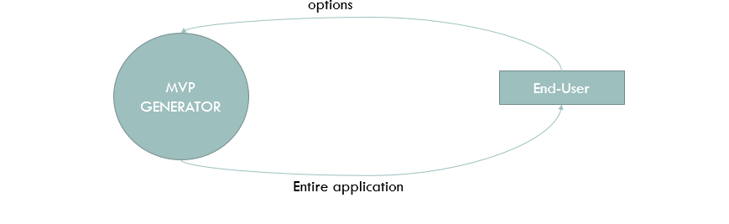
Working Of Generator

Slide 15
Best practices for application DEVELOPMENT
Component Based Development
Agile Software Development
Cohesion

Slide 16
Component Based Software Engineering
Development with the help of reusable software components.
Focus shifts from software programming to software system composing.
Involve procedures for developing software systems by choosing ideal off-the-shelf components and then assembling them using a well-defined software architecture.
Advantages:
Using off-the-shelf components helps reduce software development time and cost substantially.
Enhanced the software quality
Supports fault detection by testing the components

Slide 17
Agile Software Development
To overcome the fast changing business needs, agile methods were used in developing solutions quickly and efficiently
Agile methods highlight customer satisfaction by structuring the development process into iterations.
Each iteration produces sizeable amount of working code and artifacts of interest to customers
It is based on iterative and incremental development process, where requirements and development evolve through collaboration between self-organizing, cross-functional teams that allows rapid delivery of high quality software
A few principles of agile software development are :
Customer satisfaction by early and continuous delivery of valuable software
Welcome changing requirements, even in late development
Working software is the principal measure of progress

Slide 18
COHESION
Cohesion refers to the degree to which the elements of a module belong together.
Cohesion measures the strength of relationship between pieces of functionality within a given module.
Any software should support high cohesion level.

Slide 19
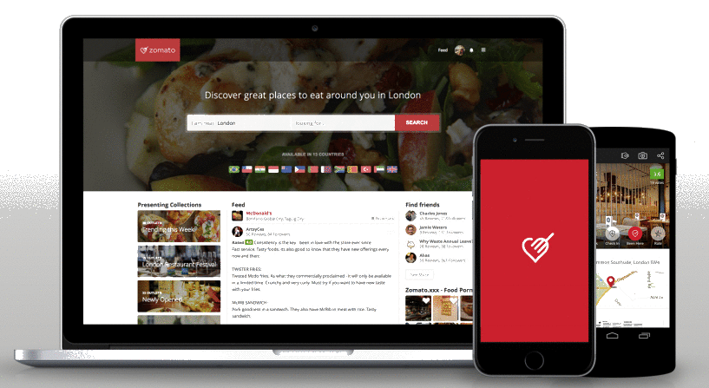
Application Development
DataBase
DB Communication Layer E.g. ORMs
ORM
SERVER
Website Assets (HTML/JS/CSS)
APIs
REST API
HTTP
Application Binary
APP STORE

Slide 20
Latest technology stack
ReactJS
Redux
NodeJS
ExpressJS

Slide 21
ReactJS
Javascript library that creates user interfaces using components. It renders user created components that can have their own state and can be in a component tree
On every update to the component, React:
Builds a new virtual DOM subtree
Diffs it with the old one
Computes the minimal set of DOM mutations and puts them in a queue
And batch executes all updates
React’s Virtual DOM

Slide 22
Creation of DOM Tree
Rendering and State Management in React
**Since the components can be simply replaced by any other component that performs the same function but with different layout/style/approach, we can allow user to choose from a variety of component replacements and truly customize entire application**

Slide 23
Redux
Microlibrary often used on top of React to manage the state with a minimal API but completely predictable behavior
Imporatnt concepts : Actions and action creators, Reducers, Store, Middleware
Flow of data in Redux

Slide 24
NodeJS
Cross-platform runtime environment for developing server-side web applications.
Contains built-in library to allow applications to act as a stand-alone web server.
Event loop and inherent CommonJS module system ensures high modularity and performance with the virtue of non blocking asynchronous calls to intensive operations.
Working of NodeJS

Slide 25
ExpressJS
Minimal and flexible Node.js web application framework that provides a robust set of features to develop web and mobile applications.
Facilitates a rapid development with scalable and pluggable code.
Some core features :
Allows to set up middleware's to respond to HTTP Requests.
Defines a routing table which is used to perform different action based on HTTP method and URL.
Allows to dynamically render HTML Pages based on passing arguments to
templates.

Slide 26
Model proposed
Development process into two phases of Skeleton and Generator development.
Skeleton represents a basic structure of search centric application, including server
side code. The more customizable skeleton is, the easier It becomes to generate
code.
Second phase uses the Skeleton to tweak and adjust its code to fulfil the
requirements of the user as described by the user.

Slide 27
Skeleton
Entire application has 4 major parts:
ORM
API
Component Fetch
Component UI
ORM
API
Component fetch
Component UI
Server
Client

Slide 28
ORM
1:n Writes
m:n Likes
Reviews
n:1 Has
User
m:n Likes
1:n Replies
m:n Bookmarks
Person
ISA
Owner
m:n Rates
Entity
1:n Manages
1:1
Updates
Admin
1:n
Manages
*Management involves creating, updating and deleting.

Slide 29
API
Second layer that acts as a controller between requests from client side and the database entities.
Each entity has its own set of APIs, in a separate module. This ensure high cohesion.
Following APIs are developed :
Users: Deals with functions of User, such as login, logout, signup, get profile, edit profile etc.
Entities: Deals with functions of Entity, such as create, search, modify entity.
Reviews: Deals with functions of Reviews, such as adding review, editing review and deleting review.
Ratings: Deals with rating of an entity by a registered user.
Bookmarks: Deals with bookmarking of entity by a registered user.

Slide 30
Component Fetch
Deals with communication with the server and update client state data using Redux store.
A fetch call is HTTP request to server with payload
Redux Store has user authentication and current entity data.
Rest of the state is stored by internal states of Components.

Slide 31
Component UI
React helps in encapsulating the UI logic into composable components.
Change in state leads to updating of node sub tree from the affected component’s node.
App
Header
Entity Header
Entity Bookmark
Entity Rating
Entity
Login
Entity Body
SearchBar
PhotoGallery
ReviewList
ReviewBox
Component tree of the entity page

Slide 32
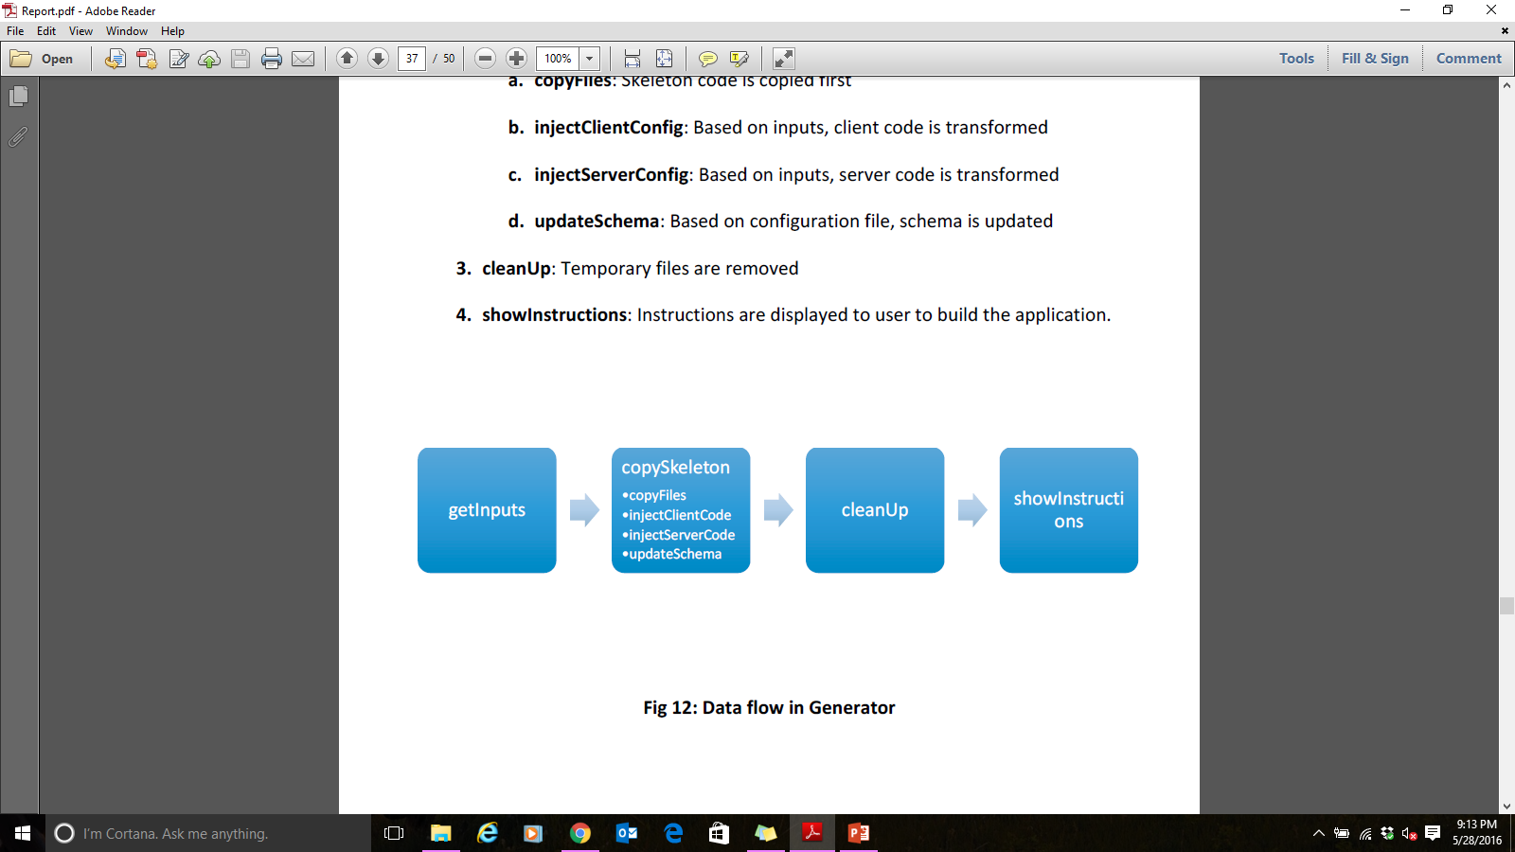
Generator
Data flow in Generator

Slide 33
Screenshots – Gym Finder

Slide 34
Screenshots – School Finder

Slide 35
Screenshots – Tutor Finder

Slide 36
Software Metrics
Approximately 2,500 lines of code

Slide 37
Future scope
It can support custom plugins that intercept the building process to inject, modify or even remove components to allow custom functionality provided to generator.
It can not only generate but update existing applications built using the generator to perform transformations to code like removal of certain components, replacement of component with some other alternative, etc.
With proper funding, native mobile applications can be developed using React Native technology to provide better functionality set by the generator.
Windows support can be added once dependencies support Windows

Slide 38
References
Mobile Internet Users In India 2016: 371 Mn by June, 76% Growth In 2015 - http://dazeinfo.com/2016/02/08/mobile-internet-users-in-india-2016-smartphone-adoption-2015/
India Restaurants - Find the best restaurants, cafés and bars in India on ... http://zomato.com/
Find & book appointments with doctors, diagnostic labs, salons, gyms & spas. Ask free health questions to doctors or get free tips from health experts. https://www.practo.com/
CarWale - Search New, Used Cars http://carwale.com/
Ivica Crnkovic, Michel Chaudron, Stig Larsson,“Component-based Development Process and Component Lifecycle”,2006
Kuda Nageswara Rao, G. Kavita Naidu, Praneeth Chakka, “A Study of the Agile Software Development Methods, Applicability and Implications in Industry”,2011
A B M Moniruzzaman, Dr Syed Akhter Hossain, “Comparative Study on Agile software development methodologies”,[4] Beck, Kent; et al. (2001).
"Principles behind the Agile Manifesto". Agile Alliance. Archived from the original on 14 June 2010. Retrieved 6 June 2010
IEEE. IEEE Std 830-1998 IEEE Recommended Practice for Software Requirements Specifications. IEEE Computer Society, 1998.
The web's scaffolding tool for modern webapps. http://yeoman.io/

Slide 39
THANK YOU

Slide 40
Demo & Q/A

