Slide 1
MVP Generator
Under the guidance of Asst Prof. Dr. Sushama Nagpal
Akanshi Gupta (216/CO/12)
Chitrasoma Singh (254/CO/12)
Divjot Singh (262/CO/12)

Slide 2
Introduction

Slide 3
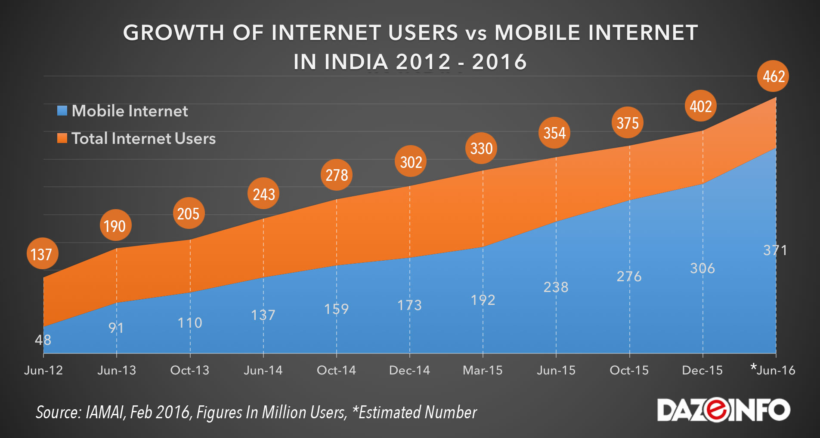
Growth of Internet and applications

Slide 4
StartupS

Slide 5
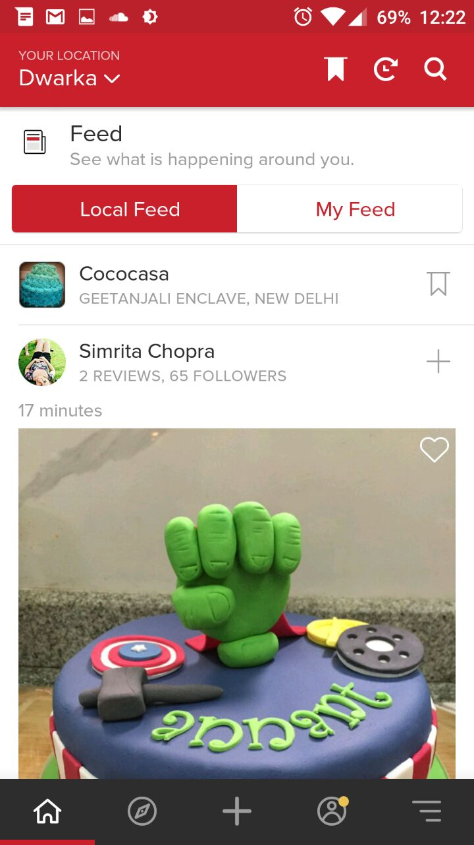
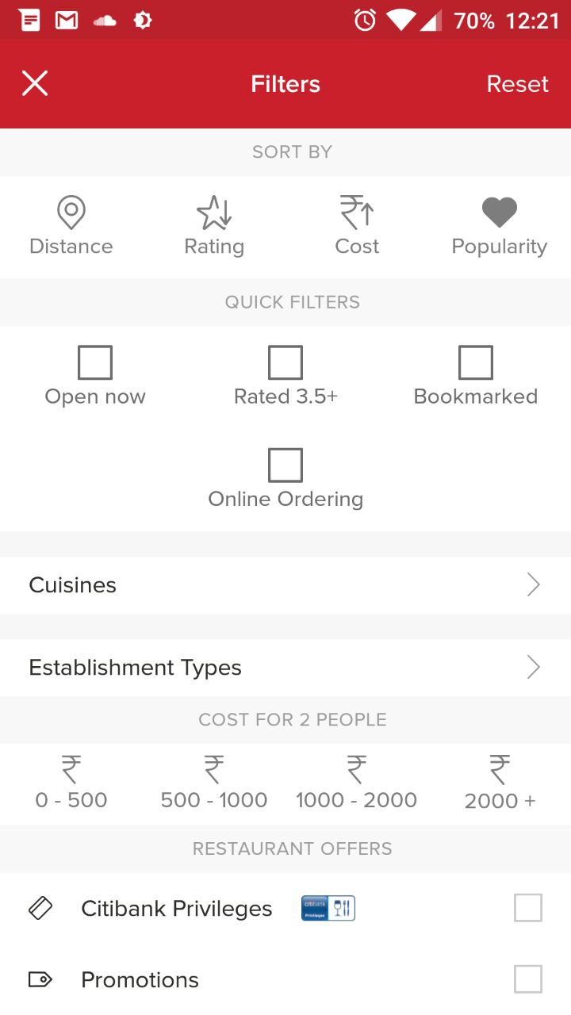
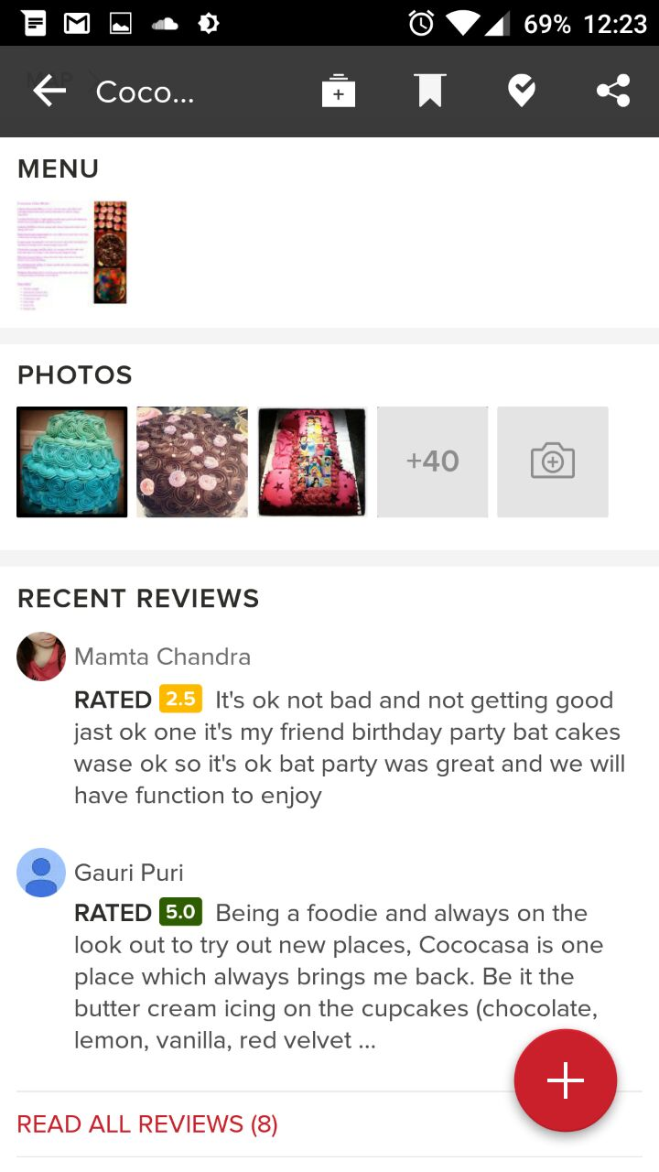
Case Study: Zomato (Restaurant finder)

Slide 6
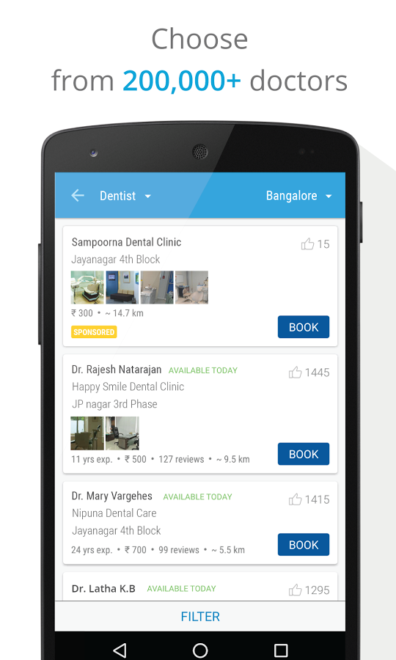
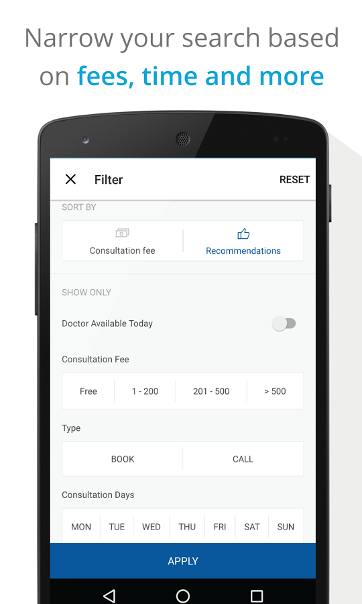
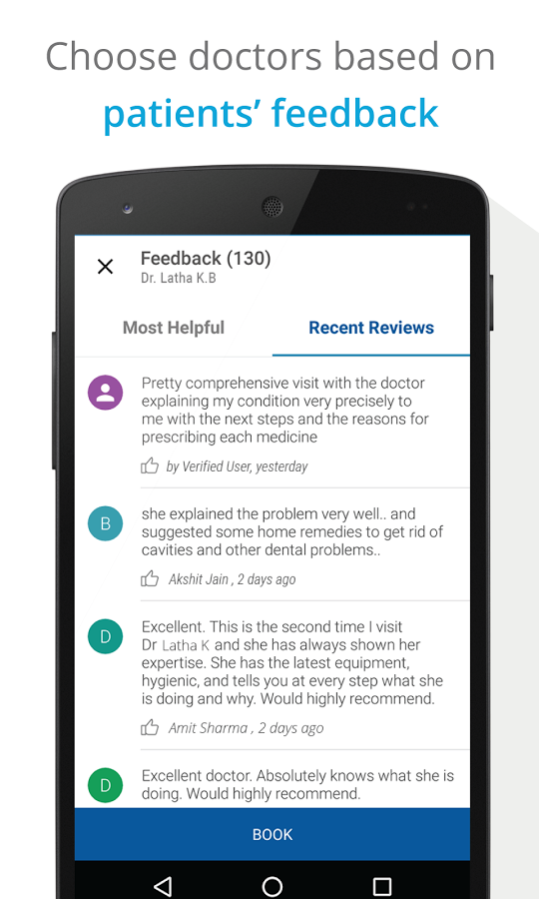
Case Study: Practo (Doctor finder)

Slide 7
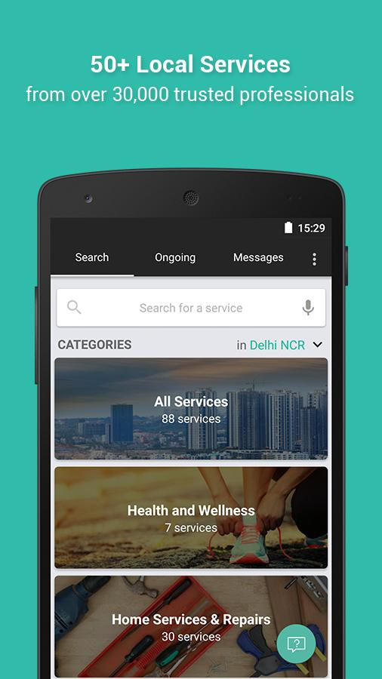
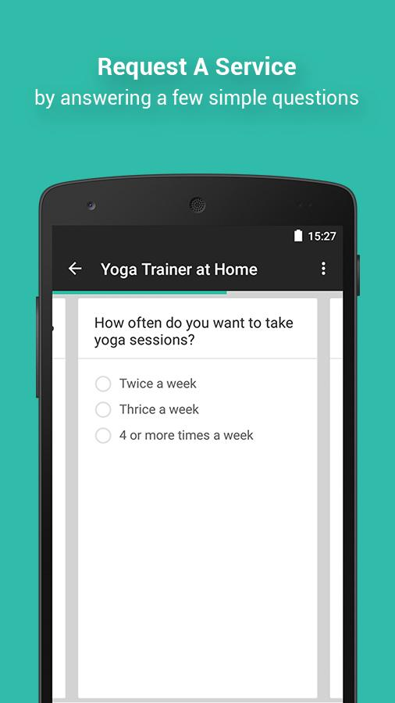
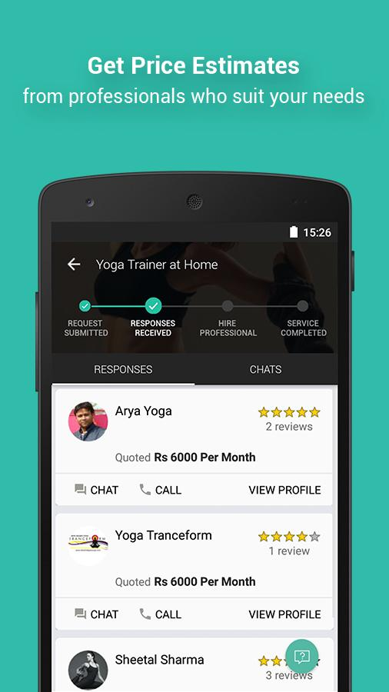
Case Study: Urban Clap (Service Worker Finder)

Slide 8
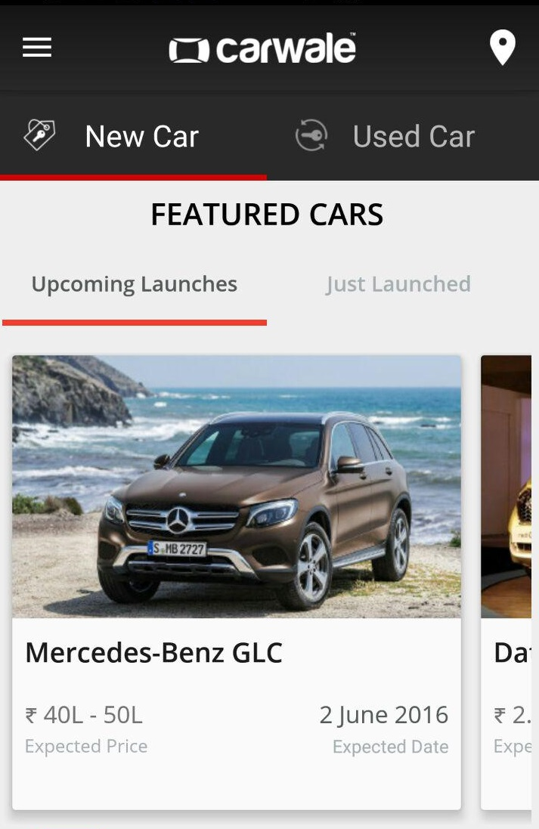
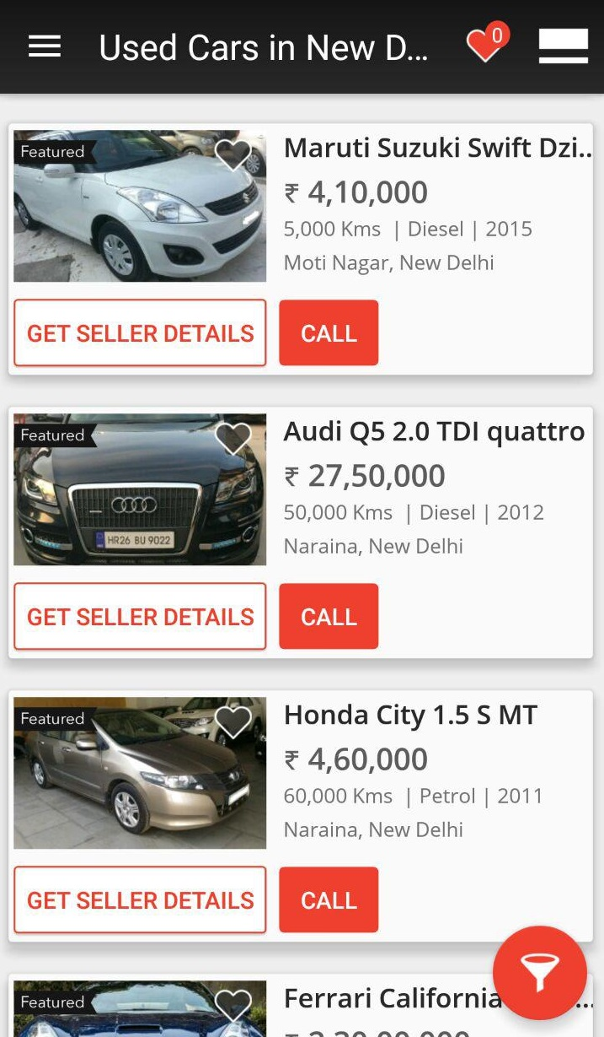
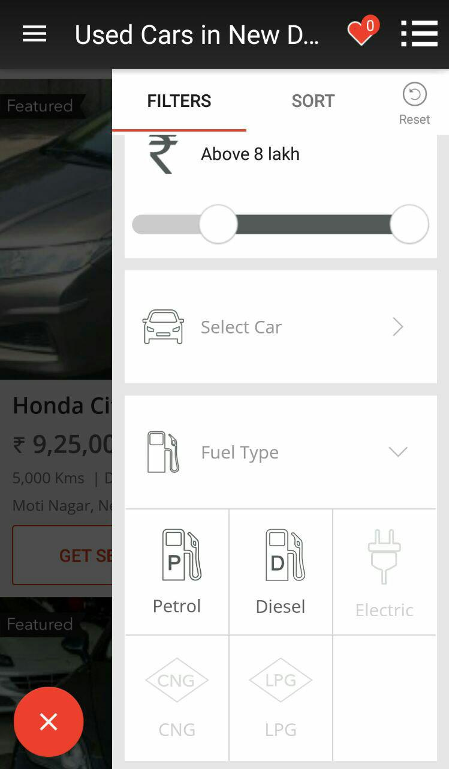
Case Study: CarWale (Car Purchasing)

Slide 9
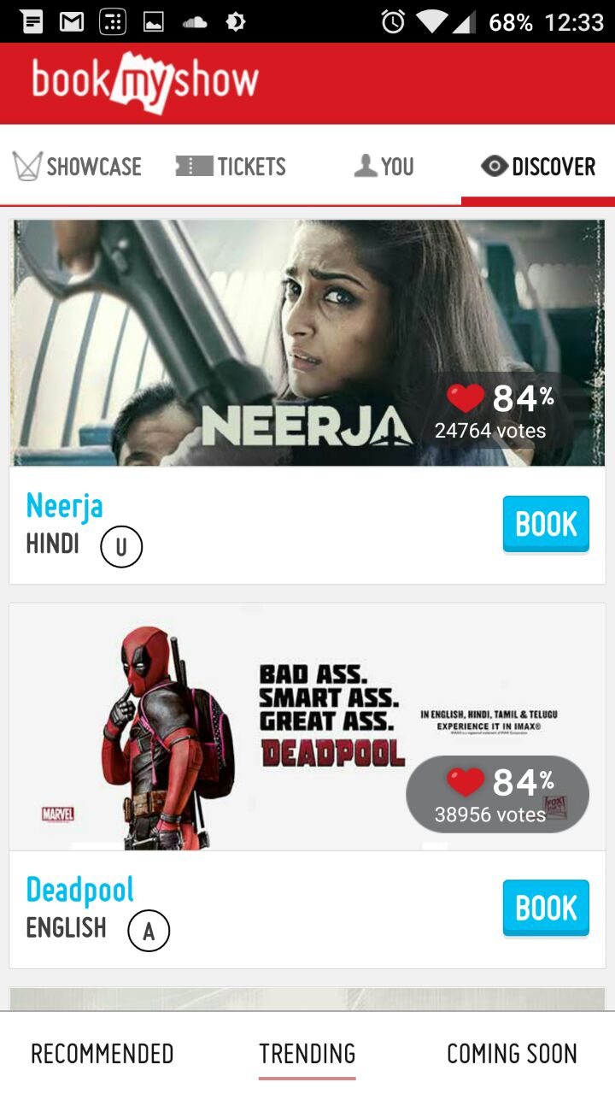
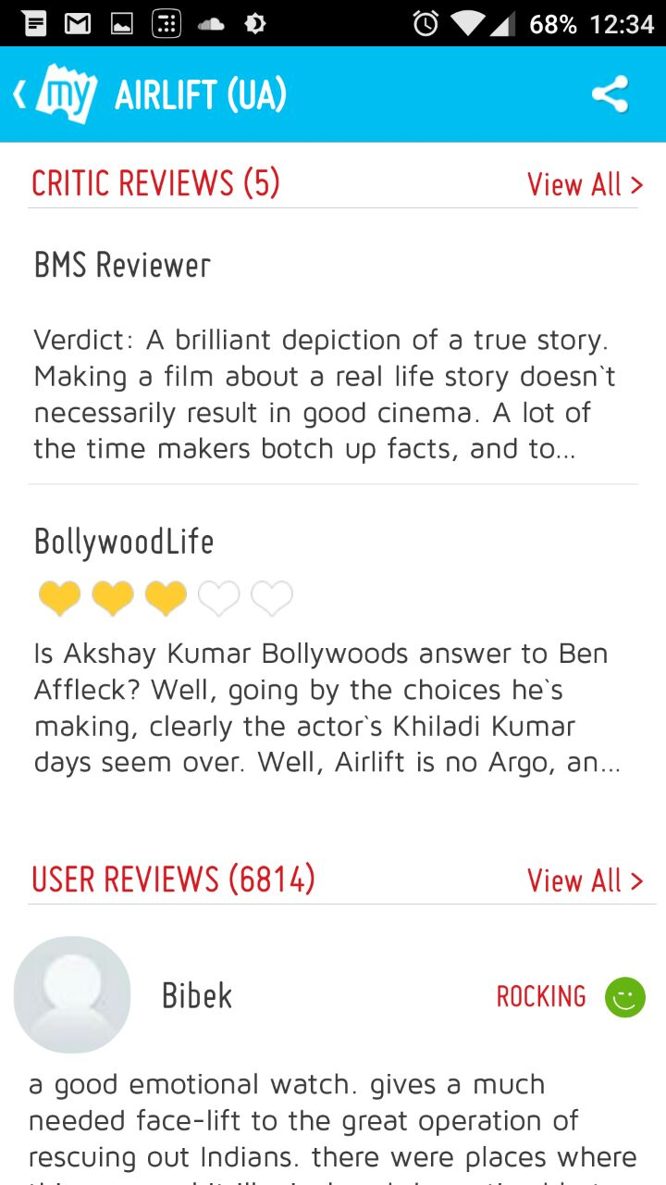
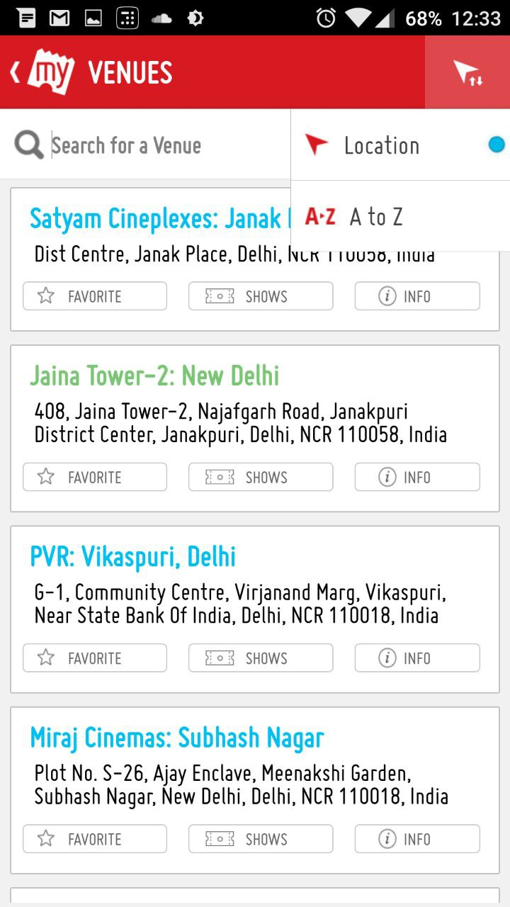
Case Study: BookMyShow (Movie Booking App)

Slide 10
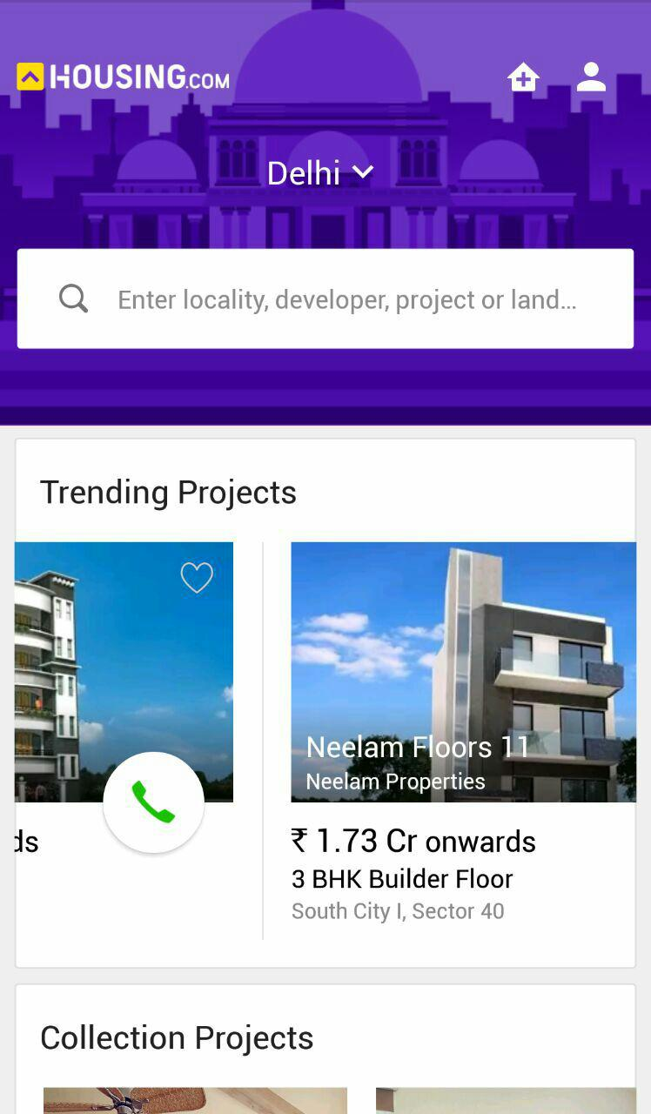
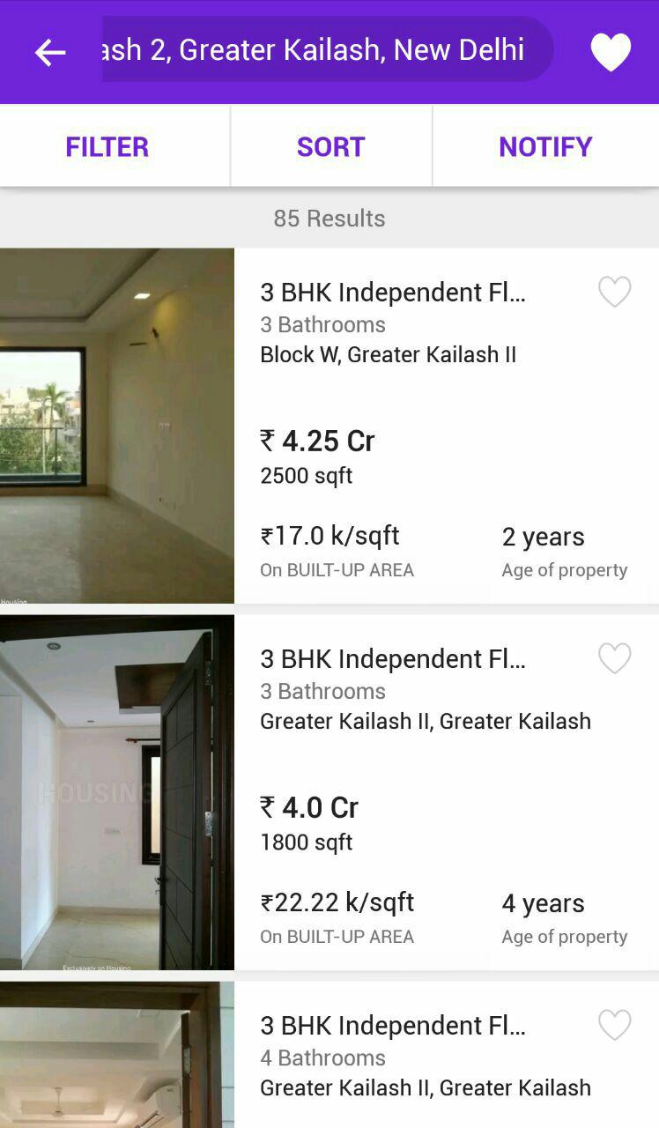
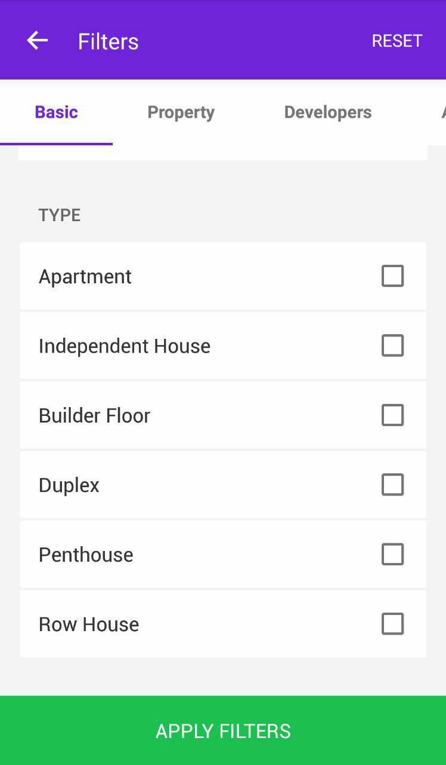
Case Study: Housing (House Finder)

Slide 11
Case Study: Conclusion
As you can see from the previous examples, they all share majority of the characteristics like the follows:
A home feed where user can look at trending entities
Sort and search entities based on popularity and attributes of the entity itself.
Read and give reviews & comments around the entity.
Contact the entity via email/phone/map directions and other mediums.
So basically, these apps only differ in the entity they allow searching around and share the same functionality and even aesthetics around other features like reviewing, searching, contacting.

Slide 12
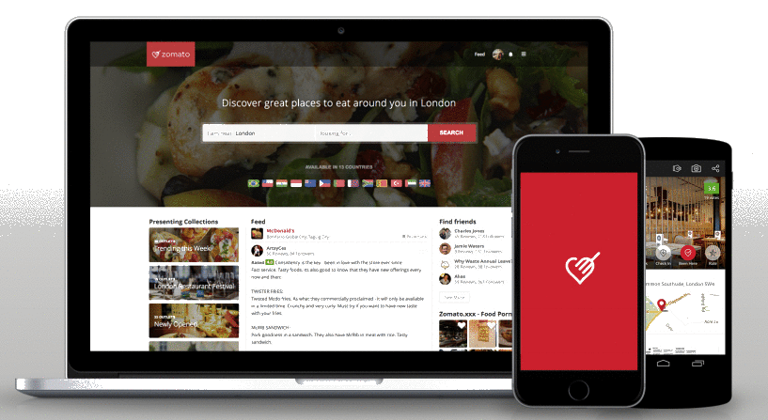
Application Development
DataBase
DB Communication Layer E.g. ORMs
ORM
SERVER
Website Assets (HTML/JS/CSS)
APIs
REST API
HTTP
Application Binary
APP STORE

Slide 13
Component Based Software Engineering

Slide 14
Agile Software Development

Slide 15
ReactJS
We rely on a JavaScript library called ReactJS that uses components to create user interfaces. This helps in developing following modular approach. Further, same components can be used both by mobile application (react-native library is used for the same) and the website, which helps in more code re-usage.
Since the components can be simply replaced by any other component that performs the same function but with different layout/style/approach, we can allow user to choose from a variety of component replacements and truly customize entire application, layout by layout.
The component approach also allows contributors to write pluggable components that can extend the functionality of the app. This might require minor code changes (5-10 lines of code), but acts as highly powerful feature.

Slide 16
Redux

Slide 17
NodeJS

Slide 18
ExpressJS

Slide 19
Skeleton
ORM
API
Component fetch
Component UI
Server
Client

Slide 20
ORM
1:n Writes
m:n Likes
Reviews
n:1 Has
User
m:n Likes
1:n Replies
m:n Bookmarks
Person
ISA
Owner
m:n Rates
Entity
1:n Manages
1:1
Updates
Admin
1:n
Manages
*Management involves creating, updating and deleting.

Slide 21
API

Slide 22
Component Fetch

Slide 23
Component UI
App
Header
Entity Header
Entity Bookmark
Entity Rating
Entity
Login
Entity Body
SearchBar
PhotoGallery
ReviewList
ReviewBox

Slide 24
Generator
options
MVP GENERATOR
End-User
Entire application

Slide 25
Screenshots – Gym Finder

Slide 26
Screenshots – School Finder

Slide 27
Screenshots – Tutor Finder

Slide 28
Demo & Q/A

Slide 29
Software Metrics
Approximately 2,500 lines of code

Slide 30
References
Mobile Internet Users In India 2016: 371 Mn by June, 76% Growth In 2015 - http://dazeinfo.com/2016/02/08/mobile-internet-users-in-india-2016-smartphone-adoption-2015/
India Restaurants - Find the best restaurants, cafés and bars in India on ... http://zomato.com/
Find & book appointments with doctors, diagnostic labs, salons, gyms & spas. Ask free health questions to doctors or get free tips from health experts. https://www.practo.com/
CarWale - Search New, Used Cars http://carwale.com/
Ivica Crnkovic, Michel Chaudron, Stig Larsson,“Component-based Development Process and Component Lifecycle”,2006
Kuda Nageswara Rao, G. Kavita Naidu, Praneeth Chakka, “A Study of the Agile Software Development Methods, Applicability and Implications in Industry”,2011
A B M Moniruzzaman, Dr Syed Akhter Hossain, “Comparative Study on Agile software development methodologies”,[4] Beck, Kent; et al. (2001).
"Principles behind the Agile Manifesto". Agile Alliance. Archived from the original on 14 June 2010. Retrieved 6 June 2010
IEEE. IEEE Std 830-1998 IEEE Recommended Practice for Software Requirements Specifications. IEEE Computer Society, 1998.
The web's scaffolding tool for modern webapps. http://yeoman.io/

Slide 31
Thank You

