Slide 1
mVP Generator
Under the guidance of Asst Prof. Dr. Sushama Nagpal
Akanshi Gupta (216/CO/12)
Chitrasoma Singh (254/CO/12)
Divjot Singh (262/CO/12)

Slide 2
A slide showing pictures of app world and 1-2 lines about it :p

Slide 3
A common pattern is observed in modern applications made by Indian Startups.
They seem to be search engines for an entity that is discussed & reviewed by users of the application.
We plan to automate the process of development of these in a modular and component based approach.

Slide 4
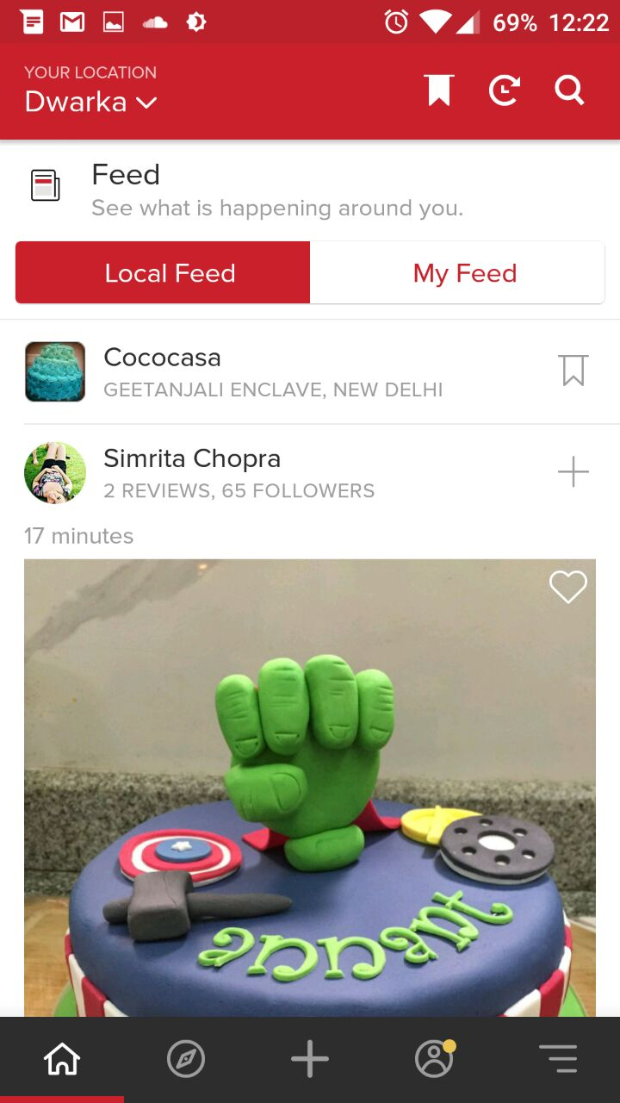
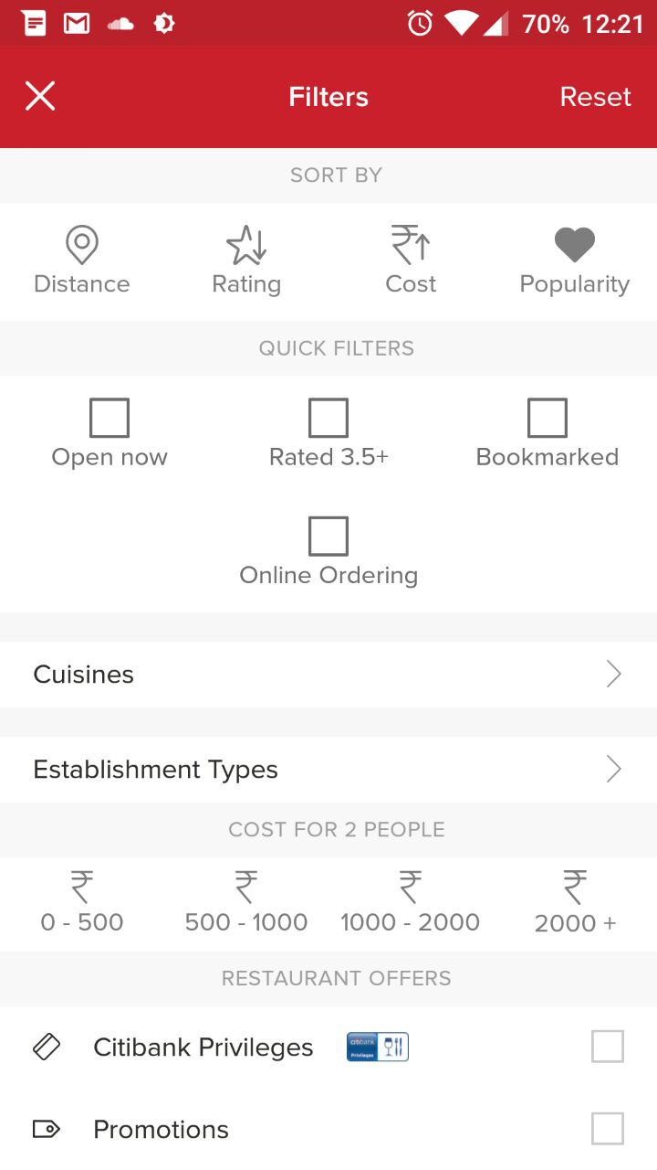
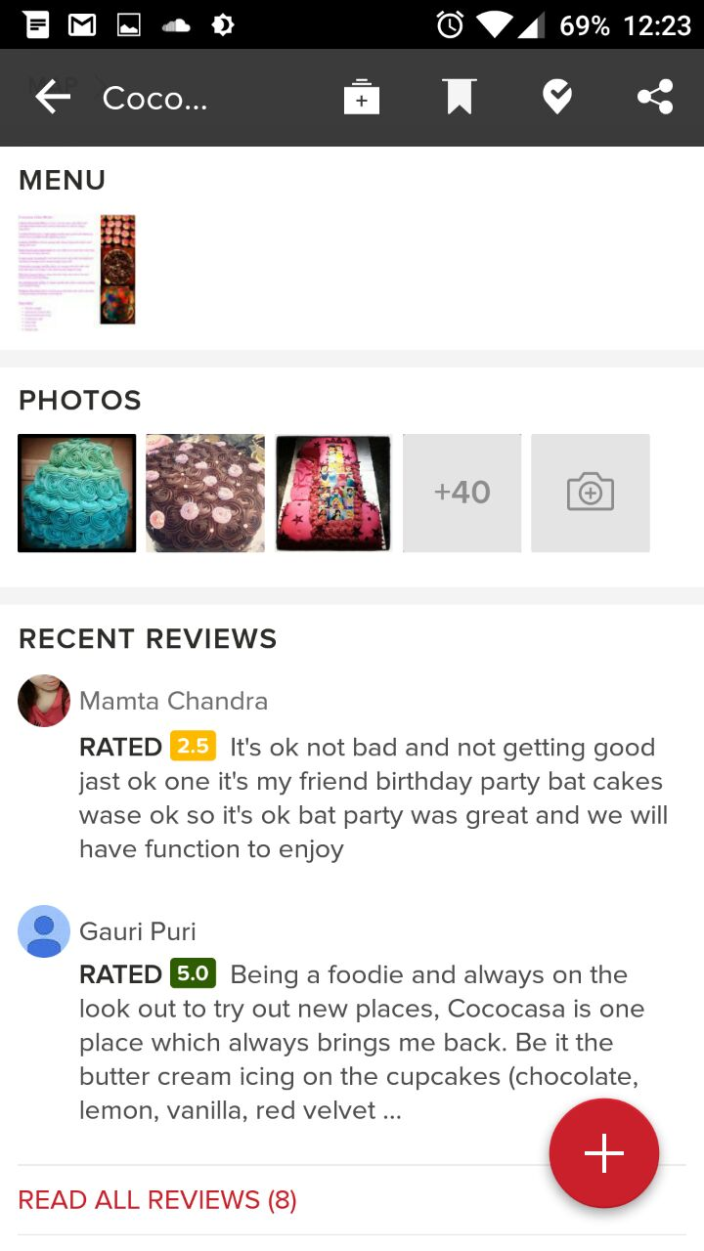
Case Study: Zomato (Restaurant finder)

Slide 5
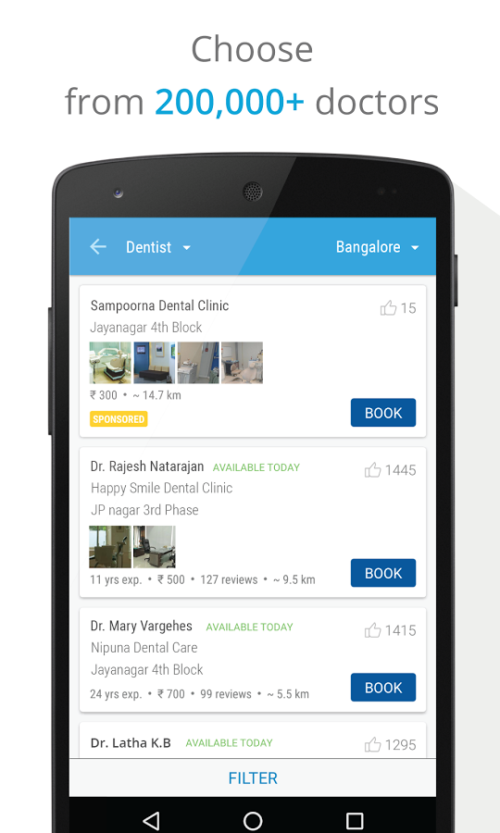
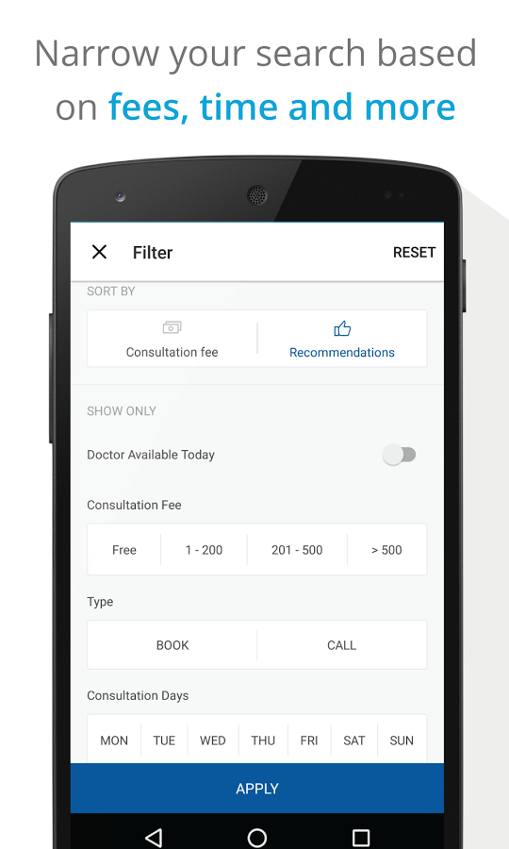
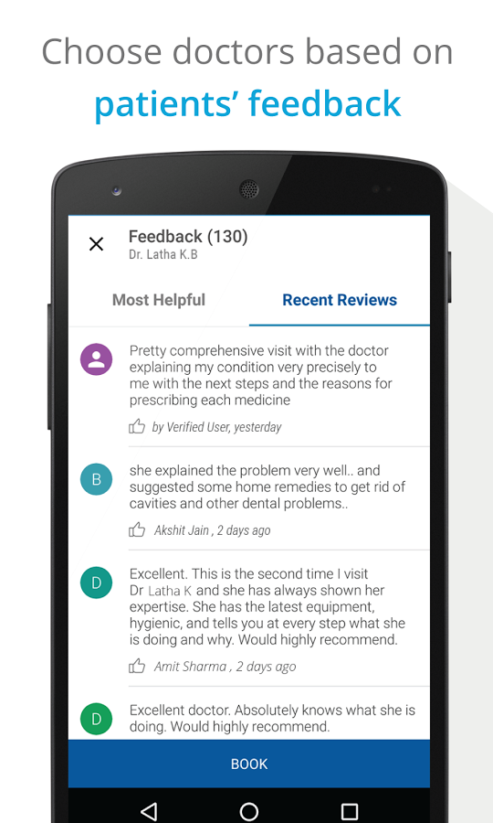
Case Study: Practo (Doctor finder)

Slide 6
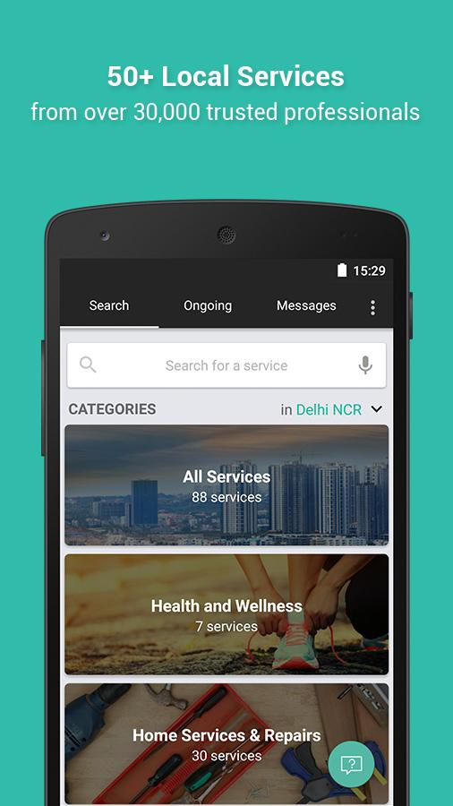
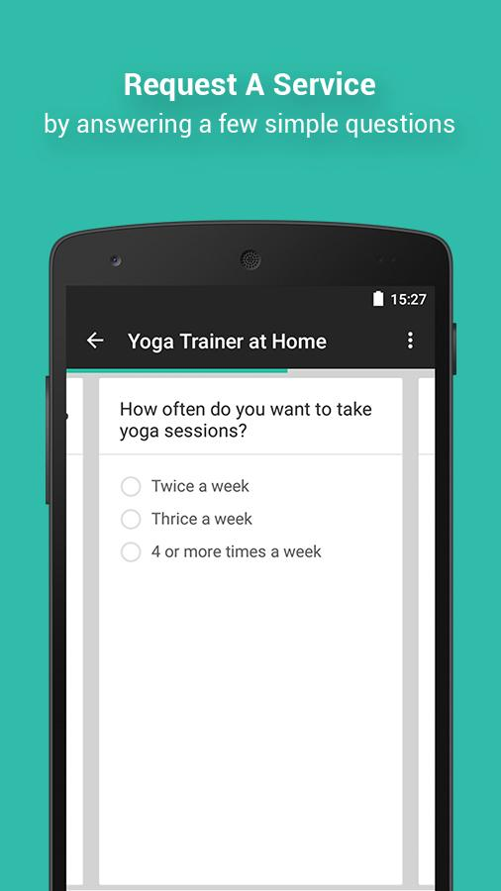
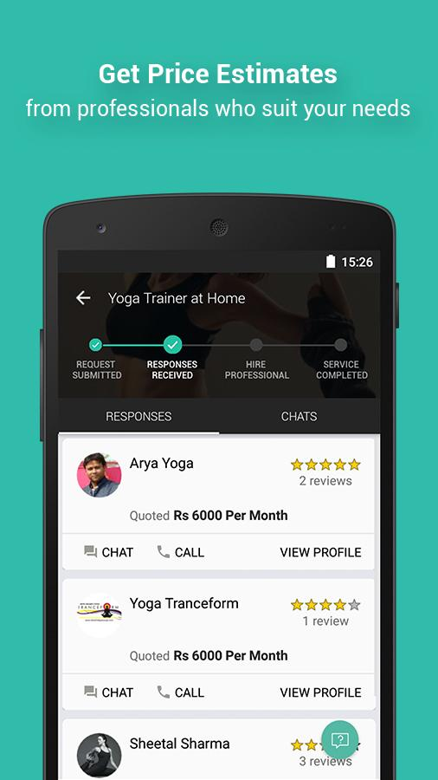
Case Study: Urban Clap (Service Worker Finder)

Slide 7
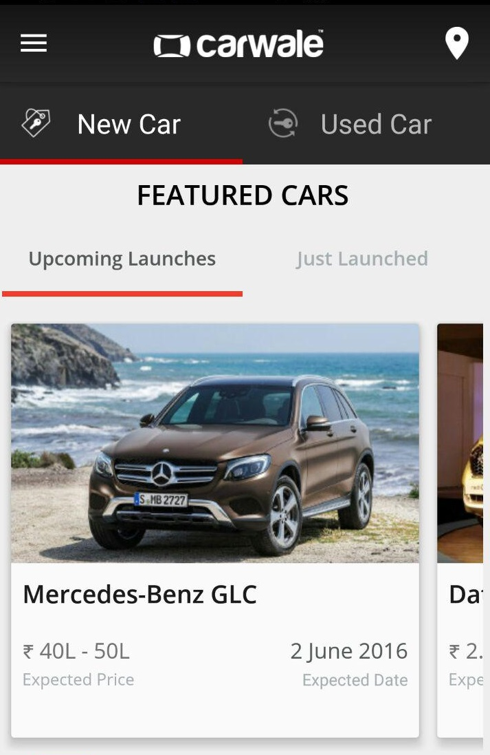
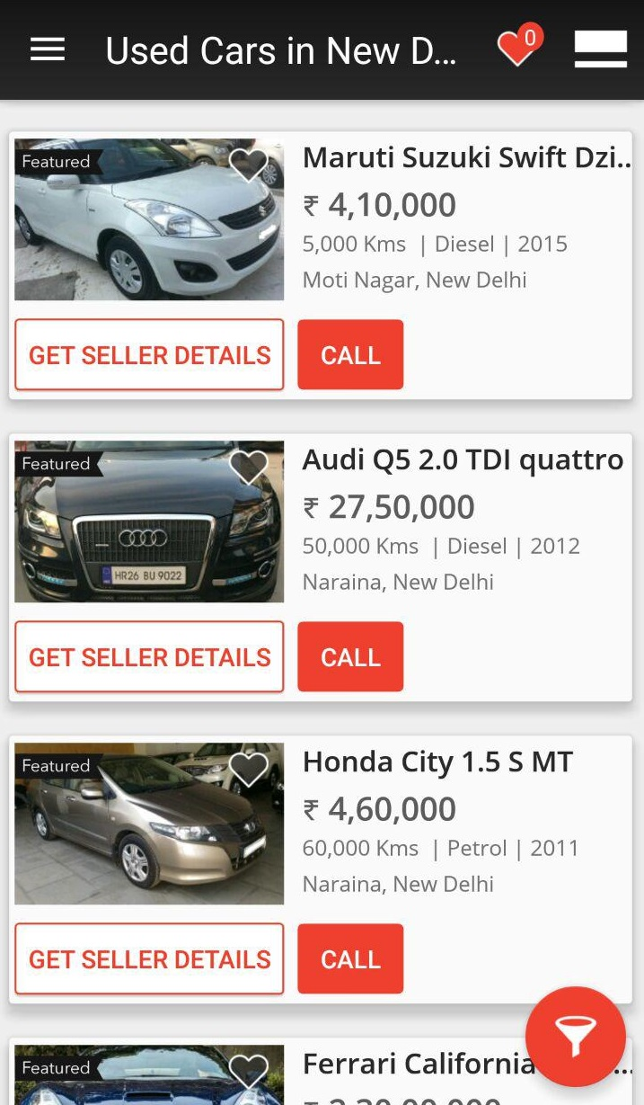
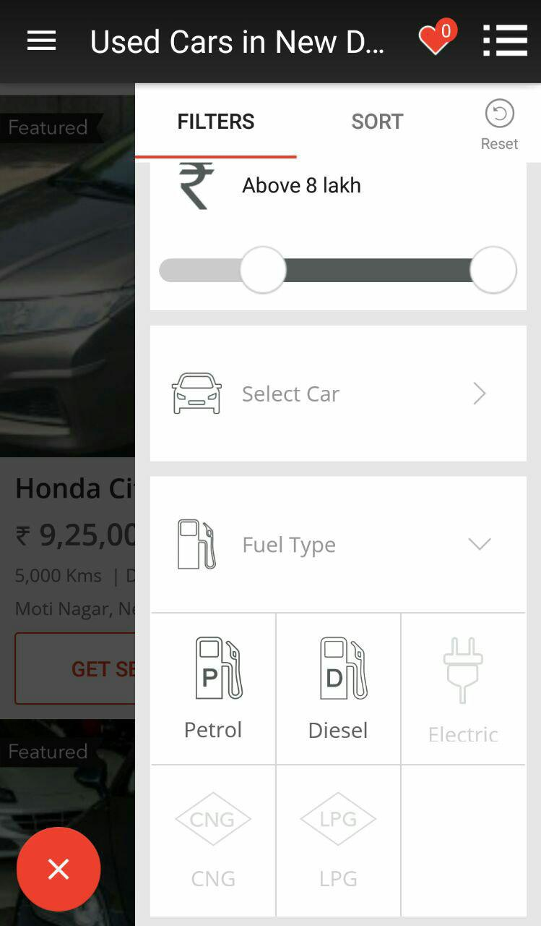
Case Study: CarWale (Car Purchasing)

Slide 8
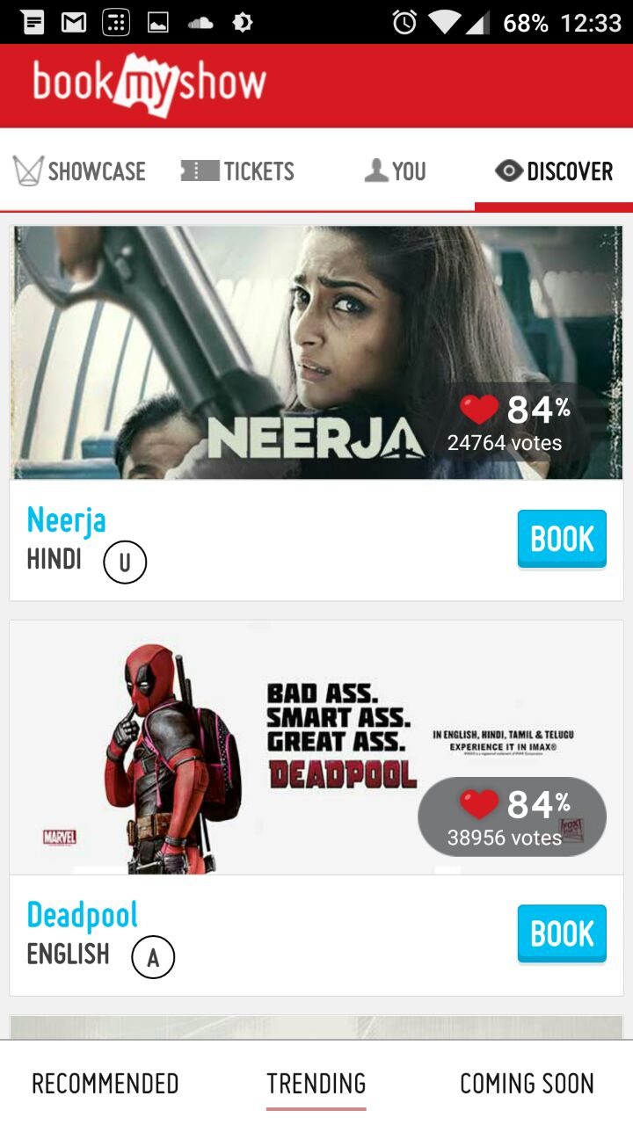
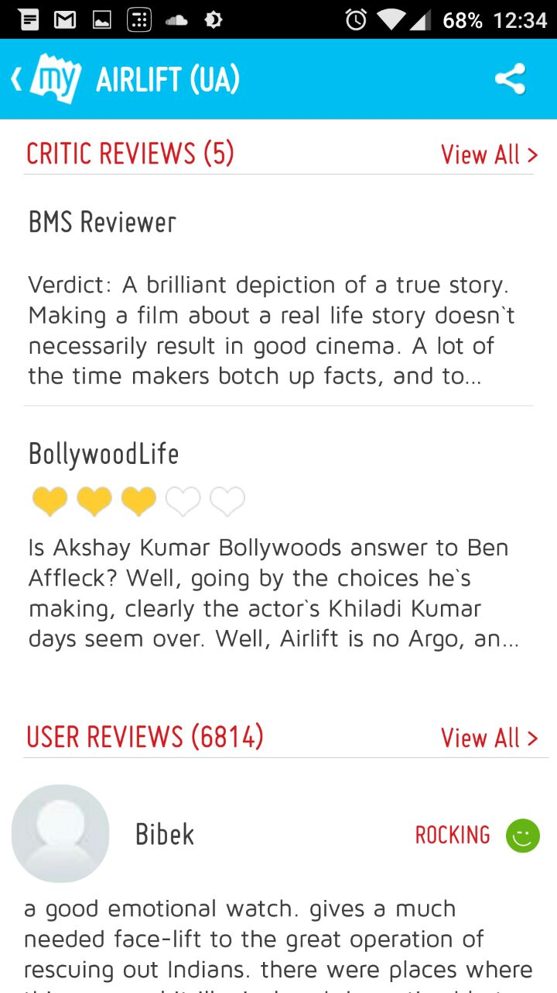
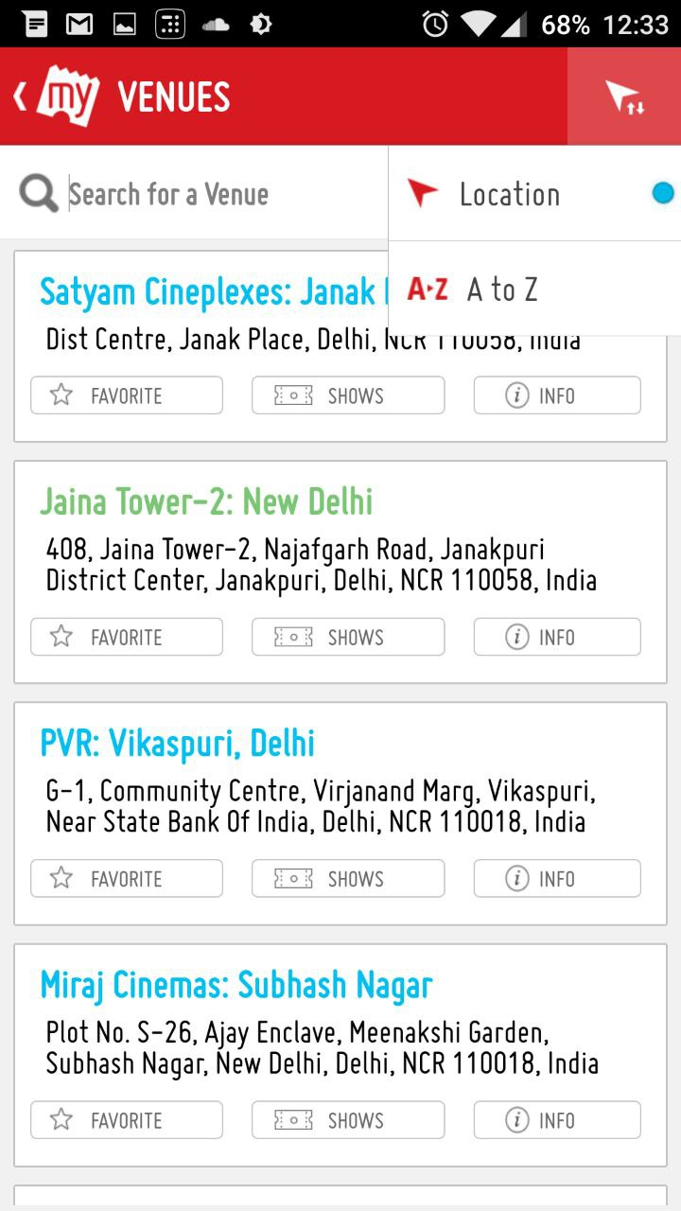
Case Study: BookMyShow (Movie Booking App)

Slide 9
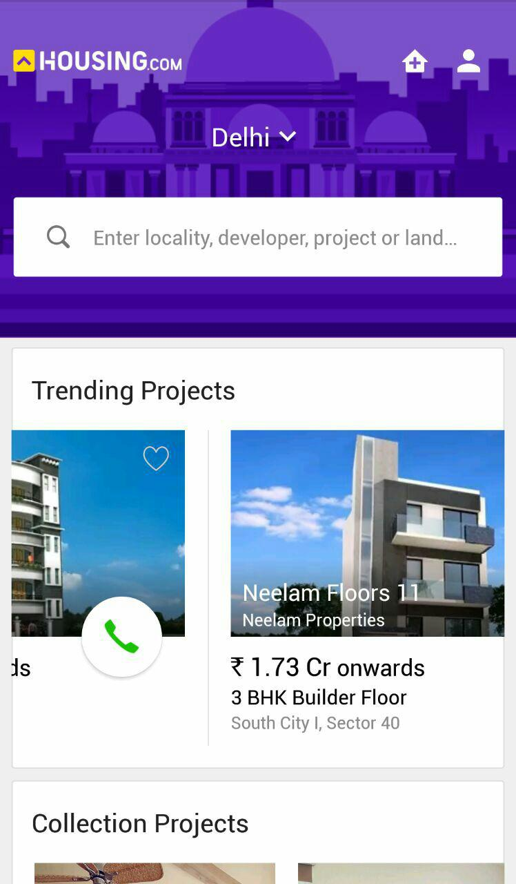
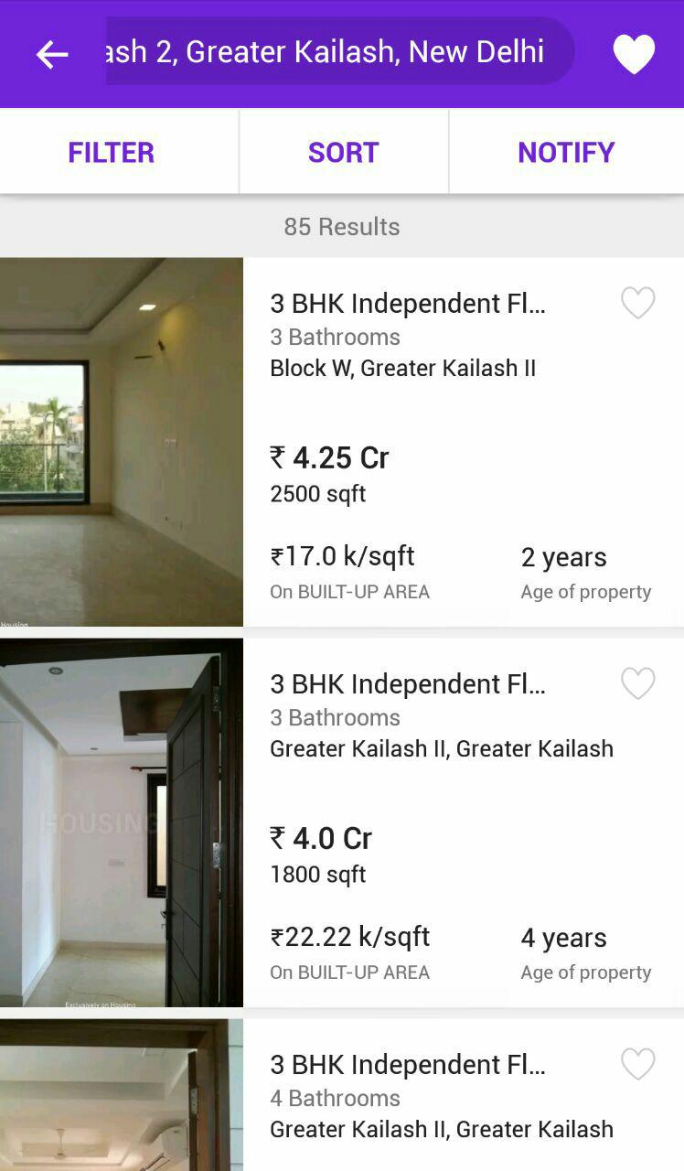
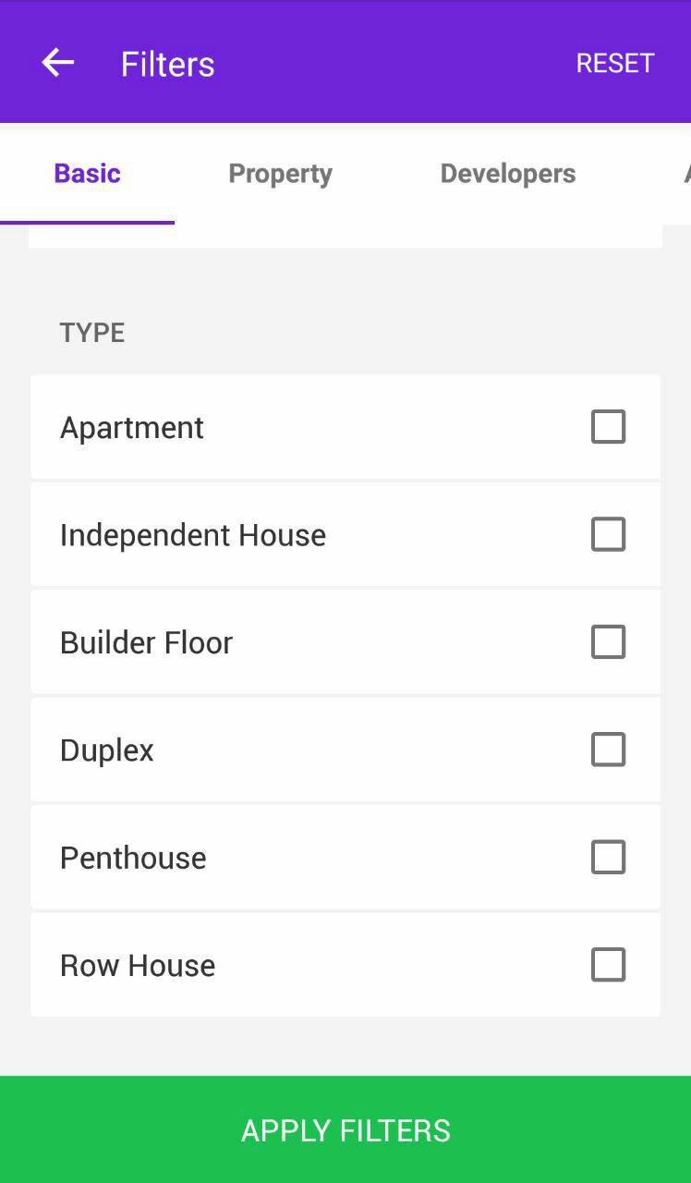
Case Study: Housing (House Finder)

Slide 10
Case Study: And lots more …
BookMyFunction: Wedding/Function venue finder
PolicyBazaar: Insurance Policy search engine
and counting …

Slide 11
Case Study: Conclusion
As you can see from the previous examples, they all share majority of the characteristics like the follows:
A home feed where user can look at trending entities
Sort and search entities based on popularity and attributes of the entity itself.
Read and give reviews & comments around the entity.
Contact the entity via email/phone/map directions and other mediums.
So basically, these apps only differ in the entity they allow searching around and share the same functionality and even aesthetics around other features like reviewing, searching, contacting.

Slide 12
Introduction
Based on our mini case study, we can observe a pattern in these apps and we plan to develop a generator that could automate the task of developing these applications and provide a Minimum Viable Product (MVP) to the end user that he/she could use to perform instant prototyping, pitch the idea to investors, and finally build the production code on top of the generated app.
We first explain the benefits, research, principles and architecture of the project.
Following that, we lay down certain principles we follow while creating this generator to ensure that we never hard-code anything and allow end-user to customize anything at any level.
Then, the phases and stages of development will be discussed. We follow these to remain productive throughout the development cycle.
Finally, the current status of the project will be discussed. (*can be removed)

Slide 13
Advantages
The generator cuts down the development process to merely seconds. The end-user will supply an options file describing the entity and other aspects of the project, and the generator would work its way out to compile entire service including Server, Database Configuration, Website & Mobile Applications. The more modular the generator is, the more customization options can be provided.
A person with an idea but lack of computer engineering skills can use the utility to immediately to analyze his/her idea directly looking at the prototype.
Modular approach of the generator allows contributors to supply plugins that can extend the functionality, without changing the core generator. This allows the generator to remain future proof.

Slide 14
Research
As per the ACM citation Component-oriented software development, we discovered how this specific pattern helps in creating scalable and flexible software.
Our project needs to be pluggable and written in such a way that any component of it can be replaced by user or by the project owner to enhance the features of the generator.
An evaluation of reactive programming and promises for structuring collaborative web applications shows how Reactive development and use of asynchronous programming is a better way of development in web applications as they provide highly responsive websites and better User Experience.

Slide 15
Principles
We are following principles while creating the generator:
We follow Component Driven Development which allows us to replace functionality with minimum code change. For example, if server is implemented in NodeJS, then it shouldn’t be difficult to create a Python server as a drop-in replacement as a component. Or say if Postgresql is used for database, then it shouldn’t be hard to write a layer that could instead communicate with MySQL. The reduced dependencies and a common protocol for communication between components allows to create highly modular generator.
We rely more on static replacement of modules than dynamic replacement. What we mean by static replacement is that, if end-user needs certain feature, instead of making changes in code, we would want to use a different module altogether. The latter is much more scalable than making changes in the code.

Slide 16
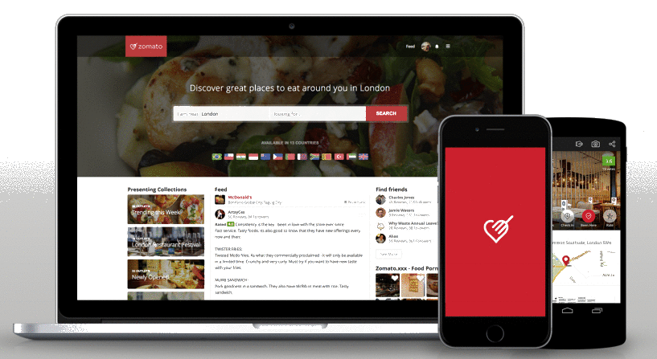
Architecture
We now discuss what architecture such an application usually follows.
DataBase
DB Communication Layer E.g. ORMs
ORM
SERVER
Website Assets (HTML/JS/CSS)
APIs
REST API
HTTP
Application Binary
APP STORE

Slide 17
Architecture: Database ERM
1:n Writes
m:n Likes
Reviews
n:1 Has
User
m:n Likes
1:n Replies
m:n Bookmarks
Person
ISA
Owner
m:n Rates
Entity
1:n Manages
1:1
Updates
Admin
1:n
Manages
*Management involves creating, updating and deleting.

Slide 18
Architecture: API
Once the Schema is created, an Object Relation Mapper (ORM) can be used to perform CRUD (create retrieve update and delete) operations on the entities. The APIs will depend on the options, however there is a general pattern in them too. For example we can implement following API routes irrespective of the options chosen by the end-user:
GET entity/:entityID POST comment/:entityID POST like/:commentID PUT user_profile/:userID
CRUD on User
CRUD on Comments/Reviews/Ratings/Likes and other user activity.
CRUD on Entity will need to respect the chosen attributes by the user. Here we will have to employ proper code generation techniques.
Once the API is created, the Application and Website will have to consume it too. This is where we would require proper generation techniques.
This is the most challenging part for the entire project.

Slide 19
Architecture: API (continued…)
Since end-user can have different specifications for choice of database and the attributes of the entity, we will have to rely on an ORM that can abstract out details of the entity and allow us to cater all the need.
The way we plan to implement this is to have a layered modular approach as follows:
If say a customer wants to use Postgresql instead of MySQL, we can rely on libraries like knex that support both of them. Catering this need would simply require change in ORM module while API uses knex’s API to query database.
Now say if a customer wants an altogether different database, for example MongoDB. In this case, we will have to rely on ORM that supports MongoDB, like Mongoose. Since the API of Mongoose is very different than knex, both ORM and API modules will have to be updated.
Similarly, the more choice and customization we provide, more modules will have to be updated. However, we can plug them from any source, or the end-user can write their own to leverage our generator’s other features, which becomes way better than to build everything from scratch for the end-user.
ORM
API
Component fetch
Component UI
Server
Client

Slide 20
Architecture: WEBSITE & APP ASSETS
We rely on a JavaScript library called ReactJS that uses components to create user interfaces. This helps in developing following modular approach. Further, same components can be used both by mobile application (react-native library is used for the same) and the website, which helps in more code re-usage.
Since the components can be simply replaced by any other component that performs the same function but with different layout/style/approach, we can allow user to choose from a variety of component replacements and truly customize entire application, layout by layout.
The component approach also allows contributors to write pluggable components that can extend the functionality of the app. This might require minor code changes (5-10 lines of code), but acts as highly powerful feature.

Slide 21
Generator
options
MVP GENERATOR
End-User
Entire application

Slide 22
Phases
The development process is split in two phases with several stages in them.
App: Develop a skeleton app that can serve the purpose for a generic application. Once it is developed, generator can use code from it and provide it to the end-user with minor changes based on options provided by end-user.
Generator: This phase will parse the options and make necessary changes to the App created in Phase 1 (if any) to meet the needs of the end-user. For each use-case, we will create extra components and slowly support a wide variety of features in a modular way.

Slide 23
Phase 1 (App): stages
Use a configuration file that has metadata like name of application, name of entity etc. This file will allow generator to simply update the configuration file and modify entire application.
Develop a static server that provides dummy data for the website.
Create website using React Components.
Create iOS and Android apps using React-Native. Reuse as many components as we can from stage 2.
Create authentication system (both with and without sessions) and a real database.
Create different visual styles and templates for customization options until we can create apps that were mentioned in case study.

Slide 24
Phase 2 (Generator): Stages
Create a basic generator that simply takes the options and performs static transformations like name of application, name of entity, theme choices, component replacements.
Create an engine to generate schema migrations using knex based on the given options.
Use above schema to transform CRUD APIs.
Modify user interface components to consume above APIs.
Add new modules that can implement a given feature until we can create apps that were mentioned in case study.

Slide 25
Current status
After learning the technologies like NodeJS, ReactJS, ReactNative in the month of January, we started with the development in late January.
So far we have achieved ~40% of the goals of the phase 1, i.e. nearly completed stage 1-3 out of 6 of phase 1.
Side by side, work on generator has been started and right now we are working on the stage 1 of phase 2.
We are using GitHub for version controlling and working together remotely.
Seeing the progress, we believe that by end of March we will have a basic generator ready that can mimic Zomato in functionality and partially in aesthetics.

Slide 26
References
ReactJS - A JavaScript library for building user interfaces
ReactNative - A framework for building native mobile apps using React
NodeJS - A JavaScript runtime built on Chrome's V8 JavaScript engine.
MongoDB – A cross-platform document-oriented database, classified as NoSQL database.
Postgresql – An object-relational database management system (ORDBMS) with an emphasis on extensibility and standards-compliance.
ORM - Object Relational Mapping is a software-programming issue in linking object-oriented code with relational databases
Knex - A SQL query builder for Postgres, MySQL, MariaDB, SQLite3, and Oracle designed to be flexible & portable
Mongoose - Elegant MongoDB object modeling for Node.js

Slide 27
Thank You

