Slide 1


Problem Solving Using Programming Java
Music Playlist & Listening Stats Manager
A console-based Java application to organise a personal music playlist and automatically track listening statistics.
Presented by
Boga Shashank
Yarlagadda Druveen
Roll No: 2620040175
Roll No: 262003528
Faculty Guide: V GopiKrishna
Console application • Core Java • File-based storage
Notes:
- Greet the panel and introduce the team.
- Read both student names and roll numbers exactly as shown.
- One-line pitch: a console Java app that organises a personal playlist and auto-tracks listening statistics.

Slide 2

1
Introduction
In the era of Spotify and Apple Music, playlists define how we listen to music. Yet there is no lightweight, offline tool that records every song you play and summarises your listening habits in one place.
This project is a menu-driven console application built in Core Java that lets a user manage a personal music playlist and automatically tracks how many times each song is played.
✓
Built with Core Java — classes & objects, ArrayList, HashMap, File I/O
✓
Playlist data persists in a plain text file between runs
✓
Every play updates counters automatically — no manual logging
✓
Statistics engine reports totals, favourite artist and Top-5 songs
Playlists generate the data — this project records and analyses it.
Notes:
- Set the context: in the streaming era playlists define how we listen — but nothing lightweight and offline records it.
- State what the app does: a menu-driven console app that manages a playlist and auto-tracks every play.
- Name the tech stack: Core Java, classes and objects, ArrayList, HashMap, File I/O.
- Say why the topic was chosen: it fills the gap for a simple offline listening tracker.

Slide 3
2
Problem Statement
“
Music listeners have no simple, offline way to record which songs they play and to see their listening habits summarised in one place.
✎
Manual logging is tedious
◉
Spreadsheets need upkeep
Writing down each played song by hand is slow, and entries are easily forgotten or duplicated.
Excel trackers must be updated manually, so play counts end up guessed instead of measured.
☁
Streaming apps are online-only
?
No instant summary
Their statistics need an internet connection and an account, and cannot be customised or exported.
Finding your most-played song or favourite artist means counting by hand.
⚑
Project goal — a lightweight, offline, auto-counting playlist and statistics manager built in Java.
Notes:
- Read the core statement in the navy card aloud.
- Walk the four pain points: manual logging, spreadsheet upkeep, online-only streaming stats, no instant summary.
- End on the goal line: lightweight, offline, auto-counting playlist and statistics manager in Java.

Slide 4
3
Objectives
Five clear objectives guided the design of the application.
01
Build a playlist manager
02
Automate play tracking
Add, view and remove songs using clean object-oriented classes.
Every play of a song increments its counter instantly — zero manual entry.
03
Generate listening statistics
04
Provide search and sort
05
Persist data with File I/O
Compute total plays, total listening time, favourite artist and the Top-5 songs.
Find any song by title or artist and rank the playlist alphabetically or by plays.
Save the playlist to a text file and reload it automatically on every run.
Notes:
- Point out that the five objectives map one-to-one to the menu features.
- Touch each briefly: playlist manager, automatic tracking, statistics, search/sort, file persistence.
- Say every objective will be verified live in the demo.

Slide 5
4
Existing System
Today, listeners track their music in three common ways — each with clear drawbacks:
Quick comparison
Method | Auto count | Offline | Full stats
Handwritten list | ✕ | ✓ | ✕
Spreadsheet | ✕ | ✓ | manual
Streaming app | ✓ | ✕ | limited
This project | ✓ | ✓ | full report
✓
Handwritten lists / spreadsheets
Play counts are noted or guessed by hand; the sheet drifts out of date and errors accumulate.
☁
Streaming apps (Spotify, Apple Music)
Rich, but online-only: they need an account and internet, and show only the statistics the app decides to expose.
▦
Database-based trackers (MySQL projects)
Powerful but heavy — installation and setup are overkill for a single listener’s needs.
Notes:
- Walk the comparison table top to bottom.
- Note each method's drawback: manual counting, online-only stats, heavy database setup.
- Finish on the gap this project fills — automatic counting, fully offline, full statistics report.

Slide 6
5
Proposed System
A lightweight Java console application where playing a song updates its counter automatically, and a built-in stats engine summarises listening habits instantly — all data stored in a plain text file.
KEY ADVANTAGES
Existing vs Proposed
⇄
⚡
Automatic play counting — statistics are always current
Feature
Existing tools
This project
Play counting
Manual entry
Automatic (+1 per play)
◌
Works fully offline — only a JDK is required, no database install
Internet needed
Often (streaming apps)
Never — 100% offline
⤓
Persistent storage — auto-saves to music_data.txt after every change
Storage
Cloud / app account
Local text file, portable
✦
Modular OOP design — 4 small classes, easy to read and extend
Statistics
Limited, app-defined
Full local report + Top-5
▿
Beginner-friendly code — heavily commented for viva explanation
Source code control
Closed
Open, simple Java classes
⚡
Pillar 1 · Automation — every play updates the counters with zero manual entry.
⤓
Pillar 2 · Persistence — every change is saved to music_data.txt on the spot.
Notes:
- Stress the two pillars: automation (plays counted with zero manual entry) and persistence (auto-save to music_data.txt).
- Walk the five advantages briefly — offline JDK-only setup, 4-class modular OOP design, code commented for the viva.
- Use the table column by column; finish on "Open, simple Java classes".

Slide 7
6
System Architecture
☻
INPUT
USER
keyboard input
Chooses menu options; types song details on the keyboard (Scanner input)
▼
Main.java — Controller
CONTROLLER
Menu loop, input validation, load-on-start and auto-save triggers
switch-case menu
▼
DATA MANAGER
ArrayList<Song>
holds the ArrayList of songs: add / remove / search / sort
CALCULATOR
HashMap totals
totals, listening time, favourite artist (HashMap), Top-5
Playlist.java — Data Manager
StatsManager.java — Calculator
▼
MODEL
Song.java — Model
POJO · 4 fields
one object per song: title, artist, duration, playCount
·
▼
save
▲
load
▤
STORAGE
music_data.txt — Persistent Storage
One line per song: title|artist|seconds|plays — reloaded at every start
✦
DATA FLOW
User presses 4
→
Main calls playSong()
→
Playlist fetches the Song
→
playCount +1
Example — Play a song:
→
auto-save writes music_data.txt
Notes:
- Narrate the exact flow: user presses 4 → Main calls playSong() → Playlist fetches the Song → playCount +1 → auto-save writes music_data.txt.
- Emphasise separation of controller / manager / model layers: Main, Playlist + StatsManager, Song.
- Point at the ▼ save / ▲ load pair — storage is written after every change and reloaded at every start.

Slide 8
7
Functionalities
Eight menu options cover the complete workflow — each maps to one menu number the user types.
★
Gold border — signature features
♪
MENU 1
⊕
MENU 2
⊖
MENU 3
▶
MENU 4
View All Songs
Add a New Song
Remove a Song
Play a Song
Neat table of No. / Title / Artist / Length / Plays.
Validated input for title, artist and length (min + sec).
Deletes by title, ignoring capital letters.
Shows NOW PLAYING banner and adds +1 to its play count.
⌕
MENU 5
⇅
MENU 6
▦
MENU 7
⤓
AUTO
Search Songs
Sort Playlist
Listening Stats
Auto-Save
Case-insensitive match on title or artist.
A–Z by title, or most-played first.
Totals, favourite artist and Top-5 ranking.
FileWriter persists the playlist after every change.
▶
Demo tip — suggested order: View All Songs (1) → Play "Believer" (4) → Listening Stats (7).
Notes:
- Each card maps to one typed menu number — walk them briefly in order 1 to 8.
- Suggested demo order: View All Songs (1), play "Believer" (4), then Listening Stats (7).
- Point out the gold-bordered cards 4 and 7 — the project's signature features.
- Auto-save runs after every change; it needs no menu option.

Slide 9
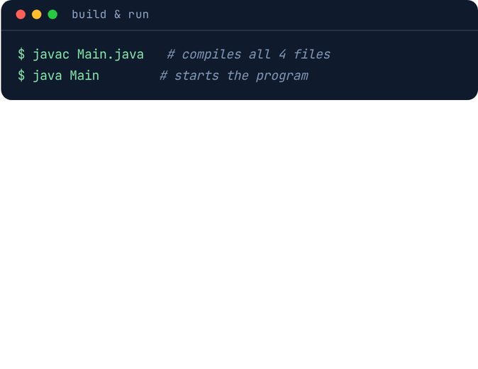
8
Implementation — Java Code Screenshots
(1 of 5) · Project overview
The complete project is 4 well-organised Java classes — 628 lines of fully commented, beginner-readable code. The next four slides show each class exactly as submitted.
CLASS | ROLE | KEY MEMBERS | LINES
Song.java | Model — represents one song | fields, constructor, play counter, file helpers | 101
Playlist.java | Data manager — the song collection | add, remove, view, search, sort | 128
StatsManager.java | Statistics engine | totals, favourite artist, Top-5 | 129
Main.java | Controller — menu and files | menu loop, input validation, save/load | 270
Total |  | 628 lines of Java | 628
Song.java
Playlist.java
2 of 5
encapsulation & the file format
3 of 5
ArrayList & the printf table
4 of 5
StatsManager.java
5 of 5
Main.java
the HashMap maths
menu loop & auto-save
ⓘ
Code shown exactly as submitted — full source files are part of the project upload.
Notes:
- One line on separation of responsibilities: model / data manager / statistics / controller.
- Each of the four classes gets its own slide with the full code next.
- Mention 628 total lines, all commented — written to be read, not just run.

Slide 10
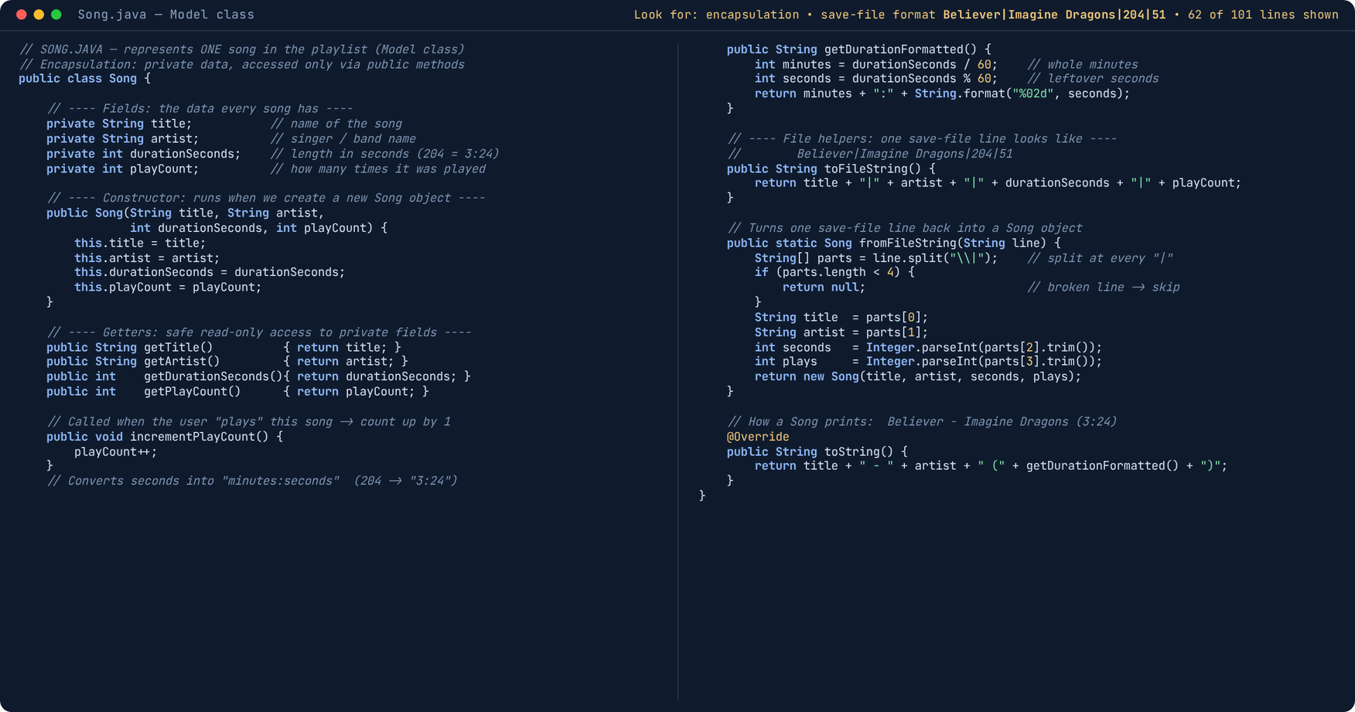
8
Implementation — Java Code Screenshots
(2 of 5) · Song.java — Model
Notes:
- Point out private fields + public getter methods — that is encapsulation.
- Show the save-file format example: Believer|Imagine Dragons|204|51.
- fromFileString is the reverse operation used when the program starts.

Slide 11
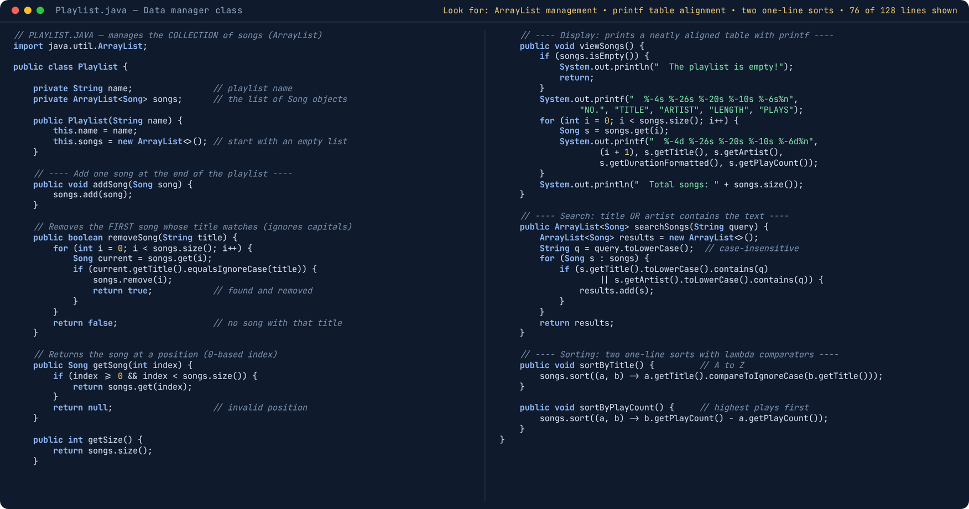
8
Implementation — Java Code Screenshots
(3 of 5) · Playlist.java — Data Manager
Notes:
- removeSong loops once and stops at the first title match (ignore case).
- printf keeps the table columns aligned — mention the %-26s width flags.
- Both sorts are one-line lambda comparators: A-Z by title, highest plays first.

Slide 12
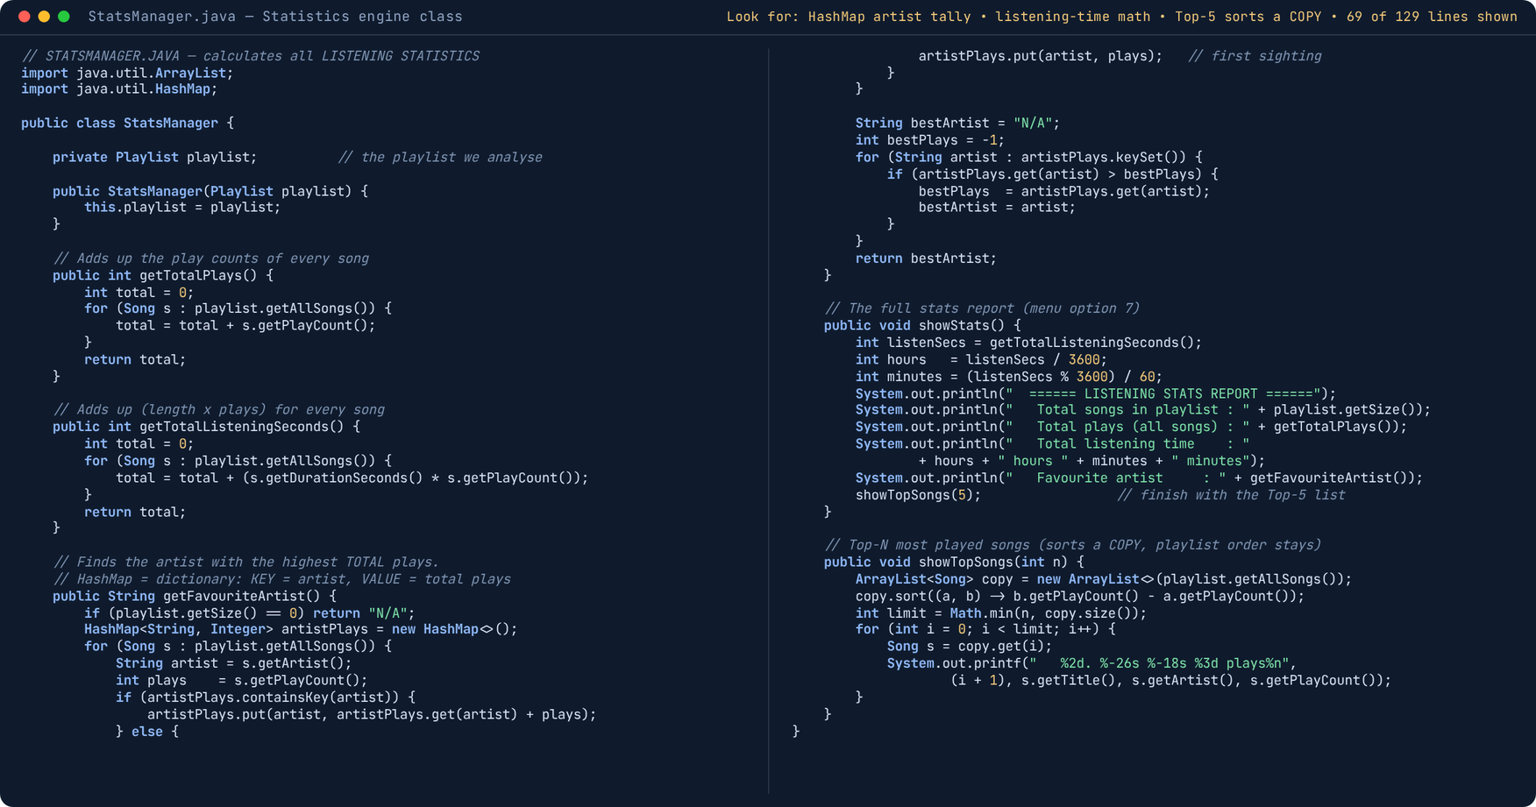
8
Implementation — Java Code Screenshots
(4 of 5) · StatsManager.java — Statistics Engine
Notes:
- Walk the HashMap artist tally once slowly: key = artist, value = total plays.
- Listening time = sum of length x plays, converted to hours + minutes.
- Top-5 sorts a COPY of the list, so the user's playlist order stays untouched.

Slide 13
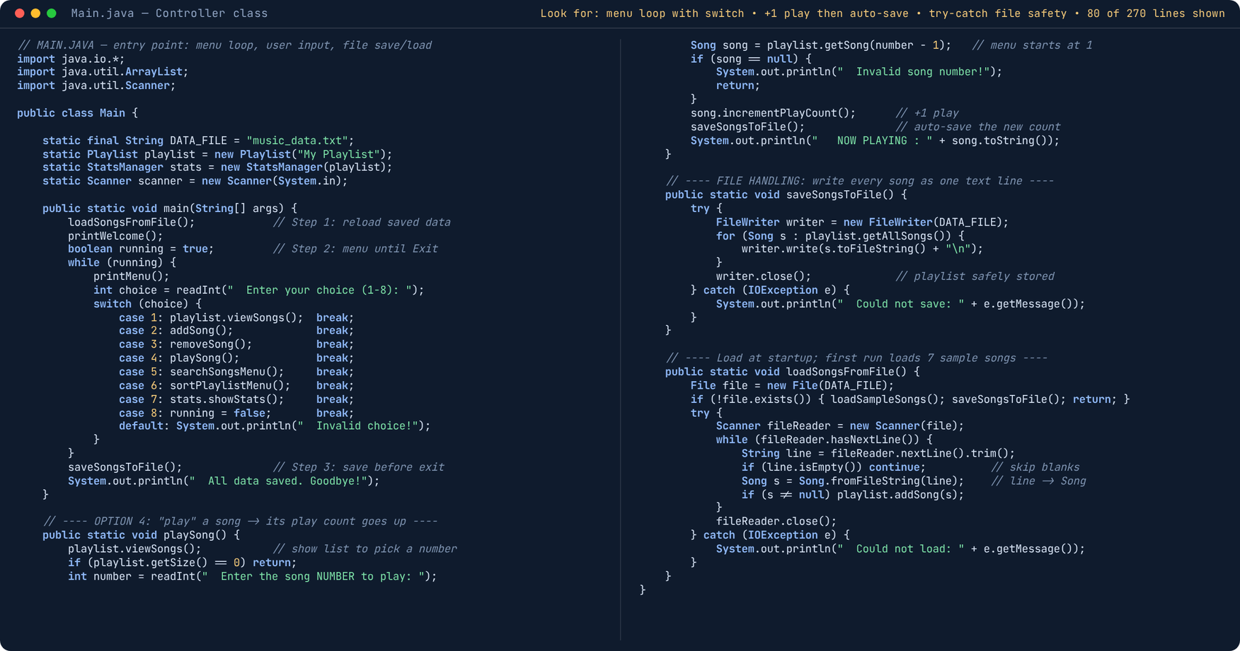
8
Implementation — Java Code Screenshots
(5 of 5) · Main.java — Controller
Notes:
- Narrate the menu loop once: print menu, read choice, switch-case dispatch.
- playSong core: get song, +1 count, auto-save — three meaningful lines.
- addSong, removeSong, search and sort handlers follow the same simple pattern (full source in upload).

Slide 14
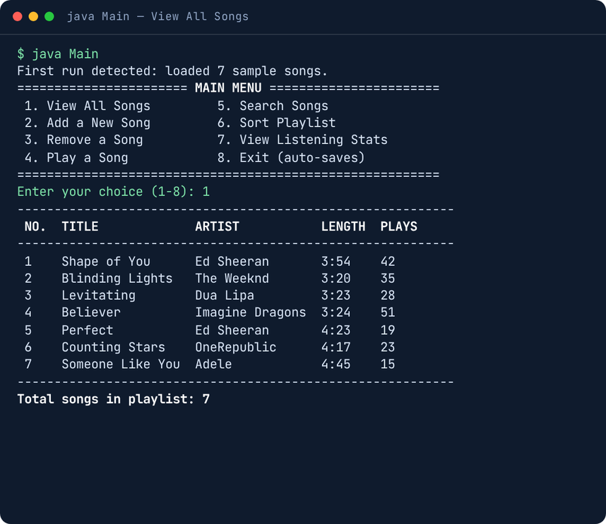
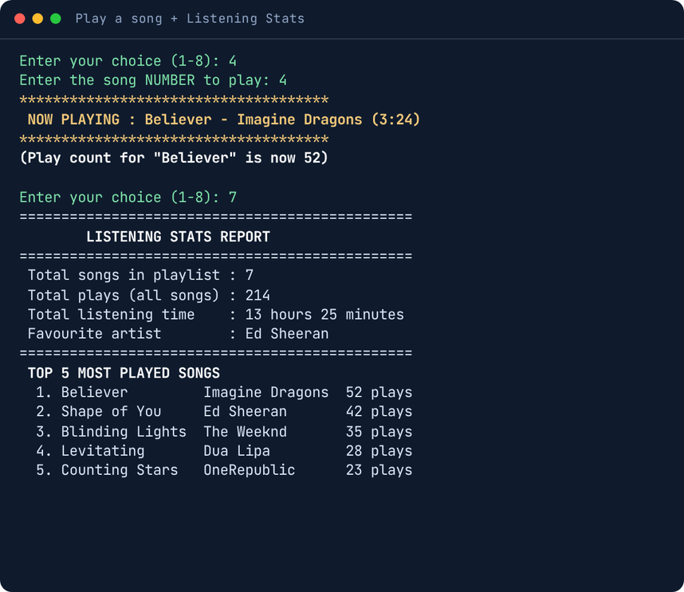
9
Output Screenshots
▦
Real table rendered with printf — columns stay aligned.
↗
Believer moved 51 → 52 plays; totals recomputed live.
◉
Live output of java Main (OpenJDK 21) — replace with your own machine’s screenshots after running the program.
Notes:
- Point at Believer moving 51 → 52 plays — and the totals and Top-5 recomputed live in the right window.
- Highlight the aligned printf table columns in the left window.
- Offer a live demo: run java Main (OpenJDK 21) in front of the panel.

Slide 15
10
Future Scope
The modular design leaves clean extension points for the next versions.
▢
GUI version
▦
Database storage
✦
Shuffle and queue
A Swing / JavaFX front-end with buttons and lists instead of typed menu numbers.
Move from text file to MySQL via JDBC to support many users and large libraries.
Random play order and a play-next queue like real music players.
👍
Smart recommendations
▣
▦
Real audio playback
Report export
Suggest songs from the favourite artist and unplayed titles.
Generate a weekly listening report as PDF or CSV.
Integrate an audio library so playing a song actually produces sound.
Notes:
- Frame the section: modular OOP design gives clean extension points for future versions.
- Highlight the top two natural next steps — GUI front-end (Swing/JavaFX) and MySQL storage via JDBC.
- Walk the remaining four briefly: shuffle/queue, smart recommendations, PDF/CSV report export, real audio playback.
- Close: the current console version is a complete, extensible Core Java base.

Slide 16
11
Conclusion
4
8
100%
0
Learning outcomes
Java classes
menu features
offline & free
manual entries per play
▿
OOP encapsulation — private data behind public methods
What we achieved
▿
Collections — ArrayList for storage, HashMap for artist totals
✓
A complete playlist manager built in Core Java — Song, Playlist, StatsManager and Main classes
▿
File I/O — FileWriter saves, Scanner loads, try-catch safety
✓
Automatic play counting with a live statistics engine (totals, favourite artist, Top-5)
▿
Input validation — readInt / readText loops that never crash
✓
Search, sort and persistent text-file storage proven across restarts
All five objectives from Slide 3 verified in the working demo
▿
Modular design — each class has one clear responsibility
✓
✓
The project meets every planned objective and provides a solid base for the GUI and database upgrades listed in Future Scope.
Notes:
- Point at the stat strip: 4 Java classes, 8 menu features, 100% offline and free, 0 manual entries per play.
- Read the four achievements aloud; stress that all five Slide-3 objectives were verified in the working demo.
- Learning outcomes: each member gives one personal line — OOP, collections, File I/O, input validation, modular design.
- End on the navy strip: every objective met, and a solid base ready for the GUI and database upgrades.

Slide 17
Thank You!
Questions and suggestions are most welcome.
♪
Music Playlist & Listening Stats Manager — Core Java Mini Project
Notes:
- Thank the panel for their time and attention.
- Invite questions and suggestions on the design, the code or the statistics engine.
- Offer the live demo: run "java Main", play a song and show the stats update live.
- Close by thanking the faculty guide once more.

