Slide 1
Logger.js
Bogdan Cornianu, Java Developer
3Pillar Global

Slide 2

Why?

Slide 3
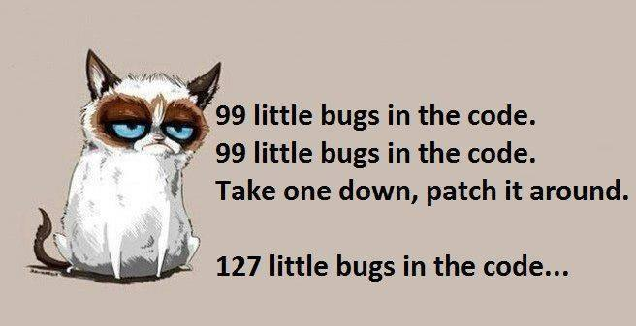
Why?
Even “funnier” if you can’t take one down!

Slide 4

“Black Box bug fixing” on client side
“Uncaught TypeError: object is not a function” does not help

Slide 5

Enter client side logging

Slide 6
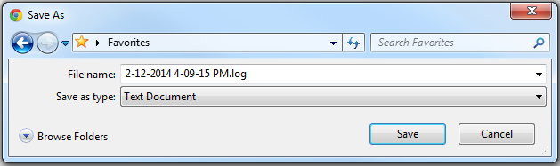
What the client sees

Slide 7
What you see
[Tue Mar 04 2014 17:40:16 GMT+0200 (GTB Standard Time)] [ERROR]> error message
[Tue Mar 04 2014 17:40:28 GMT+0200 (GTB Standard Time)] [ERROR]> second error message
[Tue Mar 04 2014 17:40:38 GMT+0200 (GTB Standard Time)] [WARN]> a warning message
[Tue Mar 04 2014 17:40:48 GMT+0200 (GTB Standard Time)] [INFO]> an information message
[Tue Mar 04 2014 17:48:40 GMT+0200 (GTB Standard Time)] [ERROR]> Uncaught Error: JS ERROR. at line 19 in http://localhost:8080/logger/main.html

Slide 8
How to use it
<script type="text/javascript" src="Logger.js"></script>

Slide 9
How to use it
Logger.log(Logger.level.Error, "error message", Logger.location.All);
Logger.error("second error message", Logger.location.Console);
Logger.warn("a warning message", Logger.location.LocalStorage);
Logger.info("an information message", Logger.location.All);

Slide 10
How to use it
Logger.getEvents(Logger.level.All);

Slide 11
How to use it
Logger.onError(true, true, function(errorMsg, url, lineNumber) {
var errorMessage = errorMsg + ' at line ' + lineNumber + ' in ' + url,
response = '';
Logger.error(errorMessage, Logger.location.LocalStorage);
response = confirm("An error occurred. Would you like to export the log events to a text file?");
if (response === true) {
Logger.exportLog();
}
return true;//suppress errors on console
});

Slide 12
How to use it
Logger.onError(true, true, function(errorMsg, url, lineNumber) {
Logger.exportLog();
return true;//suppress errors on console
});

Slide 13
Implementation highlights
Automatic export of log file on error:
onError: function(exportLog, suppressErrorAlerts, errorCallback) {
var me = this,
errorMessage = '';
if (typeof errorCallback !== 'undefined') {
window.onerror = errorCallback;
} else if (exportLog && typeof errorCallback === 'undefined') {
window.onerror = function (errorMsg, url, lineNumber) {
errorMessage = errorMsg + ' at line: ' + lineNumber + ' in ' + url;
me.log(me.level.Error, errorMessage, me.location.All);
me.exportLog();
return suppressErrorAlerts;
}
} else {
me.resetWindowErrorHandler();
}
}

Slide 14
Implementation highlights
Avoid using 3rd party libraries for saving files on the client side by using blob urls:
saveToDisk: function(content, filename) {
var a = document.createElement('a'),
blob = new Blob([content], {'type' : 'application/octet-stream'});
a.href = window.URL.createObjectURL(blob);
a.download = filename;
a.click();
}

Slide 15
How is it different?
There are other JavaScript logging libraries such as loglevel, log4js, log4javascript, but they either do not support saving the logs on the client’s machine or they need ActiveX, XPCom.
134 lines of code (whitelines included) to answer several questions on stackoverflow.com
1022 bytes minified and zipped

Slide 16

Next steps
Saving the logs directly on the server
Set maximum number of recorded events
Customize the generated file name
Add stacktrace
Use websockets to “supervise” ☺ your clients
Feel free to contribute on https://github.com/bogdan-cornianu/logger

Slide 17

Questions?

