Slide 1
MobileNets
Efficient Convolutional Neural Networks for Mobile Vision Applications
11th May, 2024 PR12 Paper Review
Iamnitchi Bogdan

Slide 2
Table of contents
01
Why Small DNNs
04
Model Structure
Why Small Deep Neural Networks
Defining the model structure
02
Recap CNNs
Experiments
05
Convolutional neural networks
Experiments – Model Choices - Hyperparameters
03
Depthwise Separable Convolution
06
Results
The key idea of the mobilenet model
The performance of the MobileNet compared to others models

Slide 3
Short introduction: AI vs ML
Artificial Intelligence
Machine learning
Vs
Computers act on their own
They act according to environment
Systems display cognitive ability
Computers make decisions
It’s an application of AI
Computers observe and analyze
Predict based on previous patterns
Pre-programmed algorithms

Slide 4
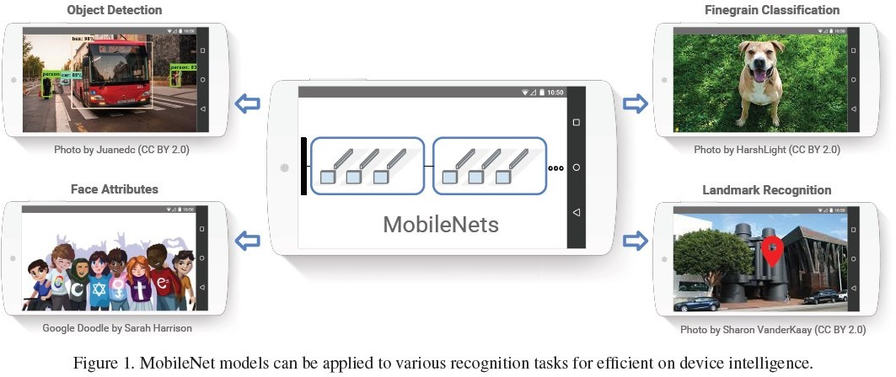
MobileNets

Slide 5
WHY SMALL DNNs
01
02
Faster
\
Updatable
Small DNNs train faster on distributed hardware
WHY
Venus has a beautiful name, but it’s hot
Why Small Deep Neural Networks?
03
04
Deployable
Efficiency
The Earth is the third planet from the Sun
Small DNNs require fewer computational resources.

Slide 6
Techniques for Small Deep Neural Networks
01 | Chatbot systems | Remove Fully-Connected Layers
02 | Decision support | Kernel Reduction ( 3x3 -> 1x1 )
03 | Customer recommendation engines | Channel Reduction
04 | Customer churn modeling | Evenly Spaced Downsampling
05 | Pricing strategies | Depthwise Separable Convolutions
06 | Customer segmentation | Shuffle Operations
07 | Image classification | Distillation & Compression

Slide 7
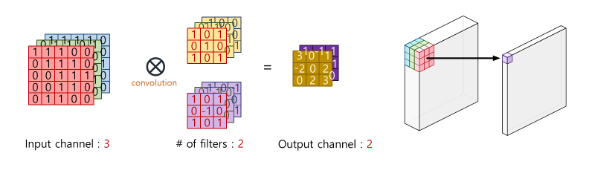
Recap about CNN – Convolution Operation
Convolution
Convolution in CNN involves applying a filter across the input data to extract features through sliding windows.

Slide 8
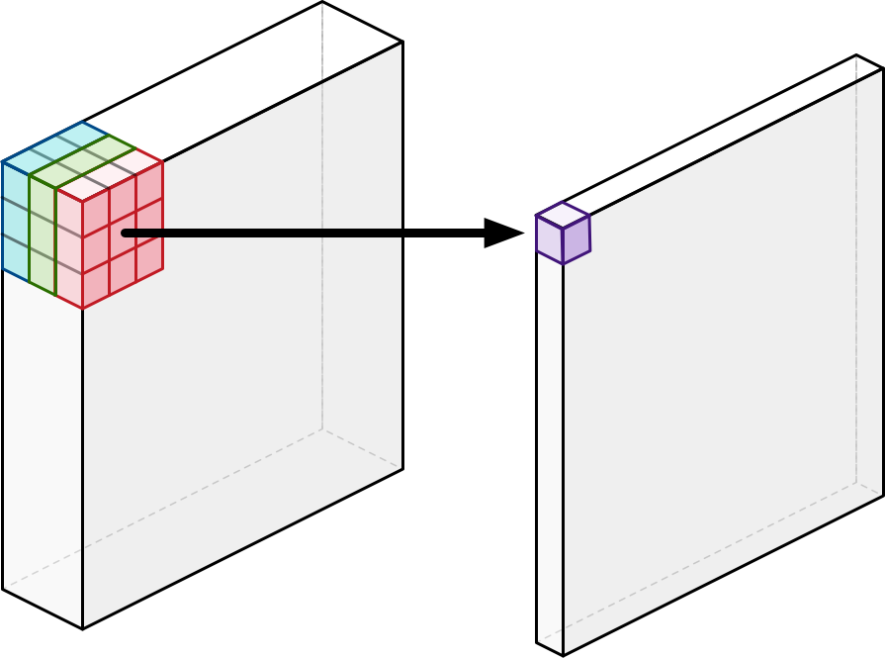
Standard Convolution
Standard Convolution
Standard convolution in CNN involves sliding a filter/kernel across the input data, computing the dot product at each position, and producing a feature map.

Slide 9
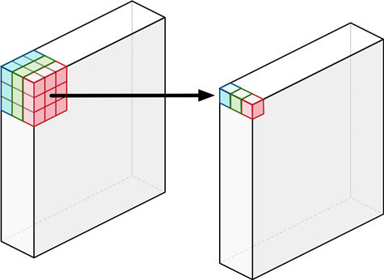
Depthwise Convolution
Depthwise Convolution
Depthwise convolution is a technique used in convolutional neural networks where each channel of the input data is convolved with its own set of filters, ensuring that the output channels remain unchanged.

Slide 10
Why should we always consider all channels?
Key Idea : Depthwise Separable Convolution!

Slide 11

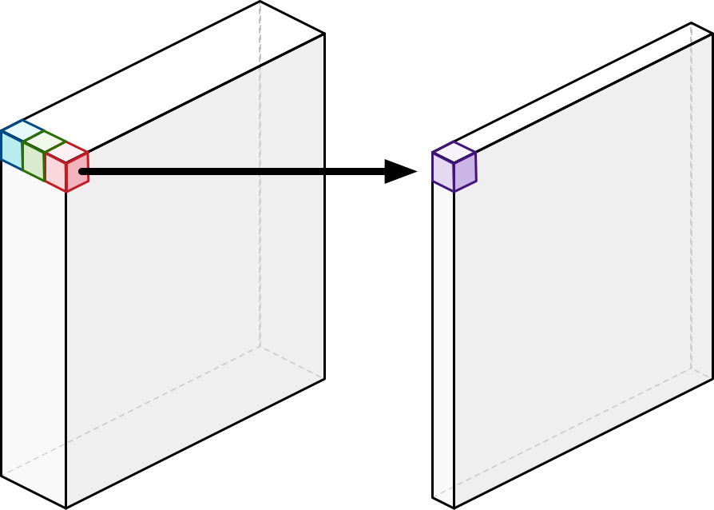
Depthwise Separable Convolution
Depthwise Convolution + Pointwise Convolution(1x1 convolution)
Depthwise convolution
Pointwise convolution

Slide 12
About Performance
Standard convolutions
Depthwise separable convolutions
Reduction in computations
Computational cost
Computational cost
Reduced
D_{K} x D_{K} x M x N x D_{F} x D_{F}
D_{K} x D_{K} x M x N x D_{F} x D_{F}
1 / N + 1 / D
2
K
If we use 3x3 depthwise separable convolutions, we get between 8 to 9 times less computations
DK : width/height of filters
DF : width/height of feature maps M : number of input channels
N : number of output channels(number of filters)

Slide 13
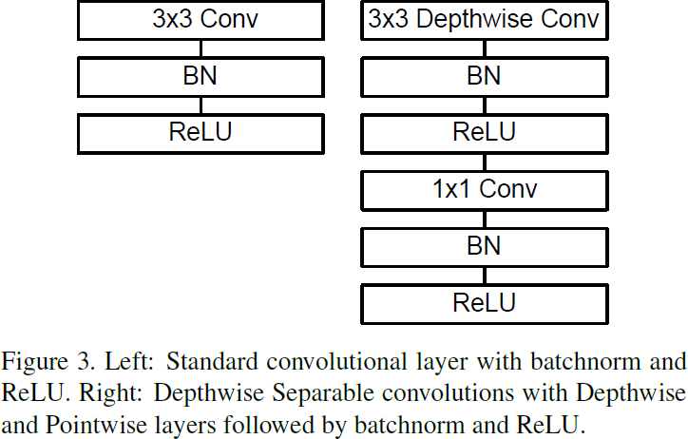
Models Layers

Slide 14
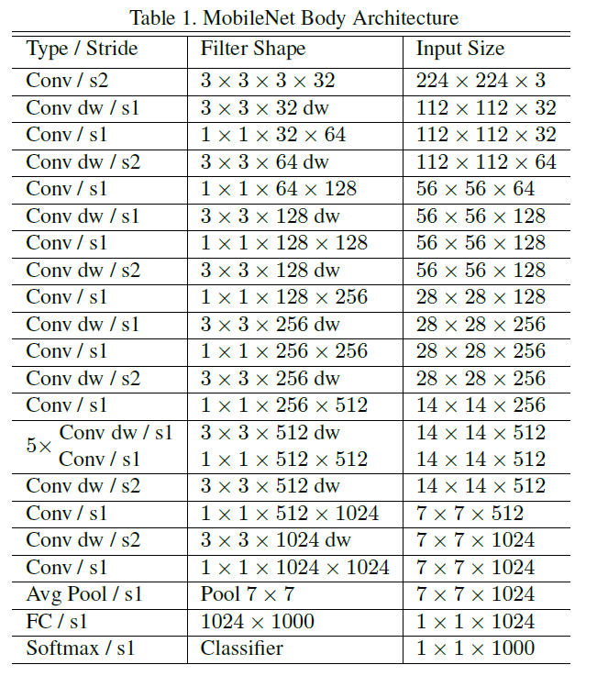
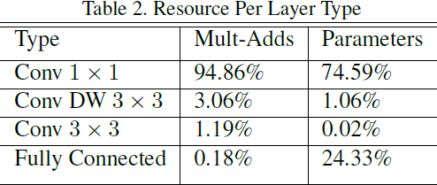
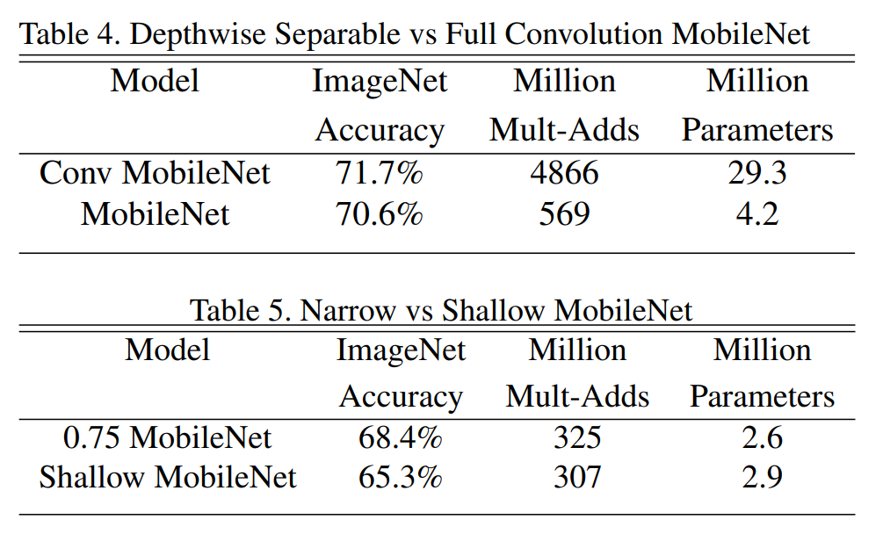
!! Model Structure !!
ML for business

Slide 15
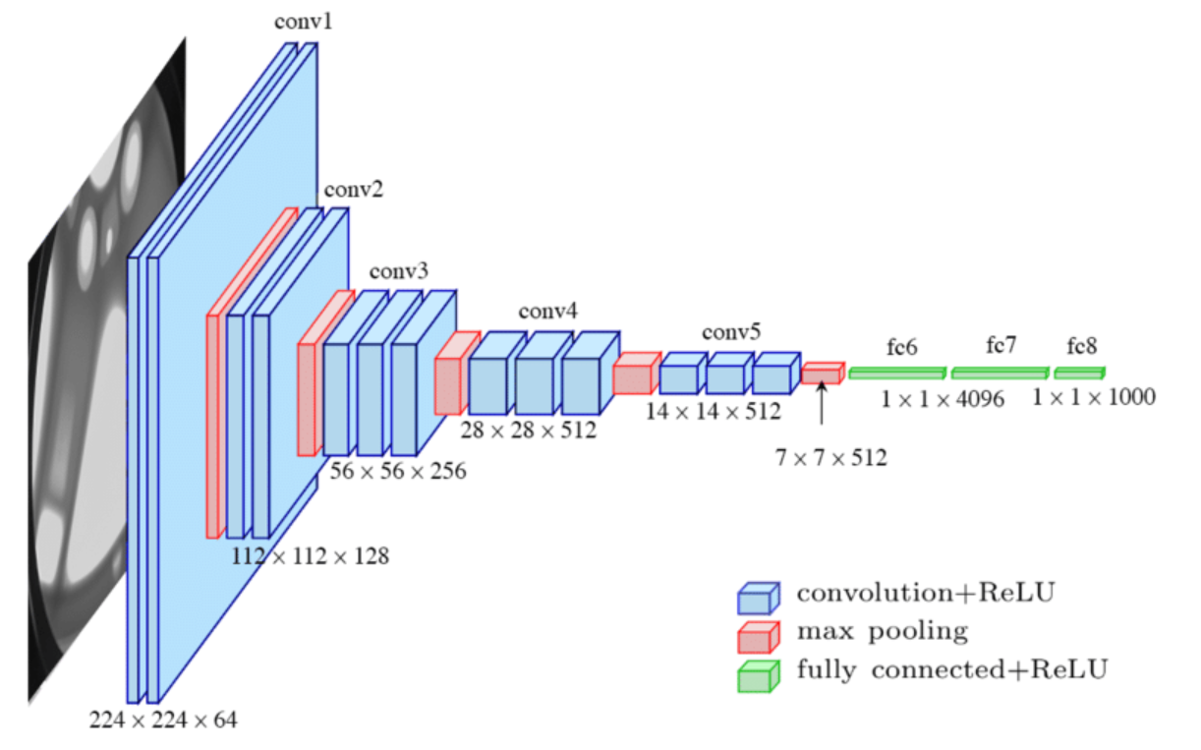
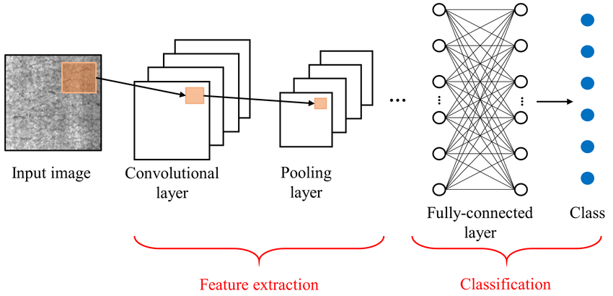
Model Structure
Convolutional Part
Fully Connected and Classification
MobileNet utilizes depthwise convolution to extract features efficiently, convolving each input channel separately with a unique set of filters while preserving the number of output channels.
For the classification stage, MobileNet employs global average pooling, summarizing the features from the previous layers into a single vector, followed by a fully connected layer and softmax activation for classification.

Slide 16
Model Shrinking Hyperparameters
Width Multiplier & Resolution Multiplier
Width Multiplier – Thinner Models
Resolution Multiplier – Reduced Representation
For a given layer and width multiplier α, the number of input channels M becomes αM and the number of output channels N becomes αN – where α with typical settings of 1, 0.75, 0.6 and 0.25
The second hyper-parameter to reduce the computational cost of a neural network is a resolution multiplier ρ
0<ρ≤1, which is typically set of implicitly so that input resolution of network
is 224, 192, 160 or 128
(ρ = 1, 0.857, 0.714, 0.571)

Slide 17
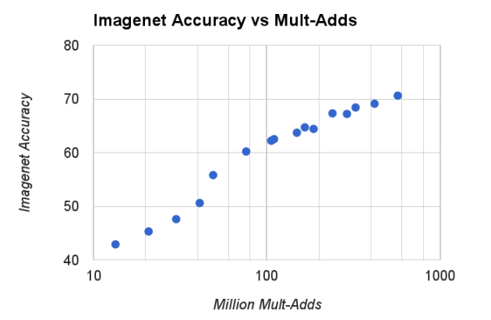
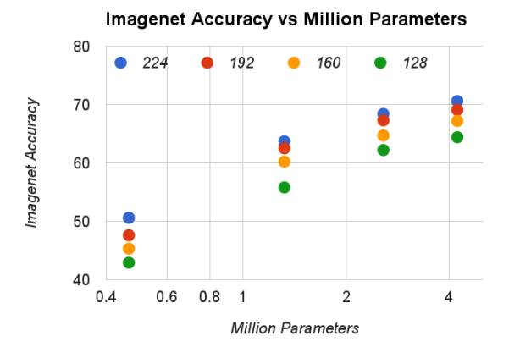
Model Shrinking Hyperparameters
The figures shows the trade off between ImageNet Accuracy and computation for the 16 models made from the cross product of width multiplier α ∈ {1, 0.75, 0.5, 0.25} and resolutions {224, 192, 160, 128}. Results are log linear with a jump when models get very small at α = 0.25.
Width Multiplier & Resolution Multiplier

Slide 18
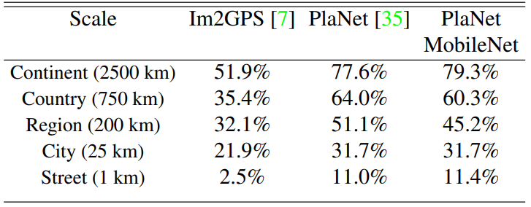
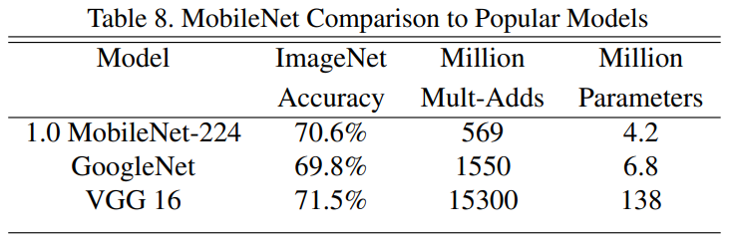
MobileNets Results
Performance of PlaNet using the MobileNet architecture. Percentages are the fraction of the Im2GPS test dataset that were localized within a certain distance from the ground truth. The numbers for the original PlaNet model are based on an updated version that has an improved architecture and training dataset.
PlaNet : 52M parameters, 5.74B mult-adds
MobilNet : 13M parameters, 0.58M mult-adds

Slide 19
Conclusion of MobileNets
That’s all folks
Conclusion. Ultimately, the best MobileNet variant to choose depends on your specific requirements and constraints, such as the target device, input image size, computational resources, and accuracy requirements.

