Slide 2

WHAT IS GIT?
►Git is a version control system that helps you keep track of changes in your project.

Slide 3
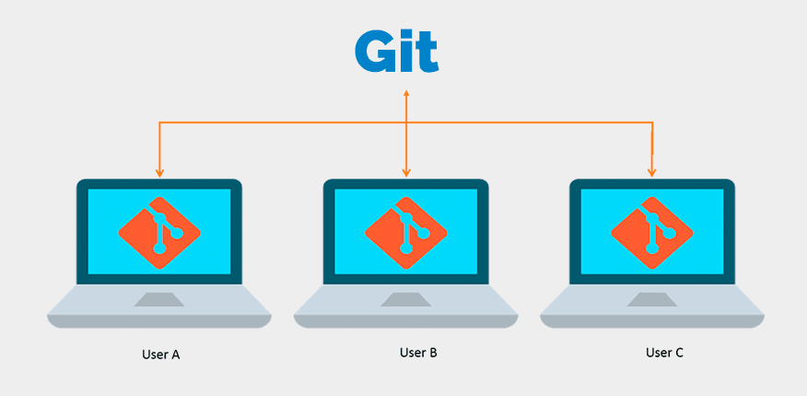
Тут про команди і тд…

Slide 4
Мб ще команди(їх багато)

Slide 5

OUR CHOICE IS GitHub

