Slide 1
WEEK 8 - sampling

Slide 2
Events
Event | Measured with | Description
L3 misses | ix86arch::LLC_MISSES | count each cache miss condition for references to the last level cache. The event count may include speculation, but excludes cache line fills due to hardware prefetch
L2 hits | L2_RQSTS:DEMAND_DATA_RD_HIT | Counts the number of demand Data Read requests initiated by load instructions that hit L2 cache.
L1 load hits | MEM_LOAD_RETIRED:L1_HIT | Counts retired load instructions with at least one uop that hit in the L1 data cache. This event includes all SW prefetches and lock instructions regardless of the data source.
Stalled cycles | UOPS_RETIRED:STALL_CYCLES | Retired uops. Cycles without actually retired uops.
For testing the sampling method
Instructions | INST_RETIRED.ANY | Counts the number of X86 instructions retired - an Architectural PerfMon event. Counting continues during hardware interrupts, traps, and inside interrupt handlers. Notes: INST_RETIRED.ANY is counted by a designated fixed counter freeing up programmable counters to count other events. INST_RETIRED.ANY_P is counted by a programmable counter.
Memory instructions | MEM_INST_RETIRED.ANY | Counts all retired memory instructions – loads and stores.
L1 data cache read accesses | PERF_COUNT_HW_CACHE_L1D:READ:ACCESS | https://icl.utk.edu/papi/forum/viewtopic.php%3Ff=2&t=1240.html

Slide 3

Sampling procedure with PAPI
7 programs run on both computers with and without load, each 100 times
2800 relative errors

Slide 4
ASUS
DDR4 SDRAM
Tiger Lake processor
Load – 4 STREAM benchmark programs

Slide 5
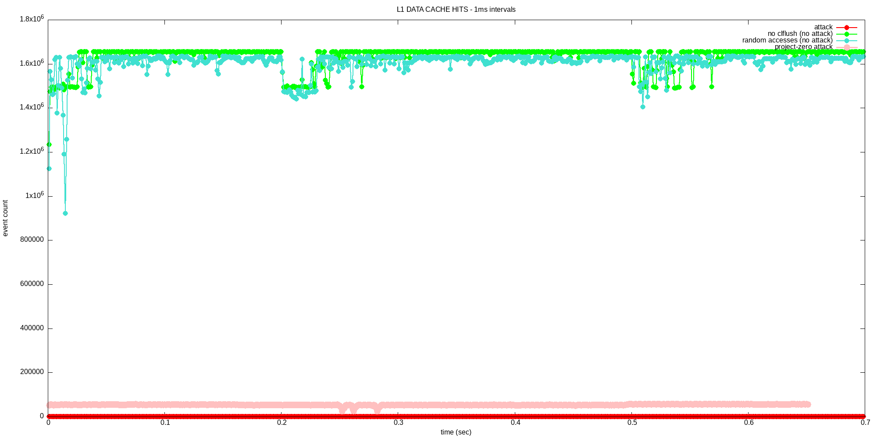

Slide 6
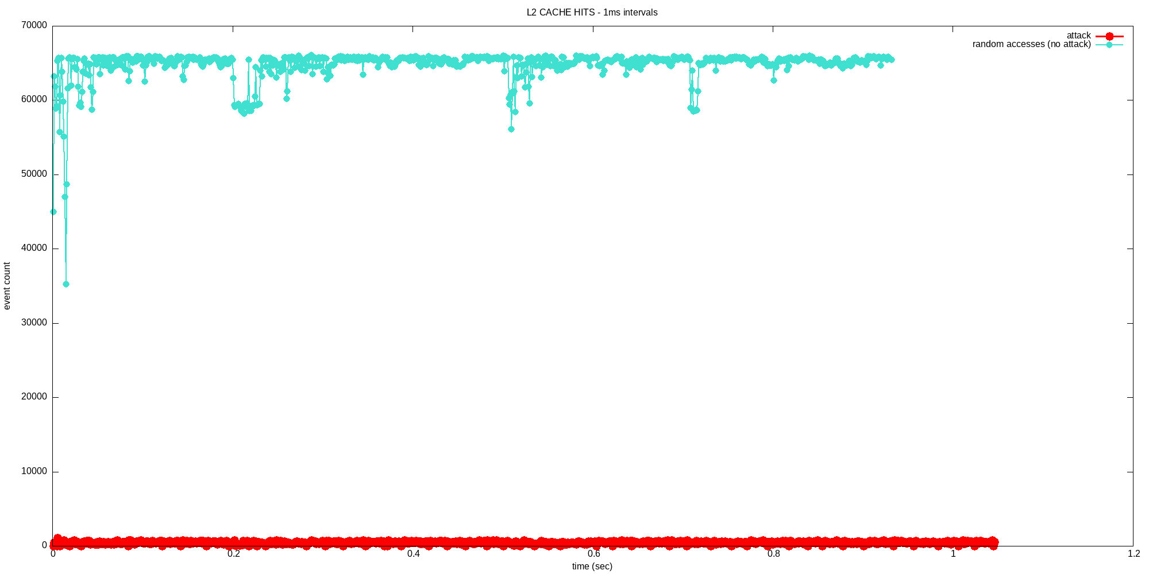
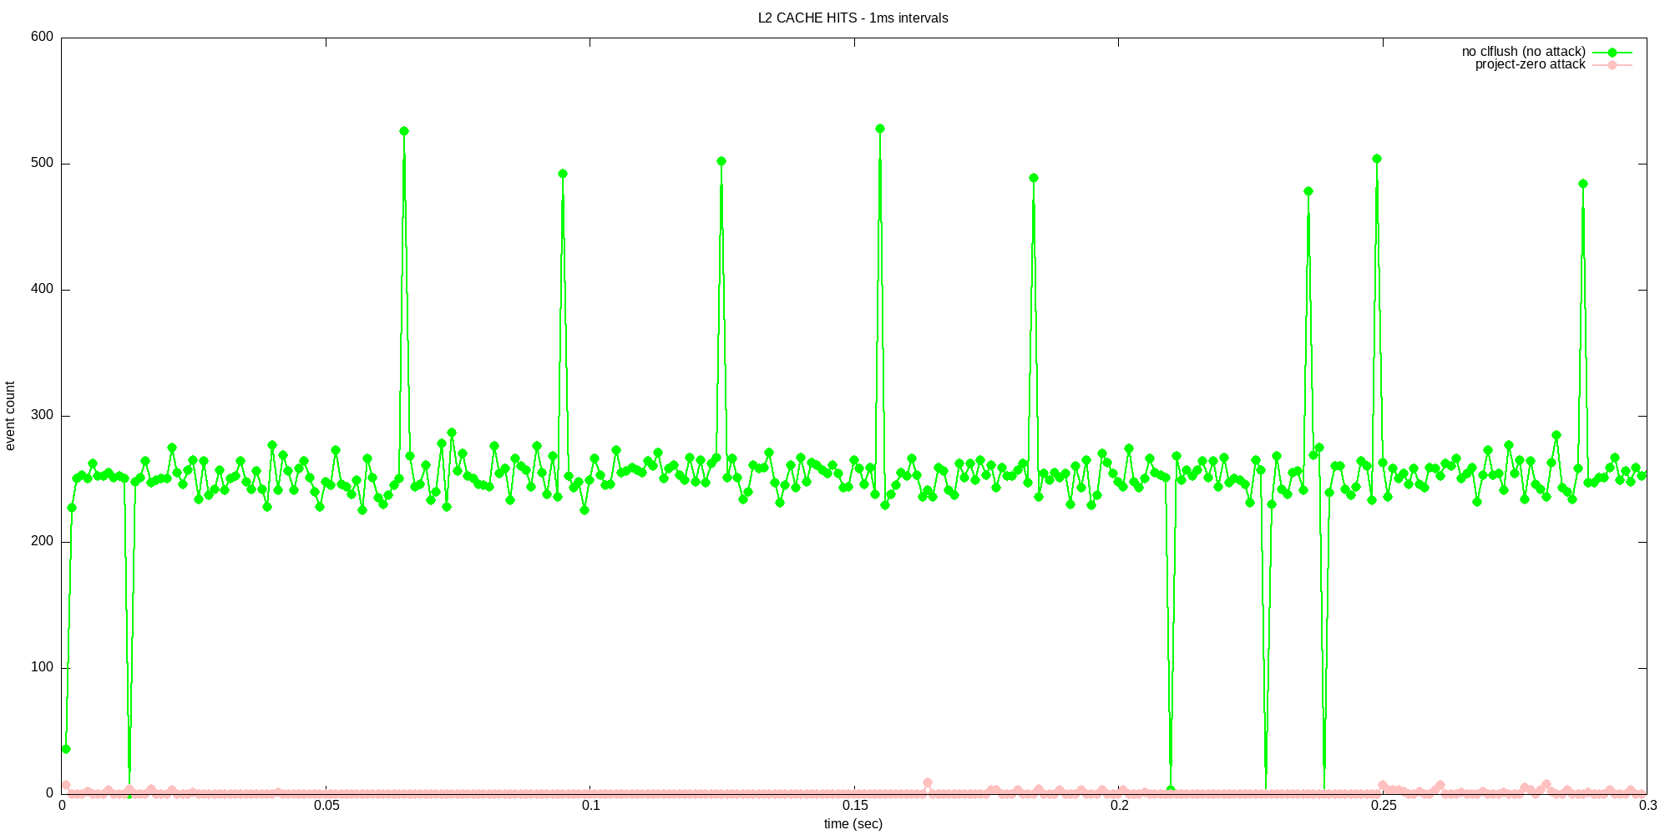

Slide 7
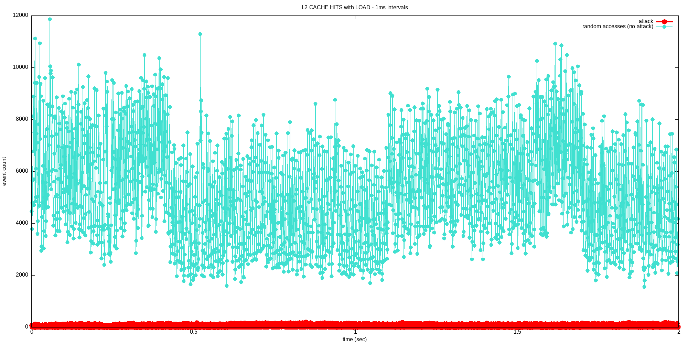
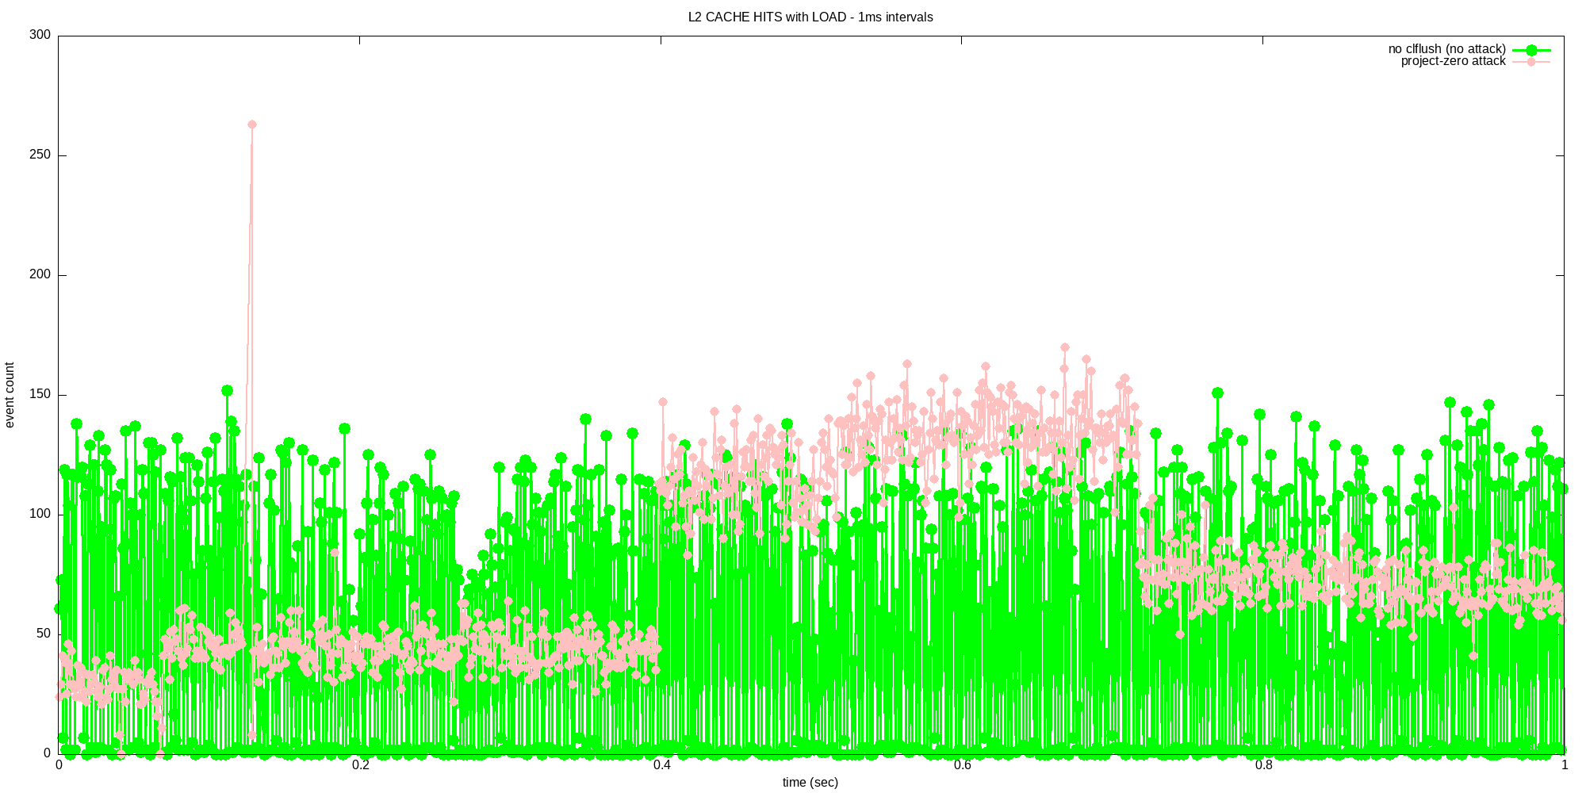

Slide 8
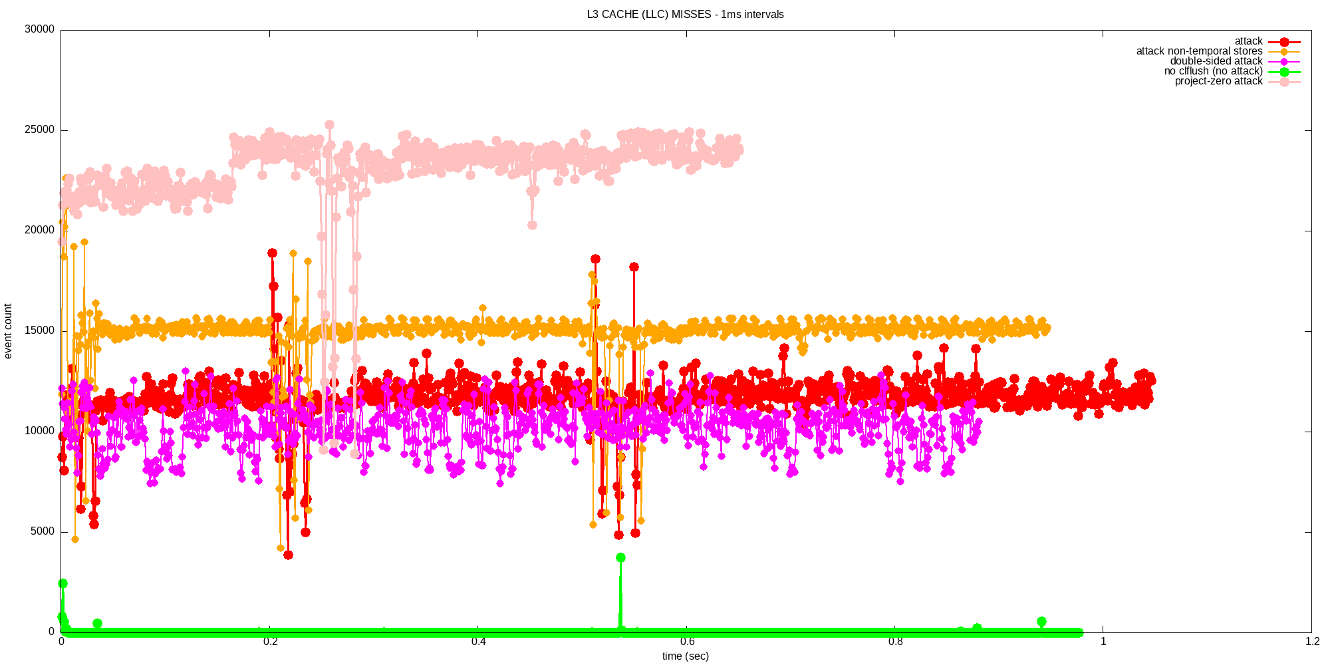

Slide 9
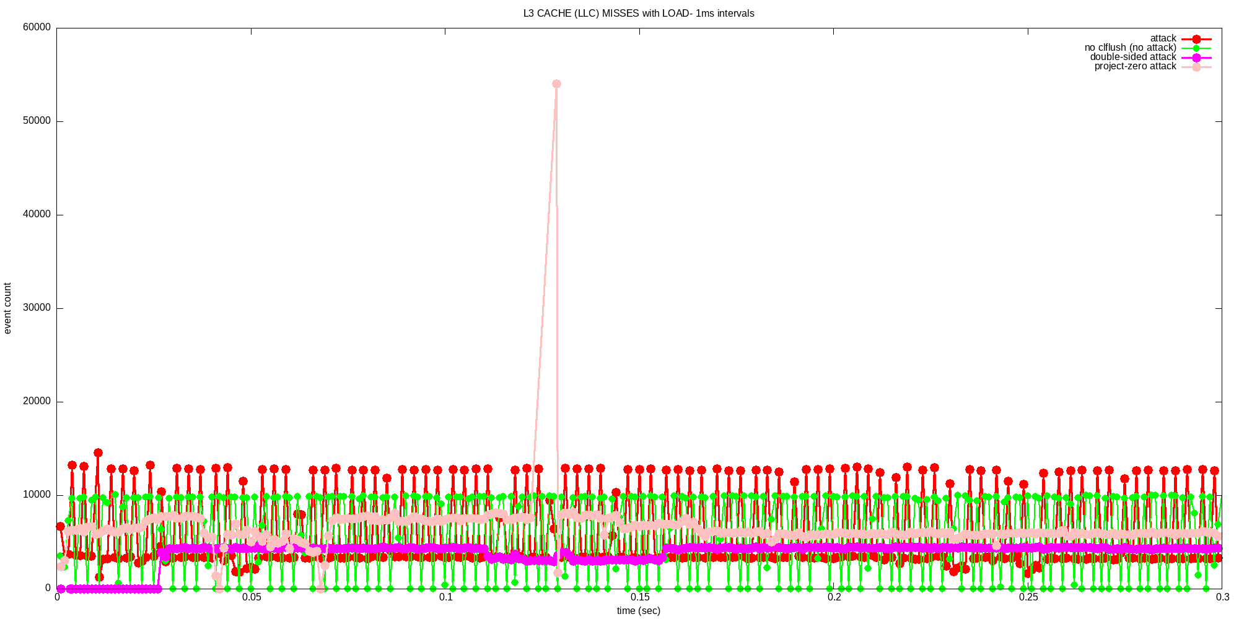

Slide 10
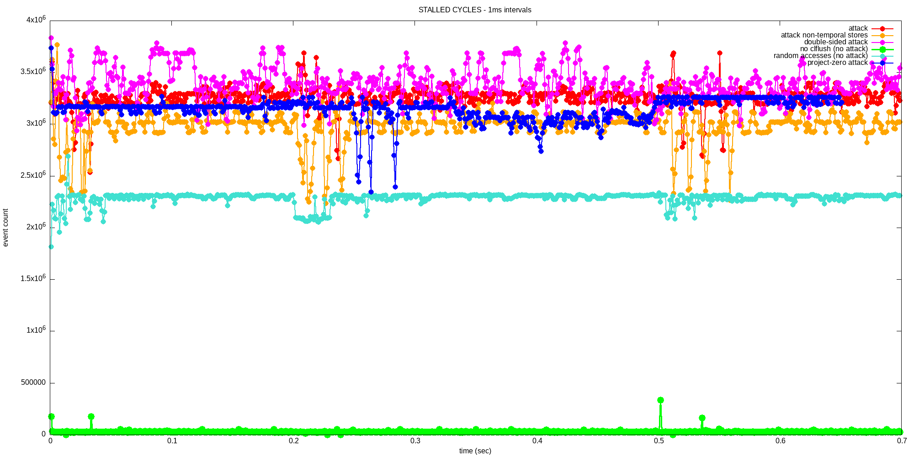

Slide 11
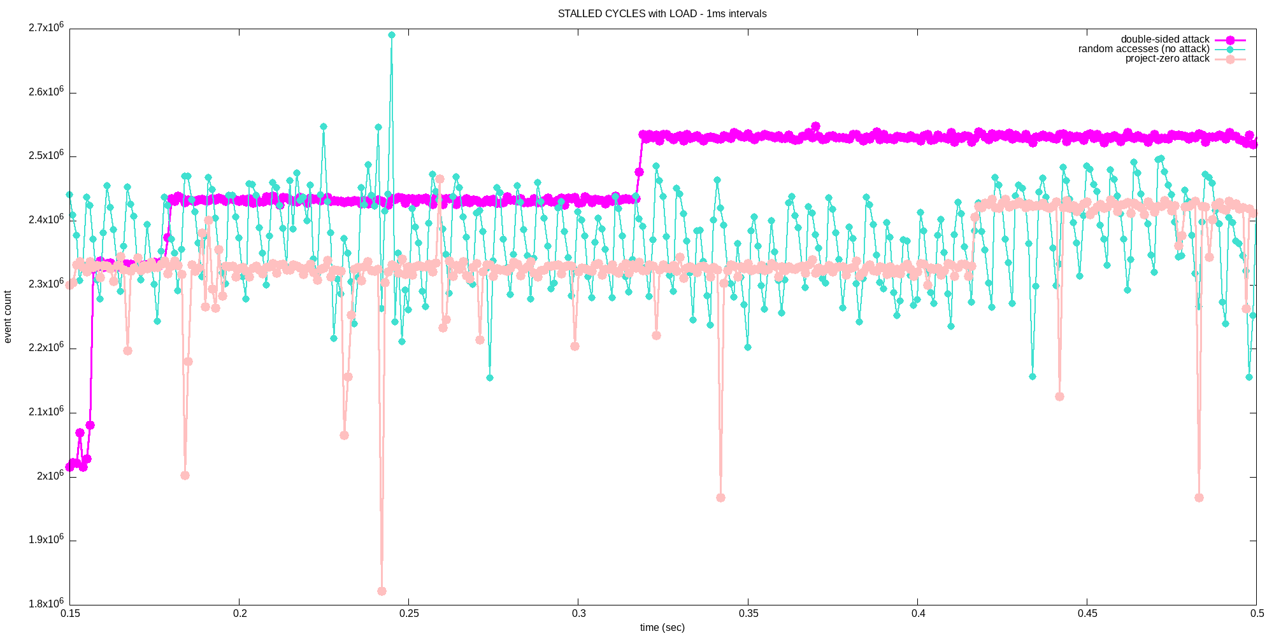

Slide 12
LENOVO
DDR4 SDRAM
Skylake processor
Load – 2 STREAM benchmark programs

Slide 13
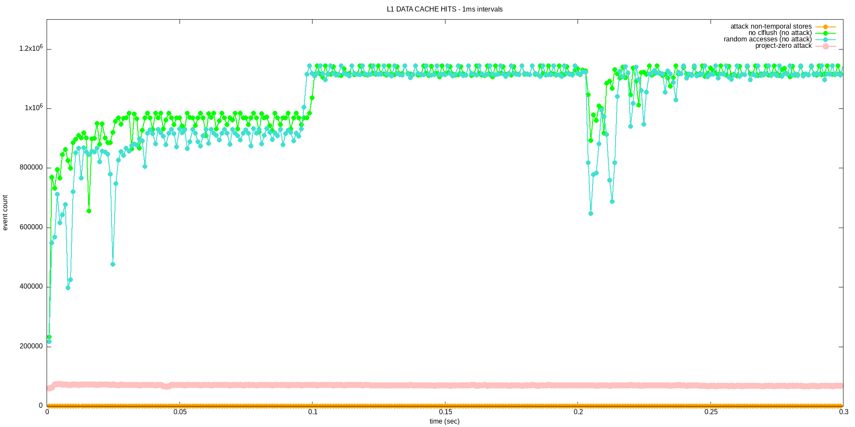

Slide 14
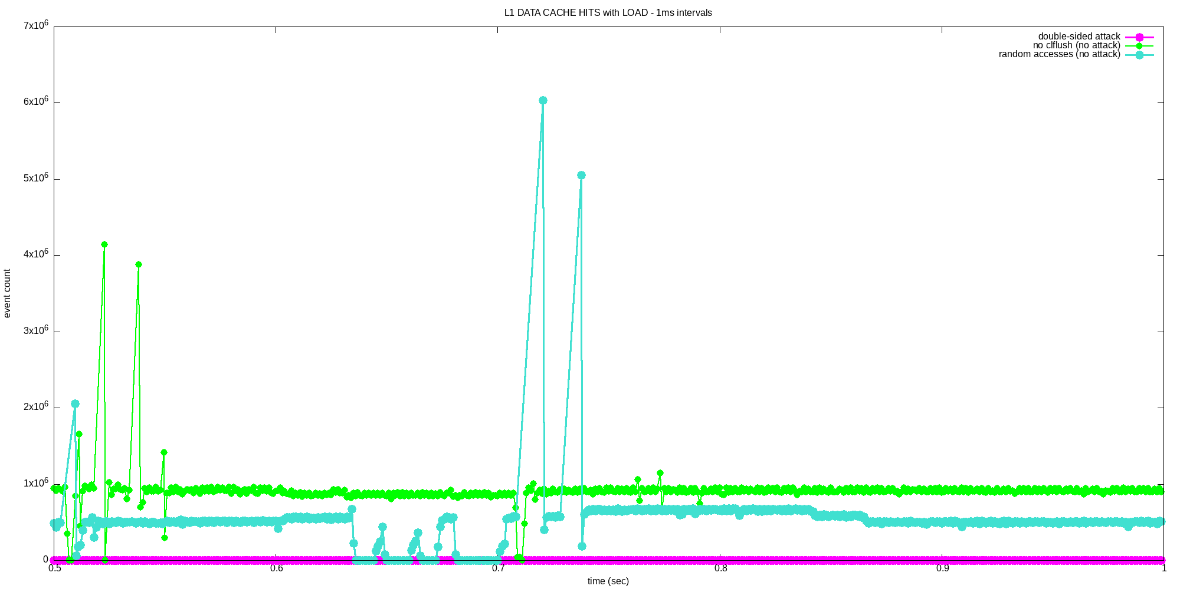

Slide 15
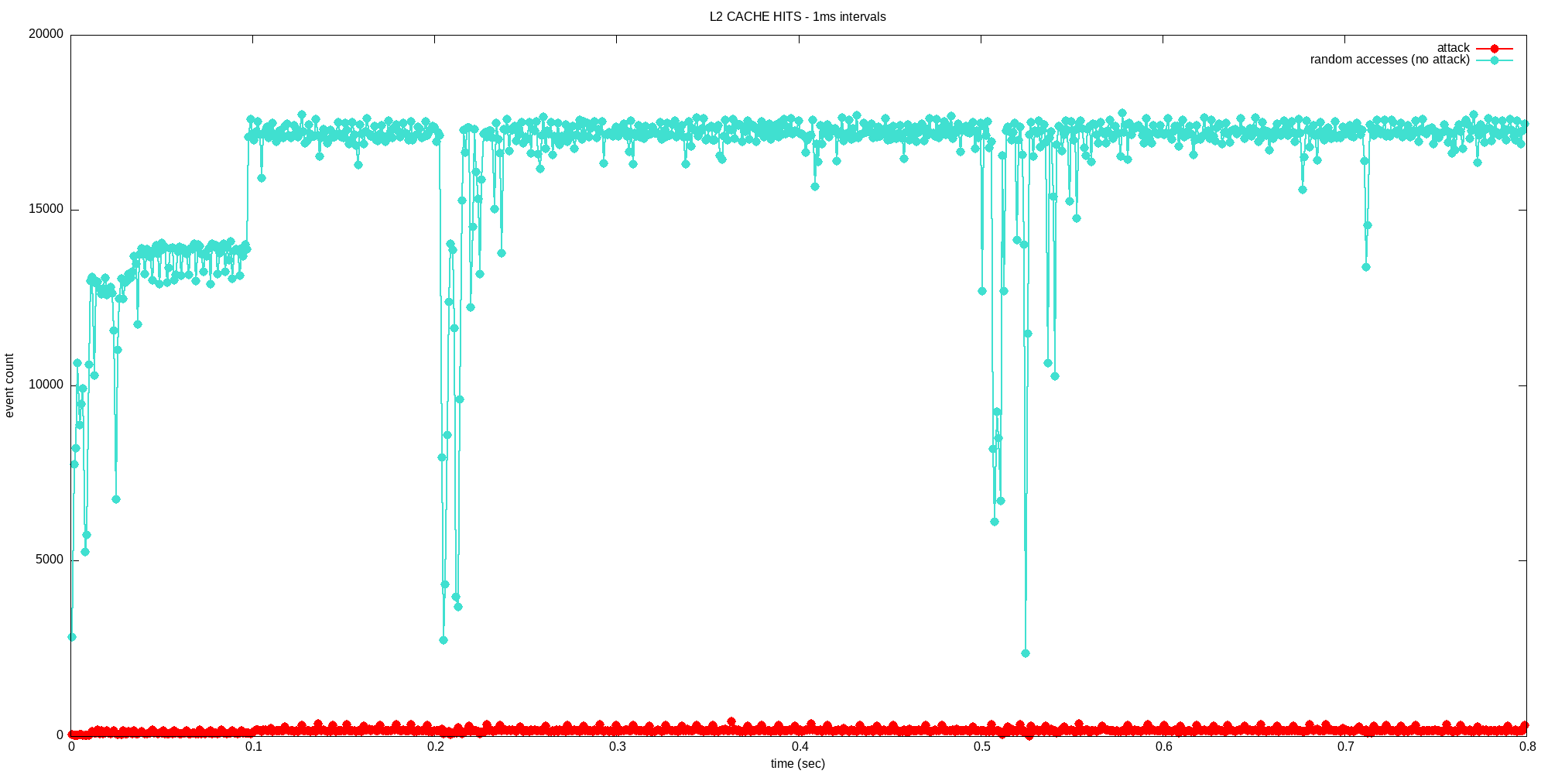
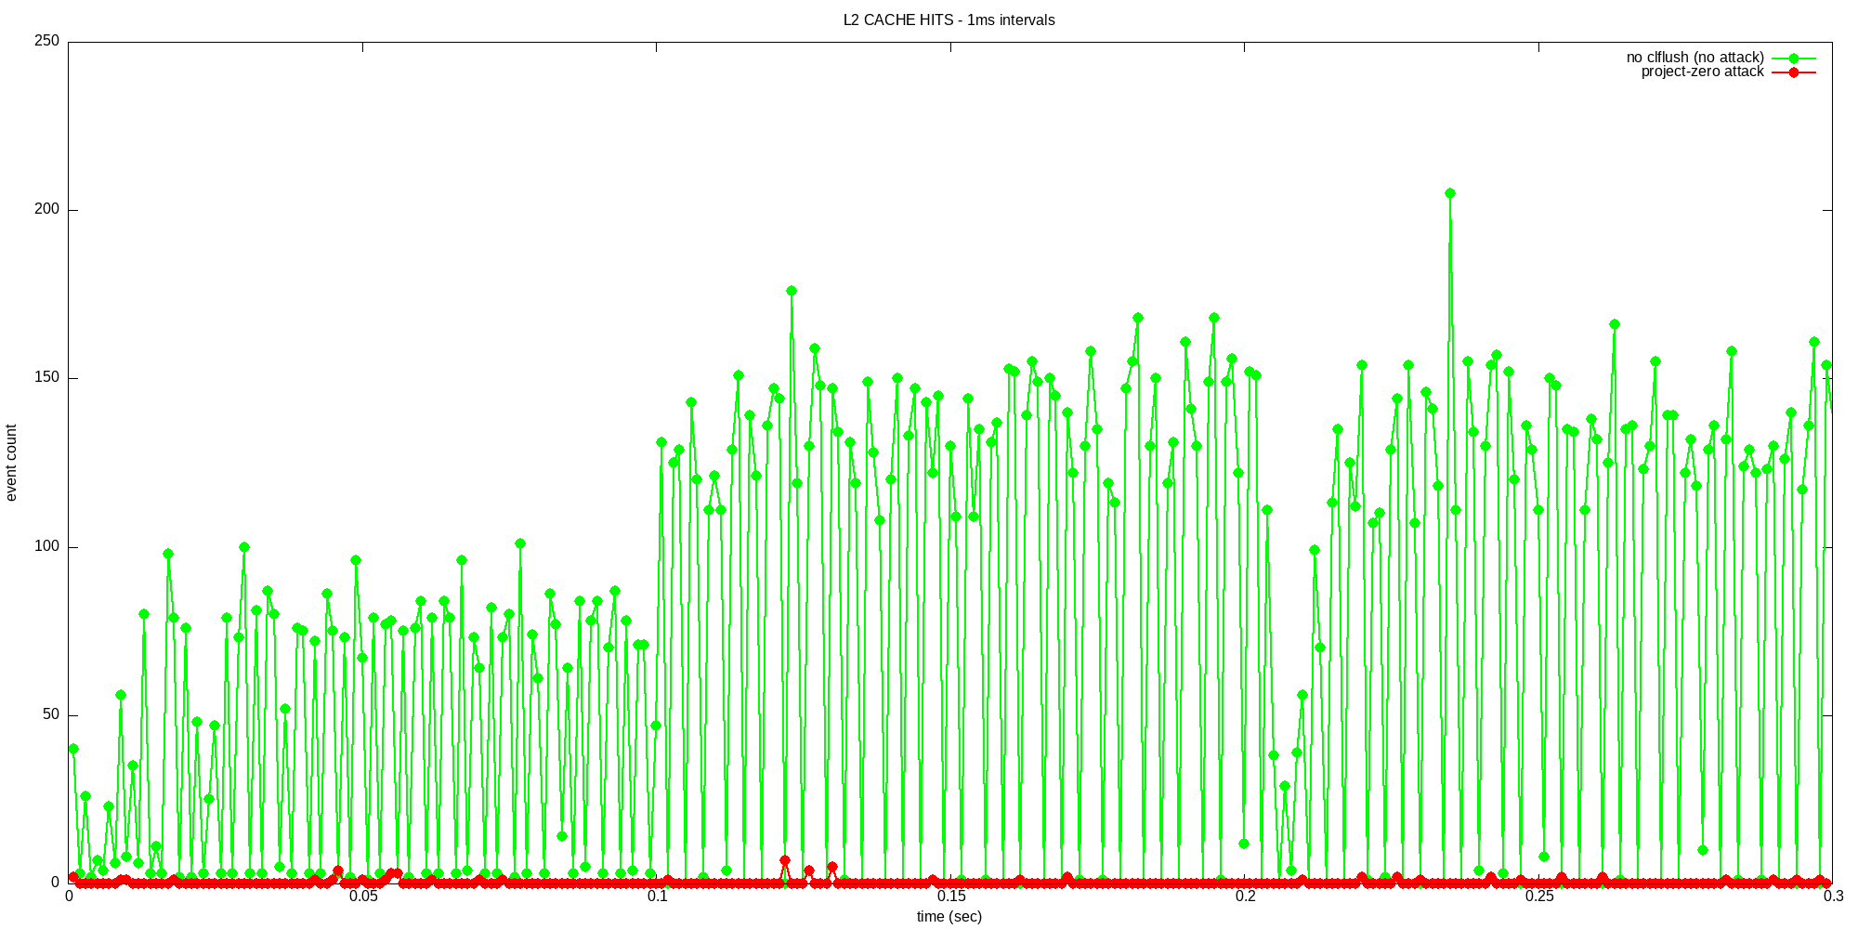

Slide 16
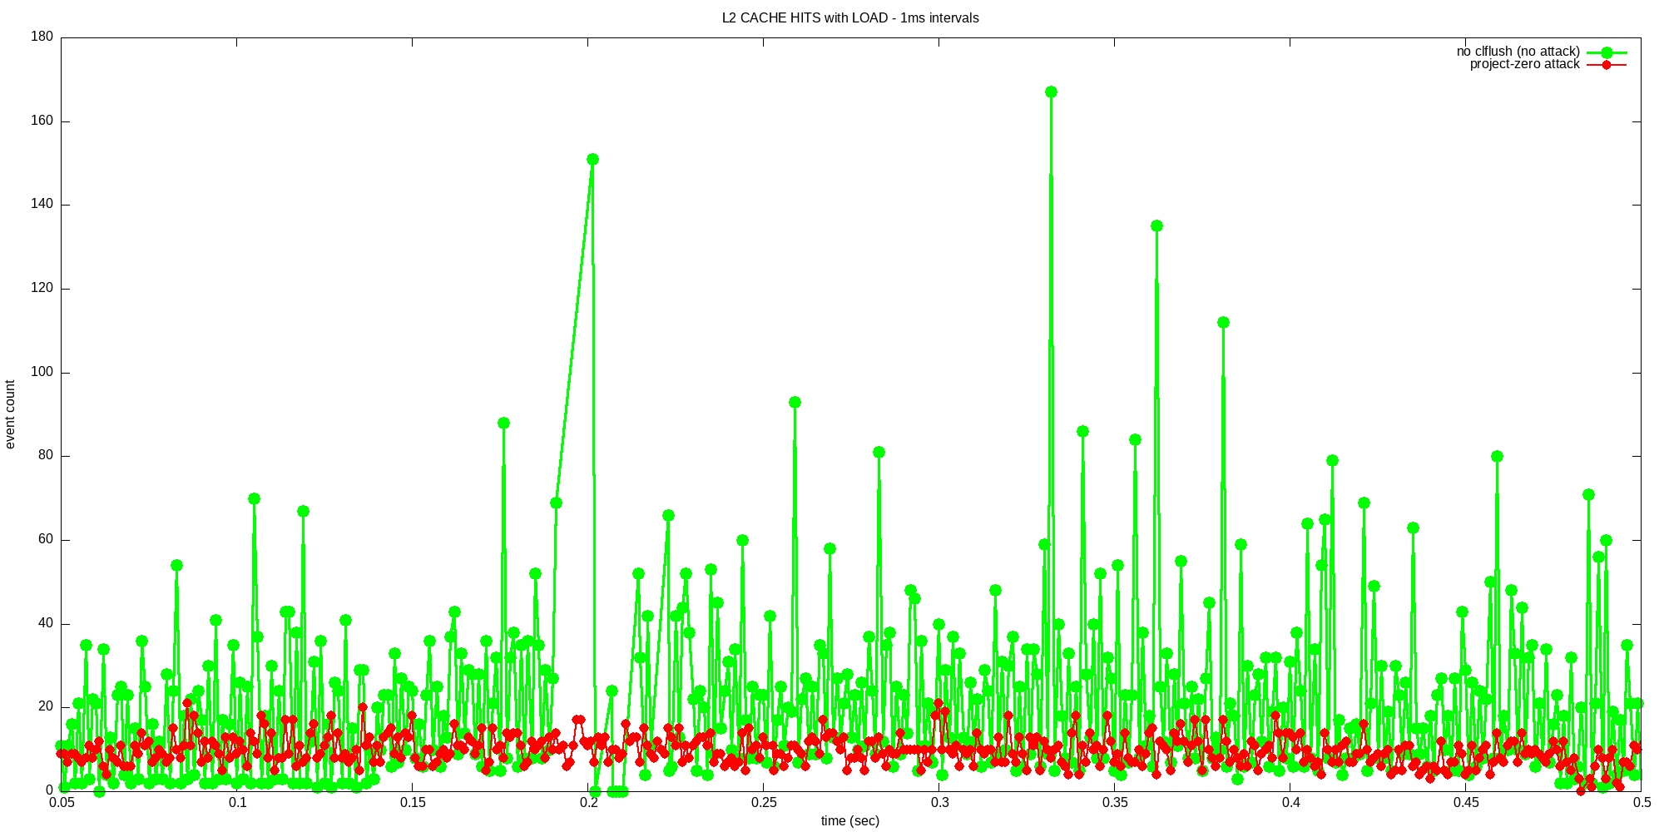
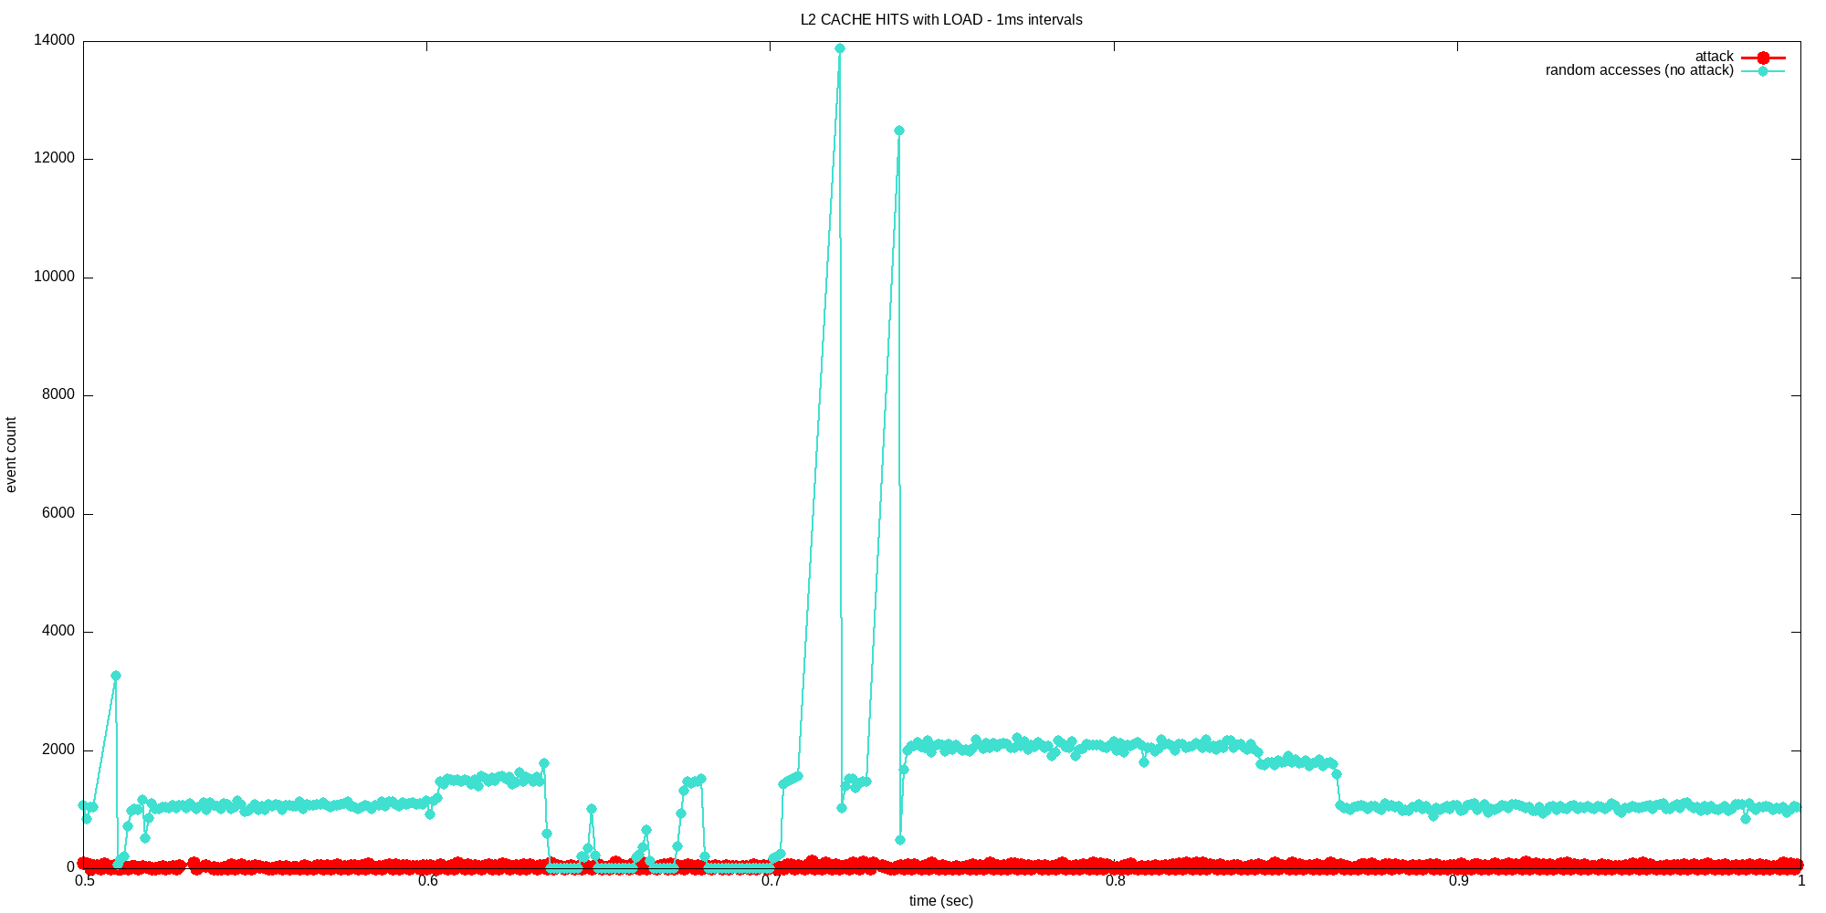

Slide 17
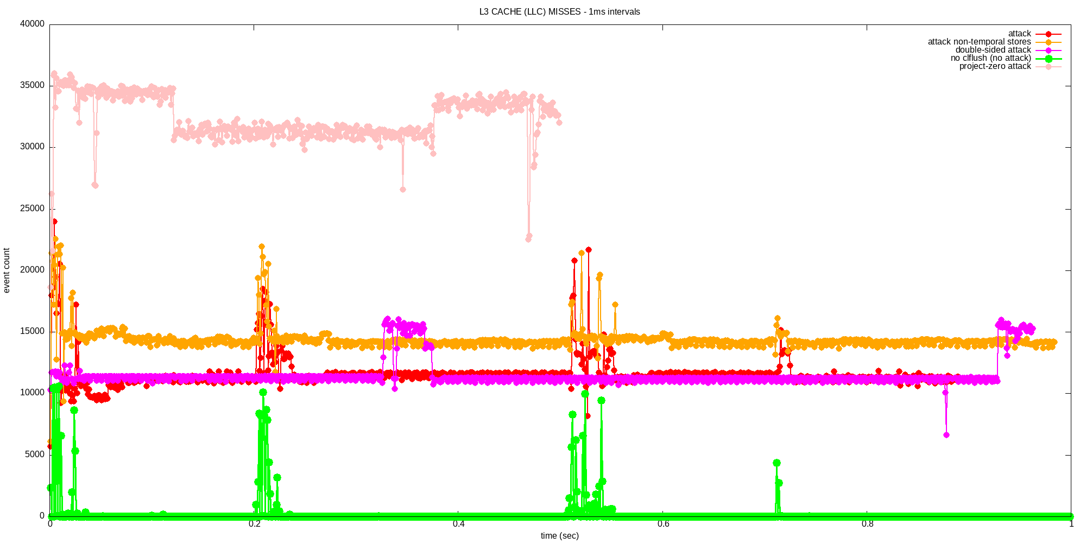

Slide 18
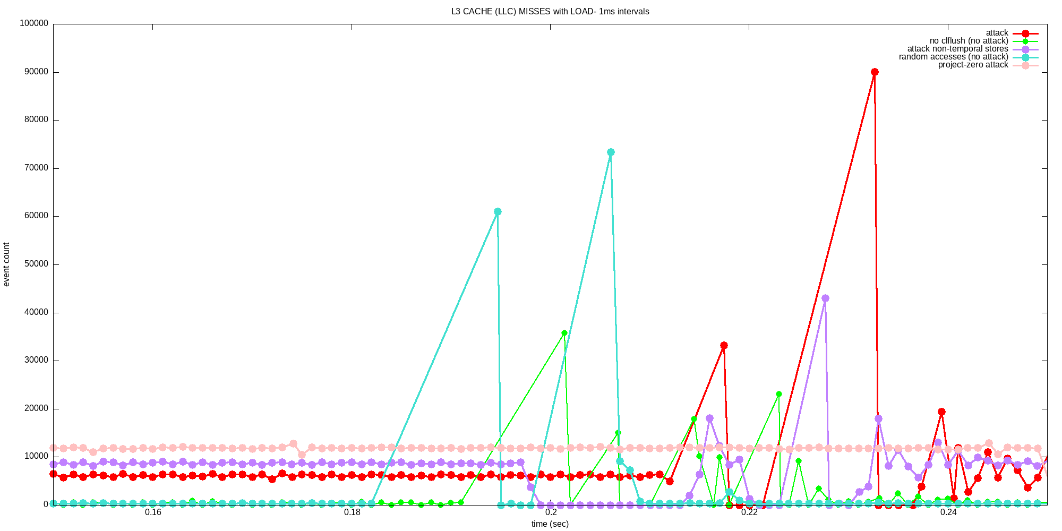

Slide 19
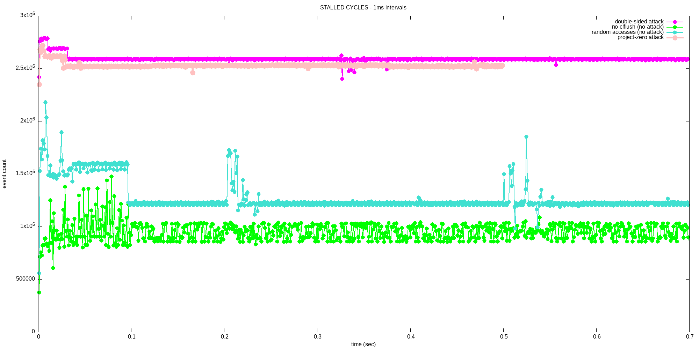

Slide 20
