Slide 1
Architectures for MT – direct, transfer and “Interlingua”
Lecture 29/01/2007
MODL5003 Principles and applications of machine translation
  slides available at:
http://www.comp.leeds.ac.uk/bogdan/

Slide 2
1. Overview
Classification of approaches to MT
Architectures of rule-based MT systems
  the MT triangle
Reviewing each architecture and its problems
Architectures compared
Limits of MT

Slide 3
2. Architectural challenges for MT : 1/3
Rule-based approaches (lecture today)
  Direct MT
  Transfer MT
  Interlingua MT
Use formal models of our knowledge of language
  to explicate human knowledge used for translation,
  put it into an “Expert System”
Problems
  expensive to build
  require precise knowledge, which might be not available

Slide 4
2. Architectural challenges for MT : 2/3
Corpus-based approaches (lecture 23/04/2007)
  Example-based MT
  Statistical MT
Use machine learning techniques on large collections of available texts;
    e.g. "parallel texts" (aligned sentence by sentence; phrase by phrase)
    "to let the data speak for themselves“
    recent decade: shift into this direction: IBM MT system
Problems:
  language data are sparse (difficult to achieve saturation)
  high-quality linguistic resources are also expensive

Slide 5
2. Architectural challenges for MT : 3/3
Corpus-based support for rule-based approaches
  current state-of-the-art technology
Speeding up the process of rule-creation
  by retrieving translation equivalents automatically

Slide 6
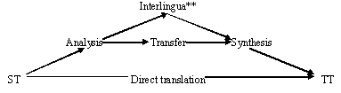
3. Possible Architecture of MT systems (the MT triangle)
**Interlingua = language independent representation of a text

Slide 7
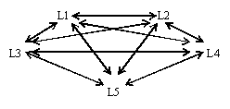
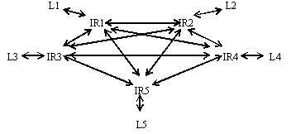
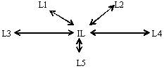
Direct
  n × (n – 1) modules
  5 languages = 20 modules
Transfer
  n × (n – 1) transfer
  n × (n + 1) in total
  = 30 modules in total
Interlingua
  n × 2 modules
  5 languages = 10 modules

Slide 8
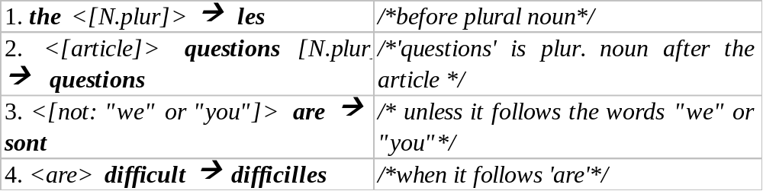
4. Direct systems
Essentially: word for word translation with some attention to local linguistic context
No linguistic representation is built
  (historically come first: the Georgetown experiment 1954-1963: 250 words, 6 grammar rules, 49 sentences)
  Sentence: The questions are difficult (P.Bennett, 2001)
  (algorithm: a "window" of a limited size moves through the text and checks if any rules match)

Slide 9
A. technical problems with direct systems: 1/4
  (“direct”=without intermediate representation)
rules are "tactical", not "strategic" (do not generalise)
    for each word-form (a member of a paradigm ) a separate set of rules is required
    rules have little linguistic significance
    there is no obvious link between our ideas about translation knowledge and the formalism
    it is hard to "think of" an accurate set of "direct" rules and to encode them manually

Slide 10
A. Technical problems with direct systems: 2/4
dealing with highly inflected languages becomes difficult
      e.g., Russian: 90.000 dictionary entries (lexemes, lemmas, headwords) have about 4.000.000 word forms
      Should there be 4.000.000 sets of rules for translation from Russian?
  What happens if we translate between two highly inflected languages?
      combinatorial grow of the number of rules:
      Any Russian adjective (24 wfs) can be translated by a German adjective (16 wfs): 24*16=384 rules ?

Slide 11
A. Technical problems with direct systems: 3/4
large systems become difficult to maintain and to develop:
    systems becomes non-manageable
    avoiding new errors when new features are introduced
    interaction of a large number of rules: rules are not completely independent
      it is difficult to find out whether the set of rules is complete

Slide 12
A. Technical problems with direct systems: 4/4
no reusability
    a new set of rules is required for each language pair
    no knowledge can be reused for new language pairs
    a multilingual system that translates in both directions between all language pairs: n × (n – 1) modules
      e.g., 5 languages = 20 modules with complex direction-specific sets of rules

Slide 13
B. Linguistic problems with direct systems:
information for disambiguation may appear not locally
    (not in the immediate context)
    (the length of the disambiguating context is not possible to predict)
B1. LEXICAL AMBIGUITY/ LEXICAL MISMATCH
    (no 1to1 correspondence between words)
B2. STRUCTURAL AMBIGUITY / STRUCTURAL MISMATCH
    (no 1to1 correspondence between constructions)

Slide 14
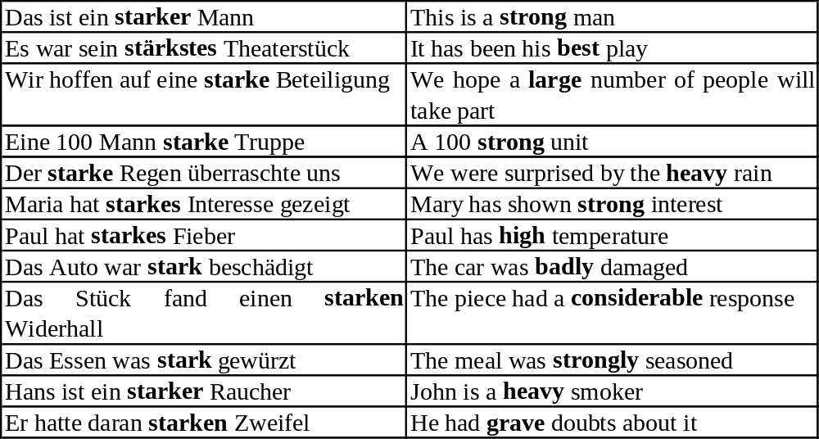
B1. LEXICAL MISMATCH: 1/2
(example by John Hutchins, 2002)

Slide 15
B1. LEXICAL MISMATCH: 2/2
The questions are hard (ex. by P.Bennett)
    hard → difficile
    → dur
What kind of information do we need here?
What happens if we have a complex sentence?
    The questions she tackled yesterday seemed very hard
    To bake tasty bread is very hard

Slide 16
B2. STRUCTURAL MISMATCH (1/2)
EN: I will go to see my GP tomorrow
JP: Watashi wa asu isha ni mite morau
    Lit: 'I will ask my GP to check me tomorrow'
EN: ‘The bottle floated out of the cave’
ES: La botella salió de la cueva (flotando)
    Lit.: the bottle moved-out from the cave (floating)
Same meaning is typically expressed by different structures

Slide 17
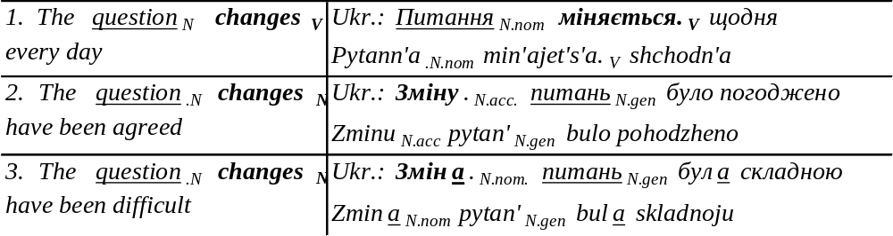
B2. STRUCTURAL MISMATCH (2/2)
  translation of the word question is also different, because its function in a phrase has changed
  translation might depend on the overall structure
    even if the function does not change in the English sentence

Slide 18
Summary: Meaning is not explicitly present
"The meaning that a word, a phrase, or a sentence conveys is determined not just by itself, but by other parts of the text, both preceding and following… The meaning of a text as a whole is not determined by the words, phrases and sentences that make it up, but by the situation in which it is used".
    M.Kay et. al.: Verbmobil, CSLI 1994, pp. 11-1

Slide 19
Advantages of direct systems
Saving resources
    Translation is much faster & requires less memory
Machine-learning techniques could be applied straightforwardly to create a direct MT system
    Direct rules are easier to learn automatically
    Generalisations and intermediate representations are difficult for machine learning
Taking advantage of structural similarity between languages
    similarity is not accidental – historic, typological, based on language and cognitive universals
    high quality of MT can be achieved

Slide 20
5. Indirect systems

Slide 21
5. Indirect systems
linguistic analysis of the ST
some kind of linguistic representation (“Interface Representation” -- IR)
ST → Interface Representation(s) → TT
Transfer systems:
    -- IRs are language-specific
    -- Language-pair specific mappings are used
Interlingual systems:
    -- IRs are language-independent
    -- No language-pair specific mappings

Slide 22
6. Transfer systems
Involve 3 stages: analysis - transfer – synthesis
Analysis and synthesis are monolingual and independent, i.e.:
    analysis is the same irrespective of the TL;
    synthesis is the same irrespective of the SL
- Transfer is bilingual, and each transfer module is specific to a particular language-pair
    (e.g., “Comprendium” MT system – SailLabs)
    Synthesis (generation) is straightforward

Slide 23
The number of modules for a multilingual transfer system
    n × (n – 1) transfer modules
    n × (n + 1) modules in total
e.g.: 5-language system (if translates in both directions between all language-pairs) has
    20 transfer modules and 30 modules in total
  (There are more modules than for direct systems, but modules are simpler)

Slide 24
Advantages of transfer systems: 1/2
reusability of Analysis and Synthesis modules
  = separation of reusable (transfer-independent) information from language-pair mapping
  operations performed on higher level of abstraction
  the tasks:
    to do as much work as possible in reusable modules of analysis and synthesis
    to keep transfer modules as simple as possible = "moving towards Interlingua"

Slide 25
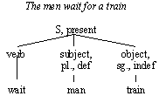
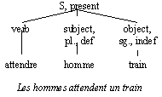
Advantages of transfer systems: 2/2
    can generalise over features, lexemes, tree configurations, functions of word groups
    can view the features & how they relate to each other
    lexical items are replaced and the features are copied
    no need to translate each inflected word form: the lexicon for transfer becomes smaller

Slide 26
Transfer: dealing with lexical and structural mismatch, w.o.: 1/2
  Dutch: Jan zwemt → English: Jan swims
  Dutch: Jan zwemt graag → English: Jan likes to swim
      (lit.: Jan swims "pleasurably", with pleasure)
  Spanish: Juan suele ir a casa → English: Juan usually goes home
      (lit.: Juan tends to go home, soler (v.) = 'to tend')
  English: John hammered the metal flat → French: Jean a aplati le métal au marteau
      Resultative construction in English; French lit.: Jean flattened the metal with a hammer

Slide 27
Transfer: dealing with lexical and structural mismatch, w.o.: 2/2
  English: The bottle floated past the rock → Spanish: La botella pasó por la piedra flotando
      (Spanish lit.: 'The bottle past the rock floating')
  English: The hotel forbids dogs → German: In diesem Hotel sind Hunde verboten
      (German lit.: Dogs are forbidden in this hotel)
  English: The trial cannot proceed → German: Wir können mit dem Prozeß nicht fortfahren
      (German lit.: We cannot proceed with the trial)
  English: This advertisement will sell us a lot → German: Mit dieser Anziege verkaufen wir viel
      (German lit.: With this advertisement we will sell a lot)

Slide 28
Is word for word translation possible?
  English: 10 pounds will buy you decent milk … (translate into German, Russian, Japanese…)
      (English has fewer constraints on subjects)
  English: "to call a spade a spade"
  English: "to kick the bucket"
Conclusion: higher quality of translation is achievable
  even for structurally different languages

Slide 29
Transfer: open questions
Depth of the SL analysis
Nature of the interface representation (syntactic, semantic, both?)
Size and complexity of components depending how far up the MT triangle they fall
Nature of transfer may be influenced by how typologically similar the languages involved are
  the more different -- the more complex is the transfer

Slide 30
Principles of Interface Representations (IRs)
IRs should form an adequate basis for transfer, i.e., they should
    contain enough information to make transfer (a) possible; (b) simple
    provide sufficient information for synthesis
    need to combine information of different kinds
  1. lematisation
  2. freaturisation
  3. neutralisation
  4. reconstruction
  5. disambiguagtion

Slide 31
IR features: 1/3
1. lematisation
  each member of a lexical item is represented in a uniform way, e.g., sing.N., Inf.V.
  (allows the developers to reduce transfer lexicon)
2. freaturisation
  only content words are represented in IRs 'as such',
  function words and morphemes become features on content words (e.g., plur., def., past…)
  inflectional features only occur in IRs if they have contrastive values (are syntactically or semantically relevant)

Slide 32
IR features: 2/3
3. neutralisation
  neutralising surface differences, e.g.,
    active and passive distinction
    different word order
  surface properties are represented as features
    (e.g., voice = passive)
  possibly: representing syntactic categories:
      E.g.: John seems to be rich
      (logically, John is not a subject of seem):
      = It seems to someone that John is rich
      Mary is believed to be rich = One believes that Mary is rich
  translating "normalised" structures

Slide 33
IR features: 3/3
4. reconstruction
  to facilitate the transfer, certain aspects that are not overtly present in a sentence should occur in IRs
  especially, for the transfer to languages, where such elements are obligatory:
    John tried to leave: S[ try.V John.NP S[ leave.V John.NP]]
5. disambiguagtion
  ambiguities should be resolved at IR, e.g., attachment of PPs.
  Lexical ambiguities can be annotated with numbers: table_1, _2…

Slide 34
7. Interlingual systems

Slide 35
7. Interlingual systems
involve just 2 stages:
    analysis ←→ synthesis
    both are monolingual and independent
there are no bilingual parts to the system at all (no transfer)
generation is not straightforward

Slide 36
The number of modules in an Interlingual system
A system with n languages (which translates in both directions between all language-pairs)
  requires 2*n modules:
    5-language system contains 10 modules

Slide 37
Features of “Interlingua”
Each module needs to be more complex
  more work on the analysis part
universal IR (not specific to particular languages)
IL based on universal semantics, and not oriented towards any particular family or type of languages
IR principles still apply (even more so):
  Neutralisation must be applied cross-linguistically,
  different surface realisations of the same meaning being mapped into one single IR
no lexical items, just universal semantic primitives:
    (e.g., kill: [cause[become [dead]]])

Slide 38
From transfer to interlingua
En: Luc seems to be ill
  → Fr: *Luc semble être malade
  → Fr: Il semble que Luc est malade
      SEEM-2 (ILL (Luc))
      SEMBLER (MALADE (Luc)) (Ex.: by F. van Eynde)
  Problem: the translation of predicates:
  Solution: treat predicates as language-specific expressions of universal concepts
      SHINE = concept-372
      SEEM = concept-373
      BRILLER = concept-372
      SEMBLER = concept-373

Slide 39
Problems with Interlingua: why it doen’t work?
Semantic differentiation is target-language specific
    runway → startbaan, landingsbaan
      (landing runway; take-of runway)
    cousin → cousin, cousine (m., f.)
  No reason in English to consider these words ambiguous
    making such distinctions is comparable to lexical transfer
    not all distinctions needed for translation are motivated monolingually: no "universal semantic features“
Concepts may be not ambiguous in the source language, but -- ambiguous in the other languages
  Adding a new language requires changing all other modules
      = exactly what we tried to avoid

Slide 40
8. Transfer and Interlingua compared
Much work is the same for both approaches
Translation vs. paraphrase
  translation is limited by conflicting restrictions
    fluency considerations
    by adequacy considerations
Bilingual contrastive knowledge is central to translation
    translators know about contrast of languages
    know correct systems of correspondences, e.g., legal terms, where "retelling" is not an option
Transfer systems can capture contrastive knowledge
IL leaves no place for bilingual knowledge
    can work only in syntactically and lexically restricted domains

Slide 41
… Transfer and Interlingua compared
Transfer has a theoretical background, it is not an engineering ad-hoc solution, a "poor substitute for Interlingua". It must be takes seriously and developed through solving problems in contrastive linguistics and in knowledge representation appropriate for translation tasks".
    Whitelock and Kilby, 1995, p. 7-9

Slide 42
Direct
  n × (n – 1) modules
  5 languages = 20 modules
Transfer
  n × (n – 1) transfer
  n × (n + 1) in total
  = 30 modules in total
Interlingua
  n × 2 modules
  5 languages = 10 modules

Slide 43
Direct
  n × (n – 1) modules
  5 languages = 20 modules
Transfer
  n × (n – 1) transfer
  n × (n + 1) in total
  = 30 modules in total
Interlingua
  n × 2 modules
  5 languages = 10 modules

Slide 44
9. Limitations of the state-of-the-art MT architectures
Q.: are there any features in human translation which cannot be modelled in principle (e.g., even if dictionary and grammar are complete and “perfect”)?
MT architectures are based on searching databases of translation equivalents, cannot
    invent novel strategies
    add / removing information
    prioritise translation equivalents
      trade-off between fluency and adequacy of translation

Slide 45
Problem 1: Obligatory loss of information: negative equivalents
ORI: His pace and attacking verve saw him impress in England’s game against Samoa
    HUM: Его темп и атакующая мощь впечатляли во время игры Англии с Самоа
    HUM: His pace and attacking power impressed during the game of England with Samoa
ORI: Legout’s verve saw him past world No 9 Kim Taek
    HUM: Настойчивость Легу позволила ему обойти Кима Таек, занимающего 9-ю позицию в мировом рейтинге
    HUM: Legout’s persistency allowed him to get round Kim Taek

Slide 46
Problem 2: Information redundancy
Source Text and the Target Text usually are not equally informative:
  Redundancy in the ST: some information is not relevant for communication and may be ignored
  Redundancy in the TT: some new information has to be introduced (explicated) to make the TT well-formed
    e.g.: MT translating etymology of proper names, which is redundant for communication :
      “Bill Fisher” => “to send a bill to a fisher”

Slide 47
Problem 3: changing priorities dynamically (1/2)
Salvadoran President-elect Alfredo Christiani condemned the terrorist killing of Attorney General Roberto Garcia Alvarado
SYSTRAN:
    MT: Сальвадорский Избранный президент Алфредо Чристиани осудил убийство террориста Генерального прокурора Роберто Garcia Alvarado
    MT(lit.) Salvadoran elected president Alfredo Christiani condemned the killing of a terrorist Attorney General Roberto Garcia Alvarado

Slide 48
Problem 3: changing priorities dynamically (2/2)
PROMT
    Сальвадорский Избранный президент Альфредо Чристиани осудил террористическое убийство Генерального прокурора Роберто Гарси Альварадо
However: Who is working for the police on a terrorist killing mission?
    Кто работает для полиции на террористе, убивающем миссию?
    Lit.: Who works for police on a terrorist, killing the mission?

Slide 49
Fundamental limits of state-of-the-art MT technology (1/2)
“Wide-coverage” industrial systems:
    There is a “competition” between translation equivalents for text segments
MT: Order of application of equivalents is fixed
Human translators – able to assess relevance and re-arrange the order
    An MT system can be designed to translate any sentence into any language
    However, then we can always construct another sentence which will be translated wrongly

Slide 50
Fundamental limits of state-of-the-art MT technology (2/2)
Correcting wrong translation: terrorist killing of Attorney General = killing of a terrorist (presumably, by analogy to “tourist killing” or “farmer killing”); not killing by terrorists
= Introducing new errors
    “…just pretending to be a terrorist killing war machine…”
    “… who is working for the police on a terrorist killing mission…”
    “…merged into the "TKA" (Terrorist Killing Agency), they would … proceed to wherever terrorists operate and kill them…”,

Slide 51
Translation: As true as possible, as free as necessary
“[…] a German maxim “so treu wie möglich, so frei wie nötig” (as true as possible, as free as necessary) reflects the logic of translator’s decisions well: aiming at precision when this is possible, the translation allows liberty only if necessary […] The decisions taken by a translator often have the nature of a compromise, […] in the process of translation a translator often has to take certain losses. […] It follows that the requirement of adequacy has not a maximal, but an optimal nature.” (Shveitser, 1988)

Slide 52
10. MT and human understanding
Cases of “contrary to the fact” translation
ORI: Swedish playmaker scored a hat-trick in the 4-2 defeat of Heusden-Zolder
MT: Шведский плеймейкер выиграл хет-трик в этом поражении 4-2 Heusden-Zolder.
  (Swedish playmaker won a hat-trick in this defeat 4-2 Heusden-Zolder)
In English “the defeat” may be used with opposite meanings, needs disambiguation:
    “X’s defeat” == X’s loss
    “X’s defeat of Y” == X’s victory

Slide 53
Why we need human or artificial intelligence in translation
    “X’s defeat” == X’s loss
    “X’s defeat of Y” == X’s victory
ORI: Swedish playmaker scored a hat-trick in the 4-2 defeat of Heusden-Zolder
Vs
  … its defeat of last night
  … their FA Cup defeat of last season
  … their defeat of last season’s Cup winners
  … last season’s defeat of Durham

Slide 54
… MT and human understanding
MT is just an “expert system” without real understanding of a text…
  What is real understanding then?
  Can the “understanding” be precisely defined and simulated on computers?

